Slide 1



APPAREL RECOMMENDATION AND PRODUCT REVIEW CLASSIFICATION IN WOMEN CLOTHING CATEGORY
Shreyansh Bhalodiya
Papa Ekow Armah
Nana Fordwouh
Wai Phyo Maung
Manjyot Kaur Gill
Surpreet Kaur Mann

Slide 2
AGENDA
Introduction
Dataset
EDA
Quantitative Model 1
NLP Text Processing
NLP Model
Final Model
Results
Future Work

Slide 3




Introduction
In today's competitive business landscape, customer reviews hold a unique place of importance. They provide valuable insights into customer satisfaction, sentiment, and recommendations.
The goal of our analysis is to leverage these insights to understand and predict customer behavior better.
We will delve into the dataset, explore customer reviews through exploratory data analysis (EDA), build predictive models using machine learning, and present our results.
So, let's embark on this journey of extracting knowledge and uncovering the potential of customer reviews in shaping business strategies.

Slide 4
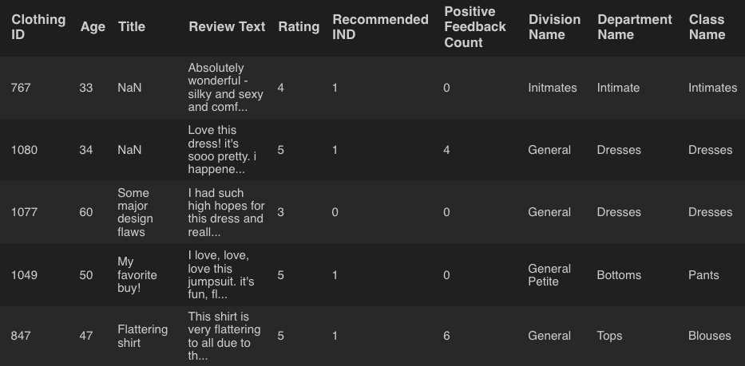
Dataset
Data Source:
Women’s E-Commerce clothing Reviews. (2018, February 3). Kaggle.
The dataset contains a wealth of customer reviews and related information.
Key Variables:
Age: The age of the customers who provided reviews.
Rating
Recommended IND: Whether the customer recommended the product (1 for recommended, 0 for not recommended).
Size of Dataset:
The dataset consists of 23485 reviews.

Slide 5
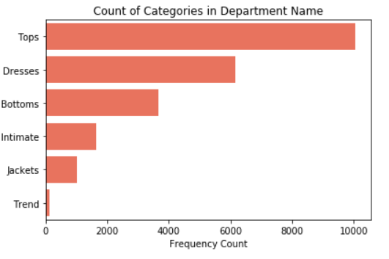
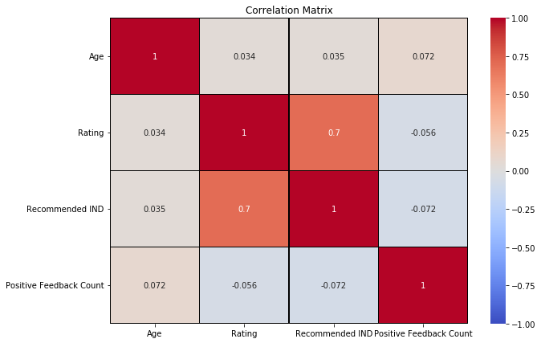
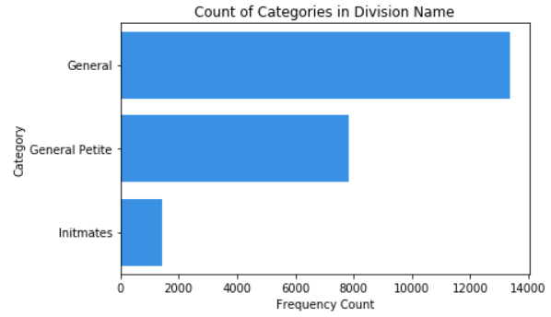
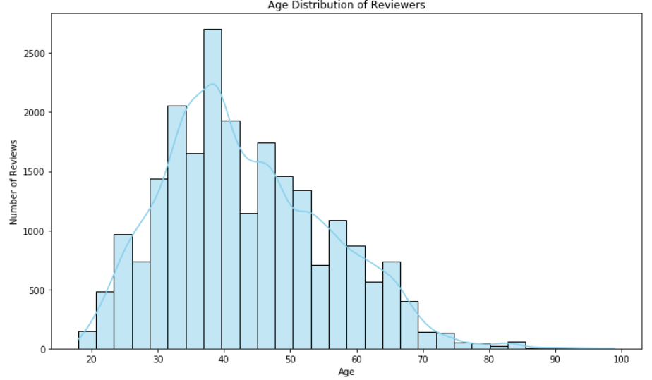
Exploratory Data Analysis

Slide 6
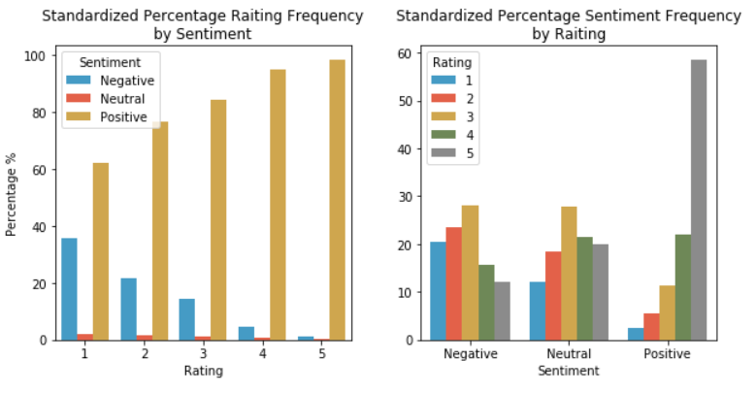
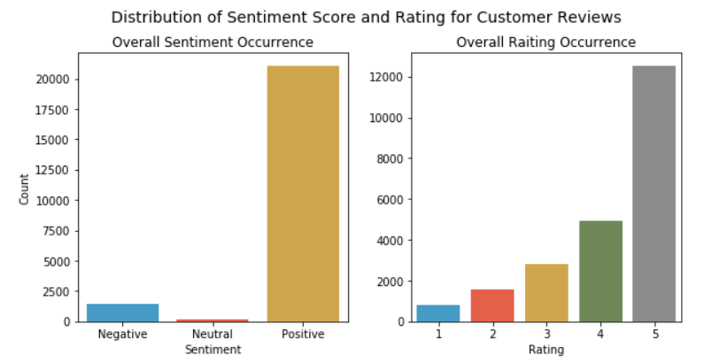
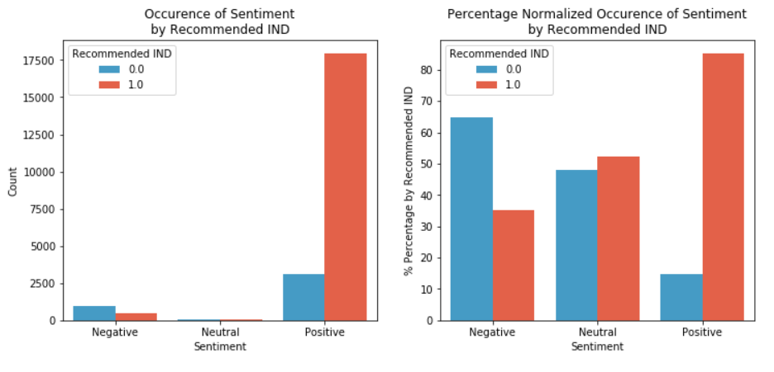
Exploratory
Sentiment
Data Analysis

Slide 7
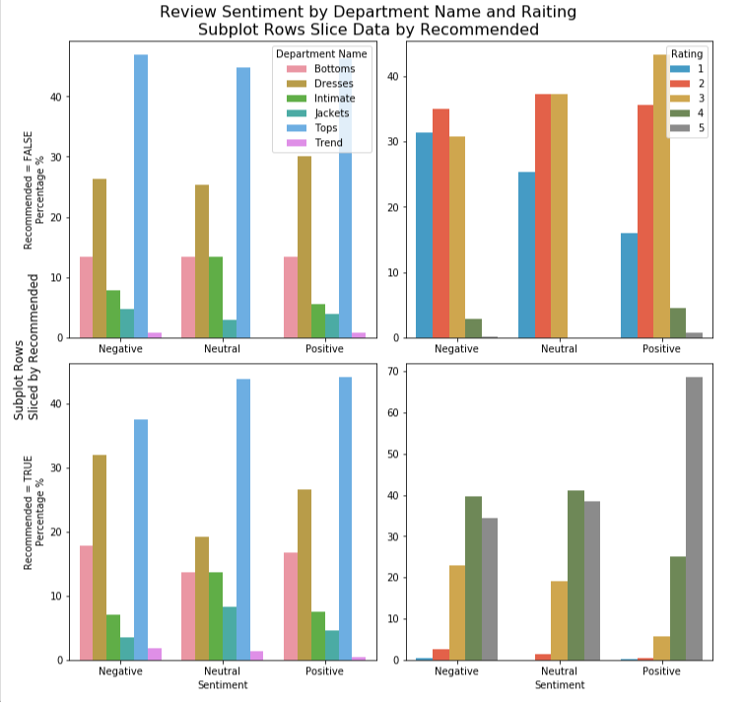
Exploratory
Sentiment
Data Analysis-2

Slide 8
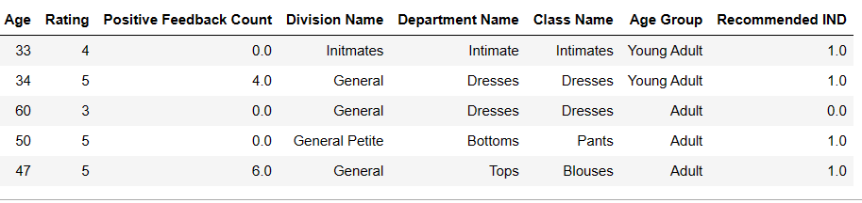


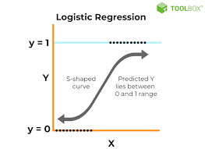

Model 1 – Product recommendation
Quantitative Modeling | Accuracy | Precision | Recall | F1-Score
Decision Tree | 91.12 | 95.6 | 94.14 | 94.2
Logistic Regression | 93.01 | 98.16 | 94.3 | 96.2
Support Vector Machine | 93.7 | 98.39 | 93.94 | 96.11
Random Forest Classification | 92.6 | 95.84 | 95.19 | 95.95
Naïve Bayes | 39.29 | 97.4 | 27.11 | 42.44

Slide 9

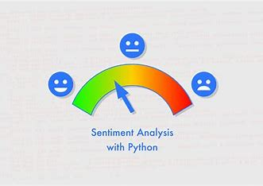


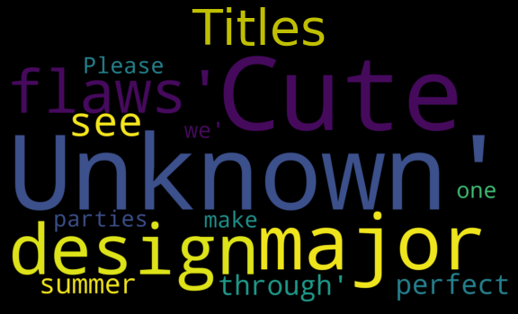


NLP- Text Processing-1
Sentiment Analysis
Polarity Score using NLTK
PS > 0 = >Positive PS = 0 =>Neutral PS < 0 =>Negative
Word Distribution and Word Cloud
Titles
Reviews
Division Name Department Name
Notes:
Quantitative Model Overview
Introduction to the models.
Brief overview of the dataset.
Introduction to Models
Introduction to familiar models.
Introduction to Naïve Bayes and its suitability for the dataset.
Decision Tree
Useful for understanding feature importance and offers a visual representation of decision-making.
Model metrics.
Logistic Regression
Simplicity and efficiency, especially for binary classification problems.
Model metrics.
Support Vector Machine
Applied SVM with a linear kernel. Powerful for high-dimensional datasets.
Model metrics.
Random Forest Classification
· Method uses multiple decision trees to improve accuracy and control overfitting.
Model metrics.
Naïve Bayes
It's known for its simplicity and speed; it didn't perform as well on our dataset.
Model metrics.
Model Comparison & Conclusion
In conclusion, while all models provided valuable insights, the Support Vector Machine and Random Forest Classifier stood out in terms of balanced performance.
Transition
That concludes my section on the quantitative models we applied and their performance metrics. I hope this provided a clear understanding of our modeling approach and results.

Slide 10
NLP- Text Processing-2
N Grams by Recommended Feature 1 Grams 2 Grams 3 Grams 4 Grams 5 Grams
Fit: Whether the product advertised size corresponds to customer size and height.
Love or Hate: The customer's personal feelings towards the product.
Product consistency: Whether the product appears as advertised, lives up to quality expectations. product.
Complements: The customer's social experience wearing the product

Slide 11
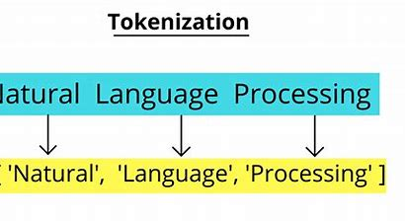
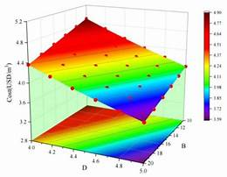
NLP- Text Processing-3
Converting Text to a Model-able format: One Hot Encoding
TfidfVectorizer()
Tokenizer
Absolutely wonderful - silky and sexy and comfortable
[absolut, wonder, silki, sexi, comfort]
Modelling

Slide 12
NLP-Modelling + FINAL DATA PREP
NLP INDIVIDUAL MODEL
INPUT -> REVIEW (ONLY)
NLP-TEXT PROCESSING 1,2,3
PREDICTION -> PRODUCT RECOMMENDATION YES/NO
RESULTS VALIDATION SET ACCURACY: 0.88 VALIDATION SET ROC: 0.84
FINAL MODEL DATA PREPARATION STEP 2
INPUT -> REVIEW -> NLP TEXT PROCESSING
SENTIMENT ANALYSIS POLARITY SCORE
LOGISTIC REGRESSION MODELLING PROBABILITIES
OUTPUT -> 2 NEW VARIABLES -> POLARITY SCORE & LOGISTIC PROBABILITIES

Slide 13
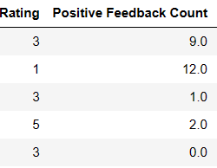
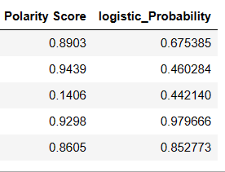
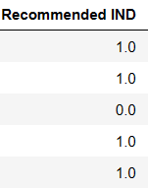
FINAL MODEL
Models | Accuracy | Precision | Recall | F1-Score
Decision Tree | 93.31 | 96.16 | 95.71 | 95.39
Logistic Regression | 95.15 | 96.76 | 97.36 | 97.07
Support Vector Machine | 95.15 | 96.39 | 97.19 | 97.06
Random Forest Classification | 94.88 | 97.04 | 96.74 | 96.89
Naïve Bayes | 93.37 | 94.05 | 94.04 | 95.90

Slide 14




Future Work
Explainable AI (XAI): Incorporate interpretability techniques for better model understanding.
Deployment: Consider deploying the model for real-time sentiment analysis.
Feedback Loop: Establish a feedback mechanism for continuous model updates.
Multilingual Analysis: Extend the analysis to handle reviews in multiple languages.

Slide 15
QUESTIONS?

