Slide 1
High Level Design
Car Comparison Module
Shreyanshi Singh Distwar
Date: 15th July 2024

Slide 2
Objective
We are building a web-based application that allows users to research about cars online. The website would allow users to search for cars, view their specifications, view the pictures, etc., You are responsible for building the Comparison module.
The module should:
● Suggest upto 10 cars that are similar to the car being viewed by the user
● Allow the user to select upto 2 other cars for comparison from the suggested list in
addition to the selected car
● Display the feature and specifications comparison table
● Provide an option to the user to see only the differences and hide the similar features

Slide 3
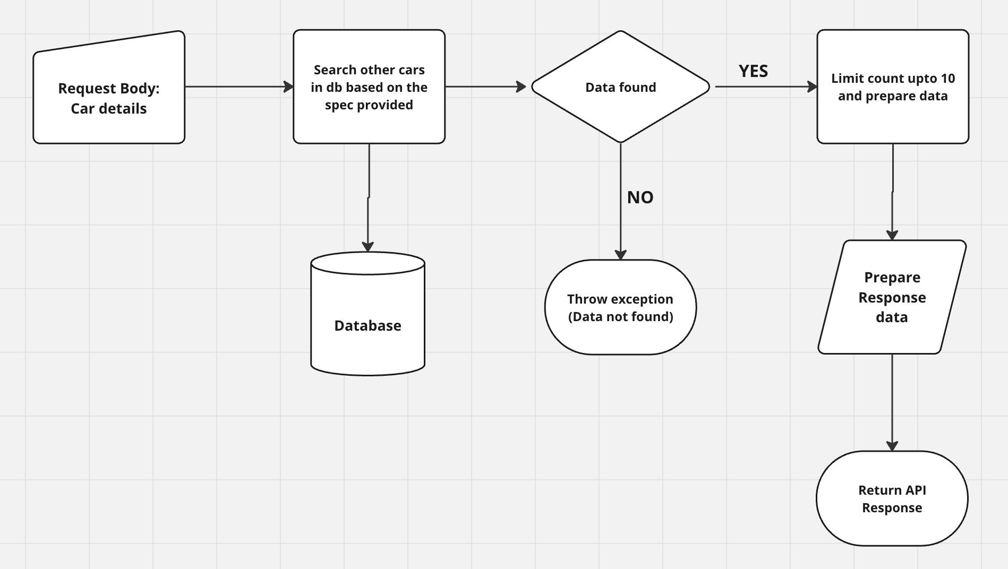
Workflow/Components/modules:
Spring Boot Application (java) with REST controller to provide the expected response.
API Interface
Unit Tests
In memory database (H2)
Postman collection (to call the APIs)

Slide 4
Data Model
CREATE TABLE CAR_DETAILS (
ID INTEGER not null,
MODEL varchar(1000) not null,
BRAND varchar(1000) not null,
ENGINE_TYPE varchar(20),
COLOR varchar(100),
NO_OF_SEATS INTEGER not null,
TANK_SIZE varchar(10) not null,
MILEAGE varchar(10) not null,
PRICE varchar(100) not null,
primary key (ID));
Car:
{
"id": 4,
"model": "ALTROZ",
"brand": "TATA",
"engineType": "PETROL",
"color": "BLACK",
"numberOfSeats": 5,
"tankSize": "63",
"mileage": "19",
"price": "700000"
}

Slide 5
Search for similar cars (upto 10) POST: url: http://localhost:8080/car/search
API Interface:
@RestController
@RequestMapping("/car")
public interface CarComparison {
@PostMapping("/search")
@Consumes(MediaType.APPLICATION_JSON)
@Produces(MediaType.APPLICATION_JSON)
ResponseEntity searchCars(@RequestBody Car input);
@GetMapping("/{id}")
@Produces(MediaType.APPLICATION_JSON)
ResponseEntity getCar(@PathVariable int id);
@GetMapping("/compare")
@Produces(MediaType.APPLICATION_JSON)
ResponseEntity compareCars(@RequestParam int id1, @RequestParam int id2);
Search car details by id
GET:
url: http://localhost:8080/car/4
Compare 2 cars (show the differences only)
GET:
url: http://localhost:8080/car/compare?id1=16&id2=6

Slide 6
Search similar cars request and logic:
Request:
{
"brand": "TATA",
"engineType": "PETROL",
"numberOfSeats": 5,
"tankSize": "60",
"mileage": "20"
}
Logic:
SELECT
ID, MODEL, BRAND, ENGINE_TYPE, COLOR, NO_OF_SEATS, TANK_SIZE, MILEAGE, PRICE FROM CAR_DETAILS
WHERE
BRAND =:brand and
ENGINE_TYPE = :engineType and
NO_OF_SEATS <= :noOfSeatsR and
NO_OF_SEATS >= :noOfSeatsL and
TANK_SIZE <= :tankSizeR and
TANK_SIZE >= :tankSizeL and
MILEAGE >= :mileageL and
MILEAGE <= :mileageR” ;

Slide 7
Questions ?

