Slide 1
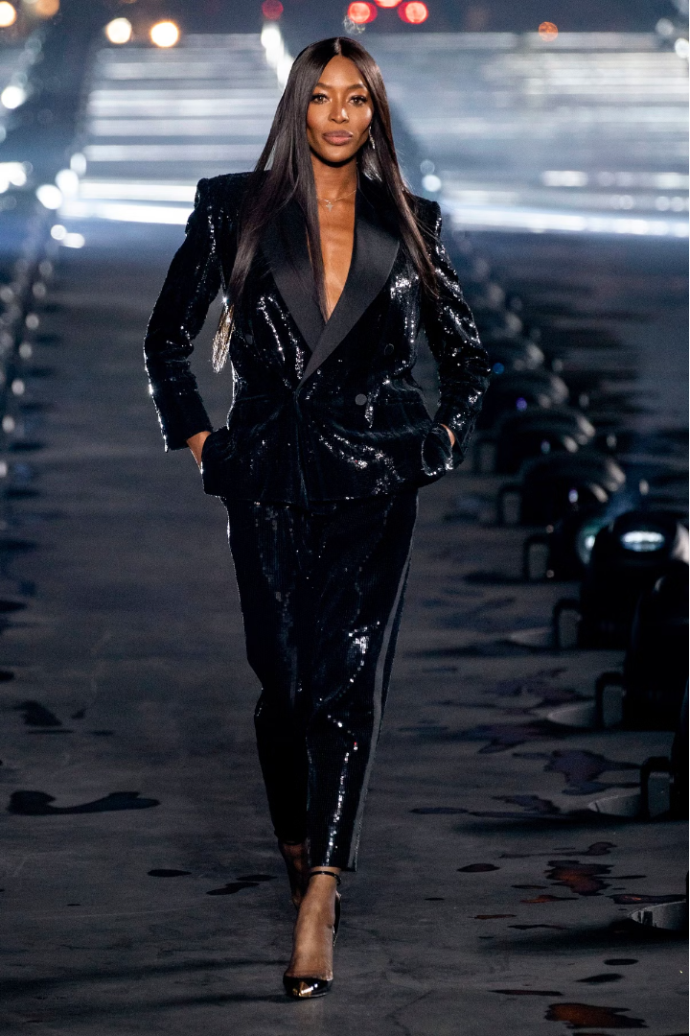
Fashion Recommendation System
Discover the power of VGG16, a renowned convolutional neural network, in creating a sophisticated fashion recommendation system. This intelligent system can analyze visual style cues and suggest personalized clothing and accessory recommendations tailored to your unique preferences.
by Amishu Negi(E23MCAG0091)
Shreyanshi Mukesh(E23MCAG0014)

Slide 2
Introduction to Fashion Recommendation Systems
1
Personalized Suggestions
2
Enhanced Shopping Experience
3
Improved Efficiency
Fashion recommendation systems leverage user data and preferences to provide tailored clothing and accessory recommendations.
By automating the product discovery process, recommendation systems save shoppers time and effort.
These systems streamline the shopping process, helping users discover new styles and items they're likely to love.

Slide 3

Overview of VGG16 Architecture
Convolutional Layers
Fully Connected Layers
Powerful Feature Extraction
VGG16 features a deep stack of convolutional layers that extract visual features from images.
The network also includes several fully connected layers that aggregate the extracted features and produce the final output.
VGG16's architecture allows it to capture rich, hierarchical representations of visual data, making it highly effective for image-based tasks.

Slide 4
Data Preprocessing and Image Encoding
Image Resizing
1
All input images are resized to a common size to fit the VGG16 model's input requirements.
2
Pixel Normalization
The pixel values of the images are normalized to a standard range to ensure consistent input for the model.
One-Hot Encoding
3
Fashion item labels are converted to one-hot encoded vectors to represent the categorical information.

Slide 5
Feature Extraction using VGG16
Pretrained VGG16
Transfer Learning
The fashion images are passed through the pre-trained VGG16 model to extract rich visual features.
The VGG16 model is fine-tuned on the fashion dataset, allowing it to learn domain-specific visual representations.
Feature Vectors
Dimensionality Reduction
The output of the VGG16 model serves as a high-dimensional feature vector for each fashion item.
Principal Component Analysis (PCA) is used to reduce the dimensionality of the feature vectors.

Slide 6
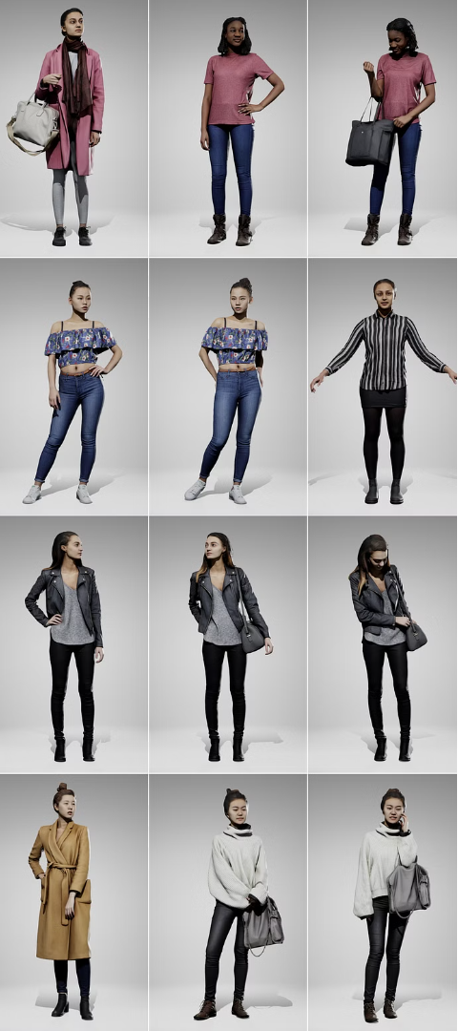



Building the Recommendation Model
Similarity Calculation
The reduced feature vectors are used to calculate pairwise similarity scores between fashion items.
Recommendation Engine
The similarity scores are then used to build a recommendation engine that can suggest visually similar items.
Personalization
User preferences and purchase history are incorporated to provide personalized fashion recommendations.

Slide 7



Evaluating the Recommendation System
Accuracy
User Satisfaction
Sales Metrics
Measuring the precision and recall of the recommendations to ensure they align with user preferences.
Gathering feedback from users to assess the overall quality and usefulness of the recommendations.
Tracking the impact of the recommendation system on sales and conversion rates.

Slide 8
Deployment and Future Enhancements
Scalable Infrastructure
Ensuring the recommendation system can handle increasing user traffic and data volumes.
Continuous Learning
Updating the model with new fashion trends and user feedback to improve recommendations over time.
Multimodal Integration
Combining visual cues with other data sources, such as user behavior and natural language, to enhance recommendation accuracy.
Ethical AI Practices
Implementing responsible AI principles to ensure the system is fair, transparent, and respects user privacy.

