Slide 1
FX Panel
Helping reduce violence one person at a time by moderating guns, arms and ammunitions.
Shreyansh Khajanchi, Abhishek Joshi

Slide 2
Why?
Lots of guns and arms on the Indian subcontinent
Most of which is untracked and their owners are anonymous
Anonymous identity gives owners confidence in their ability to get away with crime

Slide 3
What?
We are trying to track and pin point every gun and anno throughout the nation.
We make sure no bullet is unaccounted for.
We are trying to give people more confidence about their surrounding by giving them easy to understanding statistics.
We are trying to empower people by giving them data to base their decisions upon.

Slide 4
How?
An API which allow the tech savvy to exploit all the data programmatically
A user friendly web platform which allow the average Indian to get intuitive graphs, visuals and statistics to grasp data
An android application to improve availability for the user.

Slide 5
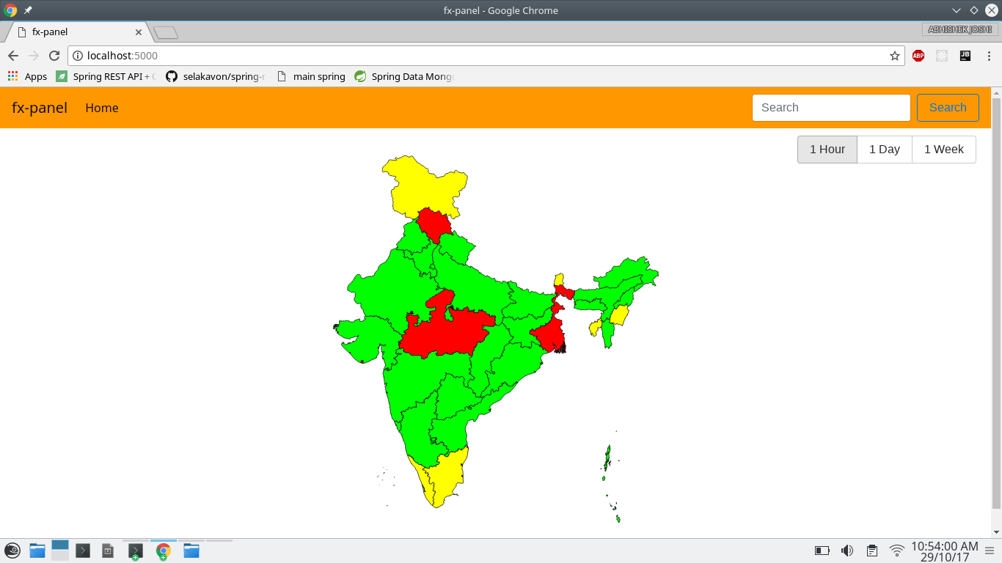
Meet the Web Interface
Display live status of the current activity in the market about how many transactions were made in the selected period of time.
Allows user to find the most safe area for their travel or life and provide a simple to use interface.

Slide 6
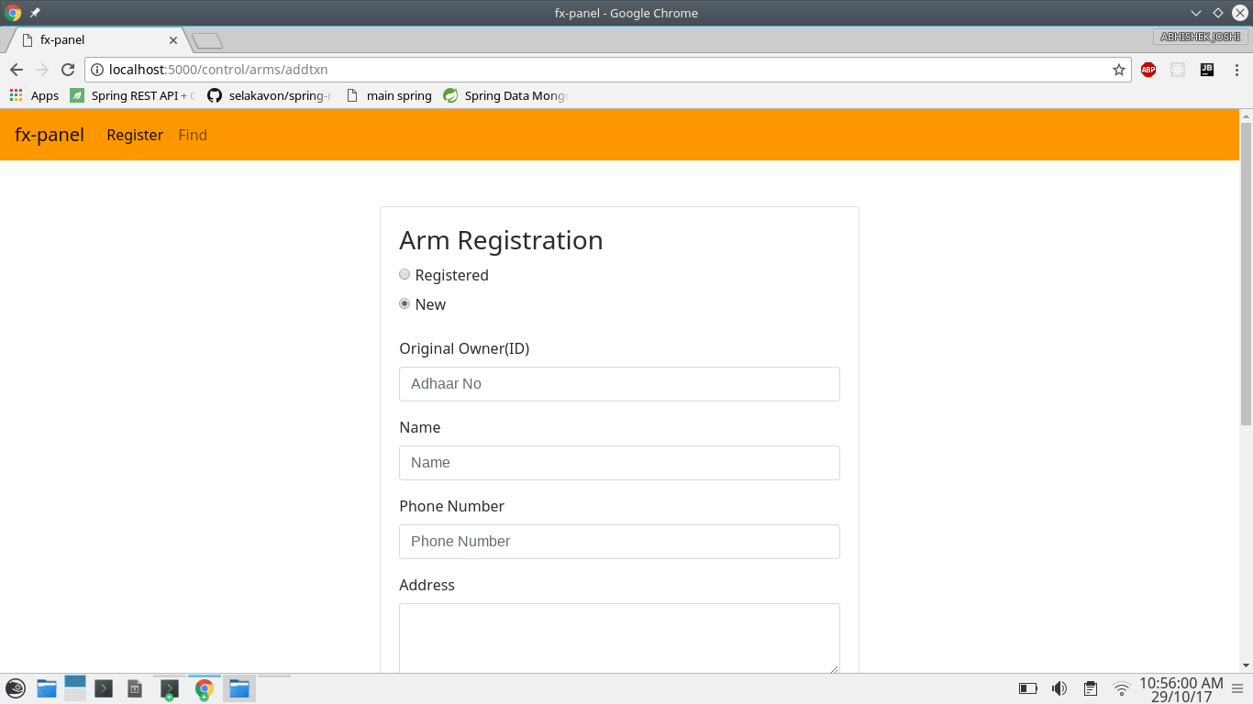
Open store to help track arms and ammo
Allows government officials to register every transaction digitally including the transfer of ownership, new sale or import.
Hence, allowing creation of a manageable open database.

Slide 7
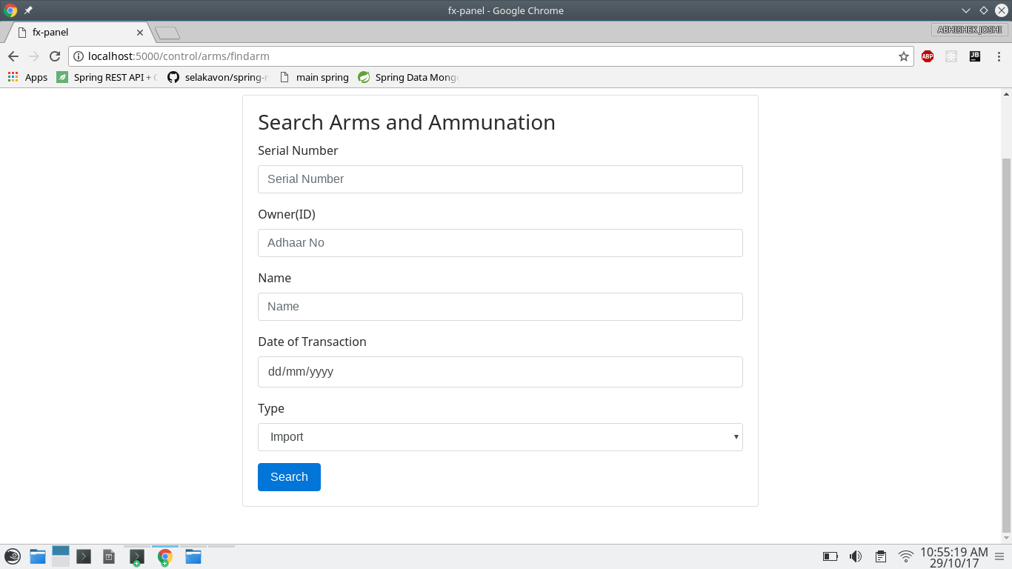
Search the database for ownership information
Once, the database has enough data, it is now possible to search for the owner of any weapon so as to track them.

Slide 8
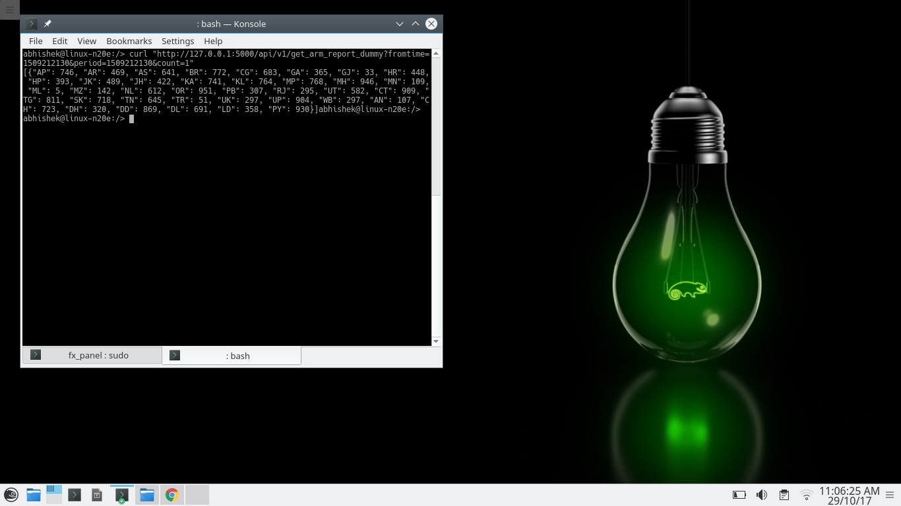
An API for the savvy
Allow easy consumption of such massive amount of the data by providing an easy to use API.
Such system foster open innovation among those with a thirst to seek answers.

Slide 9
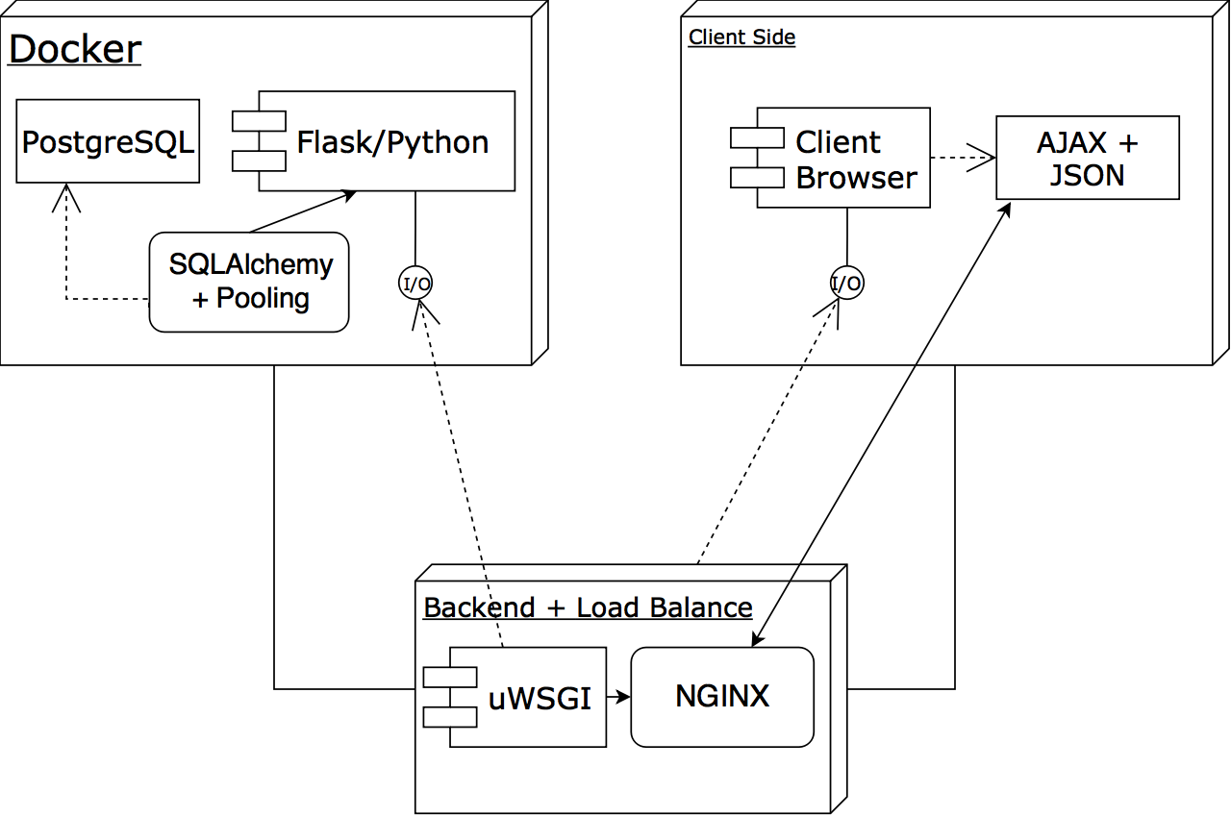
Meet the stack
Fairly complex stack including the capability to scale when needed and to defend in case of attacks such as DDOS.
Load balanced to serve thousand of users at a time and still maintain high response rates and low latency.
Mainstream frontend stack so that anybody can contribute.
We only do one-shot deploy.

Slide 10
Thank you for being awesome audience.
Presented by:
Shreyansh and Abhishek

