Slide 1
ARP Poisoning / Spoofing
By: Shreyansh Kansara
UID: 116750325

Slide 2
Address Resolution Protocol (ARP)
ARP is used for mapping IP address (Internet layer address) to MAC address (Link layer address). One of the most critical functionality in IP Suite.
It’s needed because underlying hardware communicates using ethernet addresses and not IP address.
A lookup table is created of all the mappings called as ARP lookup table.

Slide 3
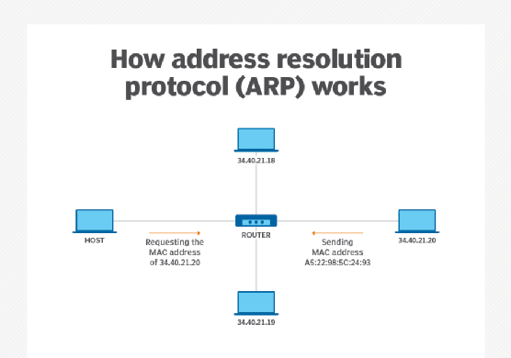
Working of ARP
Reference: https://searchnetworking.techtarget.com/definition/Address-Resolution-Protocol-ARP

Slide 4
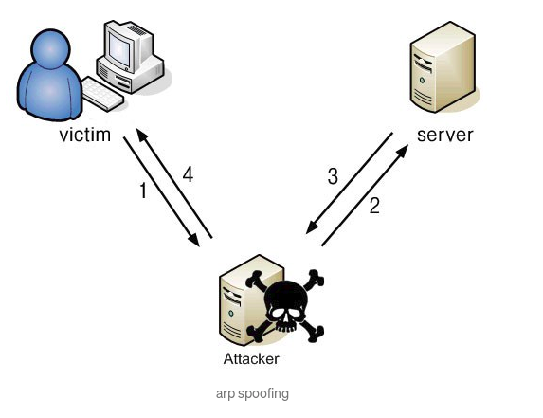
ARP Poisoning/Spoofing
ARP Poisoning is method of sending spoofed ARP response packets to the victim in order to update the ARP table entries in victim’s machine. This attack is carried out over a Local Area Network.
The process includes changing the MAC address of gateway or router with the attacker’s MAC address on the victim’s machine. The attacker thereby becomes Man in the Middle.
Reference: https://medium.com/@ravisinghmnnit12/how-to-do-man-in-the-middle-attack-mitm-with-arp-spoofing-using-python-and-scapy-441ee577ba1b

Slide 5
Implementing ARP poisoning using Python
We will be using Scapy which is a packet manipulation tool written in Python.
Following screenshots will process of crafting and sending ARP spoofed packets and successfully updating the ARP table entry in the victim’s machine.
Here I used two VM’s: one being Windows and other being Ubuntu.
Here, I have chosen Ubuntu as attacker’s machine and Windows being the victim.

Slide 6
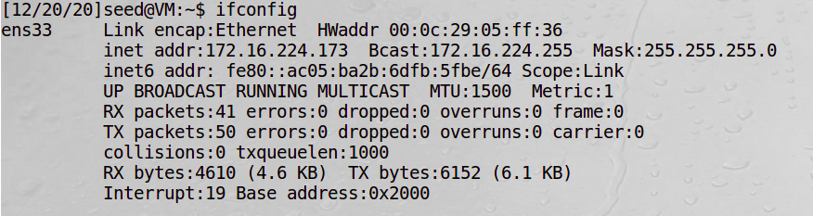
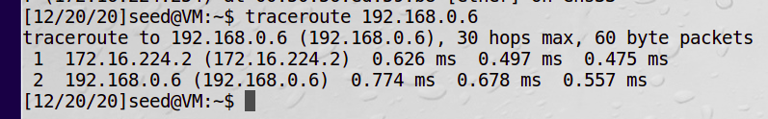
Ubuntu

Slide 7
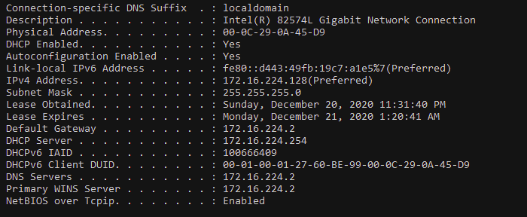
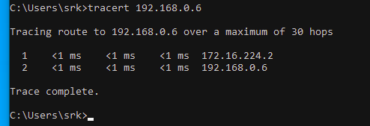
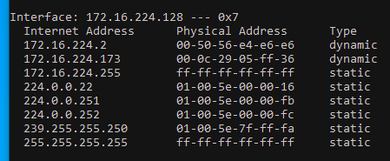
Windows

Slide 8
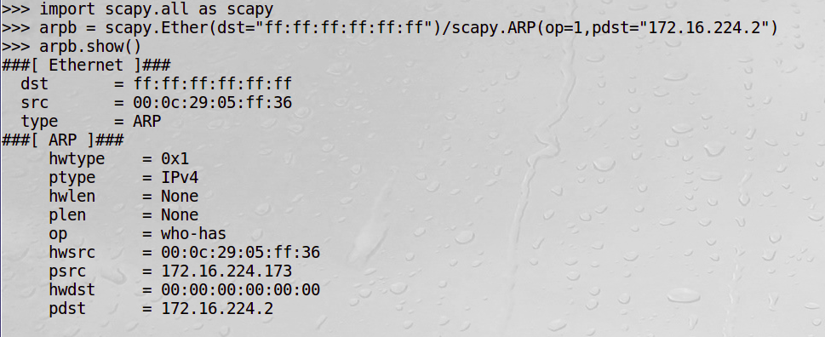
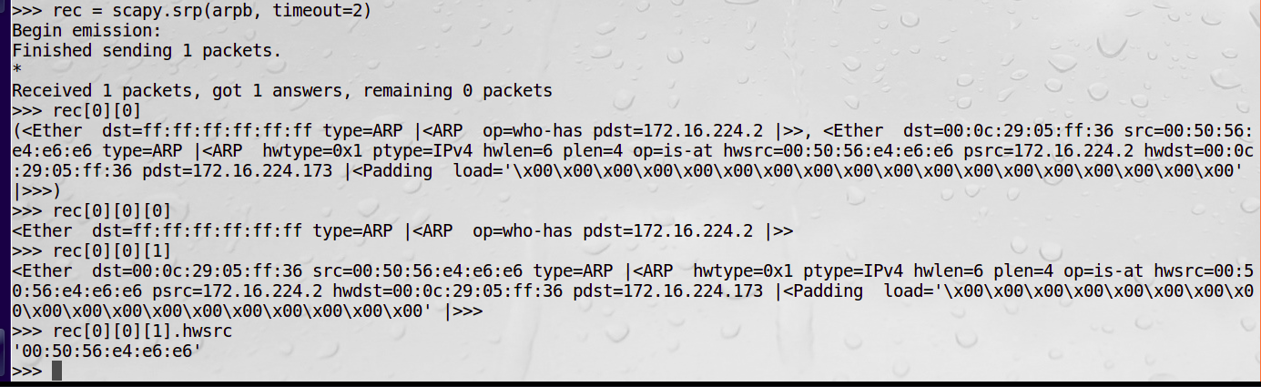
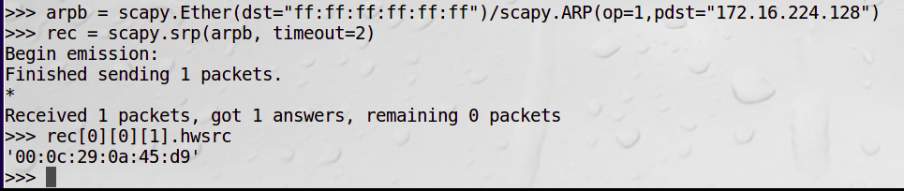
Fetching Mac address of specific IP

Slide 9
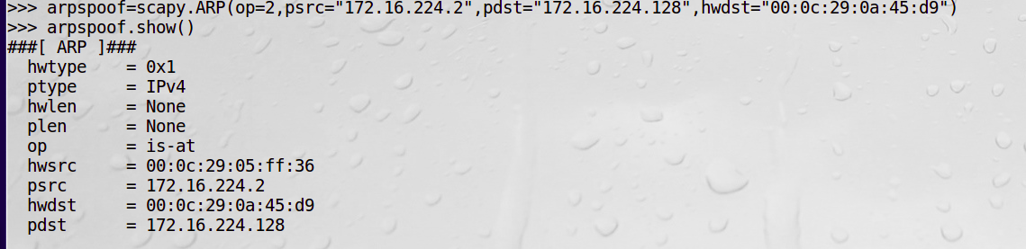

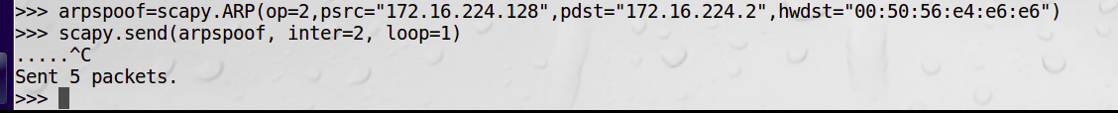
Spoofing

Slide 10
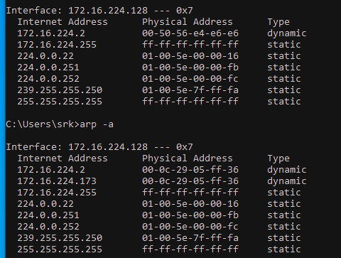
ARP Table Altered!

Slide 11
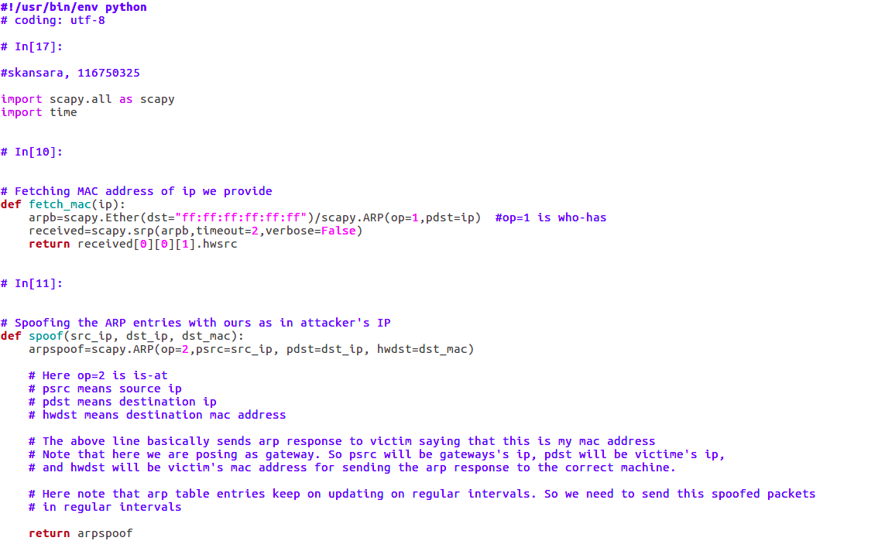
Code

Slide 12
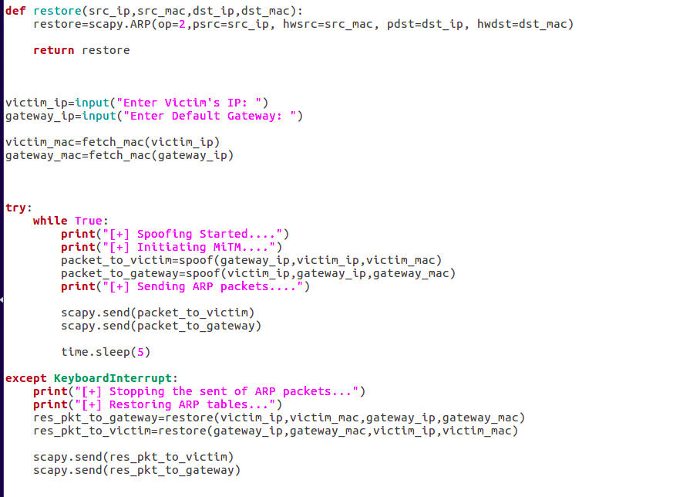

Slide 13
Prevention
Static ARP entries - read-only
Detection and prevention software - It relies on some form of certification or cross checking ARP responses. Uncertified ARP responses blocked. Can be integrated with DHCP server so both dynamic and static IP’s can be certified
Encryption - Use HTTPS
Packet filters - Blocks malicious or suspicious IP’s
Run Spoofing attack and check your defenses

Slide 14
References
https://en.wikipedia.org/wiki/Address_Resolution_Protocol
https://security.radware.com/ddos-knowledge-center/ddospedia/arp-poisoning/
https://medium.com/datadriveninvestor/arp-cache-poisoning-using-scapy-d6711ecbe112
https://medium.com/@ravisinghmnnit12/how-to-do-man-in-the-middle-attack-mitm-with-arp-spoofing-using-python-and-scapy-441ee577ba1b
https://www.comparitech.com/blog/vpn-privacy/arp-poisoning-spoofing-detect-prevent/

Slide 15
Thank you!

