Slide 1
Anthropic is worth ~$1.07T in our base case; IPO talk of $1.5T+ already prices in the bull case
Valuation of Anthropic PBC and design of a tokenized exposure vehicle | 6 November 2026
$642B – $1.72T
$5.88
$1.89T
Blended equity value range, bear to bull (3 methods)
Base-case implied token price vs $10.00 issue
Anthropic valuation needed for a pre-IPO token to break even
▪ Fundamentals support ~$1.1T. Q3-26 revenue of $17.0B and ~85% gross margin justify a premium, but growth fell from +144% to +47% QoQ and $895B of compute is already committed.
▪ A token bought at today's secondary price starts underwater. Entry at ~$1.3T plus fees means holders pay an effective $1.39T, 45% above the Series H.
▪ Recommendation: tokenize post-IPO lock-up shares (or primary allocation) rather than pre-IPO secondaries; the pre-IPO window closes with the November roadshow.
1

Slide 2
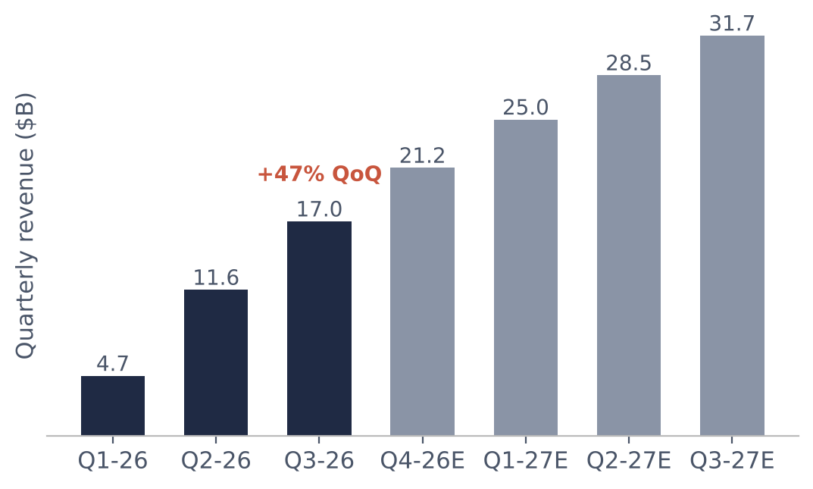
Revenue grew ~12x year on year to a $68B run-rate, but Q3 growth slowed to 47% quarter on quarter
$17.0B
$68B
Q3-26 revenue (Reported)
Q3 run-rate, x4 (Estimated)
~85%
$895B
H1-26 gross margin; S-1 warns it won't last
Compute purchase + lease commitments
48%
–$0.6B
Revenue via Amazon + Google marketplaces
Q3-26 operating loss (Q2: +$1.0B)
Source: Anthropic S-1 (26-Oct-26) and amended S-1 (2-Nov-26) via CNBC/Reuters; CNBC 17-Aug-26; Fortune 4-Jun-26.
2

Slide 3
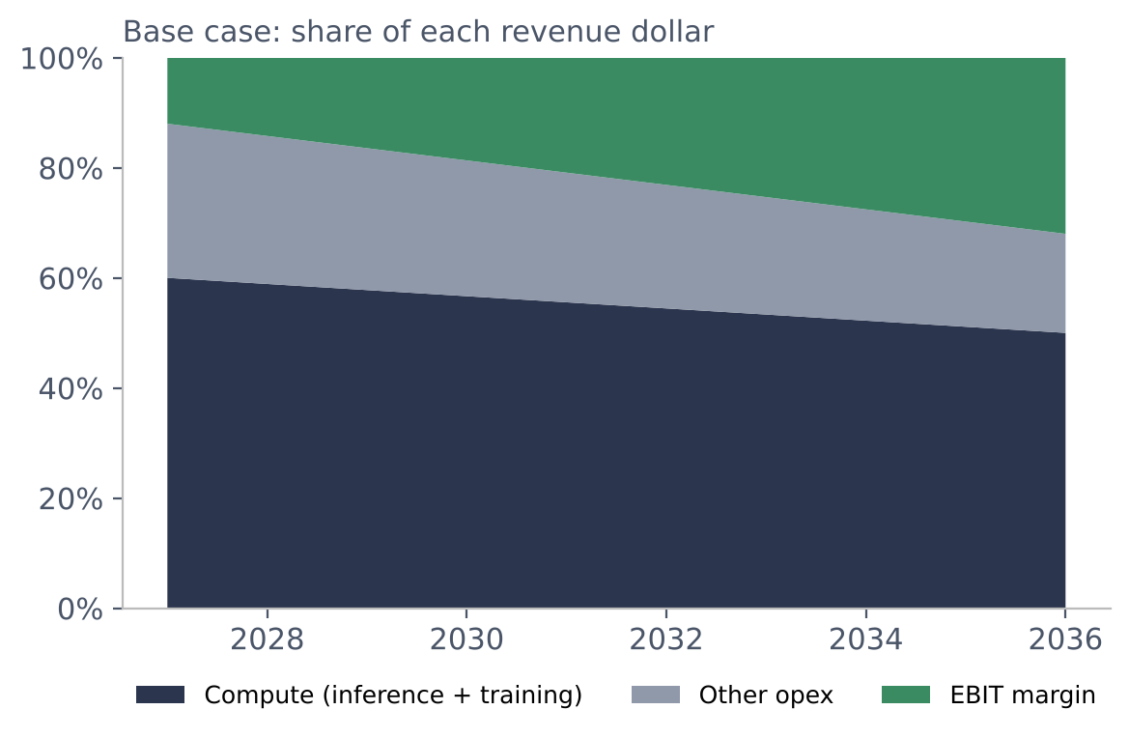
Compute is the cost base: it absorbs ~60% of revenue in 2027 and still ~50% in 2036
▪ Revenue driver: enterprise API + Claude Code; growth path decays from +75% (2027) at 0.72x per year.
▪ Inference compute (cost of revenue) rises from 18% to 30% of revenue as pricing normalizes.
▪ Training + research compute falls from 42% to 20% as revenue scales over fixed frontier-model runs.
▪ Commitment check: base-case compute 2027-29 covers only 58% of the ~$448B reportedly due before 2030: either revenue must beat our base or capacity is stranded.
Source: Model 3c_DCF (base). Commitments: amended S-1; pre-2030 split from a single secondary source (Estimated).
3

Slide 4
Three methods put base-case value between $772B and $1.42T; the DCF is the most conservative
Method | Bear | Base | Bull | What drives it
(a) Last-round anchor | $936B | $1.10T | $1.35T | Series H $965B + 0/40/100% of run-rate step-up since May
(b) Forward NTM multiple | $1.01T | $1.42T | $1.83T | NTM revenue $106B x 9x / 13x / 17x (listed peers 3-9x, private labs 34-60x)
(c) 10-year DCF | $147B | $772B | $1.90T | WACC 13/12/11%, g 2.5/3.0/3.5%, explicit compute lines
Blended (30 / 30 / 40) | $642B | $1.07T | $1.72T | DCF weighted highest: only method that prices compute
Base blend implies 9.3x EV / NTM revenue: in line with Microsoft today, for a company growing ~57% over its current run-rate.
Source: Model 3_Valuation, 3c_DCF. Equity value after 3% dilution; net cash $80B (Assumed).
4

Slide 5
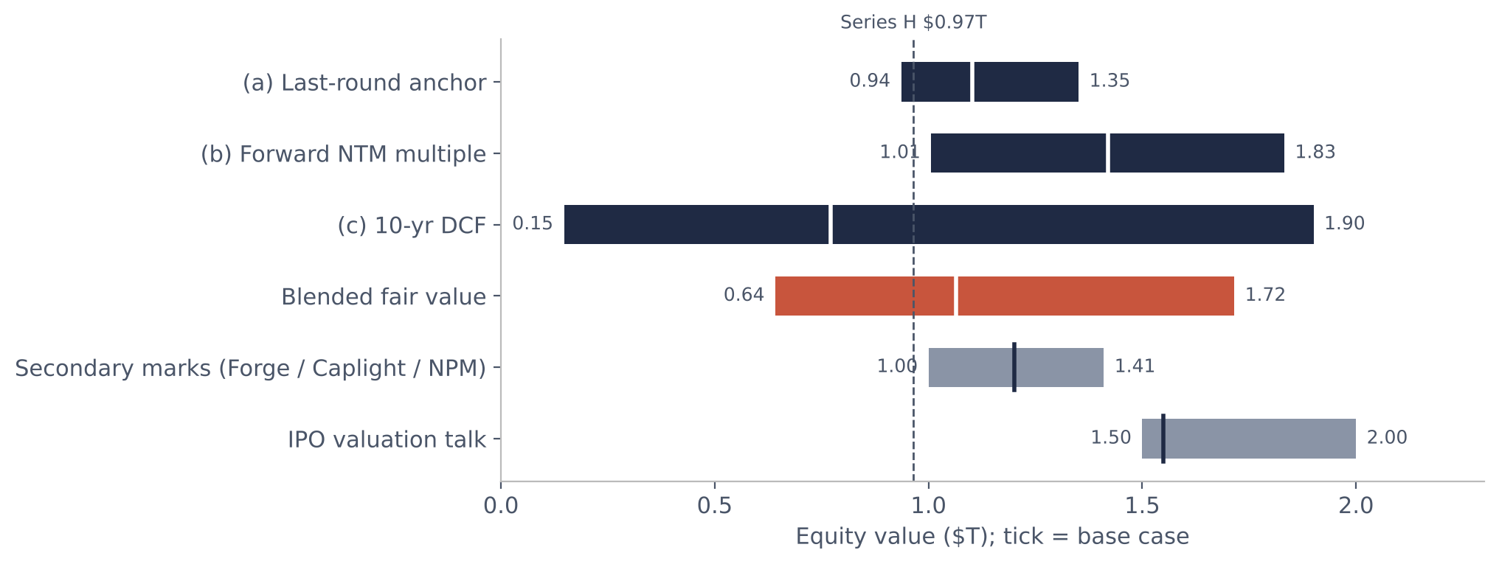
Fundamentals support ~$1.1T; secondary marks and IPO talk sit above our base case
Source: Model 3_Valuation football field. Forge (Apr-26), Caplight (Jul-26), Nasdaq Private Market (Nov-26); WSJ (4-Nov-26).
5

Slide 6
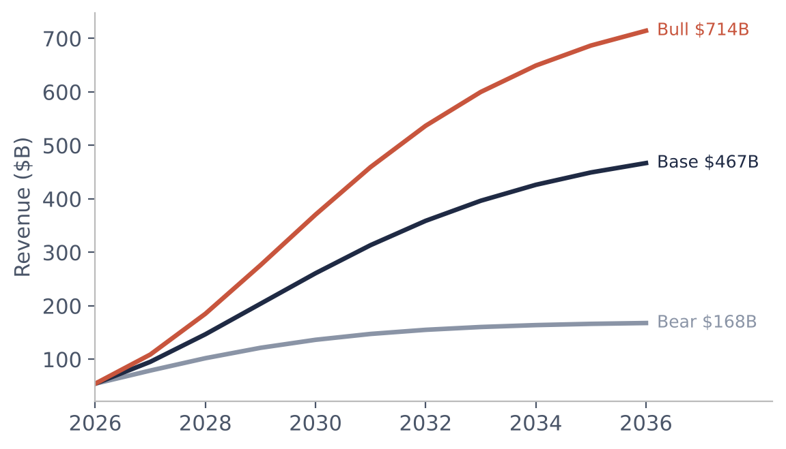
The range comes down to growth durability: 2036 revenue of $168B in the bear case vs $714B in the bull
 | Bear | Base | Bull
2027 growth | 45% | 75% | 100%
Rev CAGR 26-36 | 12% | 24% | 29%
2036 EBIT margin | 15% | 32% | 45%
DCF equity | $147B | $772B | $1.90T
TV % of EV | 78% | 60% | 65%
Blended value | $642B | $1.07T | $1.72T
Bear = price war and share loss to OpenAI / Gemini; Bull = Claude becomes the default enterprise agent platform. A $1.55T IPO needs roughly bull-case growth.
Source: Model 3c_DCF; 4_Sensitivity.
6

Slide 7
Demand for AI exposure exceeds access: secondary marks ran 46% above the last primary round
▪ Scarce supply. Employees under-sold into the $350B tender; Caplight calls Anthropic the most sought-after name the venture secondary market has seen.
▪ Access gap. Primary rounds go to ~10 mega-funds and strategics; Gulf private-wealth and family offices get no direct allocation.
▪ Fractional + programmable. $10 tokens vs $1M+ SPV minimums; on-chain cap table, automated transfer checks.
▪ But the window is short. With the S-1 public and a roadshow from ~9-Nov, the durable product is a token over lock-up shares that converts to listed stock.
$0.97T → $1.41T
Series H (May) to Nasdaq Private Market mark (Nov)
20-40%
Typical premium of pre-IPO tokens to NAV (Pantera)
–38 to –46%
One-day drop in pre-IPO tokens after company warnings
Source: Nasdaq Private Market (Nov-26), Series H (TechCrunch 28-May-26), employee tender (Apr-26), Pantera research.
7

Slide 8
A ring-fenced ADGM SPV holds board-approved shares; each token is a pro-rata claim on its NAV
Token holders
Professional / qualified investors, KYC'd, whitelisted wallets
ADGM SPV
Issues 10M tokens at $10; holds shares + cash reserve
Anthropic PBC
SPV owns 0.0072% via board-approved transfer
$100M subscription
Purchase at ~$1.3T
trade
custody
ADGM MTF
Secondary trading of tokens between whitelisted holders
Regulated custodian
Holds share certificates; daily register-to-token reconciliation
Fund manager
1.5% mgmt fee, 15% carry; NAV published from the model
manages
Exit: at IPO + 180-day lock-up the SPV either distributes listed shares to holders or sells and redeems tokens at NAV. Token supply is fixed; no synthetic or forward-contract exposure.
Source: Illustrative structure. FSRA digital-securities regime; ADGM-supervised MTF for secondary trading.
8

Slide 9
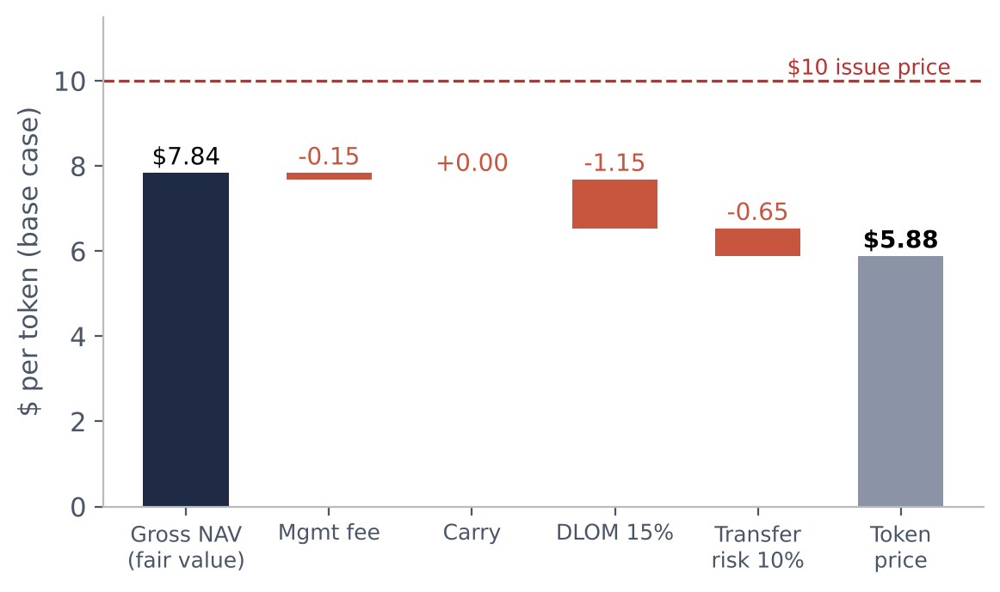
At a $1.3T entry, the base-case token is worth $5.88 against a $10 issue price
$ / token | Bear | Base | Bull | IPO mid
Gross NAV | 4.80 | 7.84 | 12.50 | 11.31
Pre-IPO price | 3.56 | 5.88 | 9.18 | 8.41
Post-IPO (lock-up) | 4.33 | 7.15 | 11.16 | 10.22
Discount to NAV | 26% | 25% | 27% | 26%
Layered discounts take ~25% off NAV pre-IPO.
Break-even Anthropic value: $1.89T pre-IPO, $1.51T once listed and in lock-up.
Fix: buy closer to fair value, cut fees, or launch post-IPO when transfer risk falls away.
Source: Model 5_Token. All discount and fee inputs Assumed (see 1_Assumptions).
9

Slide 10
Tokens over unlisted shares are securities: the path runs through ADGM FSRA or DIFC DFSA, not VARA
1. Choose the perimeter
2. Licence and vehicle
3. Eligibility
4. Issuer consent
5. Trading and exit
Tokenized securities: FSRA (ADGM) or DFSA (DIFC); mainland CMA. VARA covers virtual assets, not security tokens.
ADGM SPV or DIFC QIF / Exempt Fund; manager with FSRA/DFSA licence; QIF min. subscription $500k, Exempt Fund $50k.
Professional Clients only; VARA-style qualified test is AED 3.5M net assets or AED 700k income. Whitelisted wallets.
Board-approved transfer + ROFR waiver from Anthropic before closing; without it the transfer is void.
Admission to ADGM-supervised MTF; bilateral whitelist transfers; distribute or redeem at lock-up expiry.
Step 4 is the gating item: regulators can licence the token, but only Anthropic's board can make the underlying transfer valid.
Source: zamanathq.com, blockhertz.com, neolegal.ae (2026 summaries; verify against FSRA / DFSA rulebooks).
10

Slide 11
Transfer restrictions, not price volatility, are the risk that can take the token to zero
Risk | Likelihood | Impact | Response
Void transfer / ROFR | High | Severe | Issuer consent letter; escrow until ROFR lapses
Entry above fair value | High | High | Entry $1.39T effective vs $1.07T base fair value
NAV vs token price gap | High | High | Daily NAV; cap premium at issue; disclose break-even
Liquidity (single MTF) | High | Medium | Market-maker; redemption at lock-up expiry
Custody mismatch | Medium | High | Regulated custodian; register-to-ledger reconciliation
Wrong regulator / eligibility | Medium | Severe | FSRA / DFSA perimeter; Professional Clients only
Growth deceleration vs $895B commitments | Medium | Severe | Bear case shown; satellite sizing
Source: Model 6_Risks; Anthropic May-26 notice on unauthorized transfers (as reported).
11

Slide 12
Sources: every figure is tagged Reported, Estimated or Assumed in the model
Anthropic PBC Form S-1, SEC EDGAR CIK 0002130357 (26-Oct-26); amended S-1 (2-Nov-26) via CNBC / Reuters.
TechCrunch (28-May-26) and Orrick: Series H $65B at $965B post-money. CNBC (12-Feb-26): Series G $30B at $380B.
CNBC (17-Aug-26): $65B run-rate end-Jul; $47B in May. Motley Fool (31-Oct-26), Tomasz Tunguz: S-1 margins.
Microsoft / Nvidia blogs (18-Nov-25): $30B Azure commitment; up to $10B / $5B investment. CNBC (23-Oct-25): 1M TPUs.
Decrypt / Quartz (Apr-26, Forge ~$1T); Yahoo Finance (Jul-26, Caplight $1.2T); Nasdaq Private Market $1.41T (Nov-26).
WSJ via graniteshares / shattered.io (Nov-26): IPO talk $1.5-2.0T, investors advise $1.5-1.6T.
multiples.vc (Oct / Nov-26) listed EV / revenue; tech-insider.org (OpenAI $852B); autobound / gradually.ai (Mistral).
Fortune (4-Jun-26), leverageshares: Google ~14% stake, Amazon 12-21%, 48% of revenue via marketplaces.
zamanathq.com, blockhertz.com, neolegal.ae: FSRA / DFSA / VARA tokenized-securities summaries (2026).
Pantera Capital, CoinMarketCap Academy: pre-IPO token premiums and void-transfer warnings.
Caveat: many S-1 figures come from secondary coverage, not the filing itself. Re-verify on EDGAR before use.
12

