Slide 1

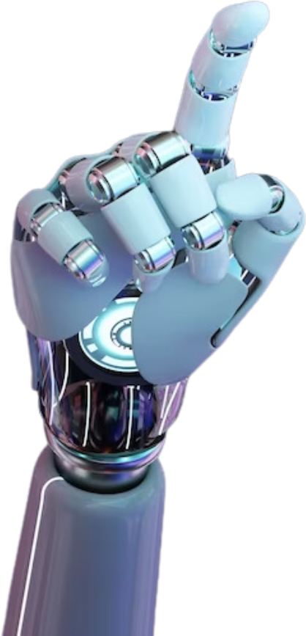

Chatbot Development
For Customer Support
Presented by Shreyansh Swaroop

Slide 2
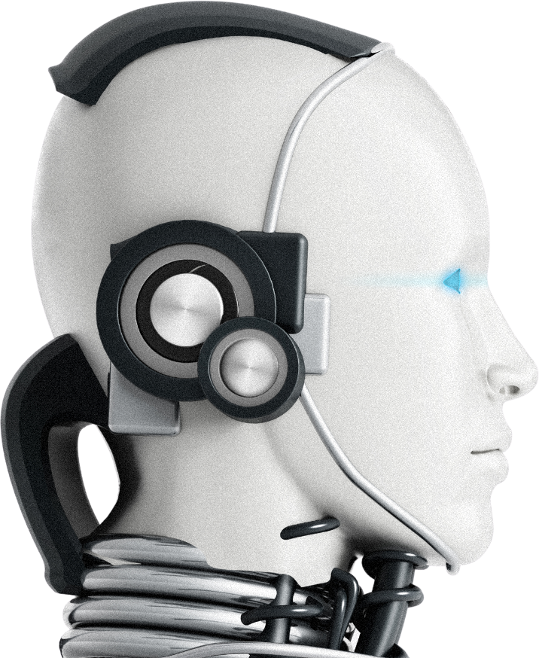
What do you mean by chatbot
A chatbot is a software application designed to simulate human conversation. It can interact with users via text, voice, or even through a visual interface. Chatbots are commonly used in various online services to provide customer support, answer questions, facilitate transactions, and more.

Slide 3
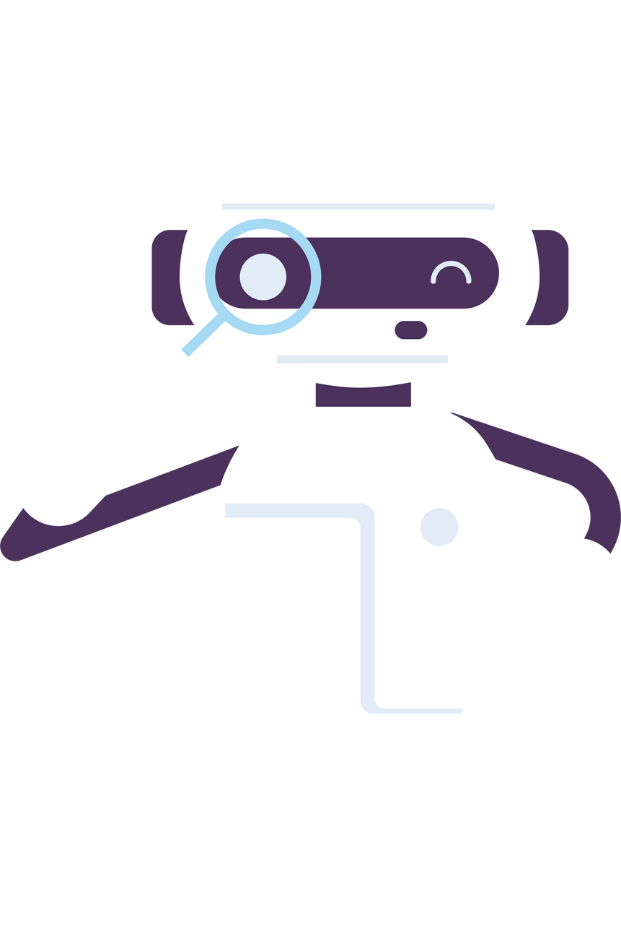
Key Features:
Natural Language Understanding: Implement natural language processing (NLP)techniques to understand user queries and intents accurately.
Dialog Management: Design dialog flows to handle conversations between the user and the chatbot, ensuring smooth interactions and context retention. Knowledge Base Integration: Integrate a knowledge base or database containing
Multichannel Support: Enable the chatbot to communicate with users across multiple channels such as website chat, messaging apps (e.g., Facebook Messenger, Slack), and email
Error Handling: Handle errors gracefully and provide helpful suggestions or alternative solutions when the chatbot cannot understand or address a user query..\
Analytics and Reporting: Incorporate analytics to track user interactions, analyze trends, and generate reports to improve the chatbot's performance over time.
Integration with Customer Support Systems: Integrate the chatbot with existing customer support systems (e.g., ticketing systems, CRM platforms) to escalate issues and capture user feedback seamlessly.

Slide 4
Technology Stack:
Dialogflow(NLP training and Webhook):
Dialogflow which is powered by Google was used to create intents and entities with respect to the domain that was selected i.e. Mutual Funds.
Based on the intents the Chatbot was trained, Small Talk is a feature offered by Dialogflow was also incorporated into the Chatbot.
Python ( Sentimental Analysis and Sentence similarity )
To work on the default fallback intent we used python modules such as vaderSentiment to do Sentimental analysis so as to verify whether the query is a Feedback or a Complaint. Part of speech tagging was also done using NLTK.corpus module.
Flask(API and REST API)
Representational State transfer (REST) API was used as a web API and was implemented using flask microframework.
SQLAlchemy(Data Base)
The identified query which is fallback content is updated in the database to provide its solution when asked the next time
Ngrok(local web server)

Slide 5
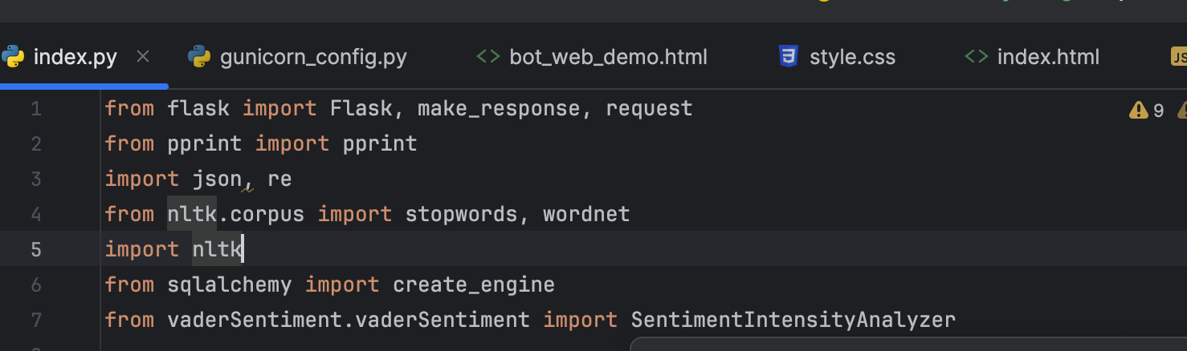
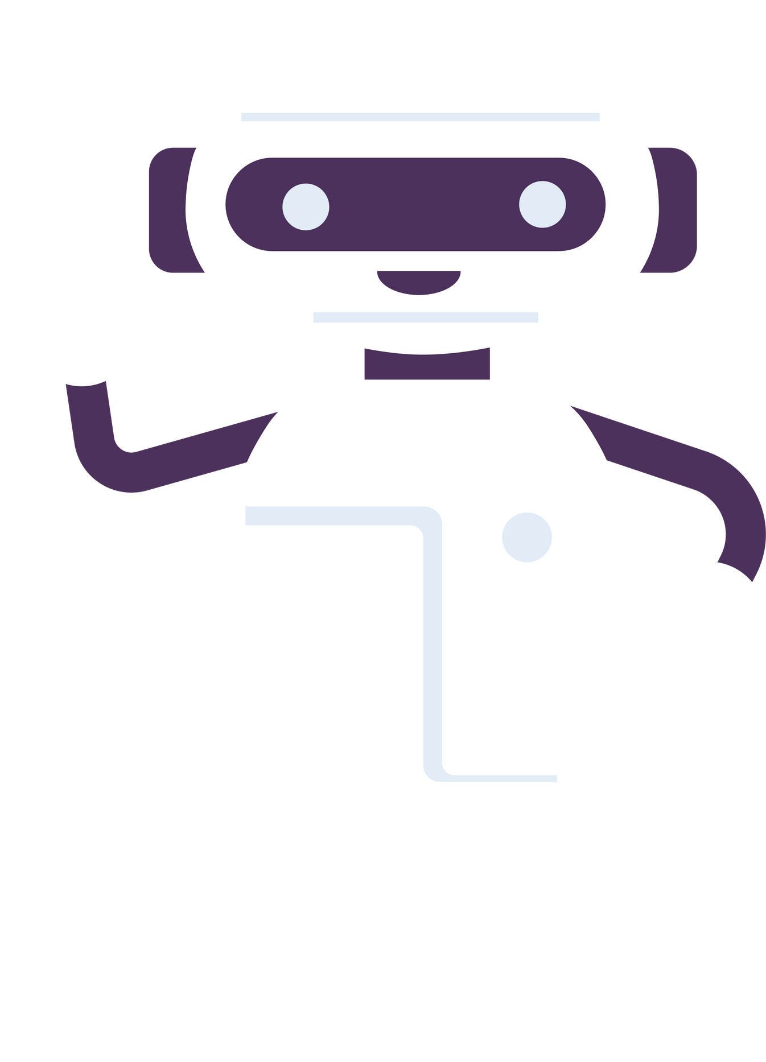
Development of the chatbot
To develop a chatbot for customer support using Python, we'll break the project into several stages:
Project Setup and Environment Preparation
Building the Chatbot Core
Training the Chatbot with Domain-Specific Data
Creating a Web Interface with Flask
Deploying the Chatbot
Continuous Improvement and Monitoring
Install required libraries:

Slide 6

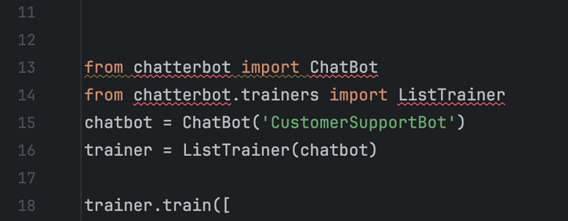
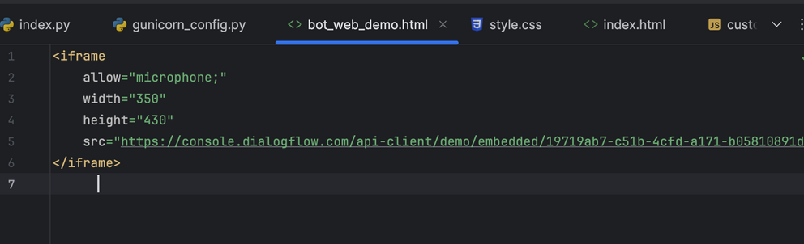
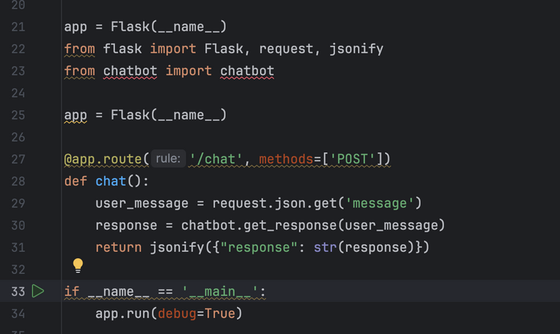
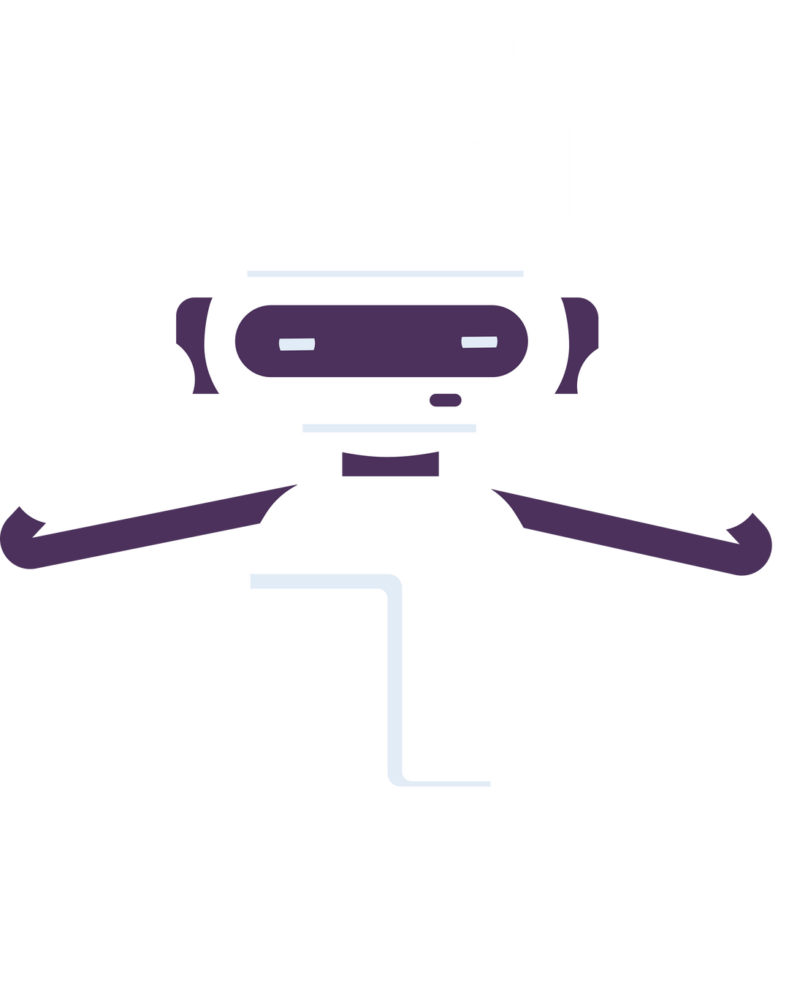
Training the Chatbot with Domain-Specific Data
Enhance the chatbot with domain-specific conversations.
Deploying the Chatbot
Here I have created the html web for deployment of the bot
Creating a Web Interface with Flask

Slide 7
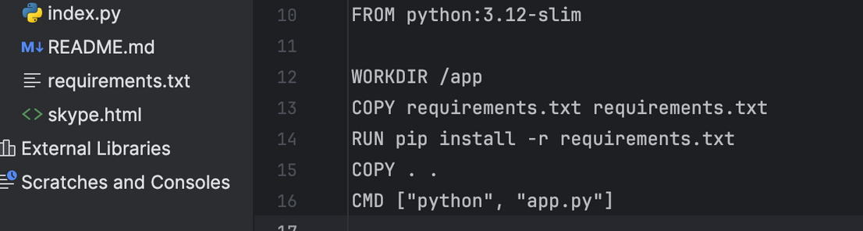
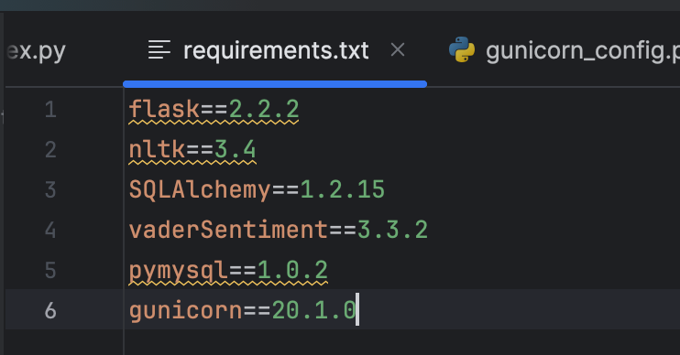
Continuous Improvement:
Feedback Loop: Implement a mechanism to capture user feedback and improve the chatbot’s responses.
Analytics: Integrate analytics to monitor chatbot performance and user interactions.
Scalability: Consider containerizing your application using Docker for easier scalability and deployment.

Slide 8
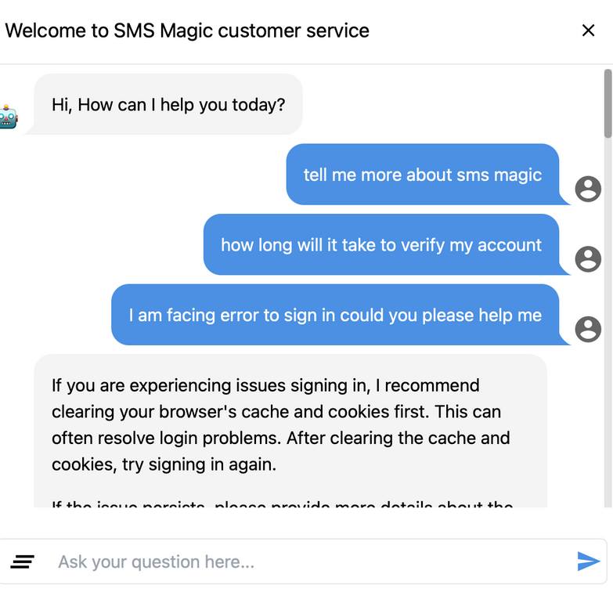
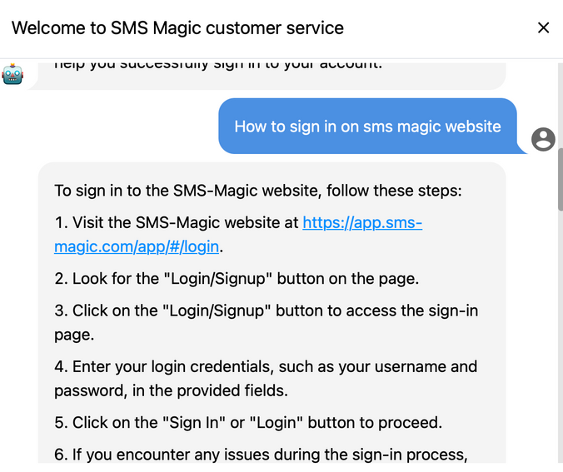
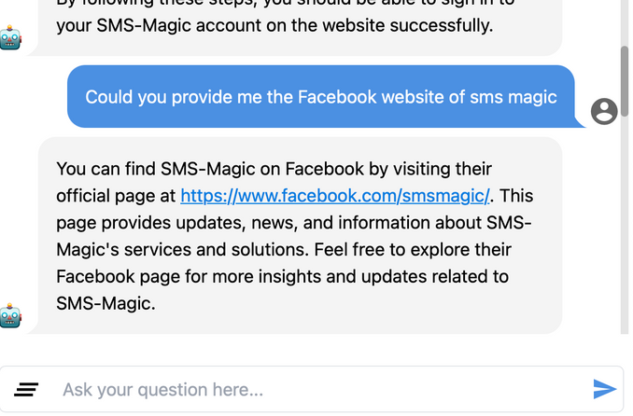
Results:
The chatbot will interacting with the users in natural language to provide assistance, answer common questions, and resolve issues related to a specific domain or product.
The users communicates with bot to resolve the problems

Slide 9
Thankyou
Shreyansh Swaroop

