Slide 1
Near Real Time Alerting
Presented by Shreyans Jain L Site Reliability Engineer Sixt Research & Development India

Slide 2
Purpose
Real-time alerting is a critical feature that ensures prompt and effective response to important events or issues.
Real-time alerting allows organizations to receive instant notifications about critical events, such as system failures, security breaches, or equipment malfunctions. These notifications can be sent to various devices, such as mobile phones, email, or desktop applications.
Real-time alerting helps organizations to reduce response time, minimize downtime, and prevent major incidents that can affect business operations, customer satisfaction, and revenue.

Slide 3
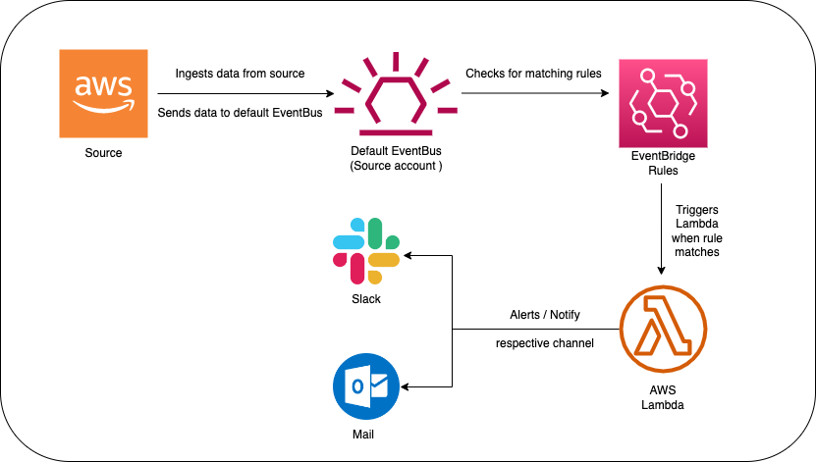
Architecture Diagram

Slide 4
Alternative approaches
CloudWatch Metric filters on Cloudtrail Logs (delay of 10-15 mins)
Cloud Custodian
Ship logs to Elasticsearch and monitor using OpenDistro
SIEM tools integrated with Cloudtrail Logs
And many other solutions primarily based on CloudTrail Logs

Slide 5
Limitations
Cannot add wildcards(*) while creating rules
Need to specify each and every EventName explicitly
Rules for global events(IAM, ConsoleLogin) should be created in us-east-1 region

Slide 6
DEMO
So lets get started with a demo !!

Slide 7
Q & A
Time for some Question & Answers

Slide 8

Thank You !!

