Slide 1

kaggle
Upadhyay Shreyans Indresh
Roll No. 18
MSc IT Part 1 Semester II
Big Data Analytics

Slide 2

Introduction
Kaggle is an online community of data scientists and machine learning practitioners.
It allows the users to find and publish datasets, explore and build models in a web-based data science environment, work with other data scientists and machine learning engineers, and enter competitions to solve data science challenges.
Founded in 2010, it started by offering machine learning competitions and now also offers a public data platform, a cloud based workbench for data science and Artificial Intelligence education.
It headquartered in San Francisco, United States.

Slide 3
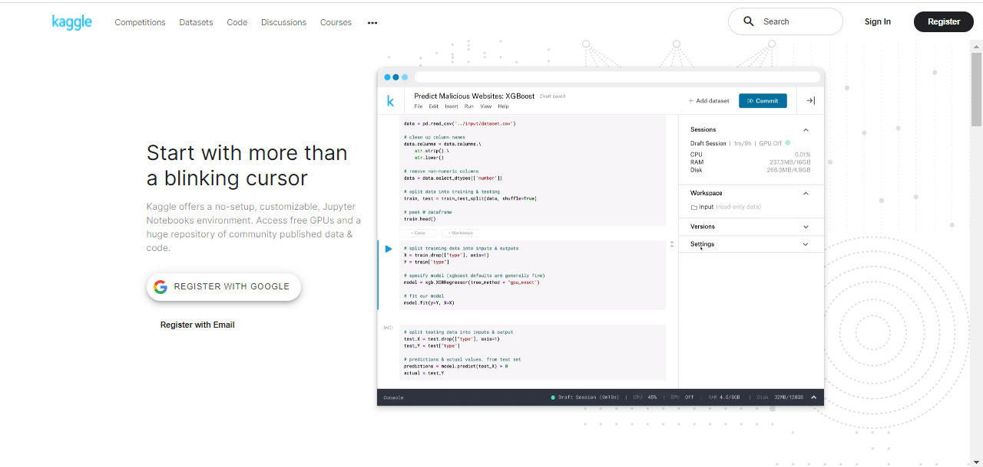
Home Screen
The Home Page of kaggle.
User can Register himself or Sign In.
It basically contains 5 buttons namely:
Competitions
Datasets
Code
Discussions
Courses
Besides that, it also contains options like:
User Rankings, Tags, Blog, Documentation, Progression, Host a Competition, Support/Contact
Team, Terms and Privacy

Slide 4
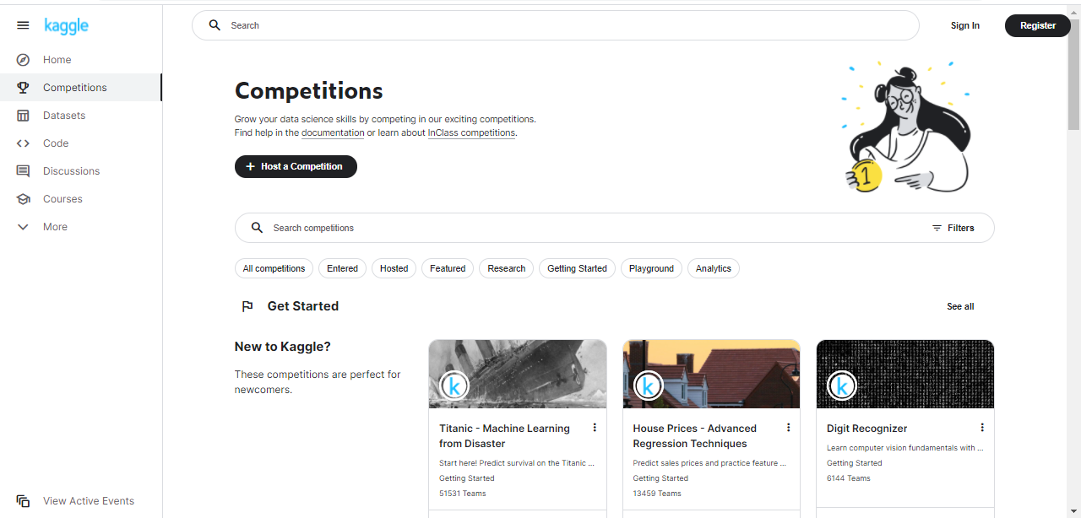
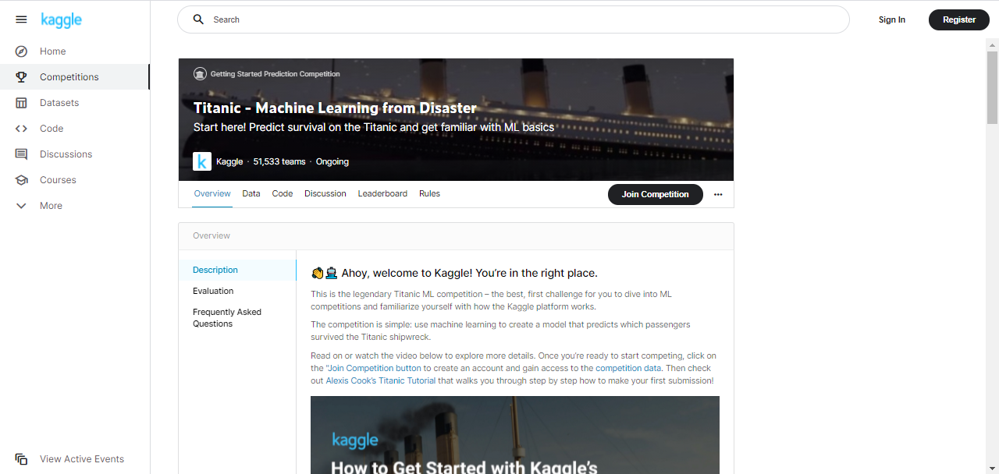
Competition
Kaggle allows users to find and publish data sets,
explore and build models in a web-based data
science environment, work with other data
scientists and ML Engineers and solve data
science challenges.
It offers n numbers of competitions like Titanic
Machine Learning from Disaster, House Prices-
Advanced Regression Techniques, Digit Recognizer.
We can have Active Competitions in kaggle.
It offers the facility to Host the competitions.

Slide 5
Datasets
Kaggle Datasets allows us to publish and share datasets privately or publicly. It provide resources for storing and processing datasets, but with certain technical specifications of 100GB per dataset limit
The datasets in kaggle are categorized as Trending Datasets, Popular Datasets, Exercise, Finance, Programming, Text Data and Social Issues and Advocacy.
Trending Datasets | Popular Datasets | Exercise | Finance | Programming | Text Data | Social Issues and Advocacy
Stress Analyssi in Social Media | Heart Attack Analysis and Prediction | Gym Environment Representations | Stock Exchange Data | Fruits-262 | World Population by Year | Brooklyn Food Waste
Paris Housing Classification | World Happiness Report 2021 | Yoga Pose classification | Loan Data | Artstation | Asia Population 2020 | Freedom in the World 2013-2021
WSJ Headline Classification | Water Quality | Korean Health Records | Consumer Complaints Datasets for NLP | Bank Marketing Dataset | Amazon Review | Korea income and Welfare

Slide 6
How to Connect kaggle Datasets to Google Colab Notebook
Step 1: Sign In to the kaggle account. Go to the account in kaggle.
Step 2: Scroll down and we will get an option as API. With this API, we can actually create our own API token. After creating the API token, a JASON file named “kaggle.jason” is downloaded, we can configure it with specific JASON file.
Step 3: Upload that JASON file to our Colab notebook.
Step 4: In our Colab Notebook, write some line of codes:
import os
os.environ['KAGGLE_CONFIG_DIR']='/kaggle.json'
!kaggle competitions download -c titanic
Step 5: Go to kaggle dataset and select the dataset you want to connect e.g. Titanic. In that dataset we will get a specific command kaggle competitions download –c titanic
Copy this API command and paste it in colab notebook with an exclamatory (!) symbol and run it. We will get two warnings #1 says: Your Kaggle API key is readable by other users on this system! To fix this, you can run 'chmod 600 /content/kaggle.json‘

Slide 7
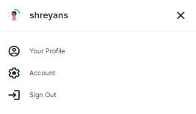
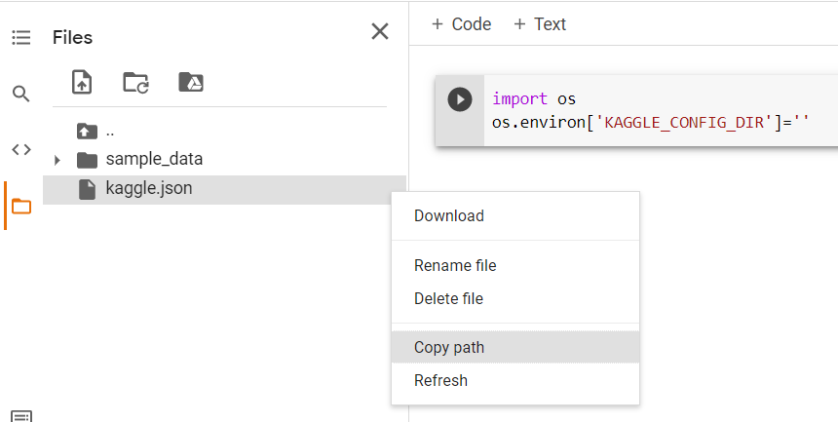
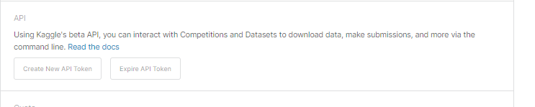
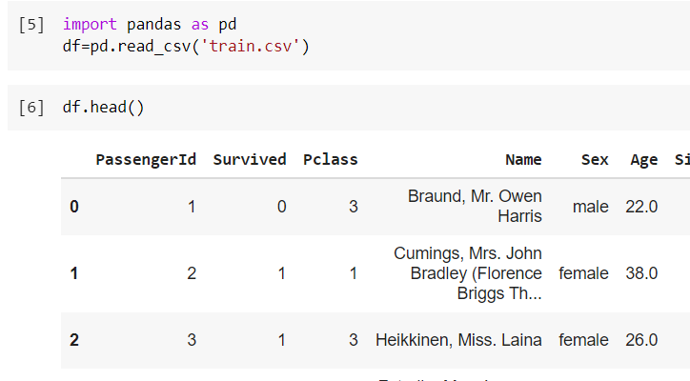
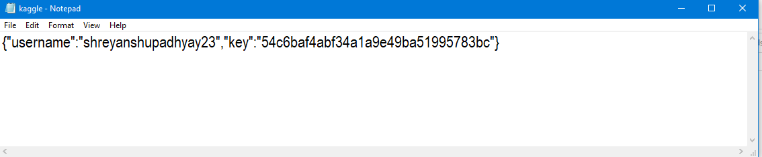
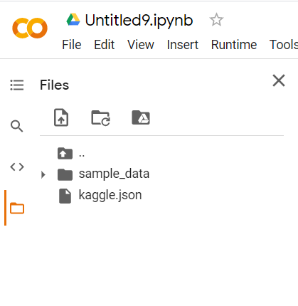

Slide 8
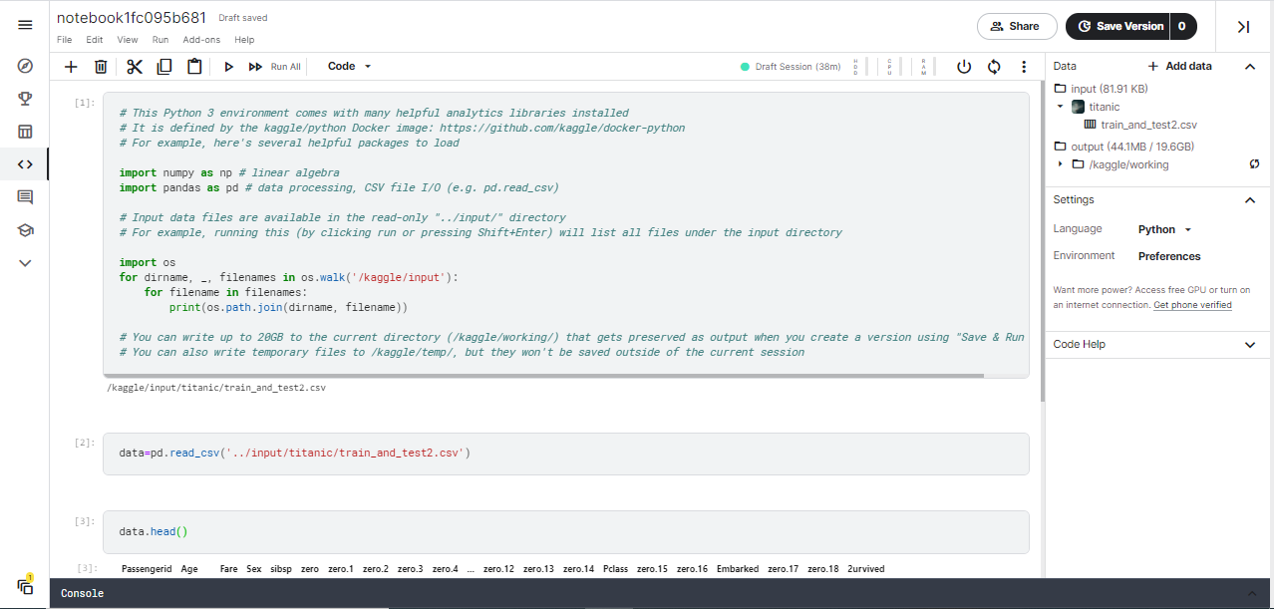
Code
kaggle provides an online notebook where users can execute the code and submit the code.
It provide the facility of session. You can start the session and once the code gets executed you can stop the session.
It provides the facility to choose the programming language from Python and R. It also provide an opportunity to choose between Notebook and Script.

Slide 9



Kaggle Ranking
Kaggle Progression System
It uses performance tiers to track the growth
of users as a data scientist.
Users can also earn medals for their achievements
and compete for data science glory on live leaderboards.
Categories of Expertise
The Progression System is designed around four Kaggle categories of data science expertise: Competitions, Notebooks, Datasets, and Discussion. Advancement through performance tiers is done independently within each category of expertise.
Novice
The User has joined the Kaggle community.
Contributor
User has completed his profile, engaged with the community and fully explored Kaggle’s plaform.

Slide 10


Expert
The user had completed a significant body of work on kaggle in one or
more categories of expertise. Once he had reached an expert tier of
category, he will entered into the site wide Kaggle ranking for that category.
Grandmaster
The user has consistently demonstrated outstanding performance
in one or more categories of expertise on kaggle to reach this
pinnacle tier

Slide 11
Thank You!

