Slide 1
STACK OVERFLOW USER ENGAGEMENT AND TOPIC TRENDS DASHBOARD
Sravani Neelapala - 016801486
Scott Kennedy - 017556890
Krishna Shreya - 017416724

Slide 2
CONTENT
Introduction
Application
Queries
ER diagram
Query Optimization
IO costs with and without optimization
Conclusion
Future improvements
References

Slide 3
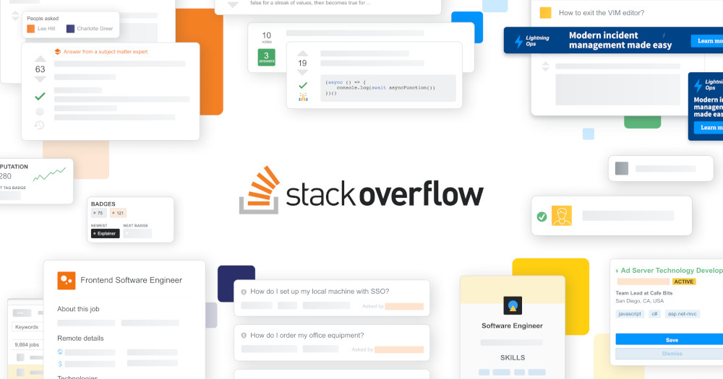
INTRODUCTION
Stack Overflow is a rapidly expanding community for obtaining answers to software development questions on topics such as algorithms, databases, languages, tools and programming environment.
The "stack overflow user engagement and topic trends dashboard" is the application planned for developing a dashboard focusing on user engagement and topic trends within stack overflow.
We designed the dashboard such that it seeks to improve user experience, encourage future and new users cultivate involvement on the stack overflow platform and engage in the community by providing useful facts, figures and insights.
This project is motivated by the need to understand the dynamics, trends, and patterns of the stack overflow community

Slide 4

OUR DASHBOARD
Hall of fame
User engagement metrics
Recommendations
Trending topics
Suggestions
Comparison table with participation rate

Slide 5
ER DIAGRAM

Slide 6
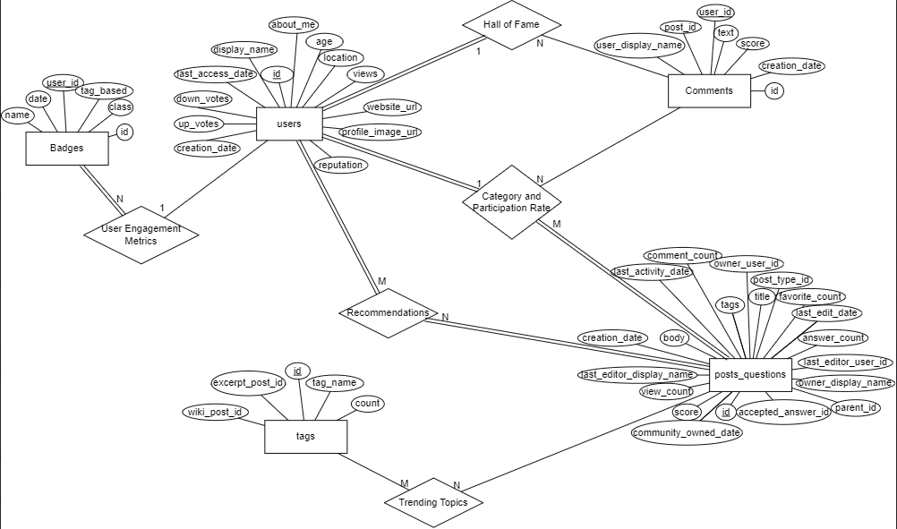

Slide 7
SIMPLE AND ADVANCED SQL QUERIES
Hall of fame - This is designed to showcase top 20 users and give them a star-ratings based on their platform activity.
User engagement metrics - This is designed to compare a particular user's platform activity with that of the top 20 users of the hall of fame table and orders them by reputation scores in descending order.
Recommendations - This is designed for giving users information about their Stack Overflow activity, such as their most popular tags, commonly asked questions, and recommendations that are personalized for them based on their behavior.
Trending topics - This is designed for identifying the trending topic on the internet by filtering out the most popular topics being searched by the users in the platform.
Suggestions - This is designed for filtering out the comments which are the feedback from the users. This could be either bugs, reports or other similar feedback
Comparison table with participation rate - This is designed to categorize users based on their activity levels in the platform by calculating the participation rate

Slide 8
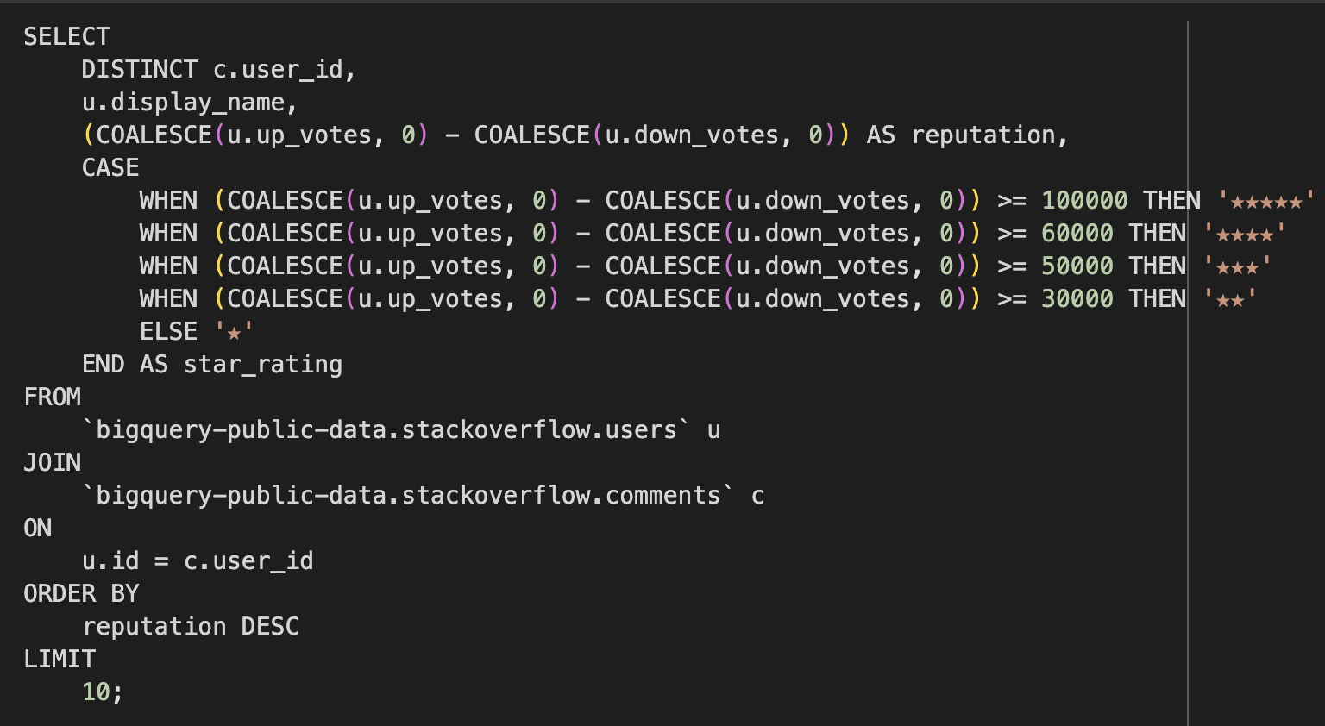
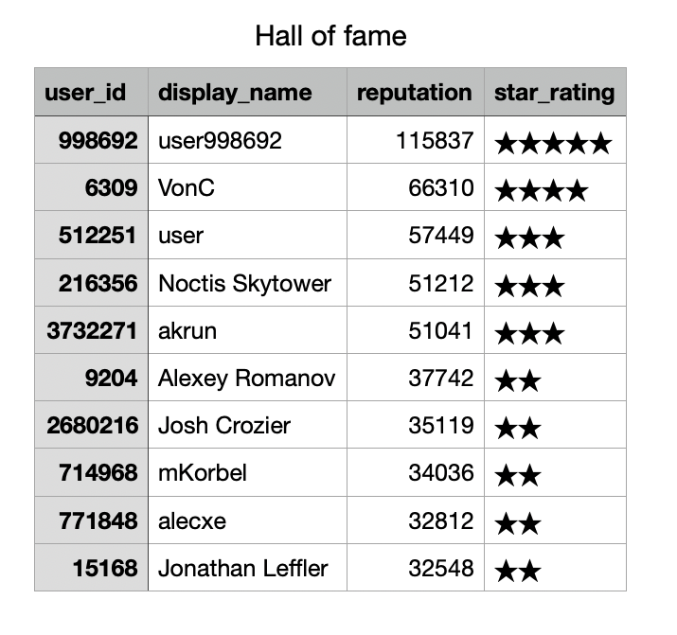
HALL OF FAME

Slide 9
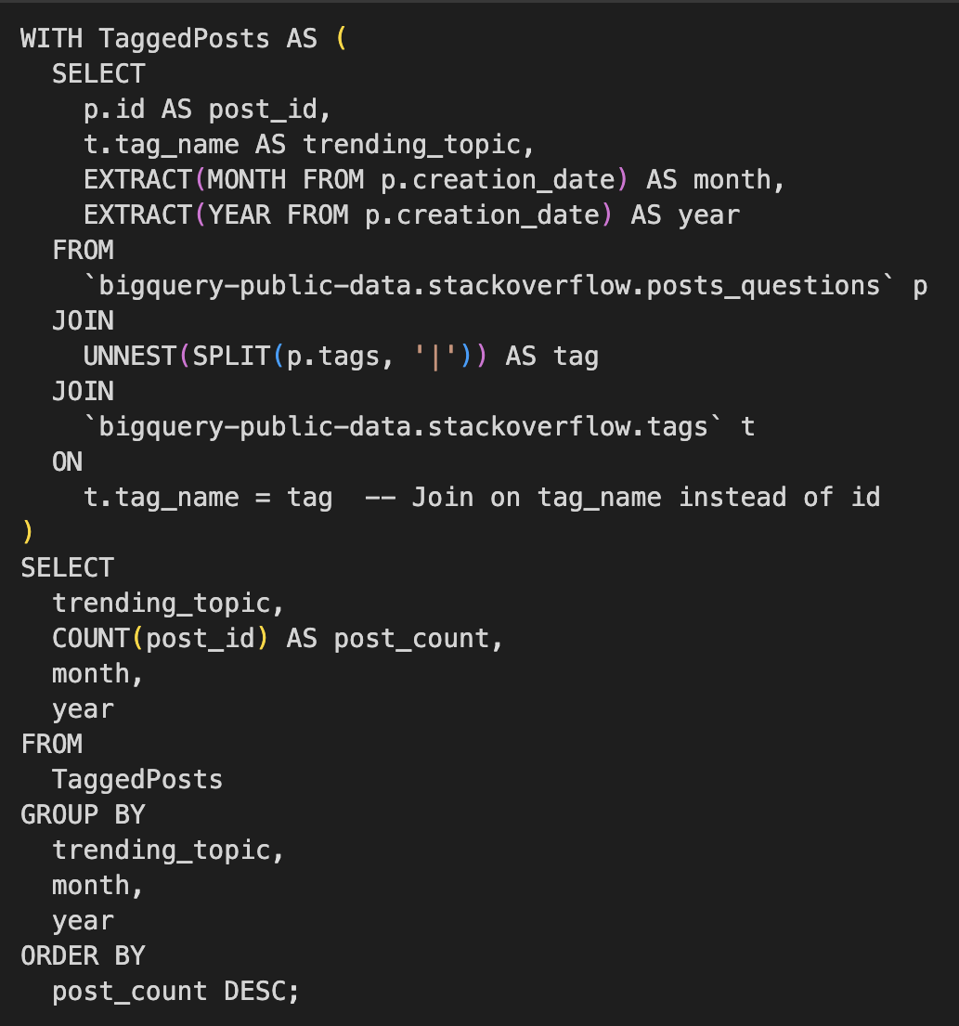
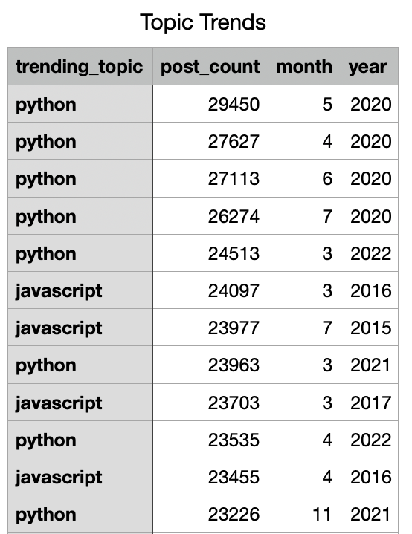
TOPIC TRENDS

Slide 10
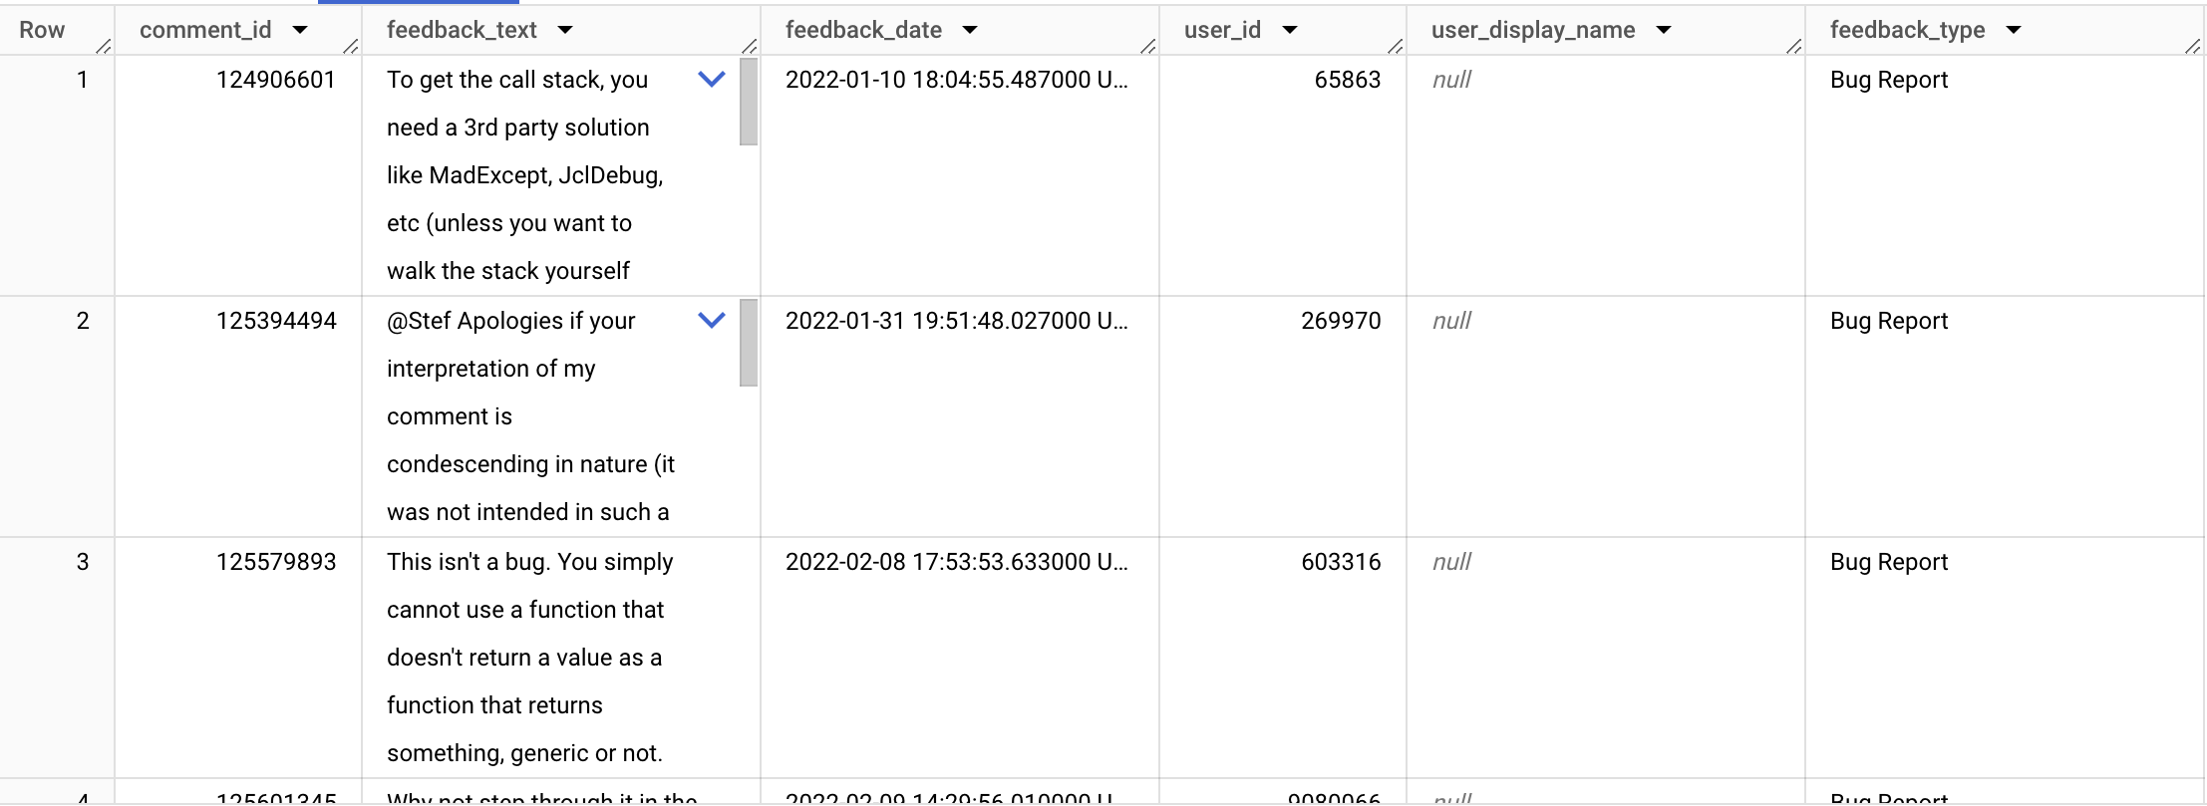
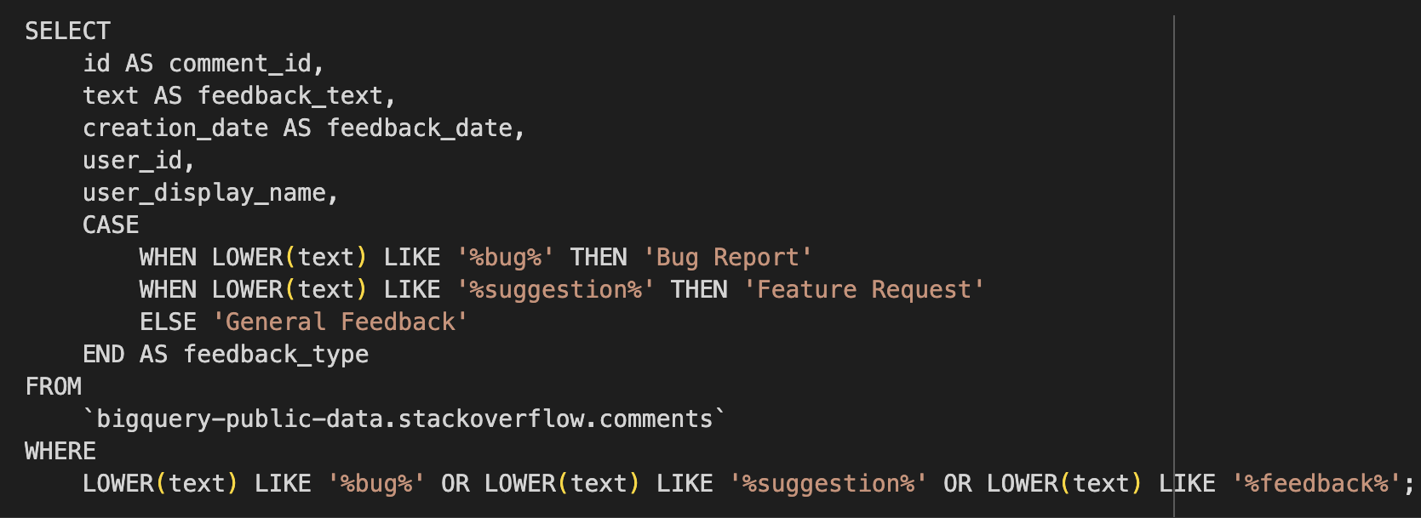
FEEDBACK

Slide 11
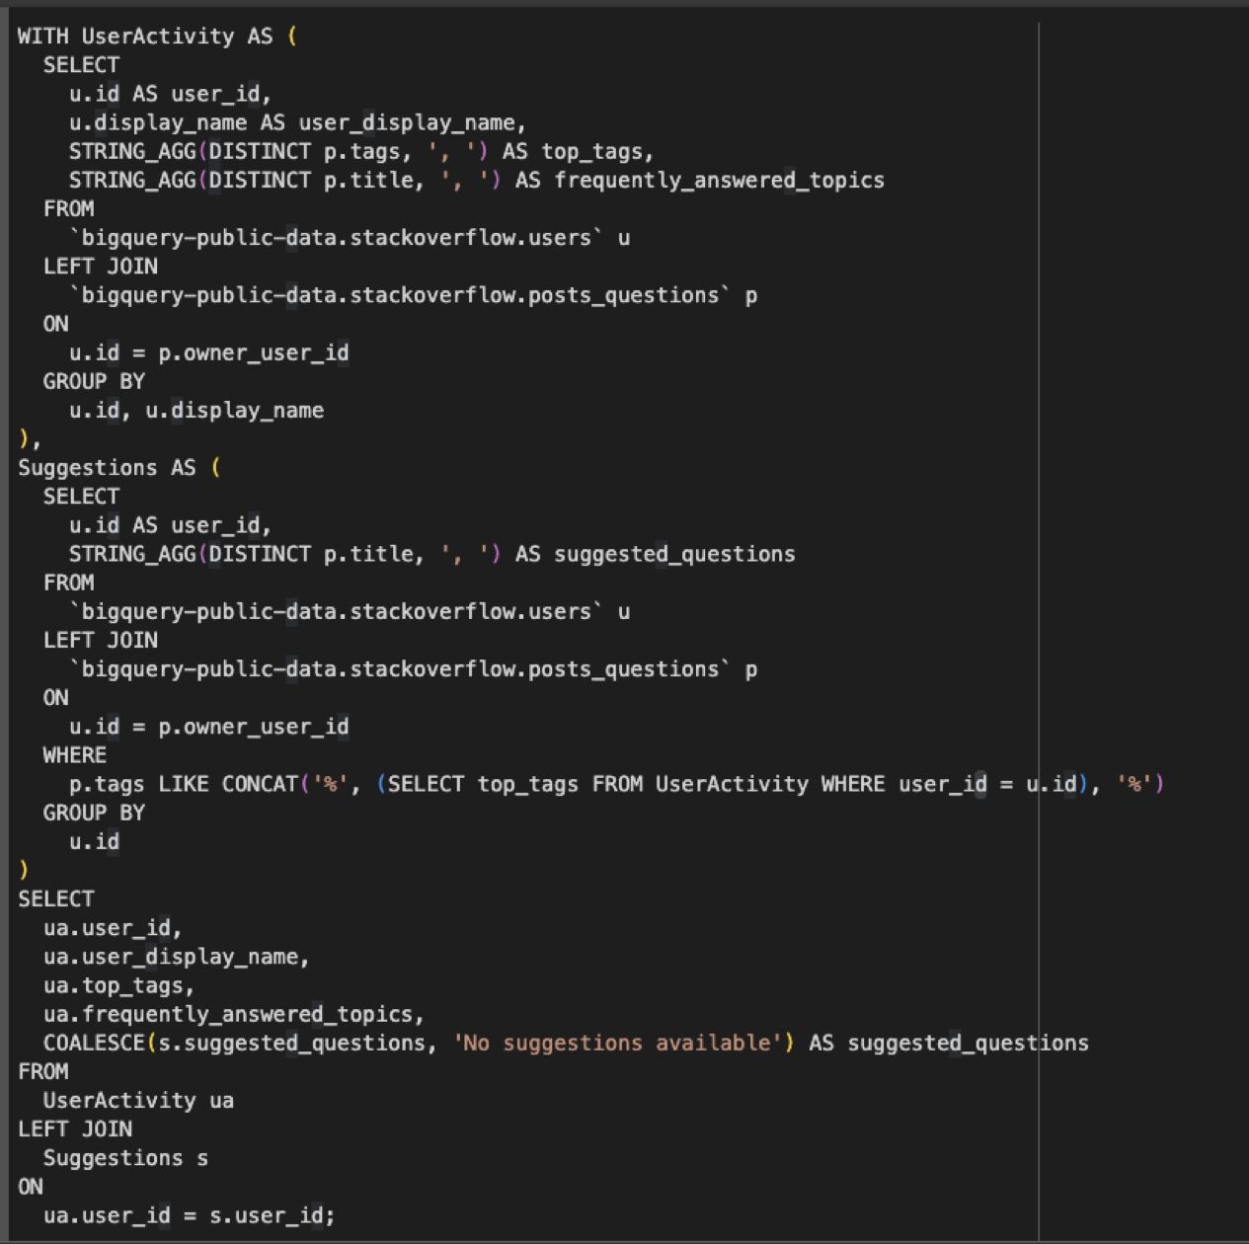
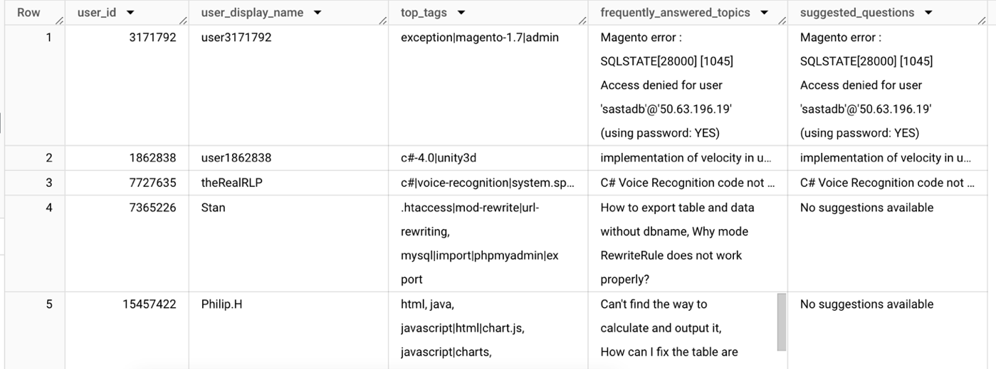
RECOMMENDATIONS

Slide 12
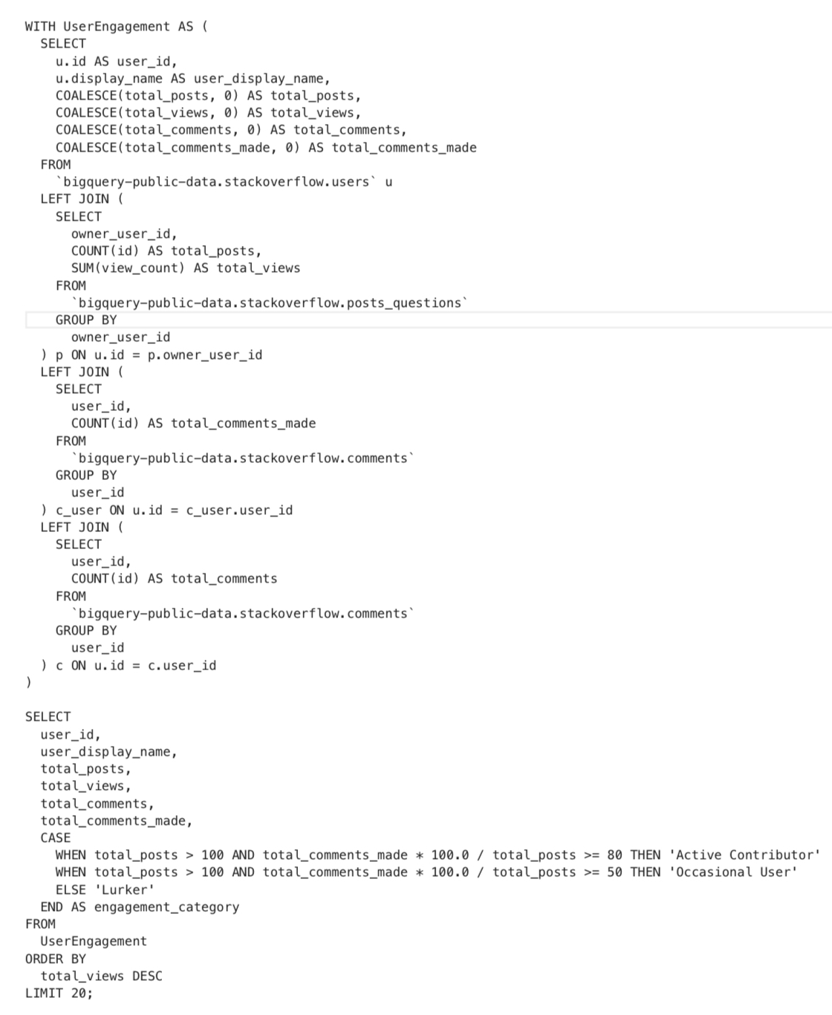
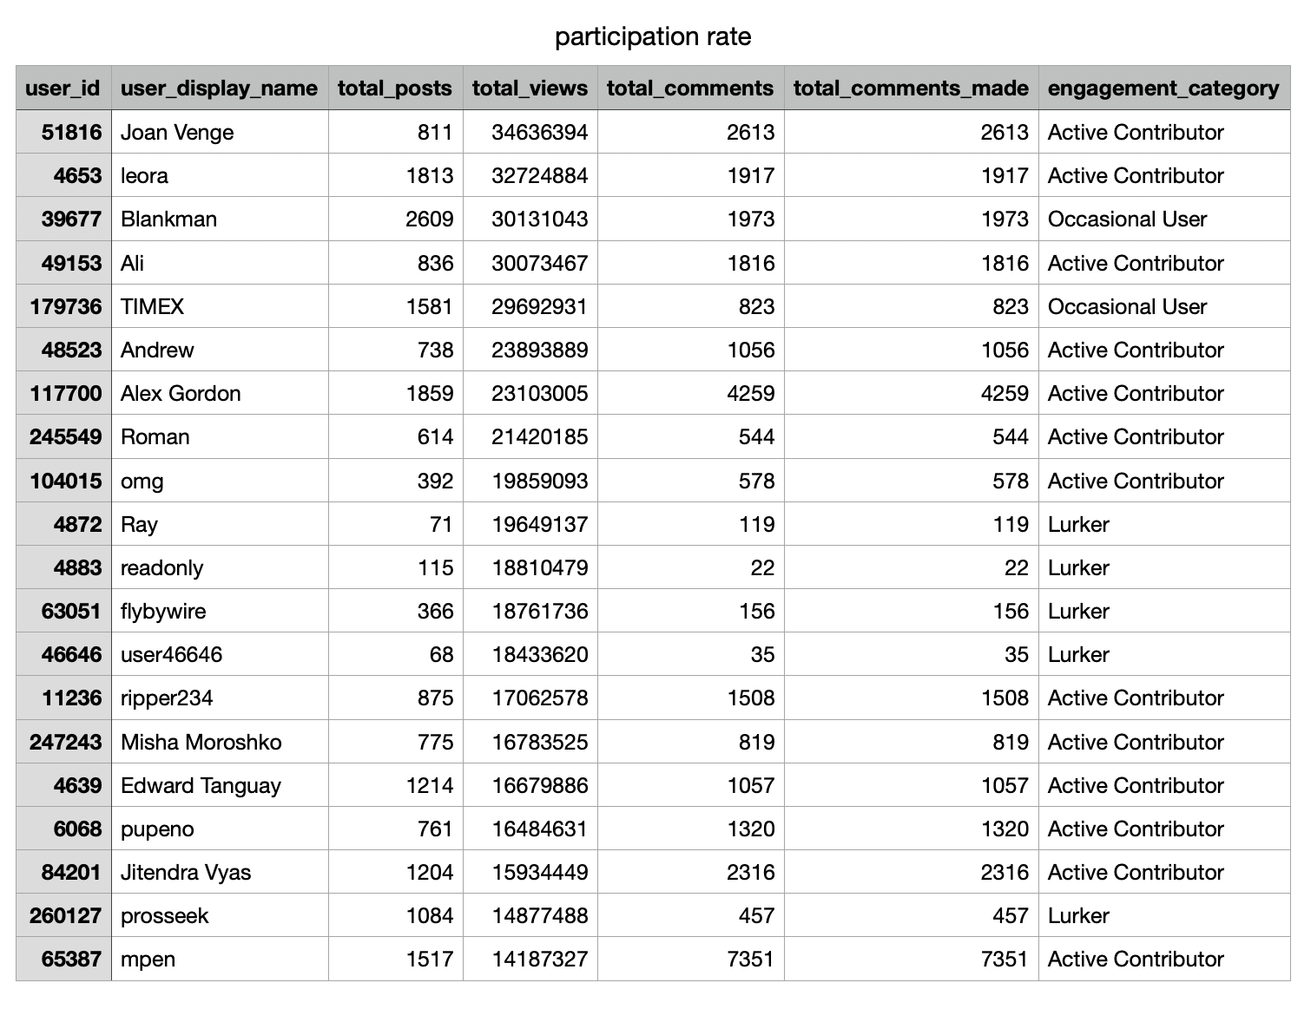
USER ENGAGEMENT AND PARTICIPATION RATE

Slide 13
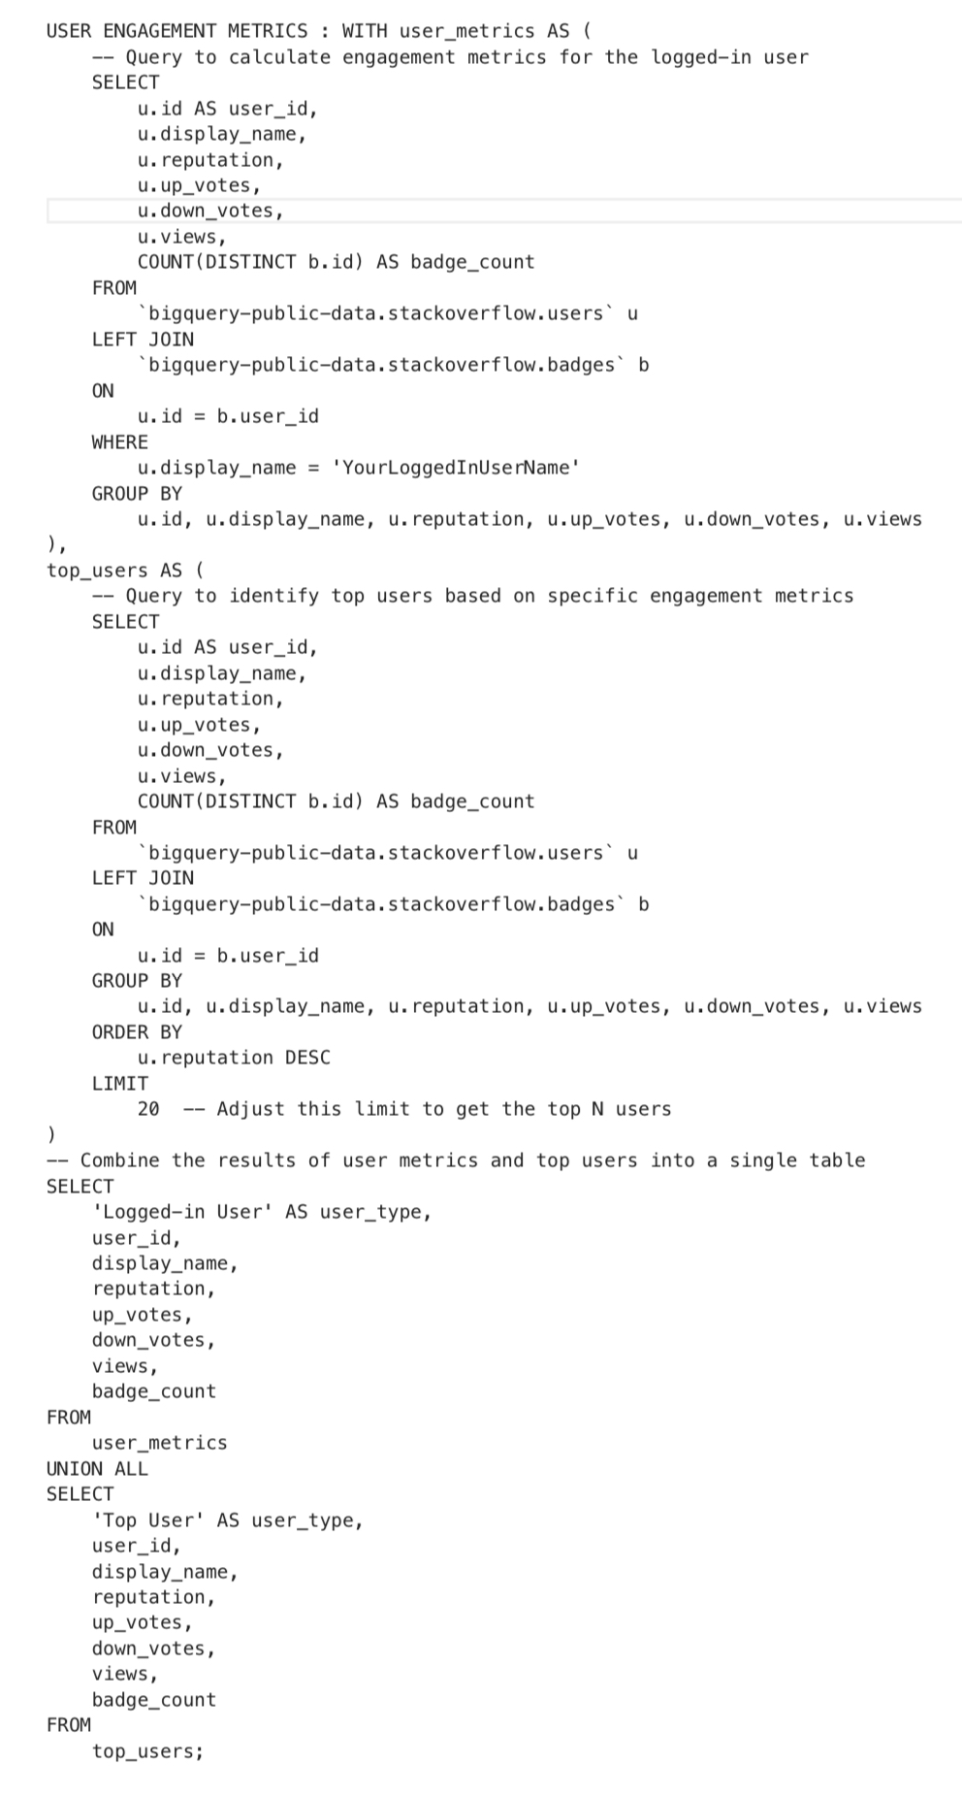
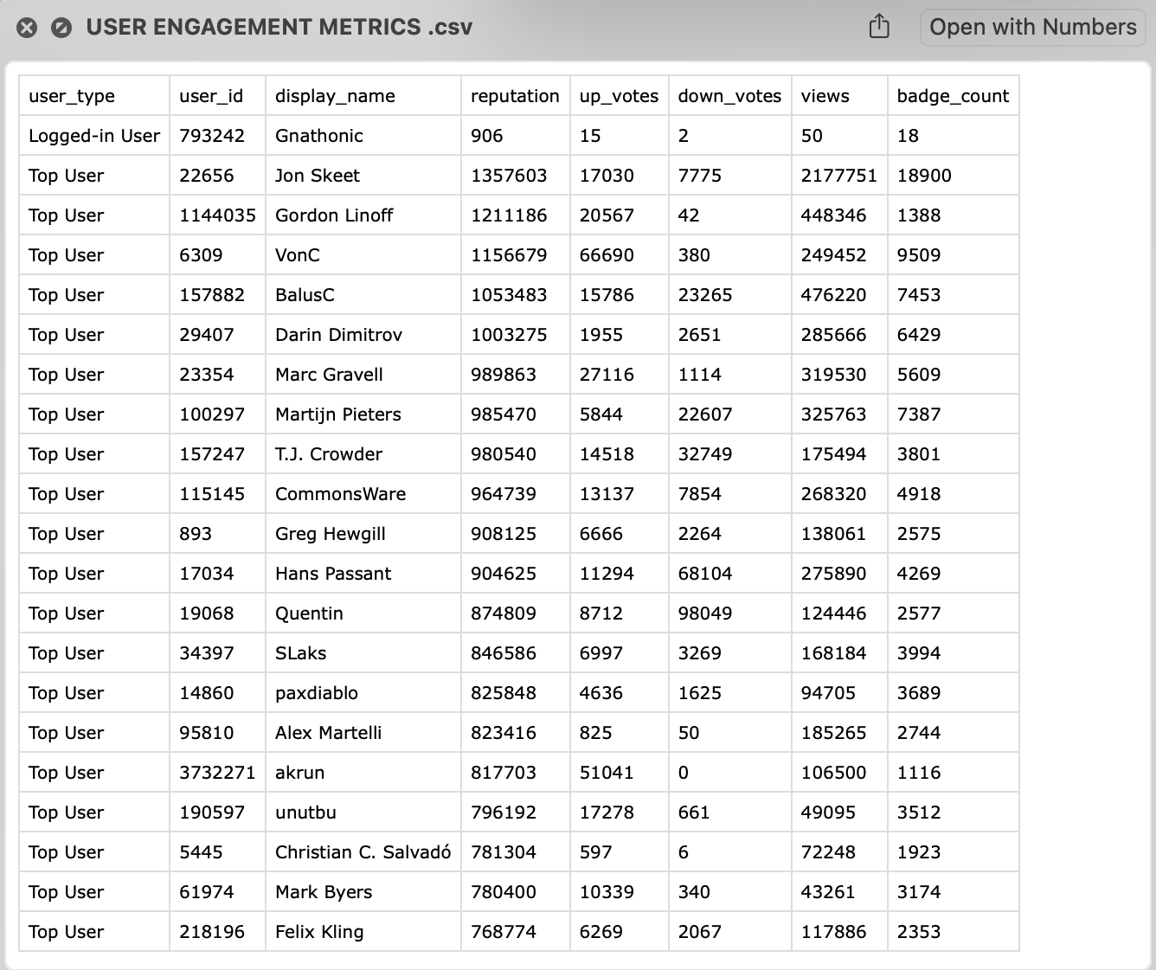
USER ENGAGEMENT METRICS AND COMPARISON

Slide 14
IO COSTS WITHOUT OPTIMIZATION
IO Costs = (Bytes processed / 1 TB) * ($5 per TB)
TABLES | IO COSTS
Hall of fame | $0.0011
User engagement metrics | $ 0.0566
Recommendations | $ 0.0022
Trending topics | $ 0.0010
Suggestions | $ 0.0001
Comparison table with participation rate | $ 0.0161

Slide 15
QUERY OPTIMIZATION
We applied query optimization for 2 tables i.e, hall of fame and user engagement metrics.
hall of fame - we limited the number of rows by using a subquery that selects only distinct user_ids from the comments table. we filtered through joins and ordered them to process faster and more efficiently.
user engagement metrics – removed the distinct word from the count aggregation method for better query performance.

Slide 16
IO COSTS with and WITHOUT OPTIMIZATION
IO Costs = (Bytes processed / 1 TB) * ($5 per TB)
TABLES | IO COST | OPTIMISED IO COST
Hall of fame | $ 0. 0011 | $ 0.000063
User engagement metrics and comparison | $ 0.0566 | $ 0.023

Slide 17
CONCLUSION
We aimed to strengthen the Stack Overflow Dataset and design a comprehensive dashboard that offers important insights that pops up on the user's screen upon opening the stack overflow website.
We achieved in creating 6 tables for our dashboard includes hall of fame table, user engagement metrics, user participation ratios, comparisons, trending topics on the internet and important feedback within the Stack Overflow Community.
We implemented various methods, implementing SQL queries from simple to advance, investigated optimization techniques and methods and calculated IO costs effectively.
Our main outcome is to encourage users to become more motivated and engaged, thus induce learning.

Slide 18
FUTURE IMPROVEMENTS
We can improve this project by thinking of other applications such as analyzing the age/location and other qualities of users and see if there are any trends for those categories.
We can also perform other optimization methods, for now we reduced the time and IO costs for our important tables.

Slide 19
REFERENCES
"Expert Recommendation System for StackOverflow," by Siraj Haji Suleman Memon
“AutoSteer: Learned Query Optimization for Any SQL Database” by Christoph Anneser1, Nesime Tatbul 2, David Cohen 3, Zhenggang Xu4, Prithviraj Pandian5 , Nikolay Laptev6 , Ryan Marcus 7
“Quality-aware skill translation models for expert finding on StackOverflow”, by Arash Dargahi¹, Nobari Mahmood Neshati², Sajad Sotudeh Gharebagh³
On code reuse from StackOverflow: An exploratory study on Android apps”, by Rabe Abdalkareem¹, Emad Shihab², Juergen Rilling³
“The Entity-Relationship Model-Toward a Unified View of Data”, by Peter Chen, 1976

Slide 20
THANK YOU

