Slide 1
◆ LIVEGUARD
A compliance co-pilot that listens during
the call — not after it.
Real-time compliance & mis-selling risk detection for BFSI call centers
Conversational AI · WebRTC · Security & Compliance

Slide 2
THE PROBLEM
Compliance is checked after the damage is already done
1
2
3
4
Agent runs the sales call
Call is recorded and filed
Manual audit happens days later
Violation is found — too late
→
→
→
A loan, insurance, or credit card pitch happens over the phone, live, with no real-time oversight.
Only a small sample of recordings — often <5% — is ever reviewed at all.
A compliance analyst listens back, if the call is even selected for review.
Regulatory fine, customer complaint, or mis-sold product has already happened.
Nobody catches it while the call is still happening.

Slide 3
THE SOLUTION
LiveGuard nudges the agent while the call is live
🎧
✓
⚠
📋
Streaming transcription
Explainable rule engine
LLM risk detection
Live agent sidebar
Both sides of the call are transcribed live as they speak — not after the call ends.
Deterministic checks for mandatory disclosures. Every nudge traces to a literal phrase match — auditable by design.
A narrow LLM layer flags softer signals: affordability stress, confusion, mis-selling language — the things a keyword can't catch.
A real-time checklist + nudge feed the agent actually sees and acts on, mid-call.

Slide 4
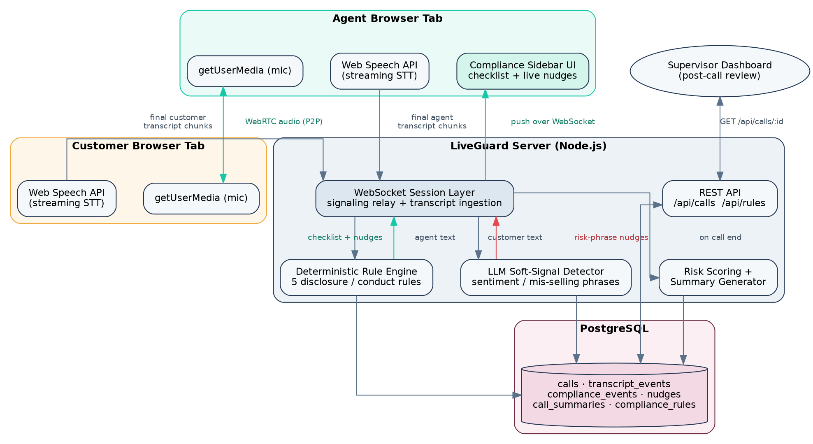
ARCHITECTURE
Signaling, transcription, and the rule engine, end to end

Slide 5
WHY THIS, WHY NOW
Live-during-the-call is the differentiator
Not a post-call dashboard
Listens to an ongoing call and nudges the agent live — "you haven't disclosed the processing fee yet" — while there's still time to fix it.
Tight domain fit
Combines conversational AI, WebRTC, and security/compliance in one system, for a BFSI-specific problem — not a generic support bot.
Genuinely hard to get right
Latency, streaming transcription accuracy, and false-positive tuning are real engineering constraints, not hand-waved.

Slide 6
WHAT IT ACTUALLY CHECKS
Five real disclosure & conduct rules
Scoped deliberately — not a comprehensive regulatory library. Rules live as data, so adding more is a data-entry task, not a code change.
Rule Product Detection Severity
RULE ID
PRODUCT
DETECTION
SEVERITY
LOAN_PROCESSING_FEE
Loan
Deterministic
High
LOAN_INTEREST_RATE
Loan
Deterministic
Critical
INSURANCE_FREE_LOOK
Insurance
Deterministic
Critical
CALL_RECORDING_CONSENT
All products
Deterministic
Medium
MIS_SELLING_RISK_PHRASE
All products
LLM-assisted
High

Slide 7
HONEST SCOPING
What we deliberately left out — and why it's safe to
Real PBX / telephony integration
Simulated as a browser-to-browser WebRTC call. The hard part — the real-time analysis pipeline — is provider-agnostic; swapping in Twilio/Exotel is an integration task, not a redesign.
Multi-language support
English only for this build. Noted as the top v2 priority for a market like India.
Full regulatory rule library
Five realistic rules across two product types instead of an exhaustive catalogue. Rules are data-driven (JSON patterns in Postgres), so scaling the catalogue is a compliance-team task, not an engineering one.

Slide 8
SCORING FIT
Mapped directly to the evaluation weighting
15%
Business Understanding
Named BFSI domain + named tech (WebRTC) straight from the brief — not a generic bot retrofitted to the theme.
20%
Innovation
Live-during-the-call detection is the differentiator against the inevitable wave of post-call "AI support bot" submissions.
15%
Solution Design / NFR
Latency handling, full audit trail, explainable rule engine — a real security/compliance conversation, not hand-waved.
10%
Presentation
A live call with a nudge popping up on screen is inherently more compelling on video than a form-filling app.

Slide 9
◆ LIVEGUARD
Catch it while it's still a conversation —
not after it's a complaint.
Source code · working demo · architecture · API docs · DB schema — all included in the submission repo.

