Slide 1
Competition Task_Sprint2
Shreya Raina

Slide 2
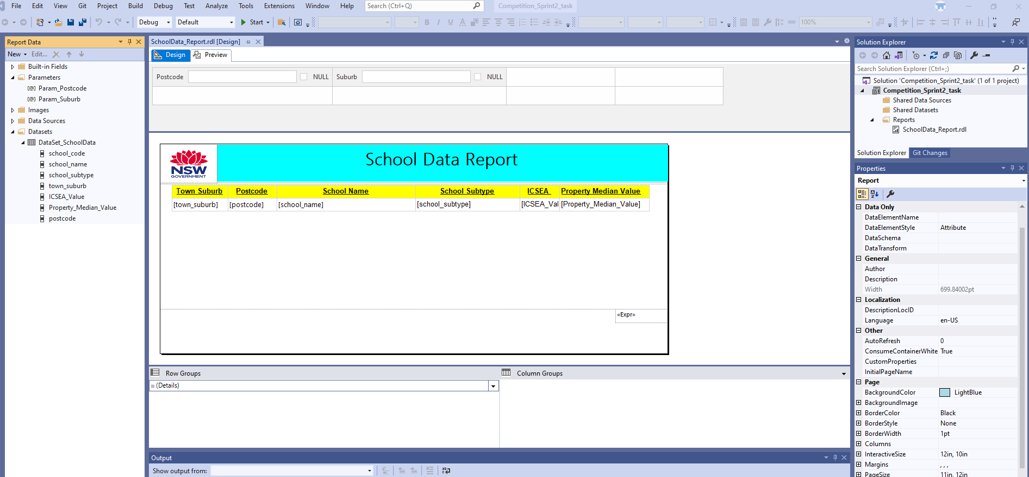
SSRS Report with details and parameters

Slide 3
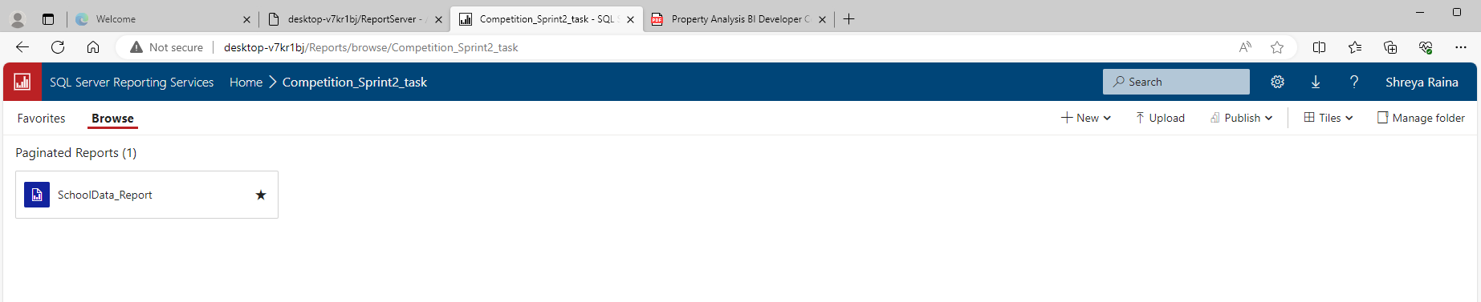
Published SSRS report into your web portal

Slide 4
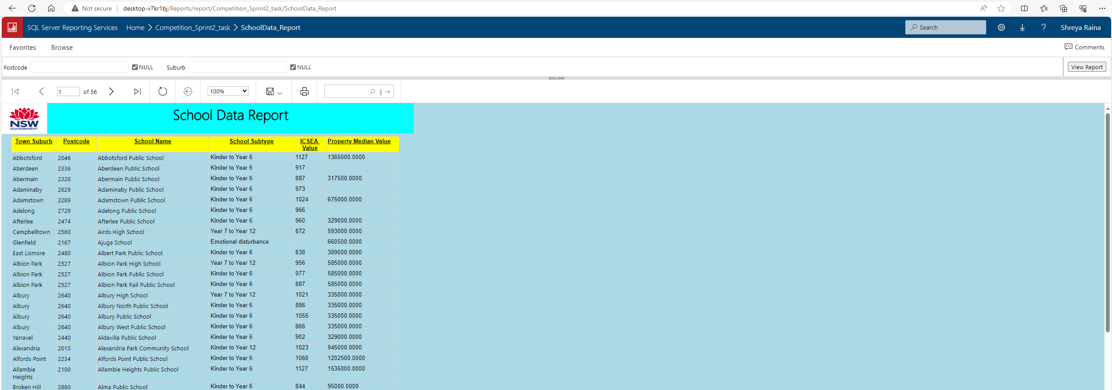
Report to be used by the user from web portal

