Slide 1
COMPETITION TASK_SPRINT1
Shreya Raina

Slide 2
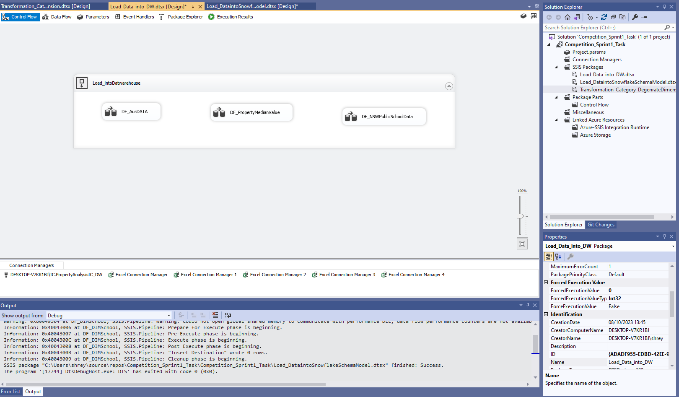

TASK:Use Visual Studio and create SSIS package, design dataflows to extract data from AUS_SubCityDistrictState_Data, NSW_PropertyMedainValue and NSW-Public-Schools-Master-Dataset (csv), and load data into tables into your Data Warehouse, use “load_” as prefix to name all your data load tables in your Data Warehouse
SSIS Packages created, designed dataflows to extract the data from excels.

Slide 3
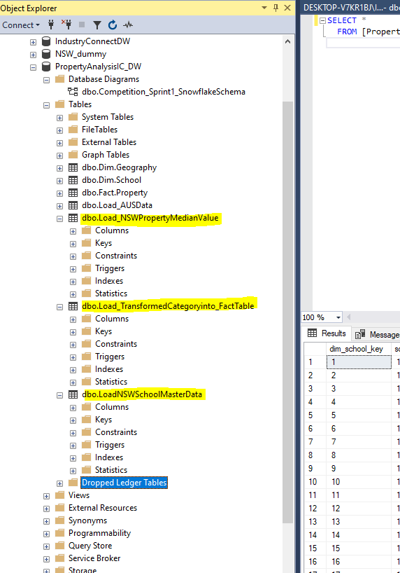

Data loaded into tables into the Datawarehouse.

Slide 4
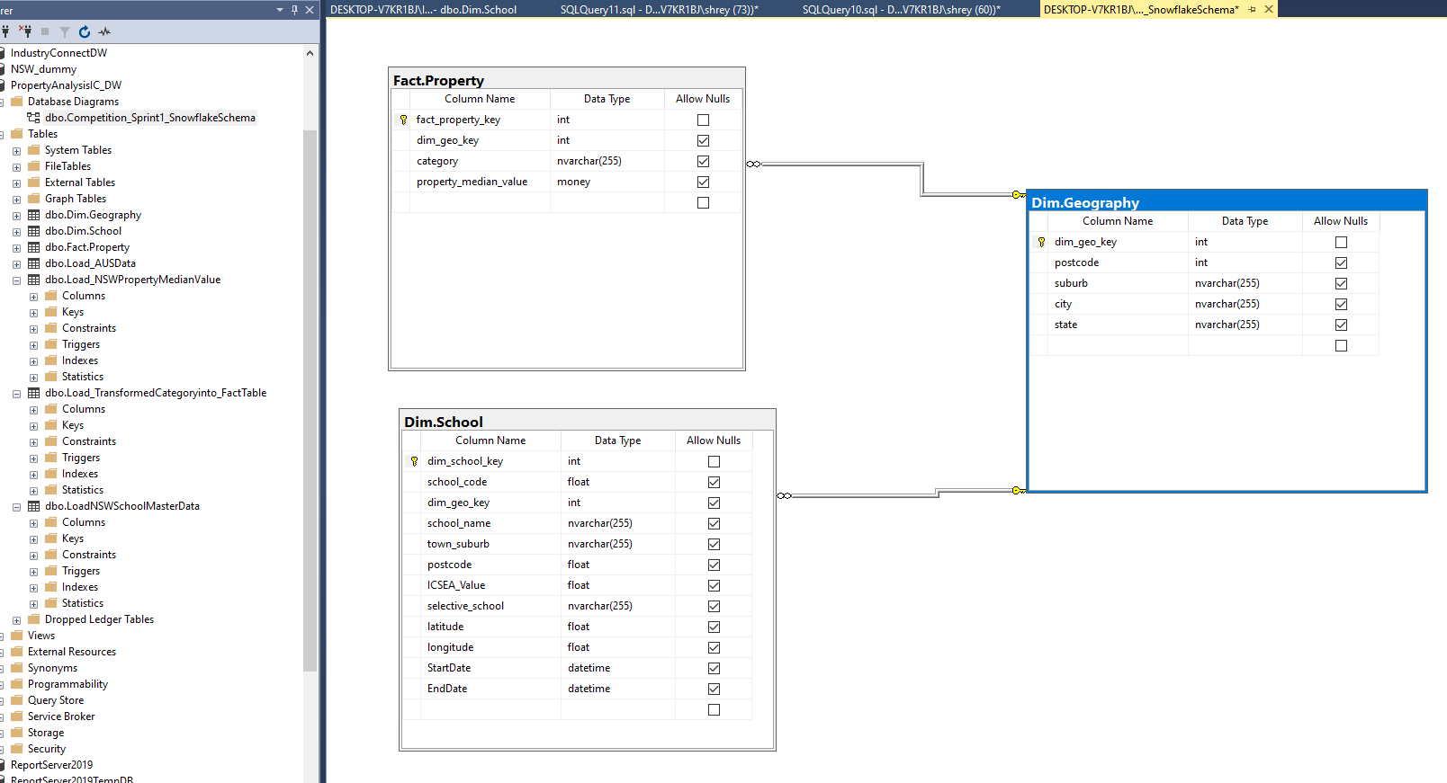
Snowflake Model

Slide 5
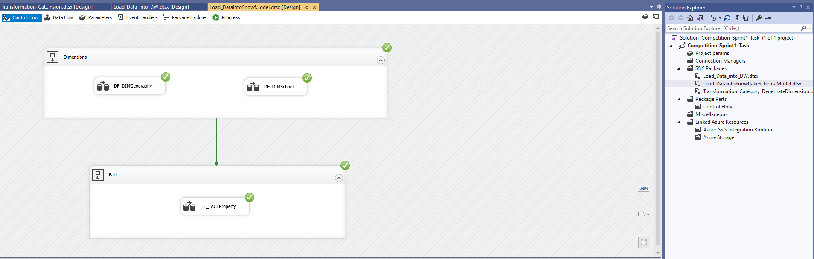
Task Create another SSIS package and design dataflows to get Data extracted from load tables, then transformed and loaded into Snowflake Schema Model or Star Schema Model.

Slide 6
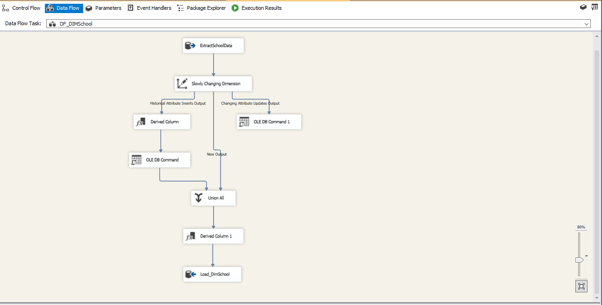
Slowly changing Dimension in Dim.School

Slide 7
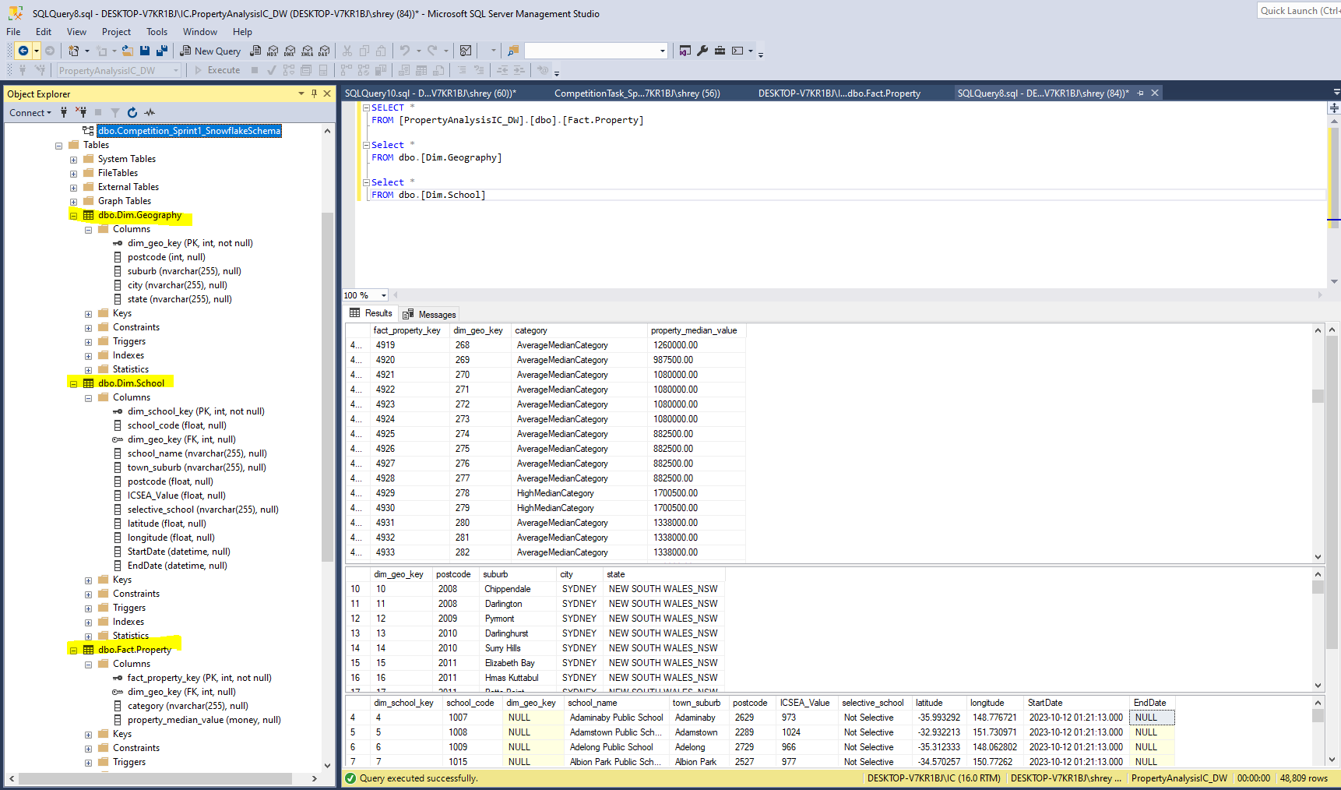
Loading the transformed data into the data warehouse tables

Slide 8
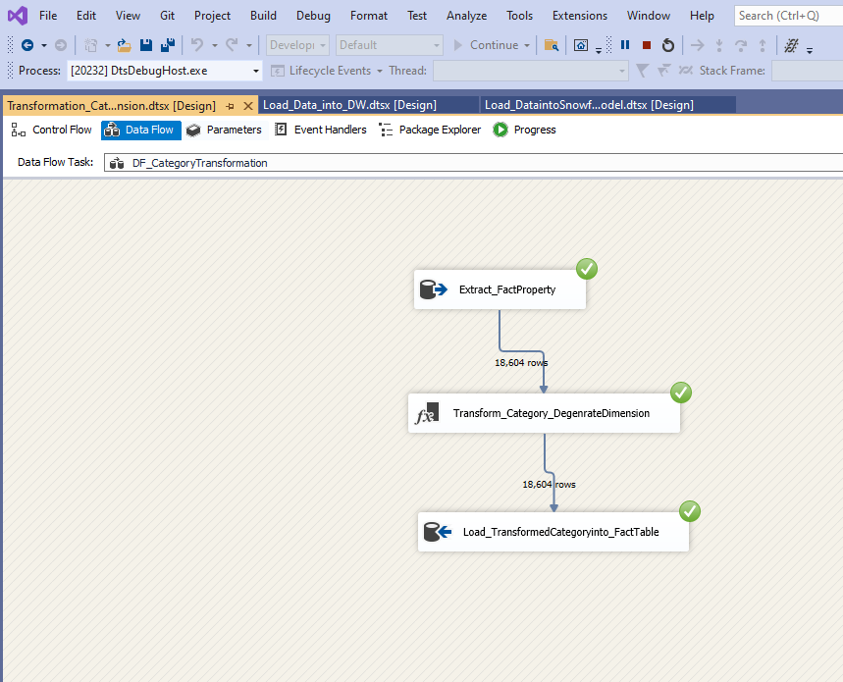
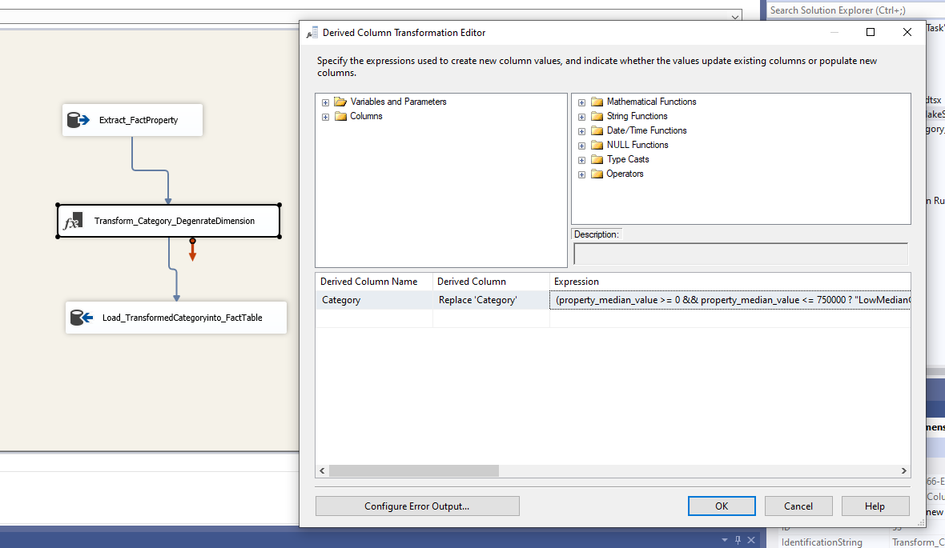
TASK: You need a “Category” as a dimension table ( or degenerate dimension in fact table), in SSIS categorize Median Value into Category 0-750k, $750k-$1.5M, $1.5M-$2.5M, $2.5M+ and load the “Category” values into dimension table (or degenerate dimension in fact table) , this is a transformation of business requirements for Property Analysis.
Expression used for Transformation : (property_median_value >= 0 && property_median_value <= 750000 ? "LowMedianCategory" : property_median_value >= 750000 && property_median_value <= 1500000 ? "AverageMedianCategory" : property_median_value >= 1500000 && property_median_value <= 2500000 ? "HighMedianCategory" : property_median_value >= 2500000 ? "VeryHighMedianCategory" : "")

Slide 9
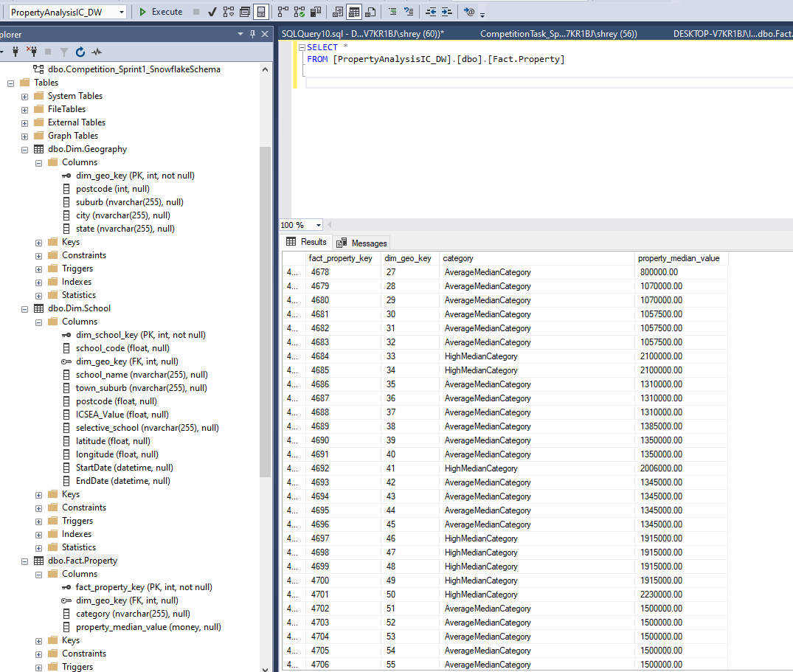
Loading category values into the fact table Fact.Property as degenerate Dimension.

