Slide 1
maven
By Shreya Neelam & Sowmya

Slide 2
What is maven?
Maven is build tool under the licence of Apache.
There are lots of libraries available on maven repository.

Slide 3
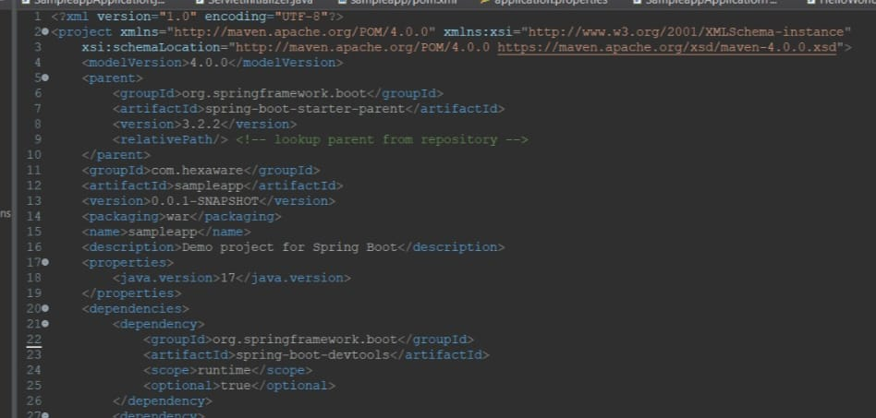
Why maven?
By using Maven , we can use third party libraries like mysql connector, spring, spring mvc, hibernate etc., easily.

Slide 4
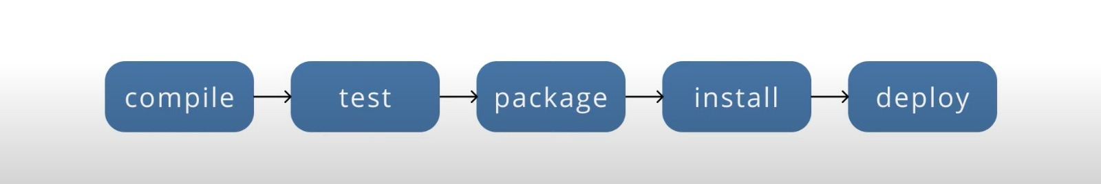
Maven lifecycle
Maven Lifecycle is the set of tasks that are executed at different stages when maven build is run. These set of stages are called Build phases.

Slide 5
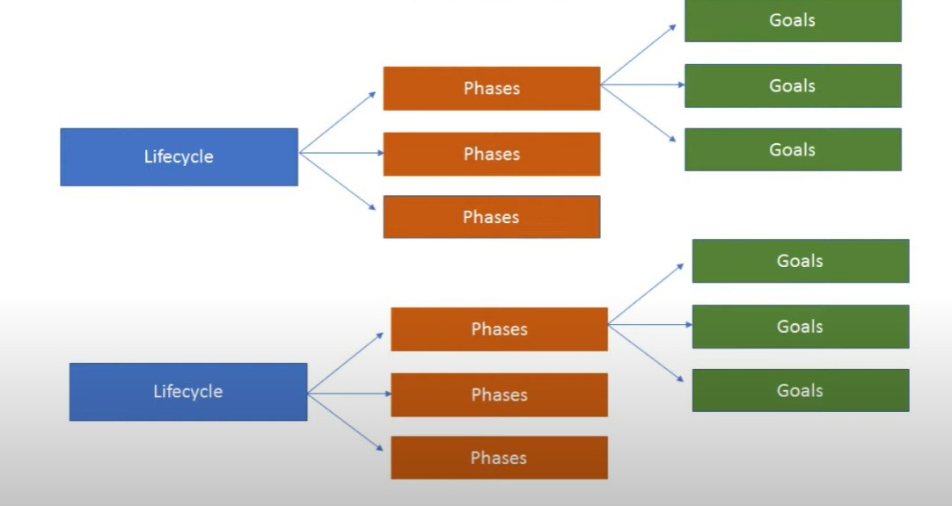
goals
It’s unit of work.
In most cases, goals are linked to phases.
Every goal runs with specified plugin.

Slide 6
ADVANTAGES OF MAVEN
Quality project information
Easy jump to new features
Increased performance of projects
Information is accessible easily

Slide 7
THANK YOU

