Slide 1
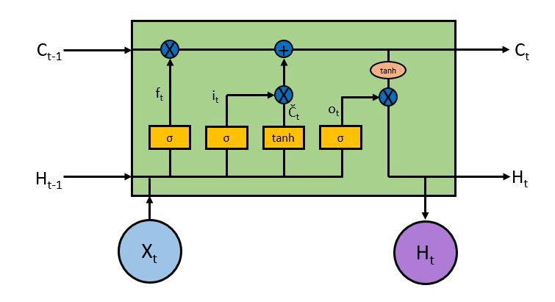
LSTMs

Slide 2
LSTM stands for Long Short-Term Memory.
It was conceived by Hochreiter and Schmidhuber in 1997 and has been improved on since by many others.
The purpose of an LSTM is time series modelling.
if you have an input sequence, you may want to map it to an output sequence, a scalar value, or a class using LSTMs.

Slide 3
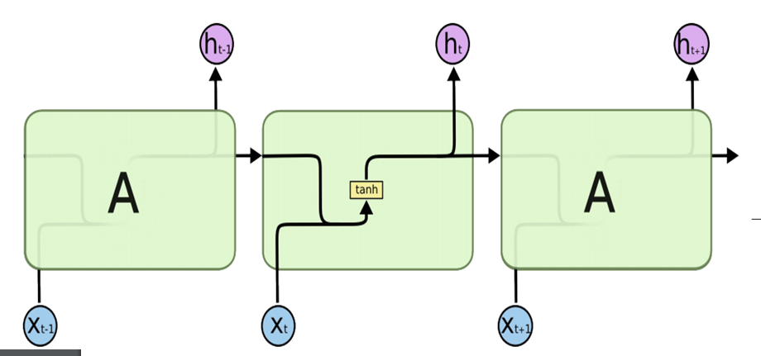
VANILLA RNN
Vanilla RNNs trained with BPTT have difficulties learning long-term dependencies (e.g. dependencies between steps that are far apart) due to vanishing/exploding gradient problem.

Slide 4
A generic RNN is capable of learning short term dependencies.
An LSTM is a particular type of RNN with a mechanism to avoid the vanishing gradient problem and learn long term dependencies.
It is still capable of learning short term dependencies, hence the name "Long-Short Term Memory".

Slide 5
LSTMs were first proposed in 1997 and are the perhaps most widely used models in NLP today.
GRUs, first proposed in 2014, are simplified versions of LSTMs.
Both these RNN architectures were explicitly designed to deal with vanishing gradients and efficiently learn long-range dependencies.

Slide 6
The key idea to both GRU and LSTM is the cell state or memory cell.
LSTM has chain like structure, with a repeating module which has Gated Architecture to regulate the flow of information to the cell state.
These gates can learn which data in a sequence is important and which is not.

Slide 7
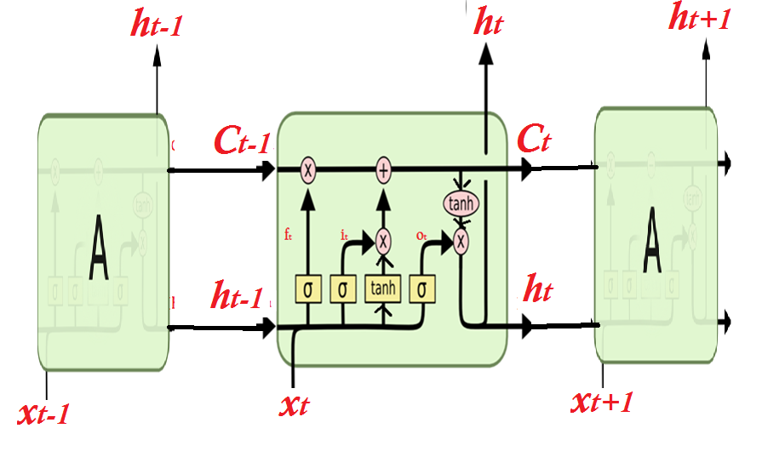
the long term memory refers to the learned weights and short term memory refers to the gated cell state values that change with each step through time t.

Slide 8
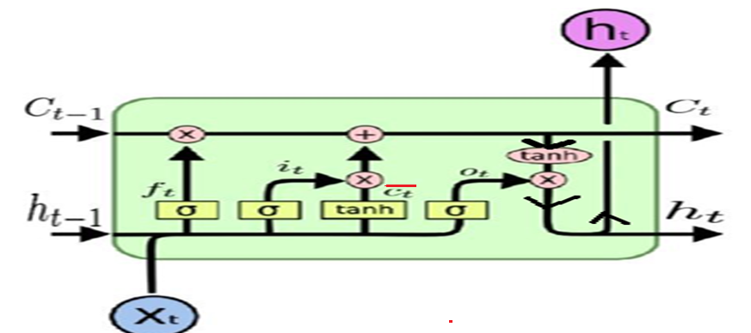
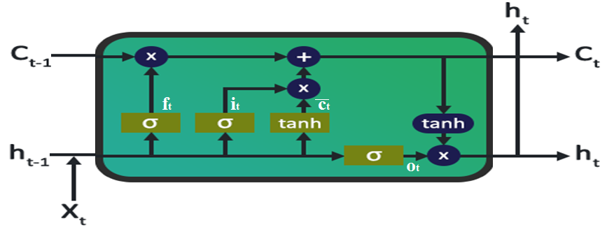

Slide 9
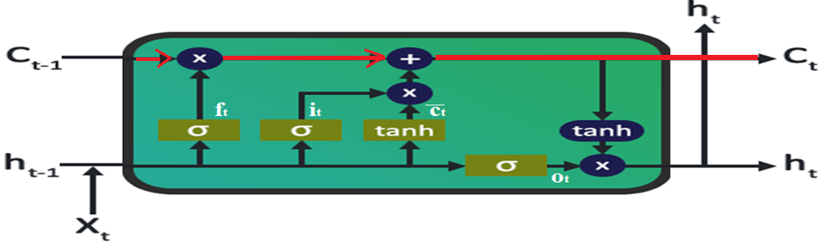
The Core Idea Behind LSTMs is the cell state, the horizontal line running through the top of the diagram.
The LSTM has the ability to remove or add information to the cell state, carefully regulated by structures called gates.

Slide 10
The forget gate chooses what values of the old cell state to get rid of, based on the current input data.
The input gate decide what to add to the cell state
the output gate determines what parts of the cell state should be passed on to the output.

Slide 11
Gates are composed out of a sigmoid neural net layer and a point-wise multiplication operation..
if x = [1 2 3] and y = [5 6 2], then
>> w = x .* y
w =[ 5 12 6]

Slide 12
Each LSTM cell receives an input from
an Input sequence, X_{t}
previous cell state, C_{t-1}
hidden state output from previous LSTM cell, h_{t-1}
Think of hidden state as part of memory cell that we want to ensure persists.

Slide 13
In deep networks, the hidden value is fed into the layer above and is thus analogous to the output of a neuron in a MLP.
The cell-state contains information that is not necessarily useful to output at the current timestep/state, but needs to transmitted down in time

Slide 14
An intuitive explanation of working of LSTM
An LSTM essentially maintains two values inside it — a hidden state ’h’ and a cell state ’c’.
At each time step t, it takes input x_{t}, h_{t-1} and c_{t-1} to update h_{t} and c_{t} using “gates” —
the input gate,
the forget gate and
the output gate.

Slide 15
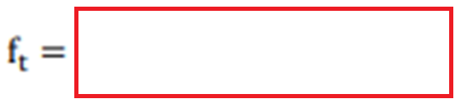

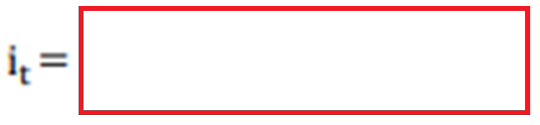

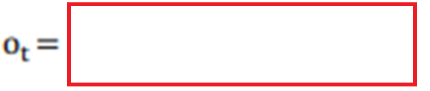




Slide 16
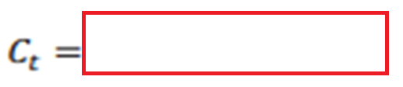




Slide 17
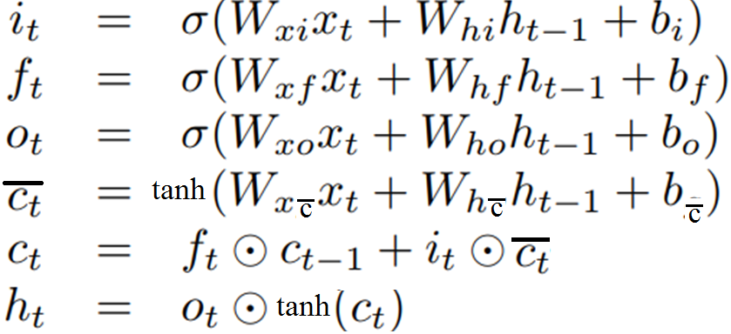

Slide 18
Example:
Input /hidden state/output : one dimensional
x₁ = 0.1, x₂ = 0.2[ Two cell LSTM]
Initial weights and biases are given.
Show one Forward pass

Slide 21
This value can be interpreted as the probability that we will allow information from input x to enter the memory cell.
Usual practice is to keep the value 0.515 ( keep gate partially open)
Alternatively, decision is made whether the information will go forward , i.e. open the gate (value 1) or close the gate(value 0)

Slide 22
No stochastic decision is made here – this is the quantity associated with the input that we'll pass to the memory cell

Slide 23
Again, a stochastic decision could be made here as to whether the previous information should be forgotten(value 0) or allowed through(value 1) or kept as it is.Lets assume for this example the value is 1

Slide 24
Again we make a stochastic decision as to whether we pass this output along. Lets assume the stochastic decision results in 1.

Slide 25
Memory cell

Slide 26


Slide 27
HIDDEN STATE:
The hidden state is separate from the memory cell, but very related.
Think of it as part of memory cell that we want to ensure persists.
The output gate decides whether/how much the signal from the memory cell gets sent forward as part of the input to next LSTM cell

Slide 29
SECONFD LSTM CELL
Weights are shared
Same equations
Use x₂ =0.2 in place of x₁
And use h₁ =0,0796 in second cell instead of h₀ in first cell
y_{2d} =0.08

Slide 30
The Second LSTM cell : Weights are shared across LSTM cells
Final output, to use for the error calculation and apply BPA ??

Slide 32
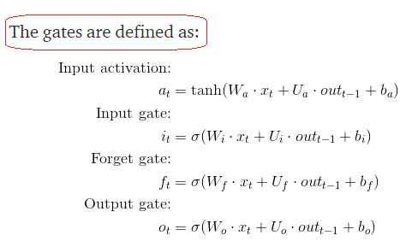
RECAPTULATE

Slide 33
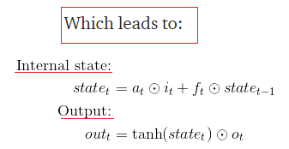
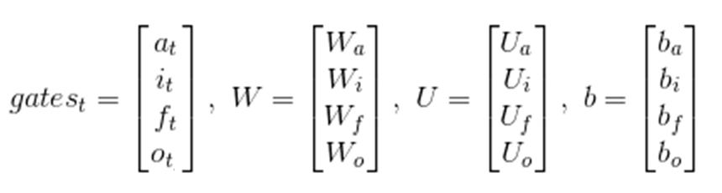
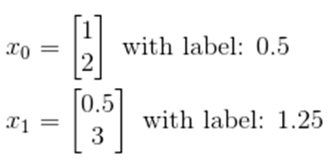
Dimensions of
W_{a} , U_{a}, b_{a},
W_{i} U_{i}, b_{i},
W_{f} , U_{f} ,b_{f} ,
W_{o}, U_{o}, b_{o}

Slide 34
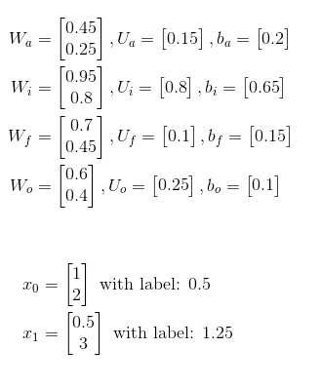
Example

Slide 35
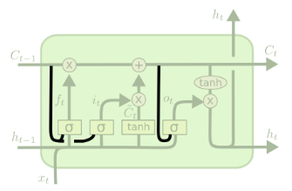
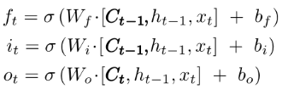
Variants on Long Short Term Memory
One popular LSTM variant, introduced by Gers & Schmidhuber (2000), is adding “peephole connections.” This means that we let the gate layers look at the cell state.

Slide 36
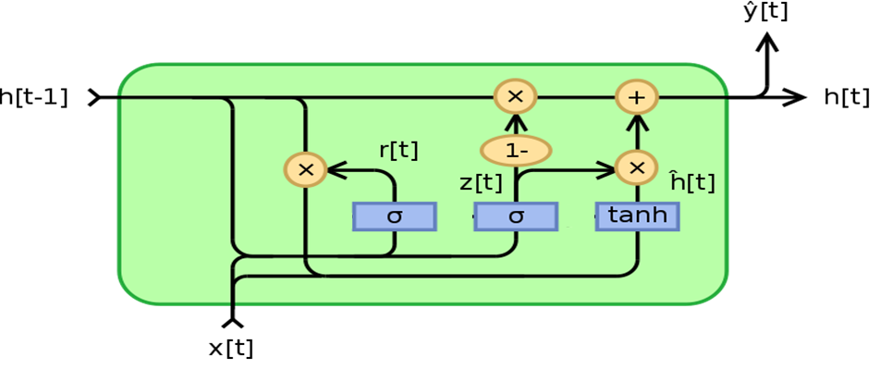

Slide 37
COMPARISON OF LSTM AND GRU
GRU has two gates, an LSTM has three gates.
GRUs don’t possess internal memory (c_{t} ) that is different from the exposed hidden state.
GRUs don’t have the output gate that is present in LSTMs.
The input and forget gates are coupled by an update gate and the reset gate is applied directly to the previous hidden state.

Slide 38
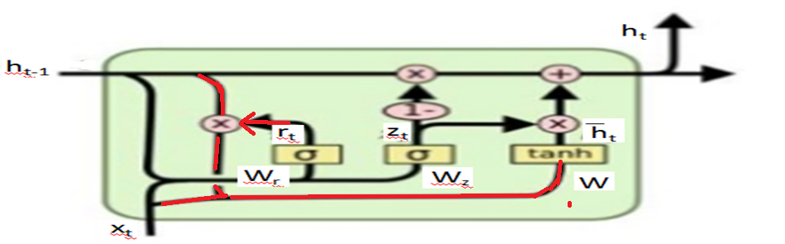

Slide 39

EXAM PROBLEM:
Normalized four dimensional weather parameter vector X is used by GRU cell to predict two dimensional weather vector Y.
Given: X 1 = [0.1, 0.5, 1.0, 0.1], X 2 = (X 1 )² .
All weight matrices have initial values of all elements as 0.1
Calculate z_{t} , r_{t} , h̃_{t} , h_{t} for (i) X 1 (ii) X 2
Truncate calculations to fourth place after decimal.

Slide 40

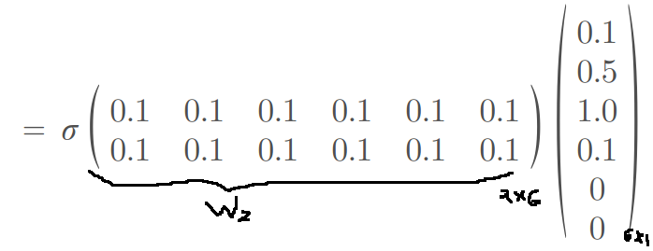
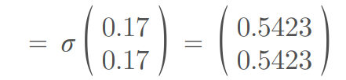
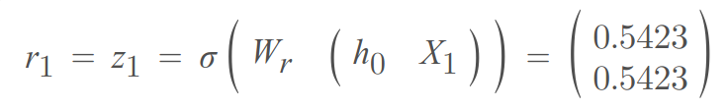

Slide 41


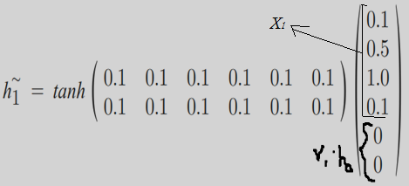

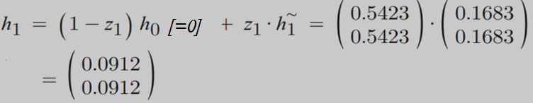

Slide 42


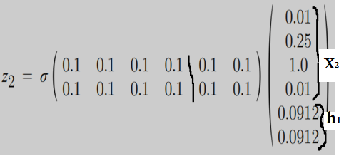



Slide 43
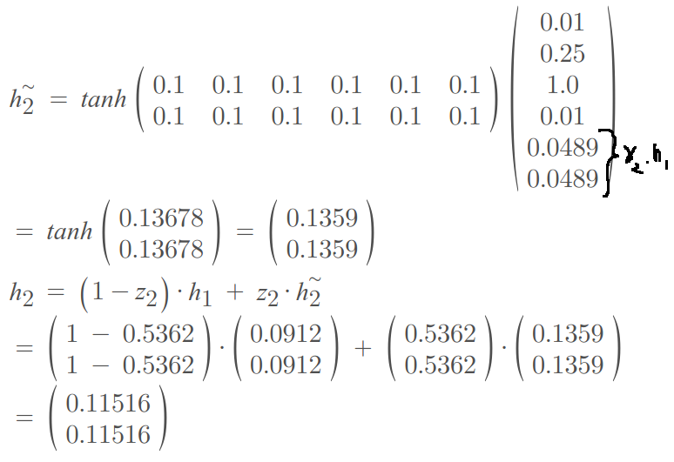

Slide 44
Transformer models are essentially attention based models.
They see the entire sentence as a whole, unlike LSTMs (or in general RNNs) where the sentence is processed sequentially - one word per time step.
During training, LSTMs need to propagate the error back in time through words one word at a time.
Transformer sees all words simultaneously - so there is no backpropagation through time.

Slide 45
END

