Slide 1
HOPFIELD NETWORK
Fundamentals of neural networks by Laurene Fausett Pearson Education

Slide 2
Hopfield model is SINGLE-LAYERED RECURRENT NETWORK.
Each neuron is connected to every other neuron.
All neurons act as input-output
It is usually initialized with appropriate weights instead of being trained.
INSTANT LEARNING

Slide 3
Characteristics of Hopfield networks–
a recurrent network with total connectivity and
a symmetric weight matrix;
Advantages of Hopfield networks–
simple prescription for the weights, with no training needed;
output settles down to a steady state.

Slide 4

John Joseph Hopfield is an American scientist most widely known for his invention of an associative neural network in 1982.
It is now more commonly known as the Hopfield Network
Professor John Hopfield
Dept. of Molecular Biology
Computational Neurobiology; Biophysics
Princeton University , New jersey

Slide 5

Dr. Hopfield described a feedback network of highly interconnected neurons that could reconstruct memories from clues
and showed how stable states of network activity could represent memories

Slide 6
Hopfield Network is the class of Recurrent Neural Networks, i.e. network with feedback connections
Hopfield showed that with these feedback connections the networks can hold memories.
Hopfield Network is not primarily associated with classification.

Slide 7
Rather than sending the pattern through the network from the input units to the output units, Signals cycle around in the network until the activity stabilizes.
An important concept for Hopfield networks is the ENERGY FUNCTION, a scalar function from the activity state of the network.

Slide 8
The Network Structure of Hopfield Network
X₁
X₂
…
X_{N}

Slide 9
Put a distorted pattern onto the nodes of the network, iterate a bunch of times, and eventually it arrives at one of the patterns we trained it to know and stays there.
So, what you need to know to make it work are:
How to "train" the network
How to update a node in the network
How the overall sequencing of node updates is accomplished, and
How can you tell if you're at one of the trained patterns

Slide 10
A Hopfield network has two versions :
Binary/Discrete
Continuous
For Binary/Discrete networks : output is either +1 or -1.
For continuous networks, output can be any value between 0 and 1
Would focus on the discrete Hopfield model, because of its straightforward mathematical description.
In its simplest form, the output function is the sign function(=1 for arguments ≥ T and –1 otherwise).

Slide 11
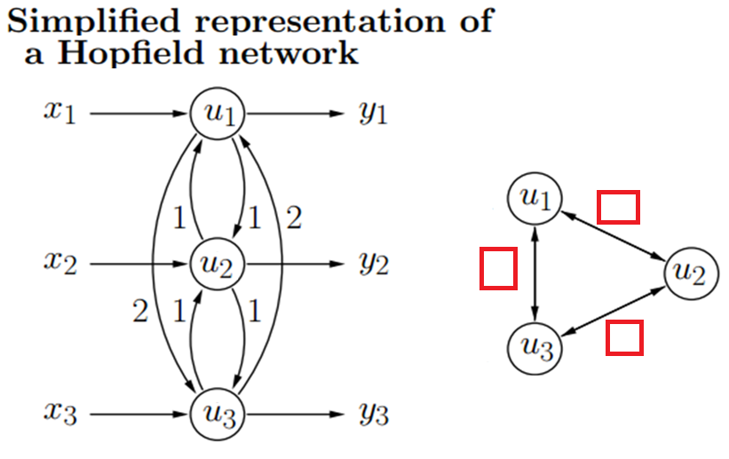
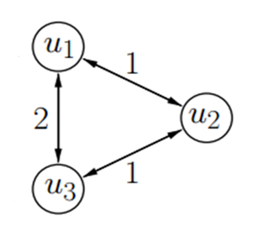
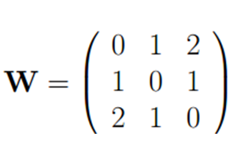
WRITE THE WEIGHT MATRIX

Slide 12
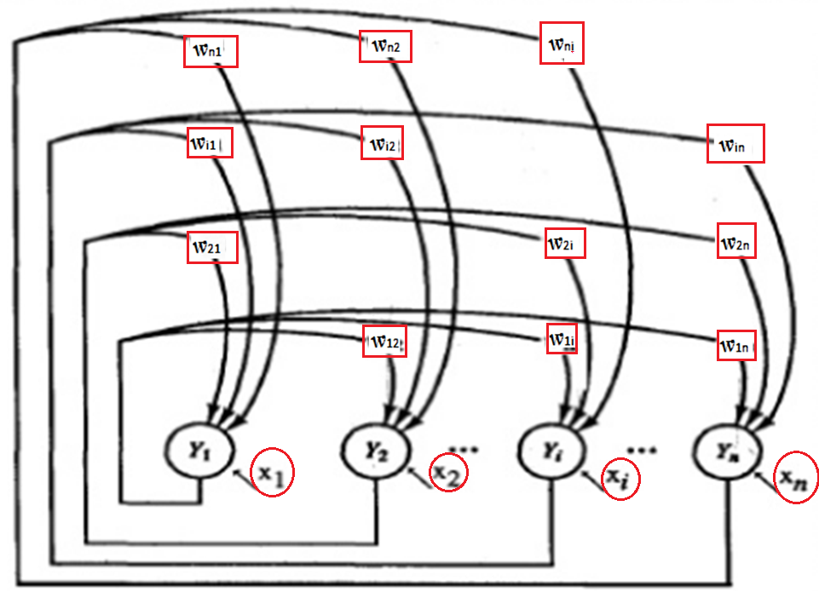

Slide 13
Two types of associative memory:
Autoassociative (Hopfield memory) and Heteroassociative.
Auto-association
retrieves a previously stored pattern that most closely resembles the current pattern.
Hetero-association
the retrieved pattern is, in general, different from the input pattern not only in content but possibly also in type and format.

Slide 14
The purpose of a Hopfield net is to store one or more patterns and to recall the full patterns based on partial/noisy input.
The states of the system corresponding to patterns which are to be stored in the network are stable states.
Stable states can be seen as `dips' in energy space.
A primary application of the Hopfield network is an Associative Memory.

Slide 15
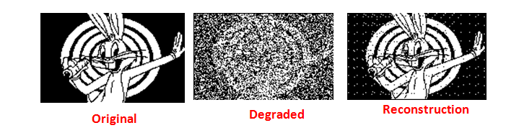
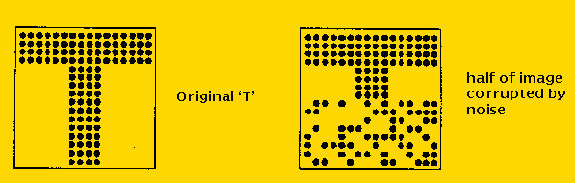
Associative memory
Produces for any input pattern a similar stored pattern
Retrieval by part/incomplete data
Noisy input can be also recognized

Slide 16
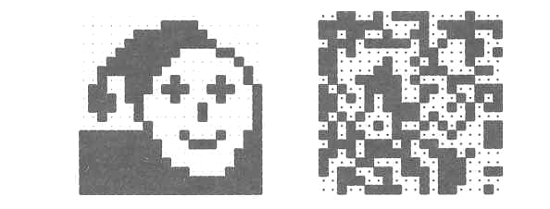
The Hopfield Network
Example: Image reconstruction (Ritter, Schulten, Martinetz 1990)
A 20×20 discrete Hopfield network was trained with 20 input patterns[one shown in the left figure and 19 random patterns ]
Weight matrix found by combining 20 patterns

Slide 17
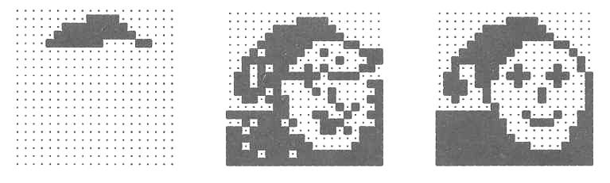
The Hopfield Network
After providing only one fourth of the “face” image as initial input, the network is able to perfectly reconstruct that image within only two iterations.

Slide 18
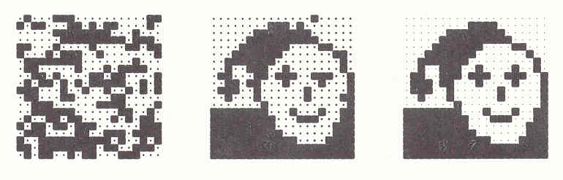
Adding noise by changing each pixel with a probability p = 0.3
After step 1 After 2nd step
After two steps the image is perfectly reconstructed.
Noise does not impair the network’s performance.

Slide 19
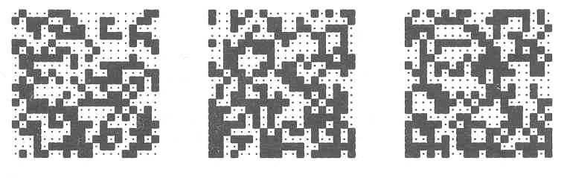
Adding noise by changing each pixel with a probability p = 0.4
the network is unable to arrive at the original image.
Instead, it converges against one of the 19 random patterns.

Slide 20
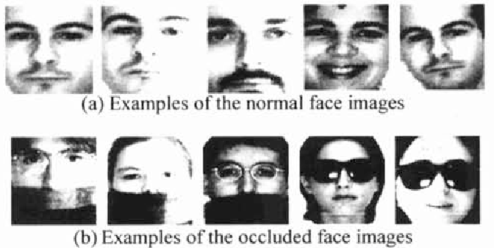
The Hopfield model constitutes an interesting neural approach to identifying partially occluded objects and objects in noisy images.
These are among the toughest problems in computer vision.

Slide 21
The weights for a Hopfield network are determined directly from the training data without need for training
Hopfield acts as a memory and the procedure for storing a single vector in Weight matrix is to take the outer product of the vector with itself
Diagonal elements define the self-connections and a unit does not connect to itself. So all the diagonal elements are set to zero.

Slide 22
To store n dimensional P patterns
Converting X(p) to bipolar [0 → -1 ] and use equation 1 when constructing W.

Slide 23

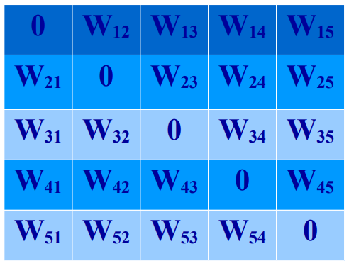
FIND WEIGHT MATRIX TO STORE V¹ = 01101 , V₁ = 0, V₂ = 1, V₃ = 1, V₄ = 0, and V₅ = 1.
Node 1
Node 2
Node 3
Node 4
Node 5
Node 1
Node 2
Node 3
Node 4
Node 5

Slide 24
WEIGHT MATRIX TO STORE FIRST PATTERN V¹ = 01101 , V₁ = 0, V₂ = 1, V₃ = 1, V₄ = 0, and V₅ = 1.
W_{ij} = (2V_{i} - 1)(2V_{j} - 1) = (2V_{j} - 1)(2V_{i} - 1) = W_{ji}
 | W₁₁ =0 W₁₂ = (2V₁ - 1)(2V₂ - 1) = (0 - 1)(2 - 1) = (-1)(1) = -1 W₁₃ = (2V₁ - 1)(2V₃ - 1) = (0 - 1)(2 - 1) = (-1)(1) = -1 W₁₄ = (2V₁ - 1)(2V₄ - 1) = (0 - 1)(0 - 1) = (-1)(-1) = 1 W₁₅ = (2V₁ - 1)(2V₅ - 1) = (0 - 1)(2 - 1) = (-1)(1) = -1 W₂₁ =W₁₂ , W₂₂ =0 W₂₃ = (2V₂ - 1)(2V₃ - 1) = (2 - 1)(2 - 1) = (1)(1) = 1 W₂₄ = (2V₂ - 1)(2V₄ - 1) = (2 - 1)(0 - 1) = (1)(-1) = -1 W₂₅ = (2V₂ - 1)(2V₅ - 1) = (2 - 1)(2 - 1) = (1)(1) = 1 W₃₁ = W ₁₃ , W₃₂ = W₂₃ , W₃₃ = 0 W₃₄ = (2V₃ - 1)(2V₄ - 1) = (2 - 1)(0 - 1) = (1)(-1) = -1 W₃₅ = (2V₃ - 1)(2V₅ - 1) = (2 - 1)(2 - 1) = (1)(1) = 1 W₄₁ = W ₁₄ , W₄₂ = W₂₄ , W₄₃ =W₃₄ , W₄₄ = 0 W₄₅ = (2V₄ - 1)(2V₅ - 1) = (0 - 1)(2 - 1) = (-1)(1) = -1
Replace 0 by -1 V = (0 1 1 01 1) becomes ( -1 1 1 -1 1 1) and find weights

Slide 25
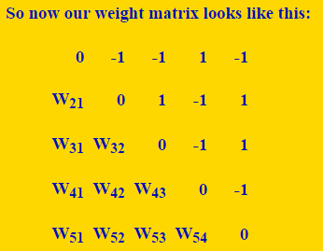
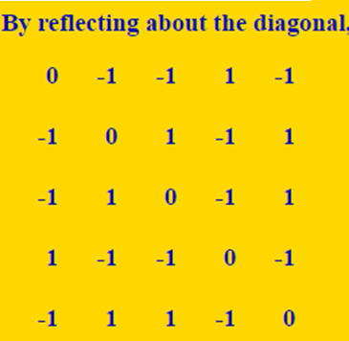
WEIGHT MATRIX FOR storing first vector : 0 1 1 0 1

Slide 26
WEIGHT MATRIX TO STORE V² = 10101 , V₁ = 1, V₂ =0, V₃ = 1, V₄ = 0, and V₅ = 1.
W_{ij} = (2V_{i} - 1)(2V_{j} - 1) = (2V_{j} - 1)(2V_{i} - 1) = W_{ji}
 | W₁₂ = (2V₁ - 1)(2V₂ - 1) = (2 - 1)(0 - 1) = (1)(-1) = -1 W₁₃ = (2V₁ - 1)(2V₃ - 1) = (2 - 1)(2 - 1) = (1)(1) = 1 W₁₄ = (2V₁ - 1)(2V₄ - 1) = (2 - 1)(0 - 1) = (1)(-1) = -1 W₁₅ = (2V₁ - 1)(2V₅ - 1) = (2 - 1)(2 - 1) = (1)(1) = 1 W₂₃ = (2V₂ - 1)(2V₃ - 1) = (0 - 1)(2 - 1) = (-1)(1) = -1 W₂₄ = (2V₂ - 1)(2V₄ - 1) = (0 - 1)(0 - 1) = (-1)(-1) = 1 W₂₅ = (2V₂ - 1)(2V₅ - 1) = (0 - 1)(2 - 1) = (-1)(1) = -1 W₃₄ = (2V₃ - 1)(2V₄ - 1) = (2 - 1)(0 - 1) = (1)(-1) = -1 W₃₅ = (2V₃ - 1)(2V₅ - 1) = (2 - 1)(2 - 1) = (1)(1) = 1 W₄₅ = (2V₄ - 1)(2V₅ - 1) = (0 - 1)(2 - 1) = (-1)(1) = -1
Replace 0 by -1 V² = (1 0 1 0 1) becomes ( 1 -1 1 -1 1) and find weights

Slide 27
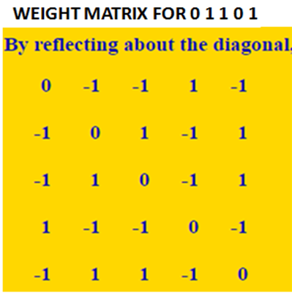
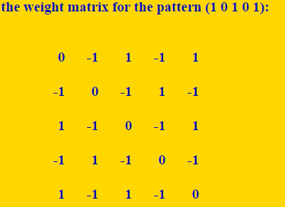
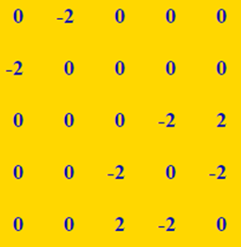
ADDITION GIVES WEIGHT MATRIX TO STORE TWO PATTERNS AS :

Slide 28
ANOTHER METHOD

Slide 29


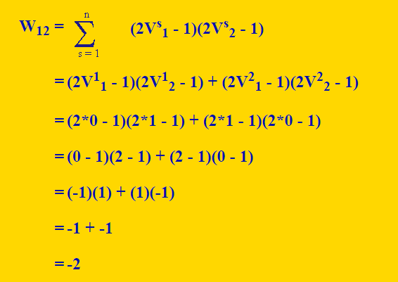

Slide 30
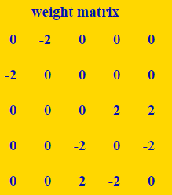
node 1 node 2 node 3 node 4 node 5

Slide 31
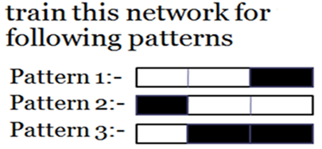
Number of nodes = dimension of pattern =3 in this case, Weight matrix dimension =3x3
Node 1 Node 2 Node 3
w₁₂ : product of first and second columns for all patterns
W₃₂ : product of third and second column for all patterns

Slide 32
When a “cue” – noisy pattern is given, there are now two ways to update the nodes:
Asynchronously: Only one unit is updated at a time. This unit can be picked at random, or a pre-defined order can be imposed from the very beginning, like even nodes/odd nodes.
Asynchronous updating is more biologically realistic
Synchronously: All units are updated at the same time.
Computations can oscillate if neurons are updated in parallel(synchronously)
Computations always converge if neurons are updated sequentially(asynchronously)

Slide 33
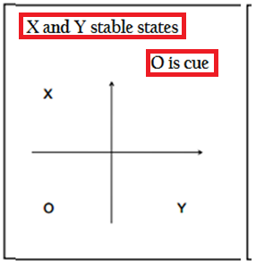
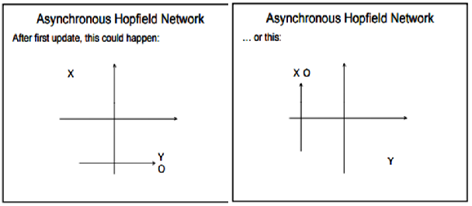
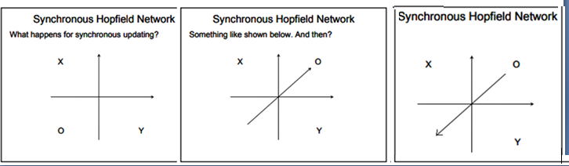

Slide 34
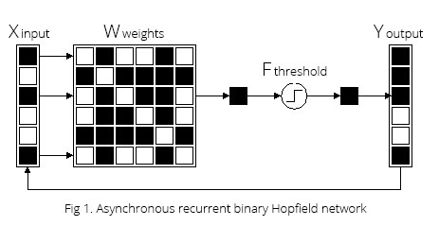
Draw Asynchronous Recurrent Binary Hopfield Network for six dimensional input/output vector

Slide 35
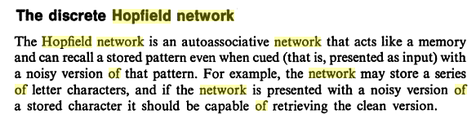
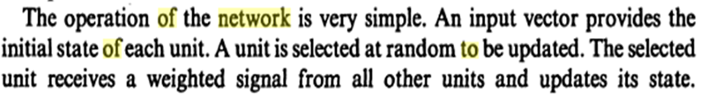
The Essence of Neural Networks By Callan Robert

Slide 36
Weight matrix to store pattern V¹ =(0 1 1 0 1) and V² =( 1 0 1 0 1)
Start at the state ( 1 1 1 1 1) and see where it goes when nodes are updated in the fixed order of 3,1,5,2,4, 3,1,5,2,4 (testing)

Slide 37






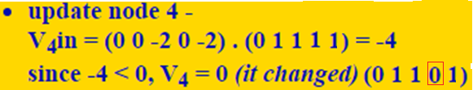
STEADY STATES
Start at state ( 1 1 1 1 1) and see where it goes when nodes are updated in the fixed order of 3,1,5,2,4
N1 N2 N3 N4 N5
Reached One of the stable states !

Slide 38



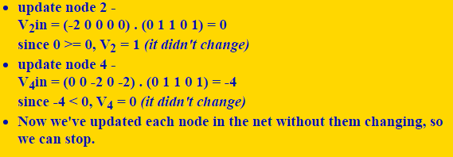
Testing again give 3,1,5,2,4
no change-converged

Slide 39
start at the state (1 1 1 1 1) and see where it goes, when using a fixed node updating order of 2, 4, 3, 5, 1, 2, 4, 3, 5, 1(testing), etc.
update node 2 - V₂in = (-2 0 0 0 0) . (1 1 1 1 1) = -2 -2 < 0, V₂ = 0 (it changed) (1 0 1 1 1)
update node 4 - V₄in = (0 0 -2 0 -2) . (1 0 1 1 1) = -4 -4 < 0, V₄ = 0 (it changed) (1 0 1 0 1 )
Update node 3 - V₃in = (0 0 0 -2 2) . (1 0 1 0 1) = 2 2 >= 0, V₃ = 1 ( NC)
N1 N2 N3 N4 N5
Update node 5 - V₅in = (0 0 2 -2 0) . (1 0 1 0 1) = 2 2 >= 0, V₅ = 1 ( NC)
Update node 1 - V₁in = (0 -2 0 0 0) . (1 0 1 0 1) = 0 since 0 >= 0, V₁ = 1 (it didn't change) Went to other Steady state. If two patterns are very similar, the order in which you update the nodes can make a difference to which stable/attractor state it goes.
STEADY STATES

Slide 40
What does such a stable state look like?
In each iteration, the activation pattern will be drawn towards stable state.
A stable network will eventually reach a condition in which the recirculated output no longer changes the network state.

Slide 41
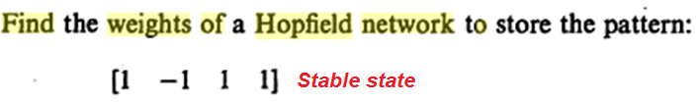
What does such a stable state look like?
In each iteration, the activation pattern will be drawn towards stable state.
A stable network will eventually reach a condition in which the recirculated output no longer changes the network state.

Slide 42
Comments:
Why converge.
Each time, E is either unchanged or decreases an amount.
E is bounded from below.
There is a limit E may decrease. After finite number of steps, E will stop decrease no matter what unit is selected for update.
The state the system converges is a stable state.
Will return to this state after some small perturbation. It is called an attractor (with different attraction basin)
Error function of BP learning is another example of energy/Lyapunov function. Because
It is bounded from below (E>0)
It is monotonically non-increasing (W updates along gradient descent of E)

Slide 43
Hopfield Observation :
A Hopfield network has limits on the patterns it can store and retrieve accurately from memory, described by :
A Hopfield network with n nodes can store N patterns, related by N < 0.15n (Hopfield Observation)
By theoretical analysis Hopfield network is limited by its memory capacity, which is only 13.8% of its total neurons

Slide 44
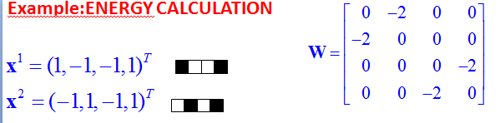
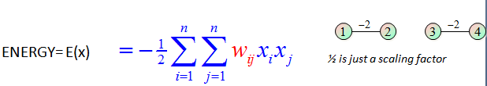

Energy for pattern 1 ( 1, -1, -1, 1) = 2[x₁ x₂ + x₄ x₃ ]= 2( -1 - 1) = - 4
Energy for pattern 2 ( -1, 1, -1, 1) = 2[x₁ x₂ + x₄ x₃ ] = 2 ( -1 - 1) = - 4

Slide 45
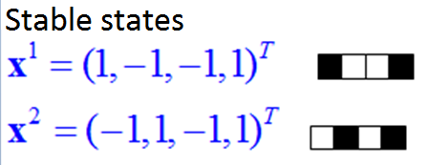
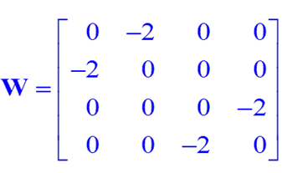

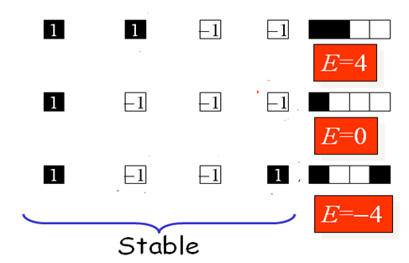

Slide 46
END

