Slide 1
RECURRENT NEURAL NETWORKS (RNNs)

Slide 2
Neural Networks Classification:
Static Networks : Output can be calculated directly from the input through feed-forward connections.
Dynamic Networks : Have feedback connections, output depends on:
the current input to the network
current and/or previous inputs/outputs/ states of the network.

Slide 3
Dynamic Neural Networks also called as RNNs have more complex architectures.
Dynamic networks have memory, they can be trained to learn sequential or time-varying patterns.
Hopfield Network, introduced in 1982 by J.J. Hopfield, is considered as one of the first network with recurrent connections

Slide 4
What Are RNNs
Recurrent Neural Networks (RNNs) are a kind of neural network that specialize in processing sequences.
Recurrent Networks are a type of ANNs to recognize patterns in sequences of data, such as:
text, genomes, handwriting, spoken word, numerical times series data emanating from sensors, stock markets and government agencies.

Slide 5
3 set of data:{(110)(010)(011)}
4 patterns of 2 input Gate: {(0,0),(0,1),(1,0),(1,1)}
In feed forward network
Is the sequence in which patterns are given important ?
NO, random selection is allowed.
Every input is independent of other.

Slide 6
In RNNs order in which data is given is important i.e. sequence must be preserved when training models and making predictions.
RNN’s use their internal state(memory) to process any sequence of inputs.
RNNs are good for sequence tasks which require any kind of previous context like Speech Recognition, Music Generation etc.

Slide 7
Applications of RNNs
Language translation and modeling
Handwriting recognition
Speech recognition, speech emotion recognition, speaker identification
Image captioning, image labeling, video description
Time series data such as stock prices to tell you when to buy or sell
Autonomous driving systems to anticipate car trajectories and help avoid accidents.

Slide 8
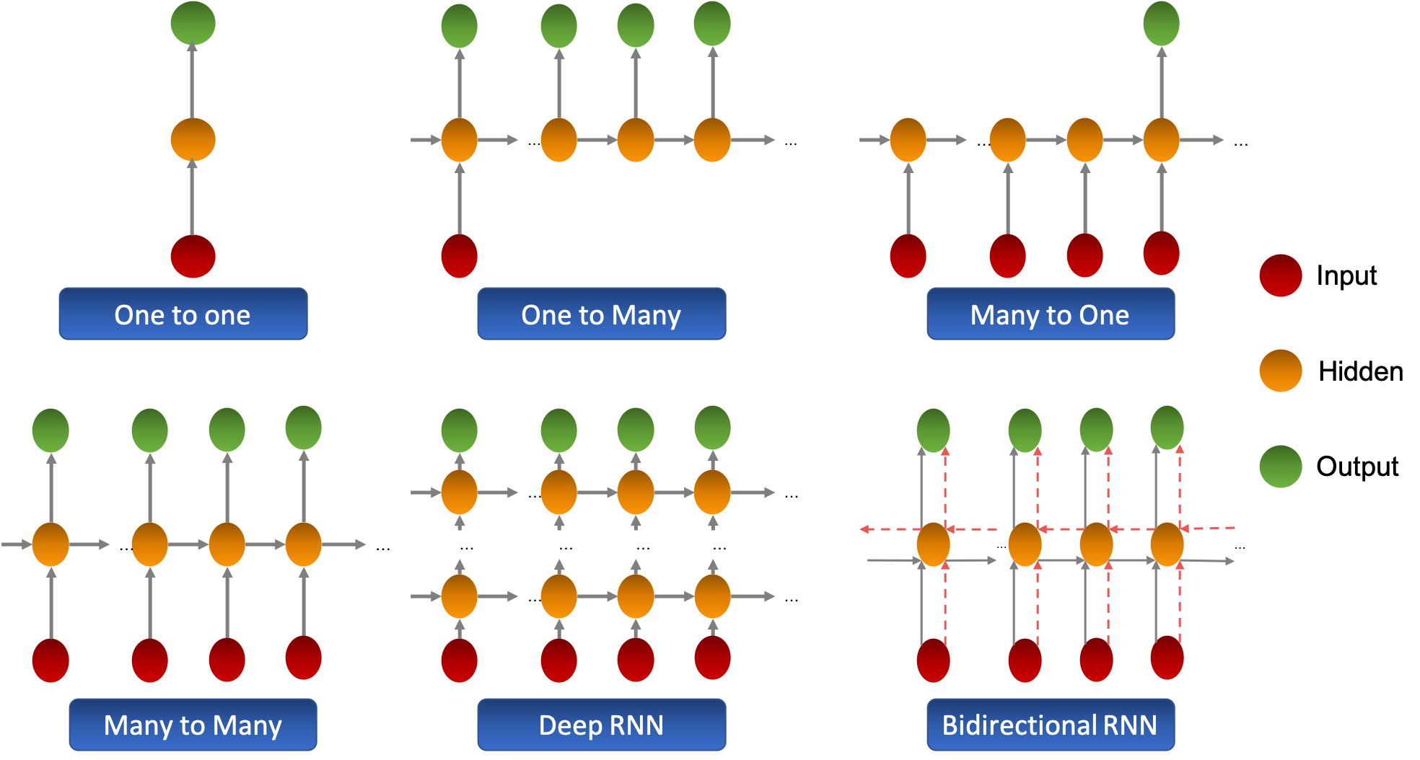

Slide 9
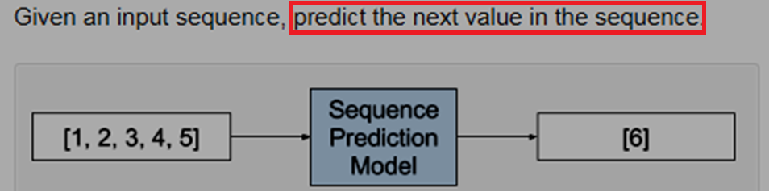
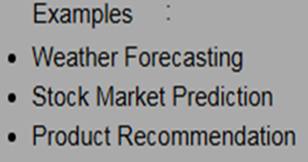
Types of sequence prediction problems:

Slide 10
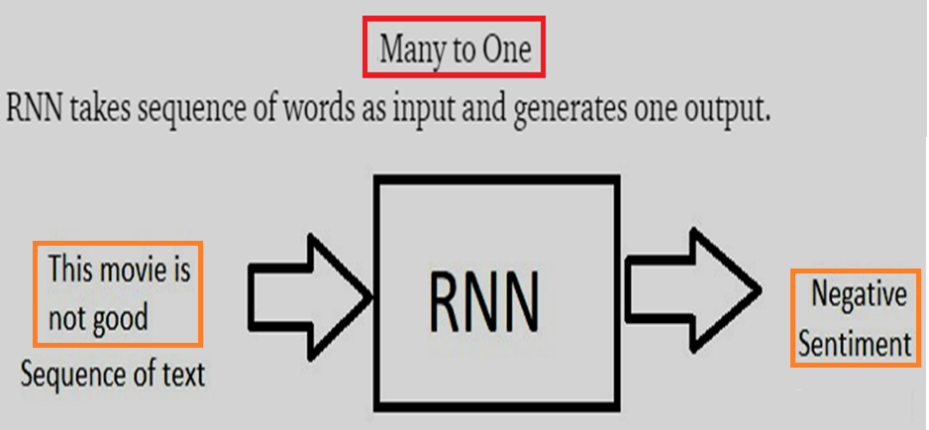
Many to one approach could be to
handle a sequence of images (for example a video) and produce one word/sentence for it

Slide 11
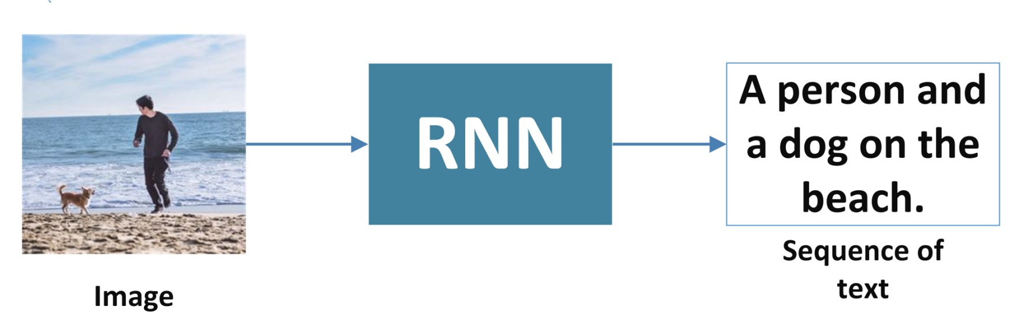
Sequence generation (One to Many)
RNN takes one input say an image and generates a sequence of words.
Applications : Text generation, Music generation, image captioning

Slide 12
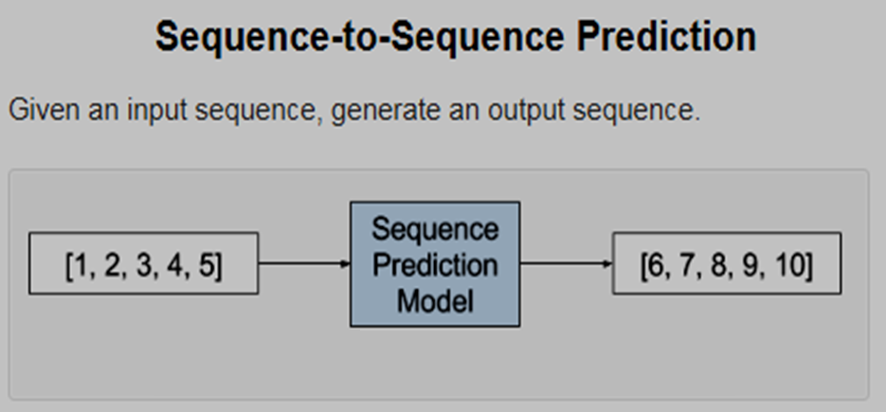
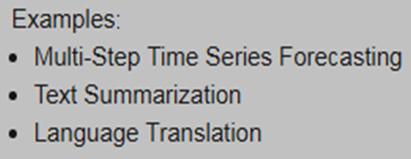
Falls under Many to Many

Slide 13

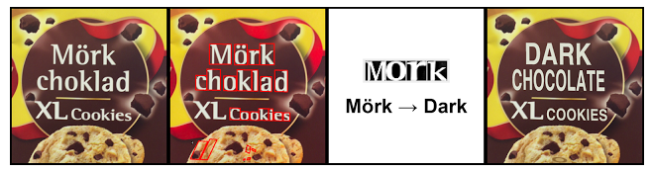

Slide 14
The real-time visual translation tool lets users point their device at printed text such as signs, object names and have the translated text appear on the screen almost immediately.
This is called instant visual translation/automatic text translation.
LSTM networks are used.

Slide 15
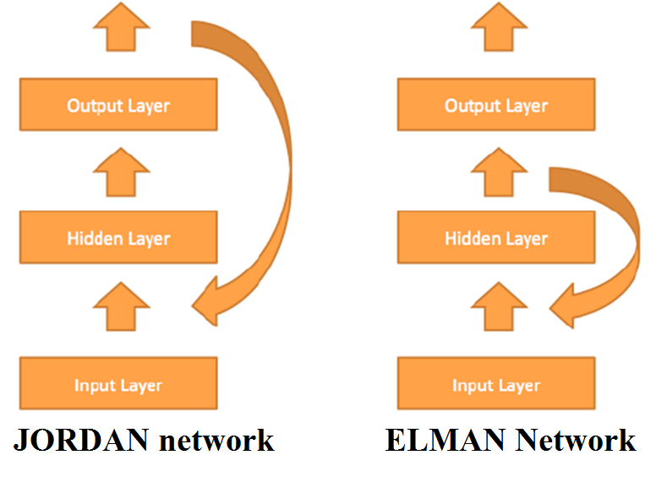

Slide 16
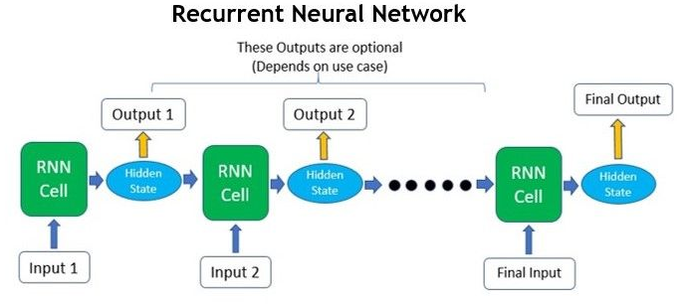
The important point to remember: the sequential units, i.e RNN cells are the same unit at different point of time and are not cascading units.

Slide 17
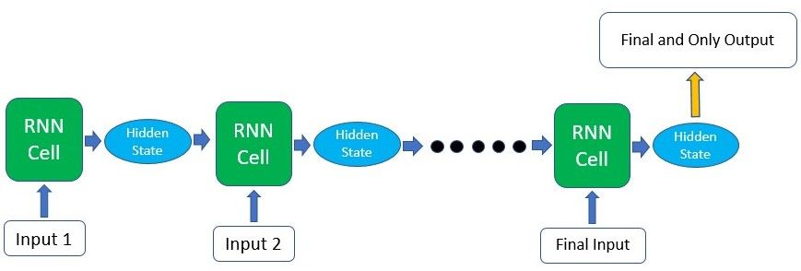
Which portion of the RNN is output ?
if you’re using the RNN for a classification task, you’ll only need one final output after passing in all the input - a vector representing the class probability scores.
if you’re doing text generation based on the previous character/word, you’ll need an output at every single time step.

Slide 18
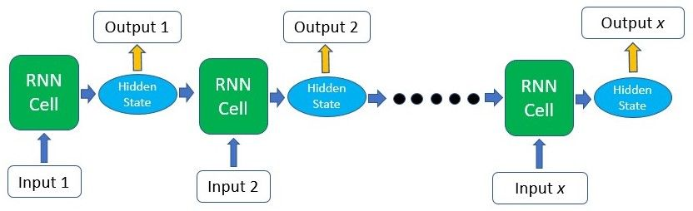
Sequence-To-Sequence translation where the output is only produced in a sequence after all the input has been passed through.

Slide 19
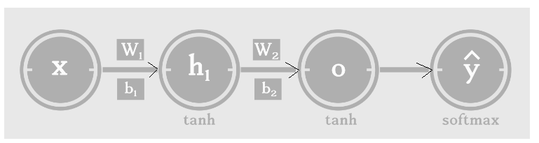
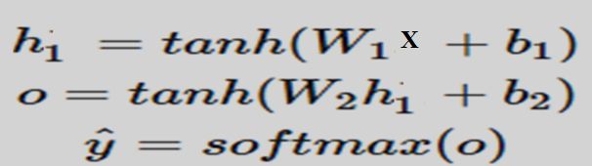
Mathematical Representation of RNNs
Feed-forward neural networks and it’s variants like Convolutional Networks, have static architecture.
weights (W)for every hidden layers are different.

Slide 20
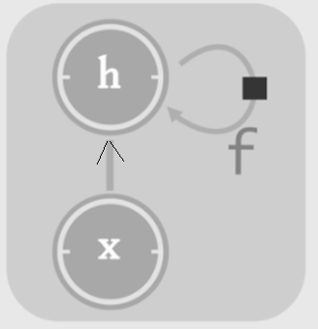
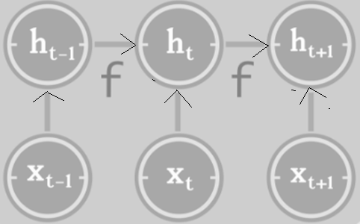
Why Unfold ??
It supports backpropagation.
Size depends on the input sequence length.
CYCLIC
Unfolded Acyclic

Slide 21
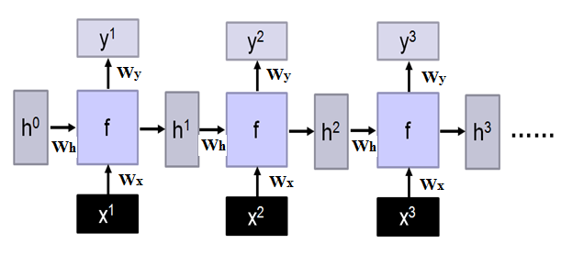
All f [activation functions] are same, all weight matrices[W_{x} W_{h} W_{y}] are identical.
if activation functions and weight matrices are different, it becomes what kind of network?
FF network

Slide 22
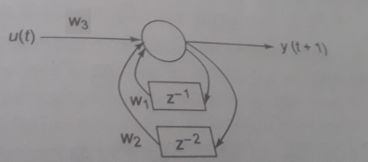
Example: Unfold Discrete linear system described by:
y(t+1) = -0.5y(t) - y(t-1) + 0.5u(t)
y(t+1) = w₁y(t) +w₂y(t-1) + w₃u(t)
w₁ , w₂ , w₃ are weights to be found using BPA

Slide 23
y(t+1) = w₁y(t) +w₂y(t-1) + w₃u(t)
y(2)=w₁ y(1) + w₂ y(0) + w₃ u(1)
y(3)=w₁ y(2) + w₂ y(1) + w₃ u(2)
.
.
y(n+1)=w₁ y(n) + w₂ y(n-1) + w₃ u(n)

Slide 24

Deep RNN
At the first time step, t = 0, there are no previous outputs, so they are typically assumed to be all zeros.
h & y = f₁(h,x), g &z = f₂(g,y)
…
…
…
z¹
z²
z³
g⁰
f₂
g¹
f₂
g²
f₂
g³
……
y¹
y²
y³
h⁰
f₁
h¹
f₁
h²
f₁
h³
……
x¹
x²
x³

Slide 25
Bi-directional RNN model is dependent on historical and future data.
The bidirectional RNN models are useful where causal structure exists such as in text and speech.
The unfolded structure of bidirectional RNN is shown in the following figure:

Slide 26
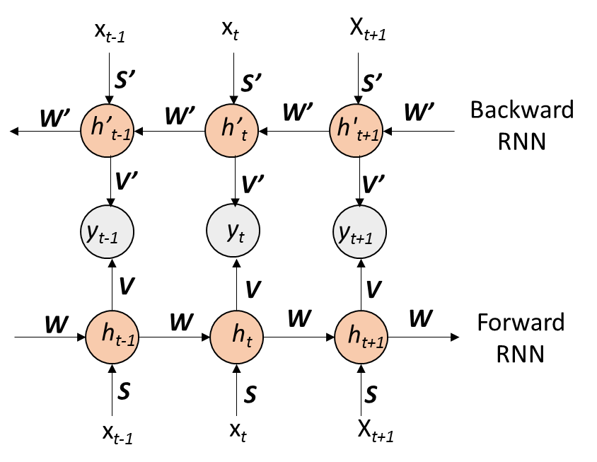

Slide 27
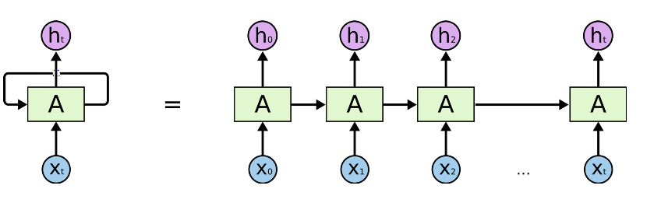
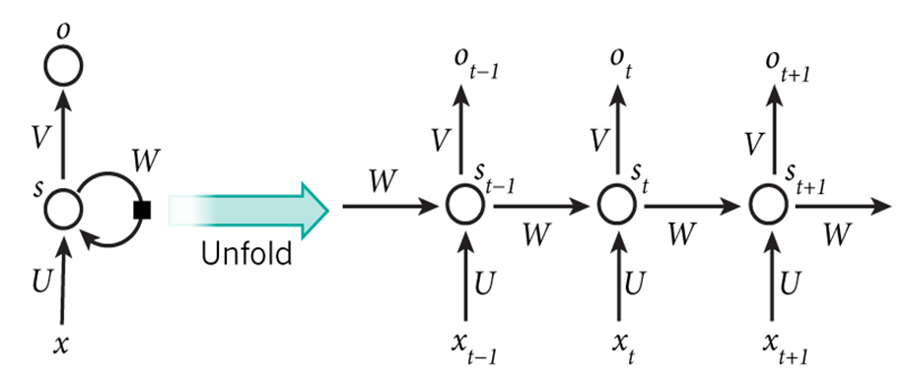
s_{t} = f(Ux_{t} + W s_{t-1})
o_{t} = g( V s_{t} )
Note: the same activation function(f and g) and the same set of parameters (U,V,W)are used at every time step.

Slide 28
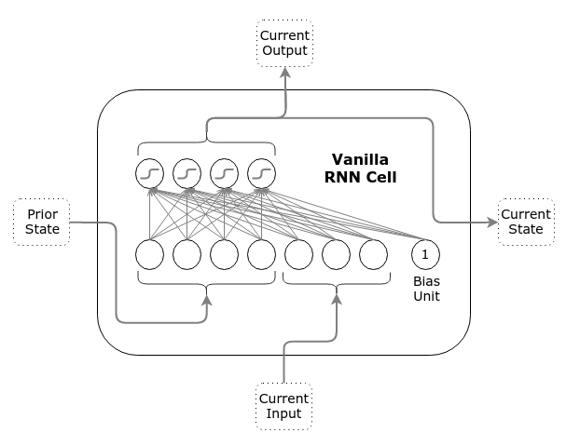
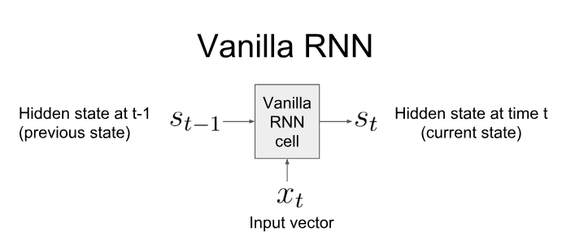
Can also write as h_{t} , h_{t-1}

Slide 29
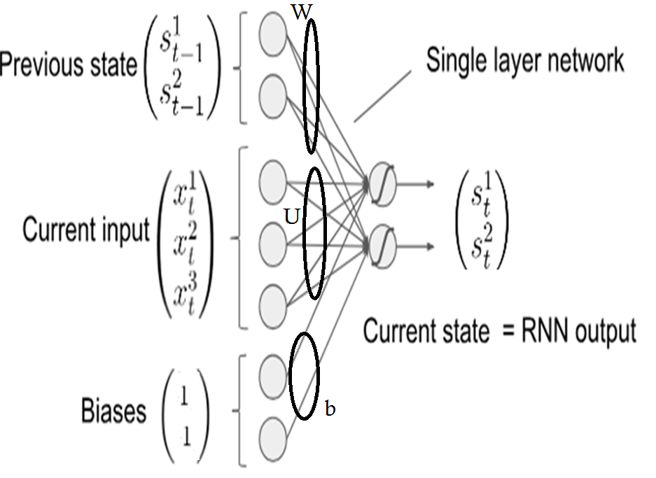

Slide 30
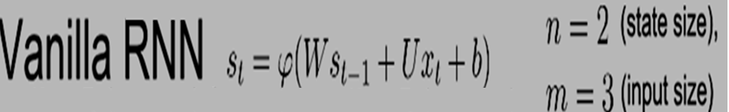
WRITE W, U and b matrices

Slide 31
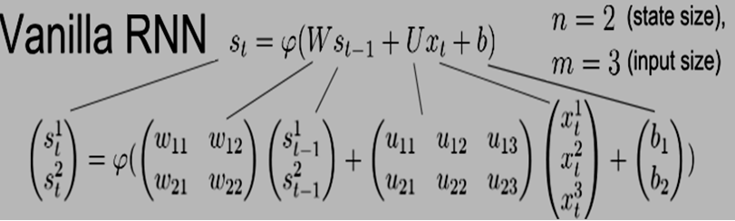

Slide 32
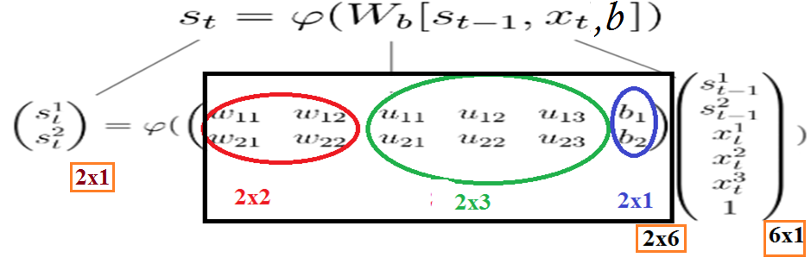
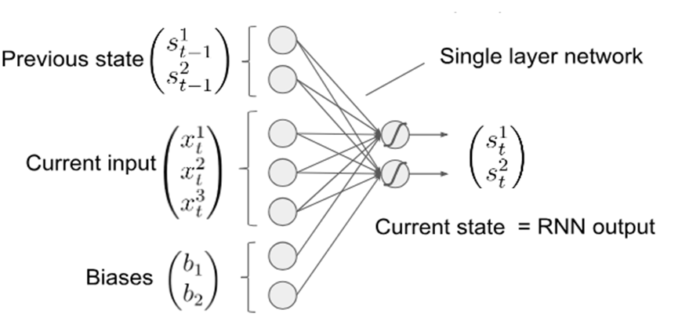
s_{t} ,h_{t} same

Slide 33
Training RNNs
RNN training is similar to training a traditional Neural Network using the backpropagation algorithm, but with a little twist.
Because the parameters are shared by all time steps in the network, the gradient at each output depends not only on the calculations of the current time step, but also the previous time steps.
This is called Backpropagation Through Time (BPTT).

Slide 34
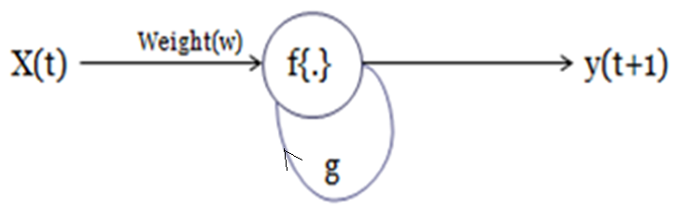
TRAINING A SIMPLE RECURRENT NETWORK
Back propagation through time(BPTT)
Input: x(t), output: y(t+1)--PREDICTION, e.g. next word in sequence
Input: x(t), output: y(t) -- TRANSLATION of each word

Slide 35
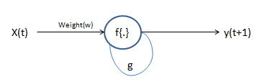
Forward response:
y(t+1)=f{w. x(t)+g. y(t)}
Where f{.} is sigmoidal activation function

Slide 36
If x(t), y(t+1) pair
y(t+1)=f{w. x(t)+g. y(t)}
y(1)=f{w. x(0)+g. y(0)}
y(2)=f{w. x(1)+g. y(1)}
y(3)=f{w. x(2)+g. y(2)}
If x(t), y(t) pair
y(t)=f{w. x(t)+g. y(t-1)}
y(1)=f{w. x(1)+g. y(0)}
y(2)=f{w. x(2)+g. y(1)}
y(3)=f{w. x(2)+g. y(2)}
.

Slide 37
General BPA
BPTT (Back propagation through Time)
Present a training input pattern and propagate it through the network to get an output.
Compare the predicted outputs to the expected outputs, calculate the error.
Calculate the derivatives of the error with respect to the network weights.
Adjust the weights to minimize the error.
Repeat.
Unroll the network
Present a sequence of timesteps of input and output pairs to the network.
Calculate and accumulate errors across each timestep.
Roll-up the network and update weights.
Repeat.
BPTT can be computationally expensive as the number of time steps increases.

Slide 38
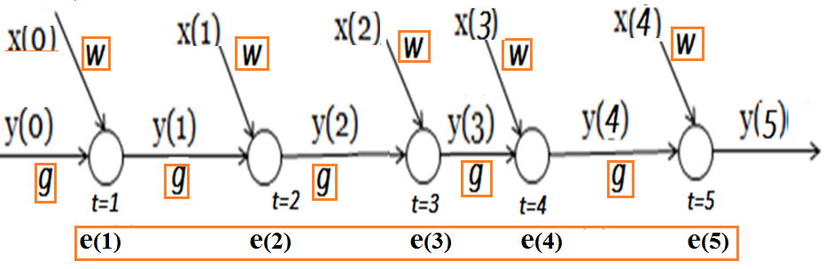
Activation Function : Logsigmoid
Prof. Behra book ”Intelligent Systems and Control”

Slide 39
FORWARD PASS : Compute the response
y(1),y(2),y(3),y(4)& to y(5), given
sequence x(0),x(1),x(2),x(3),x(4) and y(0)

Slide 40
Activation Function : Logsigmoid
2. BACKWARD PASS, loss function is MSE
2.1 compute the error e(5)
e(5)= y^{d}(5) – y(5)
δ₅ = e(5) [ y(5) (1-y(5) )]
Δw⁵ = η . δ₅ . x(4)
Δg⁵ = η . δ₅ . y(4)

Slide 41
2.2 Compute e(4), e(3), e(2) , and e(1)
e(4) = y^{d}(4) – y(4)
δ₄ = [y(4)(1-y(4) ] . [δ₅ . g + e(4)]
Δw⁴ = η . δ₄ . x(3)
Δg⁴ = η . δ₄ . y(3)

Slide 42
e(3)= y^{d}(3) – y(3)
δ₃ = [y(3)(1-y(3)] . [δ₄ . g + e(3)]
Δw³ = η . δ₃ . x(2)
Δg³ = η . δ₃ . y(2)
e(2)= y^{d}(2) – y(2)
δ₂ = [y(2)(1-y(2)] . [δ₃ . g + e(2)]
Δw² = η . δ₂ . x(1)
Δg² = η . δ₂ . y(1)

Slide 43
e(1)= y^{d}(1) – y(1)
δ₁ = [y(1)(1-y(1)] . [δ₂ . g + e(1)]
Δw¹ = η . δ₁ . x(0)
Δg¹ = η . δ₁ . y(0)

Slide 45
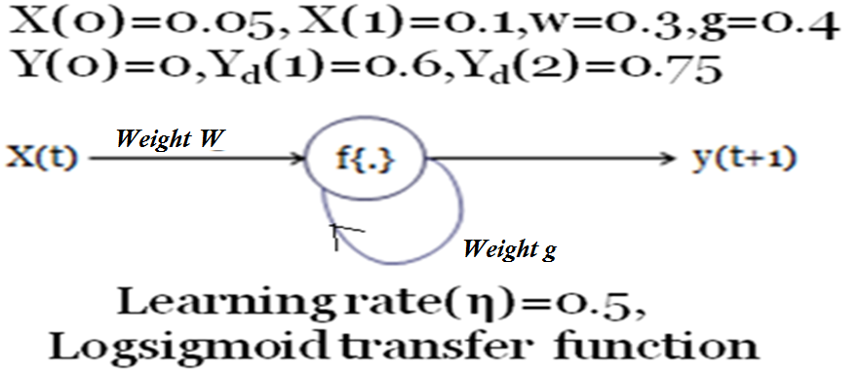

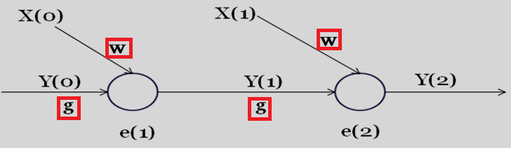
Output: y(t+1)=f{w. x(t)+g. y(t)}

Slide 46
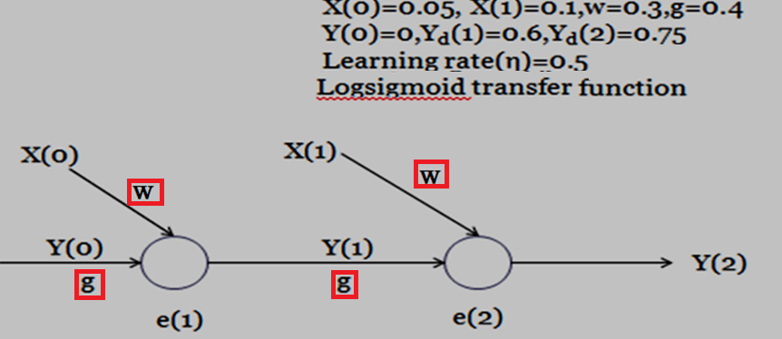
At the first time step, t = 0, there are no previous outputs, so they are typically assumed to be all zeros.

Slide 47
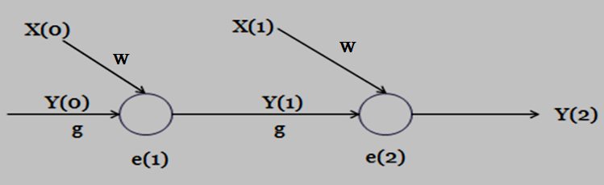
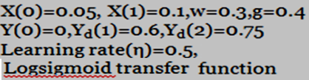
Backward Pass :
e(2)= Y^{d}(2) - Y(2) = 0.75 - 0.5575 = 0.1924
δ₂= e(2)×Y(2)×(1-Y(2))
= 0.1924 × 0.5575 × 0.4425
= 0.0474
e(1)= Y^{d}(1) - Y(1) = 0.6 - 0.5037 = 0.0963
δ₁= Y(1)×(1-Y(1))×[e(1) + δ₂×g]
= 0.5037×0.4963×[0.0963 + 0.0474×0.4]
=0.0288

Slide 48
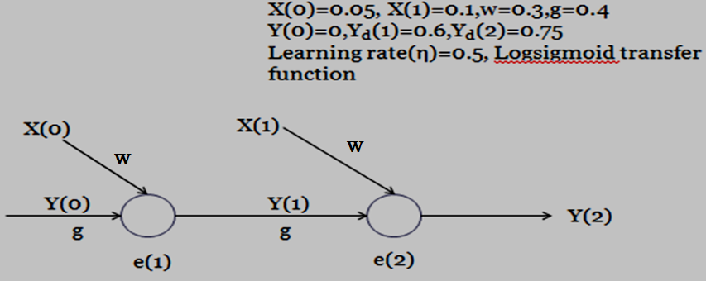
δ₂ = 0.0474; δ₁= 0.0288
Δw₂ =η×δ₂×X(1) = 0.5×0.0474×0.1 = 0.00237
Δg₂ = η×δ₂ ×Y(1)= 0.5×0.0474×0.5037 = 0.0119
Δw₁ =η×δ₁ ×X(0) =0.5×0.0288×0.05 =0.0007
Δg ₁= η×δ₁ ×Y(0) =0.5×0.0288×0=0

Slide 49
Truncated BPTT is an approximation of full BPTT that is preferred for long sequences.
full BPTT’s forward/backward cost per parameter update becomes very high over many time steps.
Truncated BPTT is the exact same thing but instead of propagating to the beginning of the sequence you only propagate backwards k steps.

Slide 50
Time Series Analysis - Case Study
(Using RNNs)

Slide 51
https://machinelearningmastery.com/time-series-prediction-lstm-recurrent-neural-networks-python-keras/

Slide 52
International Airline Passengers Prediction Problem
Problem statement
Data, First few lines
Input: year & month
Output: number of international airline passengers (in units of 1,000)
[The data ranges from January 1949 to December 1960, for 12 years, with 144 observations.]
Company
"Month","Passeners"
"1949-01",112
"1949-02",118
"1949-03",132
"1949-04",129
"1949-05",121
Data (first few lines)
If we take two time steps as input
With 1949-01 as input, desired predicted output for 1949-02 is 118
With 1949-02 as input, desired predicted output for 1949-03 is 132

Slide 53
RNN Design Specs
Problem
statement
Hyperparameters
Assumptions
Input: scalar (passenger count in current month)
Hidden state: 2 neurons
Output: scalar (passenger count for next month)
Initialize hidden state neurons with zeroes [a very common initialization used in practice]
Non-linearity @ hidden nodes: ReLU [tanh is more common; ReLU is used here for ease of calculation]
Non-linearity @ output: None [Linear,f(net)=net since it’s a regression problem]
Ignore biases for ease of calculation
Company

Slide 54
Algorithm: vanilla SGD with Truncated Backprop Through Time (TBPTT)
Truncation: two time steps [choose two time steps for ease of calculation.
Typically, a larger number like 20 can be used to capture the temporal structure in the problem]
Loss: Least Squares

Slide 55
Draw the architecture:
Input: scalar (passenger count, current month )
Hidden state: 2 neurons,
Output: scalar (passenger count for next month)

Slide 56
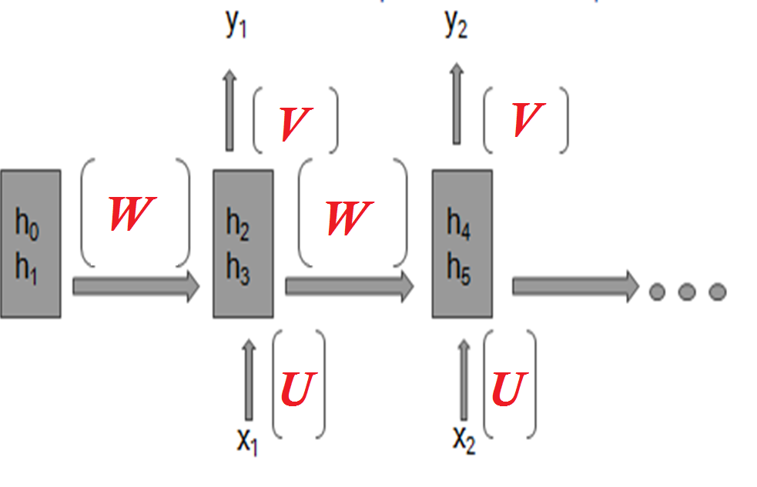
WRITE U, V and W

Slide 57
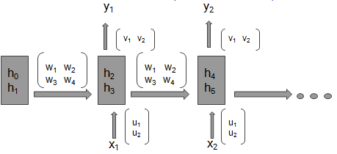

Slide 58
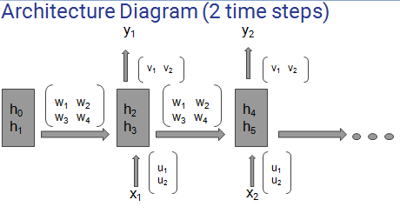
Draw the architecture: Input: scalar (passenger count)
Hidden state: 2 neurons, Output: scalar (passenger count for next month)
How many trainable parameters exist in the model?
EIGHT…. write expression for h₁, h₂, h₃ & h₄

Slide 59
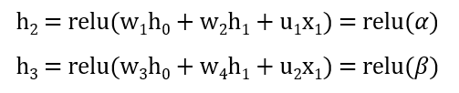


"Month","Passeners"
"1949-01",112
"1949-02",118
"1949-03",132
"1949-04",129
"1949-05",121
Desired outputs at step 1 and step2 are 𝜙₁ = 118, and 𝜙₂ = 132 respectively

Slide 60
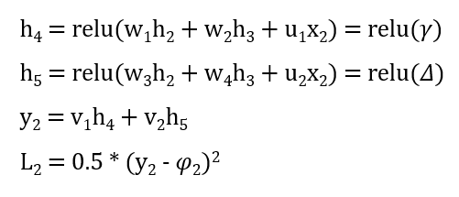


Slide 61
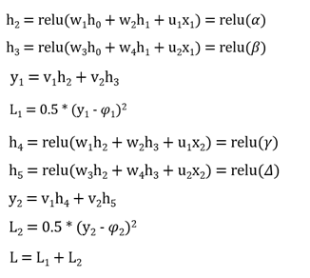
Find derivatives of L₁ and L₂ wrt all 8 weights

Slide 62
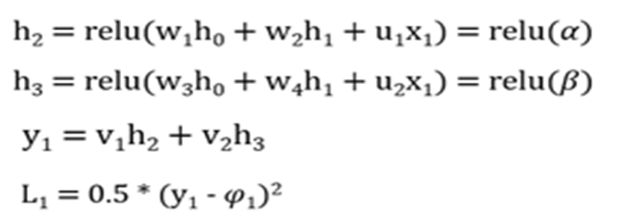





Slide 63
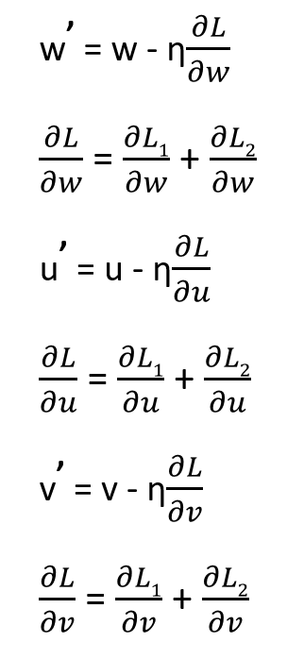
Update Equations

Slide 64
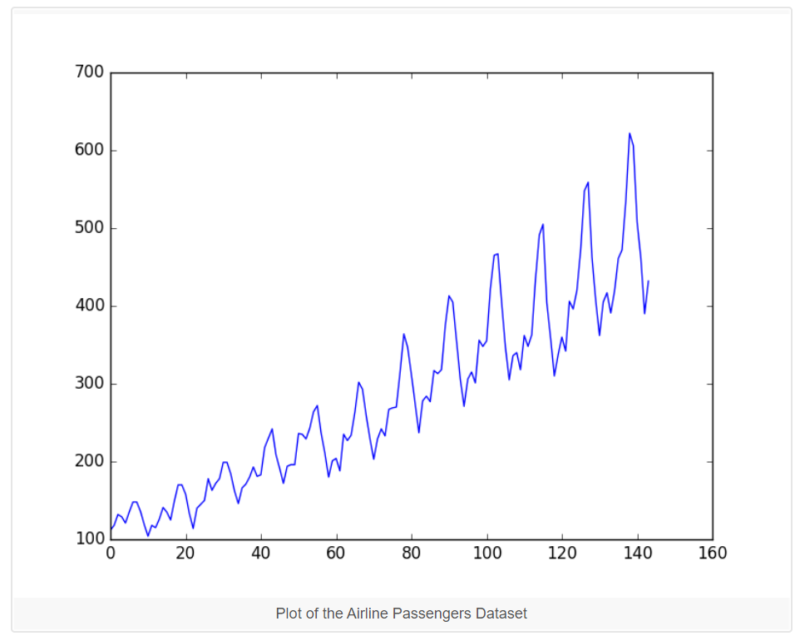
Airline Passenger Data Plot

Slide 65
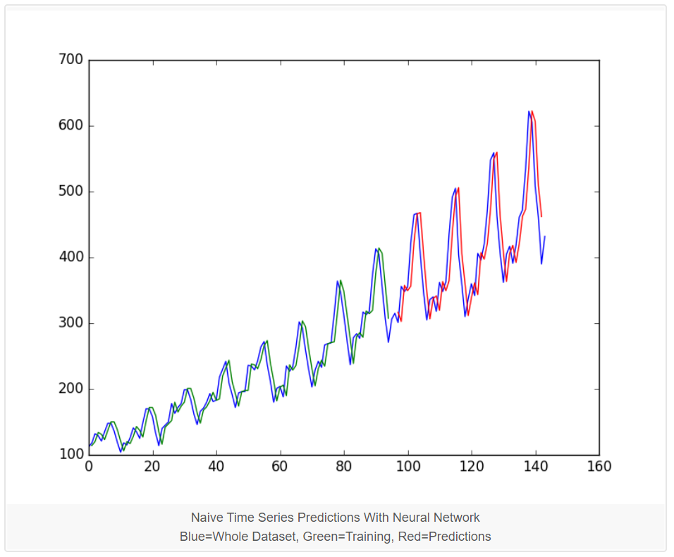
Performance of the Neural Network

Slide 66
END

