Slide 1
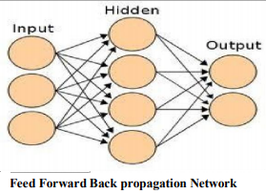
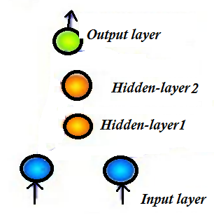
Cascade forward back propagation model
include a weight connection from the input to each layer and from each layer to the successive layers.
Make connections

Slide 2
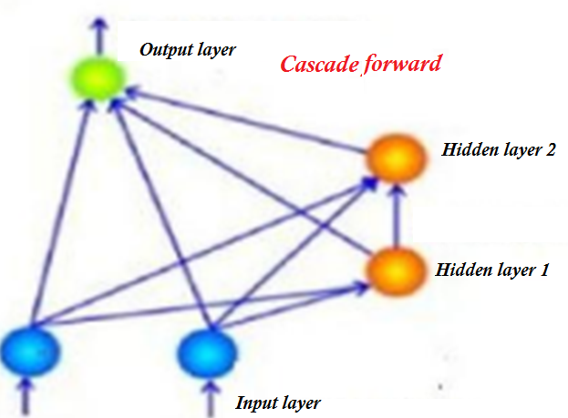

Slide 3
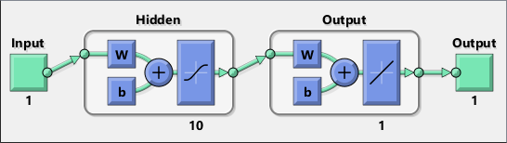
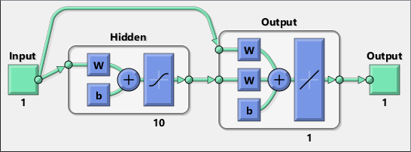
Cascade forward back propagation model
include a weight connection from the input to each layer and from each layer to the successive layers

Slide 4
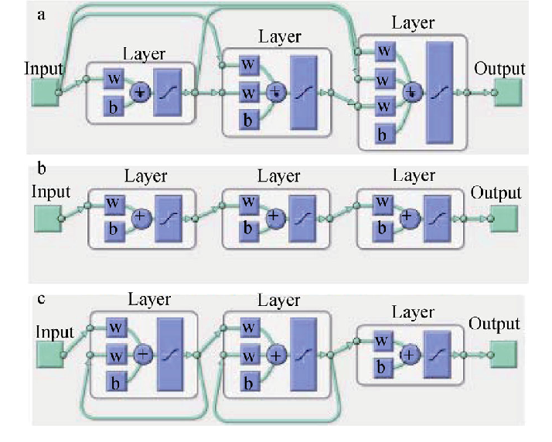

Slide 5
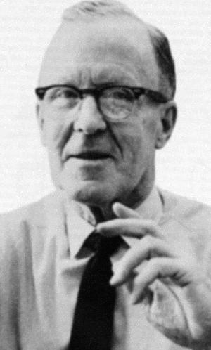
HEBB LEARNING
This rule, one of the oldest and simplest, was introduced by Donald Hebb in 1949
Donald Hebb(1904-1985) FRS was a Canadian psychologist who was influential in the area of neuropsychology, where he sought to understand how the function of neurons contributed to psychological processes such as learning.

Slide 6
In Hebbian learning, weights that produce positive correlations between the inputs and outputs of the network are increased.
The neural analog of this is to strengthen synapses that cause the inputs and outputs of the system to spike together – i.e.,
“cells that fire together wire together.”

Slide 7
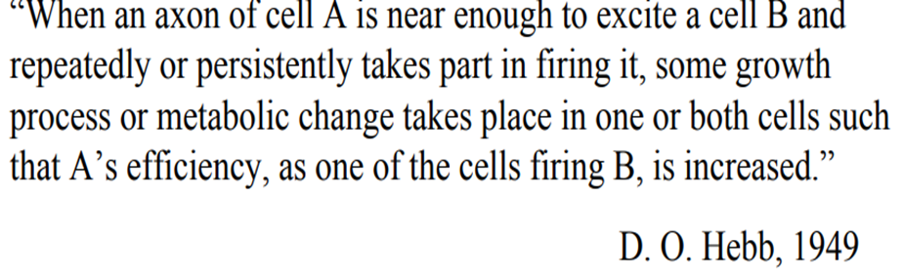
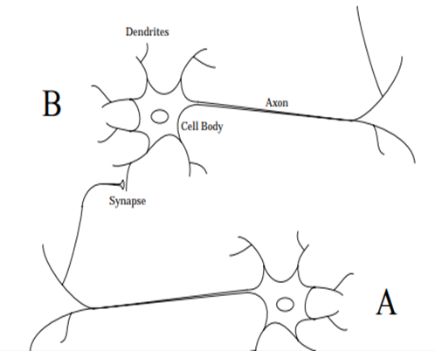
Hebbian Learning rule:
If two neurons on either side of a synapse (connection) are activated simultaneously (i.e. synchronously), then the strength of that synapse is selectively increased.

Slide 8

The Unsupervised Hebb rule [ changes dictated by actual output x input] can also be written in vector notation as

Slide 9
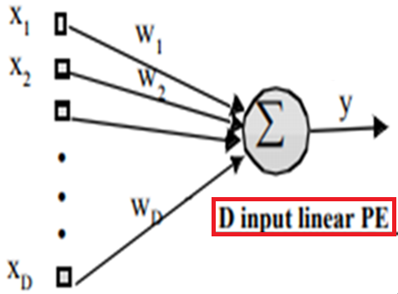
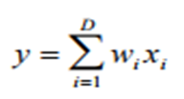
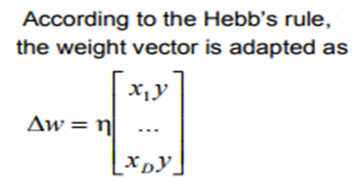
PE=processing element/neuron

Slide 10
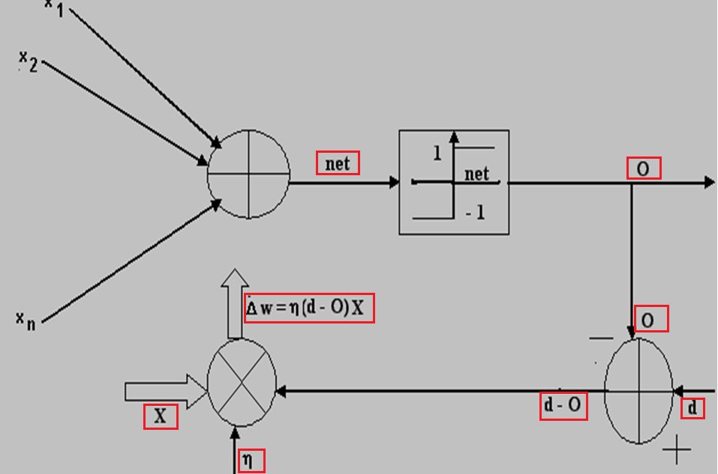
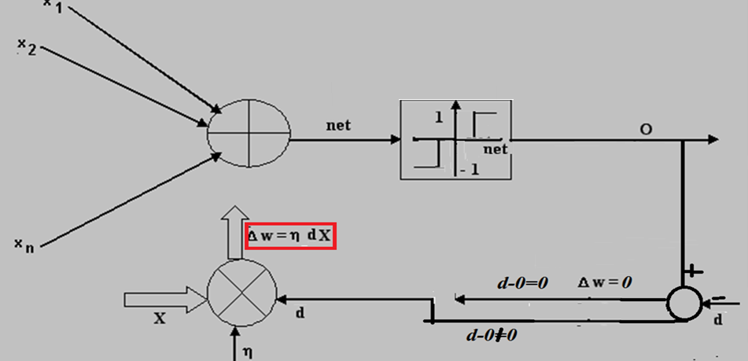

Slide 11
Hebbian Rule is similar to Perceptron rule 2, instead of desired output, actual output.
In Perceptron you apply this rule of weight change when output after applying threshold activation is not equal to target value

Slide 12
Shortcomings of Hebb Rule
If we continued to present the inputs and keep updating the weight ‘w’, then ‘w’ will become arbitrarily large, irrespective of the value of η, .
This is at odds with the biological system that inspired the Hebb rule. There are natural limitations to biological synaptic efficacy (chemical depletion etc).
Hence, Hebbian learning is intrinsically unstable, producing very large positive or negative weights.

Slide 13
Shortcomings of Hebb Rule
If we continued to present the inputs and keep updating the weight ‘w’, then ‘w’ will become arbitrarily large, irrespective of the value of η, .
This is at odds with the biological system that inspired the Hebb rule. There are natural limitations to biological synaptic efficacy (chemical depletion etc).
This is unlike the behavior we observed for backpropragation, where the weights would stabilize for a range of step sizes.
Hence, Hebbian learning is intrinsically unstable, producing very large positive or negative weights.

Slide 14
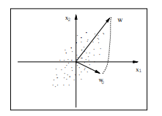
A single neuron trained using the Hebbian rule exhibits an orientation selectivity.
Fig. 6 demonstrates this property. The points depicted in Fig. 6 are drawn from a 2-dimensional Gaussian distribution and used for training a neuron. The weight vector of the neuron is initialized to w0 as shown in the gure. As the learning proceeds, the weight vector move closer and closer to the direction w of maximal variance in the data. In fact, w is the eigenvector of the covariance matrix of the data corresponding to the largest eigenvalue

Slide 15
HEBB RULE WITH DECAY
Rule 1 uses forget factor γ,
if this factor is 0.1, learning rate is 1, then when stimulus is absent new weight is 0.9 , weight decreases by 10%

Slide 16
Rule 2 does not use forget factor explicitly
The squared output y² guarantees that the larger the output of the neuron becomes, the stronger is this balancing effect (more is forgetting)

Slide 17
MAIN APPLICATION OF HEBB IS IN IMPLEMENTING ASSOCIATIVE MEMORIES
Autoassociative
Hetroassociative
BAM( bidirectional associative memory)

Slide 18
Human beings are also able to fully recall a memory by first remembering only particular aspects or features of that memory.
Human memory associates
Similar items,
Contrary/opposite items,
Items close in proximity,
Items close in succession (e.g., in a song)etc.

Slide 19
Pattern Associations
An association is any link between a system’s input and output such that when a pattern A is presented to the system, it will respond with pattern B.
When two patterns are linked by an association, the input pattern is called the stimulus and the output pattern is called the response

Slide 20
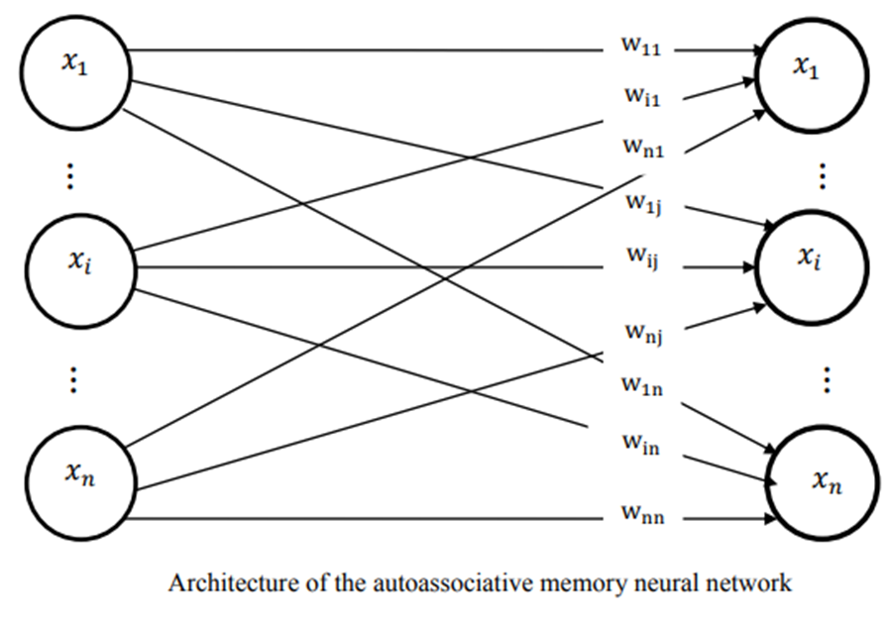

Slide 21
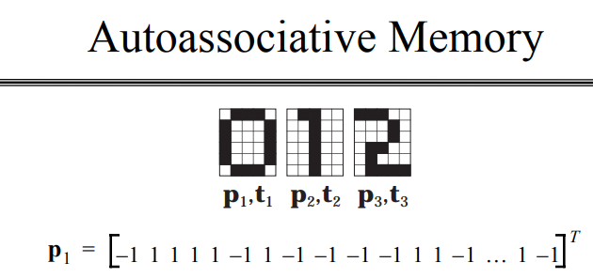
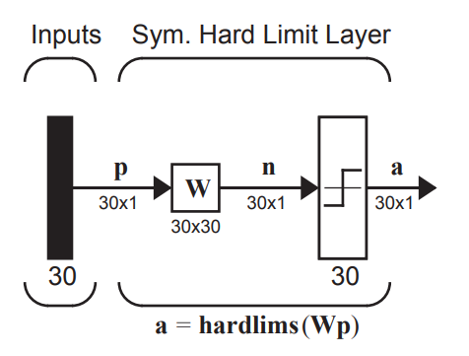


Slide 22
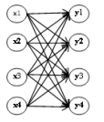
Auto-associative memories are content based memories which can recall a stored sequence when they are presented with a fragment or a noisy version of it. They are very effective in de-noising the input or removing interference from the input
In Hopfield networks with feedback loop, saved patterns will act as attractors. So, with each recursive iteration, more noise is rejected until a noiseless pattern is reconstructed at the output.

Slide 23



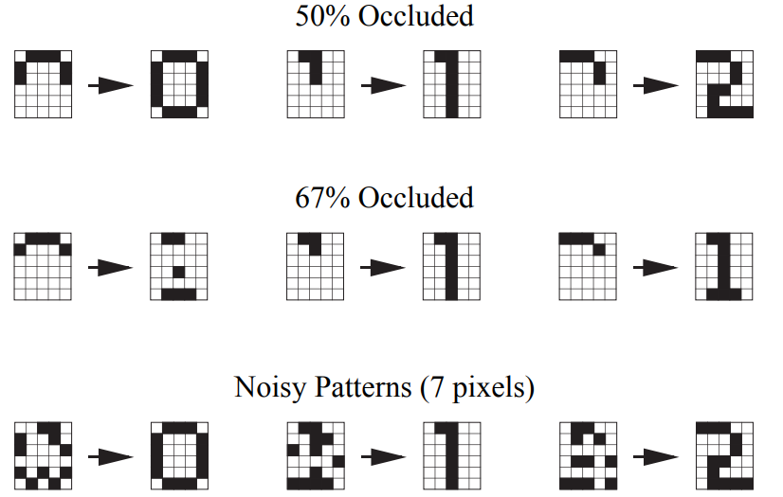

Slide 24
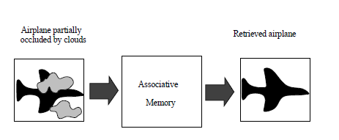

Slide 25
FEEDFOWARD AUTOASSOCIATIVE NET
Performance in general is better for bipolar vectors
In general for auto associative nets the weights on diagonal ( those which would connect an input pattern component to corresponding component in the output pattern) MAY [ not essential as in Hopfield) be set to zero to improve the net's ability to generalize(when more than one vector is stored in it)

Slide 26
Associative network can recognize as ”known “ vectors those vectors which are similar to stored vectors, but differ slightly from it.
Differences could be two forms:
MISTAKES
MISSING data

Slide 27
Bipolar (1/-1) representation of inputs and targets
Missing Data: represented by a 0.
Mistaken Data: +1 is represented as -1 and vice versa.
Binary(0/1) representation of inputs and targets
Missing Data: Cannot be represented.
Mistaken Data: 1 is represented as 0 and vice versa.
In general a net can handle more missing components than mistaken/wrong components.

Slide 28
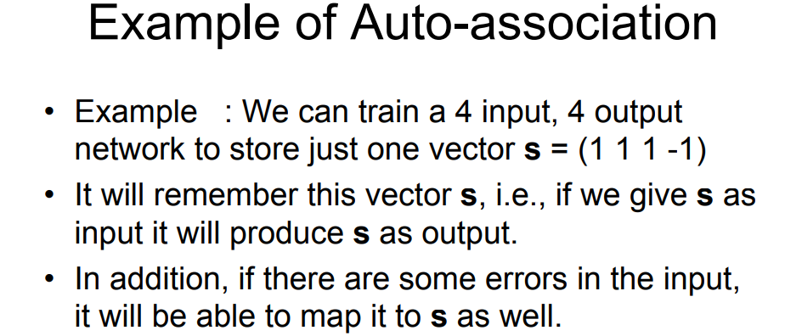
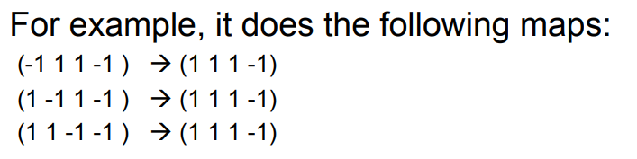

Slide 29
An Associative net to store one vector : recognizing the stored vector
Vector s = ( 1,1,1,-1) is stored with weight matrix
[s^{T}s]
Diagonal elements not forced to zero
Bipolar activation function with threshold as zero

Slide 30
Testing an autoassociative network with one mistake in (1,1,1,-1)
(1,1,1,-1) ➔ (-1,1,1,-1).W=(2,2,2,-2) ➔ (1,1,1,-1)
(1,1,1,-1) ➔ (1,-1,1,-1).W=(2,2,2,-2) ➔ (1,1,1,-1)
(1,1,1,-1) ➔ (1,1,-1,-1).W=(2,2,2,-2) ➔ (1,1,1,-1)
(1,1,1,-1) ➔ (1,1,1,1).W=(2,2,2,-2) ➔ (1,1,1,-1)
RECOGNIZES !!
TESTING AN AUTOASSOCIATIVE NETWORK WITH TWO MISTAKES IN (1,1,1,-1)
(1,1,1,-1) ➔ (-1,-1,1,-1).W=(0,0,0,0) ➔ (1,1,1,1)
Does not recognize

Slide 31
Testing an Autoassociative network with one mistake in (1,1,1,-1)
(1,1,1,-1) ➔ (-1,1,1,-1).W=(2,2,2,-2) ➔ (1,1,1,-1)
(1,1,1,-1) ➔ (1,-1,1,-1).W=(2,2,2,-2) ➔ (1,1,1,-1)
(1,1,1,-1) ➔ (1,1,-1,-1).W=(2,2,2,-2) ➔ (1,1,1,-1)
(1,1,1,-1) ➔ (1,1,1,1).W=(2,2,2,-2) ➔ (1,1,1,-1)
Testing an Autoassociative network with two mistakes in (1,1,1,-1)
(1,1,1,-1) ➔ (-1,-1,1,-1).W=(0,0,0,0) ➔ (1,1,1,1)
Does not recognize

Slide 32
(1,1,1,-1)- Stored Vector
Testing an Autoassociative Network with two “missing“ entries in input vector
(1,1,1,-1) ➔ (0,0,1,-1).W₀ =(2,2,1,-1) ➔ (1,1,1,-1)
(1,1,1,-1) ➔ (0,1,0,-1).W₀=(2,1,2,-1) ➔ (1,1,1,-1)
(1,1,1,-1) ➔ (0,1,1,0).W₀ =(2,1,1,-2) ➔ (1,1,1,-1)
(1,1,1,-1) ➔ (1,0,0,-1).W₀=(1,2,2,-1) ➔ (1,1,1,-1)
(1,1,1,-1) ➔ (1,0,1,0).W₀=(1,2,1,-2) ➔ (1,1,1,-1)
(1,1,1,-1) ➔ (1,1,0,0).W₀=(1,1,2,-2) ➔ (1,1,1,-1)
RECOGNIZES IN ALL CASES

Slide 33
AN AUTOASSOCIATIVE NETWORK WITH NO SELF-CONNECTIONS :ZEROING OUT DIAGONAL OF ORIGINAL W
Testing an Autoassociative network with two mistakes in (1,1,1,-1)
(1,1,1,-1) ➔ (-1,-1,1,-1).W=(0,0,0,0) ➔ (0,0,0,0)
(1,1,1,-1) ➔ (-1,-1,1,-1).W₀=(1,1,1,1) ➔ (1,1,1,1)
Still does not recognize

Slide 34
STORING SEVERAL VECTORS IN AN AUTO-ASSOCIATIVE NETWORK
More than one vector can be stored in an auto-associative net by simply adding the weights needed for each vector.
Theorem: an n x n network is able to store up to n-1 mutually orthogonal (M.O.) bipolar vectors , but not n such vectors.
The requirement of orthogonality places serious limitations on the Hebbian Learning Rule

Slide 35
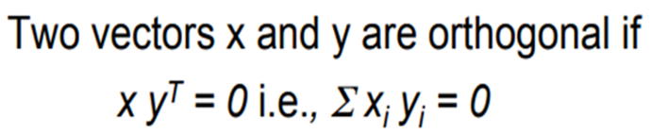
Non-orthogonal vectors cannot be stored in an auto-associative network in reliable manner. They may not always be identified.
More patterns can be stored if they are not similar to each other (e.g., orthogonal)

Slide 36
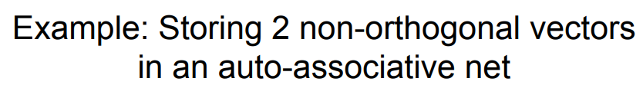
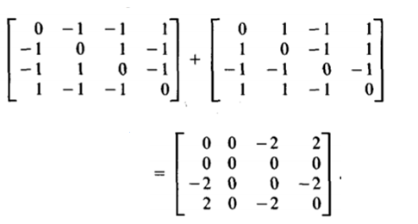
Trying to store two non-orthoganal vectors (1,-1,-1,1) and (1,1,-1,1) gives a weight matrix which cannot distinguish between two vectors

Slide 37
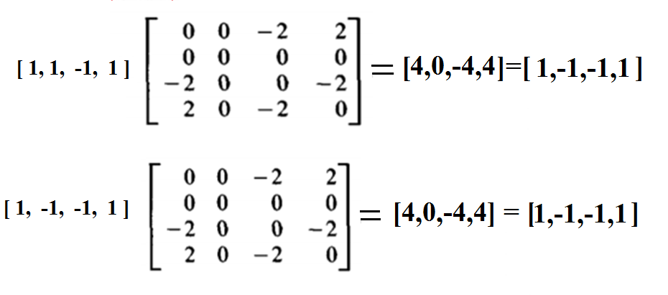
TESTING for two Stored non-orthoganal vectors (1,-1,-1,1) and (1,1,-1,1)
Same result for both, cannot distinguish between the two vectors

Slide 38
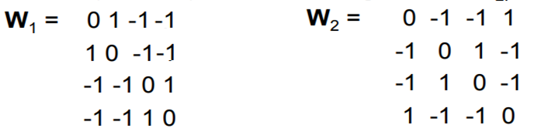
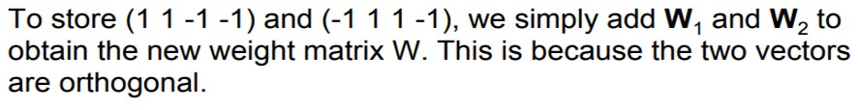
Example : store (1 1 -1 -1) and (-1 1 1 -1) [orthogonal] in an auto-associative net.

Slide 39
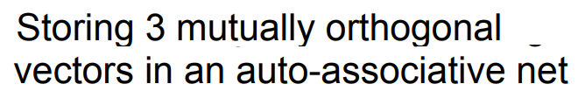

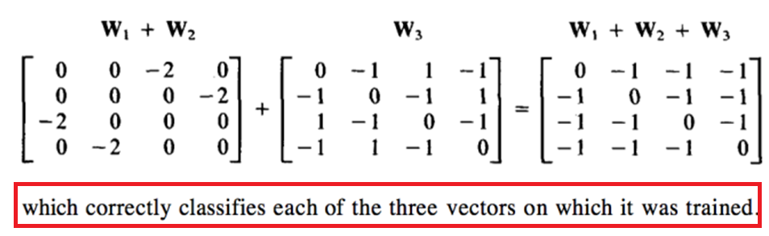
X₃ is orthogonal to both X₁ and X₂

Slide 40
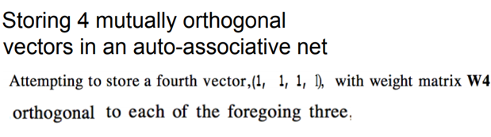
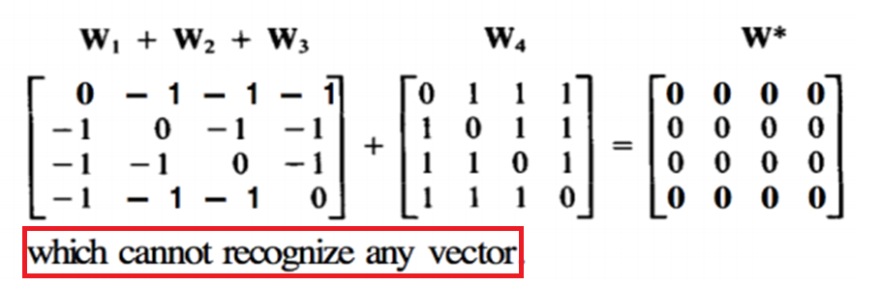

Slide 41
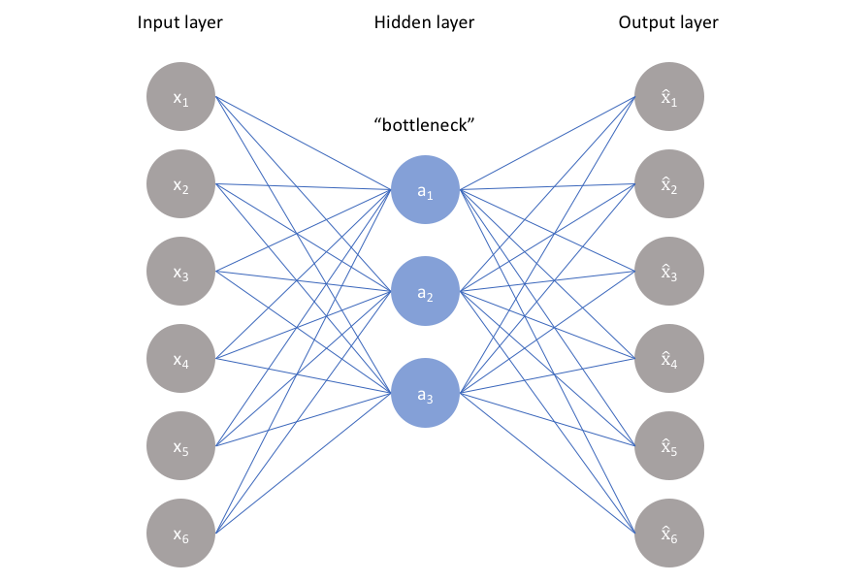
AUTOENCODER

Slide 42
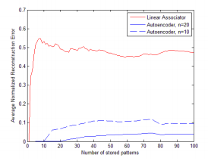
Incorporating nonlinearity into memory can significantly reduce reconstruction error.

Slide 43
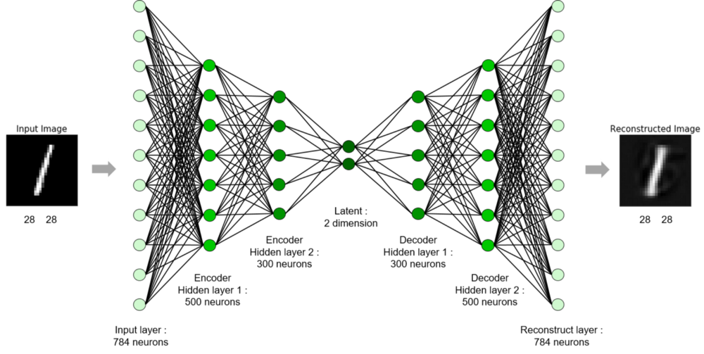

Slide 44
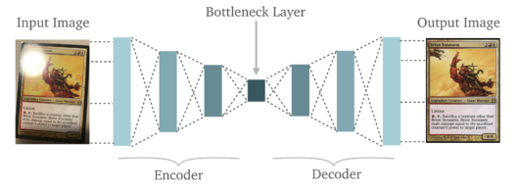
CNN based Autoencoder
That way we can extract from the middle of the network a representation of the input with fewer dimensions.
can use this idea to reproduce the same but a bit different or even better data (training data augmentation, data denoising, etc)

Slide 45
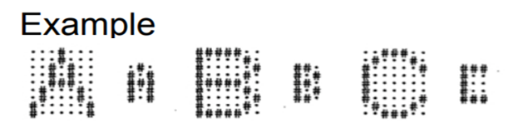
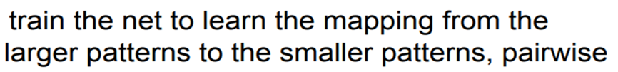
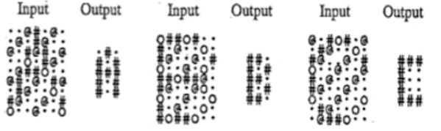
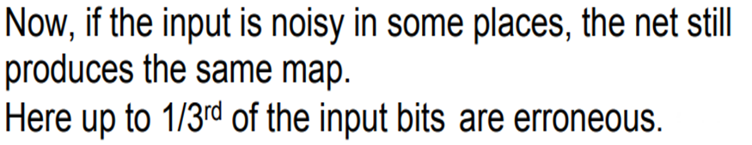

It is an example of Autoassociation/Hetroassociation

Slide 46
Weights are strengthened by desired response for HETRO associative network so it is
SUPERVISED HEBB

Slide 47
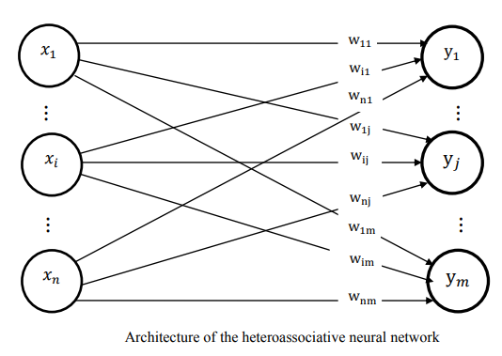

Slide 48
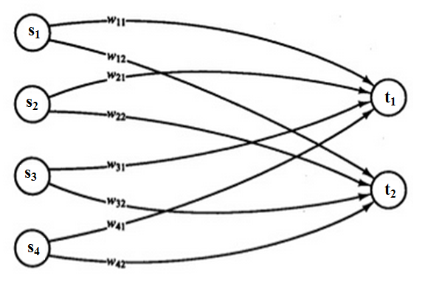
HETRO-ASSOCIATIVE net is to be trained to store the following mappings from input row vectors
s = ( s₁ , s₂, s₃, s₄ ) to output row vectors t = ( t₁ , t₂)
Write Weight matrix relating input output in terms of ws.
How to find weights ?

Slide 49
Two different ways for calculating weight matrix are used:
Iterative Method using Hebb Rule
The outer products.
New input vectors which are similar and not identical to training input vectors are tested.
A new input vector differing from the training input vector in fewer components should produce the reasonable response as the same output vector

Slide 50
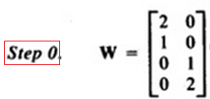
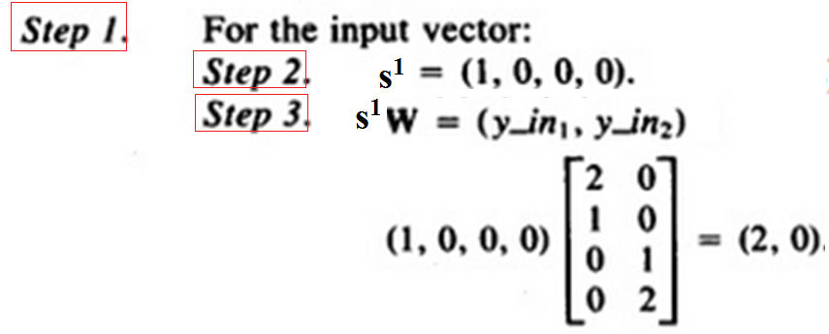
For s¹ =( 1, 0,0,0) t¹ = (1,0) For s² = ( 1, 1,0,0) t² =(1,0)
For s³ = ( 0, 0,0,1) t³ = (0,1) For s⁴ = ( 0, 0,1,1) t⁴ =(0,1)

Slide 51
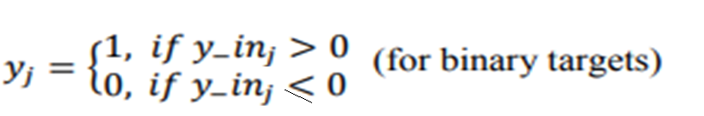
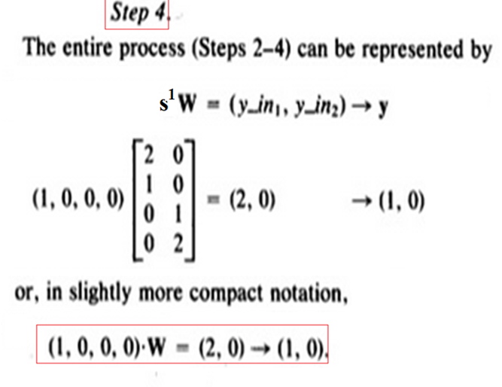

Slide 52
For s¹ =( 1, 0,0,0) t¹ = (1,0) For s² = ( 1, 1,0,0) t² =(1,0)
For s³ = ( 0, 0,0,1) t³ = (0,1) For s⁴ = ( 0, 0,1,1) t⁴ =(0,1)

Slide 53
For s¹ =( 1, 0,0,0) t¹ = (1,0) For s² = ( 1, 1,0,0) t² =(1,0)
For s³ = ( 0, 0,0,1) t³ = (0,1) For s⁴ = ( 0, 0,1,1) t⁴ =(0,1)
Testing a Hetro-associative network with input similar to training input
Test vector x =(0,1,0,0) differs from training vector
s² =(1,1,0,0) in the first component
(0,1,0,0).W = (1,0) -> (1,0)
Thus the net associates a known output pattern with this corrupted input

Slide 54
For s¹ =( 1, 0,0,0) t¹ = (1,0) For s² = ( 1, 1,0,0) t² =(1,0)
For s³ = ( 0, 0,0,1) t³ = (0,1) For s⁴ = ( 0, 0,1,1) t⁴ =(0,1)
Test pattern (0,1,1,0) differs from each of training input patterns in two components
(0,1,1,0).W=(1,1)->(1,1)
Output is not one of the outputs with which net was trained

Slide 55

STORE TWO HETRO-ASSOCIATIONS, A1:B1 AND A2:B2 IN BIPOLAR FORMS
A1 = (1, 0, 1, 0, 1, 0), B1 = (1, 1, 0, 0)
A2 = (1, 1, 1, 0, 0, 0), B2 = (1, 0, 1, 0)
transformed into the bipolar forms FOR WEIGHT MATRIX:
X1 = (1, -1, 1, -1, 1, -1), Y1 = (1, 1, -1, -1)
X2 = (1, 1, 1, -1, -1, -1), Y2 = (1, -1, 1, -1)

Slide 56
To RETRIEVE the FORWARD ASSOCIATION
Multiply A1 = (1, 0, 1, 0, 1, 0) by W to get
(4, 2, -2, -4), Apply threshold -→ (1, 1, 0, 0), which is B1.
Multiply A2 = (1, 1, 1, 0, 0, 0) by W to get
(4, -2, 2, -4), Apply Threshold-→ (1, 0, 1, 0), which is B2.

Slide 57
To find the REVERSE ASSOCIATION,
Multiply B1 = (1, 1, 0, 0) by W^{T} to get
[ 2 -2 2 -2 2 -2 ] ---.>
( 1 0 1 0 1 0)=A1
Multiply B2 = (1, 0,1, 0) by W^{T} to get[ 2 2 2 -2 -2 -2 ] ---.>
( 1 1 1 0 0 0)=A2

Slide 58
END

