Slide 1
Lecture 4

Slide 2
Parallel & Distributed System
Parallel processing improves performance
Approaches for parallel processing
  Pipelining eg. Instruction pipelining
  Multiplicity of components (Multiprocessor Systems)
    Symmetric Multiprocessing
    Asymmetric Multiprocessing
  Multiplicity of Systems
    Cluster
    Grid

Slide 3
Multiprocessor System Offers
  Increased throughput
  Economy
  Increased Reliablity
    Graceful Degradation
    Fault tollerent
Symmetric Multiprocessing :Each processor runs identical copy of OS
Asymmetric multiprocessing: master slave relation exist.
These are tightly coupled systems

Slide 4
Distributed Systems
These systems depend on network for their functionality
  Client Server Systems
  Peer to peer systems
Each processor has its own local memory
Processors communicate with each other through communication links
Loosely coupled Systems

Slide 5
Cluster System
Cluster uses multiple CPUs to accomplish computational work
Provide High availability
Asymmetric Cluster (Hot Standby )
  Hot standby machine monitors the active server
  in case of failure of active server, hot standby becomes active server.
Symmetric

Slide 6
Real Time system
Hard Real time system
Soft Real Time System

Slide 7
Computer-System Structures

Slide 8
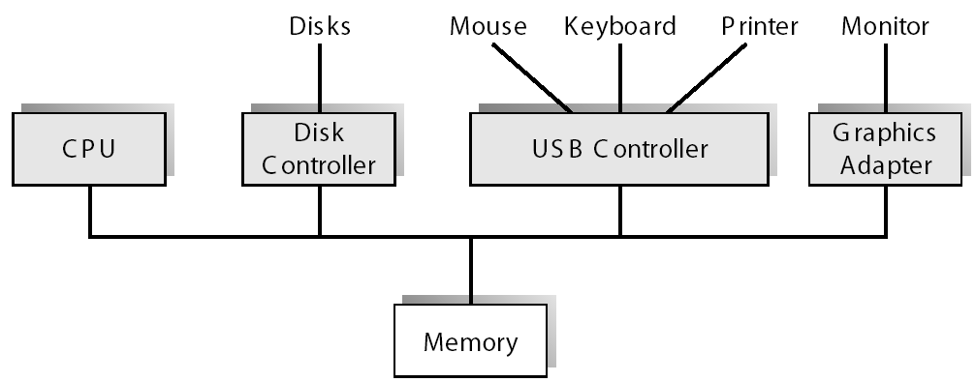
A Modern Computer System

Slide 9
Computer-System Operation
I/O devices and the CPU can execute concurrently
Each device controller is in charge of a particular device type
Each device controller has a local buffer
CPU moves data from/to main memory to/from local buffers
I/O is from the device to local buffer of controller
Device controller informs CPU that it has finished its operation by causing an interrupt

Slide 10
Common Functions of Interrupts
Interrupt transfers control to the interrupt service routine generally, through the interrupt vector, which contains the addresses of all the service routines
Interrupt architecture must save the address of the interrupted instruction
operating system is interrupt driven
IVT
Int 2
v1
v2
isr1
v3
Isr2
vn
Isr n

Slide 11
Interrupt Handling
The operating system preserves the state of the CPU by storing registers and the program counter
Determines which type of interrupt has occurred:
  Non vectored
  vectored interrupt system
Separate kernel routines determine what action should be taken for each type of interrupt

Slide 12
Lecture 5

Slide 13
I/O Structure
Synchronous I/O - After I/O starts, control returns to user program only upon I/O completion
Asynchronous I/O - After I/O starts, control returns to user program without waiting for I/O completion
  Device-status table contains entry for each I/O device indicating its type, address, and state
  Operating system indexes into I/O device table to determine device status and to modify table entry to include interrupt

Slide 14

Device-Status Table

Slide 15
Direct Memory Access Structure
Used for high-speed I/O devices. Able to transmit information at close to memory speeds
Device controller transfers blocks of data from buffer storage directly to main memory without CPU intervention
Only one interrupt is generated per block, rather than the one interrupt per byte

Slide 16
Storage Structure
Main memory – only large storage media that the CPU can access directly
Secondary storage – extension of main memory that provides large nonvolatile storage capacity
Magnetic disks – rigid metal or glass platters covered with magnetic recording material
  Disk surface is logically divided into tracks, which are subdivided into sectors
  The disk controller determines the logical interaction between the device and the computer

Slide 17
Storage Hierarchy
Storage systems organized in hierarchy
  Speed
  Cost
  Volatility
Caching – copying information into faster storage system; main memory can be viewed as a last cache for secondary storage

Slide 18

Storage-Device Hierarchy

Slide 19
Caching
Use of high-speed memory to hold recently-accessed data
Requires a cache management policy
Caching introduces another level in storage hierarchy.
  This requires data that is simultaneously stored in more than one level to be consistent

Slide 20
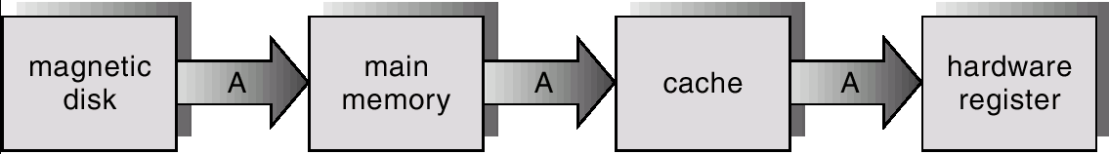
Migration of Integer “A” From Disk to Register

Slide 21
Hardware Protection
Dual-Mode Operation
I/O Protection
Memory Protection
CPU Protection

Slide 22
Dual-Mode Operation
OS must provide hardware support to differentiate between at least two modes of operations
  1. User mode – execution done on behalf of a user
  2. Monitor mode (also kernel mode or system mode) – execution done on behalf of operating system

Slide 23
I/O Protection
All I/O instructions are privileged instructions
Must ensure that a user program could never gain control of the computer in monitor mode (i.e., a user program puts a new address in the interrupt vector table )

Slide 24
Memory Protection
Must provide memory protection at least for the interrupt vector and the interrupt service routines
In order to have memory protection, at a minimum add two registers that determine the range of legal addresses a program may access:
  Base register – holds the smallest legal physical memory address
  Limit register – contains the size of the range
Memory outside the defined range is protected

Slide 25

Use of A Base and Limit Register

Slide 26

Hardware Address Protection

Slide 27
Hardware Protection
When executing in monitor mode, the operating system has unrestricted access to both monitor and user’s memory
The load instructions for the base and limit registers are privileged instructions

Slide 28
CPU Protection
Timer – interrupts computer after specified period to ensure operating system maintains control
  Timer is decremented every clock tick
  When timer reaches the value 0, an interrupt occurs
Timer commonly used to implement time sharing
Time also used to compute the current time
Load-timer is a privileged instruction

Slide 29
General-System Architecture
Given the I/O instructions are privileged, how does the user program perform I/O?
System call – the method used by a process to request action by the operating system
  Usually takes the form of a trap to a specific location in the interrupt vector
  Control passes through the interrupt vector to a service routine in the OS, and the mode bit is set to monitor mode
  The monitor verifies that the parameters are correct and legal, executes the request, and returns control to the instruction following the system call

