Slide 1
Process Management
Prof J P Misra
BITS, Pilani

Slide 2
Program & Process
Program is set of logically arranged instruction to perform a specific task.
Program is written using some kind of language and compiled to produce machine executable code.
Program is passive entity containing list of instruction stored on disk

Slide 3
Process Management
A process is a program in execution. It is a unit of work within the system.
Program is a passive entity, process is an active entity.
Process needs resources to accomplish its task
CPU, memory, I/O, files
Initialization data
Process termination requires reclaim of any reusable resources
Single-threaded process has one program counter specifying location of next instruction to execute
Process executes instructions sequentially, one at a time, until completion
Multi-threaded process has one program counter per thread
Typically system has many processes, some user, some operating system running concurrently on one or more CPUs
Concurrency by multiplexing the CPUs among the processes / threads

Slide 4
Process Management
Needs to be loaded into memory for execution
Processor Sequentially executes the instructions one by one until it encounters a branch instruction
Process is an instance of executing program
Process is characterized by
Its code, Data, stack , Heap and set of register

Slide 5
Process in memory
Max
Stack
Heap
Data
Text
0

Slide 6
Process Management Activities
The operating system is responsible for the following activities in connection with process management
Creating and deleting both user and system processes
Suspending and resuming processes
Providing mechanisms for process synchronization
Providing mechanisms for process communication
Providing mechanisms for deadlock handling

Slide 7
Process creation
Process Is created
When a new job is submitted
When a user attempts to login
to provide a service
Process can be spawned by existing process

Slide 8
How a program/job is executed ?
For executing a job , OS first creates data structure for holding the context of process
Loads the job in memory
At some point of time the scheduler schedules the job and it starts executing.
Dispatcher process dispatches ready to execute process for execution
once executing process terminates,
its time slice expires
Executing process makes I/O request and gets blocked
Dispatcher is a system process

Slide 9
Process & Multiprogramming
In multiprogramming environment, many jobs can be in memory
Jobs in memory are ready to execute
At any point of time one Job would be in running state and other jobs would be in not running state.

Slide 10
Memory Layout
Program Counter
Dispatcher
Process A
Process C
Process B

Slide 11
Execution Of Ready Processes
P1, P2, P3 are user processes
D is Dispatcher Process. It takes constant time to dispatch
D
P1
D
P2
D
P3

Slide 12
Computing system can be considered as assemblage of set of processes.
The processes can be system processes or user processes
At any given time the processes can be in different states.
The system can be modeled with the help of state transition diagram

Slide 13
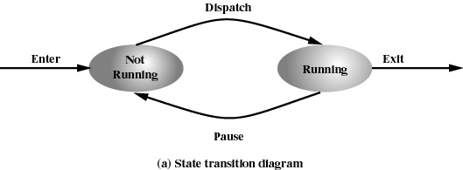
Two State Process Model
Process may in any of the 2 states
Running
Not running

Slide 14
Queuing Diagram
Queue
P0
Exit
Enter
Dispatch
Processor
P3
P2
P1
Pause
Queue May contain ready and blocked processes

Slide 15
State Transition
Not running to running state , transition occurs when
process in running state finishes execution
Makes an I/O request
Time slice for executing process expires
Running to not running state transition occurs when
Running process makes an I/O request
Time slice of executing process expires

Slide 16
Dispatcher
Dispatcher schedules a Ready process to CPU for execution.
In Two State model Not running state contains processes which are :
Ready to run
Blocked
Dispatcher is required to linearly search the queue to find Ready to run process which Increases dispatcher overhead.
Solution : Split not running state into Ready state & Blocked state

Slide 17
Three State Model
Dispatch
Ready
Running
Release
Admit
Time Out
Event Occurs
Event Wait
Blocked

Slide 18
Process States
Running: The process that is currently being executed
Ready: A process that is prepared to execute when given the opportunity
Blocked : A process can not execute until some events occur
Occurrence of event is usually indicated by interrupt signal

Slide 19
Queuing Diagram
Queue
Exit
Enter
Dispatch
Processor
Pause
Blocked Queue

Slide 20
Queuing Diagram
Queue
Exit
Enter
Dispatch
Processor
Pause
Event 1 Queue
Event n Queue

Slide 22
Three State Model
Dispatch
Ready
Running
Release
Admit
Time Out
Event Occurs
Event Wait
Blocked

Slide 23
Five State Model
Dispatch
NEW
Ready
Running
Release
Admit
Exit
Time Out
Event Occurs
Event Wait
Blocked

Slide 24
Why do we need “New” state
Whenever a job is submitted , OS creates data structure for keeping track of the process context and then it tries to load the process. While loading the process
System May not have enough memory to hold the process
To efficiently execute processes, system may put a maximum limit on processes in ready queue

Slide 25
Consider a scenario
All ready processes get blocked on I/O one by one, the system tries to bring in a process from new to ready state and it is found no memory is available to accommodate this process
Q. What do we do ?
Ans. Swapping

Slide 26
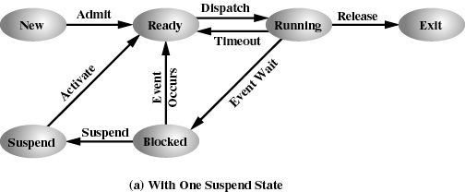
One Suspend State

Slide 27
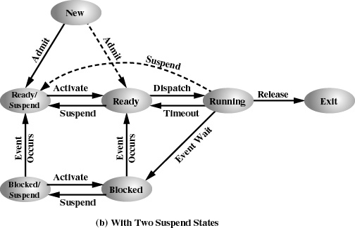
Two Suspend State

Slide 28
State Transitions
Blocked Blocked/suspended:
If Ready queue is empty and insufficient memory is available then one of the blocked process can be swapped out
If currently running process requires more memory

Slide 29
State Transitions
Blocked/ Suspended Ready/suspended
When the event for which process has been waiting occurs
Note
State information concerning to suspended process must be accessible to the OS.
Ready-suspended Ready
If Ready queue is empty
If Process in Ready-suspended state has higher priority than process in Ready state

Slide 30
State Transitions
Ready Ready/Suspend
Normally a blocked process is suspended
Suspend Ready process if it is the only way to free memory
Suspend a lower priority ready process than higher priority blocked process ?
Blocked Suspended Blocked
Running Ready suspended
Various Exit

Slide 31
Seven state process state transition Diagram

Slide 32
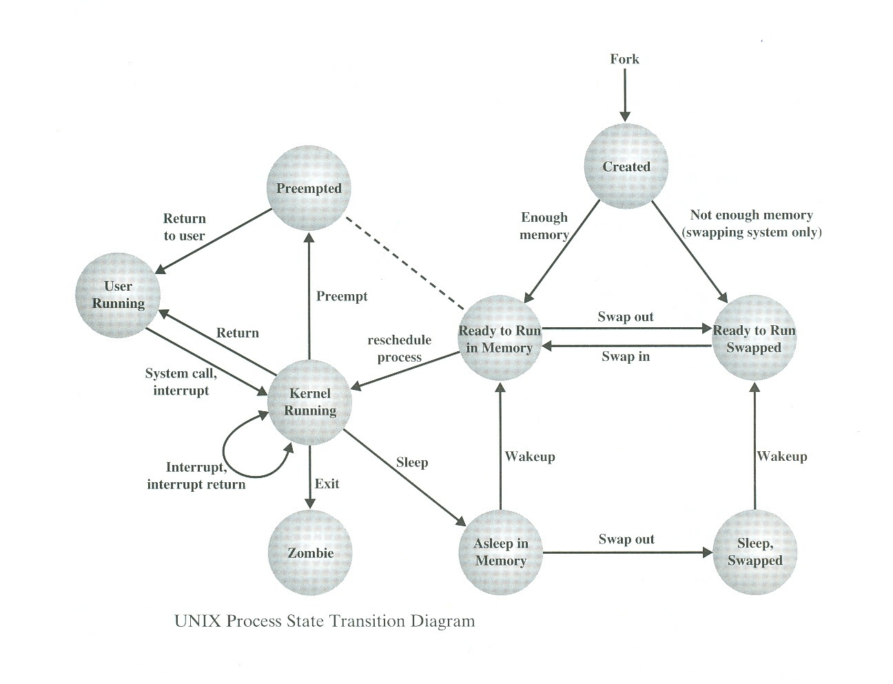
Unix Process State Transition Diagram
8
7
1
3
5
2
9
4
6

Slide 33
Unix System V
Unix uses two categories of process
System Process :
Runs in kernel mode and
performs administrative and house keeping functions such as memory allocation, process swapping, scheduling etc.
User Process :
Runs in user Mode to execute user program and utilities
Runs in kernel mode to execute instructions belonging to kernel
A user process enters in kernel mode
by issuing a system call or
exception / interrupt

Slide 34
Process 0 & Process 1
Process 0 (Swapper Process) is predefined as data structure, loaded at boot time .
Process 0 spawns process 1
Process 1(Init Process) is ancestor of all other processes except process 0

Slide 35
Process Summary
Process is an instance of executing program
In multiprogramming environment number of process can reside in system
At any instance of time processes can be in different state such as ready, Blocked, Running etc. and processes move from one state to another state depending upon certain conditions.
Processes use available system resources
OS is responsible for managing all the processes in the system

Slide 36
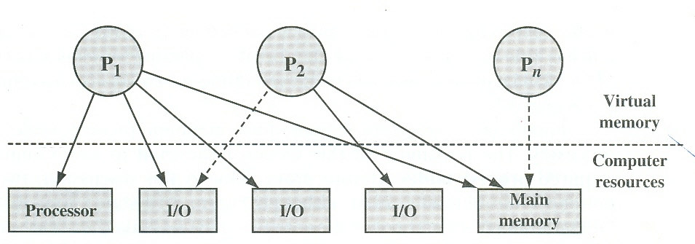
Process & Resource at some instance of time
Process & resource snapshot at some instance of time

Slide 37
OS as Process Manager
OS must have information about
the current state of processes
the current state of Resources in the system
OS must keep track of utilization of resources by processes
OS must constructs tables (control structure) to maintain information about each entity it is managing

Slide 38
OS as Process Manager
To manage processes, OS maintains following tables
Memory Tables
I/O Table
File Table
Process table

Slide 39
Memory Table & I/O Table
Memory Tables keep track
of allocation of main memory to processes
of Allocation of secondary memory to processes
Of protection attributes of main & secondary memory such as which processes can access certain shared memory region
Information needed to manage virtual memory
I/O Table: To keep track of
resource allocation,
resource availability
I/O request

Slide 40
File Table & Process Table
File Table
Provide information about
Existence of file
Location on secondary memory
Current status and attributes of file
Process table
keep track of processes

Slide 41
Operating Systems Control table
Process1
I/O Table
I/O devices
File
File Table
Processes
Memory
Process 1
Process 2
Process N
Process 3
Memory Table
Process n
Primary process Table

Slide 42
Process Image
Process image consists of
User Data
User program
System Stack
Process control block
Containing processes attributes

Slide 43
Process Management
To manage/control a process OS must know
Where process is located
Attributes of processes eg. Process id, state etc.
Collection of attributes are held in Process control block

Slide 44
Process Attributes
Process identification
Processor State Information
Processes control information

Slide 45
Process Identification
Identifier of the process
Identifier of the process that created this process
User identifier

Slide 46
Processor State Information
User Visible registers
Control and status registers
Program counter
Flags
Status register
Stack pointer

Slide 47
Processes Control Information
Scheduling and state information
Inter process communication
Process privileges
Memory management
Resource ownership & utilization

Slide 48
Functions of OS kernel
Process Management
Process creation & termination
Process scheduling & dispatching
Process switching
Process synchronization & support for IPC
Management of process control block
Memory Management
Allocation of address space to process
Swapping
Page & segment management

Slide 49
Functions of OS kernel Cont…
I/O Management
Buffer management
Allocation of I/O channels & devices to processes
Support Services
Interrupt handling
Accounting
monitoring

Slide 50
Thank you

