Slide 1
Lecture 2

Slide 2
What we have learnt
What is system
OS definition and its goals
System components :processors, memory, storage , I/O subsystems, busses , files & network
Abstract view of computing systems
Operating system as a resource manager

Slide 3
User View of OS
Provides ease of operation
Supports resource sharing
  Sequential sharing : A resource is allocated for exclusive use of program eg. CPU
  Concurrent sharing: Two or more program concurrently use same resource eg. Files, memory, disk array etc.
Systems View of OS
OS acts as Resource allocator and is responsible for handling resource request, resource allocation and optimal utilization of system resources.
Acts as control program that manages the execution of user program and prevents error and improper use of computer system.

Slide 4
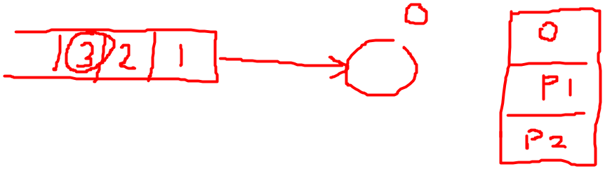
What OS Does?
Maintain a list of authorized users
Construct list of all resources in the system
Initiate execution of programs
Maintain resource usage information by programs and current status of programs
Maintain current status of all resources and allocate resources to programs when requested
Perform scheduling
Maintain information for protection

Slide 5

Goals Of Operating System
Provide user interface for ease of operation
  Command line interface (CLI) eg. Unix, DOS
  Graphical User Interface (GUI) eg. Windows
Efficient use of hardware & software resources (system)
Maximize System performance
Protection and access control
Ability to evolve and offer new services
Footprint of OS should be small !!!

Slide 6
Can we measure System Efficiency, Performance and user convenience ?
Efficiency---- CPU efficiency
System performance ----- Throughput
User services ---- Turn around time , Response time

Slide 7
Operating System and Computer Architecture are tightly bonded together.
Change in architecture usually leads to change in OS.
The requirements of OS have led to several architectural changes.

Slide 8
Different Computer Systems

Slide 9
Mainframe Systems
Are large systems
Are very expensive
Early mainframes were Batch Systems
They used punched cards and tape for data and code input
They used printer for results and error reporting
Notes:
Historically mainframes were first computer used for scientific and commercial applications. These were enormously large machine and were very expensive.

Slide 10
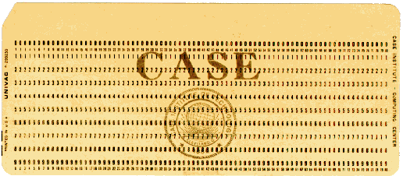
Punched Card( Hollerith's card)

Slide 11
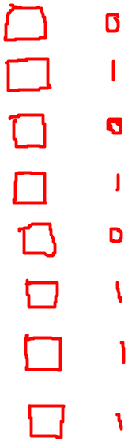
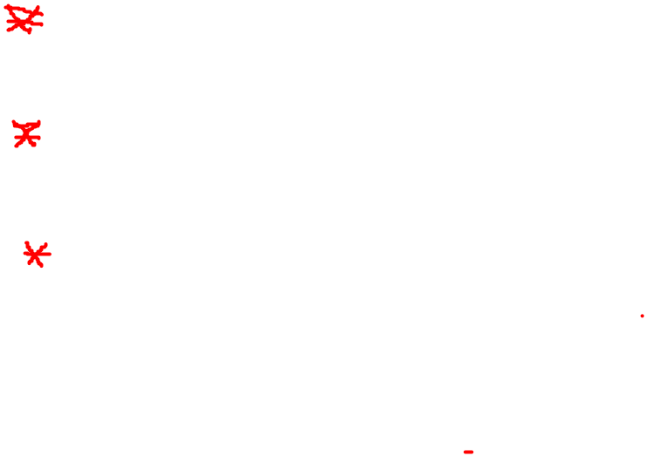

Slide 12
Mainframe Systems
Reduce setup time by batching similar jobs
Automatic job sequencing – automatically transfers control from one job to another. First rudimentary operating system.
Resident monitor
  initial control in monitor
  control transfers to job
  when job completes control transfers back to monitor

Slide 13
Batch Systems
Users submits job
Operator forms a batch by bunching user jobs
Loads job into the card reader
Computer executes these jobs sequentially and produces results on printer
Printed output is collected by operator and distributed to users.

Slide 14
Characteristics of Batch System
Once a job starts executing , until finished no other job can execute
Low CPU utilization because when program is reading data or producing output CPU is idle
No user interaction
Batch systems are appropriate for executing large jobs that require little interaction
Card Reader
Computer
Printer

Slide 15


Batch system Memory Layout

Slide 16
Main task of the Batch processing OS was to transfer control from one job to another.
  Problems
  How does the monitor know about the nature of the job (e.g., Fortran versus Assembly) How does the monitor distinguish
  (a)one job from other job?
  (b) data from program?
  Solution
  Job Control Language

Slide 17

Turn around time in batch system
Result
printing
Batch
execution
t0
t1
t2
t3
t4
t5
t6
j1
j2
jn
Job
submitted
Batch
formed
Printout
To user
Turn around time
Throughput = (t6-t0)/n

Slide 18
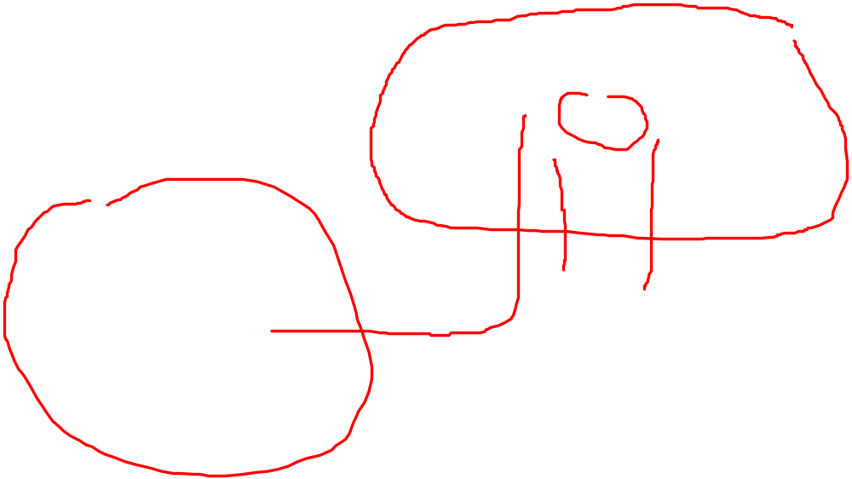
Batch system with spooling
Disk
Card Reader
Computer
Printer

Slide 19

Every executing program usually will have CPU Burst then I/O followed by CPU Burst and so on. The last burst is always CPU Burst and then program terminates
c1 io1 c2 io2 c3-------- cn
Problems of mainframe
Early days Mainframes were inefficient as execution and I/O was done sequentially
AS I/O devices are much slower than CPU execution , CPU utilization was poor
Solution
Perform execution and I/O in concurrent manner
Multiprogramming & Time sharing

Slide 20
Multiprogramming
In this environment, multiple programs are kept in memory and one program is executed at a time. When a program terminates or goes for I/O resources, another program starts executing
Multiprogramming improves CPU utilization
Improves throughput

Slide 21

Memory Layout for multiprogramming

Slide 22
OS Features Needed for Multiprogramming
Memory management – the system must allocate the memory to several jobs.
CPU scheduling – the system must choose amongst several jobs ready to run.
Allocation of devices.

Slide 23
Time sharing
A time unit is divided into small slice and each user can be allocated CPU in round robin manner
A time shared OS allows many users to share the computer simultaneously
Time shared OS uses multiprogramming and CPU scheduling to provide each user with a small portion of time shared computer
Time sharing machine with Interactive I/O devices improves user response time
Gives illusion that each user has his own machine

Slide 24
Requirements of time shared system
Needs to keep track of time
Requires Dynamic Resource allocation
  To mange memory processes can be swapped out requiring backing store
Dynamic resource allocation requires elaborate and complicated resource management and access control technique

Slide 25
Problems with early systems and change drivers
High cost of resources
  This necessitated concept of resource sharing and eventually led to the development of computer network
  Technological development and IC fabrication has been main driver for development of low cost computers and variety of peripheral devices
  Applications are main drivers for development of faster processor and computing system

Slide 26
Desktop systems
Provided interaction
Main concern is response time
Since it serves single user, optimal resource utilization and protection are not a major concern
Present day PCs support time sharing , multiprogramming and are network enabled

Slide 27
Parallel & Distributed System
Parallel processing improves performance
Approaches for parallel processing
  Pipelining eg. Instruction pipelining
  Multiplicity of components (Multiprocessor Systems)
    Symmetric Multiprocessing
    Asymmetric Multiprocessing
  Multiplicity of Systems
    Cluster
    Grid

Slide 28
Multiprocessor System Offers
  Increased throughput
  Economy
  Increased Reliablity
    Graceful Degradation
    Fault tollerent
Symmetric Multiprocessing :Each processor runs identical copy of OS
Asymmetric multiprocessing: master slave relation exist.
These are tightly coupled systems

Slide 29
Distributed Systems
These systems depend on network for their functionality
  Client Server Systems
  Peer to peer systems
Each processor has its own local memory
Processors communicate with each other through communication links
Loosely coupled Systems

Slide 30
Cluster System
Cluster uses multiple CPUs to accomplish computational work
Provide High availability
Asymmetric Cluster (Hot Standby )
  Hot standby machine monitors the active server and in case of failure of active server, hot standby becomes active server.
Symmetric

Slide 31
Real Time system
Hard Real time system
Soft Real Time System

