Slide 1
Scheduling

Slide 2
Scheduling
Processes in different state maintain Queue.
The different queues are maintained for different purpose eg.
Ready Queue : Processes waiting for CPU
Blocked : processes waiting for I/O to complete
Transition form a state where queue is maintained to next state involves decision making such as
When to move process from one state to another
Which process to move
When transitions occur, OS may be required to carry out some house keeping activity such as context switch, Mode switch etc. These activities are considered as overhead and must be carried out in efficient manner

Slide 3
What is scheduling ?
Scheduling is matter of managing queues to minimize queuing delay and to optimize performance in queuing environment
Scheduling affects the performance of the system because it determines which process will wait and which will progress

Slide 4
Types of Scheduling( Based on frequency of invocation of scheduler)
Long term scheduling: Decision to add to the pool of processes to be executed
Mid term: The decision to add to the number of processes that are partially or fully in main memory
Short Term : Which process will execute on processor
I/O scheduling : Which process’s pending I/O request is handled by an available I/O device.

Slide 5
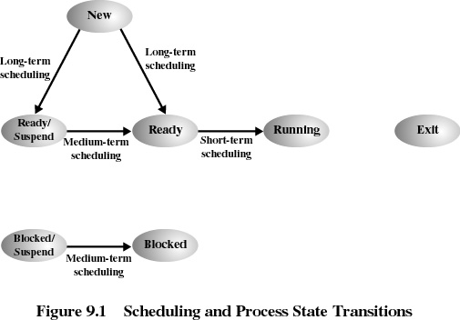

Slide 6
Long-Term Scheduling
Determines which programs are admitted to the system for processing
Controls the degree of multiprogramming
More processes, smaller percentage of time each process is executed
2 decisions involved in Long term Scheduling
OS can take one or more additional processes
Which job or jobs to accept and turn into processes.

Slide 7
Medium-Term Scheduling
Part of the swapping function
Based on the need to manage the degree of multiprogramming

Slide 8
Short-Term Scheduling
Known as the dispatcher
Executes most frequently
Invoked when an event occurs
Clock interrupts
I/O interrupts
Operating system calls
Signals

Slide 9
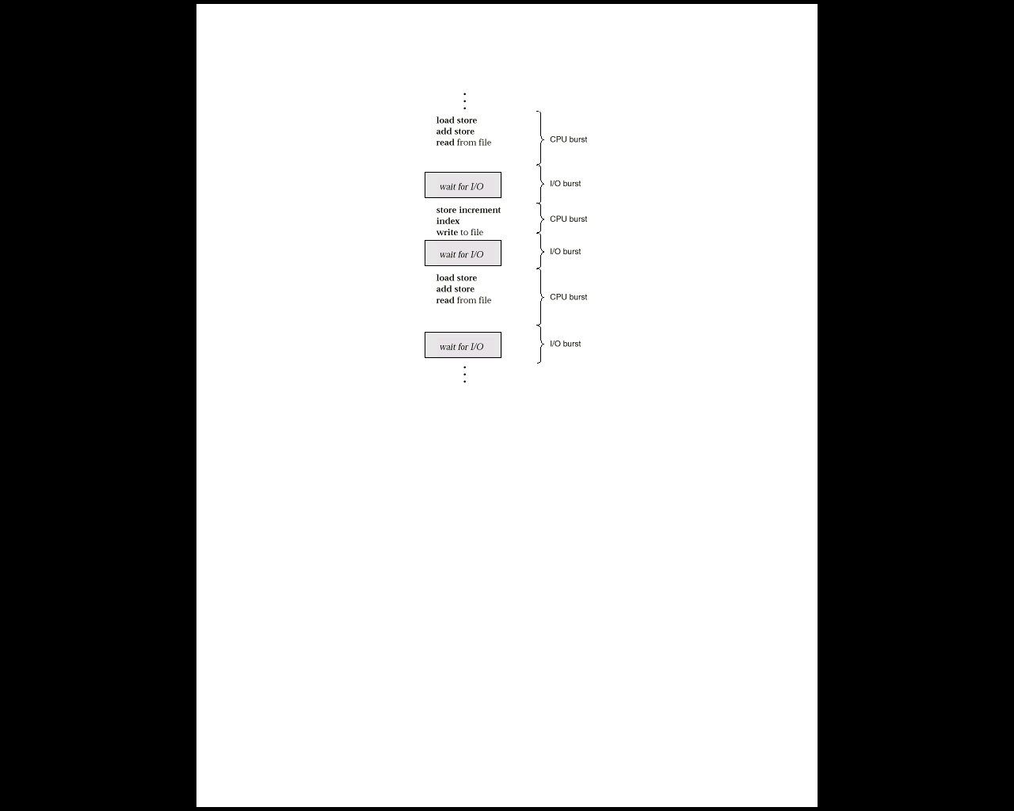
CPU Scheduling
Maximize CPU utilization with multi programming.
CPU–I/O Burst Cycle – Process execution consists of a cycle of CPU execution and I/O wait.

Slide 10
Processes Can be
CPU Bound : Processes spend bulk of its time executing on processor and do very little I/O
I/O Bound : Process spend very little time executing on processor and do lot of I/O operation
Mix of processes in the system can not be predicted

Slide 11
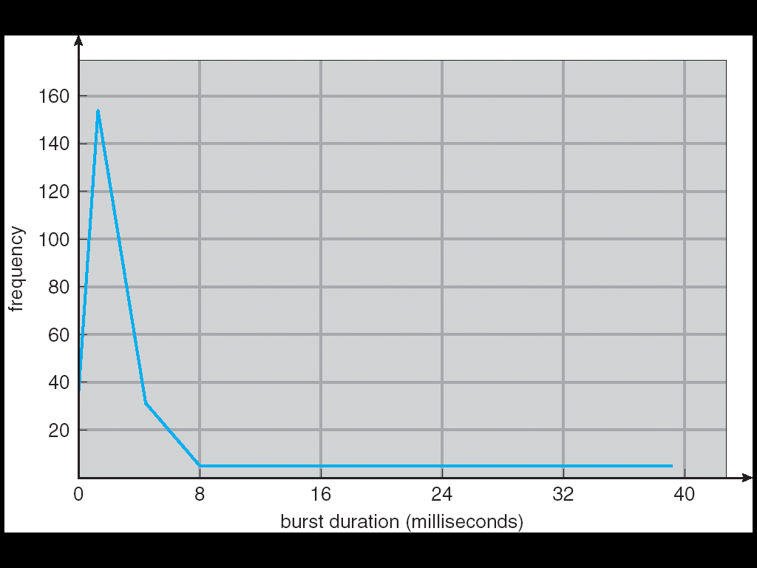
Assumption: CPU Bursts
Weighted toward small bursts

Slide 12
CPU Scheduler
Selects
the processes in memory that are ready to execute
allocates the CPU to one of them.
CPU scheduling decisions may take place when a process:
1. Switches from running to waiting state.
2. Switches from running to ready state.
3. Switches from waiting to ready.
4. Terminates.
Scheduling under 1 and 4 is non preemptive.
All other scheduling is preemptive.

Slide 13
Dispatcher
Dispatcher module gives control of the CPU to the process selected by the short-term scheduler; this involves:
switching context
switching to user mode
jumping to the proper location in the user program to restart that program
Dispatch latency – time it takes for the dispatcher to stop one process and start another running

Slide 14
Performance Measures
CPU utilization – keep the CPU as busy as possible. CPU utilization vary from 0 to 100. In real systems
it varies from 40 (lightly loaded) to 90 (heavily loaded)
Throughput – Number of processes that complete their execution per time unit.
Turnaround time – amount of time to execute a particular process (interval from time of submission to time of completion of process).
Waiting time – amount of time a process has been waiting in the ready queue (sum of the periods spend waiting in the ready queue).

Slide 15
Performance Measures
Response time – amount of time it takes from when a request was submitted until the first response is produced (not output ).
Optimization criteria
Max CPU utilization, Max throughput, Min turnaround time, Min waiting time, Min response time
Fairness
Balancing resources
Predictability

Slide 16
Scheduling Assumptions
Many implicit assumptions for CPU scheduling:
One program per user
One thread per program
Programs are independent
Clearly, these are unrealistic but they simplify the problem so it can be solved
For instance: is “fair” about fairness among users or programs?
If I run one compilation job and you run five, you get five times as much CPU on many operating systems

Slide 17
Scheduling Algorithms
First – Come, First – Served Scheduling (Run until done )
Example: Process Burst Time
P1 24
P2 3
P3 3
Suppose that the processes arrive in the order: P1 , P2 , P3 The Gantt Chart for the schedule is:
Waiting time for P1 = 0; P2 = 24; P3 = 27
Average waiting time: (0 + 24 + 27)/3 = 17
P₁
P₂
P₃
0
24
27
30

Slide 18
Turn around time:
P1=24 P2=27 P3=30
Normalized turn around time : is turn around time divided by CPU burst.
P1=24/24=1 P2 = 27/3 =9 P3=30/3=10

Slide 19
Suppose that the processes arrive in the order
P₂ , P₃ , P₁ .
The Gantt chart for the schedule is:
0 3 6 30
Waiting time for P₁ = 6; P₂ = 0; P₃ = 3
Average waiting time: (6 + 0 + 3)/3 = 3
Much better than previous case.
Convoy effect short process behind long process
Favors CPU bound processes
P2 | P3 | P1

Slide 20
FCFS scheduling
In early systems, FCFS meant one program scheduled until done (including I/O)
Now, means keep CPU until thread blocks

Slide 21
FCFS scheduling
FCFS is non preemptive : once the CPU has been allocated to a process, the process keeps the CPU till it finishes or it requests the I/O
It is not suited for time sharing system
Average wait time is not minimal as it depends on arrival and CPU burst of arriving processes

Slide 22
Shortest-Job-First (SJF) Scheduling
Associate with each process the length of its next CPU burst. Use these lengths to schedule the process with the shortest time.
Two schemes:
Non preemptive (SPN) – once CPU given to the process it cannot be preempted until completes its CPU burst.
Preemptive – if a new process arrives with CPU burst length, less than remaining time of current executing process, preempt. This scheme is know as the Shortest-Remaining-Time-First (SRTF).
SJF is optimal – gives minimum average waiting time for a given set of processes.
Optimal average response time

Slide 23
Process Arrival Time Burst Time
P₁ 0.0 7
P₂ 2.0 4
P₃ 4.0 1
P₄ 5.0 4
SJF (non-preemptive)
0 7 8 12 16
Average waiting time = (0 + 6 + 3 + 7)/4 = 4
P1 | P3 | P2 | P4

Slide 24
Process Arrival Time Burst Time
P₁ 0.0 7
P₂ 2.0 4
P₃ 4.0 1
P₄ 5.0 4
SJF (preemptive)
0 2 4 5 7 11 16
Average waiting time = (9 + 1 + 0 +2)/4 = 3
P1 | P2 | P3 | P2 | P4 | P1

Slide 25
Predicting the Length of the Next CPU Burst
Adaptive: Changing policy based on past behavior
Works because programs have predictable behavior
If program was I/O bound in past, likely in future
If computer behavior were random, it will not help
Example: SJF with estimated burst length
Use an estimator function on previous bursts: Let t_{n-1}, t_{n-2}, t_{n-3}, etc. be previous CPU burst lengths.
Estimate next burst τ_{n} = f(t_{n-1}, t_{n-2}, t_{n-3}, …)
Function f could be one of many different time series estimation schemes (Kalman filters, exponential average etc.)

Slide 26
Determining Length of Next CPU Burst
Can be done by using the length of previous CPU bursts, using exponential averaging.
α =0
τ_{n+1} = τ_{n,} Recent history does not count.
α =1
τ_{n+1} = t_{n} Only the actual last CPU burst counts.
If we expand the formula, we get:
τ_{n+1} = α t_{n}+(1 - α) α t_{n} ₋₁ + …
+(1 - α )^{j} α t_{n} _{-j} + …
+(1 - α )^{n+1} τ₀
Since both α and (1 - α) are less than or equal to 1, each successive term has less weight than its predecessor.

Slide 27
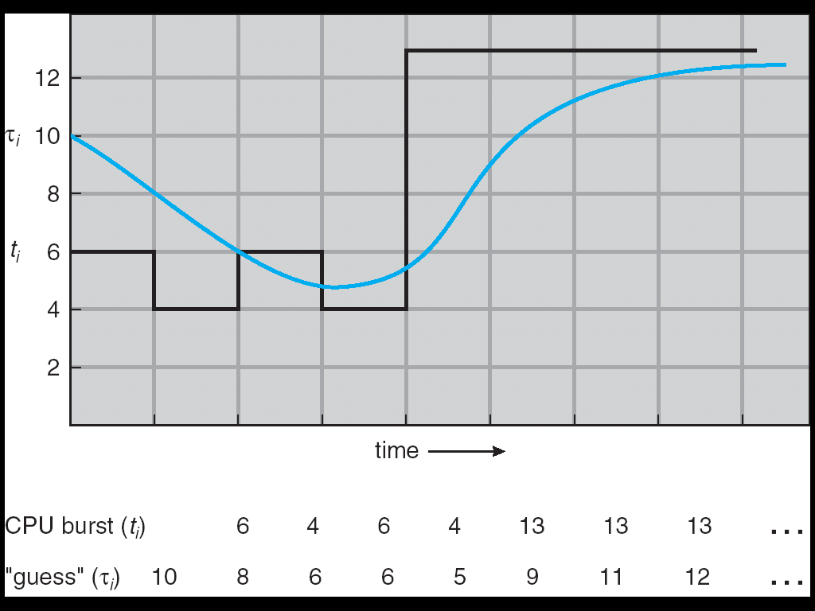

Slide 28
Priority Scheduling
A priority number (integer) is associated with each process
The CPU is allocated to the process with the highest priority (smallest integer ≡ highest priority).
Preemptive
Non preemptive
SJF is a priority scheduling where priority is the predicted next CPU burst time.
Problem ≡ Starvation – low priority processes may never execute.
Solution ≡ Aging – as time progresses increase the priority of the process.

Slide 29
Round Robin (RR)
Each process gets a small unit of CPU time (time quantum), usually 10-100 milliseconds. After this time has elapsed, the process is preempted and added to the end of the ready queue.
If there are n processes in the ready queue
Time quantum is q
each process gets 1/n of the CPU time in chunks of at most q time units at once.
No process waits more than (n-1)q time units.
Performance
q large ⇒ FIFO
q small ⇒ q must be large with respect to context switch, otherwise overhead is too high.

Slide 30
Process Burst Time
P₁ 53
P₂ 8
P₃ 68
P₄ 24
The Gantt chart is: Q=20
0 20 28 48 68 88 108 112 125 145 153
Typically, higher average turnaround than SJF, but better response.
P1 | P2 | P3 | P4 | P1 | P3 | P4 | P1 | P3 | P3

Slide 31
Example of RR with Time Quantum = 20
Example: Process Burst Time P₁ 53 P₂ 8 P₃ 68 P₄ 24
The Gantt chart is:
Waiting time for P₁=(68-20)+(112-88)=72 P₂=(20-0)=20 P₃=(28-0)+(88-48)+(125-108)=85 P₄=(48-0)+(108-68)=88
Average waiting time = (72+20+85+88)/4=66¼
Average completion time = (125+28+153+112)/4 = 104½
Thus, Round-Robin Pros and Cons:
Better for short jobs, Fair (+)
Context-switching time adds up for long jobs (-)
P₁
P₂
P₃
P₄
P₁
P₃
P₄
P₁
P₃
P₃
0
20
28
48
68
88
108
112
125
145
153

Slide 32
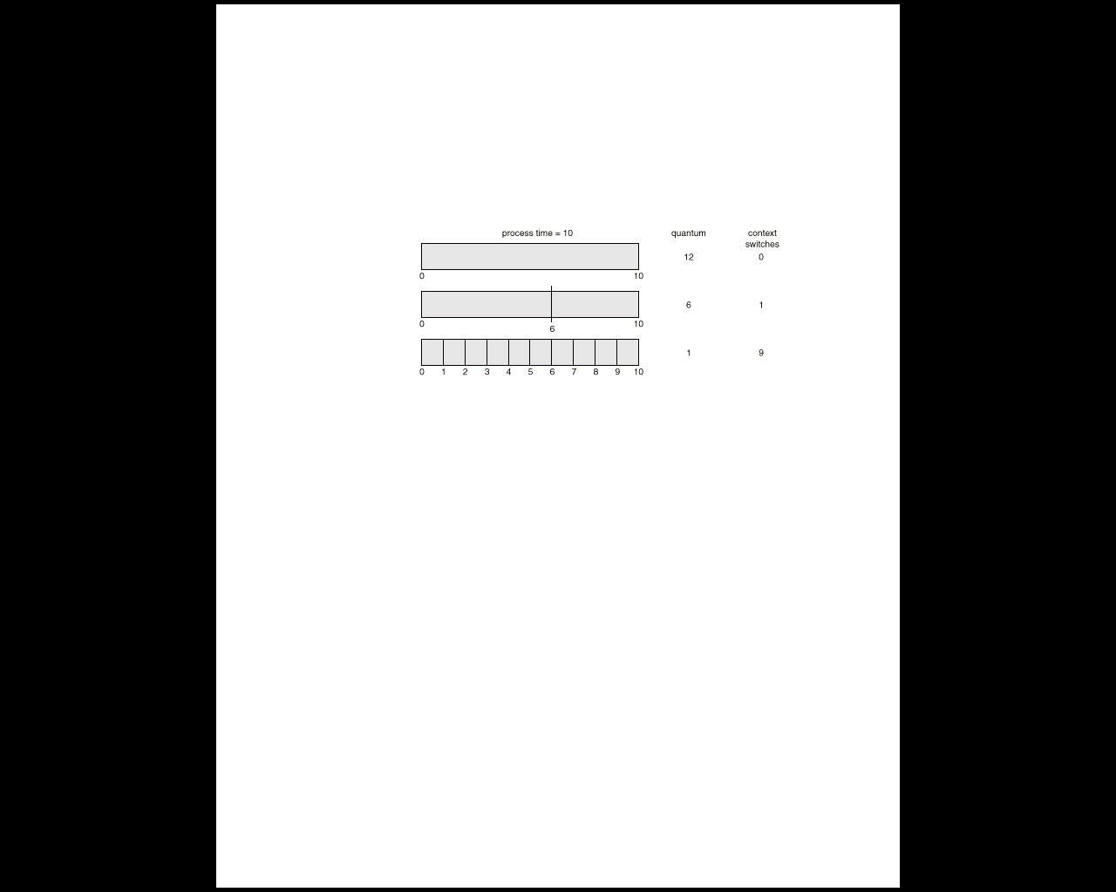
How a Smaller Time Quantum Increases Context Switches

Slide 33
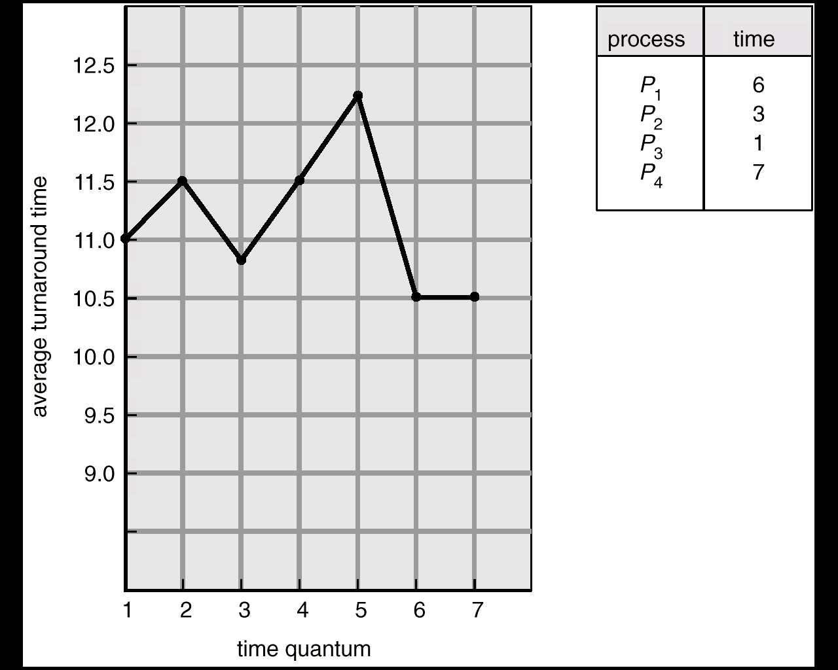
Turnaround Time Varies With The Time Quantum

Slide 34
RR Contd….
In practice, need to balance short-job performance and long-job throughput:
Typical context-switching overhead is 0.1ms – 1ms
Roughly 1% overhead due to context-switching

Slide 35
Round Robin: Issues
Favors CPU-bound processes
An I/O bound process will use CPU for a time less than the time quantum and gets blocked for I/O
A CPU-bound process run for all its complete time slice and is put back into the ready queue (thus getting in front of blocked processes)
A solution: virtual round robin
When a I/O has completed, the blocked process is moved to an auxiliary queue which gets preference over the main ready queue
A process dispatched from the auxiliary queue runs no longer than the basic time quantum minus the time spent running since it was selected from the ready queue

Slide 36
Highest Response Ratio Next
Uses normalized turn around time which is the ratio of turn around time to actual service time. For each individual process we would like to minimize the ratio.
Choose next process with the greatest value of Response ratio.where Response ratio is defined as
Response Ratio= (time spent waiting + expected
service time) / expected service time
This method accounts for the age of the process and the shorter jobs are favored.

Slide 37
Multilevel Queue
It partitions ready queue into several separate queues
Simple example: Ready queue is partitioned into separate queues based on differing response time need of process foreground (interactive)& background (batch)
Each queue has its own scheduling algorithm, foreground – RR background – FCFS
Scheduling must be done between the queues( alternatives)
Each Queue has absolute priority (starvation)
Time slice among the queues e.g. 80% to foreground in RR & 20% to background Job

Slide 38
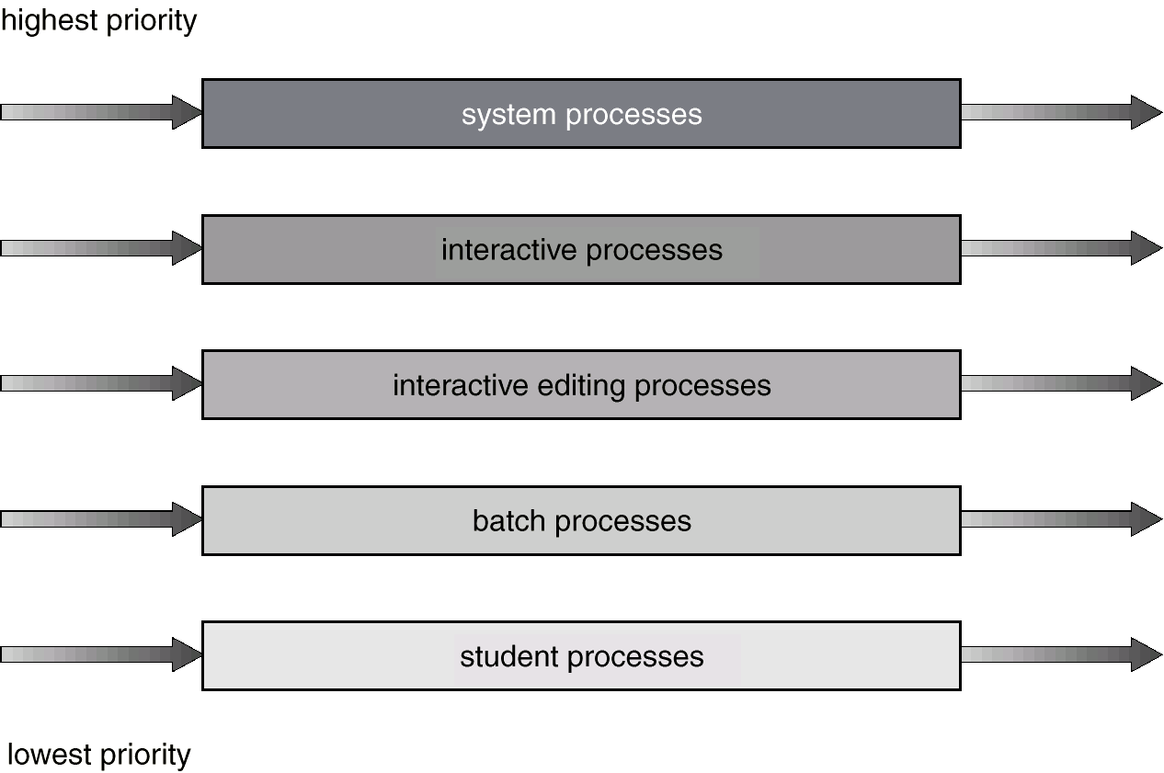

Slide 39
Multilevel Queue
The processes are permanently assigned to one queue
The processes from one queue donot move to another queue
This has advantage of low scheduling overhead but is Inflexible

Slide 40
Multilevel Feedback Queue
A process can move between the various queues; aging can be implemented this way.
Multilevel-feedback-queue scheduler defined by the following parameters:
number of queues
scheduling algorithms for each queue
method used to determine when to upgrade a process
method used to determine when to demote a process
method used to determine which queue a process will enter when that process needs service
Three queues:
Q₀ – time quantum 8 milliseconds Q₁ – time quantum 16 milliseconds Q₂ – FCFS
Scheduling
A new job enters queue Q₀ which is served FCFS. When it gains CPU, job receives 8 milliseconds. If it does not finish in 8 milliseconds, job is moved to queue Q₁.
At Q₁ job is again served and receives 16 additional milliseconds. If it still does not complete, it is preempted and moved to queue Q₂.

Slide 41
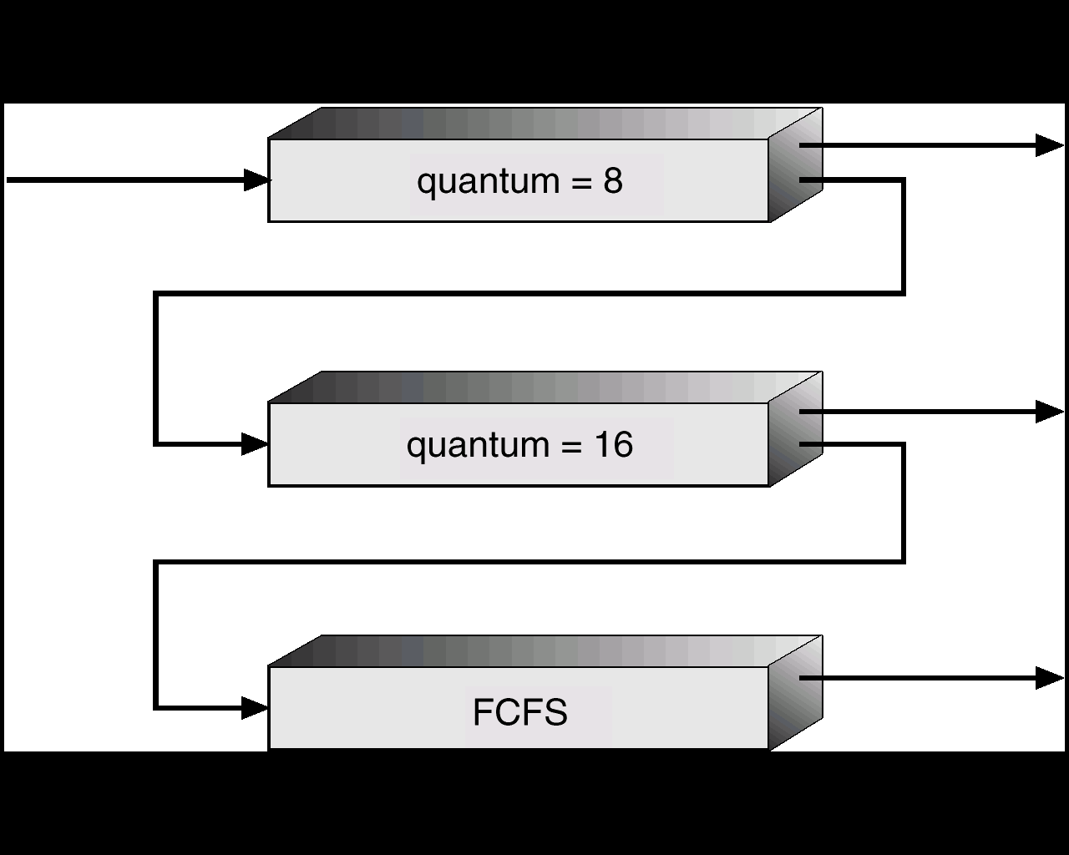

Slide 42
Fair-share Scheduling
Fairness ?
User
Process
User’s application runs as a collection of processes (sets)
User is concerned about the performance of the application made up of a set of processes
Need to make scheduling decisions based on process sets(groups)
Think of processes as part of a group
Each group has a specified share of the machine time it is allowed to use
Priority is based on the time this processes is active, and the time the other processes in the group have been active

Slide 43
Fair Share Scheduling
Values defined
P_{j}(i) =Priority of process j at beginning of ith interval
U_{j} (i) =Processor use by process j during ith interval
GU_{k}(i) =Processor use by group k during ith interval
CPU_{j}(i) =Exponentially weighted average for process j from
beginning to the start of ith interval
GCPU_{k}(i) =Exponentially weighted average for group k from
beginning to the start of ith interval
W_{k} =Weight assigned to group k, 0≤ W_{k} ≤1, Σ_{k}W_{k}=1
=> CPU_{j}(1)=0, GCPU_{k}(1)=0, i=1,2,3,….

Slide 44
Fair Share Scheduling
Calculations (done each second):
P_{j}(i) = Base_{j} + CPU_{j}(i)/2 + GCPU_{k}(i)/(4*W_{k})
CPU_{j}(i) = U_{j}(i-1)/2 +CPU_{j}(i-1)/2
GCPU_{k}(i) = GU_{k}(i-1)/2 + GCPU_{k}(i-1)/2

Slide 45
Fair Share Example
Three processes A, B, C; B,C are in one group; A is by itself
Both groups get 50% weighting

Slide 46
Traditional UNIX Scheduling
Multilevel queue using round robin within each of the priority queues
Priorities are recomputed once per second
Base priority divides all processes into fixed bands of priority levels
Adjustment factor used to keep process in its assigned band (called nice)

Slide 47
Bands
Decreasing order of priority
Swapper
Block I/O device control
File manipulation
Character I/O device control
User processes
Values
P_{j}(i) =Priority of process j at start of ith interval
U_{j}(i) =Processor use by j during the ith interval
Calculations (done each second):
CPU_{j} = U_{j}(i-1)/2 +CPU_{j}(i-1)/2
P_{j} = Base_{j} + CPU_{j}/2 + nice_{j}

Slide 48
Multiprocessor Scheduling Issues
Processors are functionally identical ?
Homogeneous
Heterogeneous
System in which i/o is attached to private bus of a processor.
Keep all processor equally busy .
Load balancing

Slide 49
Approach to MP scheduling
Asymmetric multiprocessing
All scheduling , I/O handling, System activity is handled by one processor
Other processor are used for executing user code
Simple as only one processor accesses the system data structure ( reduced need for data sharing)
Symmetric multiprocessing
Each processor is self scheduling
Can have single common queue for all processor
alternatively individual queue for each processor
Multiple scheduler, updating common data structure ( concurrency issues)
Processor affinity
Soft affinity
Hard affinity
NUMA & CPU scheduling
Load balancing

Slide 50
Load balancing
In SMP load balancing is necessary only when each processor has independent (private)ready queue
Push/pull migration
A specific task checks periodically the load of each processor .
In case of imbalance , moves process from overload to idle processor.
Pull occurs when Idle processor pulls a process from a busy processor

