Slide 1
Principles of Programming Language
Amit Dua
Computer Science and Information Systems Department
BITS, Pilani

Slide 2
Evaluating a language
Lecture 2

Slide 3
Story so far
Motivation for studying the course ✓
Architecture on which programs learn ✓
Parameters to evaluate a programming language

Slide 4
Language Evaluation Criteria
 | CRITERIA
Characteristic | READABILITY | WRITABILITY | RELIABILITY
Simplicity | ✓ | ✓ | ✓
Orthogonality | ✓ | ✓ | ✓
Data types | ✓ | ✓ | ✓
Syntax design | ✓ | ✓ | ✓
Support for abstraction |  | ✓ | ✓
Expressivity |  | ✓ | ✓
Type checking |  |  | ✓
Exception handling |  |  | ✓
Restricted aliasing |  |  | ✓

Slide 5
Cost
Training programmers to use language
Writing programs (closeness to particular applications)
Compiling programs
Executing programs: run-time type checking
Language implementation system: availability of free compilers
Reliability: poor reliability leads to high costs
Maintaining programs

Slide 6
Story so far
Motivation for studying the course ✓
Architecture on which programs learn ✓
Parameters to evaluate a programming language ✓

Slide 7
How are programming languages Implemented?

Slide 8
Language Implementation
Compiler - source code translation into machine code (all at once)
Interpreter - machine is brought up to the language (one statement at a time)

Slide 9
Implementation Methods
Compilation
Programs are translated into machine language.
Pure Interpretation
Programs are interpreted by another program known as an interpreter.
Hybrid Implementation Systems
A compromise between compilers and pure interpreters.

Slide 10
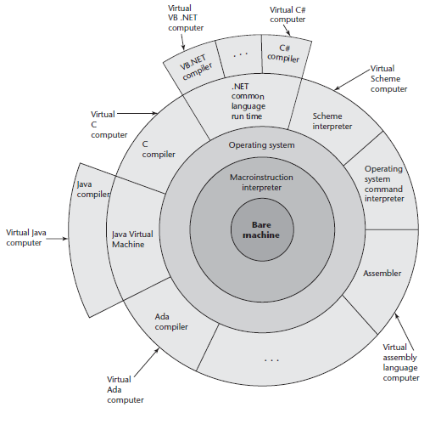
Layered View of Computer
The operating system and
Language implementation are layered over machine interface of a computer

Slide 11
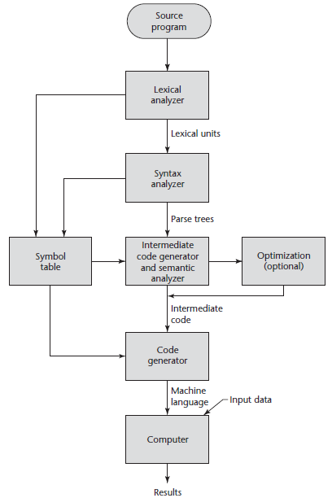
The Compilation
Process

Slide 12
Lexical analyzer
It converts the High level input program into a sequence of Tokens.
Removes the white spaces and comments.
A lexical token is a sequence of characters that can be treated as a unit.
int main() {
// variable declaration
// variable initialization
int a, b;
a = 10;
return 0; }
a = b + c ;
'int' 'main' '(' ')' '{' 'int' 'a' ',' 'b' ';' 'a' '=' '10' ';' 'return' '0' ';' '}'
id=id+id;

Slide 13
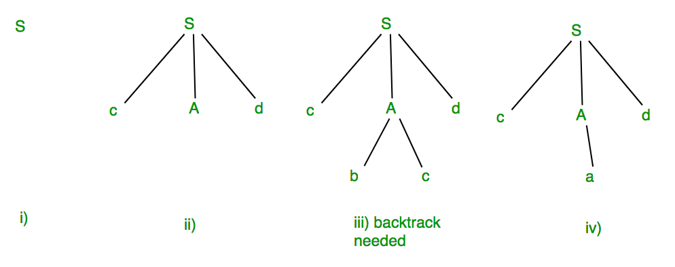
Syntax analysis
Takes tokens as input, uses the grammar of language to check if the input string can be formed by grammar.
Forms the syntax tree/parse tree.
S -> cAd
A -> bc|a
input string:“cad”

Slide 14
Semantic Analysis
Uses available information in the table to check for semantics
to verify that expressions and assignments are semantically correct (type checking) and update it accordingly.
Errors recognized by semantic analyzer are:
Type mismatch
Undeclared variables
Reserved identifier misuse
float x = 1.2;
float y = x*10;

Slide 15
Intermediate Code generation:
Generates intermediate code.
Symbol Table entries:
Each entry in symbol table is associated with attributes that support compiler in different phases.

Slide 16
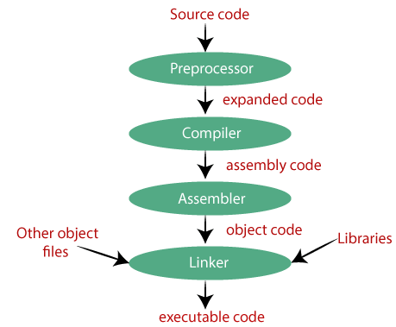
C compilation process
#include <stdio.h>
int main()
{
printf("Hello World”);
return 0;
}

Slide 17
Pure Interpretation
No translation
Program interpreted by another program (interpreter) without translation
Interpreter acts a simulator or virtual machine
Machine is brought to the level of language by building higher level machine called an interpreter that can run the language directly.
• run-time errors can easily and immediately be displayed
• Slower execution (10 to 100 times slower than compiled programs)
Decoding of higher level language programs is more complex, decoding has to be done every time a statement is executed.
• Often requires more space
• Used in APL, SNOBOL, LISP.
Now rare for traditional high-level languages
• Web scripting languages (e.g., JavaScript, PHP)

Slide 18
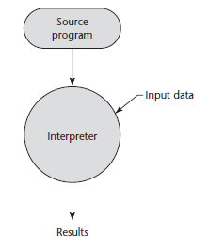
Pure Interpretation Process

Slide 19
Hybrid Implementation Systems
A compromise between compilers and pure interpreters.
A high-level language program is translated to an intermediate language that allows easy interpretation.
Faster than pure interpretation since the source language statements are decoded only once.
Examples
Perl programs are partially compiled to detect errors before interpretation.
Initial implementations of Java were hybrid;
the intermediate form, byte code, provides portability to any machine that has a byte code interpreter and a run-time system (JVM).

Slide 20
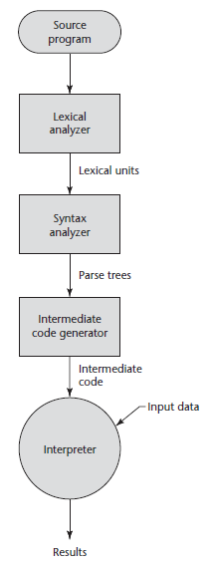
Hybrid Implementation Process

Slide 21
Just-in-Time Implementation Systems
Translate programs to an intermediate language.
Compile the intermediate language of the subprograms into machine code only when they are called.
Machine code version is kept for subsequent calls.
JIT systems are widely used for Java programs.
.NET languages are implemented with a JIT system.

Slide 22
What are different types of programming paradigm?

Slide 23
Imperative Programming
Algorithm is specified in great detail
Specific order of execution of instruction/stmt
Fortran, Pascal and C.
Fortran:
Familiar notations and efficiency
Language of choice for scientific programming:
used mathematical notations,
machine independent.

Slide 24
Imperative programming cont..
Algol 60
common language to share programs
describe numerical processes
widely admired language.
Pascal
teaching language,
similar to Algol 60 in syntactic constructs with minor differences.

Slide 25
Imperative programming cont..
C
implementation language for software for UNIX OS.
rich set of operators,
terse syntax,
efficient access to the machine.

Slide 26
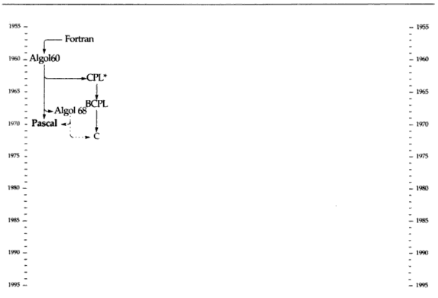
Imperative programming

Slide 27
Functional Programming
Functional Programming has its origins in lambda calculus
programming is done with expressions or declarations instead of statements
Functional code is idempotent
LISP, ML, Scheme, Haskell
LISP (list processor):
E.g. (Shakespeare wrote (the tempest))
(List with 3 elements; third is a sublist)
For Artificial intelligence.
Symbolic data processing
differential and integral calculus,
mathematical logic,
game playing, etc.

Slide 28
Functional programming cont..
MacLISP: performance and production quality
InterLISP: programming environment with a structured editor tied to the syntax.
Common LISP: is an advancement over MacLISP and InterLISP.
CLOS is an object oriented extension, Common Lisp Object System.
Scheme:
version of LISP with clean design
popular for teaching and research.
Other functional languages: ML, Miranda, Haskell

Slide 29
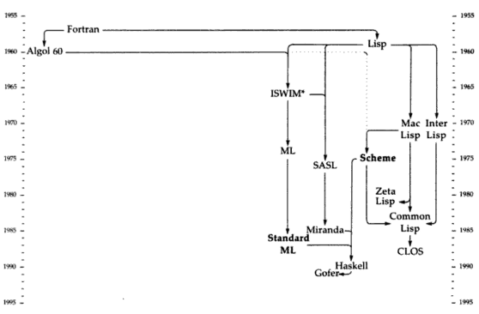
Functional programming

Slide 30
Logic Programming
Rules are specified in no particular order
Prolog:
Prolog programs have the expressiveness of logic.
for natural language processing.
uses a specialized form of logical reasoning to answer queries.
Databases, Expert systems, etc.

Slide 31
Object oriented Programming
class of objects encapsulating data and methods
classification of objects into classes and subclasses (generalization and specialization).
Inheritance and Polymorphism
Simula, C++, Smalltalk
Simula:
Designed as both a programming language and a description language.

Slide 32
Object oriented Programming contd..
C++ and Smalltalk:
notion of objects and classes.
C++
advancement over C
adds object oriented features to imperative programming in C.
Smalltalk
part of personal computing environment,
interactive system with a graphical user interface.

Slide 33
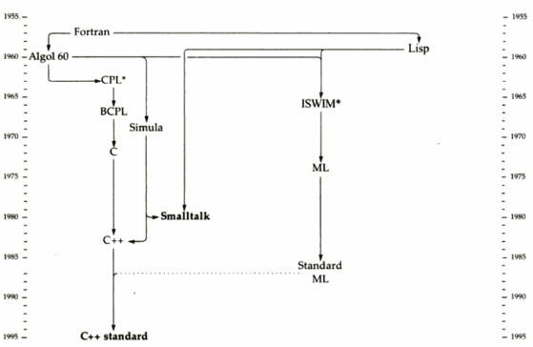
Object Oriented Programming

Slide 34
Java
Extensions to an imperative language are not intensive
e.g. expressions, assignment statements ,control statements similar to C
However, arrays, subprograms, and semantics are very different than C

Slide 35
Scripting Languages
Ruby, JavaScript, Perl
Imperative language in every sense
Hence, not a separate category

Slide 36
Markup Languages
Extensions of HTML and XML
Java Server Pages Standard Tag Library (JSTL)
eXtensible Spreadsheet Language Transformation (XSTL)
Can not be compared with any of the complete programming language

Slide 37
Special Purpose Languages
E.g.
Report program Generator (RPG)
Automatic Programming Tools (APT)
General Purpose Simulation System (GPSS)
Narrow applicability
Difficult to compare with any other language

Slide 38
Visual Languages
.NET Languages
Earlier called 4th Generation Language
Visual features in Visual Studio added just by one keystroke using .NET language

Slide 39
Story so far
Motivation for studying the course ✓
Architecture on which programs learn ✓
Parameters to evaluate a programming language ✓
Programming paradigms ✓

Slide 40
Summary
The study of programming languages is valuable for a number of reasons:
Increase our capacity to use different constructs
Enable us to choose languages more intelligently
Makes learning new languages easier
Most important criteria for evaluating programming languages include:
Readability, writability, reliability, cost
Major influences on language design have been
machine architecture and software development methodologies
The major methods of implementing programming languages are:
compilation, pure interpretation, and hybrid implementation

Slide 41
Questions

Slide 42
Discussion
Evaluate and discuss the Assembly language
Evaluate C language and MATLAB for the following application
Matrix operations
System programming

