Slide 1
Principles of Programming Language
Amit Dua
Computer Science and Information Systems Department
BITS, Pilani

Slide 2
Story so far
Motivation for studying the course ✓
Architecture on which programs learn ✓
Parameters to evaluate a programming language ✓
Implementing Programming Languages

Slide 3
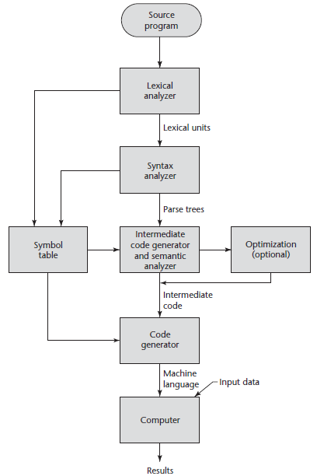
The Compilation
Process

Slide 4
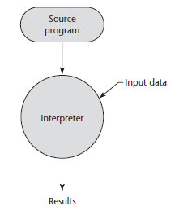
Pure Interpretation Process

Slide 5
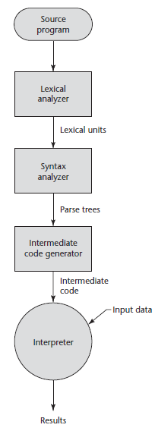
Hybrid Implementation Process

Slide 6
Just-in-Time Implementation Systems
Translate programs to an intermediate language.
Compile the intermediate language of the subprograms into machine code only when they are called.
Machine code version is kept for subsequent calls.
JIT systems are widely used for Java programs.
.NET languages are implemented with a JIT system.

Slide 7
Examples
C, C++ use compilers
Python uses interpreter
Java uses hybrid implementation, specifically JIT implementation
Tradeoff in speed and on-the-fly features + user experience +debugging

Slide 8
Code optimization
Eliminate unreachable code
Substitute variables for efficiency
Reduce execution frequency
Evaluations can be done at compile time

Slide 9
Story so far
Motivation for studying the course ✓
Architecture on which programs learn ✓
Parameters to evaluate a programming language ✓
Implementing Programming Languages ✓

Slide 10
Questions

Slide 11
Evaluating a language
Lecture 3

Slide 12
Topics
Introduction
The General Problem of Describing Syntax
Formal Methods of Describing Syntax
BNF and context-free grammars
Derivation and Parse trees
Ambiguity in grammars
EBNF

Slide 13
Introduction
Syntax: the form or structure of the expressions, statements, and program units
Semantics: the meaning of the expressions, statements, and program units

Slide 14
The General Problem of Describing Syntax: Terminology
A sentence is a string of characters from some alphabet
A language is a set of sentences
A lexeme is the lowest level syntactic unit of a language (e.g., numeric literals, operators, special symbols, etc.)
A token is a category of lexemes (e.g., identifier)

Slide 15
Example

Slide 16
Formal Definition of Languages
Recognizers
A recognition device reads input strings over the alphabet of the language and decides whether the input strings belong to the language
Example: syntax analysis part of a compiler
Generators
A device that generates sentences of a language
One can determine if the syntax of a particular sentence is syntactically correct by comparing it to the structure of the generator

Slide 17
BNF and Context-Free Grammars
Context-Free Grammars
Developed by Noam Chomsky in the mid-1950s
Language generators, meant to describe the syntax of natural languages
Define a class of languages called context-free languages
Backus-Naur Form (1959)
Invented by John Backus to describe the syntax of Algol 58
BNF is equivalent to context-free grammars

Slide 18
BNF Fundamentals
In BNF, abstractions are used to represent classes of syntactic structures-they act like syntactic variables (abstractions are also called as nonterminal symbols)
Terminals are lexemes or tokens
A rule (or production) has a left-hand side (LHS), which is a nonterminal, and a right-hand side (RHS), which is a string of terminals and/or non-terminals.

Slide 19
BNF Fundamentals (continued)
Nonterminals are often enclosed in angle brackets
Example of BNF rule:
<if_stmt> → if <logic_expr> then <stmt>
Grammar: a finite non-empty set of rules
A start symbol is a special element of the nonterminals of a grammar

Slide 20
BNF Rules
An abstraction (or nonterminal symbol) can have more than one RHS
<stmt> → <single_stmt>
| begin <stmt_list> end
Another example:

Slide 21
Describing Lists
Syntactic lists are described using recursion
<ident_list> → identifier
| identifier, <ident_list>

Slide 22
Grammars and Derivations
A grammar is a generative device for defining languages.
The sentences of the language are generated through a sequence of applications of the rules, beginning with a special nonterminal of the grammar called the start symbol.
This sequence of rule applications is called a derivation. A derivation is a repeated application of rules, starting with the start symbol and ending with a sentence (all terminal symbols)

Slide 23
Derivations
Every string of symbols in a derivation is a sentential form
A sentence is a sentential form that has only terminal symbols
A leftmost derivation is one in which the leftmost nonterminal in each sentential form is the one that is expanded.
Derivation continues until the sentential form contains no non-terminals.
Derivation order has no effect on the language generated by the grammar.

Slide 24
Progress
Introduction ✓
The General Problem of Describing Syntax ✓
Formal Methods of Describing Syntax ✓
BNF and context-free grammars ✓
Derivation and Parse trees
Ambiguity in grammars
EBNF

Slide 25
A grammar for a small Language
<program> -> begin <stmt_list> end
< stmt_list> -> <stmt> | <stmt>;< stmt_list>
< stmt> -> <var> = <expression>
<var> -> A | B | C
<expression> -> <var> + <var>
| <var> - <var>
| <var>
Can this language accept these sentences?
begin
A=B+C; B=C
end
If yes how do we prove this?

Slide 26
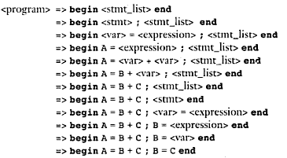
Derivation

Slide 27
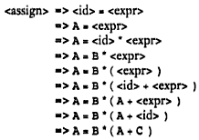
Left Derivation
Left-most derivation applies a production to the leftmost nonterminal at each step.
A = B * ( A + C )
<assign> -><id> = <expr>
<id> -> A | B | C
<expr> -> <id> + <expr>
| <id> * <expr>
| ( <expr> )
| <id>

Slide 28
Right Derivation
A right-most derivation applies a production rule to the rightmost nonterminal at each step.

Slide 29
A Grammar for Simple Assignment Statements
<assign> → <id> = <expr>
<id> → A | B | C
<expr> → <id> + <expr>
| <id> * <expr>
| ( <expr> )
| <id>
A = B * ( A + C )
<assign> => <id> = <expr>
=> <id>= <id>* <expr>
=> <id> = <id> * (<expr>)
=> <id> = <id> * (<id> + <expr>)
=> <id> = <id> * ( <id>+<id> )
=> <id> = <id> * ( <id> + C )
=> <id> = <id> * ( A + C )
=> <id> = B * (A + C)
=> A = B * ( A + C )

Slide 30
A hierarchical representation of a derivation
Parse tree for
A = B * ( A + C )
Derivation
<assign> => <id> = <expr>
=> <id>= <id>* <expr>
=> <id> = <id> * (<expr>)
=> <id> = <id> * (<id> + <expr>)
=> <id> = <id> * ( <id>+<id> )
=> <id> = <id> * ( <id> + C )
=> <id> = <id> * ( A + C )
=> <id> = B * (A + C)
=> A = B * ( A + C )

Slide 31
Ambiguity in grammar
A grammar that generates two or more distinct parse trees is said to be ambiguous.
<assign> -> <id> = <expr>
<id> -> A | B | C
<expr> -> < expr > + <expr>
| < expr > * <expr>
| ( <expr> )
| <id>
A = B + C * A

Slide 32
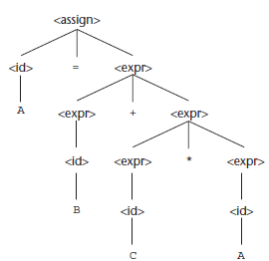
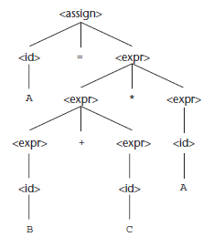
Two distinct parse trees

Slide 33
Resolving Ambiguity: Precedence
Precedence : * over +
lower in the parse tree: higher precedence

Slide 34
Using Operator precedence for designing unambiguous grammar
Use additional non-terminals and new rules.
Force different operators to different levels in the parse tree.
<assign> -> <id> = <expr>
<id> -> A | B | C
<expr> -> < expr > + <expr>
| < expr > * <expr>
| ( <expr> )
| <id>

Slide 35
Using Operator precedence for designing unambiguous grammar
A = B + C * A

Slide 36
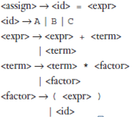
Left Most Derivation
A = B + C * A

Slide 37
Right Most Derivation
A = B + C * A

Slide 38
Parse Tree
Parse tree generated is unique as the grammar is unambiguous.

Slide 39
What about this?
A = B + C + A
A = B * C * A

Slide 40
Associativity of Operators
Represent Left associativity by left-recursive grammars and vice-versa.
When a grammar rule has its LHS also appearing at the beginning of its RHS, the rule is said to be left recursive and vice-versa.
+, -, * , / are all left associative
exponentiation operation is right associative.

Slide 41
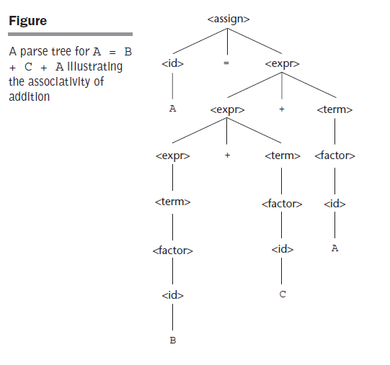
Example

Slide 42
Example
Right recursive grammar to represent the exponentiation operator which is right associative operator.

Slide 43
Problems with BNF Notation
BNF notation is too long.
Must use recursion to specify repeated occurrences.
Must use separate an alternative for every option.

Slide 44
Extended BNF
Does not add any descriptive power but increases the readability and writability of BNF.
3 extensions to BNF:
Optional parts of RHS are placed in brackets [ ]
Repetitions (0 or more) are placed inside braces { }
Multiple choice options or Alternative parts of RHSs are placed inside parentheses and separated via vertical bars

Slide 45
Tutorial problem
Conversion of BNF to EBNF:
(i) Look for recursion in grammar:
A-> aA |a
A-> a{a}
(ii) Look for common string that can be factored out with grouping and options.
A ->aB |a
A -> a [B]

Slide 46
EBNF to BNF
EBNF to BNF:
Option: []
A-> a[B]C
A’->aNC N->B| ε
Repetition: {}
A ->a{ B1B2... Bn}C
A’->aNC N->B1B2...BnN| ε

Slide 47
Example
Convert the following BNF to EBNF. Assume that <S> is the starting symbol
S → A | AC
C → bA | bAC
A → aD| abD
D → z
S → A { bA }
A → a [b] D
D → z

Slide 48
Example
Convert the following EBNF to BNF:
S → A { bA } { } repeat
A → a [b] D
D → z [ ] optional
BNF
S → A | AC
C → bA | bAC
A → aD | abD
D → z

Slide 49
BNF and EBNF versions of an expression grammar

Slide 50
EBNF limitations
Associativity of operators cannot be represented in EBNF.

Slide 51
Recent Variations in EBNF
Alternative RHSs are put on separate lines instead of using a vertical bar
Use of a colon instead of ->
Use of _{opt} for optional parts in place of square brackets.
Use of oneof for choices

