Slide 1
Principles of Programming Language
Amit Dua
Computer Science and Information Systems Department
BITS, Pilani

Slide 2
Evaluating a language
Lecture 4

Slide 3
Progress
Introduction ✓
The General Problem of Describing Syntax ✓
Formal Methods of Describing Syntax ✓
BNF and context-free grammars ✓
Derivation and Parse trees
Ambiguity in grammars
EBNF

Slide 4
A grammar for a small Language
<program> -> begin <stmt_list> end
< stmt_list> -> <stmt> | <stmt>;< stmt_list>
< stmt> -> <var> = <expression>
<var> -> A | B | C
<expression> -> <var> + <var>
| <var> - <var>
| <var>
Can this language accept these sentences?
begin
A=B+C; B=C
end
If yes how do we prove this?

Slide 5
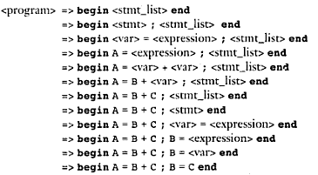
Derivation

Slide 6
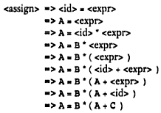
Left Derivation
Left-most derivation applies a production to the leftmost nonterminal at each step.
A = B * ( A + C )
<assign> -><id> = <expr>
<id> -> A | B | C
<expr> -> <id> + <expr>
| <id> * <expr>
| ( <expr> )
| <id>

Slide 7
Right Derivation
A right-most derivation applies a production rule to the rightmost nonterminal at each step.

Slide 8
A Grammar for Simple Assignment Statements
<assign> → <id> = <expr>
<id> → A | B | C
<expr> → <id> + <expr>
| <id> * <expr>
| ( <expr> )
| <id>
A = B * ( A + C )
<assign> => <id> = <expr>
=> <id>= <id>* <expr>
=> <id> = <id> * (<expr>)
=> <id> = <id> * (<id> + <expr>)
=> <id> = <id> * ( <id>+<id> )
=> <id> = <id> * ( <id> + C )
=> <id> = <id> * ( A + C )
=> <id> = B * (A + C)
=> A = B * ( A + C )

Slide 9
A hierarchical representation of a derivation
Parse tree for
A = B * ( A + C )
Derivation
<assign> => <id> = <expr>
=> <id>= <id>* <expr>
=> <id> = <id> * (<expr>)
=> <id> = <id> * (<id> + <expr>)
=> <id> = <id> * ( <id>+<id> )
=> <id> = <id> * ( <id> + C )
=> <id> = <id> * ( A + C )
=> <id> = B * (A + C)
=> A = B * ( A + C )

Slide 10
Ambiguity in grammar
A grammar that generates two or more distinct parse trees is said to be ambiguous.
<assign> -> <id> = <expr>
<id> -> A | B | C
<expr> -> < expr > + <expr>
| < expr > * <expr>
| ( <expr> )
| <id>
A = B + C * A

Slide 11
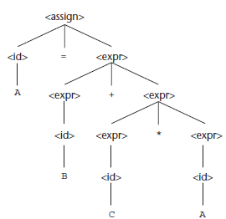
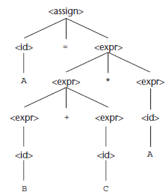
Two distinct parse trees

Slide 12
Resolving Ambiguity: Precedence
Precedence : * over +
lower in the parse tree: higher precedence

Slide 13
Using Operator precedence for designing unambiguous grammar
Use additional non-terminals and new rules.
Force different operators to different levels in the parse tree.
<assign> -> <id> = <expr>
<id> -> A | B | C
<expr> -> < expr > + <expr>
| < expr > * <expr>
| ( <expr> )
| <id>

Slide 14
Using Operator precedence for designing unambiguous grammar
A = B + C * A

Slide 15
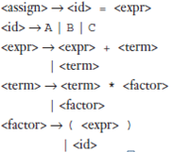
Left Most Derivation
A = B + C * A

Slide 16
Right Most Derivation
A = B + C * A

Slide 17
Parse Tree
Parse tree generated is unique as the grammar is unambiguous.

Slide 18
What about this?
A = B + C + A
A = B * C * A

Slide 19
Associativity of Operators
Represent Left associativity by left-recursive grammars and vice-versa.
When a grammar rule has its LHS also appearing at the beginning of its RHS, the rule is said to be left recursive and vice-versa.
+, -, * , / are all left associative
exponentiation operation is right associative.

Slide 20
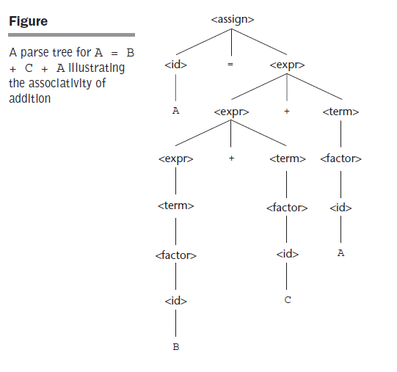
Example
A=B+C+A

Slide 21
Example
Right recursive grammar to represent the exponentiation operator which is right associative operator.

Slide 22
Problems with BNF Notation
BNF notation is too long.
Must use recursion to specify repeated occurrences.
Must use separate an alternative for every option.

Slide 23
Extended BNF
Does not add any descriptive power but increases the readability and writability of BNF.
3 extensions to BNF:
Optional parts of RHS are placed in brackets [ ]
Repetitions (0 or more) are placed inside braces { }
Multiple choice options or Alternative parts of RHSs are placed inside parentheses ( ) and separated via vertical bars

Slide 24
Conversions
BNF to EBNF
(i) Look for recursion in grammar:
BNF:
A-> aA |a
EBNF:
A-> a{a}
(ii) Look for common string that can be factored out with grouping and options.
BNF:
A ->aB |a
EBNF:
A -> a [B]

Slide 25
EBNF to BNF
EBNF to BNF:
Option: []
EBNF:
A-> a[B]C
BNF:
A’->aNC
N->B| ε
Repetition: {}
EBNF:
A ->a{B1B2... Bn}C
BNF:
A’->aNC N->B1B2...BnN| ε

Slide 26
Example
Convert the following BNF to EBNF. Assume that <S> is the starting symbol
S → A | AC
C → bA | bAC
A → aD| abD
D → z
S → A { bA }
A → a [b] D
D → z

Slide 27
Example
Convert the following EBNF to BNF:
S → A { bA } { } repeat
A → a [b] D
D → z [ ] optional
BNF
S → A | AC
C → bA | bAC
A → aD | abD
D → z

Slide 28
BNF and EBNF versions of an expression grammar

Slide 29
EBNF limitations
Associativity of operators cannot be represented in EBNF.

Slide 30
Recent Variations in EBNF
Alternative RHSs are put on separate lines instead of using a vertical bar
Use of a colon instead of ->
Use of _{opt} for optional parts in place of square brackets.
Use of oneof for choices

Slide 31
Summary
Grammar in BNF
Left most and right most derivations
Parse tree
EBNF (and conversions)

Slide 32
Questions

