Slide 1
Indian Ethics
Prof. Kumar Neeraj Sachdev
Department of Humanities and Social Sciences

Slide 2
Frameworks of Ethics
  Indian Ethics
  Utilitarian Ethics
  Deontological Ethics
  Virtue Ethics

Slide 3
A Framework of Ethics
A framework of ethics or an ethical theory is a mechanism for assessing whether a particular action, rule or a policy is ethically justified. It helps to sharpen one’s moral vision.
Certain characteristics of an acceptable ethical theory are: prescriptive, universal and practical.

Slide 4
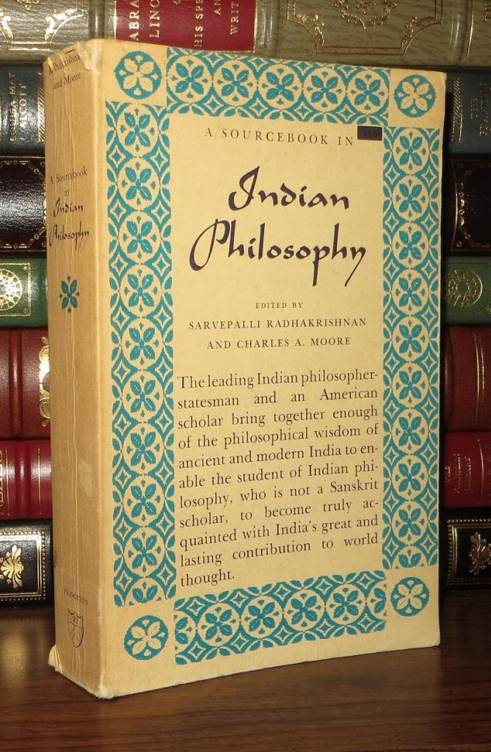

Slide 5
Some Sources of Indian Ethical Thought
Vedas (Rig Veda, Sama Veda, Yajur Veda, Atharva Veda) & Upanishads
Ramayana
Mahabharata (Bhagavadgita)
Manusamriti
Orthodox Philosophical Systems: Schools of Vedanta, Samkhya, Yoga, Vaisesika, Nyaya
Buddhism
Jainism

Slide 6


Slide 7
Indian Ethical Thought
We may understand Indian Ethical Thought as a response to the question:
How should I live a good human life?
  I should study, reflect and practically realize the true nature of myself in the world.

Slide 8
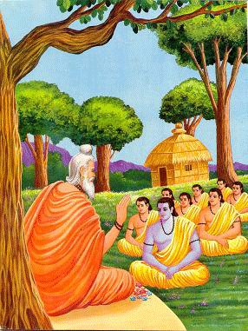

Slide 9
Some Ethical Ideas
I should understand and practice the following philosophical ideas in my life:
  Intended Action (Karma) & Detachment in Action (Nishkaama Karma)
  Virtue or Righteousness (Dharma)
  Class-Stage-Virtue (Varnaashramdharma)
  Ends of Human Life (Purusharthas)
  Buddhist Eightfold path
  Five Vows of Jainism

Slide 10
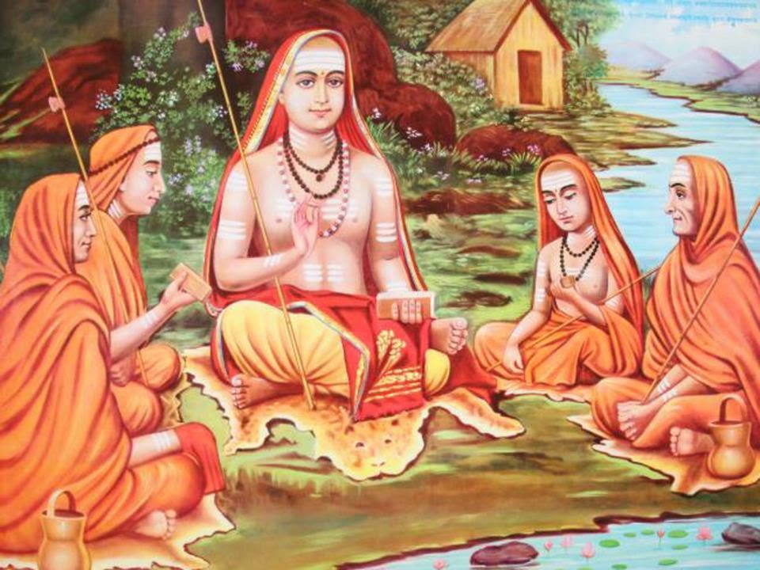

Slide 11
Classes of Society (Varna)
I should understand the working of classes of society and aspire to excel in my own class:
  Priests and Teachers for Instruction (Brahmin)
  Rulers and Warriors for Defense (Kshtriya)
  Farmers and Traders for Economic Activity (Vaisha)
  Service Providers and Servants for Labor (Shudra)

Slide 12
Stages of Human Life (Ashrama)
I should understand and live through stages of human life:
  Student Life (Brahmacharya)
  Householder Stage (Grahstha)
  Gradual Withdrawal from Worldly pursuits (Vaanprstha)
  Renunciation or Complete Withdrawal (Sannyaasa)

Slide 14
Ends of Human Life (Purusharthas)
I should understand and pursue the following ends of human life:
  Material Possession (Artha)
  Desire Satisfaction (Kaama)
  Righteous Living (Dharma)
  Spiritual Liberation (Moksha)

Slide 15
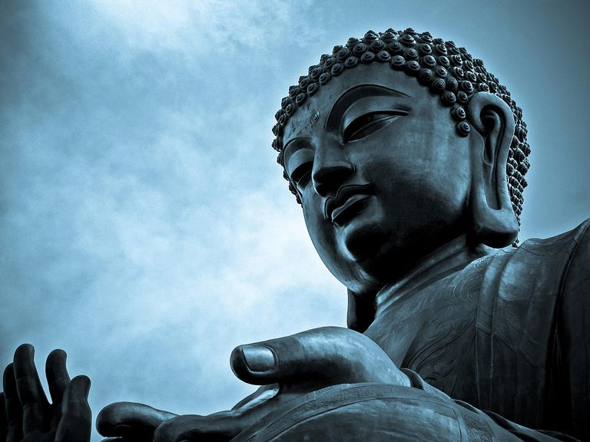

Slide 16
Buddhism
I should understand and practice the following Four Noble Truths:
There is suffering.
There is a cause of suffering:
1. Ignorance; 2. Impressions of Karmic Forces; 3. Initial Consciousness of the Embryo; 4. Psycho-Physical Organism; 5. Six Sense-organs including Mind; 7. Sense-experience; 8. Thirst for Sense-enjoyment; 9. Clinging to this Enjoyment; 10. Will to be Born; 11. Birth or Re-birth; 12. Old Age and Death

Slide 17
Ethics of Buddhism
There is a cessation of suffering.
There is a way leading to the cessation of suffering: Eightfold path (Ashtangika-Marg): Right Faith; Right Resolve; Right Speech; Right Conduct; Right Living; Right Effort; Right Thought; Right Concentration

Slide 18
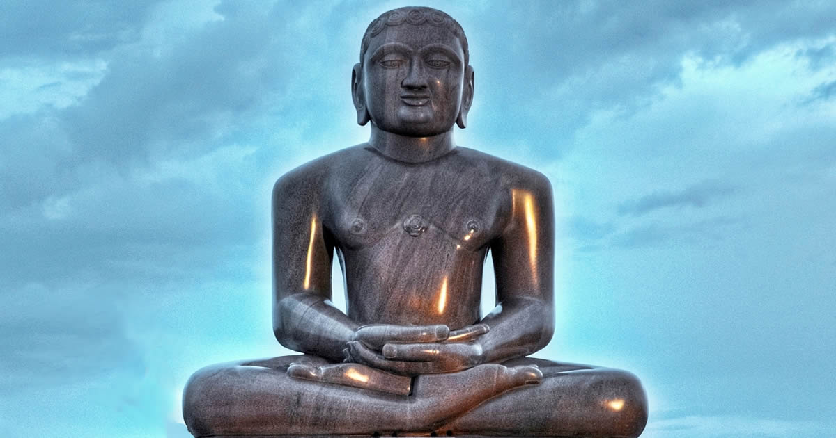

Slide 19
Ethics of Jainism
I should understand and practice the following Five Vows (Vrata – Anu Vrata and Maha Vrata):
  Non-violence (Ahimsa)
  Truth (Satya)
  Non-stealing (Asteya)
  Sexual Purity or Chastity (Brahmcharya)
  Non-possessiveness (Aparigraha)

Slide 20
Concluding Remarks
I should aspire to understand and practically realize the true nature of myself.
This will help me to attain the goal of living a spiritually liberated good human life in the world.

Slide 21
Thank you.

