Slide 1
Ethical Codes for Professions
Prof. Kumar Neeraj Sachdev
6168-F
Department of Humanities and Social Sciences

Slide 2
Across the Professions
Ethical Theories
Ethical Codes for Professions
Employer-employee Relation
Whistle Blowing
Women and Family Issues

Slide 3
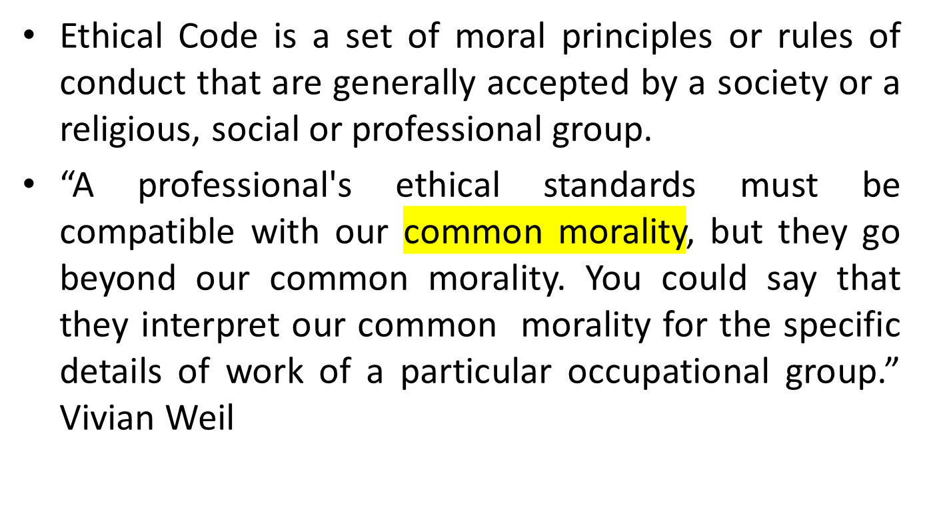
Ethical Code

Slide 4
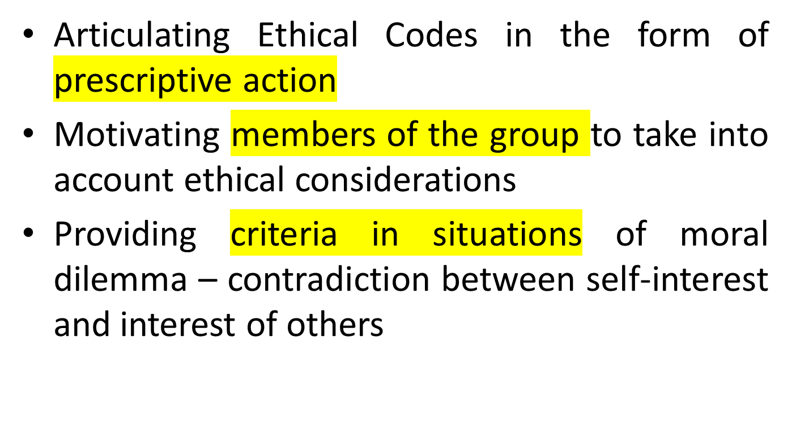
Significance of Ethical Codes

Slide 5
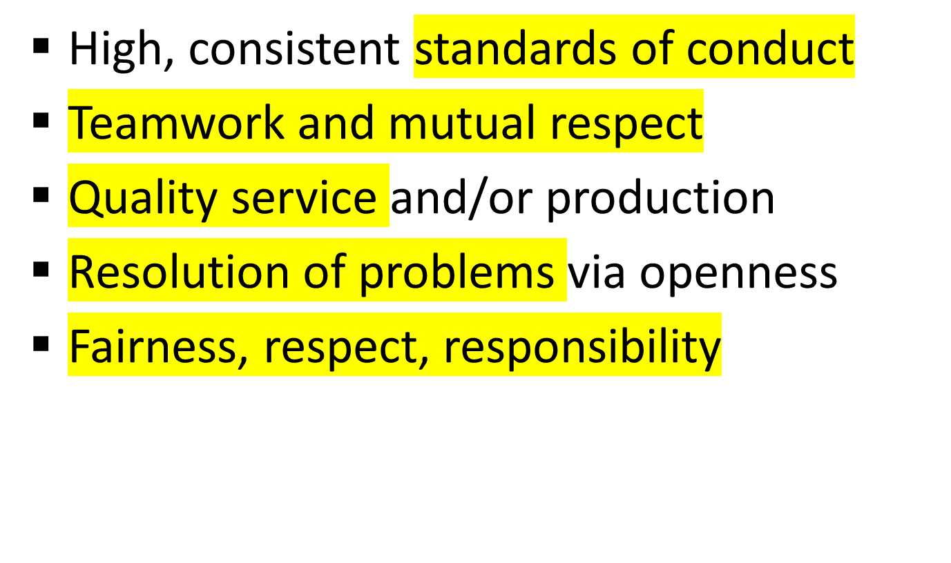
What codes should promote…

Slide 6
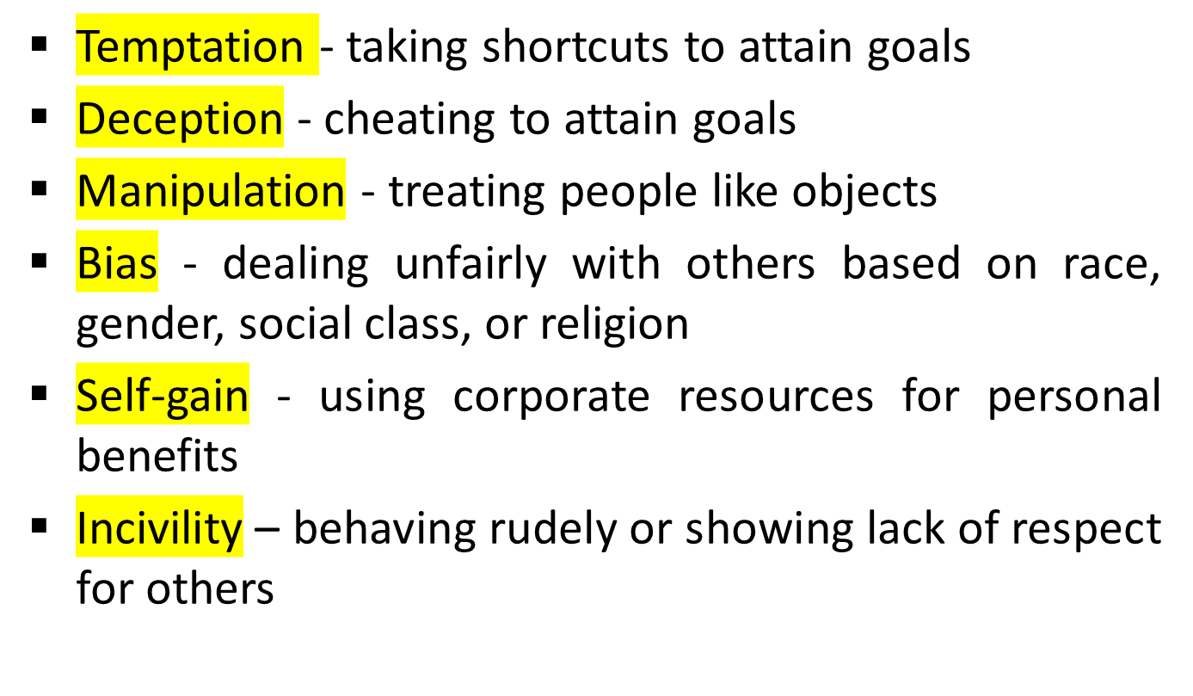
What codes should prevent…

Slide 7
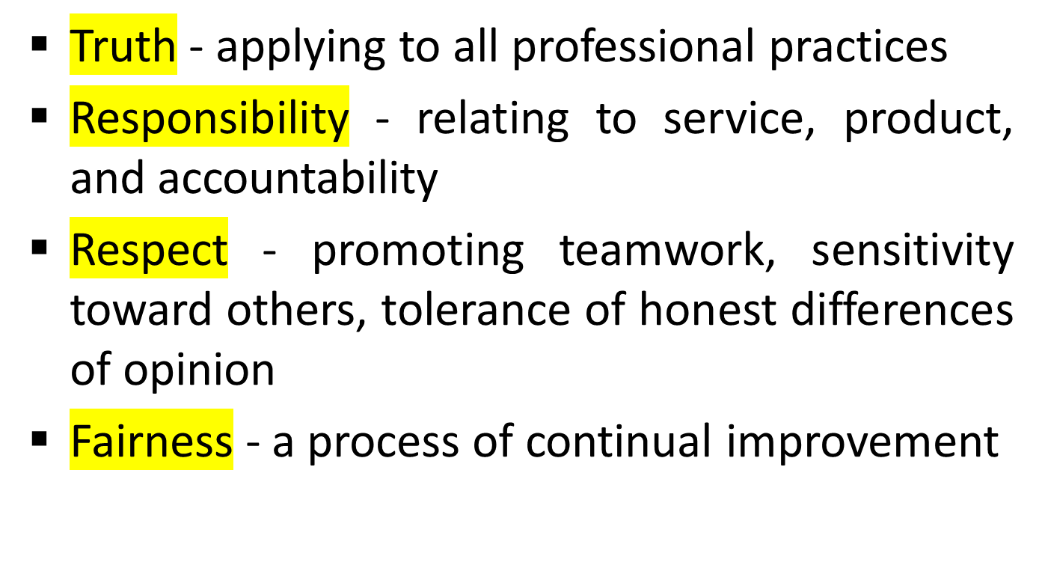
Four Values found in Most Codes

Slide 8
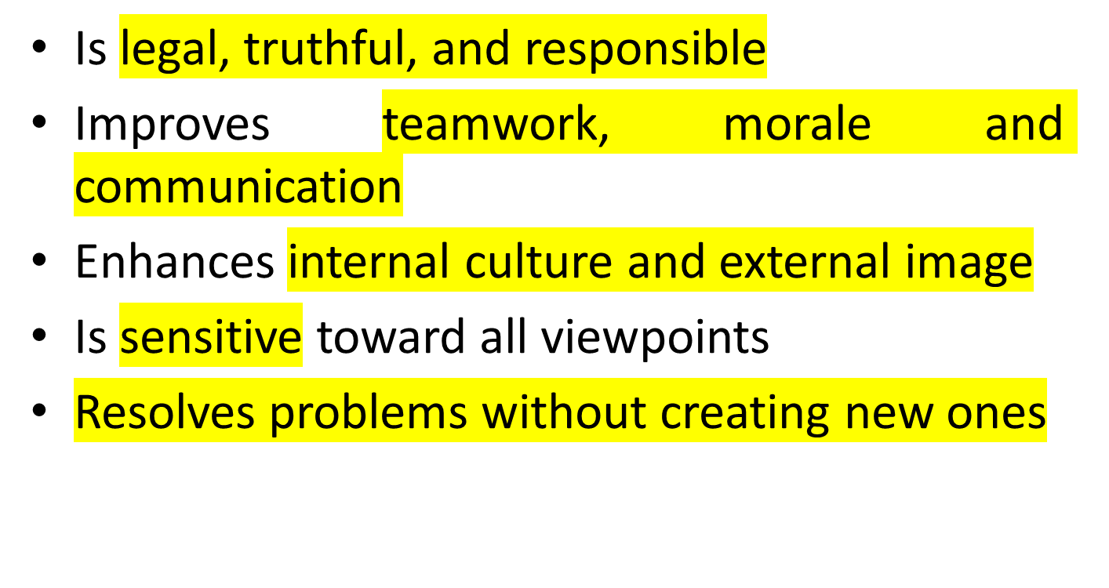
Goals of an Ethical Code

Slide 9
An Ethical Code: A Sample

Slide 10
Birla Institute of Technology and Science, Pilani
Code of Ethics
Preamble
Faculty, students and support staff believe in and abide by the motto: "Knowledge is power supreme."
Since education is a process of teaching, training and learning to collect information, improve knowledge and develop skills, a corresponding value-oriented conduct is required to give a realistic shape to such a process.

Slide 11
Seek Information and Knowledge
Faculty and students ought to focus on learning through information, knowledge and skills to gain holistic benefits of education. And in this regard…
  Collect and work on every possible piece of information and knowledge relating to the academic course or area of research
  Continuously aspire for publishing ideas and findings in books and research journals
  Constantly look for monetary support for research in India and abroad
  Explore curricular interests using academic courses listed as electives

Slide 12
Act in Coordination
Faculty, students and support staff work together in a spirit of cooperation for academic and infrastructural growth of the institute. And for this purpose…
  Work together to achieve short term and long term objectives during events such as Apogee, Interface, Oasis, BOSM and so on
  Maintain cleanliness in hostels and messes
  Create and maintain an environment of mutual trust

Slide 13
Be Fair and Disciplined
Faculty ought to be fair and impartial in teaching and evaluation
Students ought not to indulge in malpractices such as cheating in exams, misuse of makeup policy, misuse of flexibility in attendance of classes and use of mobile phones in classrooms
Students ought to be regular in classes and tests
Students ought not to damage institute property
Students ought to avoid emotionally damaging actions such as ragging

Slide 14
Commitment and Sense of Belonging
Project and maintain identity of BITS inside and outside its premises
Provide feedback for the holistic development of the institute
Be committed to maintain and raise the academic standards of the institute
Maintain and promote cultural practices of the institute such as vote for student representatives, participate in various clubs and associations - Ragamalika, Gurukul, Hindi Drama Club, English Drama Club, Recreational Activity Forum and Inter-hostel competitions
As an alumni contribute to the institute, help and support on campus students vis-a-vis infrastructure, education, adding to the pool of companies for placement, practice school stations and work integrated learning programs

Slide 15
Thank you.

