Slide 1
Employer-Employee Relation
Prof. Kumar Neeraj Sachdev
6168-F
Department of Humanities and Social Sciences

Slide 2
Issues Across Professions
Ethical Codes for various Professions
Employer-employee Relation
Whistle Blowing
Women and Family Issues

Slide 3
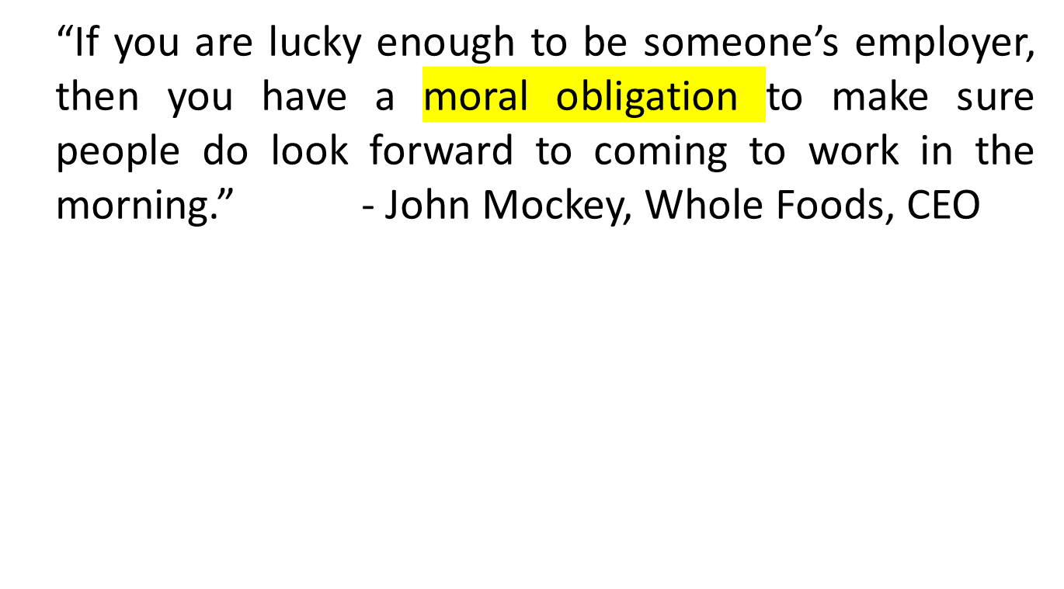
A Quote

Slide 4
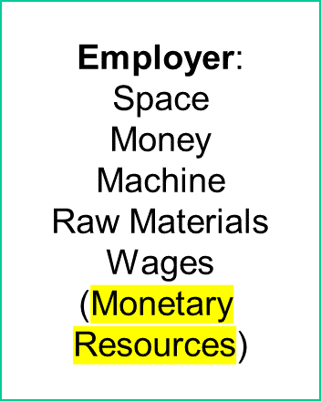

Employment
Goods / Services

Slide 5
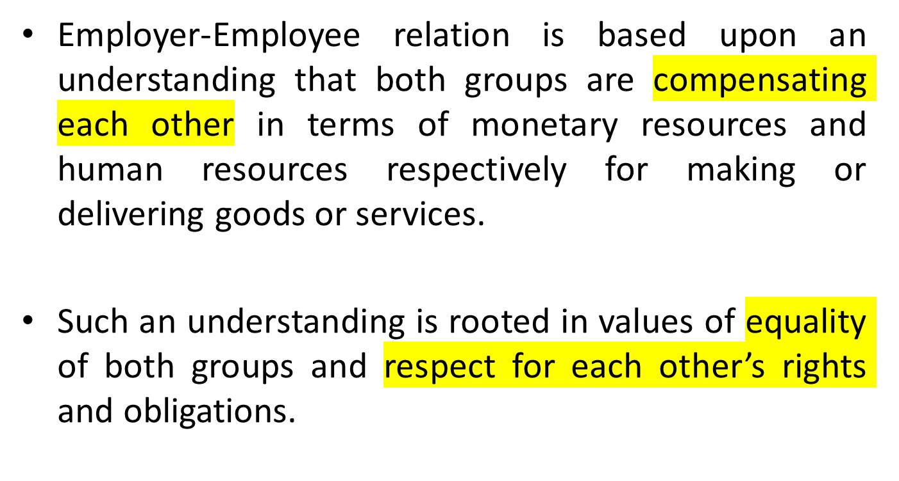
Employer-Employee Relation

Slide 6
Employment At Will (EAW)
an employer may terminate an employee at any time and for any reason unless an employment contract specifies otherwise.
Property Rights
Freedom of Contract
Considerations of Efficiency

Slide 7
Employment Issues
Compensation and Professional Growth
Discrimination and Affirmative Action
Workplace Harassment
Treating Employees or Employers as Means in Cost-Benefit Analysis
Just or Unjust Dismissal

Slide 8
Employment Rights
Fairness of Wages
Due Process in the Workplace
Freedom of Expression
Workplace Democracy
Value of Privacy
Whistle Blowing
Affirmative Action
Gender Equality
Safe and Healthy Environment

Slide 9
A Concluding Remark
Professionals need to understand the moral dimension of employer-employee relation in order to appreciate the mutual co-existence of rights and obligations of both employer and employee because they may find themselves in any of the two positions in the organization.

Slide 10
Thank you.

