Slide 1
Introduction
The main property of a neural network is an ability to learn from its environment, and to improve its performance through learning.
So far we have considered supervised or active learning − learning with an external “teacher” or a supervisor who presents a training set to the network. But another type of learning also exists: unsupervised learning.

Slide 2
In contrast to supervised learning, unsupervised or self-organised learning does not require an external teacher. During the training session, the neural network receives a number of different input patterns, discovers significant features in these patterns and learns how to classify input data into appropriate categories. Unsupervised learning tends to follow the neuro-biological organisation of the brain.
Unsupervised learning algorithms aim to learn rapidly and can be used in real-time.

Slide 3
Pattern recognition
Patterns: images, personal records, driving habits, etc.
Represented as a vector of features (encoded as integers or real numbers in NN)
Pattern classification:
Classify a pattern to one of the given classes
Form pattern classes
Pattern associative recall
Using a pattern to recall a related pattern
Pattern completion: using a partial pattern to recall the whole pattern
Pattern recovery: deals with noise, distortion, missing information

Slide 4
Here we introduce a set of rules that allow unsupervised learning
These rules give the networks the ability to learn associations between patterns that occur frequently
Once learnt, associations allow networks to perform useful tasks such as pattern recognition and recall

Slide 5
Associations
An association is any link between a system’s input and output such that when a pattern A is presented to the system, it will respond with pattern B
When two patterns are linked by an association, the input pattern is called the stimulus and the output pattern is called the response

Slide 6
Applications to Behaviorist Psychology
Experiment by Ivan Pavlov, in which he trained a dog to salivate at the sound of a bell, by ringing the bell whenever the food was presented (an example of classical conditioning)
B.F Skinner – Performed an experiment which involved training a rat to press a bar in order to obtain a food pellet (an example of instrumental conditioning)

Slide 7
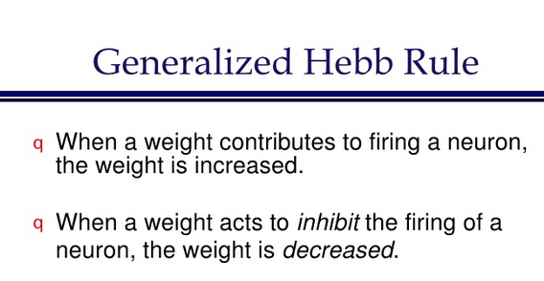
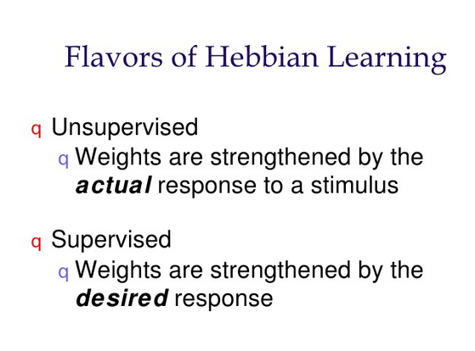

Slide 8
Hebb, in his influential book The organization of Behavior (1949), claimed
Behavior changes are primarily due to the changes of synaptic strengths between neurons I and j
In ANN, Hebbian learning law can be stated: synaptic strength increases only if the outputs of both units and have the same sign ( positive or negative).

Slide 9

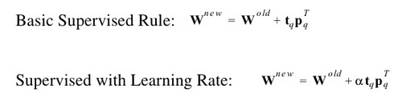

Slide 10
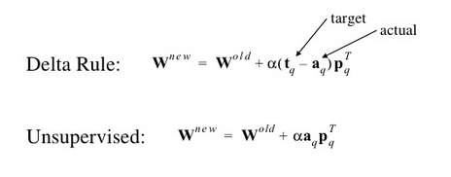

Slide 11
Simple Associative Network
An example of a simplest network implementing an association is the single input hard limiting neuron
A neurons output ‘a’ is determined from its input ‘p’ according to
We restrict the value of ‘p’ to be either 0 or 1, indicating whether a stimulus is absent or present. ‘a’ is limited to the same values by hard limit transfer function. It indicates presence or absence of network’s response

Slide 12
The presence of an association between stimulus p=1 and response a=1 is dictated by the value of ‘w’. The network will respond to the stimulus only when ‘w’ > -b

Slide 13
In order to demonstrate operation of associative learning rules without using complex networks, we will use simple networks that have two kinds of inputs
One set of inputs represent the unconditional stimulus. This is analogous to the food presented in Pavlov’s experiment,.
Another set of inputs represent the conditional stimulus. This is analogous to the bell in Pavlov’s experiment
Initially the dog salivates only when the food is presented. This is an innate characteristic that doesn’t have to be learned. However when the bell is repeatedly paired with food, the dog is conditioned to salivate at the sound of the bell even when no food is present

Slide 14
Network for Banana Associator
The N/W has both
Unconditional stimulus (banana shape) and
Conditional stimulus (banana smell).

Slide 15
Let unconditional stimulus be represented as p⁰
let conditional stimulus be represented as p
Weight (w⁰ )associated with p⁰ are fixed
weight (w )associated with ‘p’ are adjusted according to relevant learning rule

Slide 16
The definitions for unconditioned and conditioned inputs for this network are
Associate SHAPE of banana , not smell
Assign a value greater than ‘-b’ to w⁰ and assign a value less than ‘-b’ to w

Slide 17
The banana associator’s input and output function simplifies to
Network will respond only if banana is sighted p⁰ =1 whether or not banana is smelled or not p=1 or 0

Slide 18
An association will be made when w>-0.5 (=b), since then p=1 will produce the response a=1, regardless of value of p⁰
The Unsupervised Hebb rule can also be written in vector notation as

Slide 19
As with all unsupervised rules, learning is performed in response to a series of inputs presented in time (the training sequence)
At each iteration, the output ‘a’ is calculated in response to the input ‘p’ and then the weights ‘W’ are then updated with the Hebb rule.

Slide 20
The associator would start so that it would initially respond to the sight and not the smell of the banana
The associator would be repeatedly exposed to the banana. While the network’s smell sensor would operate reliably, the shape sensor would operate only intermittently (even time steps).
The training sequence would contain repetitions of the following two sets of inputs

Slide 21
Weight w representing weight for unconditional stimulus p⁰ will remain constant
‘w’ associated with conditional response ‘p’ will be updated at each iteration using unsupervised Hebb Rule with learning rate of 1

Slide 22
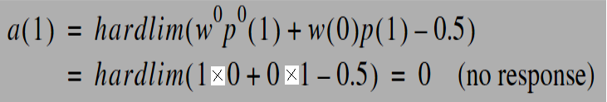
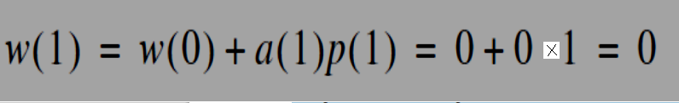
The output for the first iteration :p⁰ (1) =0 ,p(1)=1
The smell alone did not generate a response. Without a response the Hebb rule doesn’t alter ‘w’

Slide 23
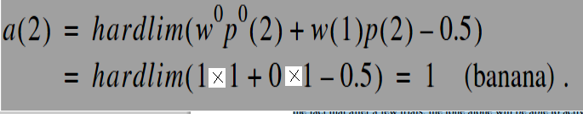

In the second iteration, both the banana’s smell and shape are detected
p⁰ (2) =0 ,p(2)=1
Because the smell stimulus and response have occurred simulataneously, the Hebb rule increases the weight between them

Slide 24
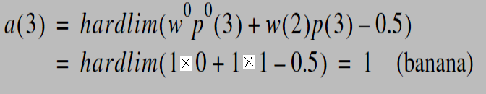

When the sight detector fails again, in the third iteration, the network responds anyway. It has made a useful association between the smell of a banana and its response.
p⁰ (3) =0 ,p(3)=1
From now on the network is capable of responding to bananas that are detected either by sight or smell. Even if the network suffers with intermittent faults,

Slide 25
Example
Classical conditioning can be modeled with a hebbian synapse.
Consider an unconditioned stimulus (an airpuff),
an unconditioned response (eye blink),
a conditioned stimulus (a tone) and a conditioned response(eye blink).

Slide 26
Under normal conditions, an animal responds to an air puff with an eye blink.
It does not respond to a tone with an eye blink.
If the tone is paired with the air puff several times, then the animal acquires an association between the airpuff and the tone, and will now respond to the tone alone with an
eye blink.

Slide 27
Consider a “black box” neural approach where one neuron receives input from the airpuff and from the tone. The neurons output represents the eye blink. The neuron is wired in such a way that at first, the airpuff but not the tone activates the neuron and produces an output.
If we apply the airpuff input and the tone input together several times, then the neuron is active while the tone-input is active, and a hebbian learning rule will reinforce the strength of the connection between the tone and the neuron.
This will lead to the fact that after a few trials, the tone alone will be able to activate the neuron.

Slide 28
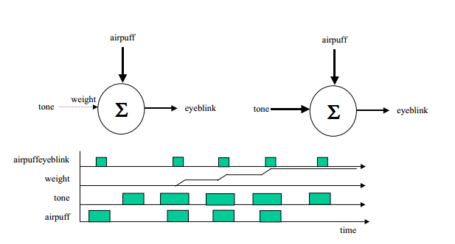

Slide 29
Associative Memory neural Network
Associative Memory neural Networks are nets in which the weights are determined in such a way that the net can store a set of P pattern associations.
Each association is a pair of vectors [ s(p), t(p)], with p= 1,2,…P
The net will find an appropriate output vector that corresponds to an input vector X that may be either one of the stored patterns s(p) or a new pattern ( corrupted by noise)
http://www.slideshare.net/zaripices/fundamentalsofneuralnetworkslaurenefausett
Laurene Fausett Fundamentals of neural networks p110-118

Slide 30
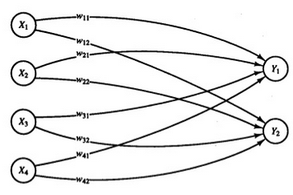
Suppose a net is to be trained to store the following mappings from input row vectors
s =( s₁ , s₂, s₃, s₄ ) to output row vectors t = ( t₁ , t₂)
For s ₁ ( 1, 0,0,0) t (1,0) For s ₂ ( 1, 1,0,0) t (1,0)
For s ₃ ( 0, 0,0,1) t (0,1) For s ₄ ( 0, 0,1,1) t (0,1)

Slide 31
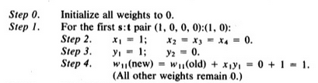


Slide 32

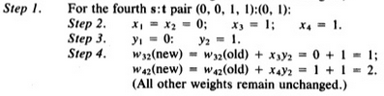


Slide 33
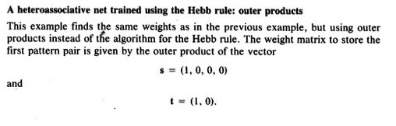
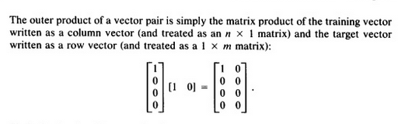

Slide 34
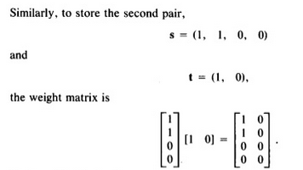
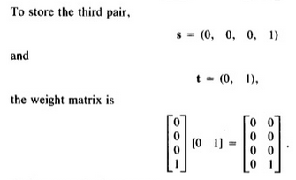

Slide 35
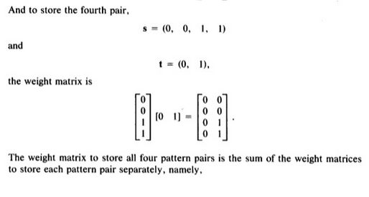


Slide 36
AUTOASSOCIATIVE NET [ p121-125 of Fausett]
For an auto associative net, the training input and target output are identical
Process of training often called STORING the vectors, may be binary or bipolar
A stored vector can be retrieved from distorted or partial (noisy) input if input is sufficiently similar to it.
The performance of net is judged by its ability to reproduce a stored pattern from noisy input
Performance in general is better for bipolar vectors
In general for auto associative nets the weights on diagonal ( those which would connect an input pattern component to corresponding component in the output pattern) set to zero give better results

Slide 37
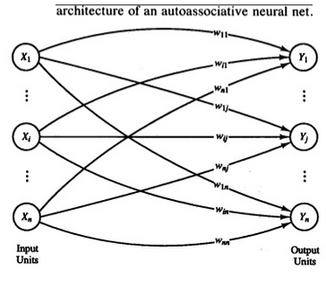

Slide 38
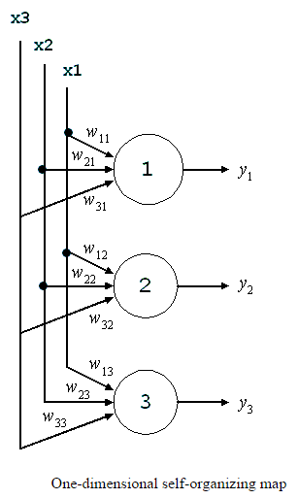
Self-Organizing Maps
Self-organizing maps are a special class of artificial neural networks based on competitive unsupervised learning.
During the competitive learning process the neurons are tuned selectively, that is the training data select the winning neurons.
.

Slide 39
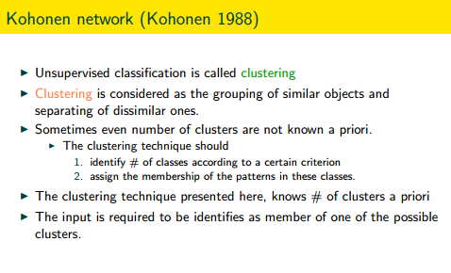

Slide 40
The Kohohen neural network does not use any sort of activation function.
Kohonen neural network does not use any sort of a bias weight.
The most significant difference between the Kohonen neural network and the feed forward back propagation neural network is that the Kohonen network trained in an unsupervised mode.
This means that the Kohonen network is presented with data, but the correct output that corresponds to that data is not specified. Using the Kohonen network this data can be classified into groups.

Slide 41
The competitive learning rule defines the change Δw_{ij} applied to synaptic weight w_{ij} as
where x_{i} is the input signal and α is the learning rate parameter.

Slide 42
The overall effect of the competitive learning rule resides in moving the synaptic weight vector W_{j} of the winning neuron j towards the input pattern X. The matching criterion is equivalent to the minimum Euclidean distance between vectors.

Slide 43
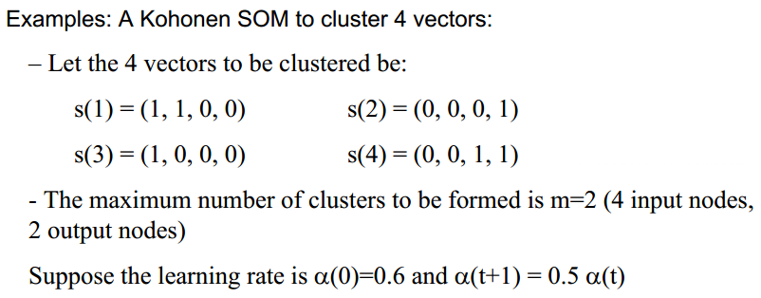
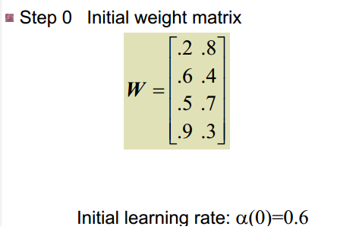

Slide 44
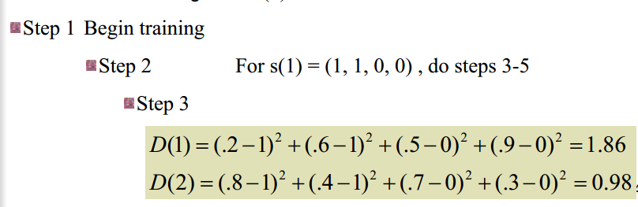
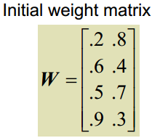
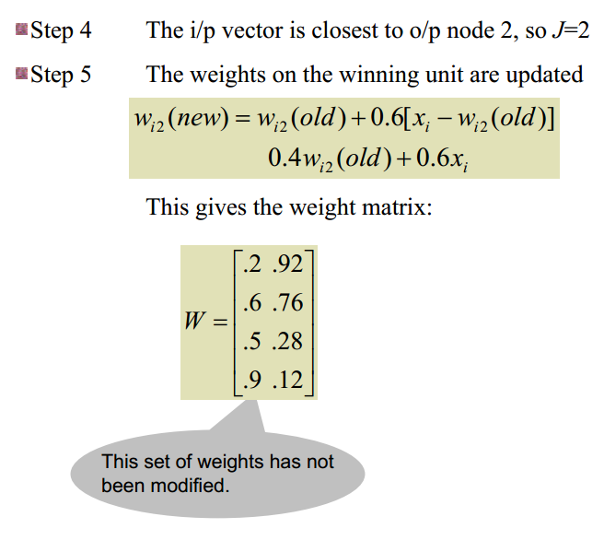

Slide 45
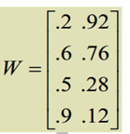
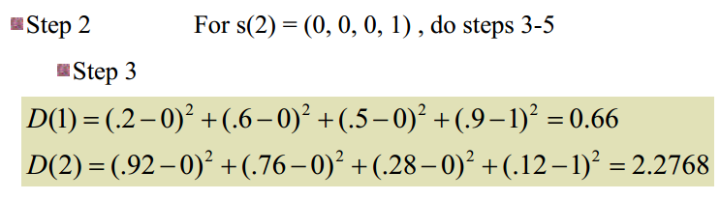
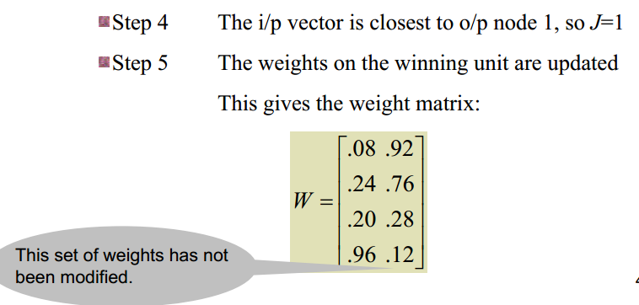


Slide 46
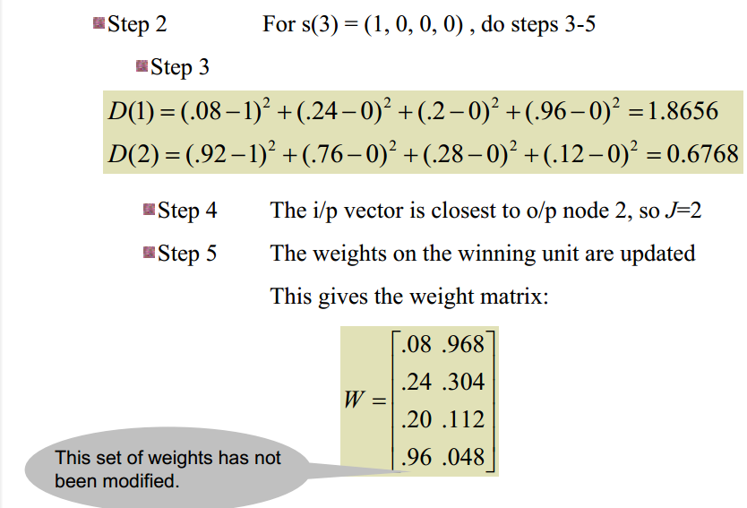
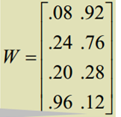


Slide 47
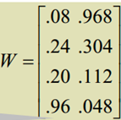
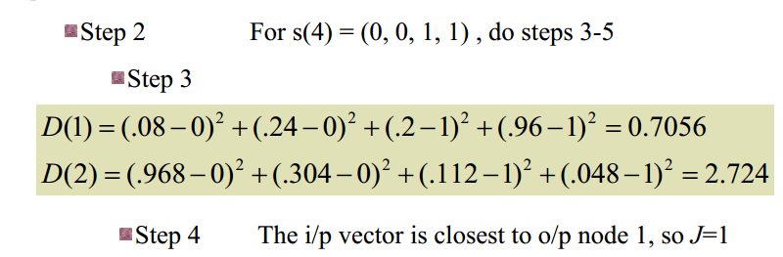
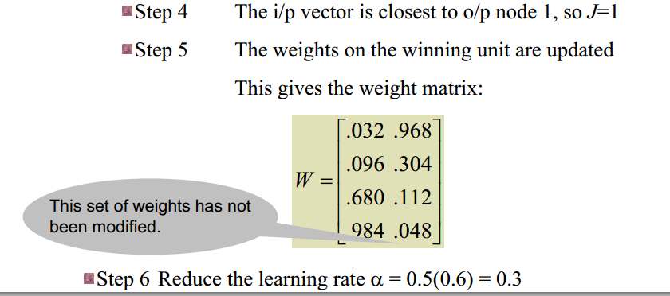

Slide 48
