Slide 1
Optimization BITS F312 Neural Networks and Fuzzy Logic Ankush Jahagirdar 18/11/2016

Slide 2
Genetic Algorithm

Slide 3
Fitness function f(x_{1,} x_{2, ….,} x_{N}) , chromosome size will be Nl
Population size : M in each generation,
Elite Count: EC
If crossover probability is p_{c}
Crossover children CC = round(p_{c} ×(M – EC))
Mutation Child MC = (M – EC – CC)

Slide 4
For example, let’s assume
Dimension N=2,
No. of bits per variable l=5
Population size M=20
Elite Children EC=2
Crossover Probability p_{c} =80% (or crossover fraction =0.8)
Then
Chromosome size
= Nl = 2 * 5 = 10
No. of chromosomes in mating pool
= M-EC = 20 – 2 = 18

Slide 5
Will these 18 elements in the contain Elite Children?
Yes.
Such selection is termed as Greedy,
because we are biased towards stronger chromosomes.
No. of Crossover Children
CC = round(p_{c} ×(M – EC)) = round(0.8 ×(20-2)) = 14
No. of Mutation Children
MC = (M – EC – CC) = 20-2-14 = 4
Next generation will consist of 2 EC, 14 CC, 4 MC.

Slide 6
If the selection is too greedy, then after few generations there will be less possible combinations of parents.
This causes a problem of Premature Convergence.
There are various approaches to overcome this problem.
One of the approaches is to increase the mutations.
There is always a tradeoff between exploration and exploitation.

Slide 7
Exploitation consists of probing a limited (but promising) region of the search space with the hope of improving a promising solution S that we already have at hand. This operation amounts then to intensifying (refining) the search in the vicinity of S. By doing so, we would be doing, de facto, a local search.
Exploration, on the other hand, consists of probing a much larger portion of the search space with the hope of finding other promising solutions that are yet to be refined. This operation amounts then to diversifying the search in order to avoid getting trapped in a local optimum. By doing so, we would be doing a global search.

Slide 8
Reproduction Operators comparison
Single point crossover
→
Cross point
Two point crossover
→

Slide 9
Reproduction Operators
Uniform crossover
→
Is uniform crossover better than single crossover point?
Trade off between
Exploration: introduction of new combination of features
Exploitation: keep the good features in the existing solution

Slide 10
Differential Evolution

Slide 11
Differential Evolution (DE)
Price and Storn developed DE to be a reliable and versatile function optimizer that is easy to use.
The first written publication on DE appeared as a technical report in 1995.
Since then, DE has proven itself in competitions like the IEEE’s International Contest on Evolutionary Optimization (ICEO) in 1996 and 1997 and in the real world on a broad variety of applications.

Slide 12
Basic Idea Behind Differential Evolution (DE)
Like nearly all EAs, DE is a population-based optimizer that attacks the starting point problem by sampling the objective function at multiple, randomly chosen initial points.
Preset parameter bounds define the domain from which the N_{p} vectors in this initial population are chosen (Fig. 1).
Each vector is indexed with a number from 0 to (N_{p} − 1).

Slide 13
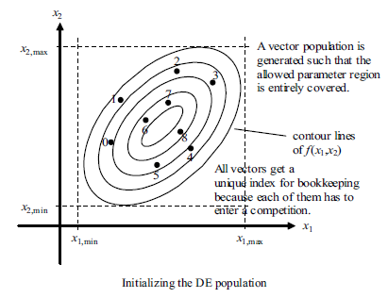
Fig. 1

Slide 14
Like other population-based methods, DE generates new points that are perturbations of existing points.
DE perturbs vectors with the scaled difference of two randomly selected population vectors (Fig. 2).
To produce the trial vector, u₀, DE adds the scaled, random vector difference to a third randomly selected population vector (Fig. 3).

Slide 15
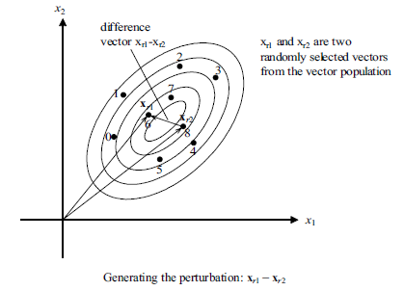
Fig. 2

Slide 16
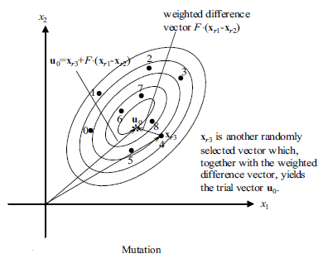
Fig. 3

Slide 17
In the selection stage, the trial vector competes against the population vector of the same index, which in this case is number 0.
Fig. 4 illustrates the select-and-save step in which the vector with the lower objective function value is marked as a member of the next generation.
Fig. 5–6 indicate that the procedure repeats until all N_{p} population vectors have competed against the randomly generated trial vector.
The survivors of the N_{p} pairwise competitions become parents for the next generation in the evolutionary cycle.

Slide 18
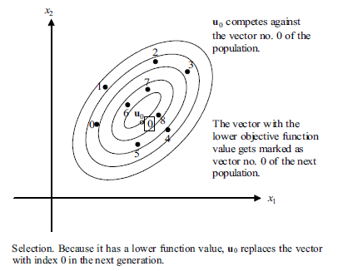
Fig. 4

Slide 19
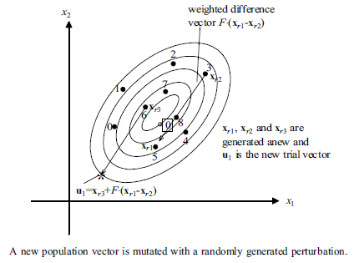
Fig. 5

Slide 20
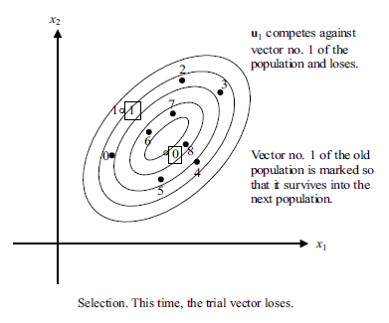

Slide 21
Steps for Differential Evolution (DE)
Consider a maximization or minimization problem:
Maximize or Minimize Fitness Function F(x) = f(x)
Initial population range is given as x_{L} ≤ x ≤ x_{U} where x = [x⁽⁰⁾ x⁽¹⁾ ... x^{(Np)}]^{T} and x^{(i)} = [x₁^{(i)}, x₂^{(i)}, ...., x_{N}^{(i)}] where i = 0, 1, 2, ..., (N_{p} – 1)
For unconstrained optimization, boundary values are not applicable to evolved variables whereas for constrained optimization, evolved variables should follow it strictly.
Important steps for DE realization
Uniform initial population creation
Fitness function Evaluation
Application of DE operators: Mutation, Crossover, Selection
Check boundary conditions and termination criteria

Slide 22
Initial Population Creation
DE uses following code for uniform creation of initial population x = [x⁽⁰⁾ x⁽¹⁾ x⁽²⁾ ... x^{(Np)}]^{T} of size N_{p}×N, where N = no. of variables and N_{p} = no. population members:
Note: Row no. varies from 0 to (N_{p} – 1) and column no. varies from 1 to N.

Slide 23
Evaluation of DE Fitness Function
For minimization, it is called as Cost Function.
For maximization, it is called as Profit Function.

Slide 24
Differential Mutation
For the 1×N parameter vector x^{(i)}, we have differential mutation defined as
v^{(i)} = F × (x^{(r1)} – x^{(r2)}) + x^{(r3)}
where
i = 0, 1, 2, …, (N_{p} – 1)
F is Amplification factor
random integer indexes r₁ ≠ r₂ ≠ r₃ ≠ i ∈ {0, 1, 2, …, (N_{p} – 1)}

Slide 25
Crossover and Trial vector
Generate a 1×N random number vector and compare it with constant Crossover Rate (CR), which results in a logical constant given as follows:
K₁^{(i)} = rand(1×N) ≤ CR
For example: K₁^{(i)} = [0.9 0.3 0.8 0.5 0.2] ≤ 0.8 = [0 1 1 1 1]
Generate another logical constant K₂^{(i)} which is complement of K₁^{(i)} as follows:
K₂^{(i)} = K₁^{(i)} < 0.5
For example: K₂^{(i)} = [0 1 1 1 1] < 0.5 = [1 0 0 0 0]

Slide 26
Generate trial vector as a result of crossover operation between mutation and population vectors as given below:
u^{(i)} = K₁^{(i)} v^{(i)} + K₂^{(i)} x^{(i)}
Above equation means that if random values in crossover operation are
less than or equal to CR, take element resulting from mutation operation as trial population element,
greater than CR, take current population element as trial population element.

Slide 27
Selection and Next Generation Population
Evaluate fitness function F(u) for the trial vector u.
Compare F(u^{(i)}) with F(x^{(i)}) such that if
F(u^{(i)}) ≤ F(x^{(i)}), then x^{(i)} := u^{(i)} i.e. trial vector replaces current population vector for next generation DE optimization.
F(u^{(i)}) > F(x^{(i)}), then x^{(i)} := x^{(i)} i.e. keep current population vector for next generation DE optimization.

Slide 28
Termination criteria
Following termination criteria can be used to Stop DE procedure.
Maximum number of Generations, say G = 100, is reached.
After certain number of generations, say G = 50, change in fitness function values for two consecutive generations is than threshold value, say
{(f_{G=52})-(f_{G=51}) < 10⁻⁶.

Slide 29
Choice of Key Parameters
Population size should be 5-10 times more than the dimension of the problem.
Choose F=0.5 initially. If this leads to premature convergence, then increase F.
Optimal range of F is 0.4 < F < 1
Choose CR=0.9 first, then CR=0.1.
Based on the speed, choose a value between 0 and 1.

Slide 30
Numerical Example for DE
Use unconstrained DE to minimize the objective function:
f(x₁, x₂) = x₁ - x₂ + 2x₁² + 2x₁x₂ + x₂²
Following additional information are provided:
(a) Boundary values of variables: 0 ≤ x₁, x₂ ≤ 6.
(b) Initial population of variables (x₁, x₂), given in Table 1.
(c) Take crossover rate (CR) = 0.8, amplification factor (F) = 1.2
(d) Random indexes r₁, r₂ and r₃ for mutation operation in first generation are given in Table 1 with difference vector represented as (x ^{(r1)} – x ^{(r2)}).
(e) Random number vector K₁ for crossover operation in first generation is given in Table 1.
Show calculations for first generation to obtain (i) fitness function (ii) mutation vector (iii) trial vector (iv) next generation population.

Slide 31
Table 1
Pop no | Initial x₁ | Initial x₂ | r₁ | r₂ | r₃ | K₁
0 | 3.677337 | 0.222648 | 8 | 14 | 7 | [0.460200 0.699338]
1 | 2.338032 | 3.289922 | 14 | 15 | 3 | [0.894391 0.591400]
2 | 0.528440 | 5.870270 | 4 | 6 | 16 | [0.317430 0.260761]
3 | 1.187137 | 4.523740 | 2 | 7 | 6 | [0.381619 0.315992]
4 | 3.133475 | 4.677932 | 15 | 11 | 13 | [0.058299 0.882461]
5 | 3.216689 | 2.511420 | 19 | 15 | 0 | [0.659134 0.978825]
6 | 0.447552 | 1.098901 | 15 | 10 | 14 | [0.115894 0.613161]
7 | 4.642198 | 1.944511 | 1 | 19 | 3 | [0.086053 0.824881]
8 | 2.412028 | 0.662900 | 3 | 18 | 13 | [0.095357 0.457195]
9 | 5.517039 | 5.075050 | 19 | 16 | 17 | [0.006763 0.796946]
10 | 4.422031 | 4.354949 | 16 | 11 | 7 | [0.214108 0.073992]
11 | 3.360381 | 3.322859 | 15 | 2 | 9 | [0.845929 0.354696]
12 | 4.689647 | 2.206954 | 2 | 6 | 10 | [0.781496 0.255899]
13 | 4.020225 | 3.727019 | 9 | 19 | 17 | [0.062814 0.146946]
14 | 4.645876 | 2.039149 | 8 | 3 | 5 | [0.564136 0.544190]
15 | 4.023861 | 3.511431 | 17 | 11 | 18 | [0.244590 0.716581]
16 | 5.000684 | 5.525994 | 11 | 14 | 4 | [0.005858 0.551914]
17 | 3.093430 | 4.681739 | 8 | 14 | 7 | [0.604323 0.201341]
18 | 4.498183 | 2.810695 | 9 | 7 | 13 | [0.889923 0.197326]
19 | 5.460903 | 3.884746 | 0 | 9 | 6 | [0.127865 0.064069]

