Slide 2
RBF network
This is becoming an increasingly popular neural network with diverse applications and is probably the main rival to the multi-layered perceptron(MLP)
Much of the inspiration for RBF networks has come from traditional statistical pattern classification techniques

Slide 3
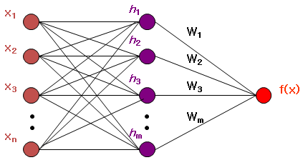
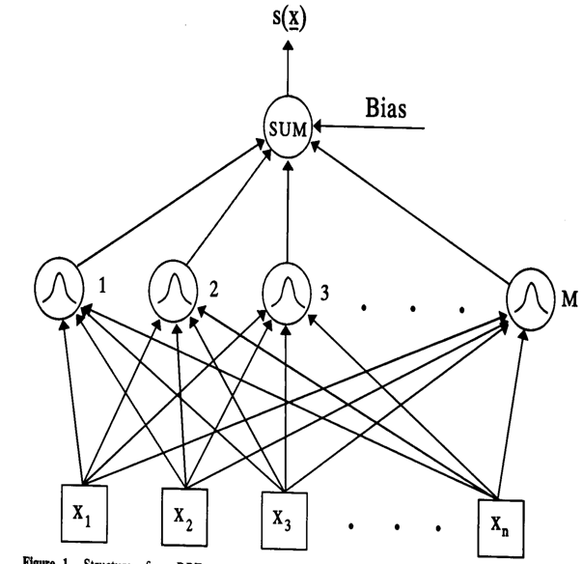

Slide 4
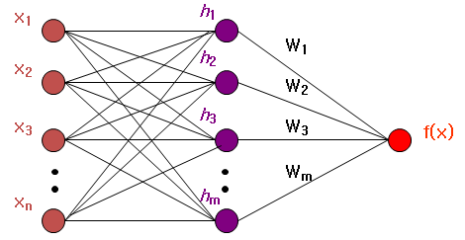
Radial-Basis Function network (RBF) involves three layers with entirely different roles.
The input layer made up of source nodes that connect the network to its environment.
The second layer, the only hidden layer, applies a nonlinear transformation from the input space to the hidden space
The output layer is linear, supplying the response of the network to the activation pattern applied to the input layer.

Slide 5
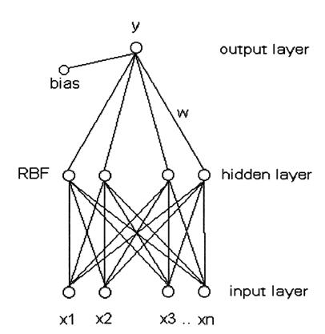
RBF network
The basic architecture for a RBF is a 3-layer network,
The input layer is simply a fan-out layer and does no processing.
The second or hidden layer performs a non-linear mapping from the input space into a (usually) higher dimensional space in which the patterns become linearly separable.

Slide 6
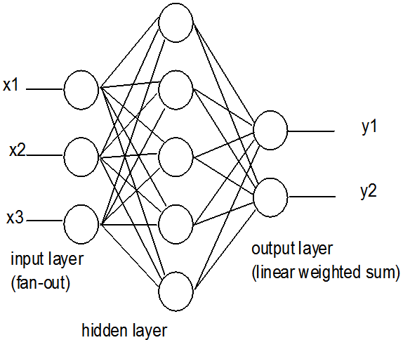
Output layer
The final layer performs a simple weighted sum with a linear output.
If the RBF network is used for function approximation (matching a real number) then this output is fine.
However, if pattern classification is required, then a hard-limiter or sigmoid function could be placed on the output neurons to give 0/1 output values.

Slide 7
RBF network is a three-layer feedback network, in which each hidden unit implements a radial activation function and each output unit implements a weighted sum of hidden units output.
Its training procedure is usually divided into two stages.
First, the centers and widths of the hidden layer are determined by clustering algorithms.
Second, the weights connecting the hidden layer with the output layer are determined by Singular Value Decomposition or Least Mean Squared algorithms.
The number of basis functions controls the complexity and the generalization ability of RBF networks.
RBF networks with too few basis functions cannot fit the training data adequately due to limited flexibility

Slide 8
HIDDEN NEURON MODEL
Hidden units: use radial basis functions
φ_{σ}( || x - t||)
the output depends on the distance of
the input x from the center t
x₁
φ_{σ}( || x - t||)
t / c/ μ is called center
σ is called spread
center and spread are parameters
x₂
x_{m}

Slide 9
RBF network parameters
What do we have to learn for a RBF NN with a given architecture?
  The centers of the RBF activation functions
  the spreads of the Gaussian RBF activation functions
  the weights from the hidden to the output layer
Different learning algorithms may be used for learning the RBF network parameters ( centers, spreads and weights).
Two levels of Learning
  Center and spread learning
  Output layer Weights Learning

Slide 10
Various learning strategies
how the centers of the radial-basis functions of the network are specified.
Fixed centers selected at random
Self-organized selection of centers
Supervised selection of centers

Slide 11
Learning Algorithm 1
Centers: are selected at random
  centers are chosen randomly from the training set
Spreads: are chosen by normalization:
Then the activation function of hidden neuron ’i’ becomes:

Slide 12
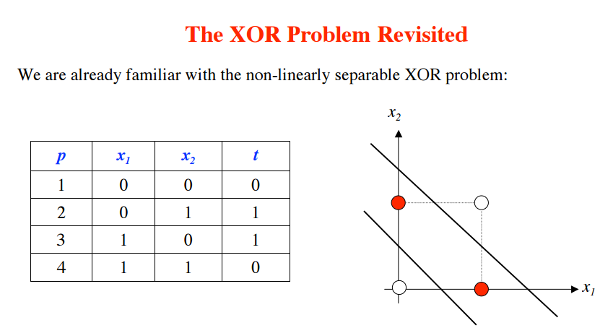

Slide 13

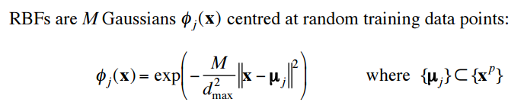

Slide 14
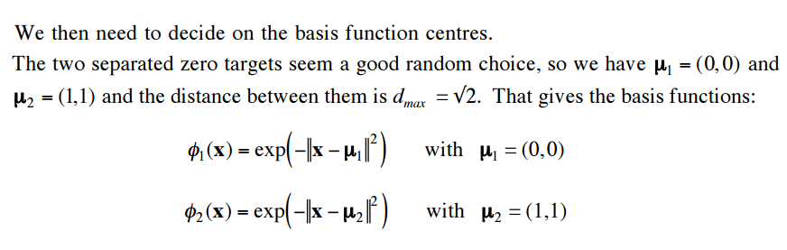

Slide 15
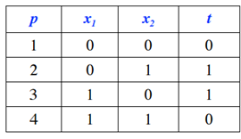
Select all σ’’s the same and equal to some multiple of the average distance between basis function center µ’s. (some authors recommend 1/4 of dist between clusters)

Slide 17
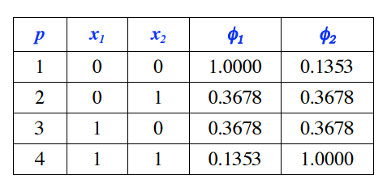

Slide 18
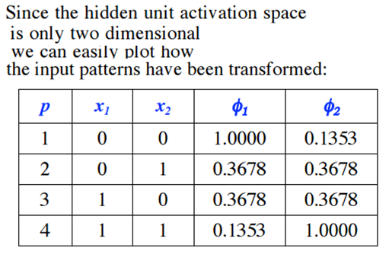
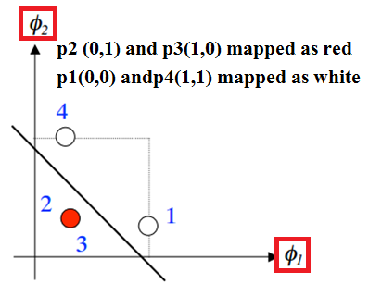

Slide 19
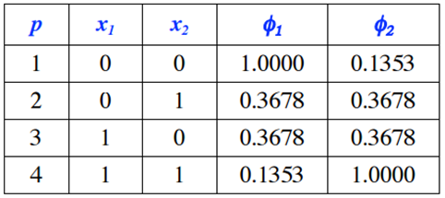
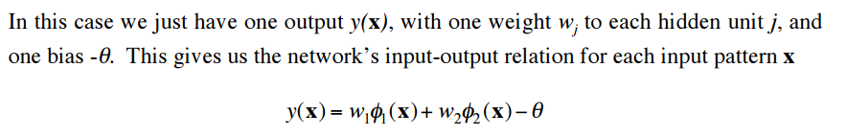

Slide 20
