Slide 1
Document Intelligence Platform
Intelligent Document Extraction, Validation & API Platform
AI Engineer Intern Technical Case Study
End-to-end document upload → extraction → validation → persistence → dashboard
Supported documents: Invoice, Balance Sheet, Profit & Loss, Cash Flow Statement
Document Intelligence Platform | AI Engineer Intern Technical Case Study | 1

Slide 2
Problem & Objective
Convert financial documents in PDF/JPG/PNG into structured, machine-readable information.
Extract meaningful visible fields, comparative-period values, tables and invoice line items.
Validate financial relationships using deterministic arithmetic checks with configurable tolerance.
Expose results through REST APIs and a browser dashboard, with persistent database storage.
Return PASS / FAILED processing outcomes and evidence such as source text and page number.
Document Intelligence Platform | AI Engineer Intern Technical Case Study | 2

Slide 3
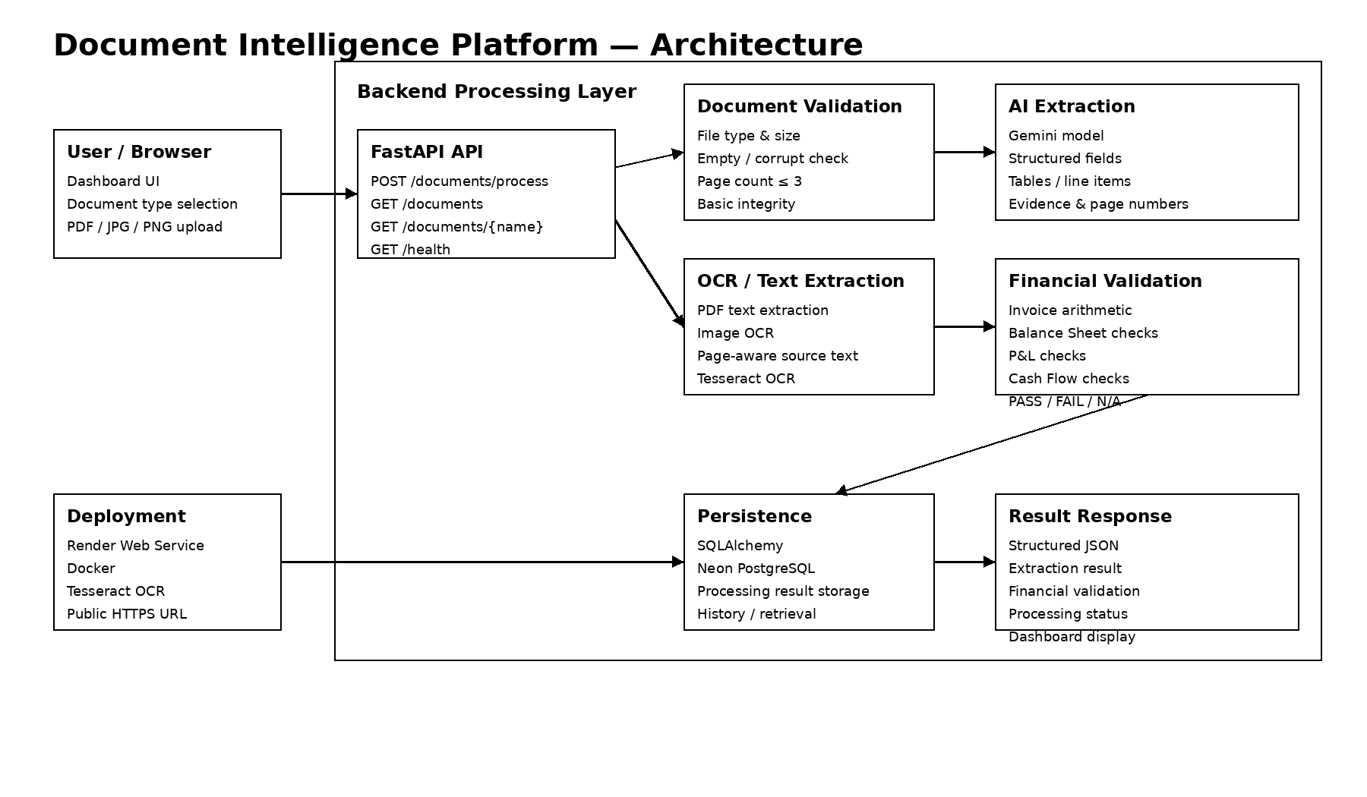
Solution Architecture
Document Intelligence Platform | AI Engineer Intern Technical Case Study | 3

Slide 4
Processing Pipeline
1. Validate upload: supported type, file integrity, size and maximum 3 pages.
2. Extract text from PDFs; use OCR for image/scanned documents.
3. Send page-aware content to Gemini for structured extraction.
4. Normalize extracted numeric values while preserving original evidence.
5. Run document-type-specific financial validation.
6. Store the complete result in PostgreSQL and return structured JSON.
7. Dashboard renders metadata, fields, tables, validation and processing history.
Document Intelligence Platform | AI Engineer Intern Technical Case Study | 4

Slide 5
Technology Stack
Backend: Python, FastAPI, Pydantic, SQLAlchemy
Document processing: PyMuPDF, Pillow, Tesseract OCR
AI extraction: Google Gemini structured-output workflow
Database: Neon PostgreSQL
Frontend: HTML, CSS, JavaScript
Deployment: Render Web Service + Docker
API documentation: FastAPI Swagger / OpenAPI
Document Intelligence Platform | AI Engineer Intern Technical Case Study | 5

Slide 6
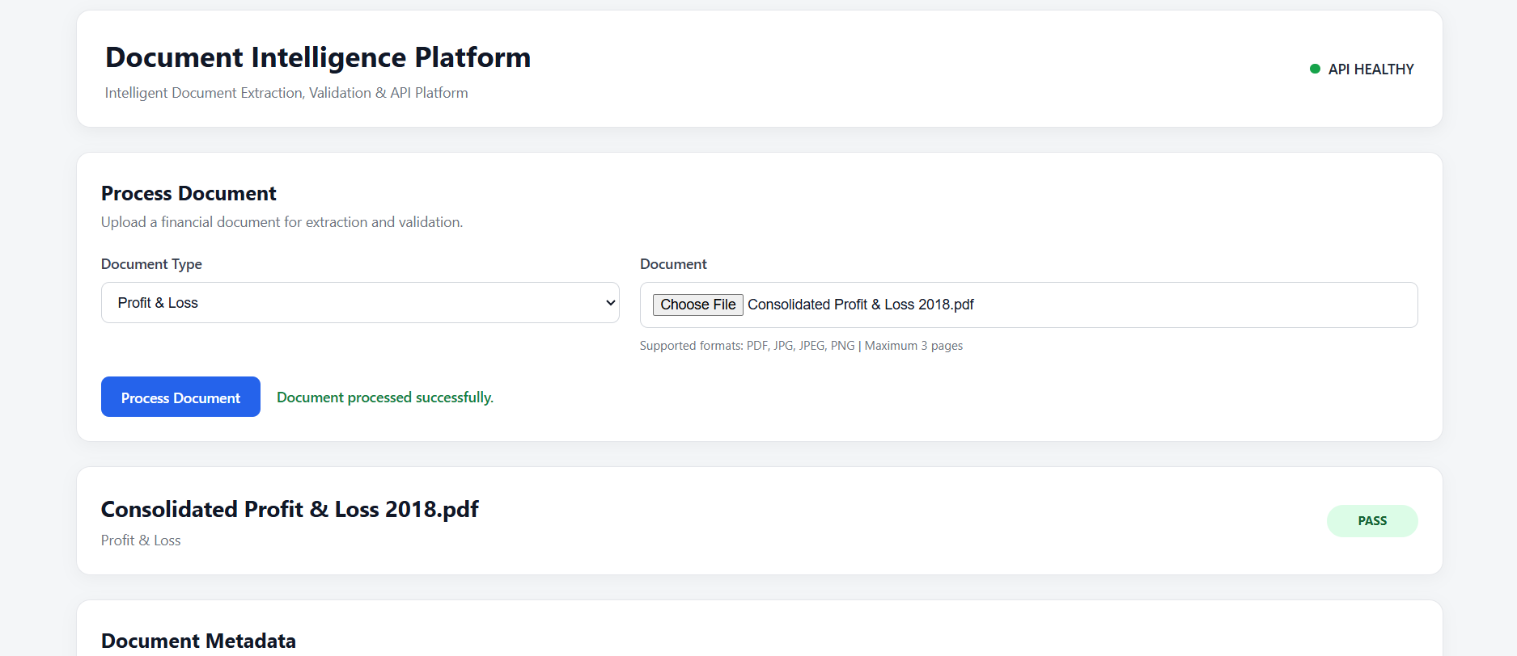
Production Demo — Successful Extraction
Document Intelligence Platform | AI Engineer Intern Technical Case Study | 6

Slide 7
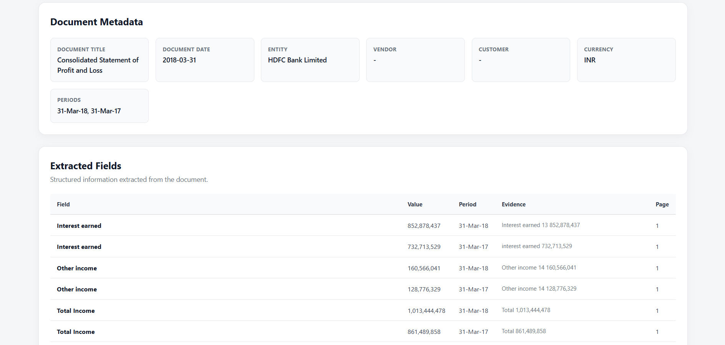
Structured Extraction & Evidence
Document Intelligence Platform | AI Engineer Intern Technical Case Study | 7

Slide 8
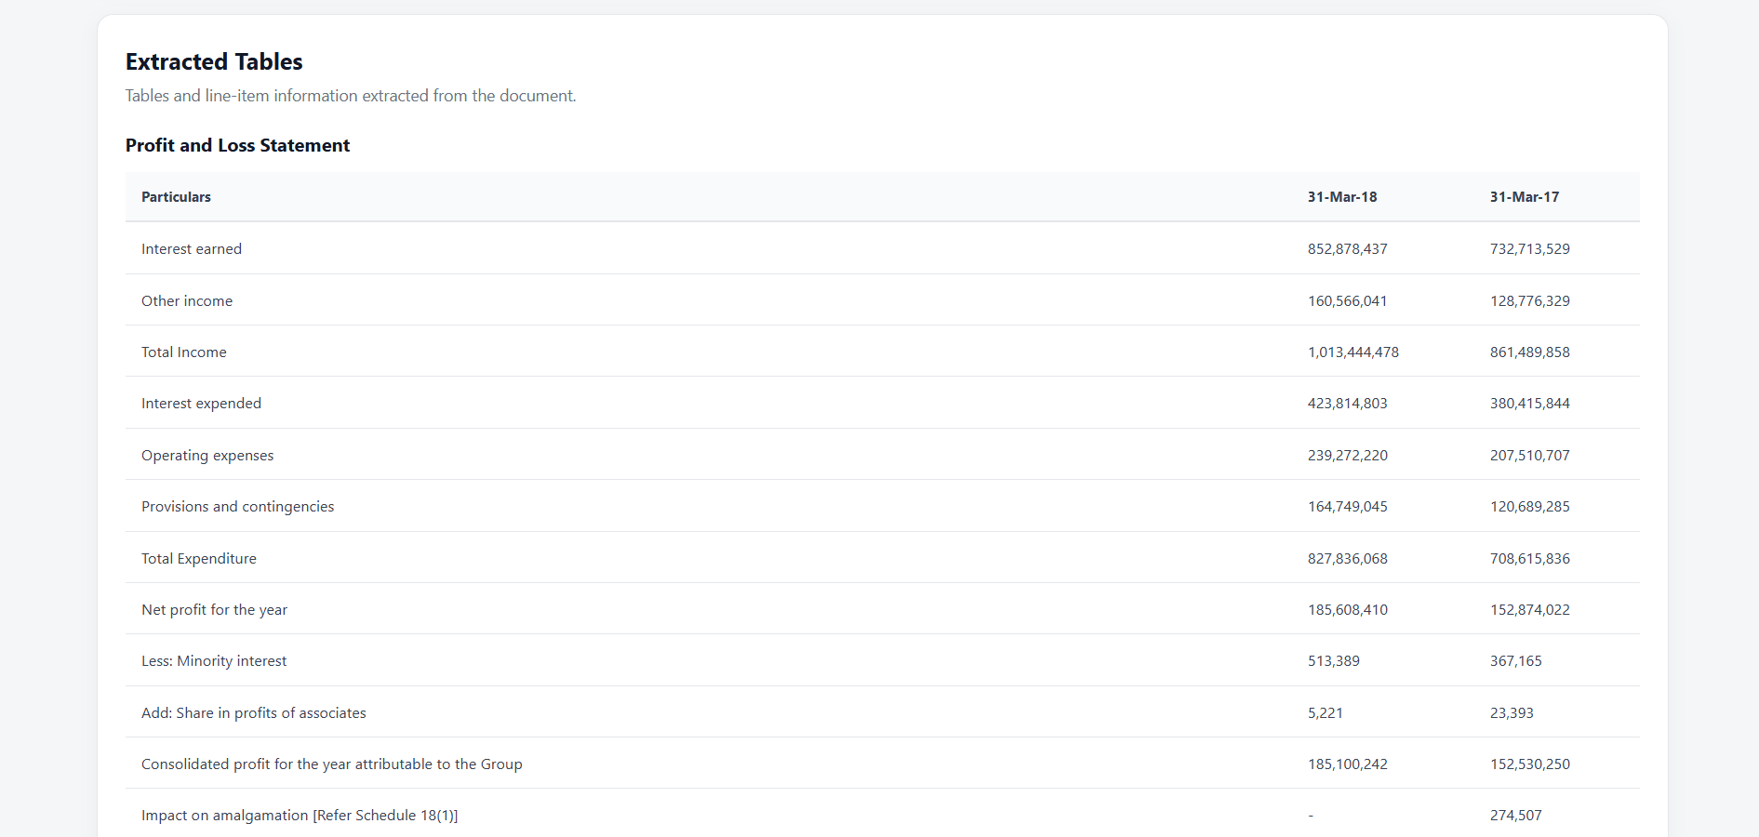
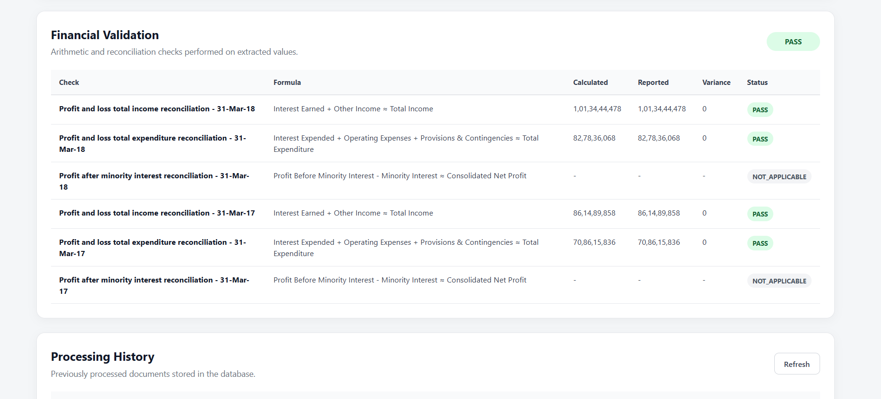
Tables & Financial Validation
Document Intelligence Platform | AI Engineer Intern Technical Case Study | 8

Slide 9
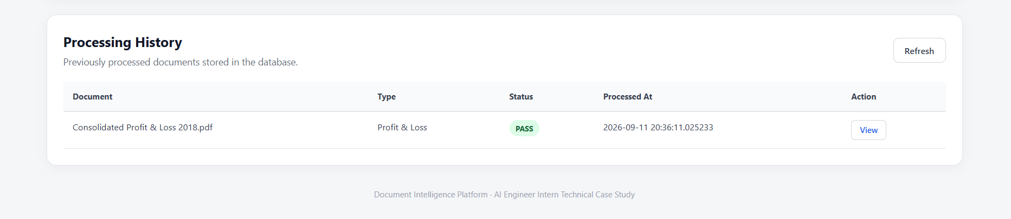
Persistence & API
Persistent processing history is stored in Neon PostgreSQL.
Public REST endpoints support processing, listing, retrieval by document name and health checks.
Swagger/OpenAPI is publicly available on the deployed service.
Document Intelligence Platform | AI Engineer Intern Technical Case Study | 9

Slide 10
Validation Strategy
Invoice: quantity × unit price, line-total reconciliation, tax/total arithmetic.
Balance Sheet: assets vs liabilities + equity and component reconciliations.
Profit & Loss: income/expenditure reconciliations for each comparative period.
Cash Flow: operating + investing + financing + FX reconciliation and opening/closing cash.
Missing required inputs produce NOT_APPLICABLE rather than assumptions.
Tolerance is configurable through FINANCIAL_TOLERANCE.
Document Intelligence Platform | AI Engineer Intern Technical Case Study | 10

Slide 11
Testing & Reliability
Automated test suite: 18 passed, 3 skipped (direct Gemini tests skipped after free-tier quota exhaustion).
Validated file handling, extraction schema, OCR, financial calculations, database operations and document service flow.
Production PASS flow verified with Consolidated Profit & Loss 2018.pdf.
Production persistence and retrieval verified through Processing History and View.
AI provider fallback is implemented for Gemini model availability/quota failures.
Document Intelligence Platform | AI Engineer Intern Technical Case Study | 11

Slide 12
Deployment & Security
Frontend and API are publicly deployed through a Render Web Service.
Docker image includes Tesseract OCR for production image/scanned-document support.
Neon PostgreSQL provides persistent cloud storage.
Secrets are supplied through environment variables and excluded from Git.
Configuration is externalized through environment variables and .env.example.
Free-tier instances may sleep after inactivity, increasing the first-request latency.
Document Intelligence Platform | AI Engineer Intern Technical Case Study | 12

Slide 13
Limitations & Production Improvements
Current LLM extraction depends on external model availability and quotas.
Longer documents are intentionally limited to 3 pages by the case-study requirement.
Production scaling would benefit from asynchronous job queues for long-running OCR/LLM processing.
Add stronger model-provider redundancy, retries with backoff and observability/metrics.
Add authentication, rate limiting, object storage and versioned document/result management for production.
Document Intelligence Platform | AI Engineer Intern Technical Case Study | 13

Slide 14
AI Coding Assistant Declaration
AI assistance: ChatGPT was used during development for code generation, debugging, architecture guidance, test support and documentation drafting.
All generated code was reviewed, executed, tested and modified as required.
The final implementation was validated through automated tests and live production verification.
The developer retains responsibility for understanding the implementation and explaining design decisions.
Document Intelligence Platform | AI Engineer Intern Technical Case Study | 14

Slide 15
Thank You
Document Intelligence Platform
Document Intelligence Platform | AI Engineer Intern Technical Case Study | 15

