Slide 1
Will fading gasoline inflation make the 2-year note beat a 6-month bill?
Investment research | Market prices as of November 6, 2026
2.08%
4.61%
No trade at current prices
6-month bill return
Breakeven 1.5-year yield
Recommendation
Notes:
Note 91282CRU7 vs bill 912797WX1, settle 2026-11-09, horizon 2027-05-06.

Slide 2
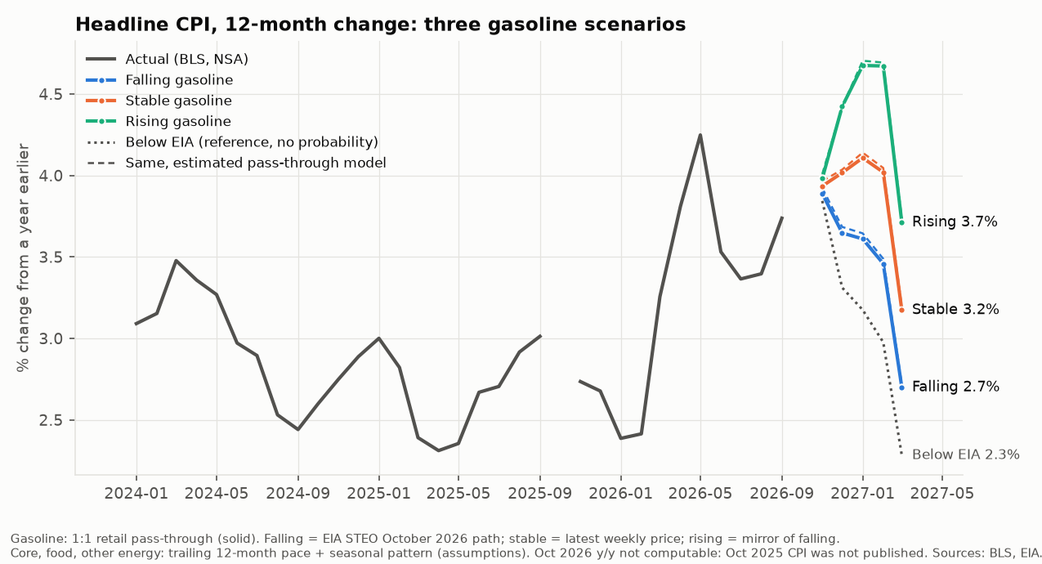
Gasoline is fading, but headline CPI only drops in March 2027 data
1
October 2026 pump prices averaged $4.31, under EIA's $4.40
2
EIA path: $3.66 by March 2027
3
Headline y/y: 2.7% (EIA) to 3.7% (rising)
4
Stable case first rises to 4.1% (January 2027)
Notes:
Core, food and other energy are assumptions (trailing 12-month pace). Sources: BLS, EIA.

Slide 3
The market already prices a 19 bp rise in the 1.5-year yield
4.42%
4.51%
4.61%
1.5-year yield if the curve does not move
2-year yield today
Market forward = breakeven
1
Fed funds (effective): 3.88%
2
Kim-Wright term premium: 0.30% (1-yr), 0.44% (2-yr)
3
The note wins only if the yield ends below the forward
Notes:
Forward from the note financed at the bill; cross-checked against the bootstrapped par curve.

Slide 4
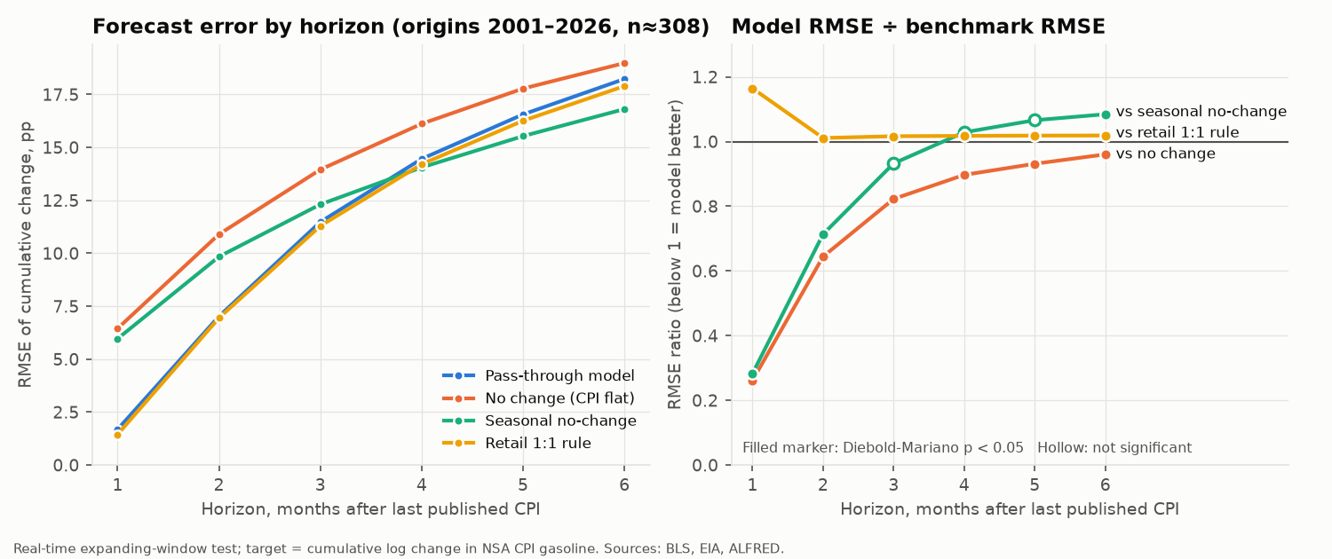
Weekly gas prices predict next month's CPI print, not gasoline itself
1
1-month error 74% below no change
2
6 months out: ratio 0.96
3
A 1:1 rule beat the estimated model, so it is the baseline
Notes:
308 real-time forecasts, 2001-01 to 2026-09.

Slide 5
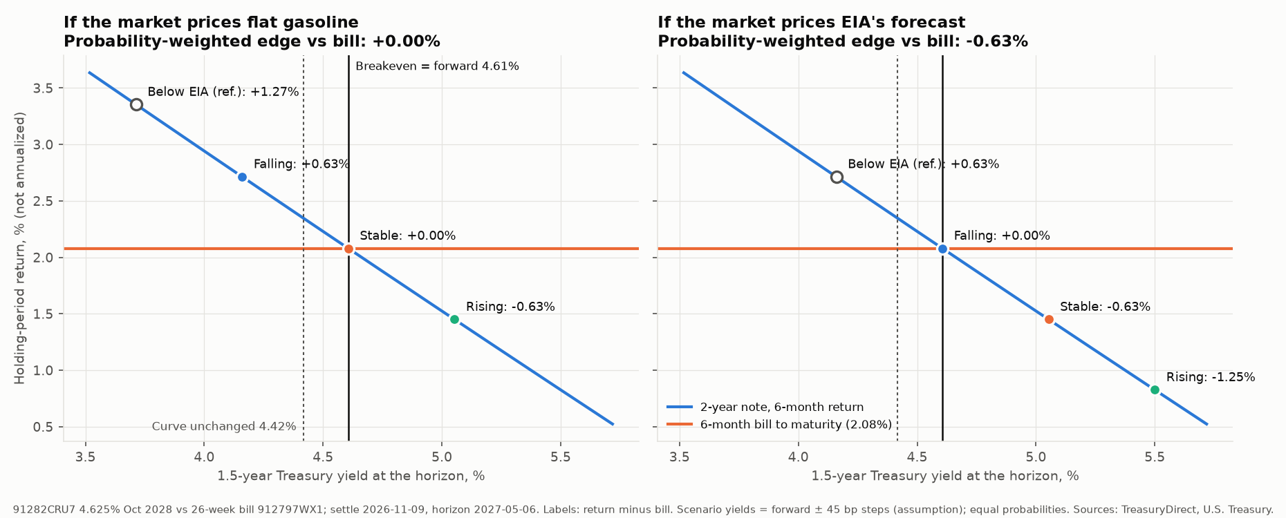
Expected edge vs the bill: +0.00% if flat gasoline is priced, -0.63% if EIA's forecast is
Notes:
Left: market prices flat gasoline. Right: market prices EIA's forecast. Scenario yields are assumptions.

Slide 6
What would change the call
1
Gasoline 5% below EIA
2
2-year yield at 4.89%
For a full month, with the 2-year yield not falling: supports the note
Now 4.51%: the entry level with the outlook unchanged
3
Core above 3.6%
4
Brent $10 over EIA
3-month annualized core: argues against the note
Supply disruption returns: rising-gasoline case
Notes:
Full trigger table in the memo, section 6.

Slide 7
No trade at current prices
1
Enter if the 2-year yield reaches 4.89% with the gasoline outlook unchanged
Next releases to watch
Nov 10: CPI for October 2026 (BLS, 8:30 ET)
Nov 10: EIA Short-Term Energy Outlook
Dec 9: FOMC decision (December 8-9), with projections
Dec 10: CPI for November 2026 (BLS, 8:30 ET)
2
Or if gasoline runs 5%+ below EIA's path while yields hold
3
Meanwhile the 6-month bill earns 2.08% to May 6, 2027
Notes:
Rerun python run_all.py after each release.

