Slide 1
sEcure data hiding in images using steganography
CAPSTONE PROJECT
Presented By: Shreyas Kumar M
College Name : NMAM Institute of Technology, Nitte
Department : Computer Science Engineering

Slide 2
OUTLINE
Problem Statement
Technology used
Wow factor
End users
Result
Conclusion
Git-hub Link
Future scope

Slide 3
Problem Statement
With the increasing need for secure communication, traditional encryption methods are often targeted by attackers. This project addresses the problem of covert message transmission by embedding secret messages inside images using Least Significant Bit (LSB) steganography. The method ensures minimal image distortion while adding a layer of passcode protection for security.

Slide 4
Technology used
Python – The primary programming language for the implementation.
OpenCV – Used for image processing and pixel manipulation.
NumPy – Helps handle image arrays efficiently.
PNG Image Format – Chosen to avoid compression loss and ensure accurate message retrieval.

Slide 5
Wow factors
Uses Least Significant Bit (LSB) steganography for hiding data.
Passcode-protected encryption & decryption.
Secure data transmission with minimal visual alteration.

Slide 6
End users
Individuals requiring secure message transmission.
Cybersecurity professionals for covert communication.
Privacy-conscious users.

Slide 7
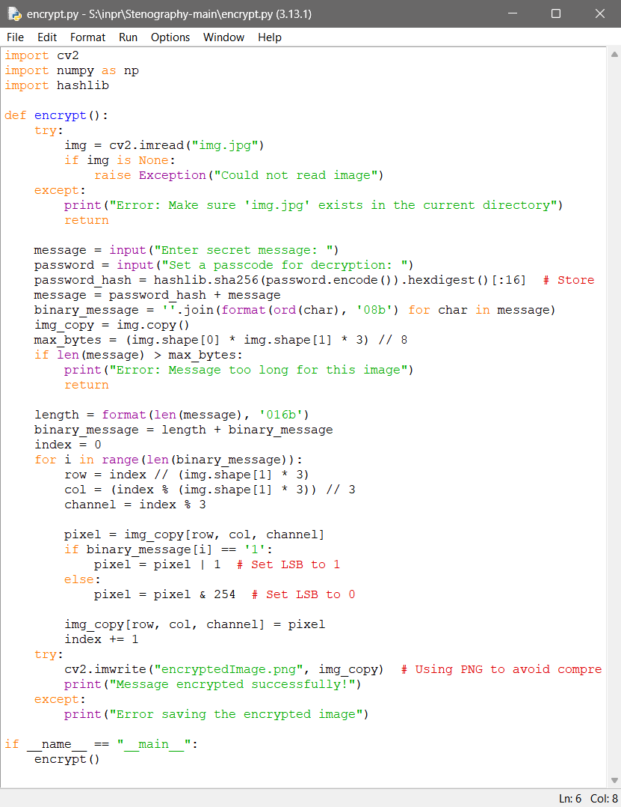
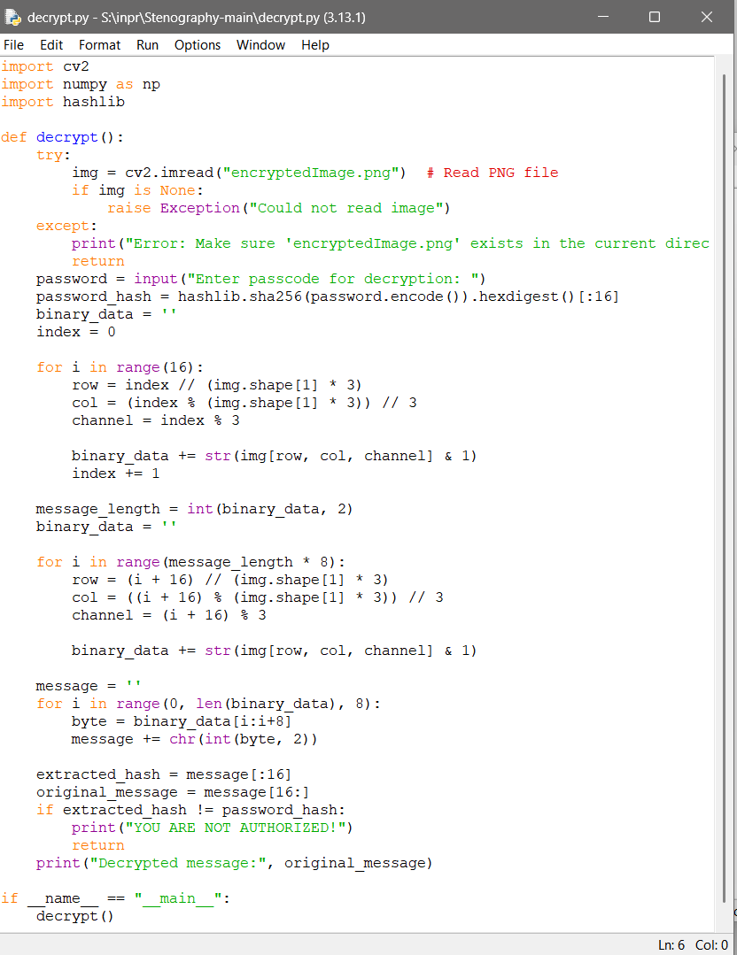

Results

Slide 8
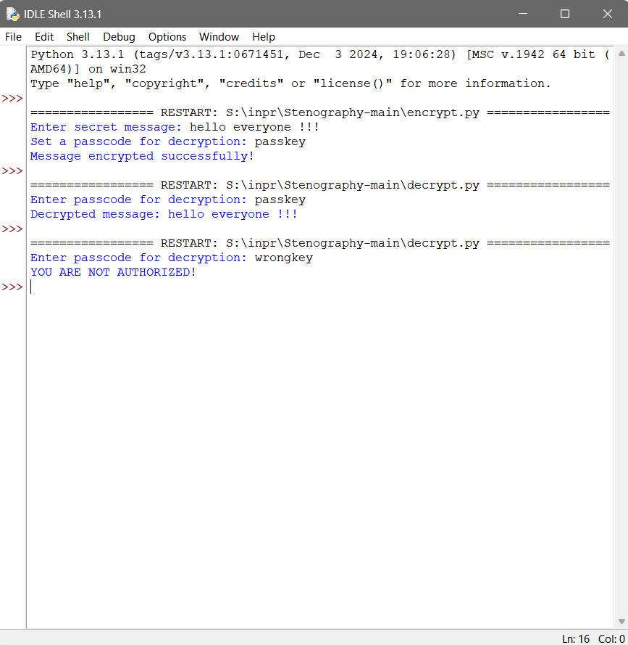


Slide 9
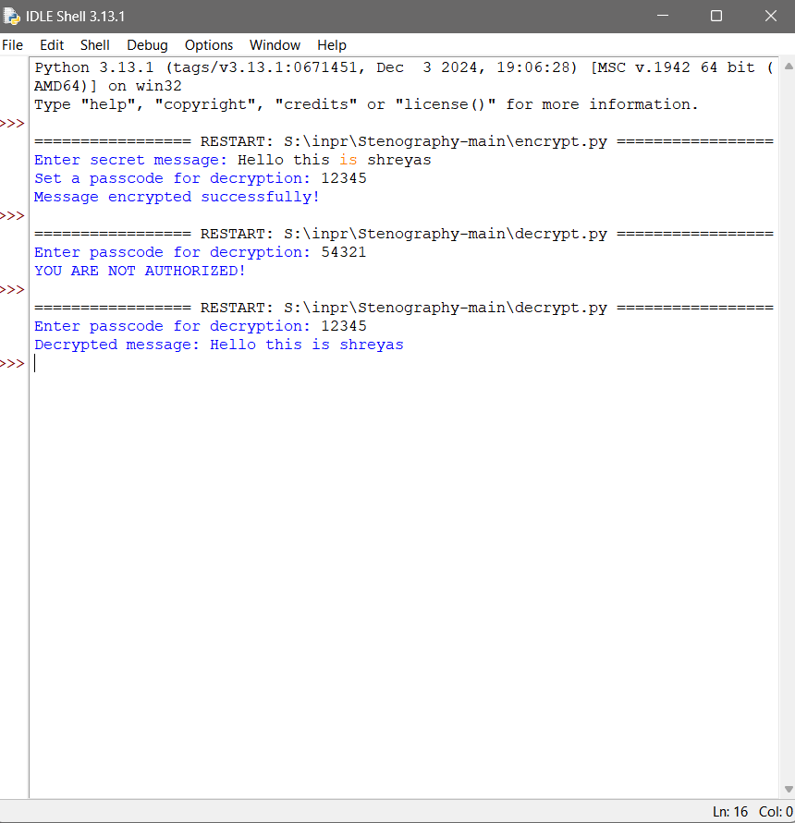

Slide 10
Conclusion
This project provides a reliable and secure method for hiding messages in images using Python and OpenCV. By leveraging LSB steganography, it allows covert communication without altering image quality. The addition of passcode protection enhances security, making it a practical solution for private messaging.

Slide 11
GitHub Link
https://github.com/shreyas-kumar-M/InvisiblePixels/tree/main

Slide 12
Future scope(optional)
AES Encryption Before Embedding – Adding an extra security layer before storing data in images.
Support for Multiple Image Formats – Expanding beyond PNG to JPEG and BMP.
GUI-Based Application – Creating a user-friendly interface for non-technical users.
Mobile Application – Implementing the project for Android and iOS devices.
Larger Storage Capacity – Optimizing encoding techniques to store larger messages within images.

Slide 13
THANK YOU

