Slide 1
Arduino Based
Authentication and Intrusion Detection System

Slide 2
Submitted by
Shreyas Malhotra | [redacted] | [redacted]

Slide 3
Project Objectives
Security Awareness: Every 13 seconds a home burglary takes places, 4 burglaries a minute, 240 an hour and nearly 6,000 a day!
Effective Protection: Installing a home security system means to protect your home and valuables, and to keep your family safe from potential break-ins by intruders.
Low-Cost: We intend to create a robust and cost effective Arduino based security solution which includes Authentication and Intrusion Detection for gates.

Slide 4
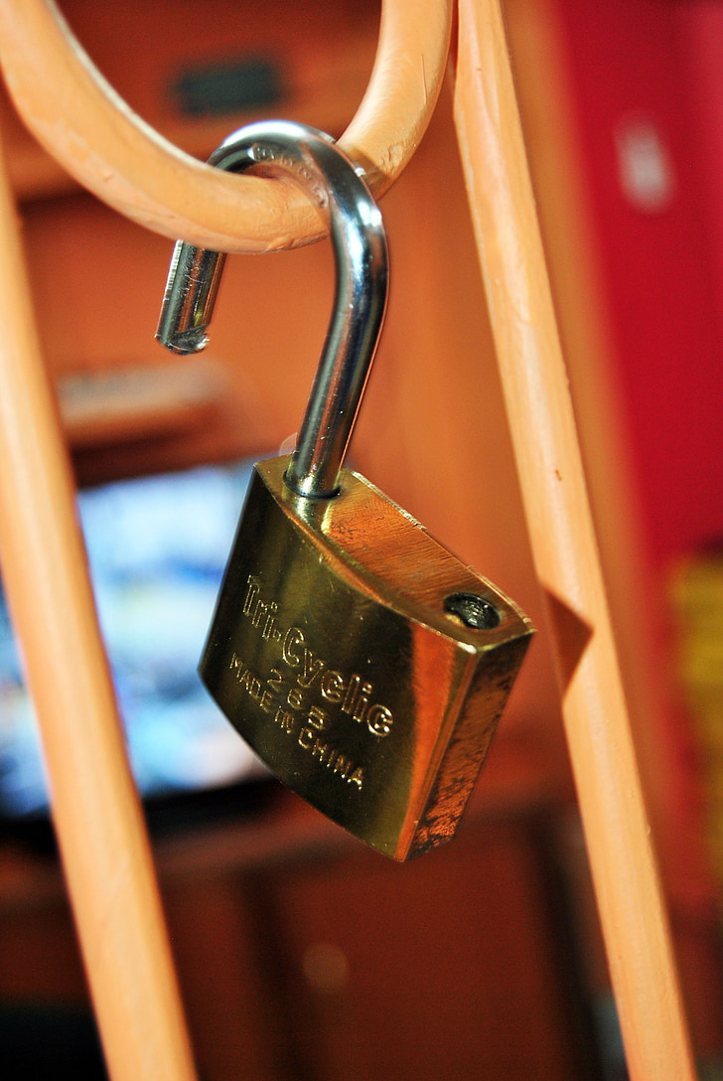
Problem Formulation
Traditional security systems often rely on basic locks and keys, which can be easily bypassed with lock picking techniques.
Considering this, we decided to opt for an electrical authentication system, which is not as easy to bypass, and requires the correct pass code to provide an individual with access.

Slide 5
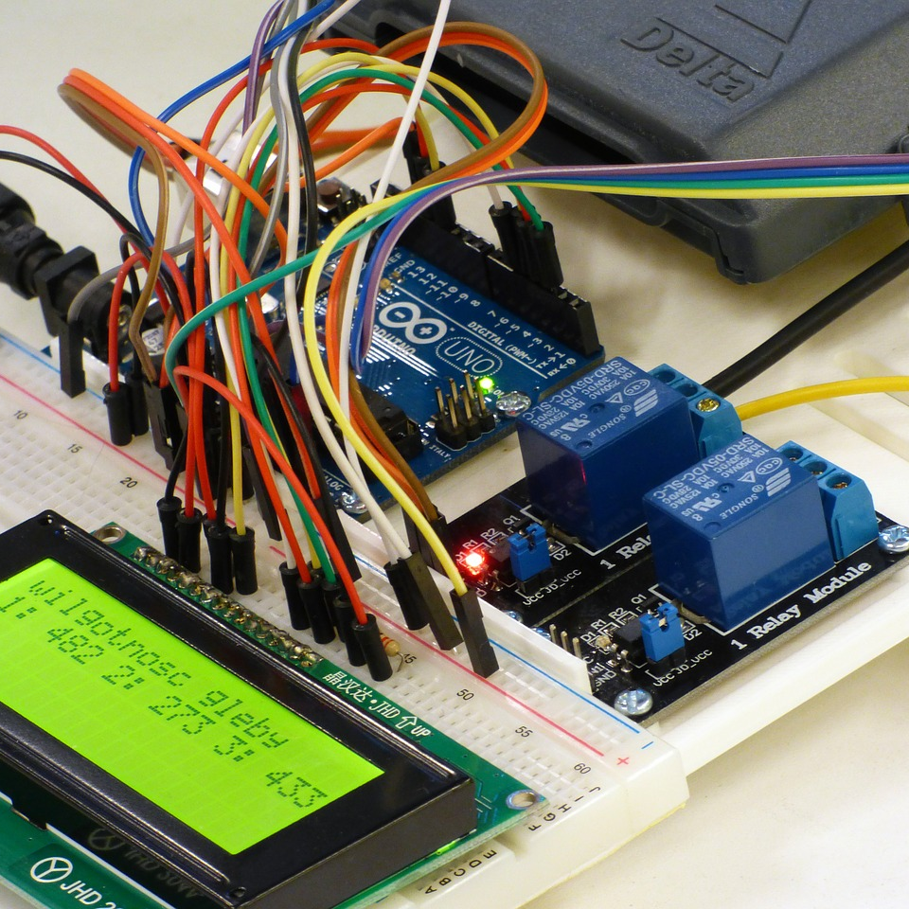
Solution Development
Our project focuses on utilizing an Arduino Uno along with some components to create a robust, cost-effective solution that not only grants access to authorized individuals via a keypad, but also detects and responds to unauthorized intrusion attempts using the PIR sensor and a loud buzzer.

Slide 6
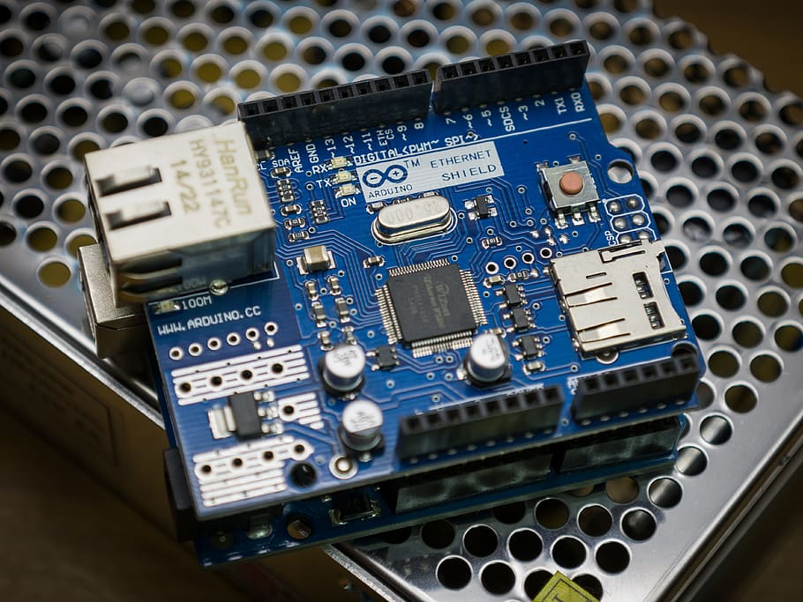
A short introduction to the Arduino Uno
The Arduino Uno is a popular open-source microcontroller board designed for easy and versatile prototyping of electronic projects.
It features an Atmel ATmega328P microcontroller, multiple digital and analog pins, and a USB interface for programming and communication with a computer.

Slide 7
An analysis of the key components used

Slide 8
List of Project Components
Arduino Uno
Half Breadboard
Servo Motor
Buzzer
PIR Sensor
4X4 Matrix Keypad
Jumper Wires

Slide 9
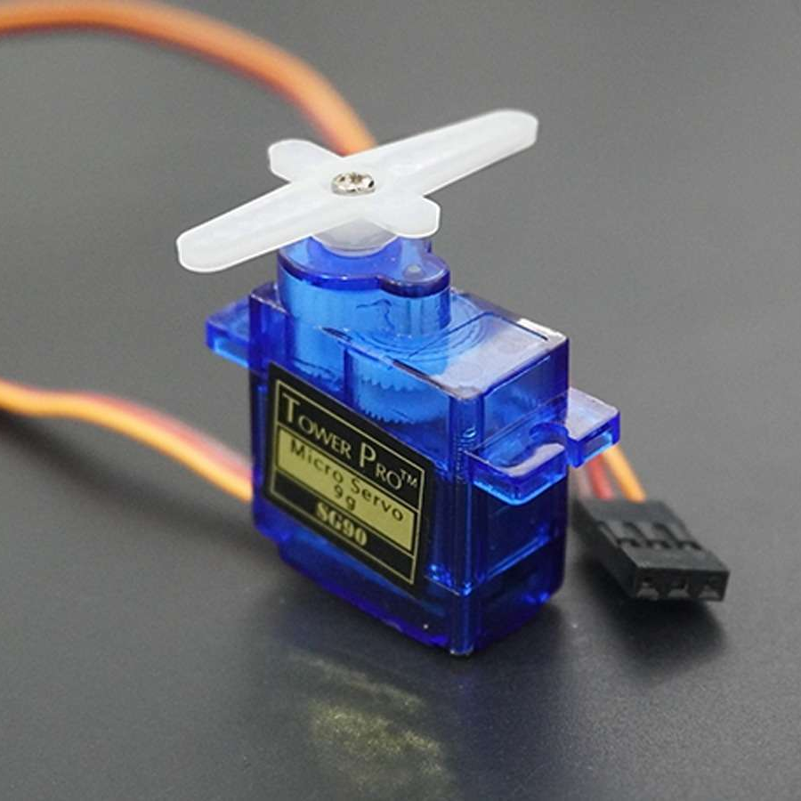
Servo Motor
A servo motor is an electric motor that uses feedback to maintain a specific position or rotation angle. It is commonly used in various applications where accurate and controlled movement is required.
Servo motors operate by receiving input signals that define their desired position, and they adjust their position to match this input.

Slide 10
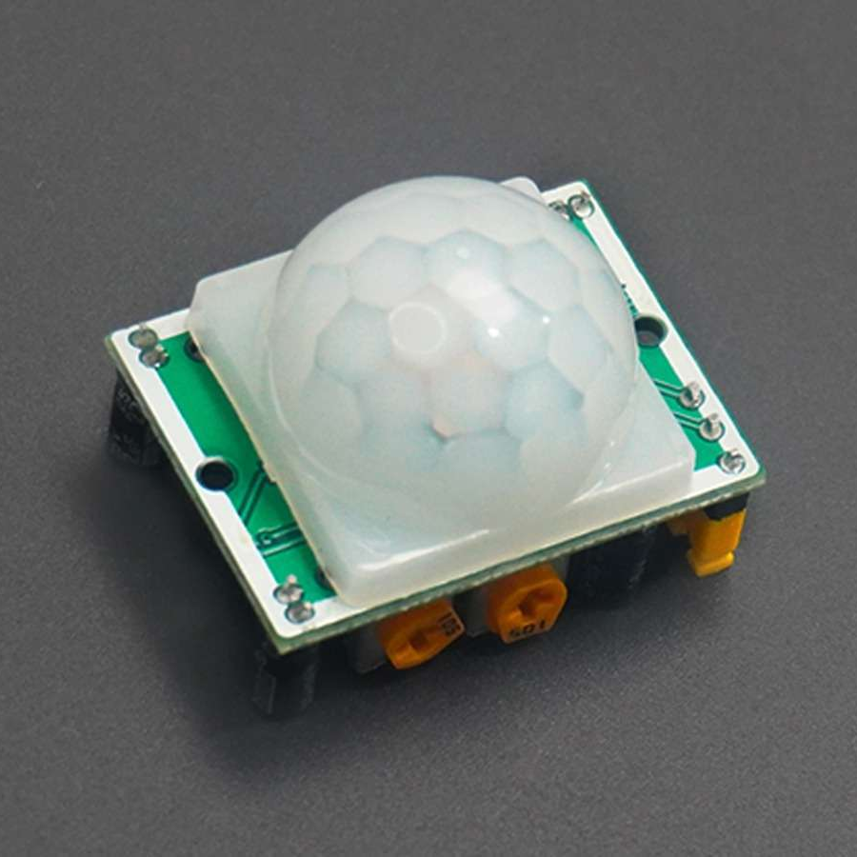
PIR Sensor
A Passive Infrared (PIR) sensor is a motion-detection device commonly used in security systems and automation. It detects changes in heat radiation within its field of view.
When a warm object, such as a person, moves within the sensor's range, it triggers an electrical signal. PIR sensors are passive, meaning they do not emit any energy themselves but instead react to infrared radiation changes.

Slide 11
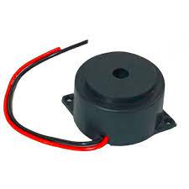
Buzzer
A buzzer is an electronic device that generates an audible sound, often a loud and distinctive beep or tone, when activated.
It is commonly used to provide audible alerts, warnings, or notifications in various applications.

Slide 12
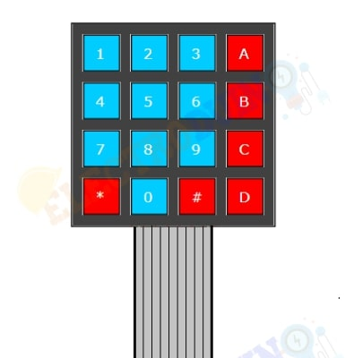
4x4 Matrix Keypad
A 4x4 keypad, also known as a matrix keypad, is a versatile input device that offers a convenient and intuitive way to interact with electronic systems.
Comprising 16 tactile keys organized in a 4x4 grid, this compact interface allows users to input numerical, alphanumeric, or custom commands.

Slide 13
Project Methodology

Slide 14
Working Methodology
Authentication: Users use the keypad to enter a specific code for authentication.
Successful Authentication: When the correct code is entered, the Arduino activates a servo motor, which opens a latch, allowing access to the secured area.
Unauthorized Intrusion: If an incorrect code is entered, or an intruder attempts unauthorized access, a PIR (Passive Infrared) sensor comes into play.
Intrusion Detection: The PIR sensor detects any movement within its range, signaling potential intrusion.
Buzzer Alert: Upon detecting unauthorized intrusion, the system triggers a loud buzzer, alerting occupants and deterring the intruder.

Slide 15
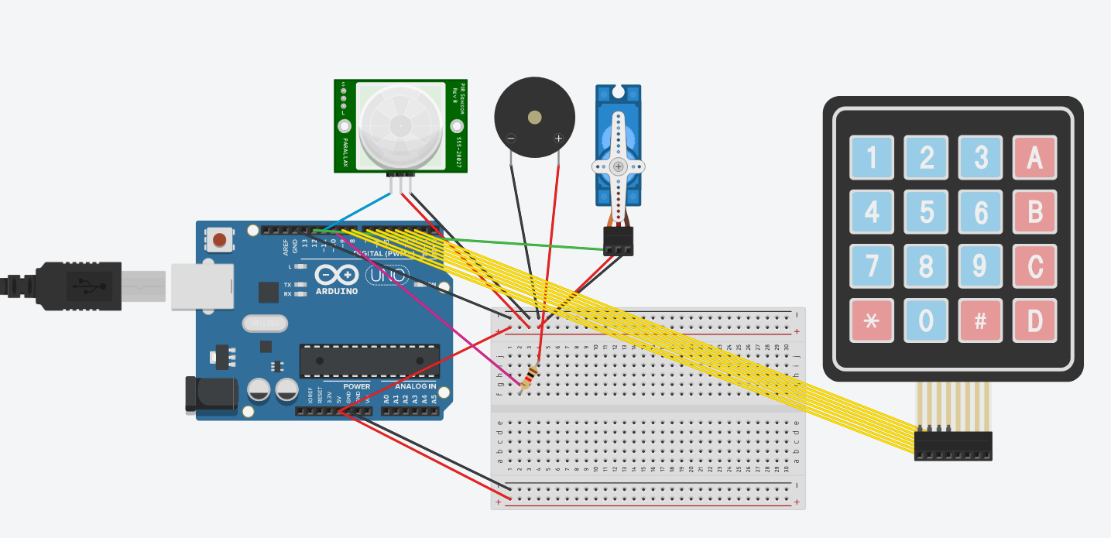
Circuit Diagram

Slide 16
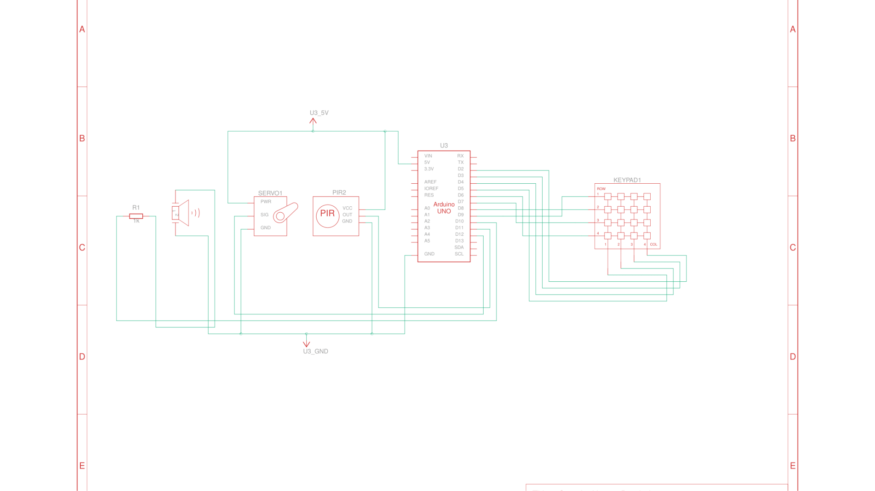
Block Diagram

Slide 17
Advantages
Enhanced Security: The project provides a higher level of security compared to traditional lock-and-key systems by requiring a specific code for access.
Open Source: Open-source nature enables community collaboration and continuous improvement, enhancing the project's security and functionality over time.
Customization: The project allows for easy code customization, making it adaptable to different security needs.
Cost-Effective: It offers a cost-effective way to improve home security, particularly in comparison to more complex commercial systems.

Slide 18
Disadvantages
Continuous Power Requirement: The system relies on continuous power, which can be a disadvantage in situations where power outages are common or in off-grid applications.
False Alarms: PIR sensors can trigger false alarms due to environmental factors like moving curtains or pets, potentially causing unnecessary disturbances.
Maintenance Requirements: Regular maintenance and troubleshooting may be necessary to ensure the system's reliability.
Code Modification for Passcode Changes: Changing the passcode requires modifying the code on the Arduino, which can be a drawback in terms of user-friendliness and convenience.

Slide 19
Future Scope
GSM Integration: Incorporating a GSM module to the system can enable it to send alerts via text messages or calls to authorized users when unauthorized access is detected or when nobody is at home. This enhances remote monitoring and security.
Mobile App Interface: Developing a mobile app to control and monitor the security system remotely, allowing users to change the passcode, view sensor status, and receive real-time alerts.
Biometric Authentication: Implementing biometric authentication methods such as fingerprint or facial recognition for even more secure and convenient access control.

Slide 20
Conclusion
In conclusion, our "Intrusion Detection" project demonstrates a practical and cost-effective approach to enhancing home security.
While it has its limitations, such as code management and false alarms, it serves as a foundation for future improvements. With potential expansions like GSM integration, mobile app control, and biometric authentication, our project can evolve to meet the ever-growing demands of modern home security.
By continuing to innovate and adapt, we can provide users with a robust, user-friendly, and customizable solution to safeguard their homes effectively.

Slide 21
Thanks!

