Slide 1
Gender Age Prediction Using CNN
Shreyas Redij - 001053076

Slide 2
Outline
Problem Statement
Data Source
Age and Gender Distribution
Feature Engineering And Data Cleaning
Technical approach and Architecture
Implementation and Code
Performance Evaluation
Results
Conclusion and Future Scope
References

Slide 3
Problem Statement
Age prediction is quite tedious task as compared to that of Gender as looks can be misleading.
Age and gender classification is an inherently challenging problem because of the discrepancy of dataset.
The goal of this project it to classify the age and gender of the faces in an image.
Our aim is to develop CNN which classifies between gender and Age
Applications for this technology have a broad scope such as video surveillance and human-computer interaction

Slide 4
Data Source
Wiki Data set has been used
We crawled all profile images from pages of people from Wikipedia with the same meta information]
Data set has 62,328 images with following information
Date of Birth
Year when the photo was taken
Path to file
Gender
Name
Location of the face
Face Detection
Face Score
Second Face Score

Slide 5
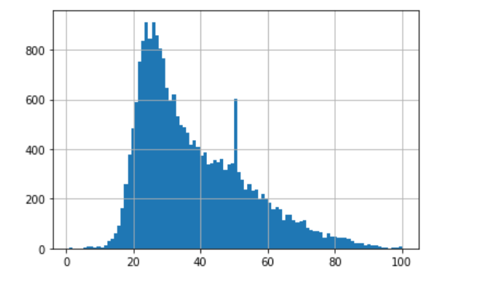
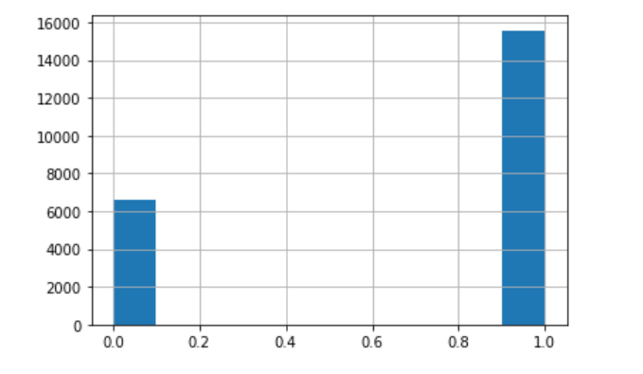
Age and Gender Disturbution

Slide 6
Feature Engineering And Data Cleaning
Dataset is available in MATLAB format hence we converted it into pandas dataframe.
Extracting age of the age from date_of_birth and photo taken filed
Take only valid ages(Between 0 to 100)
Remove pictures that with null values
Take the column which is above the threshold face score(Threshold is 3)

Slide 7
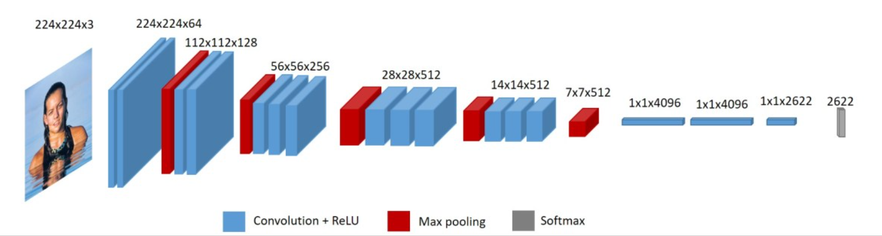
Technical approach and architecture
The ConvVGG-16 architecture for image classification

Slide 8
Technical approach and architecture
The main idea behind VGG is that we are using 3*3 kernel and increase the size of convolution layers which reduces the number of parameters for calculation.
Transfer learning
Here we have used Transfer learning using the weights from Deep Face Recognition.
The same model VGG model.
Lock the layer weights for early layers because they could already detect some patterns.
Multi-class classification problem. Loss function is categorical crossentrophy. Optimization is Adam to converge loss faster

Slide 9
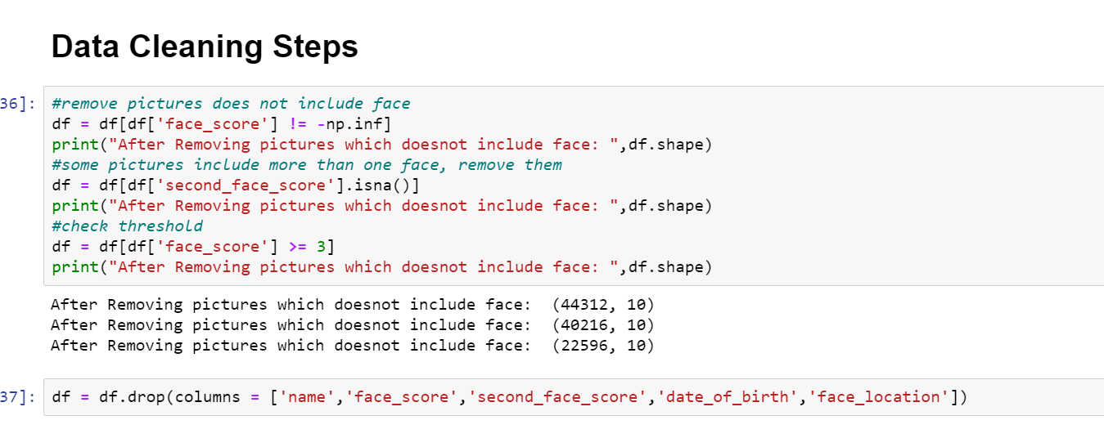
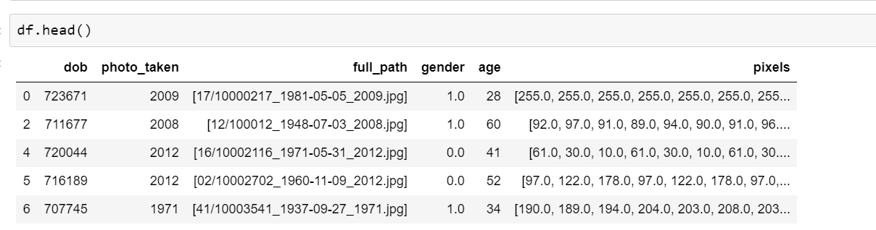
Implementation and code

Slide 10

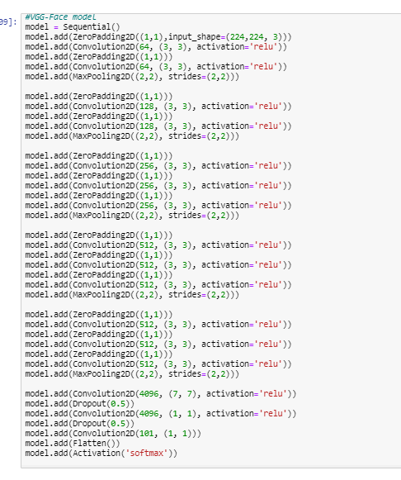
Implementation and code

Slide 11
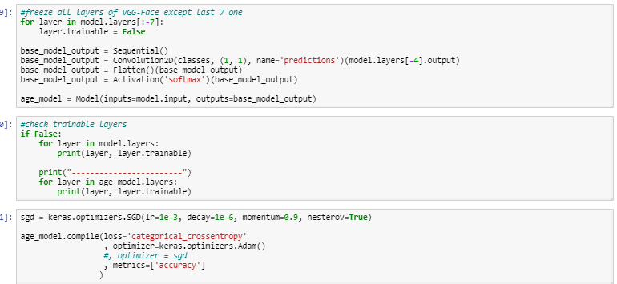
Implementation and code
Freeze all the starting layers
Apply Optimizer as Adam and loss function as categorical crossentrophy

Slide 12
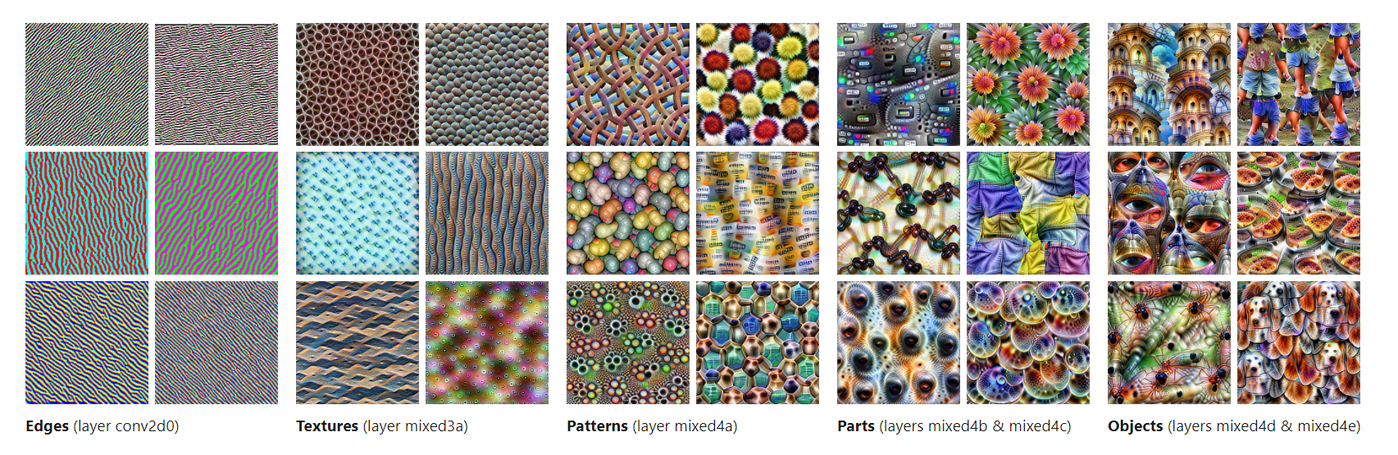
Implementation and code

Slide 13
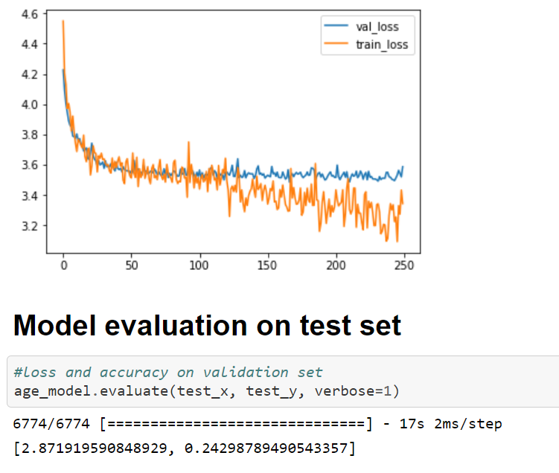
Performance Evaluation Model has been trained on NVIDIA QUADRO

Slide 14
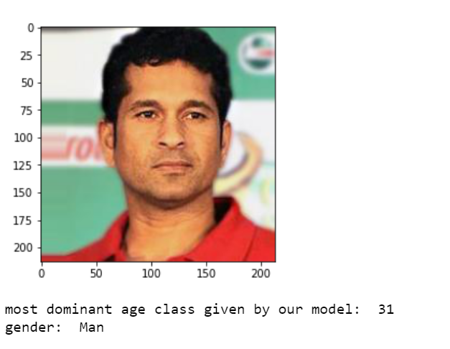
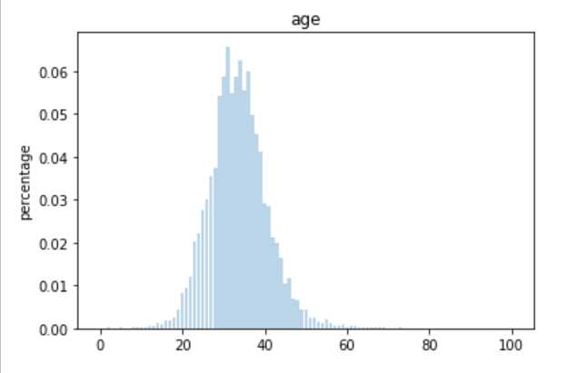
Results for our model

Slide 15
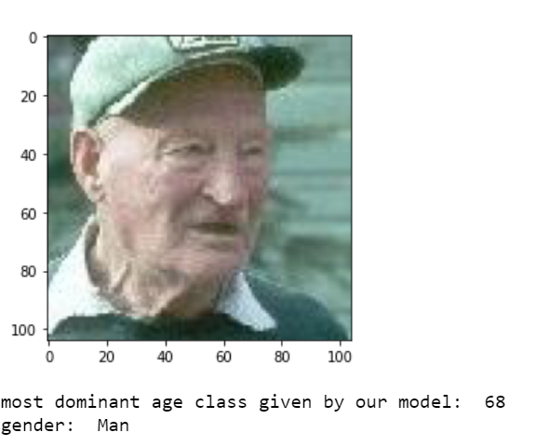
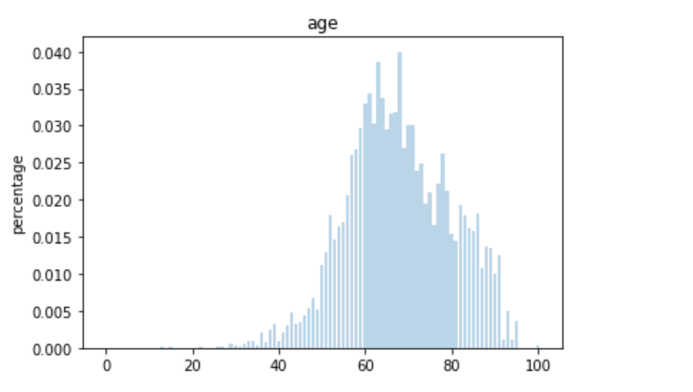
Results for our model

Slide 16
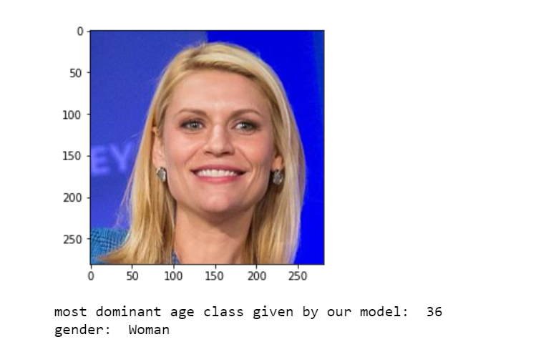
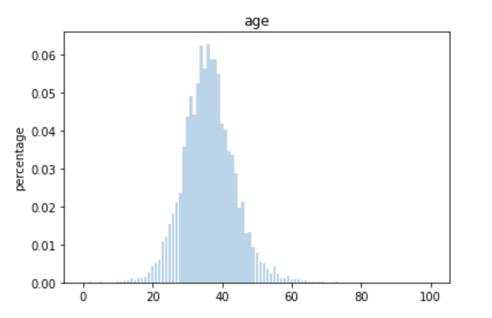
Results for our model

Slide 17
Conclusion and Future scope
We have built a model using CNN to predict age and gender.
The model accuracy can be increased if we have more labeled data for various ages .
Currently working to incorporate open CV with the current model
We need to train images with more than one face

Slide 18
References
Open CV age detection with Deep learning
https://www.pyimagesearch.com/2020/04/13/opencv-age-detection-with-deep-learning/
https://www.learnopencv.com/age-gender-classification-using-opencv-deep-learning-c-python/
Pre-Trained weights
https://sefiks.com/2018/08/06/deep-face-recognition-with-keras/
Data set
https://data.vision.ee.ethz.ch/cvl/rrothe/imdb-wiki/

Slide 19
Thank You

