Slide 1
Sentiment Analysis
Guided by Prof. Perepi Rajarajeshwari
Team members: Shreyas S (21BCE0673)

Slide 2
Introduction to Sentiment Analysis
Sentiment analysis, also known as opinion mining, is a subfield of Natural Language Processing (NLP) that focuses on identifying and extracting the subjective information from text data. It involves determining the emotional tone or sentiment behind a body of text, categorizing it as positive, negative, or neutral.
Sentiment analysis is the computational task of identifying and categorizing opinions expressed in text, especially to determine whether the sentiment is positive, negative, or neutral.
It can be applied to various types of content, such as reviews, social media posts, news articles, or customer feedback.

Slide 3
ABSTRACT
Sentiment analysis is a crucial application of natural language processing (NLP) that aims to analyse and classify the sentiments expressed in textual data. With the exponential growth ofuser-generated content on social media and other platforms, sentiment analysis has gained importance in understanding public opinion, consumer feedback, and social trends. This project focuses on developing a sentiment analysis model capable of classifying text into categories such as positive, negative, and neutral sentiments.

Slide 4
Proposed model
The proposed methodology for sentiment analysis on Amazon Alexa reviews involves the use of several machine learning algorithms to classify sentiment into positive, negative, or neutral categories. Initially, the review text is preprocessed by cleaning, tokenizing, and lemmatizing to ensure high-quality input data. For sentiment classification, XGBoost (Extreme Gradient Boosting) is used for its strong performance in handling large datasets and its ability to manage overfitting, making it effective for text classification tasks. Additionally, the Random Forest Classifier, an ensemble learning method based on decision trees, is applied for its ability to capture complex patterns in the data and its robustness against overfitting. Both models are trained on features extracted using techniques like TF-IDF, and their performance is evaluated using metrics such as accuracy, precision, recall, and F1-score to ensure optimal results in predicting user sentiment.

Slide 5
Explanation
Steps:
Text Cleaning: Removing noise, such as HTML tags, emojis, special characters,
and converting text to lowercase.
Tokenization: Splitting the text into individual words or tokens using libraries
like spaCy or NLTK.
Stop Words Removal: Filtering out common words that do not contribute
significantly to sentiment, like “the” or “and.”
Stemming and Lemmatization: Reducing words to their root forms to simplify
text and reduce vocabulary size.
Impact: Effective preprocessing enhances the relevance of features extracted for
sentiment prediction.

Slide 6
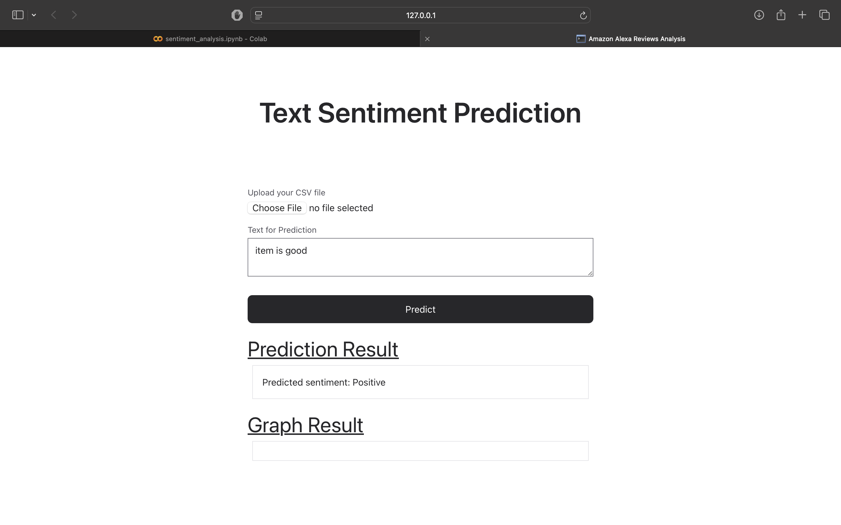
Results

Slide 7
Conclusion
The proposed sentiment analysis model for Amazon reviews provides a comprehensive framework that combines classical machine learning algorithms with advanced deep learning methods. By integrating techniques such as BERT and LSTM networks alongside ensemble learning approaches, the model is well-equipped to understand and classify the sentiment of Amazon reviews effectively. Ultimately, the ensemble learning strategy enhances the robustness and accuracy of sentiment predictions. The model’s scalability and efficiency make it suitable for processing large datasets, a key requirement for analysing Amazon’s extensive review database. Moreover, the combination of real-time processing capabilities and state-of-the-art NLP techniques positions this model to make significant contributions to understanding consumer sentiment, aiding businesses in decision-making and improving customer experiences.

