Slide 1


JSS Academy Of Technical Education,Bengaluru
Internship Presentation
On
Weather Forecast System
Using Full Stack Web Development
Shreyas P USN-1JS20CS157
Shubhankar Sharma USN-1JS20CS158

Slide 2
Abstract
The word Web Development is made up of two words, that is: Web: It refers to websites, web pages or anything that works over the internet. Development: It refers to building the application from scratch. Web development can range from developing a simple single static page to complex dynamic pages.
The Web based Weather Forecast System is meant to provide more comfortable place to receive the information of a specific city.
The intent of this project is to facilitate the user with much specificized image of data collected by the organization “Open Weather” only on single place. And to gather the data related to the search made by the traffic on the website.

Slide 3

COMPANY PROFILE
Corporate Name: PRINSTON SMART ENGINEERS
Main Office: Vishnuvardhan Statue Rd, Vishwa Priya Nagar, Begur, Bengaluru, Karnataka 560068
Phone: +91 9810 188 747
Contact Person: Mrs. Fraheen Farhath (Managing Director)
Email Address: Prinston.Smart@gmail.com
Year Stand Up: 2004
Company Category: IT Software/Embedded

Slide 4
REQUIREMENT SPECIFICATION
The system requirement and specification of our project is as follows:
Hardware Requirements
Processor: i3 Core Processor
Monitor: 1024 * 768 Resolution Color
Keyboard: Any keyboard
Motherboard: Any.
Hard disk: 1 TB HDD
I/O Device: Standard input and output devices.
Internet connection is required.
Software Requirements
VS Code
MySQL
Web Browser
Node.js

Slide 5
INTRODUCTION
Aim of the Project
It is very common in a country like India which is in tropical region on earth. Due to this nature the change in the climate is highly unpredictable but as the improvement of human race in the field of space technology the information gathering becoming easy day by day. But the distribution of this information is not easy.
Even after the gathering and distribution of the information, it is difficult to a person to find the specific detail related to the weather of the required place.
Purpose of the Project
This project is made to provide the clear image of the data to the user and the information will be specified and makes the sense of relevancy for the search made by the user, other then providing the stack of information which can be irrelevant to the user.

Slide 6
About the Project
The proposed project ids Weather Forecast website.
The role of this website is to provide a easy to use user interface which formats the information in few words with differentiable entities. This is informative to the person in day in day out. Even it can be used to provide the information on the big holdings for the promotional and informative purposes as well. By the organization which continuously monitors the weather for providing the assistance when required by the public.
Objectives of the Project:
Learn the Full Stack Web Development
Learn New Skills of color pelleting the information
Professionally
Get Constructive Feedback
Establish Yourself Professionally

Slide 7
TRAINING CONTENT
Front End Technology
HTML- Hyper Text Markup Language
HTML (Hypertext Markup Language) is a text-based approach to describing how content contained within an HTML file is structured. This markup tells a web browser how to display text, images and other forms of multimedia on a webpage. HTML is a formal recommendation by the World Wide Web Consortium (W3C) and is generally adhered to by all major web browsers.
CSS- Cascading Style Sheet
Cascading Style Sheets (CSS) is a stylesheet language used to describe the presentation of a document written in HTML or XML (including XML dialects such as SVG, MathML or XHTML). CSS describes how elements should be rendered on screen, on paper, in speech, or on other media.

Slide 8
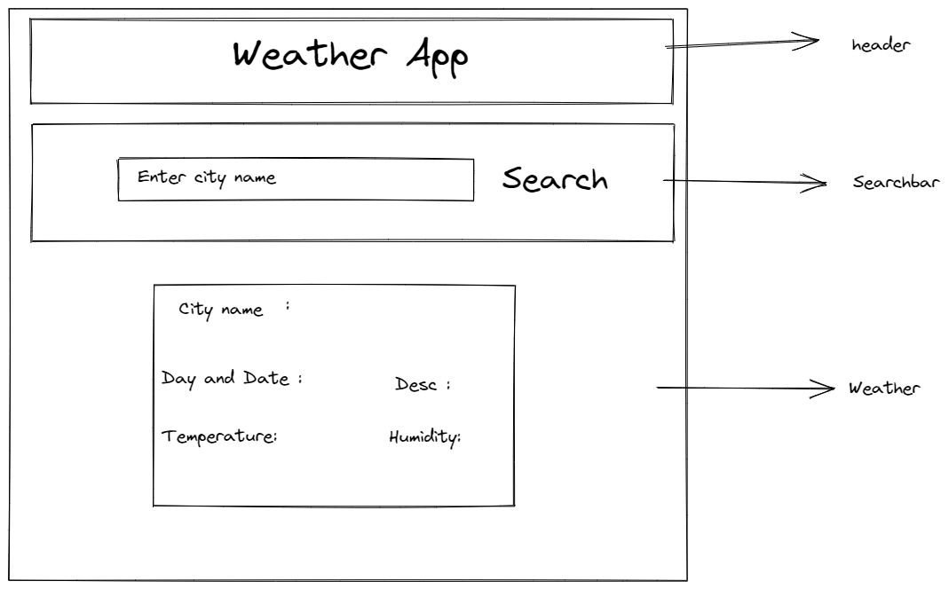
SNAPSHOTS
Website Layout

Slide 9
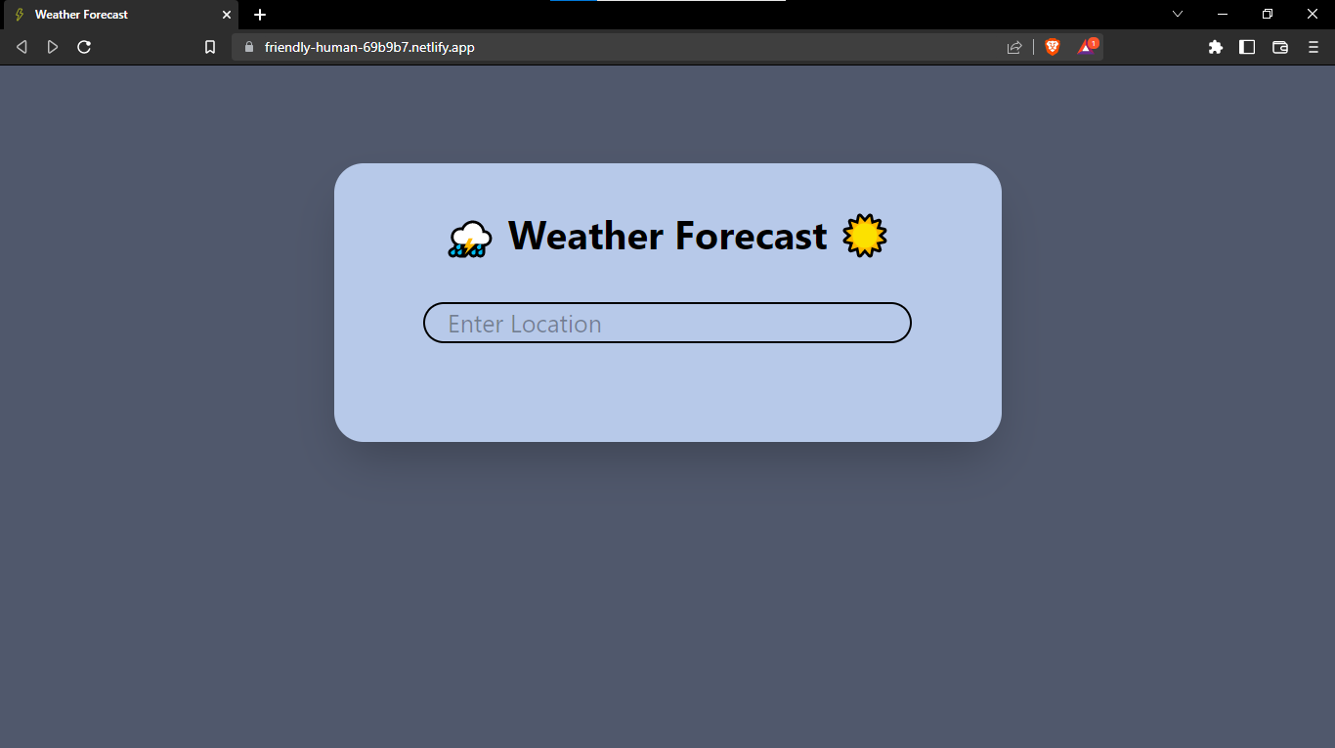
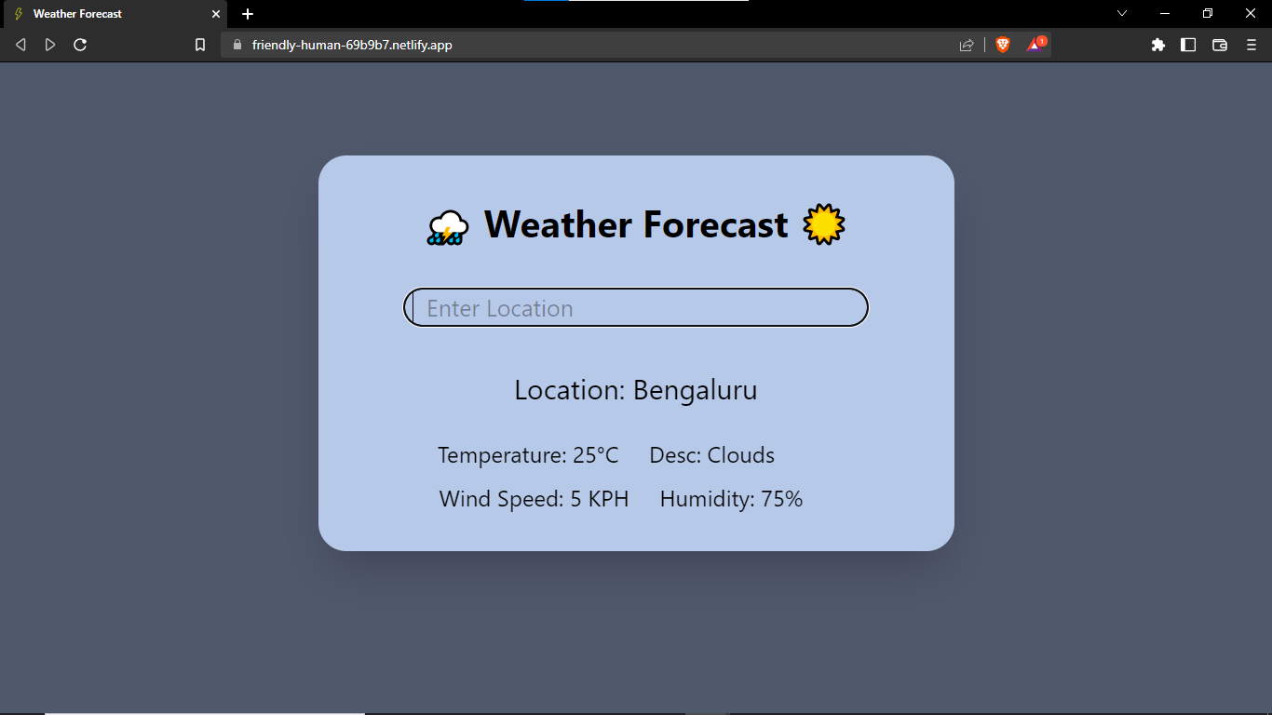
Before Search
After Search

Slide 10
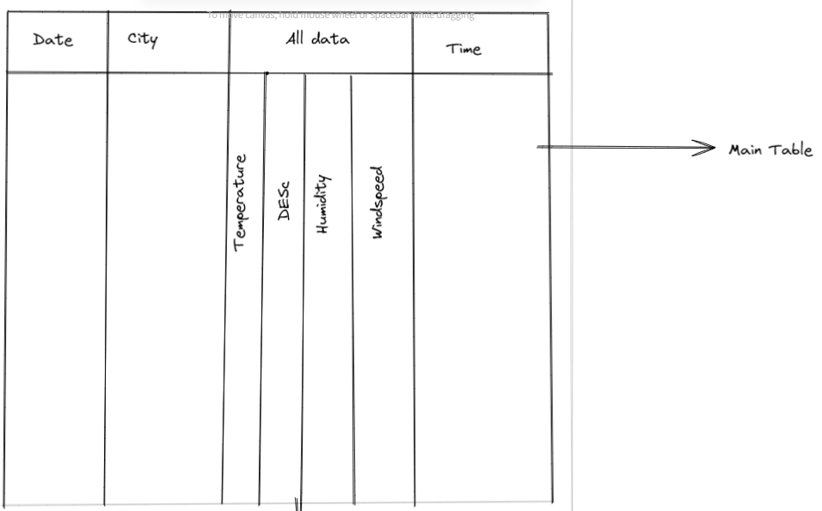
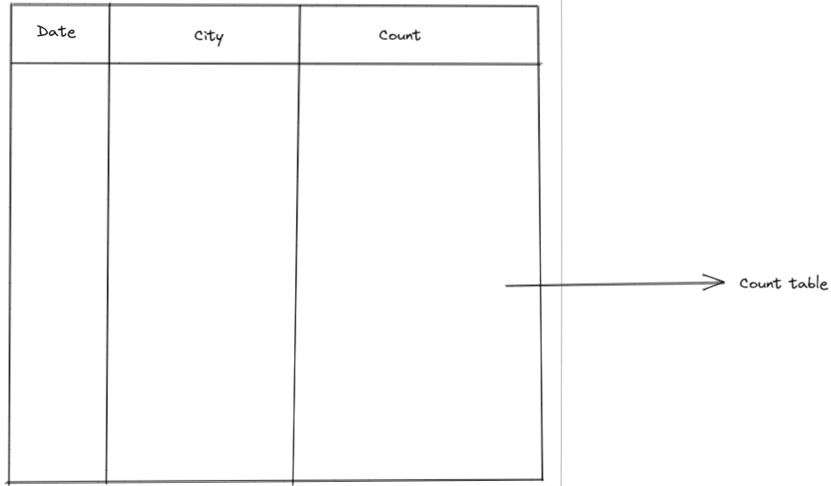
Database Layout
Main Table
Count Table

Slide 11
References
BOOKS
Sumitra Arora: MySQL
Web Programming with HTML, CSS, Bootstrap, JavaScript, React.JS, PHP, and MySQL Third Edition
MySQL(TM): The Complete Reference.
WEBSITE
https://reactjs.org/docs/getting-started.html
https://www.freecodecamp.org/news/learn-react-by-building-a-weather-app/
https://www.w3schools.com/
https://excalidraw.com/

