Slide 1


JSS Academy Of Technical Education,Bengaluru
Internship Presentation
On
Weather Forecast System
Using Full Stack Web Development
Shreyas P USN-1JS20CS157
Shubhankar Sharma USN-1JS20CS158

Slide 2
Abstract
The word Web Development is made up of two words, that is: Web: It refers to websites, web pages or anything that works over the internet. Development: It refers to building the application from scratch. Web development can range from developing a simple single static page to complex dynamic pages.
The Web based Weather Forecast System is meant to provide more comfortable place to receive the information of a specific city.
The intent of this project is to facilitate the user with much specificized image of data collected by the organization “Open Weather” only on single place. And to gather the data related to the search made by the traffic on the website.

Slide 3

COMPANY PROFILE
Corporate Name: PRINSTON SMART ENGINEERS
Main Office: Vishnuvardhan Statue Rd, Vishwa Priya Nagar, Begur, Bengaluru, Karnataka 560068
Phone: +91 9810 188 747
Contact Person: Mrs. Fraheen Farhath (Managing Director)
Email Address: Prinston.Smart@gmail.com
Year Stand Up: 2004
Company Category: IT Software/Embedded

Slide 4
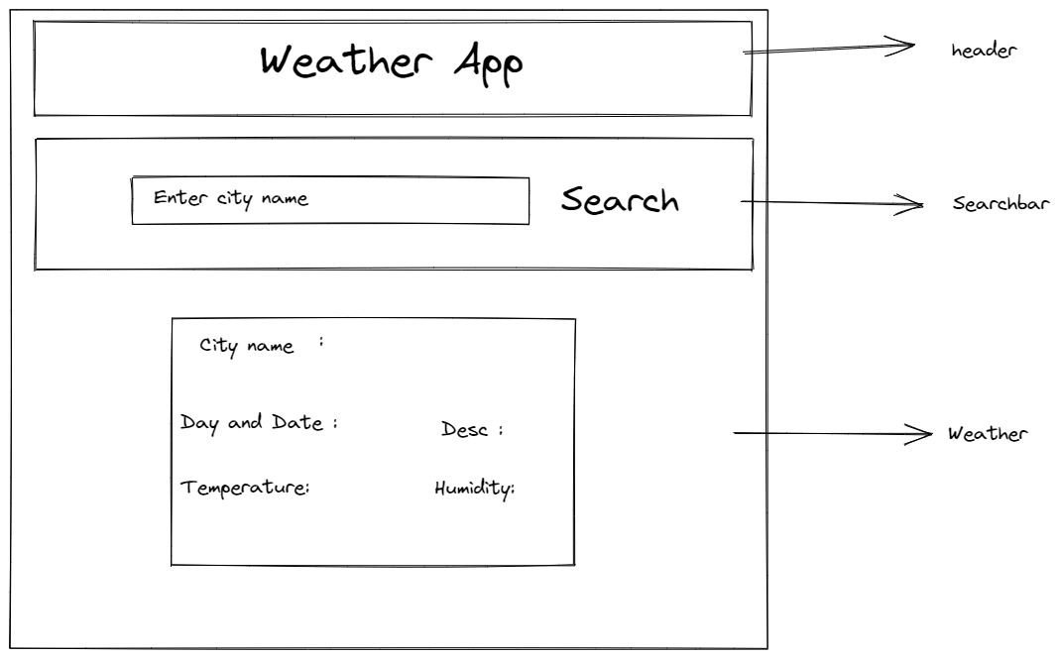
SNAPSHOTS
Website Layout

Slide 5
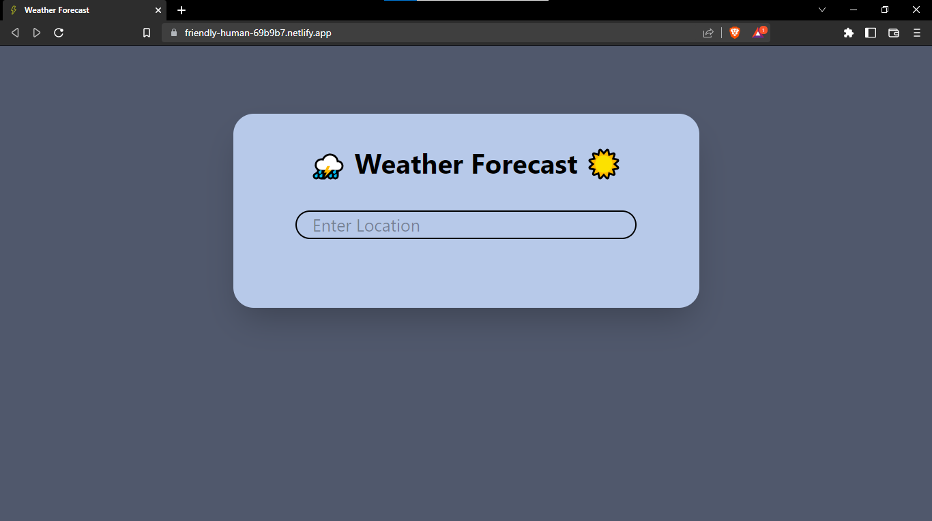
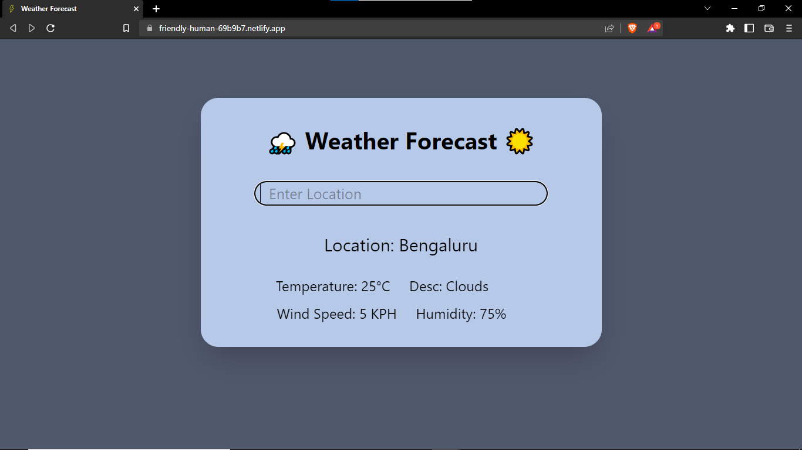
Before Search
After Search

Slide 6
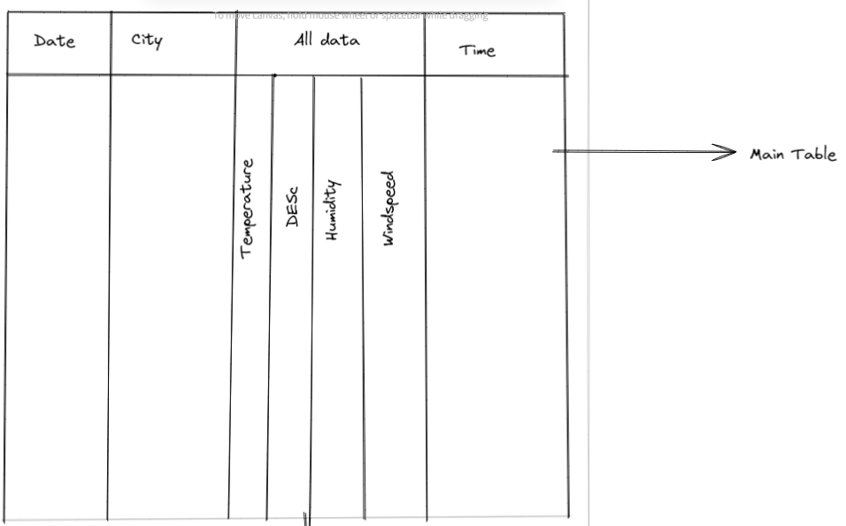
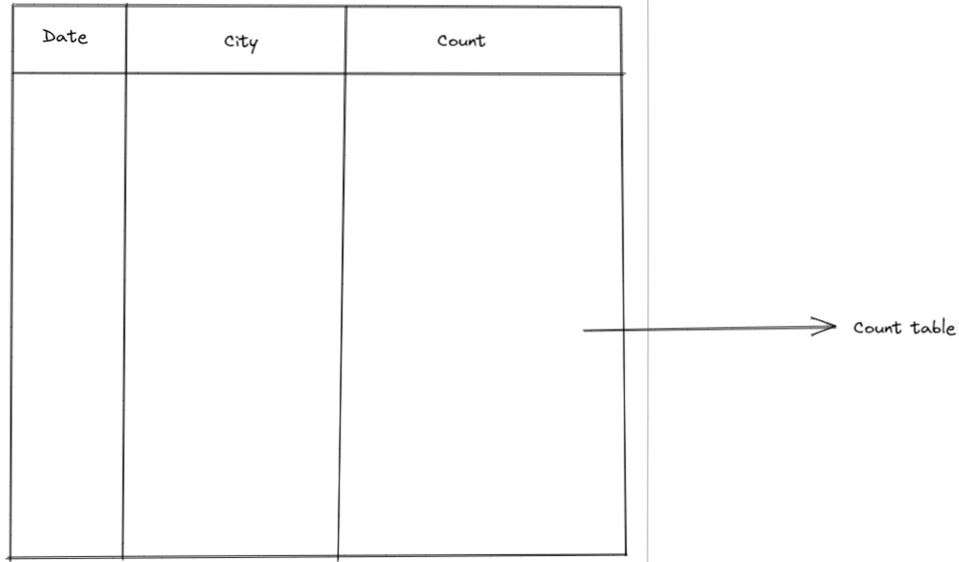
Database Layout
Main Table
Count Table

Slide 7
References
BOOKS
Sumitra Arora: MySQl
WEBSITE

