Slide 1
Capstone Project: Livin it
By:
Krina Patel,
Yash Patel,
Huy Ngo &
Shreyas Joshi
Advisor: Professor Melusky

Slide 2
Overview
Introduction
Primary goals
Summary

Slide 3
Introduction
Use Case Diagram by Shreyas
Important features from Use Case by Yash
Domain Model by Huy
GUI by Krina

Slide 4
Primary goals
-A application that matches Users around university campuses with housing options that match their needs
-Budgetary requirements
-Spatial needs
-Additional (pets, non smoking etc.)
-Features for property owners to find reliable renters

Slide 5
Use Case Diagram

Slide 6
Important features from Use Case Diagram
• Login - the logging would be one of the most important feature because the project requires both tenant and property owner to have an account so they can interact with each other while scouting out the houses. In this use use what login does is asks user/tenant and property owner to login and once they are logged in it gives them fully access to web app.
• Search - The search function is really important in this use case as well because for users and house owners this is very important for the web app. There are many things search does in this use case for example tenant can search for house by square feet, or search by their budget, or search by houses size or etc. once they hit the search button it will show them their preferences they wanted to see. From then they select the house they like.

Slide 7
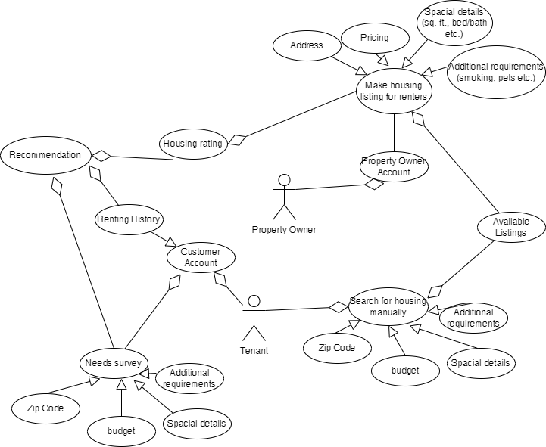
Domain Model Text

Slide 8
Languages
Database
JavaScript
HTML
CSS
My SQL
Framework
React.js

Slide 9
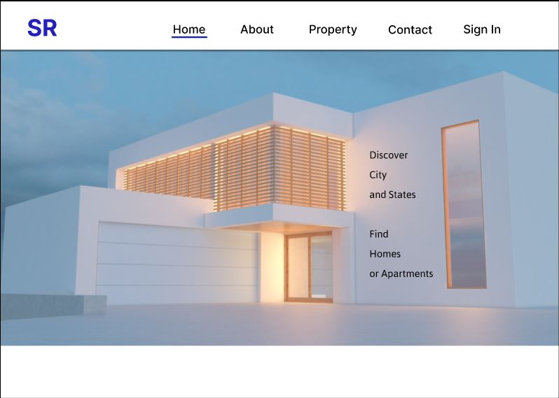
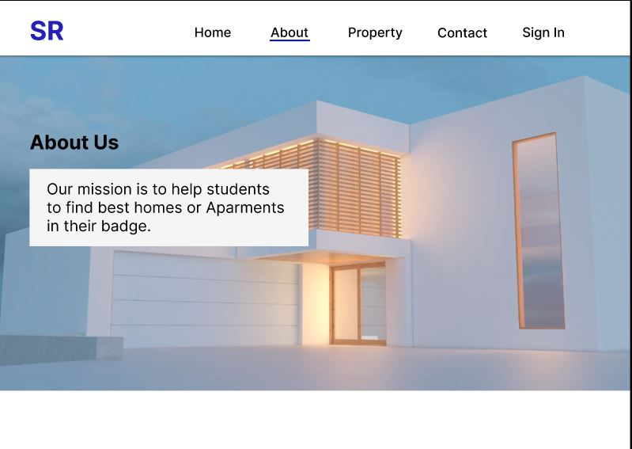
GUI

Slide 10
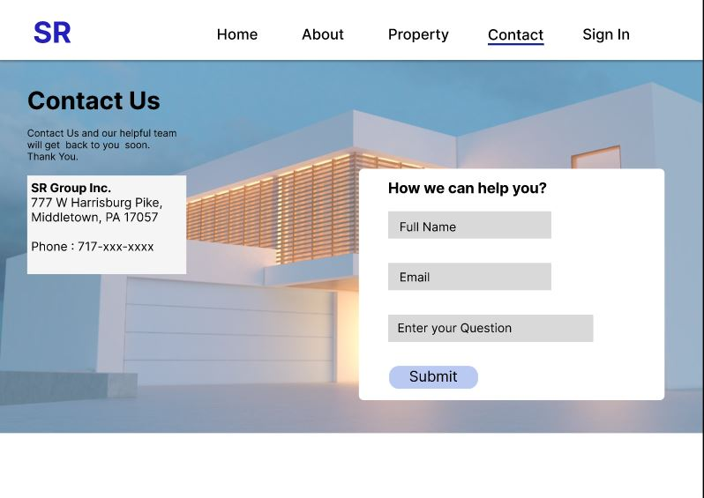
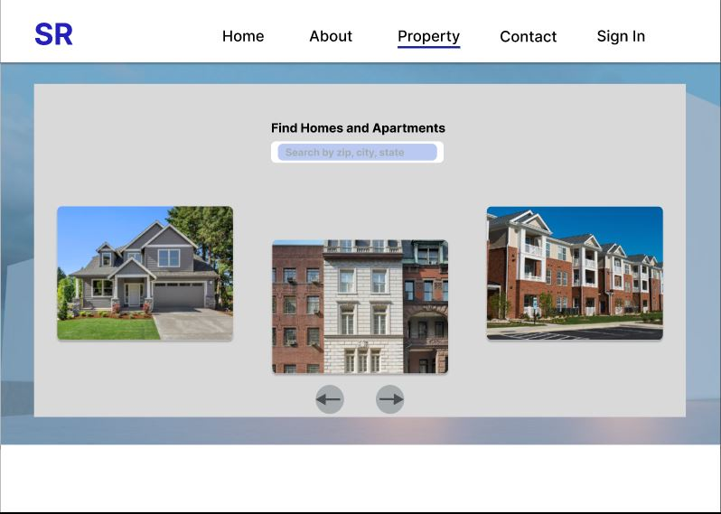
GUI

Slide 11
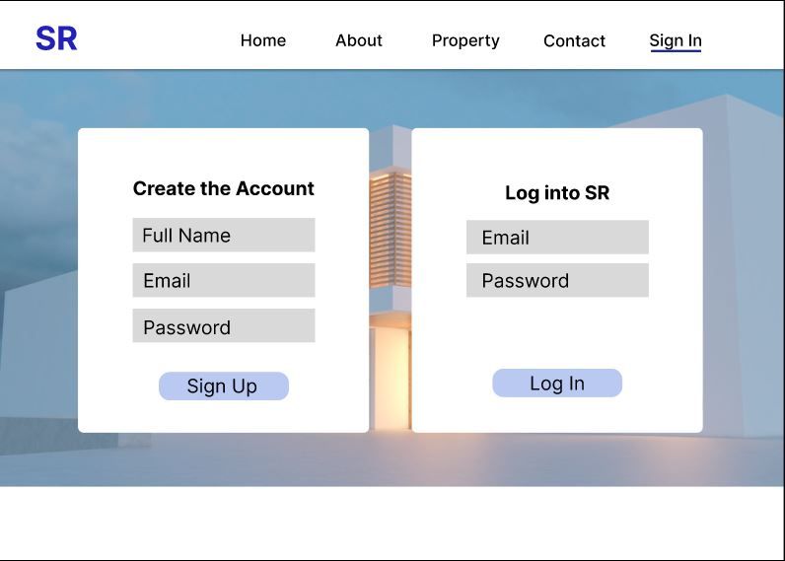
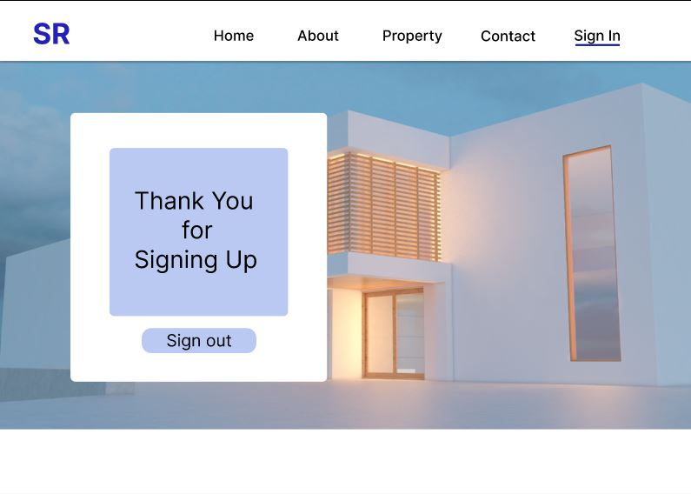
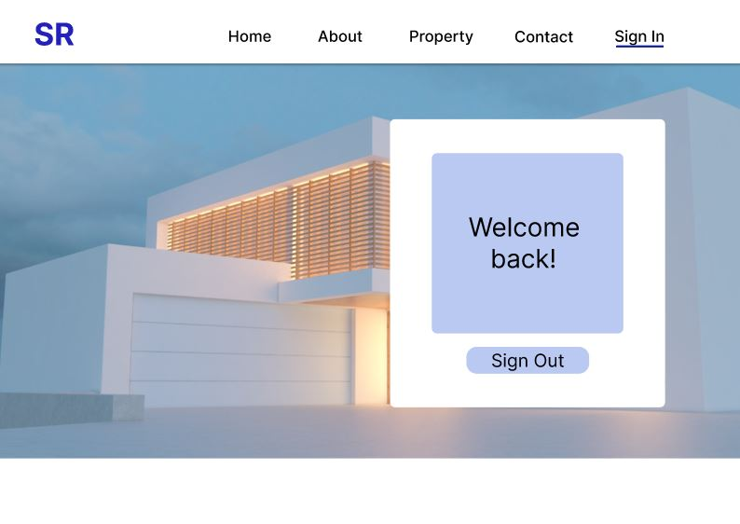
GUI

Slide 12
Link to GUI Demo
GUI Demo

Slide 13
Thank you Any questions?

