Slide 1
QC Hackathon
Analysis on Reddit dataset
Rohan Khairnar
Shreyas Vaidyanath
Stuthi Rao
Vyom Sharma
By
Team 49ers

Slide 2
Goal - To identify factors having direct impact on
economic stability of Charlotte.
Problem Statement:
Identifying cascades of false and sensitive information being spread in the area which could potentially impact people’s behavior in connection with topics trending in and around Charlotte. Finding probable solutions that could help establish the economic stability and mobility.

Slide 3
Approach
Data Understanding and Normalization
Sentiment Analysis and WordCloud - identify trending topics.
Visualizations - Generating patterns over the polarity, frequency, score and count of comments based on various domains.
Network Analysis - Identifying the Degree, Betweenness and Closeness Centrality and Six Degrees of Separation theory.
Predictive Analytics

Slide 4
Technologies Used
Python - Data Normalization, Sentiment Analysis, Network Analytics, Predictive Analytics
Tableau - For major Visualizations
SAS - Text Analysis and Clustering

Slide 5
Hypothesis
Text Analysis and Clustering - Highly discussed topics with words clustered together - Weekday-wise analysis - Surprising theories - Sensitive Topics and user’s contribution

Slide 6
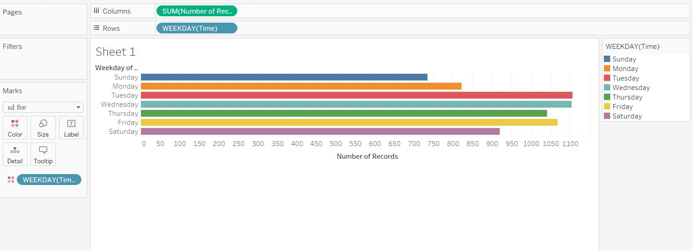
Visualizations
Most posts on Reddit on the basis of days of the week.

Slide 7
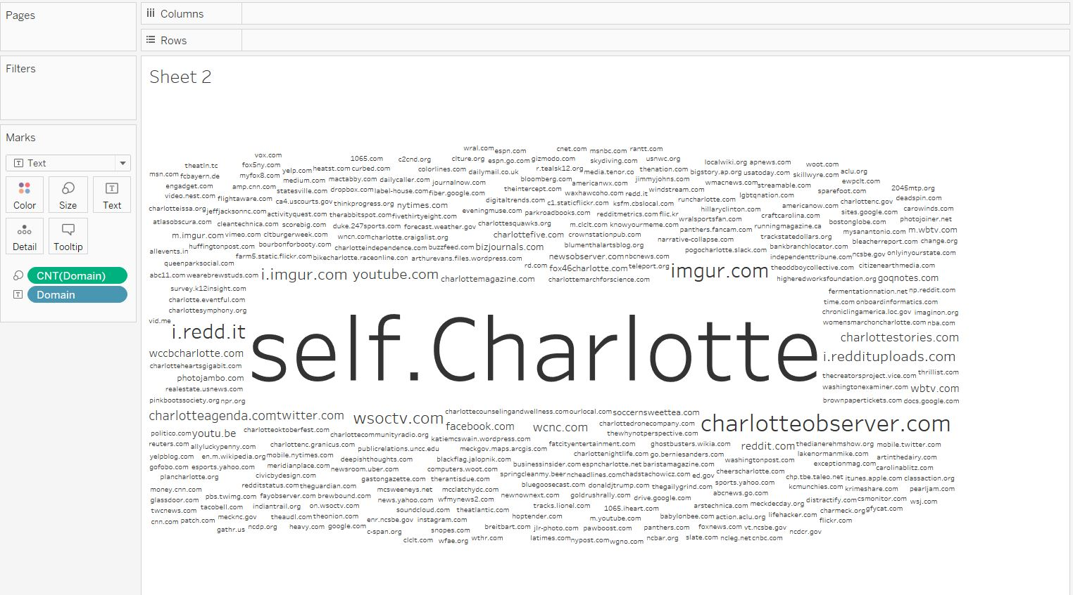
Visualizations

Slide 8
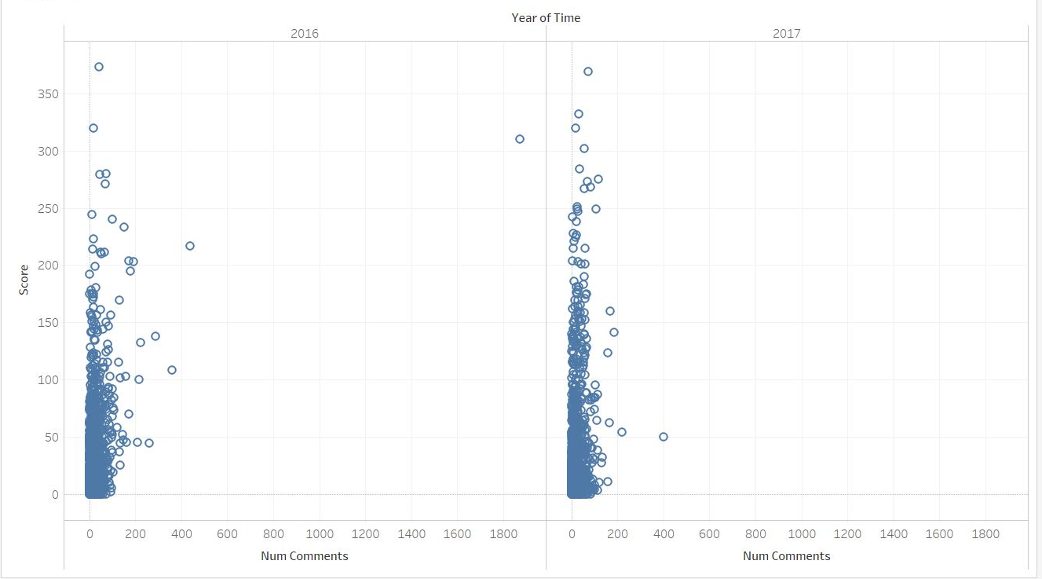
Visualizations
Number of comments vs. Score For the year 2016 and 2017

Slide 9
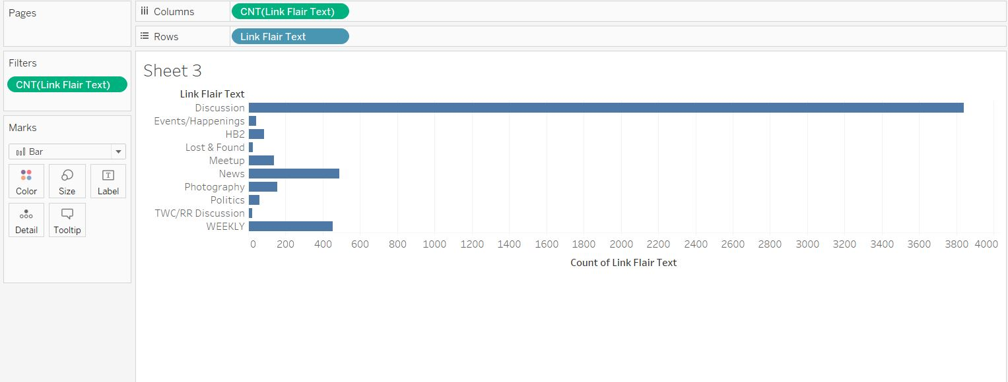
Visualizations
Most discussed topics:

Slide 10
Thank you
By Team 49ers

