Slide 1

Co-founder in your journey of wealth creation
Portfolio Review
PREPARED FOR
AZBY Family
₹5.34 Cr reviewed · As of 21 July 2026 · Ionic Wealth NDPMS Desk
Illustrative template — AZBY Family is fictional; all holdings are dummy data for template design.

Slide 2

Contents
A decision-first review, tiered for the audience in the room
01
Foundations
IPS · gaps up front · mandate · how we score
02
The Portfolio
snapshot · concentration · sector & cap
03
Direct Equity
the book scored · spotlights · the sells · quality · ESG
04
Mutual Funds
the fund book · how we evaluate · fund actions
05
The Plan
house-view fit · drift · cost · tax · deployment · order sheet
06
Risk, Growth & Frontier
risk analytics · stress tests · frontier · projection
07
Family Office
consolidation · governance · goal funding · liquidity
A
Appendix
chart library · registers · methodology
Tiers →
RM · CORE — always show
STANDARD — add analytics
UHNI — family office
APPENDIX — on demand
AZBY Family · illustrative template · Ionic Wealth
Private & Confidential
1

Slide 3
SECTION 01
Foundations
Who the family is, the standard we hold the book to, and how we score.
Investment Policy Statement
Where you stand vs your policy
Mandate & method
How we score a stock
AZBY Family · illustrative template · Ionic Wealth
Private & Confidential
2

Slide 4
RM · CORE
Investment Policy Statement
The standard we hold this book to — standardised by risk profile
The mandate
Strategic asset allocation — by risk profile
Risk profile | Aggressive
Time horizon | Long term (7+ years)
Primary objective | Long-term wealth creation
Return objective | Real growth above inflation
Liquidity need | Low near-term; buffer staged
Mandate | Non-discretionary (NDPMS)
Construction | Core–satellite
Review cadence | Quarterly refresh
Sleeve | Conservative | Moderate | Aggressive ▸
Domestic equity | 25–35% | 45–55% | 55–70%
Foreign equity | 5–10% | 10–20% | ~25% of eq
Gold & silver | 5–10% | 5–10% | 5–10%
Debt / arbitrage | 45–60% | 20–35% | 5–15%
Style tilt | low-vol | low-vol+value | low-vol+value
Single-name limit | <5% | <6% | <8% of eq
Single-AMC limit | <25% | <25% | <25%
Single-sector limit | <25% | <30% | <30%
Our understanding of the family
First-generation promoter family; primary wealth from an operating business. Comfortable with equity risk and a long horizon, with a partial liquidity event anticipated. Priorities: compounding the core, reducing single-name risk, and building the diversifiers the book currently lacks.
The Aggressive column is this family's policy; limits reuse the house guidelines applied throughout this review.
AZBY Family · illustrative template · Ionic Wealth
Private & Confidential
3

Slide 5
RM · CORE
Where you stand vs your policy
Five gaps to close, one strength to keep — surfaced up front
Policy standard | Where you are today | Status
Single-name < 8% of equity | Titan Company 11.2%; top-10 33.2% of book | GAP
Single-AMC < 25% (funds) | Largest fund house 25.4% | GAP
Foreign equity ~25% of equity | ~4.4% of book, developed-market light | GAP
Gold & silver 5–10% sleeve | ~0.8% (a residual gold FoF), no sized sleeve | GAP
Every holding scores ≥ 40 | 15 of 76 stocks score < 40 (10.6% by value) | GAP
Funds beat benchmark over 3Y | Every seasoned fund beats its benchmark | STRENGTH
The executive summary attaches an action to each gap. Statuses use the house guidelines in the IPS.
AZBY Family · illustrative template · Ionic Wealth
Private & Confidential
4

Slide 6
RM · CORE
Executive summary
A sound core carrying avoidable concentration — five gaps, five actions
₹5.34 Cr total reviewed
76 / 21 stocks / schemes
33.2% top-10 weight
15 of 76 rated Sell
Gap we found | Action that closes it | Impact
Top-10 33.2%; Titan Company at the single-name limit | Trim toward < 8% of equity | frees ₹9.5 L; largest name within limit
15 stocks score < 40, incl. Reliance at 29 | Run the Sell programme | ₹0.56 Cr proceeds; Sell-weight → 0%
Foreign equity ~4.4% vs ~25% target | Redeploy toward foreign equity (direction) | steps toward the target, 60:40 DM:EM
No sized gold / silver sleeve | Open a small 75:25 sleeve (direction) | adds the missing diversifier
Funds: AMC 25.4%, a Regular-plan duplicate, sub-scale 2nd small-cap | Switch / redeem / exit — 3 structural actions | 21 → 19 schemes
Strength — the fund book is sound: every scheme with a 3-year record beats its benchmark; the three fund actions are structural, not performance. Proceeds bridge — ₹0.56 Cr Sells + ₹0.10 Cr trim = ₹0.66 Cr to redeploy; +₹0.21 Cr fund actions = ₹0.87 Cr reorganised.
AZBY Family · illustrative template · Ionic Wealth
Private & Confidential
5

Slide 7
RM · CORE
Mandate & method
How to read this review
The mandate
Non-discretionary (NDPMS): we recommend Sell, Trim, Switch, Redeem or Hold on holdings you already own. The model never issues a Buy.
Scoring benchmark: the NIFTY-750 cross-sectional percentile (the Ionic Quant Scorecard).
Allocation reference: the Ionic Wealth House View, Dec 2025 — the asset-mix we steer toward.
The Ionic Score
A 0–100 composite of quality, valuation, growth and momentum, refreshed each quarter on point-in-time data.
Read over two horizons and blended 0.60 × 3-year + 0.40 × 1-year.
A name is a Sell below 40; at 40+ it is a Hold. The model issues no Buy.
An analyst may argue a Sell up to a Hold — never a Hold down to a Sell.
What core–satellite means
The core (the majority of the book) holds steady, high-quality positions that anchor returns and turn over rarely. Satellites are smaller, deliberate tilts — a sector, a factor, a theme — sized to add return without moving the whole book. Each quarter we test whether every satellite still earns its place; the core changes seldom.
The line every holding must clear 40 · on the binding horizon
AZBY Family · illustrative template · Ionic Wealth
Private & Confidential
6

Slide 8
STANDARD
How we score a stock
A model builds the number; an analyst signs it off
The five pillars, over two horizons
Pillar | What it measures | Built from
Quality | durability of the business | ROE, ROCE, margins, accruals
Value | what you pay for it | P/E vs peers and own history
Growth | structural + recent growth | 3Y & 1Y revenue / earnings
Price-trend | long & recent price behaviour | 3Y & 1Y vs the market
Sector-macro | the tailwind behind the name | house sector read (0–100)
The human overlay
A score starts the conversation; it does not end it.
Every flagged name is read by an analyst before it reaches this deck.
The analyst can soften a Sell to a Hold on evidence — never harden a Hold to a Sell.
Scores are point-in-time and can be stale or wrong; the desk is the check on that.
Where the model has no coverage (recent listings, ETFs, demergers) there is no score — we carry those on judgement, not silence.
How it combines. Each pillar is a 0–100 percentile across the NIFTY-750 universe. Horizons blend 0.60×3Y + 0.40×1Y; a name is a Sell below 40 on the binding horizon. Balance-sheet gate: every non-financial name is first gated GREEN / AMBER / RED; a RED gate caps quality however strong the other pillars.
AZBY Family · illustrative template · Ionic Wealth
Private & Confidential
7

Slide 9
SECTION 02
The Portfolio
Where the money sits, and where it is over-concentrated.
Snapshot
Concentration & risk
Sector & market-cap positioning
AZBY Family · illustrative template · Ionic Wealth
Private & Confidential
8

Slide 10
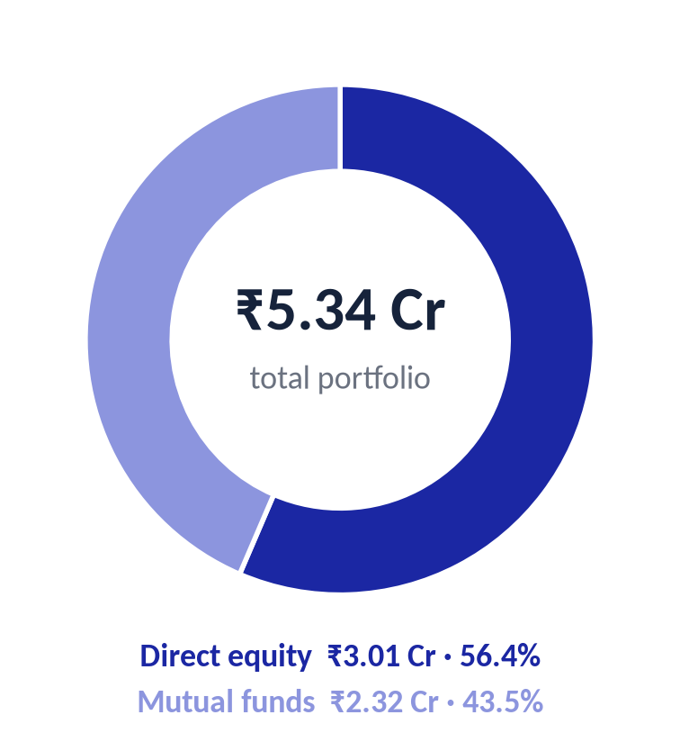
RM · CORE
Snapshot
₹5.34 crore, split across direct equity and funds
Direct equity
₹3.01 Cr · 76 stocks
Mutual funds
₹2.32 Cr · 21 schemes
Largest position
6.3% of book · Titan Company
Construction
Core–satellite
Stance
Aggressive, long horizon
Rated Sell
15 stocks · 10.6% by value
AZBY Family · illustrative template · Ionic Wealth
Private & Confidential
9

Slide 11
RM · CORE
What changed since last review
The book is reviewed every quarter — here is the delta
6 score upgrades
3 score downgrades
2 new Sell flags
4 prior actions completed
Name | Move | Why it moved
Bharti Airtel | Hold → Hold | score 55 → 59, momentum firming
Tata Power | Hold → Sell | 1Y growth stalled; crossed below 40
HCL Technologies | Sell → Hold | 1Y growth firmed to 51; upgraded
Adani Enterprises | Hold → Sell | growth slowing against the price
Coforge | Hold → Hold | score 51 → 56 on the IT re-rating
VIP Industries | Sell → Sell | still the weakest name; ROE negative
A Hold moves to a Sell only on the quarterly refresh, a governance flag, or a breach of the single-name guideline on price alone. Nothing here is permanent.
AZBY Family · illustrative template · Ionic Wealth
Private & Confidential
10

Slide 12
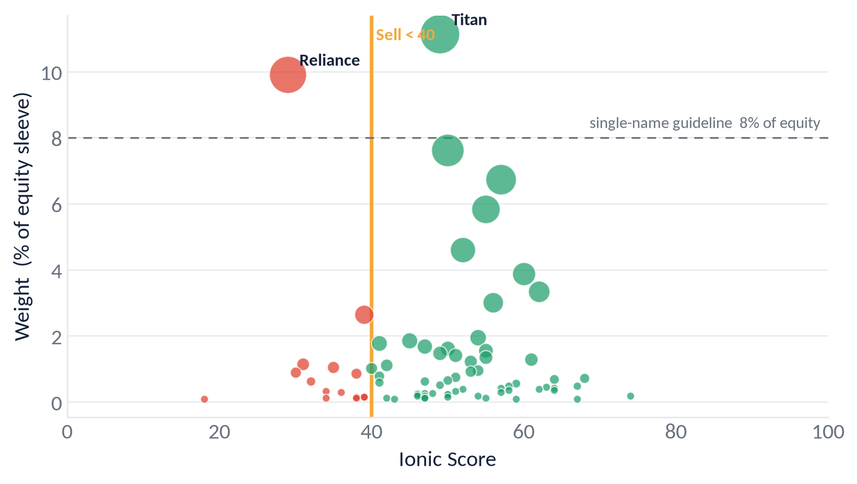
RM · CORE
Concentration & risk
The top ten names carry a third of the book
Metric | Book | Guideline | Status
Top-5 single names | 23.3% | < 25% | WITHIN
Top-10 single names | 33.2% | < 30% | BREACH
Largest name (of equity) | 11.2% | < 8% | BREACH
Names > 8% of equity | 2 | 0 | WATCH
Largest AMC (funds) | 25.4% | < 25% | BREACH
Largest sector (equity) | 24.4% | < 30% | WITHIN
Single-name rows are measured on the equity sleeve (₹3.01 Cr) — the base that drives the trim. Bubble: colour = call, size = position value.
AZBY Family · illustrative template · Ionic Wealth
Private & Confidential
11

Slide 13
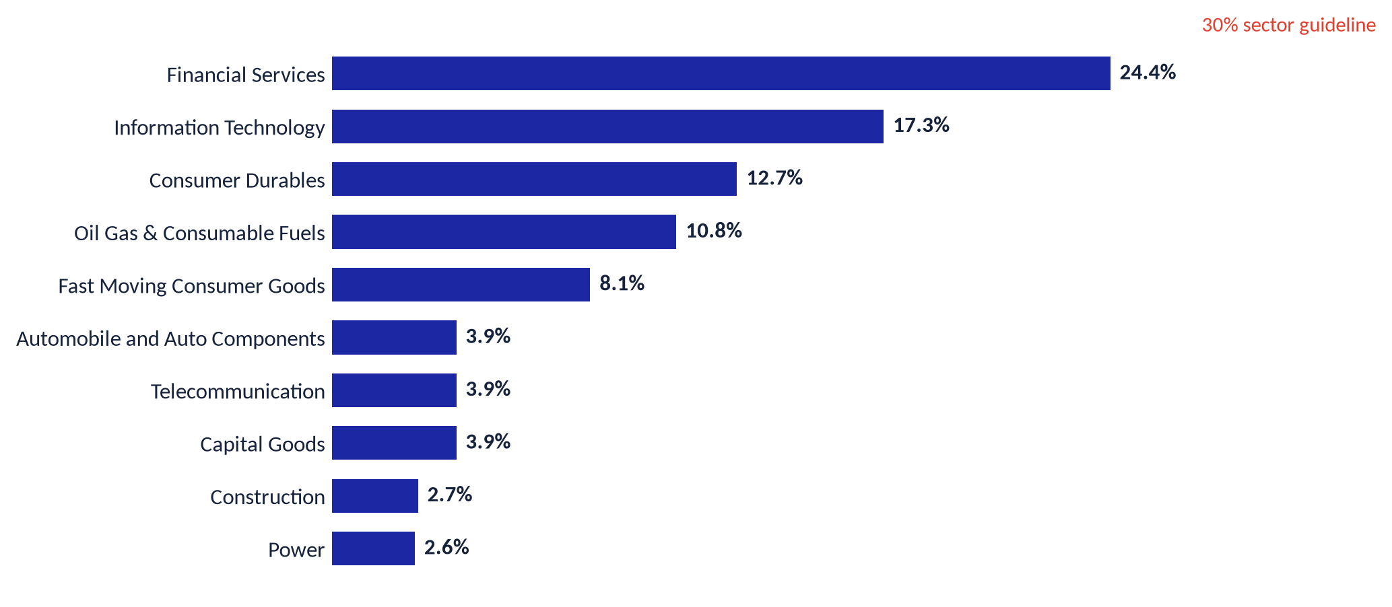
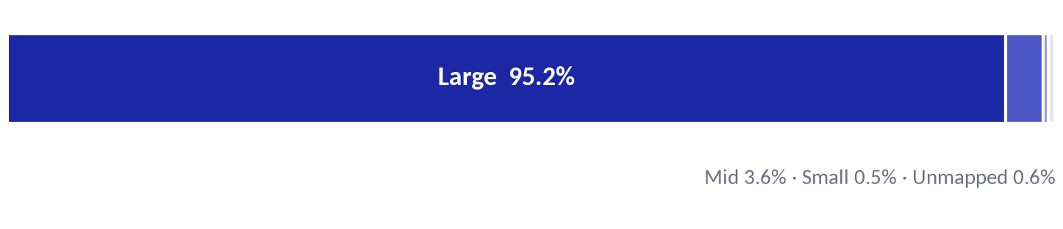
RM · CORE
Sector & market-cap positioning
A large-cap book; two sectors lead
Sector exposure
Market-cap split
Scope. Direct equity only (₹3.01 Cr, 76 stocks). The ₹2.32 Cr fund book (43.5% of the portfolio) is not in these charts; its stock-level constituents are not available, so fund exposure is read at category level (Section 04).
A large-cap core lowers volatility and liquidity risk; under 5% sits in mid/small, leaving room to add diversified SMID if more growth beta is wanted.
AZBY Family · illustrative template · Ionic Wealth
Private & Confidential
12

Slide 14
SECTION 03
Direct Equity
76 names, one bar to clear: a score of forty.
The whole book, scored
The equity book (treemap)
Spotlights
The names we would sell
Quality vs price · factor profile
AZBY Family · illustrative template · Ionic Wealth
Private & Confidential
13

Slide 15
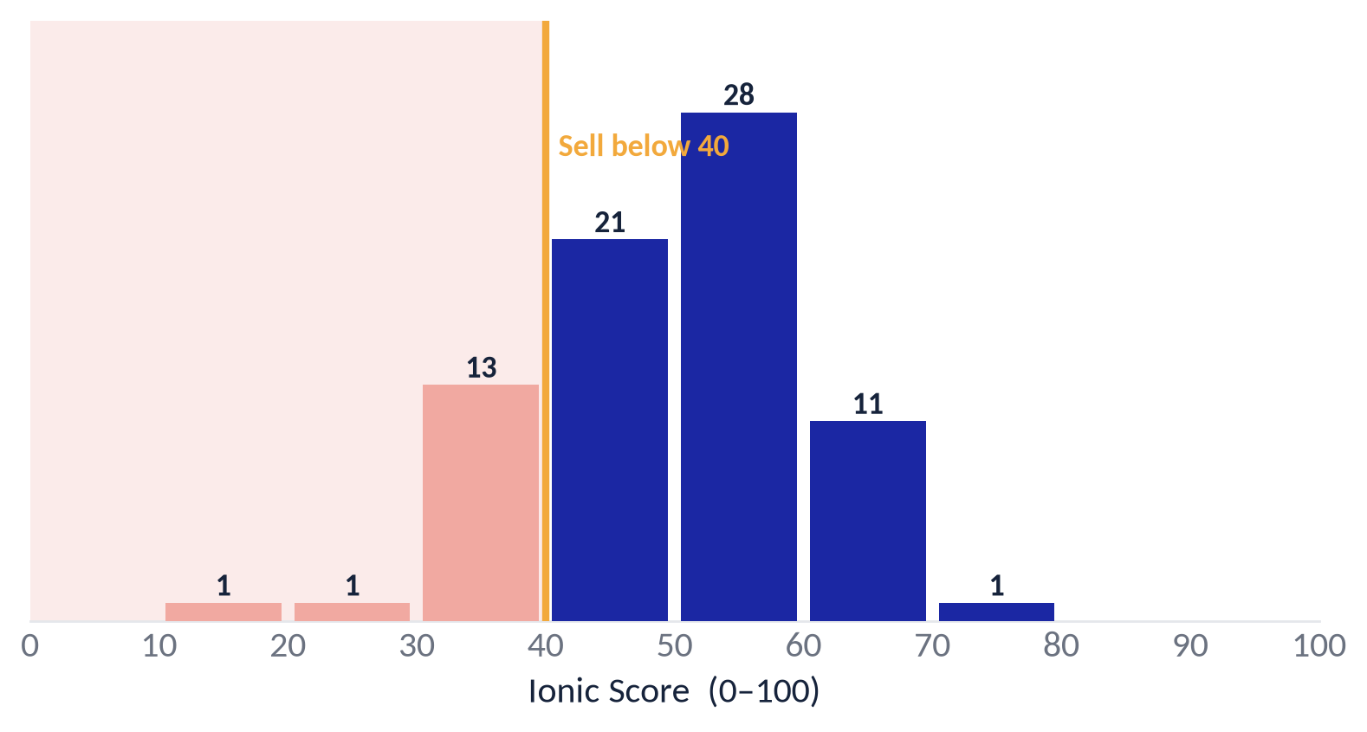
RM · CORE
The whole book, scored
76 stocks; 15 fall below the line
15 of 76 names score below 40 (10.6% of the book by value). Bars left of the amber line are the Sell zone; the score shown is the binding, lower-horizon read.
AZBY Family · illustrative template · Ionic Wealth
Private & Confidential
14

Slide 16
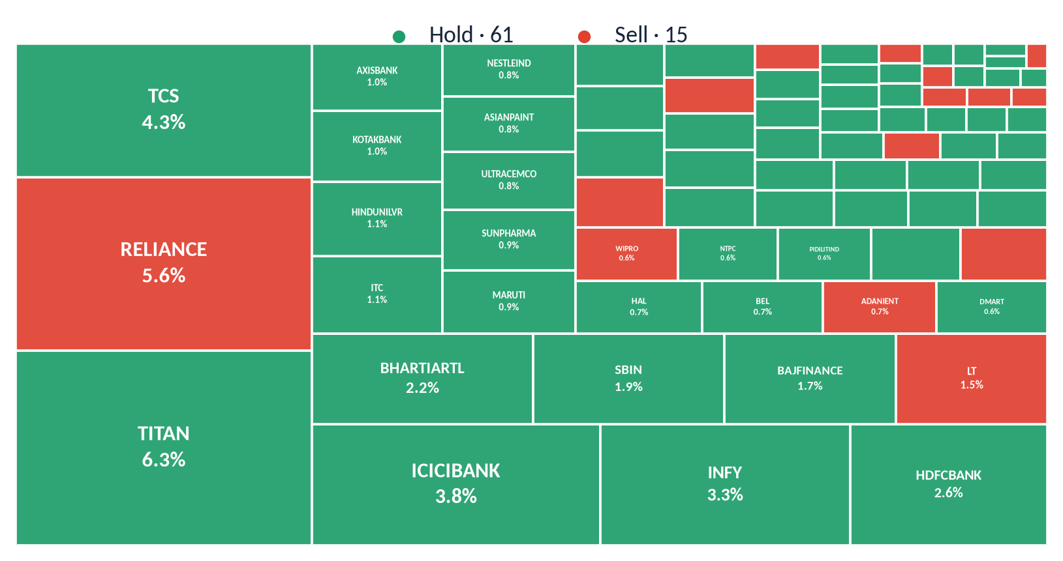
STANDARD
The equity book
Where every rupee sits, and what the scorecard says
Tile area = share of the total portfolio; colour = call.
AZBY Family · illustrative template · Ionic Wealth
Private & Confidential
15

Slide 17
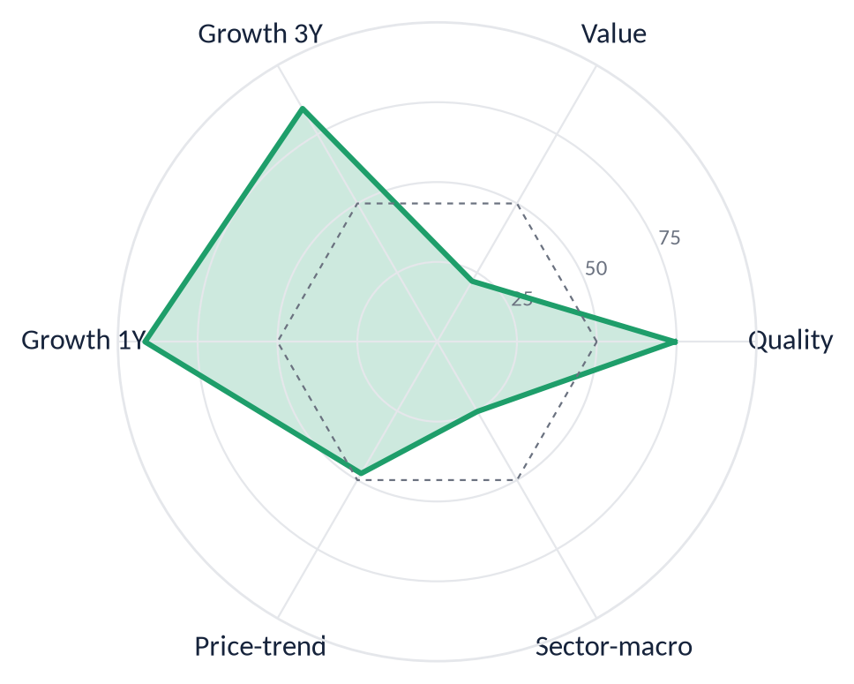
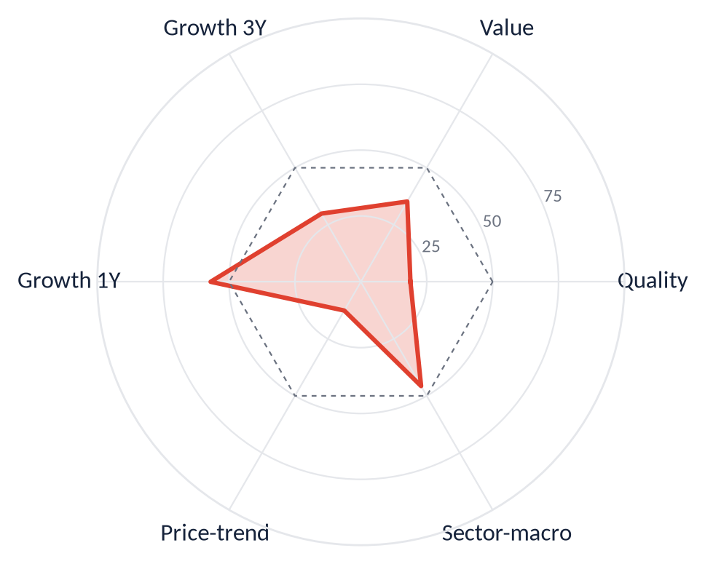
STANDARD
Spotlights
The largest holding we keep, and the largest we would sell
Titan Company
Reliance Industries
HOLD
SELL
6.3% of book · score 49
ROE 31.5% · 80.9x P/E
5.6% of book · score 29
ROE 9.5% · 23.5x P/E
Highest-conviction core holding: quality and growth are among the best in the book. The one caution is valuation and sheer position size — so we watch the weight and trim toward the guideline rather than add.
The second-largest single holding, and the scorecard flags it a Sell: quality and price-trend are weak, and ROE is thin for a name this size. We would reduce toward a normal weight and redeploy into stronger core names.
AZBY Family · illustrative template · Ionic Wealth
Private & Confidential
16

Slide 18
RM · CORE
The names we would sell
15 names below the line — about ₹0.56 Cr of proceeds
# | Name | Wt | Score | Primary reason | Analyst view
1 | Reliance Industries | 5.6% | 29 | weak price trend; quality below peers | concur — size risk, not quality; reduce
2 | Larsen & Toubro | 1.5% | 39 | sector headwind; weak price trend | concur — sector headwind; exit
3 | Adani Enterprises | 0.7% | 31 | slowing growth; soft recent growth | concur — growth slowing vs price
4 | Wipro | 0.6% | 35 | weak price trend; sector headwind | concur — cheap for a reason
5 | Tata Power | 0.5% | 30 | soft recent growth; weak price trend | concur — growth stalled
6 | GAIL India | 0.5% | 38 | slowing growth; soft recent growth | concur — growth not translating
7 | Godrej Consumer | 0.3% | 32 | slowing growth; quality below peers | concur — quality gap at the price
8 | Max Financial Svcs | 0.2% | 34 | weak price trend; soft recent growth | concur — trend weak
9 | Tata Consumer | 0.2% | 36 | quality below peers; weak price trend | concur — thin quality
10 | Jubilant Foodworks | 0.1% | 38 | sector headwind; weak price trend | concur — QSR headwind
11 | Info Edge | 0.1% | 39 | sector headwind; quality below peers | concur — quality vs multiple
12 | Swiggy | 0.1% | 39 | quality below peers; sector headwind | concur — not yet profitable
13 | Jio Financial | 0.1% | 38 | quality below peers; weak price trend | concur — growth real, profitability isn't
14 | Varun Beverages | 0.1% | 34 | weak price trend; soft recent growth | concur — trend soft
15 | VIP Industries | 0.1% | 18 | soft recent growth; slowing growth | concur — weakest name in book
15 names · 10.6% of book · est. proceeds ₹0.56 Cr. Full per-name rationale in the holdings annexure (appendix).
AZBY Family · illustrative template · Ionic Wealth
Private & Confidential
17

Slide 19
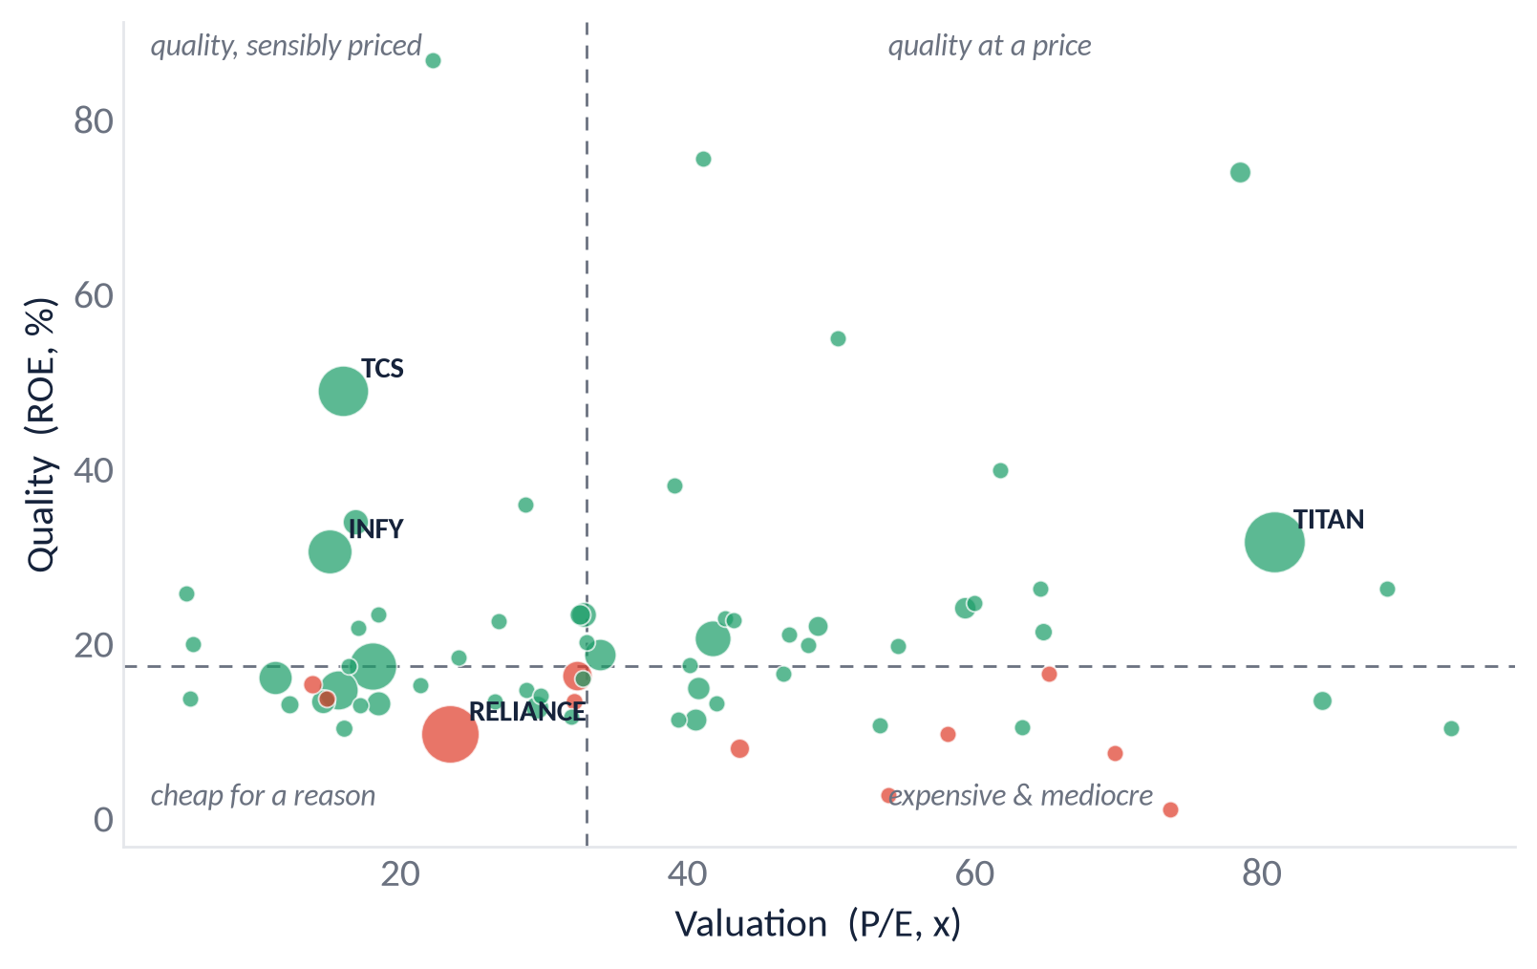
STANDARD
Quality versus price
Are we paying fair prices for the quality we own?
The four quadrants
Every holding on quality (ROE) against valuation (P/E); bubble size is position value, colour is the call. The names to question sit bottom-right — expensive for the quality they deliver. Green Holds cluster top-left; red Sells lean expensive-and-mediocre.
AZBY Family · illustrative template · Ionic Wealth
Private & Confidential
18

Slide 20
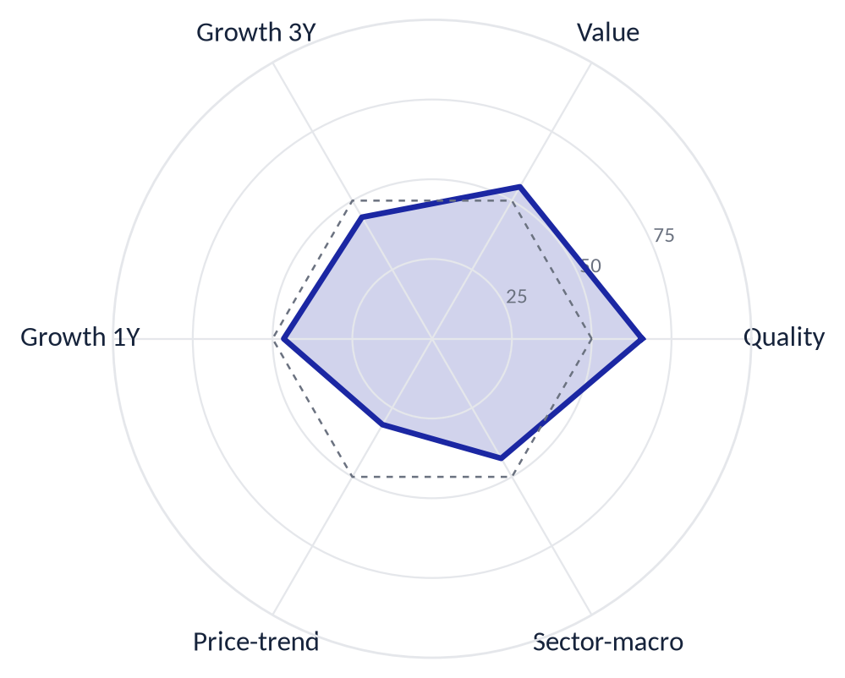
STANDARD
The book's factor profile
How the equity book scores across the pillars
What the profile says
Weighted across the equity book, the strongest pillar is quality (65.8) and the weakest is price-trend (31.1). A quality-led, trend-light profile is consistent with a large-cap growth book; it also explains why a stretch in price-trend is a common reason names fall below the line. The dashed ring marks the market average (50).
AZBY Family · illustrative template · Ionic Wealth
Private & Confidential
19

Slide 21
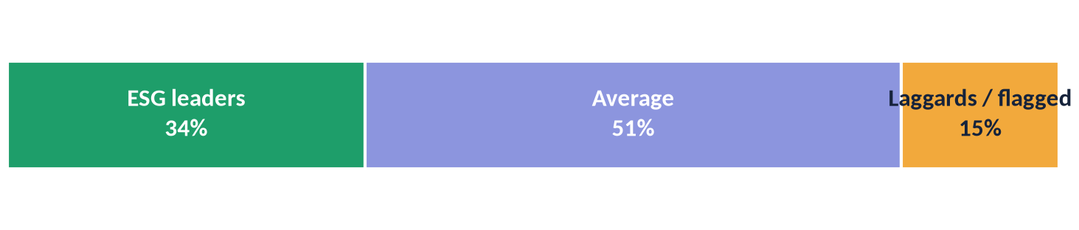
STANDARD
ESG & responsibility profile
Where the equity book sits on environmental, social and governance quality
By ESG tier (share of the equity book)
How we use it
ESG ratings are third-party, blended with our own governance read. Leaders can be held with confidence; laggards are flagged for engagement or review, not an automatic sell — the Ionic Score still governs the call.
Leaders — held with confidence
Flagged for review / engagement
Titan Company
Infosys
TCS
Bharti Airtel
Hero MotoCorp
Adani Enterprises
Coal-linked utilities
Balrampur Chini
VIP Industries
Illustrative ESG tiers for template design; a live review sources ratings from the client's chosen ESG provider.
AZBY Family · illustrative template · Ionic Wealth
Private & Confidential
20

Slide 22
SECTION 04
Mutual Funds
₹2.32 crore across 21 schemes — judged on more than alpha.
The fund book
How we evaluate equity funds
How we evaluate hybrids
Evaluation × allocation
Three fund actions
AZBY Family · illustrative template · Ionic Wealth
Private & Confidential
21

Slide 23
RM · CORE
The fund book
₹2.32 crore across 21 schemes
By category
By fund house
Small Cap | 26.5%
Flexi Cap | 15.1%
International | 10.2%
Thematic-Infra | 9.8%
Multi Cap | 7.3%
Hybrid-Multi Asset | 6.9%
Hybrid-Arbitrage | 5.4%
Mid Cap | 4.6%
Hybrid-BAF | 4.1%
HSBC | 25.4%
Franklin | 14.0%
PPFAS | 13.3%
Nippon | 9.1%
ICICI Prudential | 6.9%
Motilal Oswal | 6.8%
Tata | 5.4%
HDFC | 4.1%
Invesco | 3.2%
Largest fund house 25.4% (guideline < 25%). Only the seasoned schemes carry a 3-year record; the rest are too young, passive, international or cash-like to score on alpha alone — so we judge them on the frameworks that follow.
AZBY Family · illustrative template · Ionic Wealth
Private & Confidential
22

Slide 24
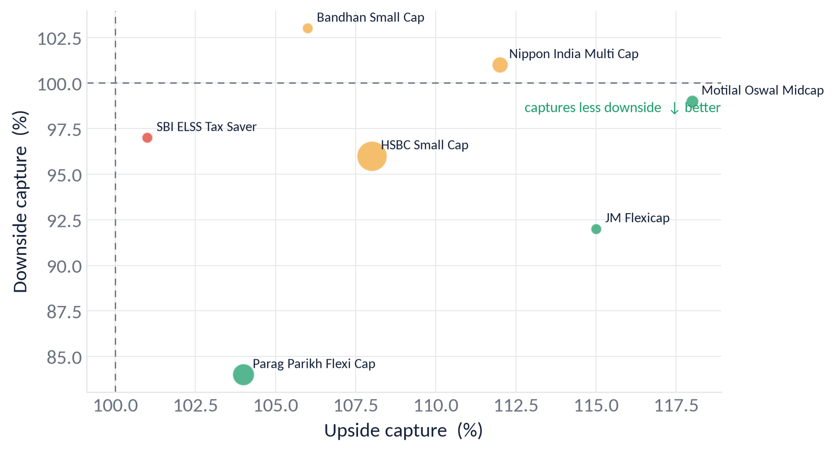
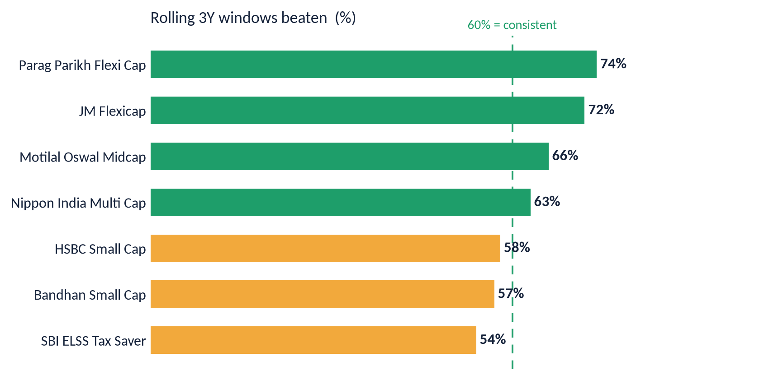
STANDARD
How we evaluate equity funds
Capture + consistency, over the house category rules
The house rules
Preferred: Flexi cap · factor/passive (value, low-vol) · index. Dis-preferred: Multi cap (forced cap quotas) and active large-cap (persistent alpha is rare — prefer factor/passive). A fund prefers if it loses less downside (capture < 100), beats its benchmark in ≥ 60% of rolling windows, and sits in a preferred category. It is replaced on the opposite.
Live on the book: Nippon (Multi cap) is switched despite strong alpha; the value index funds are kept (value is house-favoured); momentum index funds are held but watched (momentum is on hold).
AZBY Family · illustrative template · Ionic Wealth
Private & Confidential
23

Slide 25
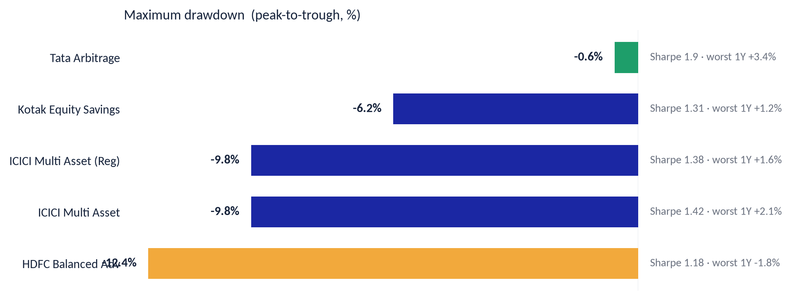
STANDARD
How we evaluate hybrids
Risk-adjusted return, drawdown, and the worst rolling year
Why not alpha
Hybrids exist to shape risk, not to beat an equity benchmark on return. We judge them on:
RAR — Sharpe and Sortino above the category median.
Max drawdown — meaningfully shallower than pure equity; arbitrage ≈ 0.
Worst rolling-1Y — contained; an arbitrage fund should never print negative.
The Regular-plan ICICI holding has risk identical to the Direct plan already held — so the only differentiator is the trail cost. That is a redeem, not a risk call.
AZBY Family · illustrative template · Ionic Wealth
Private & Confidential
24

Slide 26
STANDARD
Evaluation × allocation
A fund's quality is read against whether its sleeve is over- or under-weight
Sleeve under-weight · fund strong ▲ upper / weak ▼ lower
Sleeve over-weight
GROW — top up with redeployment JM Flexicap (flexi, under-weight)
KEEP as primary, trim the sleeve HSBC carries a trimmed small-cap sleeve
UPGRADE — re-select, don't just add International (under-weight & under-3Y)
CUT FIRST — weak fund, over-weight sleeve Bandhan small-cap · Nippon multi-cap
The exits are the bottom-right cell (weak funds in over-weight sleeves); the redeployment fills the under-weight sleeves — international, value, flexi, and the absent gold/silver.
AZBY Family · illustrative template · Ionic Wealth
Private & Confidential
25

Slide 27
RM · CORE
Three fund actions
Structural, not performance — each named against the framework
SWITCH
REDEEM
EXIT
Nippon India Multi Cap → Flexi cap
ICICI Multi-Asset (Regular) → Direct
Bandhan Small Cap → HSBC carries it
Passes on performance (+9.4pp alpha) but fails on category: multi-cap's forced cap quotas remove the manager's cap-sizing — the flexibility the Flexi > Multi rule keeps. Moves a stub toward an under-weight preferred sleeve.
Risk metrics are identical to the Direct plan already held; the only difference is the Regular-plan trail — a permanent cost with no risk offset. Pure cost cleanup; sleeve weight unchanged.
Also passes on performance; fails on overlay — small-cap is the most over-weight sleeve and a sub-scale second fund adds cost and mechanical overlap. Re-test HSBC vs Bandhan at Q3 before finalising the primary.
Fund overlap — pending look-through: stock-level holdings are not yet available for the equity schemes, so we flag it as a data gap rather than force a grid from mismatched index lists. The redundancy worth removing is already above.
AZBY Family · illustrative template · Ionic Wealth
Private & Confidential
26

Slide 28
SECTION 05
The Plan
The sells, the fund actions, the cost, the tax, and where the money goes.
House-view fit
What you pay today
Tax impact
Deployment
Before & after · order sheet
AZBY Family · illustrative template · Ionic Wealth
Private & Confidential
27

Slide 29
RM · CORE
House-view fit
The plan closes the gaps against the house view
Dimension | House view (Dec 2025) | Today | What the plan does | Fit
Domestic equity | Incrementally positive | Core, large-cap heavy | Trim concentration | ALIGNED
Foreign equity | ~25% of equity, 60:40 | ~4.4% of book | Step up via redeployment | GAP
Gold & silver | Positive, 75:25 | No sized sleeve | Add a small sleeve | GAP
Momentum factor | On hold | Held passively | No new momentum adds | ALIGNED
Low-vol / value | Favoured | Value-light | Redeploy Sell proceeds here | ALIGNED
The redeployment plan (two slides on) fills the two GAP rows with sized, sequenced allocation direction.
AZBY Family · illustrative template · Ionic Wealth
Private & Confidential
28

Slide 30
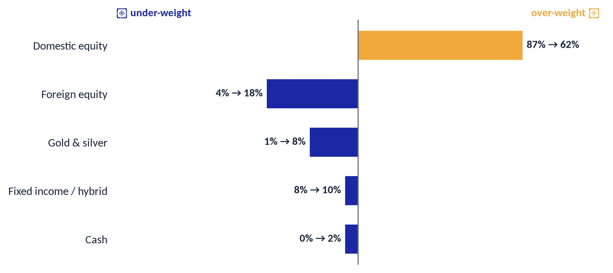
STANDARD
Allocation drift & rebalancing
Where the book has drifted from policy, and the bands that trigger a rebalance
Rebalancing policy
Rebalance a sleeve when it drifts more than ±5 percentage points from its policy weight, or at the quarterly review — whichever comes first.
Fund the moves from the Sell proceeds and the anticipated liquidity event, staged to manage entry and tax.
Reading the chart. Domestic equity is the one materially over-weight sleeve; foreign equity and gold are the biggest shortfalls. The plan's redeployment closes exactly these gaps — the same story as house-view fit, expressed as drift.
AZBY Family · illustrative template · Ionic Wealth
Private & Confidential
29

Slide 31
RM · CORE
What you pay today
Most of the book is already low-cost; the saving is consolidation + one transparent fee
Cost line | Base | Rate | Annual ₹ | bps
Fund TER — Direct plans (20 schemes) | ₹2.30 Cr | wtd [to source] | [to source] | [src]
Fund TER — Regular-plan trail (1 scheme) | ₹0.05 Cr | [to source] | [to source] | [src]
Direct equity (self-held, 76 stocks) | ₹3.01 Cr | nil ongoing | ₹0 | 0
Advisory / PMS fee (if any today) | ₹5.34 Cr | [to source] | [to source] | [src]
Current all-in recurring |  |  | [to source] | [src]
Where CoPilot saves
The book is already ~99.5% direct plans — so plan conversion is a small win (one ₹0.05 Cr line).
The durable saving is consolidating 21 → 19 schemes, removing duplicated exposure, and folding a fragmented fee base into one transparent CoPilot fee.
Every [to source] rate is confirmed against the latest factsheets and the CoPilot fee schedule before dealing. Cost and tax are shown on separate slides so neither double-counts the other.
AZBY Family · illustrative template · Ionic Wealth
Private & Confidential
30

Slide 32
STANDARD
Tax impact of the plan
What the actions trigger, how we minimise it, and the file that unlocks the equity estimate
Rate framework (FY26-27; confirm with adviser): equity LTCG (>12m) 12.5% above the ₹1.25 L annual exemption; STCG 20%. A switch is a redemption for tax.
Action | ₹ L | Holding | Character | Note
Nippon Multi-Cap (switch) | 1.7 | > 1y | LTCG 12.5% | switch = redemption for tax
ICICI Multi-Asset Regular (redeem) | 2.4 | recent | STCG 20% | consolidate to Direct; check net-of-tax vs trail
Bandhan Small-Cap (exit) | 3.7 | > 1y | LTCG 12.5% | small ticket, low tax drag
Direct-equity Sells + Titan trim | 66 | mixed lots | pending | not computable until demat trade file is shared
Tax-aware sequence
This FY: book losses first (harvest), then LTCG up to ₹1.25 L tax-free, then the high-conviction Sells regardless of tax.
Next FY: remaining LTCG sells + the Titan trim, on a fresh exemption.
One file closes this gap. Share the demat trade file (acquisition dates + costs per lot) and the next review computes exact per-lot STCG/LTCG, finalises the harvest set, and locks the two-FY sequence. Until then the equity tax figure is intentionally blank, not guessed.
AZBY Family · illustrative template · Ionic Wealth
Private & Confidential
31

Slide 33
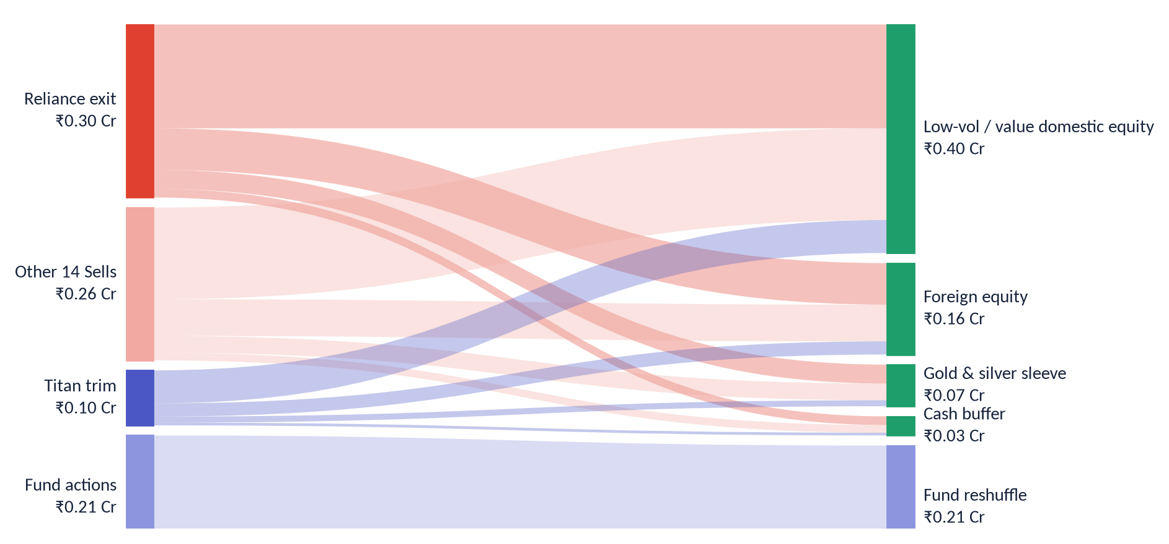
RM · CORE
Deployment — where the money moves
Every rupee freed has a destination, and every destination has a reason
Destination | ₹ L | Why
Low-vol / value domestic equity | 40 | Favoured style tilt; the book is value-light
Foreign equity (60:40 DM:EM) | 16 | Largest open gap vs the ~25%-of-equity target
Gold & silver sleeve (75:25) | 7 | No sized sleeve today
Cash buffer (staged) | 3 | Freed cash is never assumed fully invested
Proceeds bridge. ₹0.56 Cr Sells + ₹0.10 Cr Titan trim = ₹0.66 Cr cash to redeploy. The ₹0.21 Cr of fund actions recirculates inside the fund book (not new-sleeve cash); total reorganised ₹0.87 Cr.
Expressed as allocation direction for freed cash, actioned on your instruction — no specific security is recommended for purchase (non-discretionary mandate).
AZBY Family · illustrative template · Ionic Wealth
Private & Confidential
32

Slide 34
RM · CORE
Before & after
The book, before and after the plan
Measure | Today | Proposed / target
Largest single name (of equity) | 11.2% | 8.0% (guideline)
Sell-rated weight | 10.6% | 0.0%
Top-10 weight | 33.2% | toward < 30%
Regular-plan fund | one holding | 0
Foreign-equity share | ~4.4% | toward 25% of equity
Fund schemes | 21 | 19
Proposed values are guidelines or house-view targets, not forecasts of return.
AZBY Family · illustrative template · Ionic Wealth
Private & Confidential
33

Slide 35
RM · CORE
Priority actions
The order sheet — sequenced and tax-aware
# | Action | Instrument | Instruction | ₹ L | Proceeds to
1 | TRIM | Titan Company | Toward the single-name guideline | 9.5 | Low-vol / value
2 | SELL | Reliance Industries | Full exit, scored 29 | 30 | Low-vol / value
3 | SELL | 14 further Sell names | Scored below 40 | 26 | Redeploy per plan
4 | SWITCH | Nippon Multi-Cap | Reshape to flexi-cap | 1.7 | Flexi-cap fund
5 | REDEEM | ICICI Multi-Asset (Regular) | Duplicate, costlier plan | 2.4 | ICICI Direct plan
6 | EXIT | Bandhan Small-Cap | Sub-scale duplicate | 3.7 | Primary small-cap
Total value reorganised ₹87.1 L (₹0.87 Cr). Reviewed with client on ____________________
Sequence sells tax-aware per the tax slide; amounts indicative pending dealing. Non-discretionary — actioned on your instruction.
AZBY Family · illustrative template · Ionic Wealth
Private & Confidential
34

Slide 36
SECTION 06
Risk, Growth & Frontier
How much risk the book carries, how it behaves under stress, and where it could grow.
Portfolio risk analytics
Stress & scenario analysis
The opportunity set
Growth projection
AZBY Family · illustrative template · Ionic Wealth
Private & Confidential
35

Slide 37
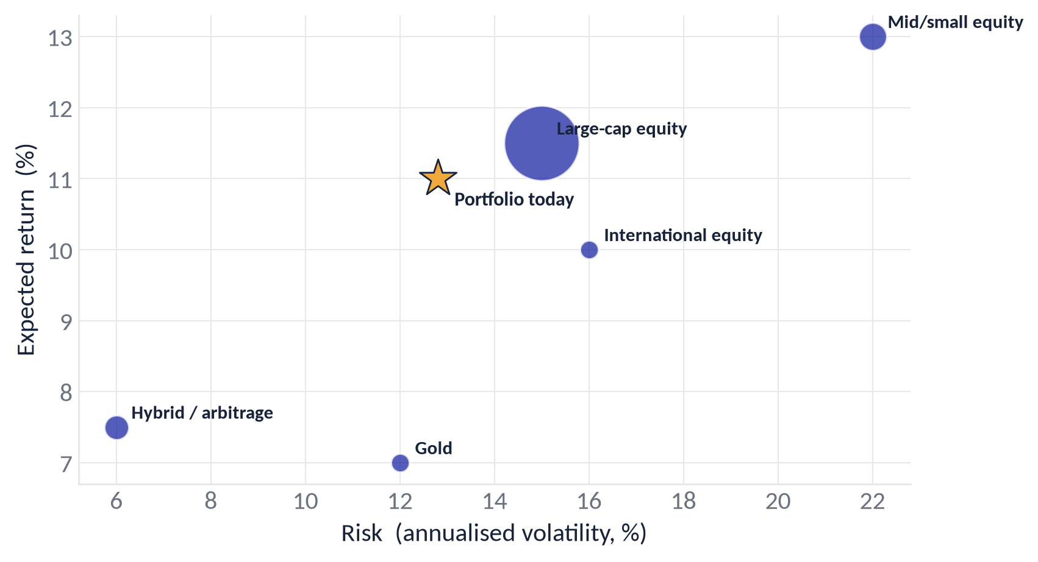
STANDARD
Portfolio risk analytics
How much risk the book carries, and of what kind
Risk & return by sleeve
Measure | Value | Reading
Annualised volatility | 12.8% | moderate for an aggressive equity book
Beta vs Nifty | 0.98 | moves broadly with the market
Sharpe ratio | 0.71 | reward per unit of total risk
Sortino ratio | 0.94 | reward per unit of downside risk
Maximum drawdown | -16.6% | worst peak-to-trough over the window
1-month VaR (95%) | -6.9% | loss not expected to be exceeded 19 months in 20
Tracking error | 3.4% | active risk vs the reference index
AZBY Family · illustrative template · Ionic Wealth
Private & Confidential
36

Slide 38
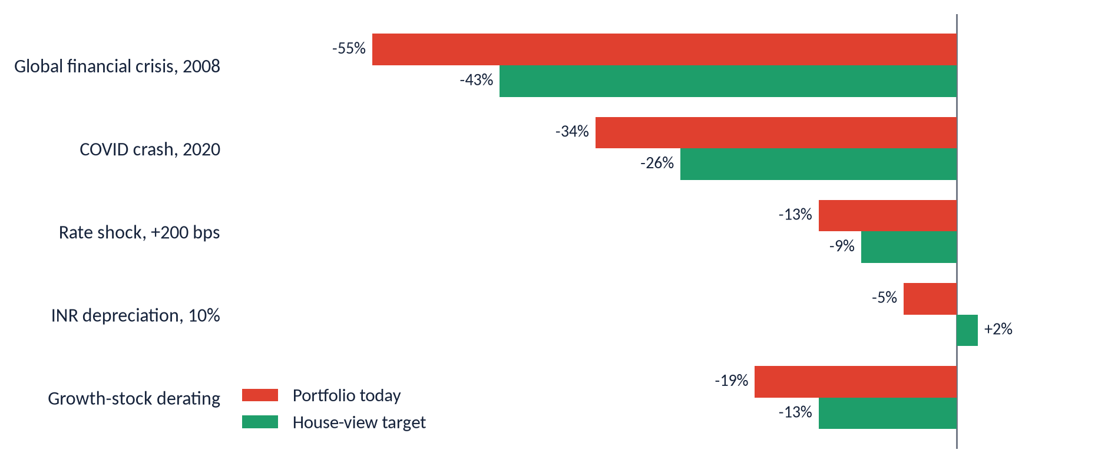
STANDARD
Stress & scenario analysis
How the book behaves in historical and hypothetical shocks
Why the target is more resilient
In every drawdown scenario the house-view target loses less than the book today. The reason is diversification: the foreign-equity, gold and debt sleeves the plan adds are exactly what cushion a single-market equity shock. One scenario — a sharp INR depreciation — actually helps the target, because unhedged foreign assets gain in rupee terms.
Shocks applied to current vs target allocation using long-run asset-class assumptions; illustrative, not a forecast.
AZBY Family · illustrative template · Ionic Wealth
Private & Confidential
37

Slide 39
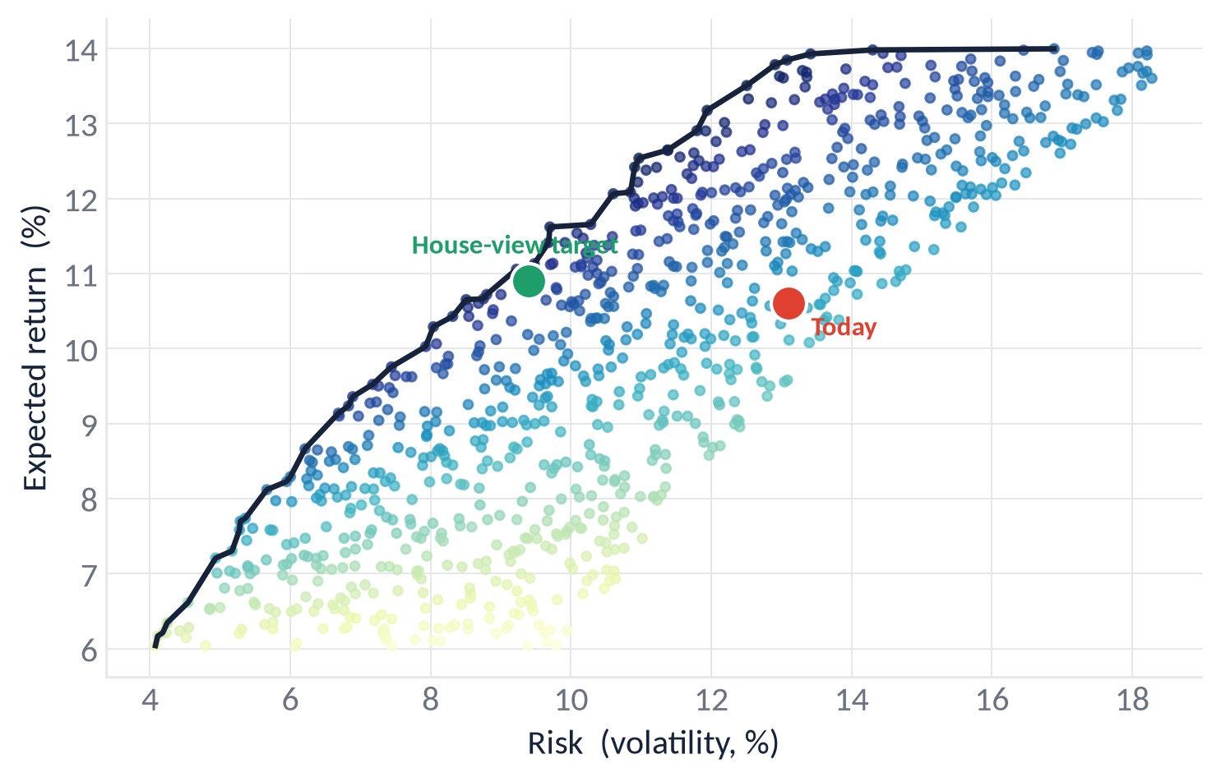
STANDARD
The opportunity set
Where the book sits against an efficient frontier
Reading the map
Each dot is a feasible asset-class mix; colour rises with reward-per-unit-risk, and the upper-left edge is the efficient frontier. Today (red) sits inside the frontier — too much single-basket equity risk for its return. The house-view target (green) steps left by adding international, gold and a debt cushion.
Illustrative opportunity set from long-run capital-market assumptions, not a forecast.
AZBY Family · illustrative template · Ionic Wealth
Private & Confidential
38

Slide 40
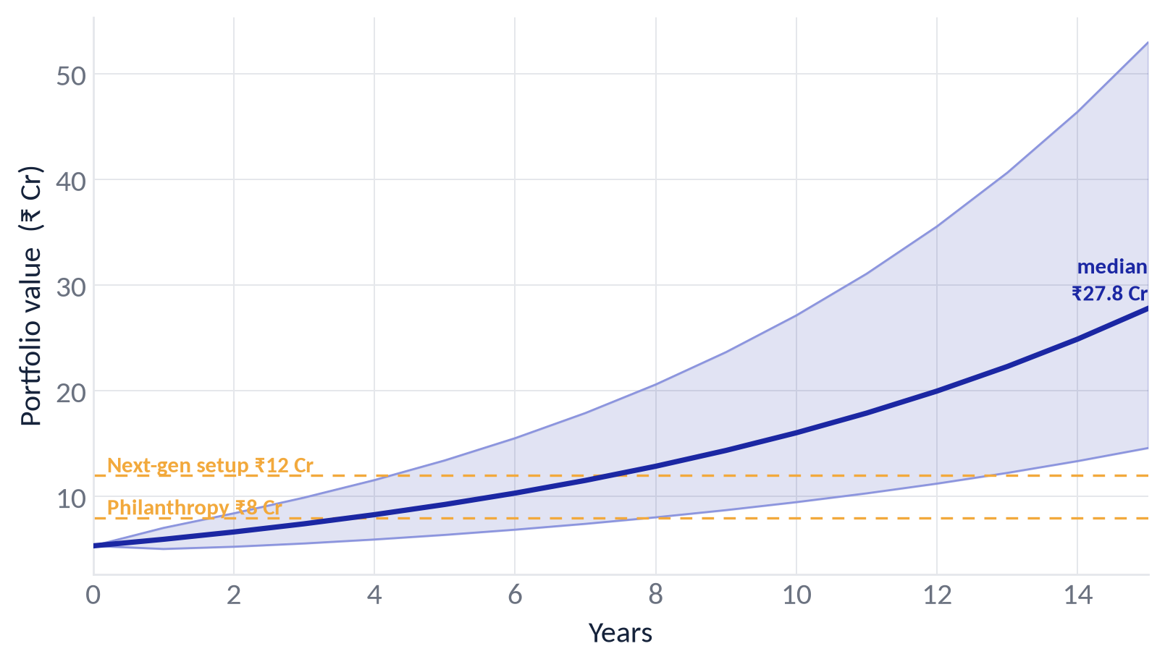
STANDARD
Growth projection
Where this book could grow, and the goals it can fund
Reading the cone
At an assumed 11% return and 13% volatility, the book's central path roughly doubles in about seven years. The shaded band is the 10th–90th percentile of outcomes; real experience will vary. Dashed lines are illustrative goal corpora.
Illustrative lognormal projection, not a forecast.
AZBY Family · illustrative template · Ionic Wealth
Private & Confidential
39

Slide 41
SECTION 07
Family Office
For the UHNI family office: consolidation, governance and goal funding.
Consolidated view
Governance & succession
Goal funding
AZBY Family · illustrative template · Ionic Wealth
Private & Confidential
40

Slide 42
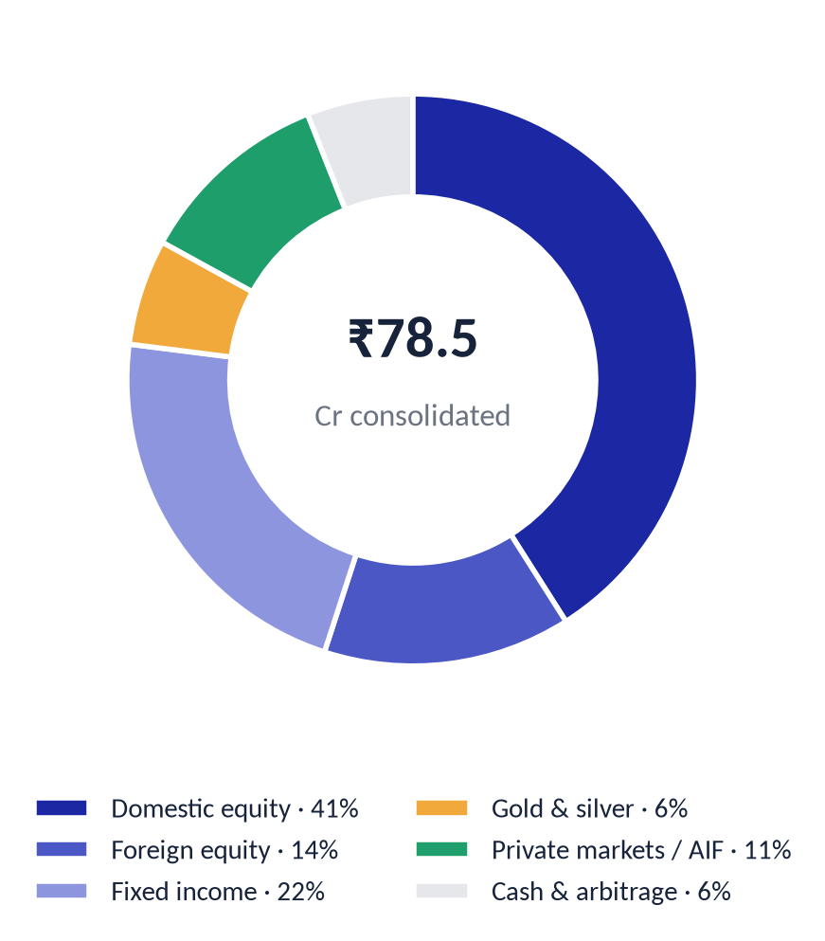
UHNI · FAMILY OFFICE
Consolidated view
AZBY Family Office — ₹78.5 Cr across five entities
By entity
Entity | Mandate | ₹ Cr
Family Private Trust | Discretionary — next-gen beneficiaries | 34.2
AZBY Holdings HUF | Hindu Undivided Family | 12.6
Operating Co. Treasury | Surplus treasury, promoter entity | 18.9
Individual — Promoter | Personal demat & funds | 9.4
Individual — Spouse | Personal demat & funds | 3.4
A family-office review consolidates every entity into one look-through — the same scorecard and house-view discipline applied across trust, HUF, treasury and individual demats, with entity-level tax and governance layered on top.
AZBY Family · illustrative template · Ionic Wealth
Private & Confidential
41

Slide 43
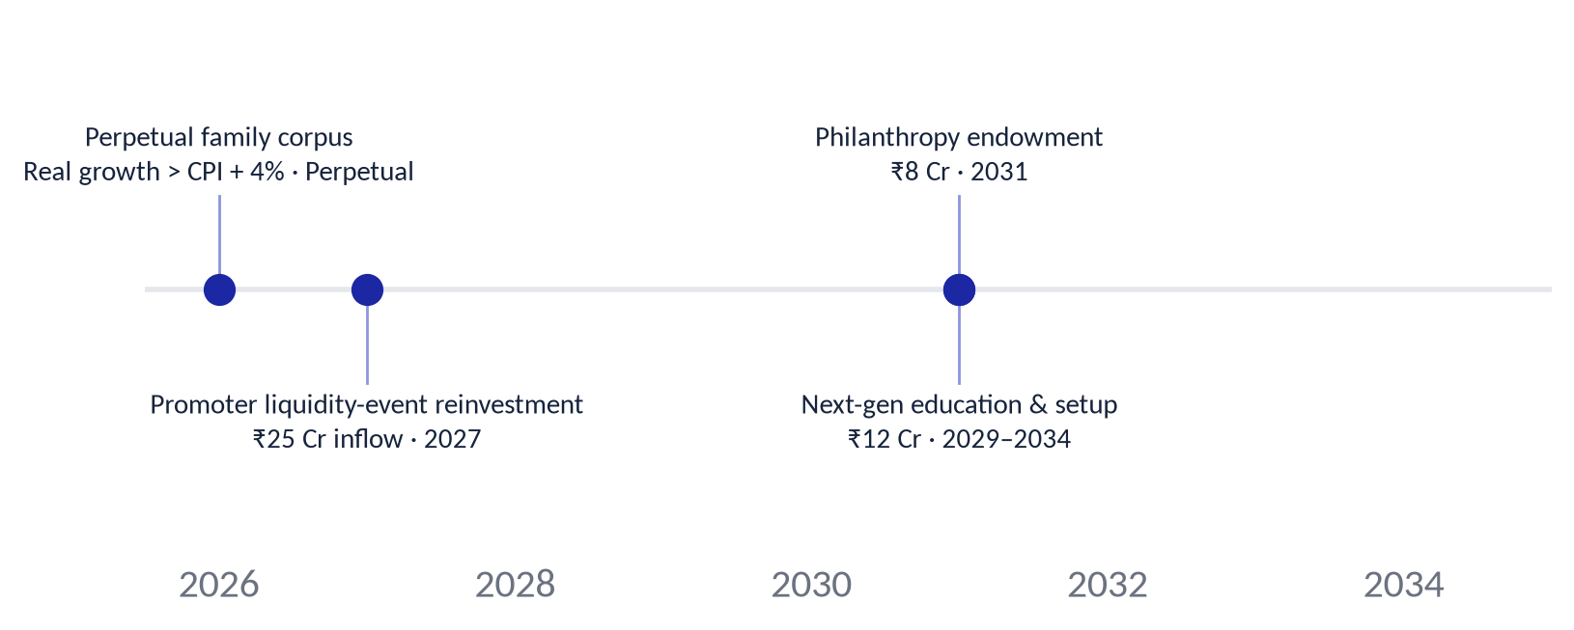
UHNI · FAMILY OFFICE
Governance & succession
The layer above the portfolio, for a multi-generational book
Investment governance
Succession & structure
A written IPS per entity, an annual asset-allocation review, and a documented rebalancing policy so decisions survive any single decision-maker.
Trust and HUF structures aligned to the family's succession intent; beneficiary classes, trustee powers and a letter of wishes reviewed with counsel.
Liquidity & events
Philanthropy & legacy
A liquidity ladder for the anticipated promoter event, with reinvestment sequenced into the house-view sleeves rather than deployed at once.
An endowment sleeve with its own spending policy, ring-fenced from the family corpus and reported separately.
AZBY Family · illustrative template · Ionic Wealth
Private & Confidential
42

Slide 44
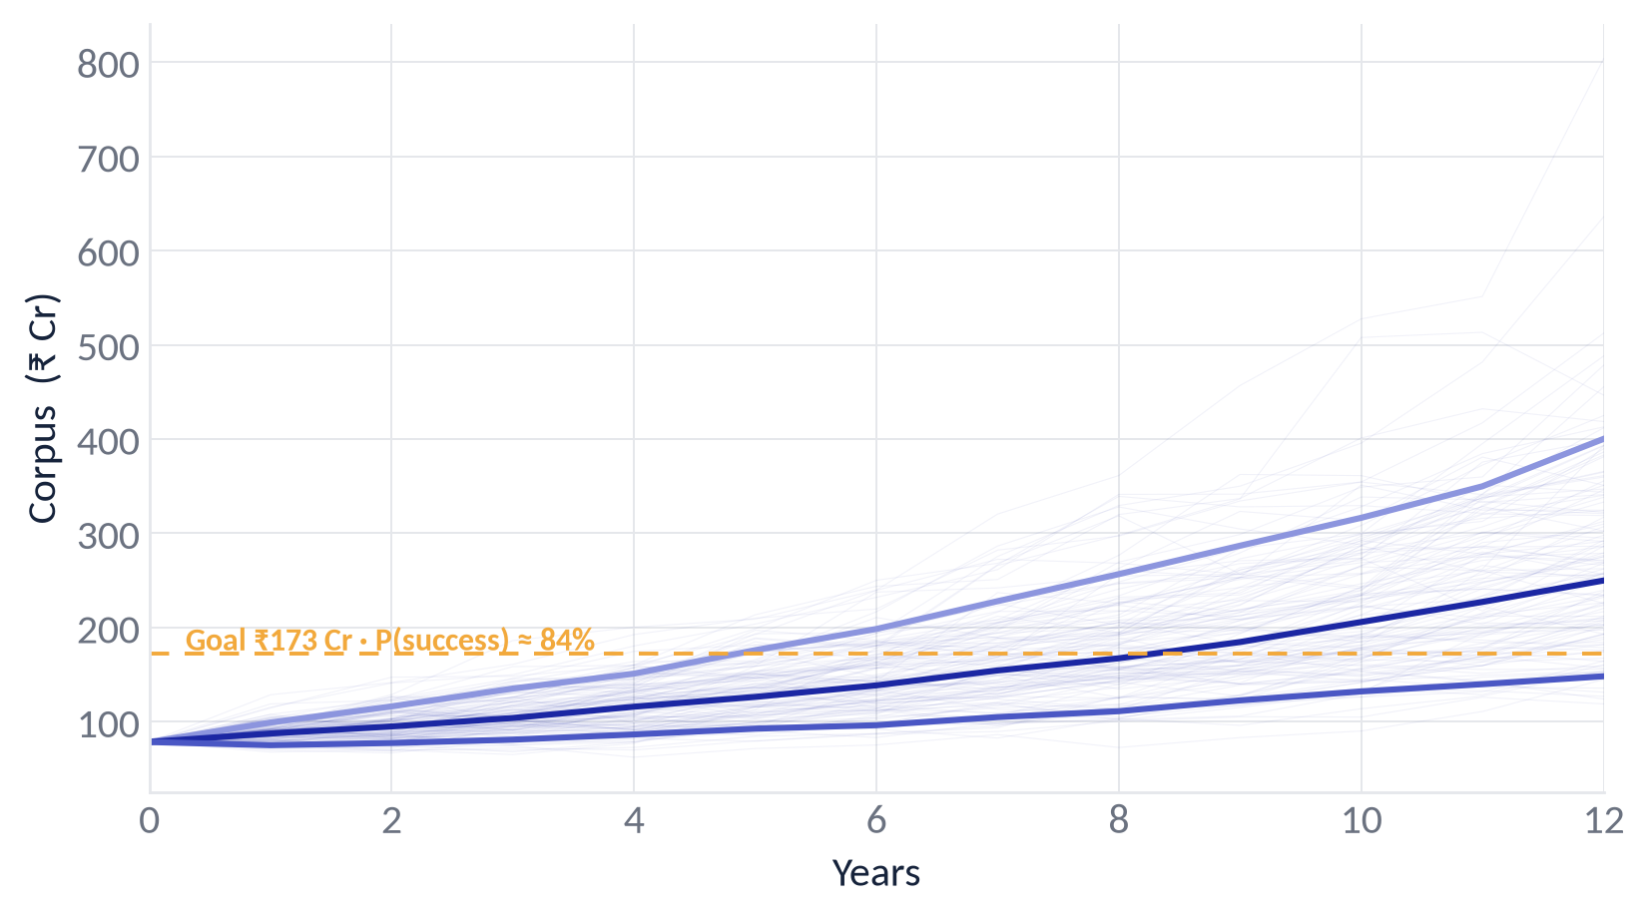
UHNI · FAMILY OFFICE
Goal funding
Probability the corpus funds the family's goals
Reading the fan
Each faint line is one simulated path for the family corpus; the bold lines are the 10th, 50th and 90th percentiles. Against the illustrative goal, the probability of success is read where the paths clear the dashed line.
Illustrative Monte-Carlo simulation on long-run assumptions; not a forecast or a guarantee.
AZBY Family · illustrative template · Ionic Wealth
Private & Confidential
43

Slide 45
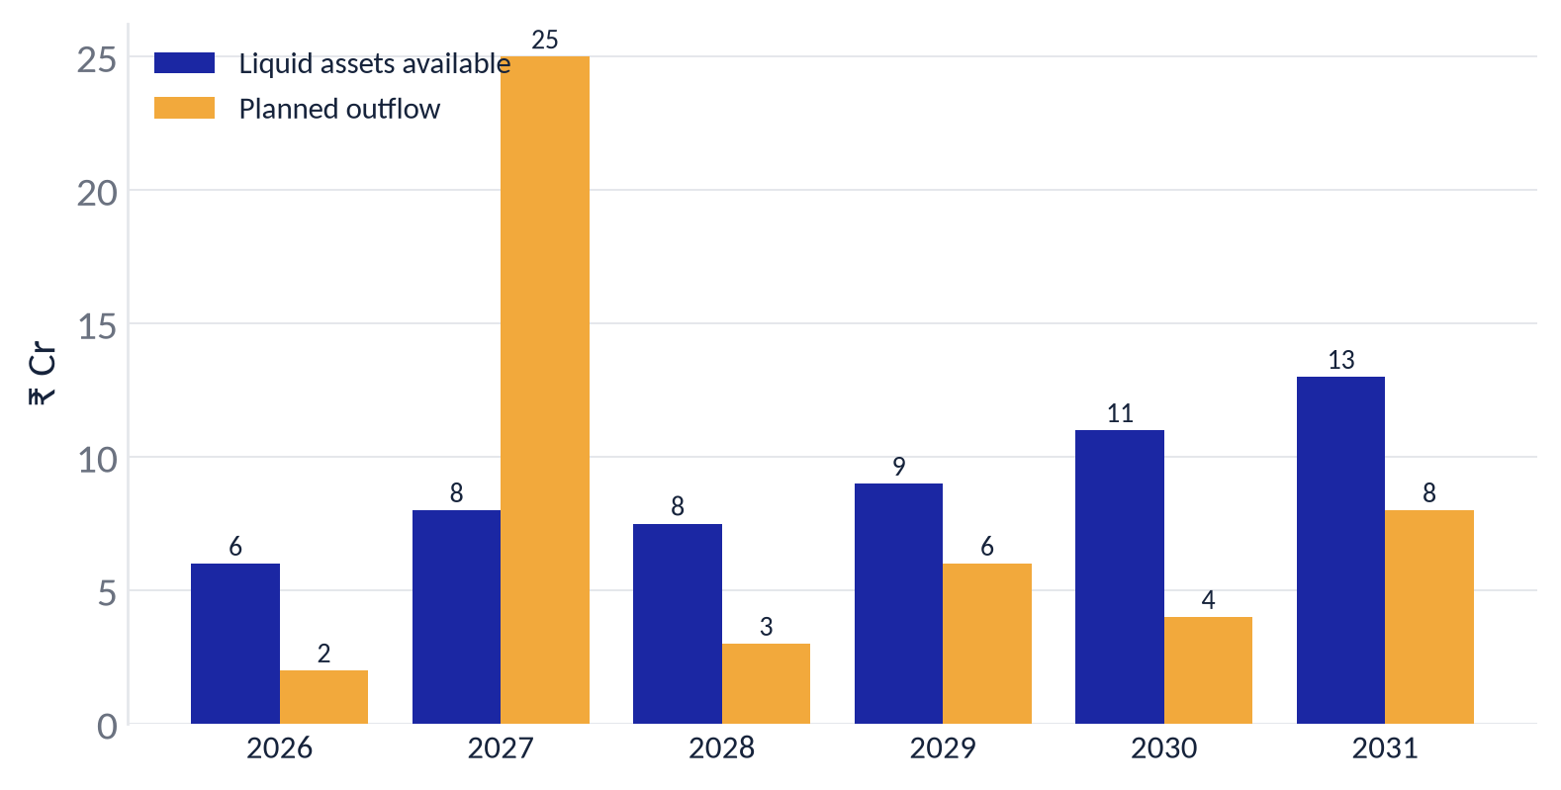
UHNI · FAMILY OFFICE
Liquidity ladder
Matching liquid assets to the family's planned outflows
The one year to plan for
Standing liquid assets cover planned outflows in every year except 2027, when the ₹25 Cr next-gen reinvestment lands. That is pre-funded from the anticipated promoter liquidity event and staged into the house-view sleeves over several quarters, rather than deployed in one tranche.
A liquidity ladder is refreshed each review as goals and dates firm up.
AZBY Family · illustrative template · Ionic Wealth
Private & Confidential
44

Slide 46
SECTION A
Appendix
A reusable chart library, the full registers, and the method.
Chart library (templates ready for any client)
Direct-equity register
Mutual-fund register
Methodology & basis of preparation
AZBY Family · illustrative template · Ionic Wealth
Private & Confidential
45

Slide 47
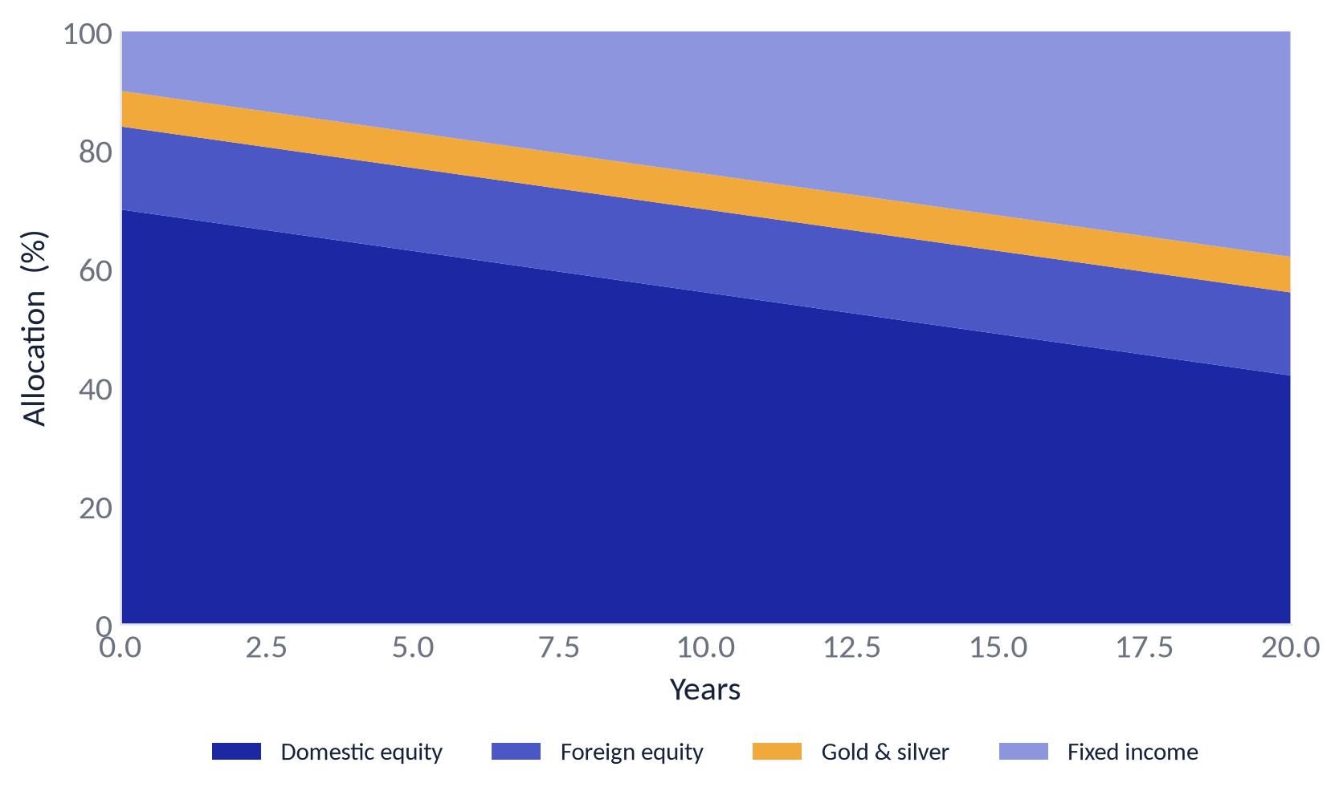
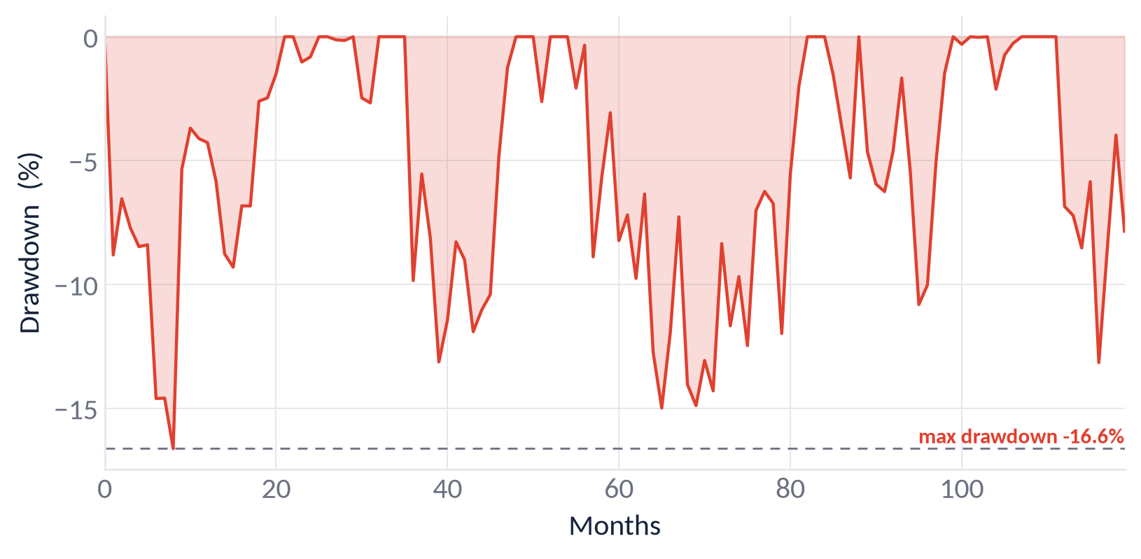
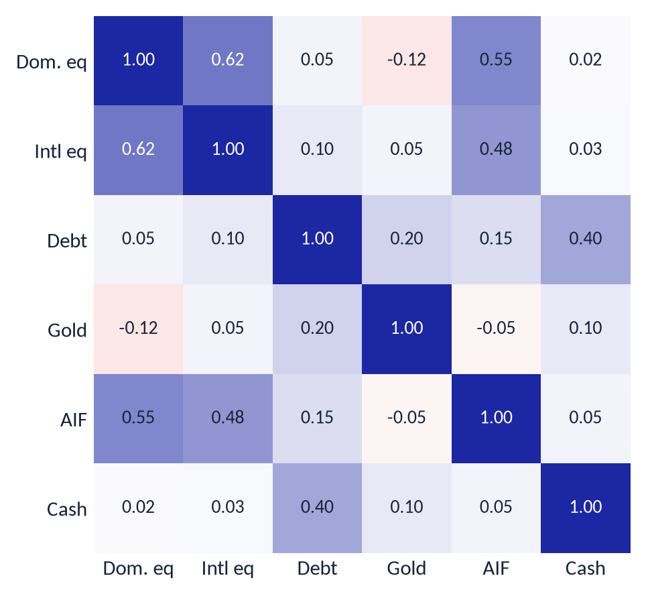
APPENDIX
Chart library
Reusable analytics — ready for any client, shown here on AZBY data
Allocation glidepath
Drawdown / underwater
Asset-class correlation
Rolling-return consistency
These are template charts wired to the same data model — an advisor can drop any of them into a client review without rebuilding.
AZBY Family · illustrative template · Ionic Wealth
Private & Confidential
46

Slide 48
APPENDIX
Direct-equity register
Every holding, every score, every call · 1 of 2
Name | Wt | Score | Call
Titan Company | 6.3% | 49 | Hold
Reliance Industries | 5.6% | 29 | Sell
Tata Consultancy Svcs | 4.3% | 50 | Hold
ICICI Bank | 3.8% | 57 | Hold
Infosys | 3.3% | 55 | Hold
HDFC Bank | 2.6% | 52 | Hold
Bharti Airtel | 2.2% | 60 | Hold
State Bank of India | 1.9% | 62 | Hold
Bajaj Finance | 1.7% | 56 | Hold
Larsen & Toubro | 1.5% | 39 | Sell
ITC | 1.1% | 54 | Hold
Hindustan Unilever | 1.1% | 45 | Hold
Kotak Mahindra Bank | 1.0% | 41 | Hold
Axis Bank | 1.0% | 47 | Hold
Maruti Suzuki | 0.9% | 50 | Hold
Sun Pharma | 0.9% | 55 | Hold
UltraTech Cement | 0.8% | 49 | Hold
Asian Paints | 0.8% | 51 | Hold
Nestle India | 0.8% | 55 | Hold
Name | Wt | Score | Call
Hindustan Aeronautics | 0.7% | 61 | Hold
Bharat Electronics | 0.7% | 53 | Hold
Adani Enterprises | 0.7% | 31 | Sell
Avenue Supermarts | 0.6% | 42 | Hold
Wipro | 0.6% | 35 | Sell
NTPC | 0.6% | 40 | Hold
Pidilite Inds | 0.6% | 54 | Hold
Hindalco Industries | 0.5% | 53 | Hold
Tata Power | 0.5% | 30 | Sell
GAIL India | 0.5% | 38 | Sell
Tech Mahindra | 0.5% | 41 | Hold
HCL Technologies | 0.4% | 51 | Hold
Bajaj Auto | 0.4% | 68 | Hold
Hero MotoCorp | 0.4% | 64 | Hold
Cipla | 0.4% | 50 | Hold
Power Grid Corp | 0.4% | 47 | Hold
Godrej Consumer | 0.3% | 32 | Sell
Dabur India | 0.3% | 41 | Hold
Coforge | 0.3% | 59 | Hold
Source: Ionic Quant Scorecard. Sorted by weight.
AZBY Family · illustrative template · Ionic Wealth
Private & Confidential
47

Slide 49
APPENDIX
Direct-equity register
Every holding, every score, every call · 2 of 2
Name | Wt | Score | Call
Persistent Systems | 0.3% | 49 | Hold
Polycab India | 0.3% | 67 | Hold
Siemens | 0.3% | 58 | Hold
Power Finance Corp | 0.3% | 63 | Hold
REC | 0.3% | 57 | Hold
Samvardhana Motherson | 0.2% | 64 | Hold
Federal Bank | 0.2% | 62 | Hold
Central Depository Svcs | 0.2% | 52 | Hold
BSE | 0.2% | 64 | Hold
Computer Age Mgmt | 0.2% | 58 | Hold
Max Financial Svcs | 0.2% | 34 | Sell
LIC Housing Finance | 0.2% | 51 | Hold
Tata Consumer | 0.2% | 36 | Sell
Marico | 0.2% | 57 | Hold
United Spirits | 0.2% | 48 | Hold
Colgate-Palmolive | 0.2% | 46 | Hold
Britannia Industries | 0.1% | 47 | Hold
Atul | 0.1% | 46 | Hold
Deepak Nitrite | 0.1% | 50 | Hold
Name | Wt | Score | Call
SRF | 0.1% | 50 | Hold
Balrampur Chini | 0.1% | 46 | Hold
Exide Industries | 0.1% | 54 | Hold
Bharat Forge | 0.1% | 47 | Hold
Suzlon Energy | 0.1% | 74 | Hold
Kaynes Technology | 0.1% | 50 | Hold
Jubilant Foodworks | 0.1% | 38 | Sell
Info Edge | 0.1% | 39 | Sell
Swiggy | 0.1% | 39 | Sell
Jio Financial | 0.1% | 38 | Sell
Varun Beverages | 0.1% | 34 | Sell
Trent | 0.1% | 47 | Hold
Mphasis | 0.1% | 42 | Hold
IRCTC | 0.1% | 55 | Hold
Blue Dart Express | 0.1% | 47 | Hold
Supriya Lifescience | 0.1% | 59 | Hold
Syngene Intl | 0.1% | 43 | Hold
Lupin | 0.1% | 67 | Hold
VIP Industries | 0.1% | 18 | Sell
Source: Ionic Quant Scorecard. Sorted by weight.
AZBY Family · illustrative template · Ionic Wealth
Private & Confidential
48

Slide 50
APPENDIX
Mutual-fund register
Every scheme, category, plan and action
Scheme | House | Category | Plan | ₹ L | 3Y vs bench | Action
HSBC Small Cap | HSBC | Small Cap | Direct | 59.0 | +6.2pp | HOLD
Parag Parikh Flexi Cap | PPFAS | Flexi Cap | Direct | 31.0 | +4.8pp | HOLD
Franklin Build India | Franklin | Thematic-Infra | Direct | 22.7 | under 3Y | HOLD
Nippon India Multi Cap | Nippon | Multi Cap | Direct | 17.0 | +9.4pp | SWITCH
ICICI Pru Multi Asset | ICICI Prudential | Hybrid-Multi Asset | Direct | 14.4 | under 3Y | HOLD
Tata Arbitrage | Tata | Hybrid-Arbitrage | Direct | 12.5 | under 3Y | HOLD
Motilal Oswal Midcap | Motilal Oswal | Mid Cap | Direct | 10.6 | +13.5pp | HOLD
Franklin Asian Equity | Franklin | International | Direct | 9.8 | under 3Y | HOLD
HDFC Balanced Advantage | HDFC | Hybrid-BAF | Direct | 9.5 | under 3Y | HOLD
Invesco Global Consumer | Invesco | International | Direct | 7.4 | under 3Y | HOLD
Edelweiss US Tech FoF | Edelweiss | International | Direct | 6.4 | under 3Y | HOLD
Kotak Equity Savings | Kotak | Hybrid-Equity Savings | Direct | 5.3 | under 3Y | HOLD
SBI ELSS Tax Saver | SBI | ELSS | Direct | 4.5 | +2.1pp | HOLD
Nippon India Gold Savings | Nippon | Commodity-Gold FoF | Direct | 4.2 | under 3Y | HOLD
JM Flexicap | JM | Flexi Cap | Direct | 4.2 | +13.1pp | HOLD
Motilal Nifty500 Momentum 50 | Motilal Oswal | Index-Factor Momentum | Direct | 3.2 | under 3Y | HOLD
UTI Nifty500 Value 50 | UTI | Index-Factor Value | Direct | 2.9 | under 3Y | HOLD
Bandhan Small Cap | Bandhan | Small Cap | Direct | 2.6 | +8pp | EXIT
Motilal BSE Enhanced Value | Motilal Oswal | Index-Factor Value | Direct | 2.0 | under 3Y | HOLD
ICICI Pru Multi Asset (Reg) | ICICI Prudential | Hybrid-Multi Asset | Regular | 1.7 | under 3Y | REDEEM
UTI Nifty200 Momentum 30 | UTI | Index-Factor Momentum | Direct | 1.5 | under 3Y | HOLD
Source: client statement; QFRA fund NAV feed. Capture, consistency and hybrid risk metrics refreshed each quarter.
AZBY Family · illustrative template · Ionic Wealth
Private & Confidential
49

Slide 51
APPENDIX
Methodology & basis of preparation
How the numbers are built, and what they can and cannot say
The Ionic Score
Basis of preparation
A 0–100 cross-sectional composite of quality, valuation, growth and momentum pillars.
Blended 0.60 × 3-year + 0.40 × 1-year; a Sell triggers below 40, and the model never issues Buy.
Refreshed each quarter on point-in-time data; a score can be stale or wrong, and is read alongside an analyst.
All figures are illustrative template data for a fictional family; no real client is depicted.
Fund capture, consistency and hybrid risk metrics are computed from the NAV feed at each quarterly refresh.
Tax estimates cover the fund book until a demat trade file supplies equity acquisition lots and costs.
Fund look-through (overlap) is pending each scheme's latest portfolio disclosure.
AZBY Family · illustrative template · Ionic Wealth
Private & Confidential
50

Slide 52
RM · CORE
Engagement & next steps
How we work together from here
1
2
3
4
Confirm & sign off
Share the demat trade file
Execute, tax-aware
Monitor & refresh
Review the order sheet together and confirm the actions you're comfortable with. Nothing is executed without your instruction.
Acquisition dates and costs per lot unlock the exact equity tax estimate and the harvest set — the one open data item.
We sequence the sells and redeployment across two financial years to use both LTCG exemptions and stage entry.
Quarterly rescore and rebalance-band checks via Ionic CoPilot; a full review each quarter, or sooner on a material change.
Your Ionic Wealth team Relationship manager · [name] · [email] · [direct line] Review cadence: quarterly
AZBY Family · illustrative template · Ionic Wealth
Private & Confidential
51

Slide 53
DISCLAIMER
This is an illustrative template built on fictional data (the “AZBY Family”) to design a standard portfolio-review deck; it depicts no real client and is not investment advice. In a live review, recommendations are Sell (including full Exit or, for a fund, Redeem), Switch, Trim or Hold on holdings already owned; the model does not issue Buy calls. Scores are model output on point-in-time data and can be wrong or stale. Past performance is not indicative of future results. Mutual fund investments are subject to market risk; read all scheme-related documents carefully. Tax treatment depends on individual circumstances and may change; consult a tax adviser before dealing.
IONIC WEALTH
Private & Confidential · Illustrative template

