Slide 1

IONIC WEALTH
BY ANGEL ONE
Portfolio Review Engine
An NDPMS client-reporting product, end to end
FOR REVIEW BY
Product Approval Committee
Methodology, workflow, controls, and the deliverable itself
INTERNAL · Prepared by the Portfolio Review desk · As of 2026-08-04 · Sample pages use a synthetic demo book, never a real client's holdings

Slide 2

Private & Confidential
00 · THE PROPOSAL
What is being approved
A scored, evidence-backed portfolio review, produced as a repeatable product
751 / 751
3
60
4
STOCKS SCORED
CLIENT TIERS
PAGE MODULES
QA GATE LAYERS
quant + analyst
depth by audience
one library
all must pass
The product is a client portfolio review: every direct holding and every fund carries a score, a call and a written reason.
THE APPROVAL SOUGHT
The engine is frozen and rerunnable. The same holdings file produces the same deck, and every number traces to a source.
Sign-off to use this engine as the standard NDPMS review deliverable for onboarding and periodic reviews, on the frozen methodology and the four-layer quality gate described here. Two real client books have already been produced end to end under this process.
It reviews existing holdings only, and the vocabulary is Sell, Trim or Hold.
Three depth tiers serve a family office, a typical NDPMS client and an RM-led conversation from one module library.
Coverage as of 2026-08-03. Sample pages in this deck are rendered from a synthetic demo book.
Portfolio Review · 02

Slide 3
Private & Confidential
00 · THE PROPOSAL
Input and output
One holdings statement in, one reviewed and signed deck out
1
Holdings statement
A client's CAS, demat or CAMS/Kfintech statement. Parsed to a validated holdings table, with corrupted or unmatched rows flagged to the RM rather than dropped.
2
Match to coverage
Equity matched by ISIN to the scored universe; funds matched by verified scheme identity to the fund frameworks. Anything unmatched is disclosed, never guessed.
3
Score and read
Frozen scoring engine produces the numbers; a sector analyst writes the case. The analyst can rescue a score-driven Sell to Hold, and cannot force the reverse.
4
Assemble the deck
The module library renders the tier the client's audience needs, computing every narrative sentence from the data rather than from stored prose.
5
Prove it
Four QA layers: two geometry checks, a client-copy scan, and a visual read of the rendered pages. All must pass.
6
Analyst sign-off
The reviewing analyst confirms the pack, name by name, before it goes to the client.
THE POINT
The judgment stays human. What the engine removes is the variance.
Portfolio Review · 03

Slide 4
Private & Confidential
00 · THE PROPOSAL
Engine-led review against a manual one
The same judgment, reached faster and applied to everything the client owns
A MANUAL REVIEW
THIS ENGINE
Turnaround per client
About a week
A few hours
Holdings covered
The larger names, sampled
Every holding, no sampling
Scored universe behind it
None maintained
751 names, refreshed weekly
Consistency between reviewers
Varies with who does it
One weight set, applied identically
Audit trail
Notes, if they were kept
Dated research and journalled state, per name
Cost of the next client
Another full cycle
Assembly is scripted; research is incremental
What stays human
Everything
The call, the override, the sign-off
WHAT THIS COMPARISON IS NOT SAYING
Not that the engine reviews better than an analyst. That the analyst should spend their time on judgment rather than assembling arithmetic, and a client with 98 holdings should get all 98 looked at. The week-versus-hours figure is our own estimate, not a measured benchmark.
Turnaround and coverage for the engine are observed from the two client books produced to date; the manual baseline is an internal estimate and is labelled as such.
Portfolio Review · 04

Slide 5

Private & Confidential
01
SECTION 01
The model
What produces a score, what produces a call, and what the evidence shows
Scoring architecture
Where the weights come from
Gates and the call
The one number a client sees
Coverage, and does it work

Slide 6
Private & Confidential
01 · THE MODEL
Scoring architecture
Two horizons, seven pillars, never blended at the analyst's desk
PILLAR
WHAT IT MEASURES
3-YEAR WEIGHT
1-YEAR WEIGHT
Quality
Return on equity and capital, ranked within sector
20%
16%
Growth
Revenue compounding, three-year and trailing-twelve-month
20%
16%
Value
Earnings, book and cash-flow yield versus sector and size peers
18%
16%
Stage / technical
Price trend against its own history and its sector
14%
26%
Sector & macro
Sector strength, adjusted for cyclicality in the current regime
11%
13%
Ownership flow
Institutional buying and selling across recent quarters
9%
8%
Accumulation
Volume-flow trend behind the price
8%
5%
WHY TWO HORIZONS
DISCIPLINE BEHIND THE RANKS
A three-year score leans on fundamentals; a one-year score leans on market behaviour. Keeping them apart means a good business in a bad tape and a weak business in a strong tape read differently, instead of averaging into the same middle.
Every input is winsorised before ranking, so one outlier cannot claim an extreme percentile. Value ranks within sector and size tier, because a cement multiple and a software multiple are not comparable numbers.
Frozen scoring contract; discounted-cash-flow is deliberately excluded as a mechanical pillar and lives as the analyst's own reverse-DCF judgment.
Portfolio Review · 06

Slide 7
Private & Confidential
01 · THE MODEL
Where the weights come from
Set by judgment, not fitted to returns, and we would rather say so
58 / 42
48 / 52
0
8
3-YEAR SPLIT
1-YEAR SPLIT
WEIGHTS FITTED TO RETURNS
QUARTERLY REBALANCES
fundamentals / market
fundamentals / market
none optimised
of clean point-in-time data
The weights encode a stated view: over three years fundamentals should dominate, over one year market behaviour should. The shipped weights deliver exactly that, at 58/42 and 48/52.
THE LIVE QUESTION ON THIS PAGE
Value sits at 18% of the three-year score, the smallest of the three fundamental pillars, which is arguably wrong for a discipline whose job is deciding what to exit. Raising it is under consideration.
No weight was fitted to maximise a backtested return. With eight quarterly rebalances of clean history, optimising would be curve-fitting dressed as rigour.
What we do claim is narrower and checkable: one set of weights applied identically to every name, frozen, versioned, and changeable only by signed amendment.
WHY WE HAVE NOT SIMPLY RAISED IT
The weights are a hypothesis the forward record will judge, not a proven finding.
Sixty per cent of the Value pillar is price-to-earnings by construction, so moving Value from 18% to 25% would take that one ratio from 10.8% to 15.0% of the whole score, and a low-multiple tilt in India loads onto public-sector and cyclical names. Valuation also already enters twice more, through the analyst's own reverse-DCF and the forward adjustment. We would rather test it on the point-in-time harness than assert it.
Splits are the fundamentals block (quality, growth, value) against the market block (stage, sector and macro, ownership, accumulation), computed from the shipped weights on the previous page.
Portfolio Review · 07

Slide 8
Private & Confidential
01 · THE MODEL
Gates, penalties, and the call
A score can be capped by risk before it is ever compared
Overlay gates apply after the weighted composite and can cap a score outright.
GATE
TRIPS WHEN
EFFECT
Balance-sheet safety
Debt/equity above 2.5x or interest cover below 1.5x
Caps the score at 40
Balance-sheet caution
Debt/equity above 1.5x or interest cover below 3x
Multiplies the score by 0.85
Liquidity
Median traded value below the bar for the stock's size tier
Caps the score at 40
THE LENDERS EXEMPTION
RED FLAGS COMPOUND
Banks, NBFCs and insurers are exempt from the debt/equity trigger: leverage is their business model, not distress. They are judged on asset quality instead.
Penalties scale non-linearly, so several problems are punished far harder than one blemish. A clean bill of health earns a small capped boost.
THE CALL
Score below 40, on either horizon
SELL
40 to 50, with a concentration or risk flag
TRIM
50 and above
HOLD
ONE-WAY OVERRIDE
A Sell can be rescued to Hold with a written reason. A Hold cannot be forced to Sell; it escalates.
Portfolio Review · 08

Slide 9
Private & Confidential
01 · THE MODEL
The one number a client sees
A blended score, then a bounded forward adjustment
Ionic Score = 0.60 x three-year score + 0.40 x one-year score + forward adjustment
The adjustment makes the number forward-looking. It is bounded, and it can never flatter a name we are telling the client to exit.
ANALYST'S FORWARD GROWTH VIEW
ADJUSTMENT
READING
TWO COHERENCE CAPS
Below 5%
-15
Structurally stagnant or declining
A name growing below 10% can be marked down but never up. And a name the analyst rates Sell can never be lifted by the adjustment. Both caps exist because earlier versions could perversely raise the score of a name we were recommending the client exit.
5 to 10%
-5
Below nominal growth in the economy
10 to 15%
0
Steady compounder, the neutral zone
15 to 20%
+5
Strong
20 to 25%
+10
Exceptional momentum
CONVICTION, PRICED
Where the analyst and the engine disagree, the disagreement itself moves the score: a rescued Sell earns a small credit, an analyst Sell a small debit. Agreement moves nothing.
25% and above
+15
Hypergrowth, evidence required
Growth is the analyst's forward three-to-five-year view, explicitly not trailing growth. Parroting trailing growth into this field is a named failure mode in the analyst brief.
Portfolio Review · 09

Slide 10
Private & Confidential
01 · THE MODEL
The fund frameworks
Two independent engines, and a deliberately hard bar to sell a fund
QFRA-1 · SHORT-TERM FRAMEWORK
QFRA-2 · LONG-TERM FRAMEWORK
Ranks every fund in a category on how much of its benchmark's rise it captures versus how much of the fall, over a common six-month window, then applies a downside filter after ranking. Covers 181 funds across six categories.
A curated shortlist of 40 funds across eight categories, scored 0-100 with a letter grade and a conviction level, built for a multi-year holding rather than a six-month window. Its only two verdicts are Active and Index-core: it has NO sell verdict, by design.
HOW A FUND ACTUALLY GETS SOLD, STATED PRECISELY
QFRA-1 is the only engine that can originate a sell, because it is the only one with a sell verdict. QFRA-2 cannot vote to sell; it can only veto one, since an Active rating is evidence against exiting. Absence from its curated forty is not a negative signal. Disagreement defaults to Hold.
Category coverage is honest: hybrid, sectoral, index, liquid and debt funds sit outside both frameworks and are reported as No View, never given a manufactured score.
Scheme identity is verified fund by fund, with the fund house and mandate confirmed. Name-similarity matching is prohibited after it produced real mis-matches.
A fund with under seven months of record gets No View regardless of what the engines compute.
Fund models re-run at April-end and October-end; monthly net-asset-value history accrues in between so each run has a full window.
Portfolio Review · 10

Slide 11
Private & Confidential
01 · THE MODEL
Coverage today
What is actually scored, as of this review
751
751
560 / 191
126
2
STOCKS IN THE UNIVERSE
WITH ANALYST RESEARCH
HOLD / SELL
ESCALATIONS
CLIENT BOOKS SHIPPED
quant layer complete
100% coverage
the current book of calls
open for desk ruling
end to end
Full analyst coverage was reached on 3 August 2026: all 751 names carry an engine score and a written human case.
REFRESH, NOT REBUILD
Coverage is maintained weekly by an incremental router, not a full re-run: names that reported get fresh research, news-only names get a cheap delta look, the rest carry forward.
191 Sells against 560 Holds is about a quarter of the universe, in line with the engine's historical rate. Far below that would suggest override leakage.
The 126 escalations are a feature, not a backlog: cases where an analyst thinks a passing score is wrong and is barred from forcing the change.
WHAT IS NOT CLAIMED
Two real client books already run on this exact process.
Coverage is not a track record. These are point-in-time reviews, and the engine has not yet run through a full market cycle under this operating model.
Portfolio Review · 11

Slide 12
Private & Confidential
01 · THE MODEL
Does it work
What the point-in-time test shows, and what it does not
BASKET, EQUAL-WEIGHT, QUARTERLY REBALANCE
CAGR
SHARPE
MAX DRAWDOWN
Top 10 by score
41.3%
1.28
-2.3%
Bottom 10 by score
32.4%
0.89
-12.6%
Nifty 500, cap-weighted total return
30.3%
1.75
-5.6%
Eligible universe, equal-weighted
44.3%
2.00
-6.2%
December 2021 to September 2024, 8 quarterly rebalances. Survivorship-safe universe, fundamentals lagged 90 days, entry lagged one session, regime tilt switched off.
WHAT THE TEST DOES SUPPORT
WHAT IT DOES NOT SUPPORT
The top decile beat the bottom by 9 points of CAGR and the index by 11, at a fraction of the drawdown: 2.3% against 12.6% and 5.6%. That gap is what we defend, because it follows from what the gates screen out.
It is not a return edge. Against 2,000 random ten-name baskets the top decile sat at the 44th percentile, long-short Sharpe was about zero, and it trailed an equal-weighted universe by 2.8 points a year. Eight quarters is underpowered.
THE LINE WE WILL ACTUALLY SAY
A downside-protection tilt, but no statistically significant return selection. The analyst overlay is the real product, and it is only testable forward.
Quant core only: the analyst layer is present-day judgment and cannot be rebuilt point-in-time, so it is excluded from every figure above. Red-teamed; an earlier version of this test was invalid and was corrected.
Portfolio Review · 12

Slide 13
Private & Confidential
01 · THE MODEL
The top and bottom of the book, named
What the score is actually saying about real holdings today
TOP 5 BY BLENDED SCORE
BOTTOM 5 BY BLENDED SCORE
STOCK
SECTOR
3Y
1Y
CALL
STOCK
SECTOR
3Y
1Y
CALL
EMMVEE 78.8
Capital Goods
77.9
80.2
HOLD
RVNL 15.1
Construction
14.2
16.4
SELL
SKFINDUS 76.8
Capital Goods
79.8
72.3
HOLD
VIPIND 17.9
Consumer Durables
17.4
18.7
SELL
SAATVIKGL 76.6
Capital Goods
79.4
72.4
HOLD
DBL 19.3
Construction
19.6
18.8
SELL
WELCORP 74.5
Capital Goods
73.2
76.5
HOLD
NETWORK18 21.5
Media
22.0
20.7
SELL
SUZLON 73.6
Capital Goods
75.8
70.3
HOLD
ICICIPRULI 22.0
Financial Services
25.9
16.1
HOLD
THE LAST ROW IS THE OVERRIDE, WORKING
AND A CONCENTRATION WE SHOULD OWN
ICICIPRULI scores 22 and the analyst still says Hold, on sector-aware reasoning about an insurer that the score cannot see. That rescue is written down against the name, and it is the only direction an analyst is allowed to move a call.
All five top names are Capital Goods. That is the regime tilt and the trend pillars pulling in the same direction, and it is exactly why the score flags candidates for review rather than being used to build a portfolio.
Blended = 0.60 x three-year plus 0.40 x one-year, before the analyst forward adjustment. Scored universe of 751 names, full range 15.1 to 78.8. Internal page: these are live calls on real names.
Portfolio Review · 13

Slide 14

Private & Confidential
02
SECTION 02
The workflow
What runs when, and who owns each step
Cadence and ownership

Slide 15
Private & Confidential
02 · THE WORKFLOW
Cadence and ownership
What runs when, and who owns it
CADENCE
WHAT RUNS
OWNER
AUTOMATED
Weekly
Stock re-score through the incremental router
Portfolio Review desk
Yes
Weekly
Paper reconciliation and the risk pack
Risk
Yes
Monthly
Fund net-asset-value history refresh
Data
Yes
Monthly
Month-end checkpoint and analytics pack
CEO office
Yes
Apr / Oct
Full fund-model re-run and reconciliation
Fund desk
Yes
Apr / Oct
Client deck rebuild for every active mandate
Portfolio Review desk
Draft only
Per client
Onboarding review on a new statement
Relationship manager
On demand
THE ONE DELIBERATE MANUAL GATE
Deck rebuilds are automated only as far as a marked draft. A client copy requires a human countersignature every single time. That gate is not an efficiency gap left to close later; it is the control that keeps an automated pipeline from ever speaking to a client on its own.
Scheduled jobs are re-armed each working session from the operating calendar, which is the source of truth if the two ever disagree.
Portfolio Review · 15

Slide 16

Private & Confidential
03
SECTION 03
Quality control
What stops a wrong page reaching a client
The gate stack

Slide 17
Private & Confidential
03 · QUALITY CONTROL
The gate stack
Four layers, each catching what the others cannot
1
Geometry
Two independent checks for text overflowing its box, elements overlapping, and content spilling past the page frame. Machine-checkable, run on every build.
2
Client copy
A scan for internal vocabulary, engine codenames, source citations, recommendation language we do not use, and unrenderable characters. Also run against the data file, because a scrub at render time cannot rescue a whole sentence of internal audit trail.
3
Visual read
The deck is converted to PDF and pages are actually looked at. This layer exists because the geometry checks inspect declared shape positions, not rendered pixels, and a real clipped table survived both of them.
4
Reconciliation
Any figure appearing on two pages must reconcile or be explicitly scoped. Counts on a summary page are computed from the same source as the detail pages, never retyped.
THEN, AND ONLY THEN, A PERSON
Passing all four gates makes a deck eligible for review, not approved. The Principal or CEO countersignature is the fifth layer, and it is the one that actually authorises a client copy.
Portfolio Review · 17

Slide 18

Private & Confidential
04
SECTION 04
The deliverable
Real rendered pages from the review deck
Understanding the mandate
The portfolio x-ray
The equity book
The fund book
Recommendations

Slide 19
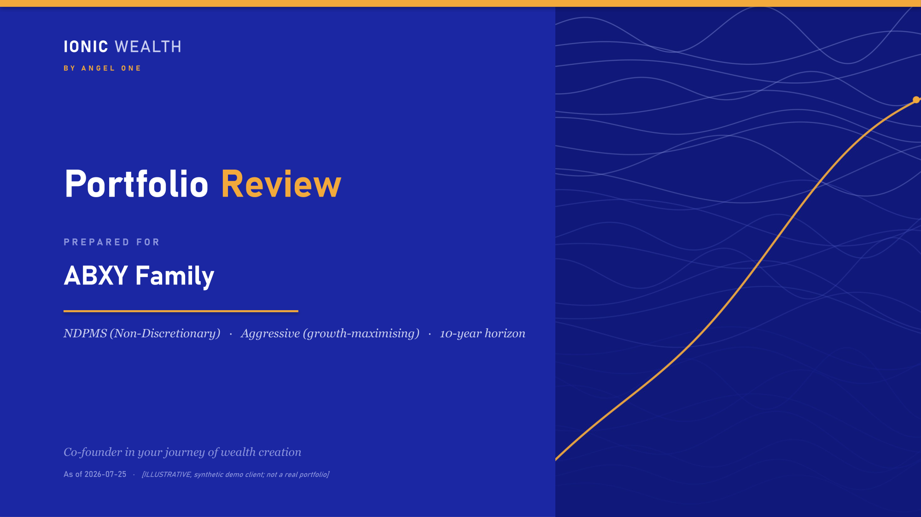
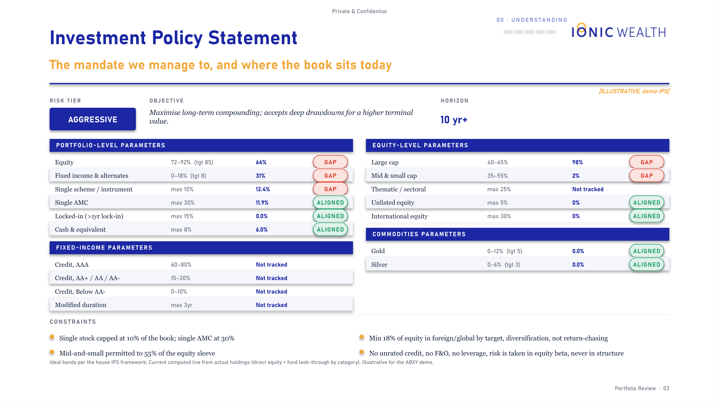
Private & Confidential
04 · THE DELIVERABLE
Sample pages
How it looks in the client's hands (1 of 7)
PAGE 1
PAGE 3
Cover. Client, mandate and as-of date, with the synthetic-book label printed on the page.
The mandate page. Every parameter's Current column is computed live from the holdings, never typed.
Rendered from the house demo book on an aggressive mandate. Synthetic holdings, real engine, real template.
Portfolio Review · 19

Slide 20
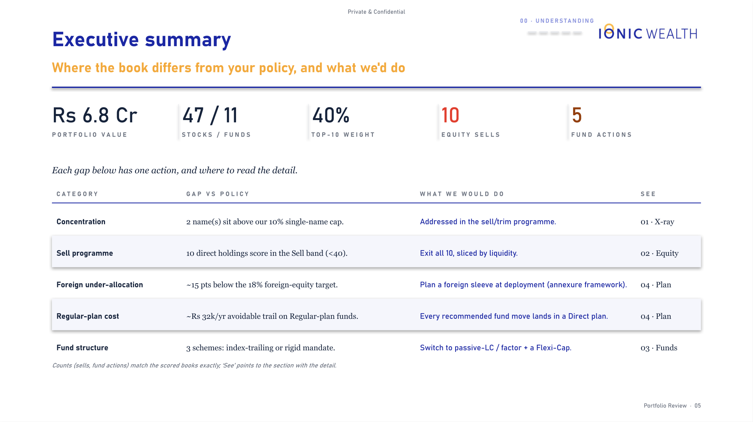
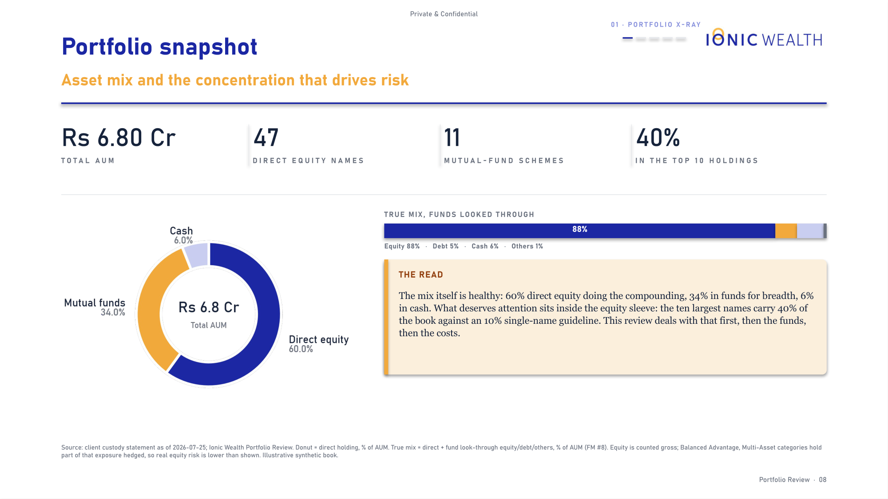
Private & Confidential
04 · THE DELIVERABLE
Sample pages
How it looks in the client's hands (2 of 7)
PAGE 5
PAGE 8
Executive summary. Five gaps, each with one action and a pointer to the page that proves it.
Snapshot. Composition, and an explicit statement of what is in scope versus out.
Rendered from the house demo book on an aggressive mandate. Synthetic holdings, real engine, real template.
Portfolio Review · 20

Slide 21
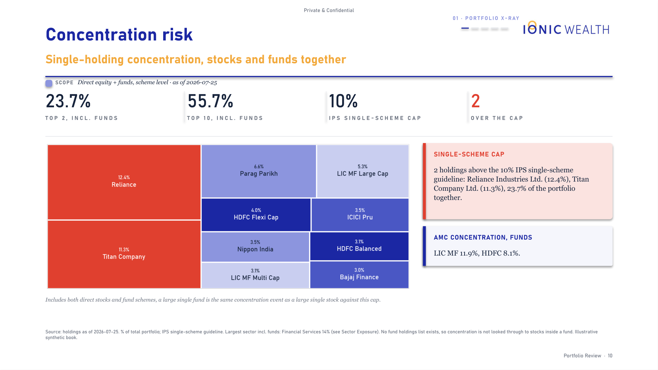
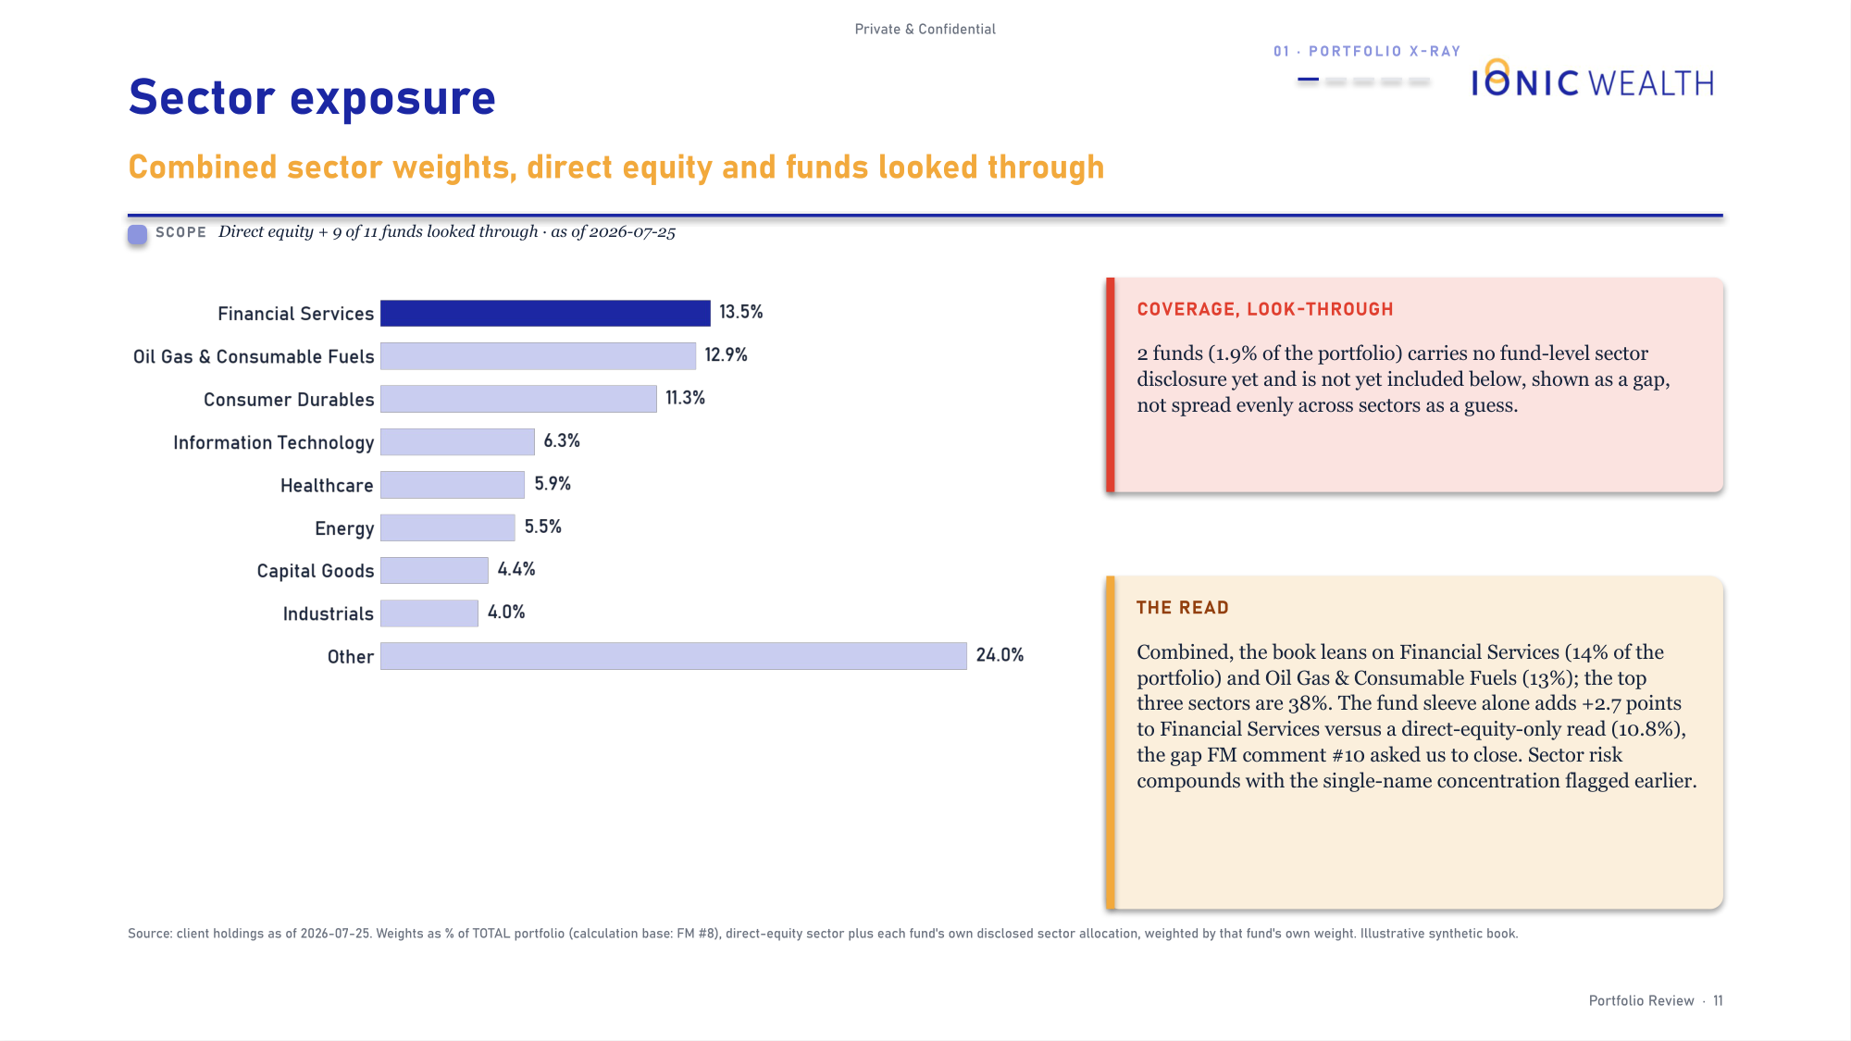
Private & Confidential
04 · THE DELIVERABLE
Sample pages
How it looks in the client's hands (3 of 7)
PAGE 10
PAGE 11
Concentration, measured against this mandate's own cap rather than a generic rule.
Sector weights, with a standing note that the fund sleeve is not looked through here.
Rendered from the house demo book on an aggressive mandate. Synthetic holdings, real engine, real template.
Portfolio Review · 21

Slide 22
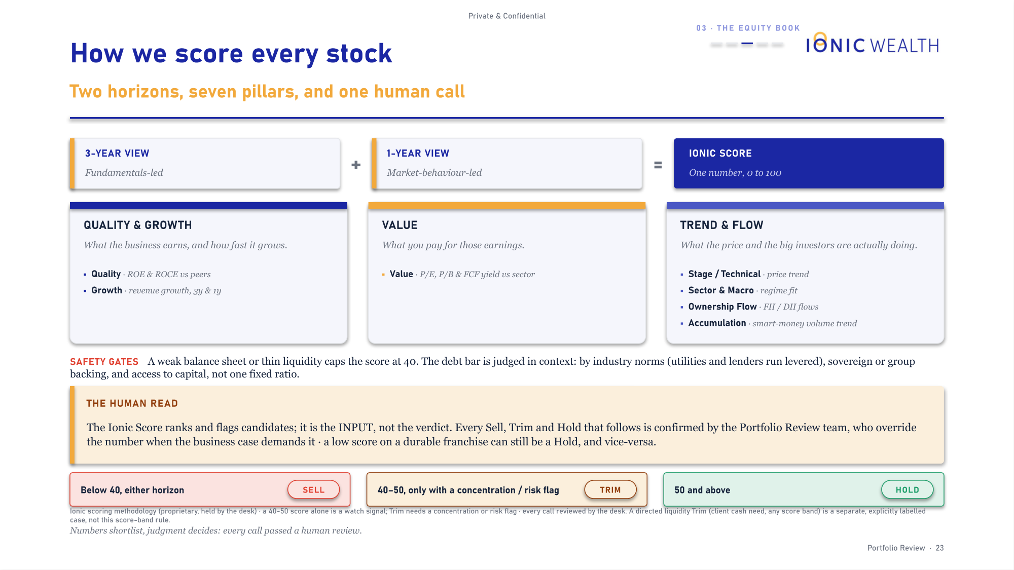
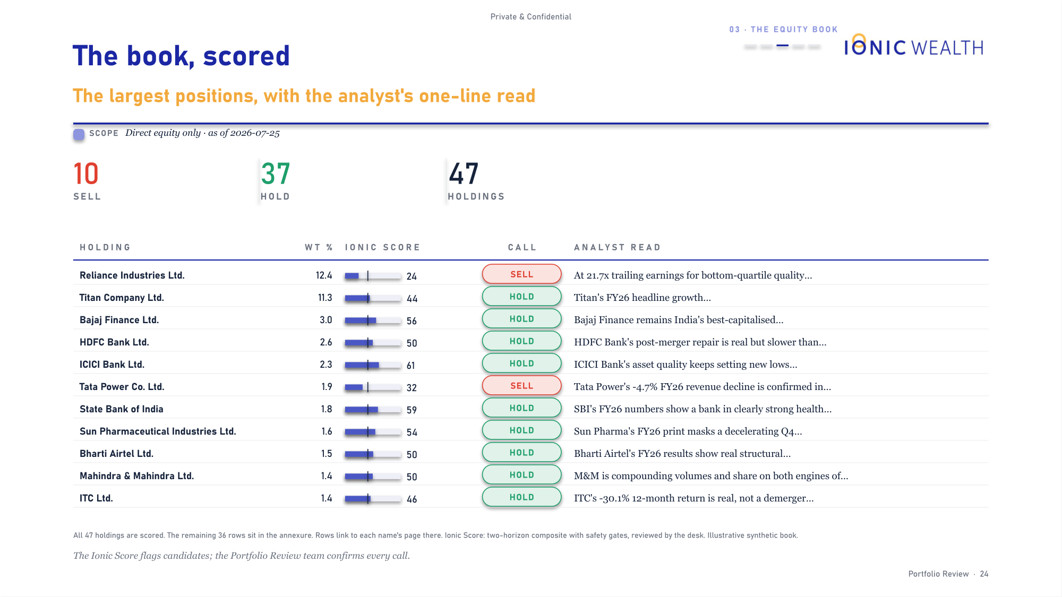
Private & Confidential
04 · THE DELIVERABLE
Sample pages
How it looks in the client's hands (4 of 7)
PAGE 23
PAGE 24
The scoring method, explained to the client in plain language.
Every holding with its score, its call, and the desk's one-line read.
Rendered from the house demo book on an aggressive mandate. Synthetic holdings, real engine, real template.
Portfolio Review · 22

Slide 23
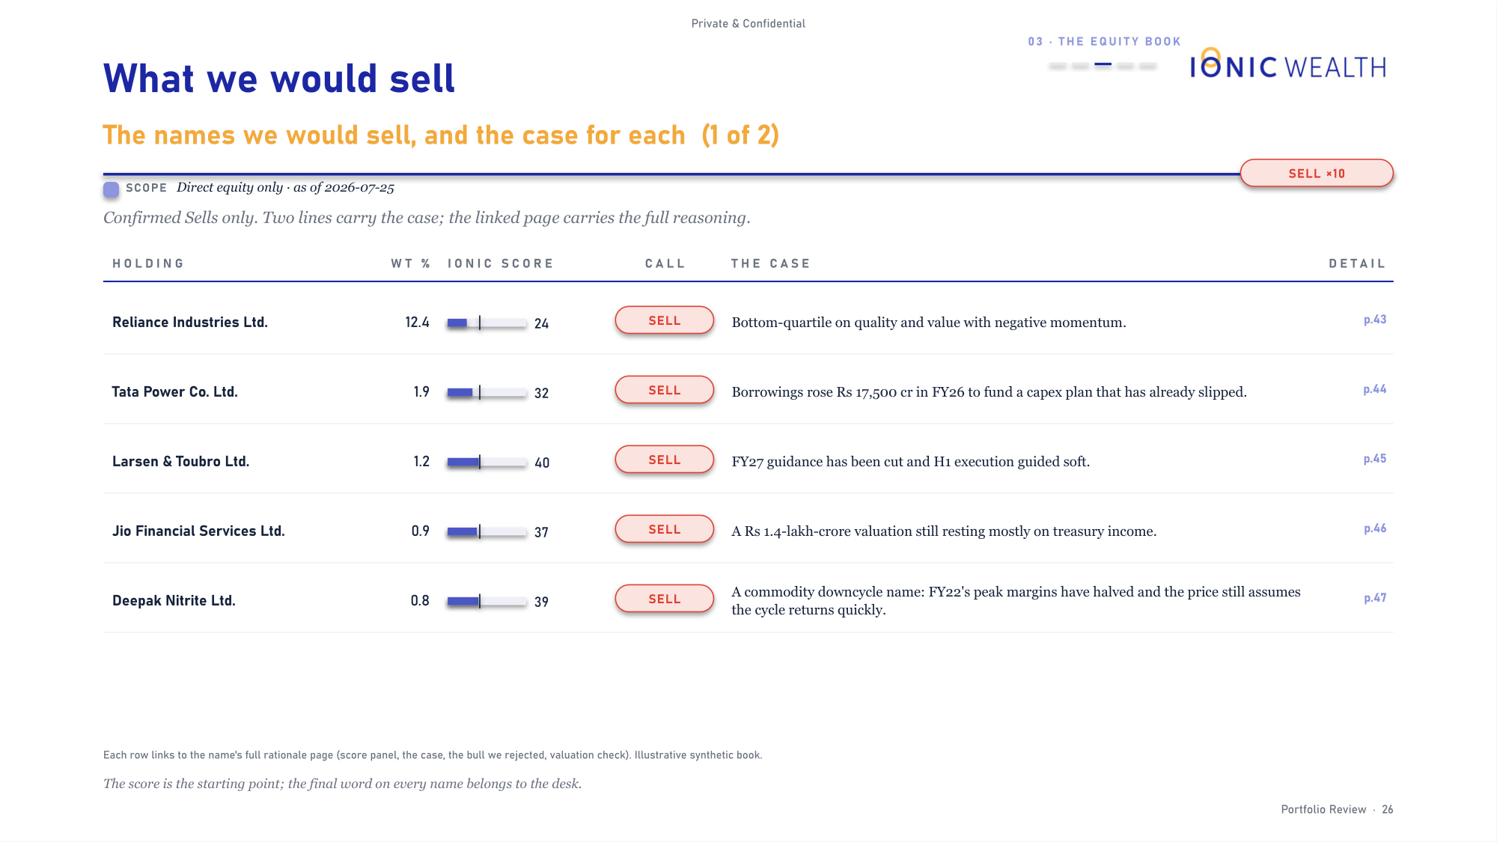
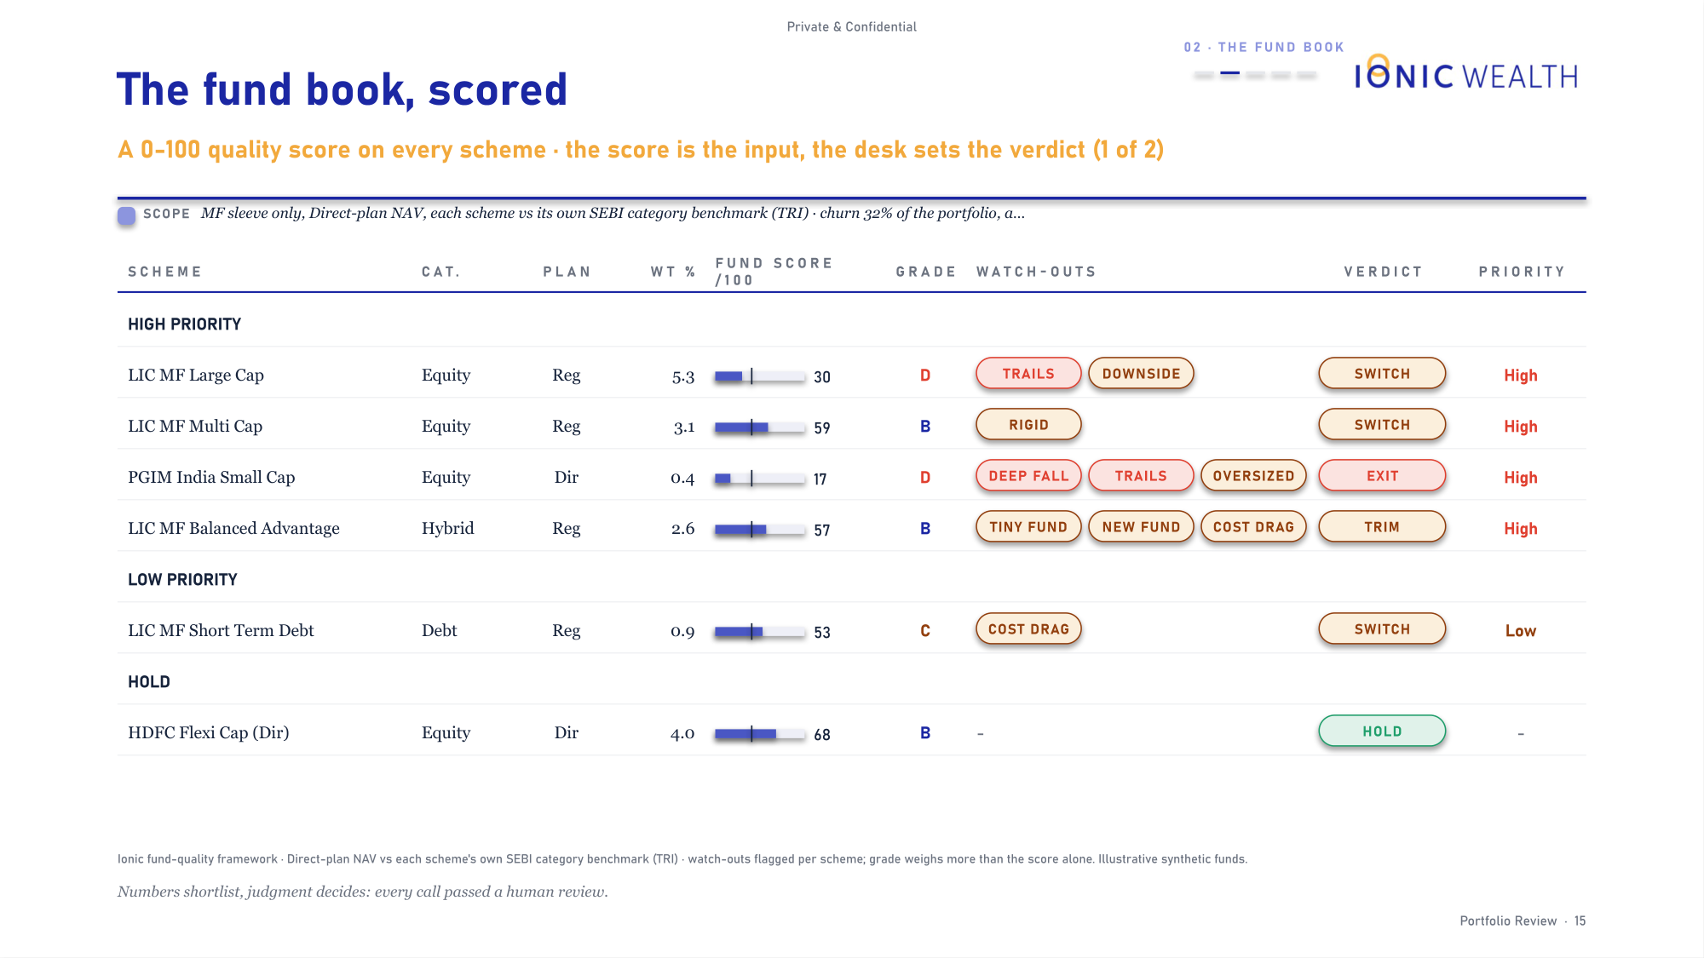
Private & Confidential
04 · THE DELIVERABLE
Sample pages
How it looks in the client's hands (5 of 7)
PAGE 26
PAGE 15
The sell list. Confirmed sells only, each linked to its full rationale page.
The fund book: a 0-100 quality score and a grade for every scheme.
Rendered from the house demo book on an aggressive mandate. Synthetic holdings, real engine, real template.
Portfolio Review · 23

Slide 24
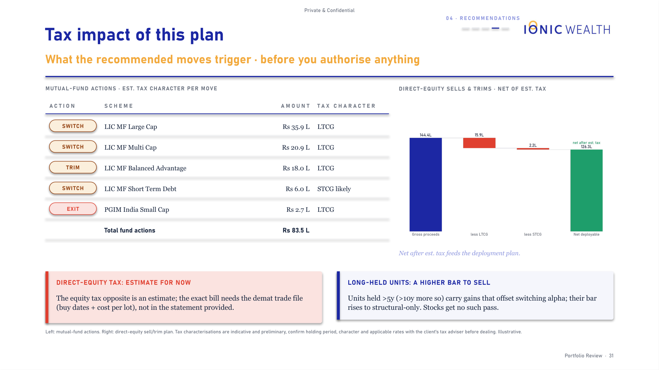
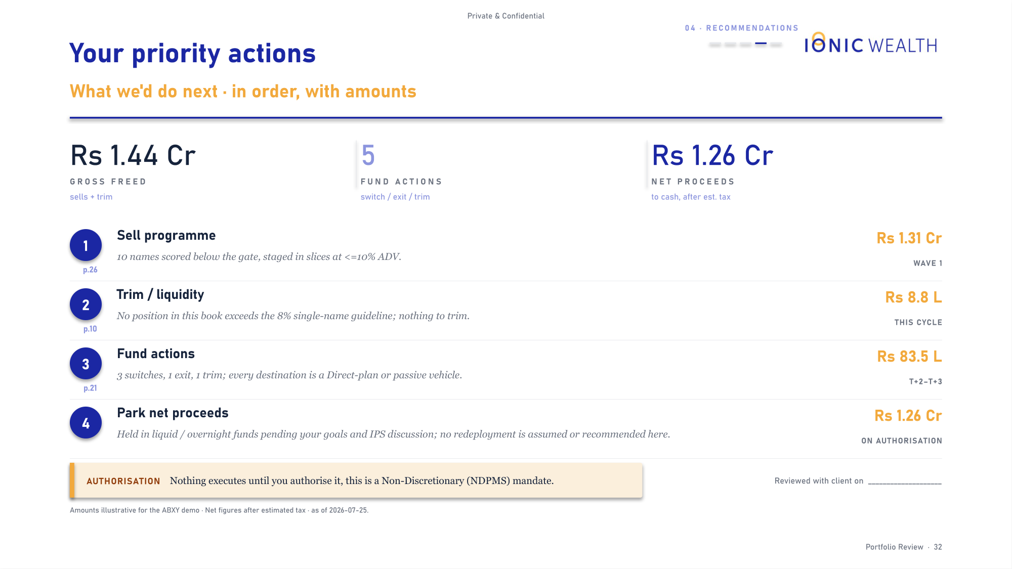
Private & Confidential
04 · THE DELIVERABLE
Sample pages
How it looks in the client's hands (6 of 7)
PAGE 31
PAGE 32
Tax. Fund actions on the left, the direct-equity plan on the right, each scope named.
The action plan, in order, with amounts and an authorisation line.
Rendered from the house demo book on an aggressive mandate. Synthetic holdings, real engine, real template.
Portfolio Review · 24

Slide 25
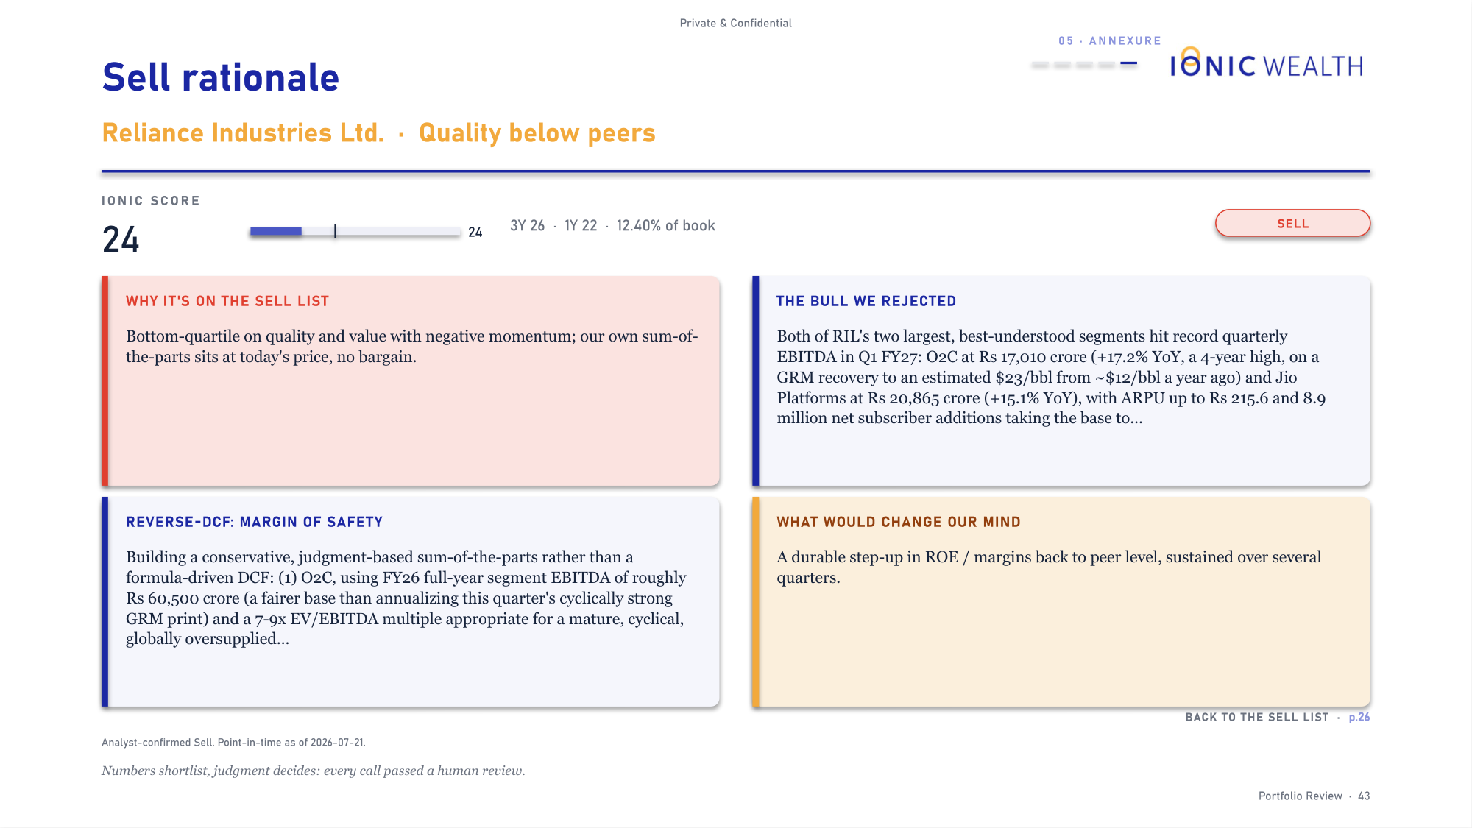
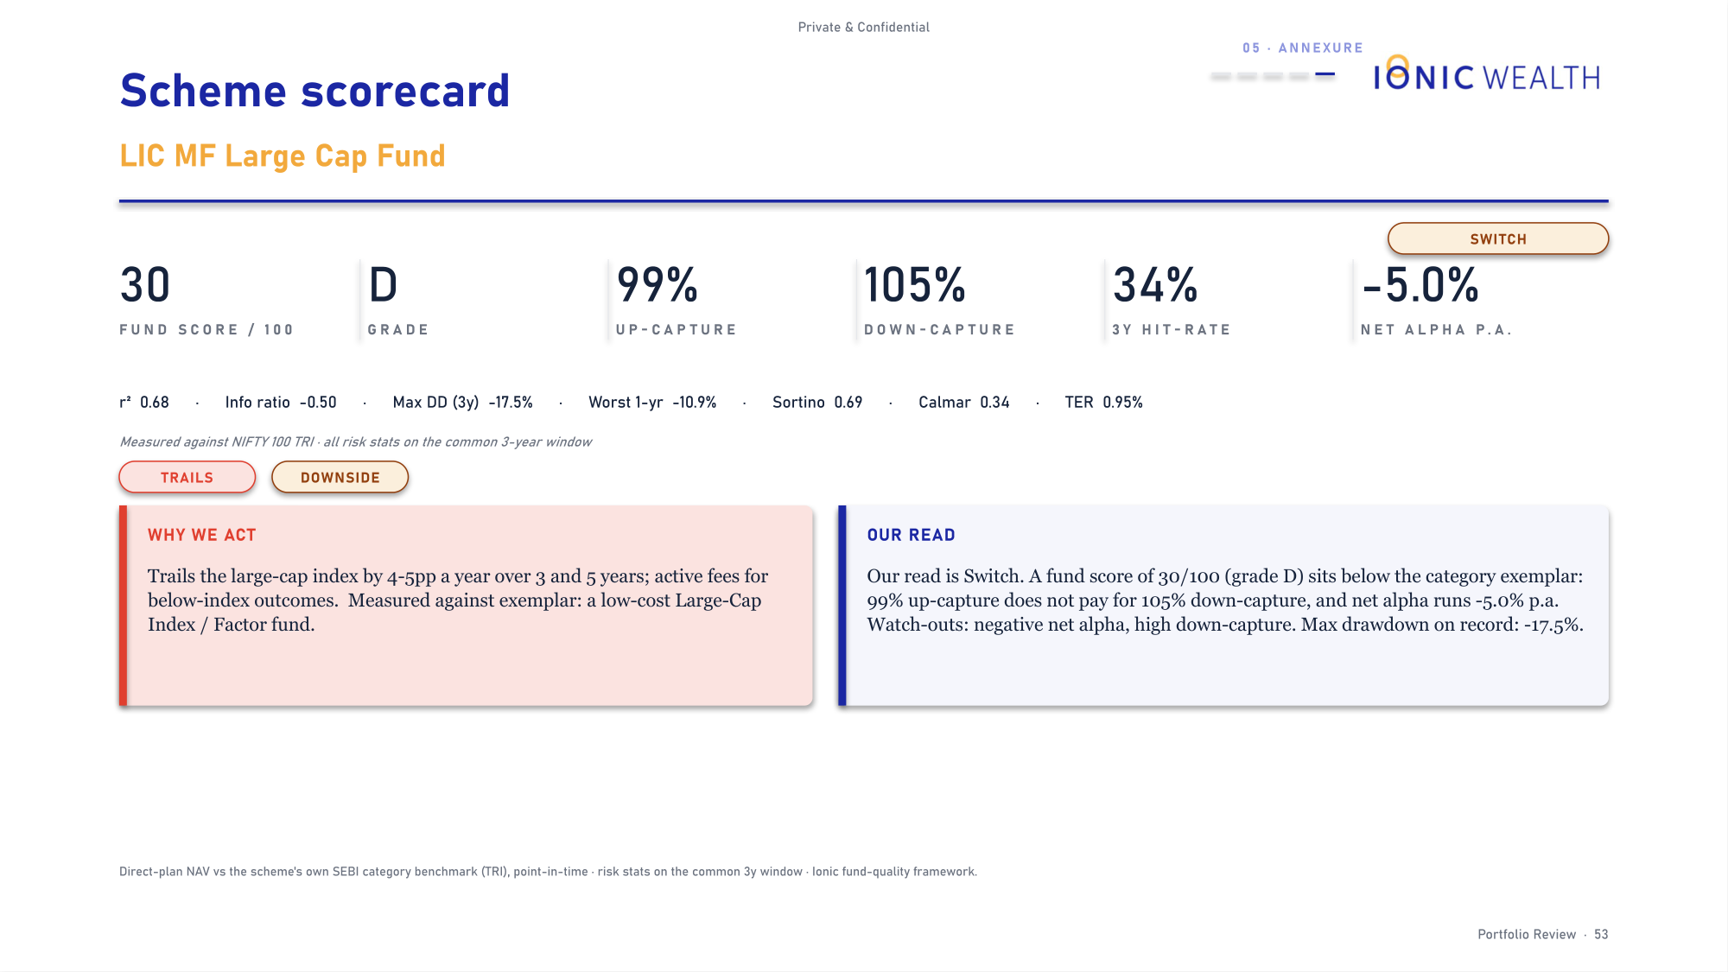
Private & Confidential
04 · THE DELIVERABLE
Sample pages
How it looks in the client's hands (7 of 7)
PAGE 43
PAGE 53
One card per sell: the case, the bull we rejected, the reverse-DCF, and the exit test.
One scorecard per fund action, showing the metric battery behind the call.
Rendered from the house demo book on an aggressive mandate. Synthetic holdings, real engine, real template.
Portfolio Review · 25

Slide 26

Private & Confidential
05
SECTION 05
Controls
The compliance posture this product is built to
Compliance posture

Slide 27
Private & Confidential
05 · CONTROLS AND THE ASK
Compliance posture
Built for a non-discretionary mandate, and constrained accordingly
CONTROL
HOW IT IS ENFORCED
No buy recommendations
The vocabulary is Sell, Trim or Hold. This is a review of holdings the client already owns, not a solicitation. The word is blocked by the client-copy scan.
No target prices
No page carries a price objective or an implied return promise. Valuation is expressed as a judgment on what the multiple already assumes.
Tax is flagged as an estimate
Tax characterisations are labelled indicative, with the client's own adviser named as the authority before dealing.
Gaps are disclosed, not filled
Where cost basis, coverage or fund data is missing, the deck says so on the page rather than substituting an assumption.
Every client copy is signed
Principal or CEO countersignature, with no standing exemption for a repeat client or a routine refresh.
THE STANDING RULE BEHIND ALL OF IT
We do not fabricate. An estimate is labelled an estimate, a gap is shown as a gap, and a number we cannot source does not go on a client page. Every control above follows from that one commitment.
Portfolio Review · 27

