Slide 1
QFRA 2.0
Quantitative Fund Ranking Algorithm
Product Approval Committee
Indian equity mutual funds · HNI advisory · Direct-plan basis · price-return benchmarks
Recommendations as of 2026-05-27 · deck built 2026-08-06 · model frozen at v2.0
Internal committee paper. Not for client distribution.

Slide 2

Private & Confidential
CONTENTS
What this deck covers
00
The two frameworks, and a one-page summary
what each framework is · how well each is evidenced · the ask in brief
01
What it is, and what it is not
the mandate · v1 to v2 · no machine learning, and why · where the alpha comes from · versus the rating houses
02
How a rank is produced
the pipeline · CALIBRE · SENTINEL · the Mid sleeve · the current final two · a sample scorecard
03
The evidence, honestly
raw versus deployed · by category · the selection edge · hit rates · a 3-year topper · the cadence
04
The two frameworks
why QFRA-1 is complementary · where each one drives the call
05
Track record and the ask
every review period since 2018 · live so far · churn · what we rejected · how we validate our own models · limits · the decision sought
Five of the nine headline figures in the previous committee pack did not survive an audit against the engine's own outputs. They are corrected here, not repeated.
Audit trail: 03_RESEARCH_DESK/qfra2_pac_prep/NUMBER_AUDIT.md
QFRA 2.0 · 01

Slide 3
Private & Confidential
THE TWO FRAMEWORKS
What each one is, before anything else
The desk runs two fund frameworks on one calendar. They differ in horizon, in what they may conclude, and in how well each is evidenced
QFRA-1 SHORT TERM
QFRA-2 LONG TERM
Question it answers
Which funds are capturing the upside now
Which two funds should beat the category index over 3 to 5 years
Horizon
6-month capture windows
3 to 5 years, factor-adjusted
Verdicts it can emit
BUY / SELL / HOLD
ACTIVE / INDEX CORE only. There is NO sell verdict
Who may originate a sell
This framework only
Cannot. It may only VETO one
Coverage
6 categories, from the desk workbook
8 categories, 99 Direct-plan funds after gates
Universe depth
All funds on the category sheet
5 to 9 eligible funds in a deployed category
Benchmark basis
Price return
Total return in its own docs
Evidence
906-formation replay: BUY leg strong, SELL leg near a coin flip
Bootstrapped selection skill, but the held book realised far less
Cadence
April and October month end
The same calendar, run together
THEY ARE NOT INDEPENDENT, AND THAT CHANGES WHAT AGREEMENT MEANS
QFRA-1 ranks on the 6-month capture ratio, which QFRA-2 already carries at a weight of 0.30 plus a three-year down-capture term, so the capture family is 40% to 48% of the QFRA-2 score. When both agree, part of that is one signal agreeing with itself.
Sources: the qfra1-rerun and qfra2-rerun skills; overlap verified at final_model.py:154. Benchmark basis: TRI is not obtainable on our network, so every index we hold is price-return, measured 2026-08-06.
QFRA 2.0 · 02

Slide 4
Private & Confidential
EXECUTIVE SUMMARY
What is being asked, and on what evidence
One page. The two edge figures are both here on purpose: the second one is what a client actually received
+1.65%
+0.09%
3.9 / yr
+0.65%/yr
3Y EDGE, UNCONSTRAINED RANK
3Y ALPHA, THE BOOK HELD
BOOK CHANGES, 8-YEAR REALISED
LIVE SINCE JAN-2025
over a random pick, pooled
after the churn rule
average hold near 3 years
the 6 categories in scope
What it is
A ranking engine that publishes the top two funds in each category, expected to beat the category index over three to five years. It has no sell verdict, and it abstains where it cannot show an edge.
Where the edge is
Largest in Large & Mid at +2.86%/yr and Flexi at +1.90%/yr over a random pick of the same eligible field. In Small the level is the market's, not ours. In Mid it is absent, which is why Mid runs a momentum index.
The ask
Approve deployment across the six categories in scope, on the corrected numbers, with the model frozen at v2.0 and re-run every six months.
WHY BOTH EDGE FIGURES ARE ON THIS PAGE
Selection skill is measured on the unconstrained ranking. Clients hold the churn-constrained one, and the churn discipline that makes the product attractive on tax absorbs most of the measured edge. Quoting only the first figure is how the previous pack read; section 3 does the arithmetic in full.
Edge and pooled figures: QFRA2_HANDOFF.md section 5. Held book: QFRA2_recommendation_performance.md. Live: QFRA2_realized.csv, rank<=2, six in-scope categories. Audit: qfra2_pac_prep/NUMBER_AUDIT.md.
QFRA 2.0 · 03

Slide 5

Private & Confidential
01
SECTION 01
What it is, and what it is not
The mandate, the absence of machine learning, and where the alpha actually comes from
5-10

Slide 6
Private & Confidential
01 · WHAT IT IS
The mandate
One job, stated narrowly
8
99
2
6
CATEGORIES RANKED
DIRECT-PLAN FUNDS IN THE UNIVERSE
FUNDS RECOMMENDED PER CATEGORY
CATEGORIES DEPLOYED
What it does
Ranks the eligible funds in a category and publishes the top 2, from a top-5 shortlist, expected to beat the category Total-Return index over 3 to 5 years.
What it is not
Not a market call, not a timing model, and not a sell engine. It has no Sell verdict at all: its verdicts are Active and Index core.
Who it is for
HNI advisory on a Direct-plan basis, measured against Total-Return benchmarks, reviewed twice a year.
Deployment scope
Large as an index core, Large and Mid, Mid as a momentum sleeve, Flexi, Multi, Small. Focused and Value are ranked but not deployed.
Universe replicated from Mf_qfra2/data/verified_navs_*.csv, 2026-08-04. Verdicts from QFRA2_current.csv.
QFRA 2.0 · 05

Slide 7
Private & Confidential
01 · WHAT IT IS
QFRA 1.0 to QFRA 2.0
What changed, and why a second version was needed
v1 was a narrow, short-horizon, high-churn ranker. v2 is broad, validated, low-churn and built for money that stays invested
DIMENSION
QFRA 1.0
QFRA 2.0
Signals
Capture ratios only, a narrow base
Factor alpha, appraisal ratio, information ratio, up and down capture, momentum, Calmar, quality beta
Alpha horizon
One year
Three to five years, sized for money that compounds
Method
Rule-based, static scoring
Still rule-based: percentile ranks within a category and date, weights fixed by hand, then validated out of sample
Selection
Direct rules
A top-five shortlist, then a final two, with a discretionary gate that may only veto or trim
Turnover
Frequent changes, high churn
Low churn: 3.9 book changes a year realised over eight years, tax-aware
Investor fit
Tactical, lump sum
Long horizon, suitable for a staggered entry
Risk control
None
SENTINEL loser screen, the CALIBRE scorecard, and out-of-sample validation
TWO ROWS THIS TABLE USED TO CARRY, AND NO LONGER DOES
The previous version called the method a dynamic, AI/ML-assisted ranking and the selection step an ML rank. Neither is true of the engine, so both were removed rather than softened. The very next page sets out what is actually there.
Signals and gates: final_model.py. Churn: the 8-year realised history. Deleted claims: qfra2_pac_prep/AI_ML_AUDIT.md.
QFRA 2.0 · 06

Slide 8
Private & Confidential
01 · WHAT IT IS
No machine learning, and why that is the right answer
The previous pack claimed an AI/ML ranking. There is none, and adding one would recreate a failure we already tested
WHAT THE EARLIER DECK CLAIMED, AND WHAT IS ACTUALLY THERE
It called the method an "AI/ML-assisted ranking" and the selection an "ML rank". Neither is true: across all 137 engine files there is no scikit-learn, LightGBM, XGBoost, TensorFlow, PyTorch or Keras. The same build script also printed "ML on the cross-section: too small, it memorises one era", so the pack contradicted itself.
LAYER
WHAT IT ACTUALLY IS
Signals
Six to eight per-fund measures over a 756-day window: information ratio, down-capture, Calmar, momentum, alpha stability, capture ratio.
Factor step
One ordinary least-squares regression. The only estimated coefficients anywhere in the engine, and they feed just 2 of the ranked inputs.
Combination
Cross-sectional percentile ranks blended with hand-set constants: an equal-weight average, then 0.9 and 0.1, then 0.7 and 0.3.
Screens
Fixed percentile and asset thresholds. Nothing is fitted.
Audit: qfra2_pac_prep/AI_ML_AUDIT.md. Engine: final_model.py, factors_live.py:223, features.py:38.
QFRA 2.0 · 07

Slide 9
Private & Confidential
01 · WHAT IT IS
Where we do use AI, and whether to add it here
The boundary matters: an analyst agent doing research is not the same claim as a model that learns its weights
WHERE AI IS ACTUALLY USED, AND WHERE IT IS NOT
The stock scorecard runs one language-model research agent per stock, and that is real. It is judgment and research, not a fitted ranker. It is also entirely stock-side: checked in both directions, there is no path by which that research reaches this fund model, and no path by which this model reaches the stock agents. The fund engine consumes no AI output at all.
TWO THINGS IN THE REPOSITORY THAT LOOK LIKE AI AND ARE NOT
A legacy script does contain a real random-forest model. It sits outside the frozen engine, nothing imports it, and it hard-codes another machine's file paths. A second file named for an AI overlay detects manager changes from a hard-coded list, and its own comment says it is mocked to demonstrate the architecture. Neither is in the pipeline.
RECOMMENDATION: KEEP THE ENGINE, DROP THE CLAIM
Fitting weights on 5 to 9 funds per category is how a model memorises one era, which is what the research already found and rejected. Parsimony is the defensible position: few orthogonal signals, no fitted weights, nothing to overfit. If the committee wants real machine learning later, the credible route is a pooled panel learner across fund-months to replace the hand-set blend constants. That is new validated work, not a relabelling of what already exists.
qfra2_pac_prep/AI_ML_AUDIT.md. Stock-side agent research: STOCK_SCORECARD_750/FROZEN_METHODOLOGY.md.
QFRA 2.0 · 08

Slide 10
Private & Confidential
01 · WHAT IT IS
Where the alpha comes from
Four sources, each measured, and one of them is knowing when to stop
1
SELECTION, measured not described
Factor-adjusted alpha and appraisal ratio, significance-gated. On the unconstrained ranking this is worth +0.48%/yr, with a 95% bootstrap interval of +0.06% to +1.05%.
2
SCREENING OUT LOSERS
SENTINEL flags closet indexing, a low-quality book and no measured skill. It lifts our own top-decile beat-the-index rate from 48.5% to 56.6%, the single largest validated lever in the model.
3
ABSTAINING WHERE WE HAVE NO EDGE
Large and Mid Cap are routed to an index core because active selection there is not distinguishable from a blind pick. Mid runs a momentum index instead, worth about +9%/yr over the plain mid-cap index.
4
NOT TRADING IT AWAY
The churn rule holds a fund unless a challenger clears a material margin, delivering 3.9 book changes a year and an average holding near three years. This protects long-term capital gains treatment.
AND THE HONEST SUBTRACTION
Source 4 pays for itself in tax and operations, but it also absorbs most of source 1. The deployed book's realized edge is far smaller than the ranking's, and that arithmetic is the next section.
Bootstrap and SENTINEL from QFRA2_evidence.csv. Churn from the 8-year realised history. Momentum sleeve from qfra2_smartbeta.py.
QFRA 2.0 · 09

Slide 11
Private & Confidential
01 · WHAT IT IS
Why not simply use the rating houses
Seven differences, and the one that does not flatter us
The difference is method and disclosure. It is not a wide performance margin, and this page does not claim one
DIMENSION
RATING HOUSES, STAR-CHASING
QFRA 2.0
Edge
Qualitative, or last year's return
Factor-adjusted alpha, gated on statistical significance
Plan and basis
Often Regular plan, price return
Direct plan throughout, total-return benchmarks in the model's own documents
Validation
In sample, or none published
Walk-forward out of sample, plus a year-block bootstrap
Loser control
None: every fund gets a rating
SENTINEL lifts our own top-decile beat rate from 48.5% to 56.6%
Abstention
Rates every fund in every category
Routes to an index core or a factor sleeve where we cannot show an edge
Turnover and tax
High, or simply not discussed
3.9 book changes a year, and the rule that produces it is published
Limits
Rarely stated
Stated: one era, a thin universe, and a held book well below the ranking
THE HONEST VERSION OF THIS COMPARISON
A rating house does not claim a factor-adjusted edge, so on that row there is nothing to beat. And our own held book earned +0.09%/yr at three years. What this page claims is a better method and fuller disclosure, not a wide margin.
SENTINEL lift: QFRA2_evidence.csv. Held book: QFRA2_recommendation_performance.md. Rating-house column describes published retail methodology in general, and names no competitor.
QFRA 2.0 · 10

Slide 12

Private & Confidential
02
SECTION 02
How a rank is produced
The pipeline end to end, the quality scorecard, the negative screen, and the churn rule
12-17

Slide 13
Private & Confidential
02 · HOW IT WORKS
The pipeline, step by step
Point-in-time throughout. Every weight below is a fixed constant
STEP
WHAT HAPPENS
0
Data
Direct-Growth NAVs and a price-to-total-return benchmark, strictly point-in-time.
1
Eligibility
At least 3 years of returns as a hard gate, plus an asset floor, cost and true-to-label checks. Leaves 5 to 9 funds in a deployed category.
2
Factor model
Regress on six factors for alpha, its t-statistic, R-squared, quality beta and appraisal.
3
Signals
Information ratio, down-capture, Calmar, momentum, appraisal, quality beta, alpha stability, 6-month capture.
4
Rank
Percentile-rank each signal within the category and date.
5
Score
Average the ranks, then 0.9 of that plus 0.1 of alpha stability.
6
Capture blend
0.7 of the score plus 0.3 of the 6-month capture ratio.
7
Routing
Active, or an index core for Large and Mid, or the Mid momentum sleeve.
8
SENTINEL
Subtract one point per loser trait, then take the top 5.
9
CALIBRE
Quality scorecard and a discretionary gate that may only veto or trim, never flatter.
10
Final two
Rank, take two, then apply the churn rule against the book already held.
Mf_qfra2/mr_x_framework/src/final_model.py. Model frozen at v2.0; no weight on this page is fitted.
QFRA 2.0 · 12

Slide 14
Private & Confidential
02 · HOW IT WORKS
CALIBRE, the seven pillars of a rank
Rewritten this review so that every pillar says something we can actually evidence
PILLAR
WHAT IT MEANS
EVIDENCE
C
Conviction
Top-of-category funds earn our biggest calls, while new ones start smaller.
Computed
A
Alpha
Factor alpha and appraisal ratio, gated on clear activeness.
Computed
L
Leadership
Manager tenure, key-person exit risk, AMC governance, true to mandate.
Analyst
I
Integrity
Fair fees versus category, with nothing hidden from the investor.
Computed
B
Benchmark
Win rate and up and down capture versus the total-return index.
Computed
R
Resilience
Down-capture, drawdown, alpha stability, concentration, holdings quality.
Mixed
E
Edge
A validated edge, cost-efficient and clean of red flags.
Computed
TWO PILLARS WERE WRONG AND ARE NOW FIXED
Integrity used to read as Active Share, concentration, price-earnings discipline and return-on-capital quality. That is portfolio construction, not integrity, and two of the four were never computed: there is no return-on-capital formula in the engine, and the price-earnings item is a NAV-trend proxy that disclaims itself. Conviction used to read "within-category rank, clamped to track-record tier", which is accurate and unreadable.
qfra2_pac_prep/CALIBRE_PILLARS.md. Analyst-judgment pillars are labelled as such and applied one-directionally.
QFRA 2.0 · 13

Slide 15
Private & Confidential
02 · HOW IT WORKS
SENTINEL and the churn rule
The negative screen, and the discipline that decides when not to act
SENTINEL: SCREEN OUT LOSERS RATHER THAN ONLY RANK WINNERS
Per fund, relative to its own category, raise one flag for each proven decay trait and subtract them from the blended score. R-squared in the top quartile means closet indexing. Quality beta in the bottom quartile means a junk book. Appraisal in the bottom quartile means no skill per unit of risk. It lifts our own top-decile beat-the-index rate from 48.5% to 56.6%. Only 3 of 12 candidate traits survived out of sample. It is deliberately switched off for Mid and Value, which mean-revert.
THE CHURN RULE, AND WHAT IT COSTS
An incumbent is replaced only if a challenger beats it by a material margin in rank and the incumbent has fallen out of the category's top quartile, with at most one swap per category per review. Realised over eight years: 3.9 book changes a year, average holding near three years. The earlier pack said 2.6 a year; that figure is not supported by any output, including the chart data in the script that printed it.
ONE CONSEQUENCE THE COMMITTEE SHOULD HOLD ON TO
SENTINEL is a shortlist screen: it decides which candidates reach the top five. It is not a verdict on a fund a client owns, and our pipeline was briefly wired as though it were. Fixed, and covered in section 4.
SENTINEL lift from QFRA2_evidence.csv. Churn from qfra2_charts_ceo.py chart data and the realised history.
QFRA 2.0 · 14

Slide 16
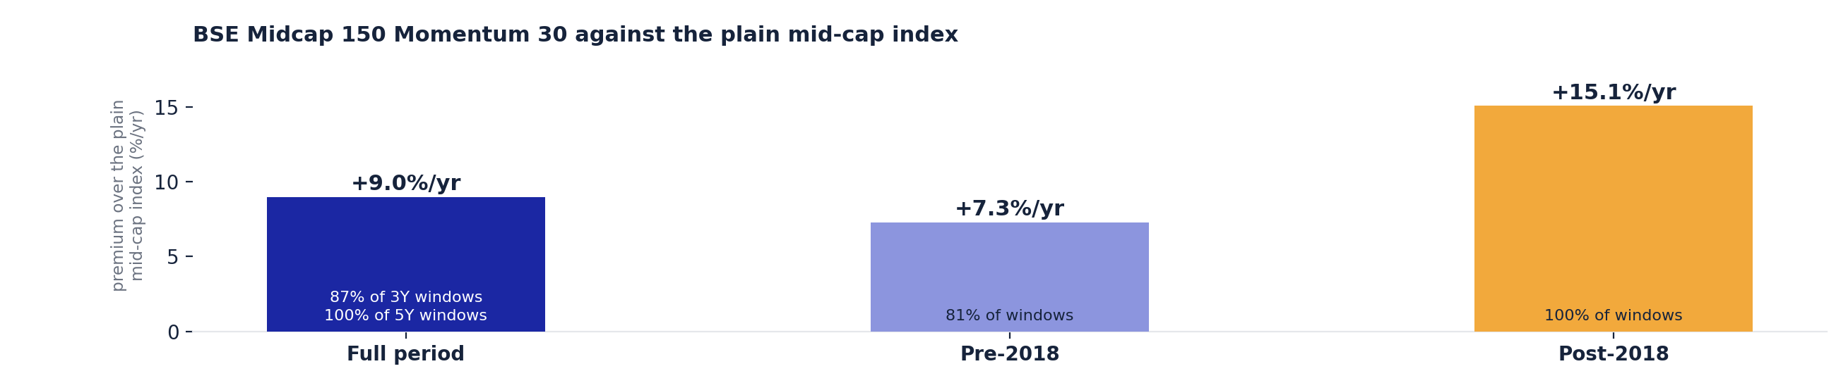
Private & Confidential
02 · HOW IT WORKS
The Mid Cap sleeve, and why it is not an active fund
The one category where the routing step overrides the ranking
The sleeve cleared the same out-of-sample bar that every model retune failed, which is what separates an enhancement from a rescue
WHY NOT AN ACTIVE MID-CAP FUND
Mid-cap active selection is indistinguishable from chance over the eight-year replay: the model's picks returned -2.55%/yr against a random pick's -2.61%. The deployed mid book was the worst of the eight categories at -3.16%/yr. There is no stock-picking edge here to sell.
THE STRUCTURE, AND WHAT CAN GO WRONG WITH IT
The momentum index carries 50 to 60% of the sleeve and one active fund the rest. Momentum can crash: worst drawdown about -72%, no better than the index it beats. Pre-2022 history is backfilled, and a real vehicle costs 0.3 to 0.5% a year plus tracking error.
Premium and win rates: QFRA2_HANDOFF.md section 4; pre-2018 split from qfra2_charts_ceo.py. Active mid edge: HANDOFF section 5. Held book: QFRA2_recommendation_performance.md. Sleeve spec: QFRA2_MID_SLEEVE.md.
QFRA 2.0 · 15

Slide 17
Private & Confidential
02 · HOW IT WORKS
The current final two, per category
What the engine actually publishes, as of the last run
The output the committee is being asked to approve, straight from the engine's recommendation file
CATEGORY
ROUTING
FINAL TWO
QFRA
CALIBRE
SENTINEL
CONVICTION
Large Cap
index core
HSBC Large Cap · Invesco India Largecap
100 · 88
C · C
clear · clear
Low, index-lean
Large & Mid Cap
active
ICICI Pru Large & Mid · Franklin India Equity Adv
100 · 80
A · A
clear · flagged (1)
High
Mid Cap
momentum sleeve
Quant Mid Cap · Aditya Birla SL Midcap
100 · 88
C · C
clear · clear
Low, index-lean
Flexi Cap
active
Kotak Flexicap · HDFC Flexi Cap
100 · 83
A · A
clear · clear
High
Multi Cap
active
Invesco India Multicap · ICICI Pru Multicap
100 · 80
A · A
clear · clear
High
Small Cap
active
Aditya Birla SL Small Cap · Sundaram Small Cap
100 · 83
A · A
clear · clear
High
THREE THINGS TO READ OFF THIS TABLE BEFORE APPROVING IT
In deployment the Mid slot-1 fund is replaced by the BSE Midcap 150 Momentum 30 index, for the reason on the previous page; the ranked fund stays as the active half. A score is a rank within its own category, so Large Cap's 88 and Flexi's 83 are not comparable quantities. And Focused and Value are ranked by the engine but are not in the ask.
Verbatim from mr_x_framework/outputs/recommendations/QFRA2_current.csv, rank<=2, asof 2026-05-27. Column merit_grade is shown as CALIBRE, the pending rename. Out-of-scope ranks: Focused (360 ONE, HSBC), Value/Contra (two closed Sundaram series with no continuous NAV).
QFRA 2.0 · 16

Slide 18
Private & Confidential
02 · HOW IT WORKS
What one fund's output looks like
Aditya Birla SL Small Cap Fund, Direct Growth · Small Cap · active
The client-facing scorecard the engine produces per fund. Four fields, each computed, and no forecast
100 / 100
A
clear
0.84
QFRA SCORE, WITHIN CATEGORY
CALIBRE GRADE
SENTINEL, NO LOSER FLAGS
DOWN-CAPTURE VS CATEGORY
Drivers
Top-quartile factor alpha and appraisal ratio, a favourable six-month capture ratio, no SENTINEL flag, and the highest absolute alpha of the eight categories.
What would change our mind
A SENTINEL flag; falling out of the category's top quartile while a challenger clears the churn margin; or a hard red flag such as a manager exit or a capacity breach.
Live
Recommended January 2025. Realised +7.3%/yr alpha to 2026-05-27, the best of the twelve in-scope picks.
WHAT THIS PAGE USED TO CLAIM, AND DOES NOT
The previous version carried a chip reading P(beat 3-5y) about 56%. The engine does not compute it: the figure was a hardcoded string, and the model's own specification defers the calibrated probability as in-sample only and says not to promise it client-facing. It is removed rather than re-estimated.
Fields verbatim from QFRA2_current.csv for this fund. Realised alpha from QFRA2_realized.csv. Deferred probability: MODEL_SPEC.md Part D, steps 9 and 11; finding 1 in qfra2_pac_prep/NUMBER_AUDIT.md.
QFRA 2.0 · 17

Slide 19

Private & Confidential
03
SECTION 03
The evidence, honestly
What the ranking earns, what the deployed book earns, and how both compare with the obvious alternative
19-24

Slide 20
Private & Confidential
03 · THE EVIDENCE
The number we have been quoting is the wrong book
Selection skill is measured on the unconstrained ranking. Clients hold the churn-constrained one
BOOK
1Y MEDIAN ALPHA
3Y MEDIAN ALPHA
3Y WIN RATE
5Y MEDIAN ALPHA
CHANGES / YR
HELD: deployed, churn-constrained
-0.09%
+0.09%
51.0%
+0.20%
3.9
RAW: top 2, no churn rule
+1.62%
+0.56%
56.7%
+0.85%
9.8
Benchmark, total return
0.00%
0.00%
n/a
0.00%
0
WHAT THIS MEANS, PLAINLY
The marketed +0.48%/yr is a selection-skill measure consistent with the raw row. The book a client actually holds returned +0.09%/yr at three years, with a win rate of 51%. The churn discipline that makes the product attractive on tax and operations absorbs almost the whole measured edge. The engine's own performance file says so: the low-churn book gives up roughly half a point a year at three to five years in exchange for about 60% less turnover.
QFRA2_recommendation_performance.md, 2018-H1 to 2024-H2, active categories pooled.
QFRA 2.0 · 19

Slide 21
Private & Confidential
03 · THE EVIDENCE
The same book, category by category
Where the deployed book actually delivered, and where it did not
DEPLOYED CATEGORY
HELD 3Y MEDIAN ALPHA
READ
Flexi Cap
+2.16%
The only category where the realised book beat the theory.
Large Cap
-0.25%
Index core, as designed.
Large & Mid Cap
-0.38%
Best theoretical edge, worst delivery gap.
Small Cap
-1.34%
A rising tide, not our selection.
Multi Cap
-2.35%
Worst edge of the six; a blind pick wins.
Mid Cap
-3.16%
Why Mid is routed to a momentum index.
ONE OF THESE ROWS SHOULD DECIDE SOMETHING
Held-book alpha is negative in five of the eight ranked categories. It is positive in Flexi, and in Focused and Value, which this deck excludes from deployment. That exclusion was decided on edge over a blind pick rather than on realised alpha, and the two lenses disagree here.
QFRA2_recommendation_performance.md, per-category HELD book, 2018-H1 to 2024-H2.
QFRA 2.0 · 20

Slide 22
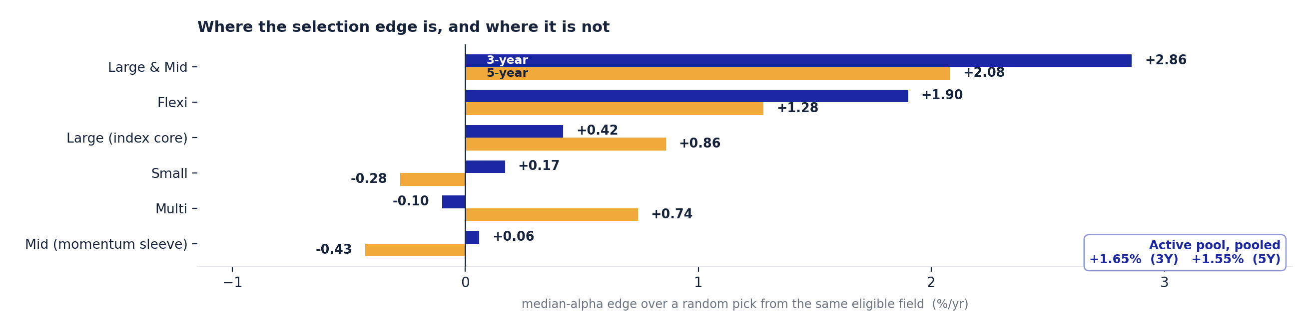
Private & Confidential
03 · THE EVIDENCE
Where the selection edge is, by category
The unconstrained ranking, against a random pick of the same field
READ THE SHAPE, NOT THE POOLED NUMBER
The edge is concentrated: Large & Mid at +2.86%/yr and Flexi at +1.90%/yr do almost all the work, and in those two a random pick actually loses to the index. Small is +0.17%, Multi is -0.10% and Mid is +0.06%, three of the six deployed categories where the ranking adds nothing measurable at three years. This is the unconstrained ranking; the book a client held earned a fraction of it, two pages back.
QFRA2_HANDOFF.md section 5, the qfra2_vs_random.py panel. Total-return benchmarks here use the model's documented dividend add-back, which is modelled rather than vendor-official. Chart: chart_qfra2_evidence.py.
QFRA 2.0 · 21

Slide 23
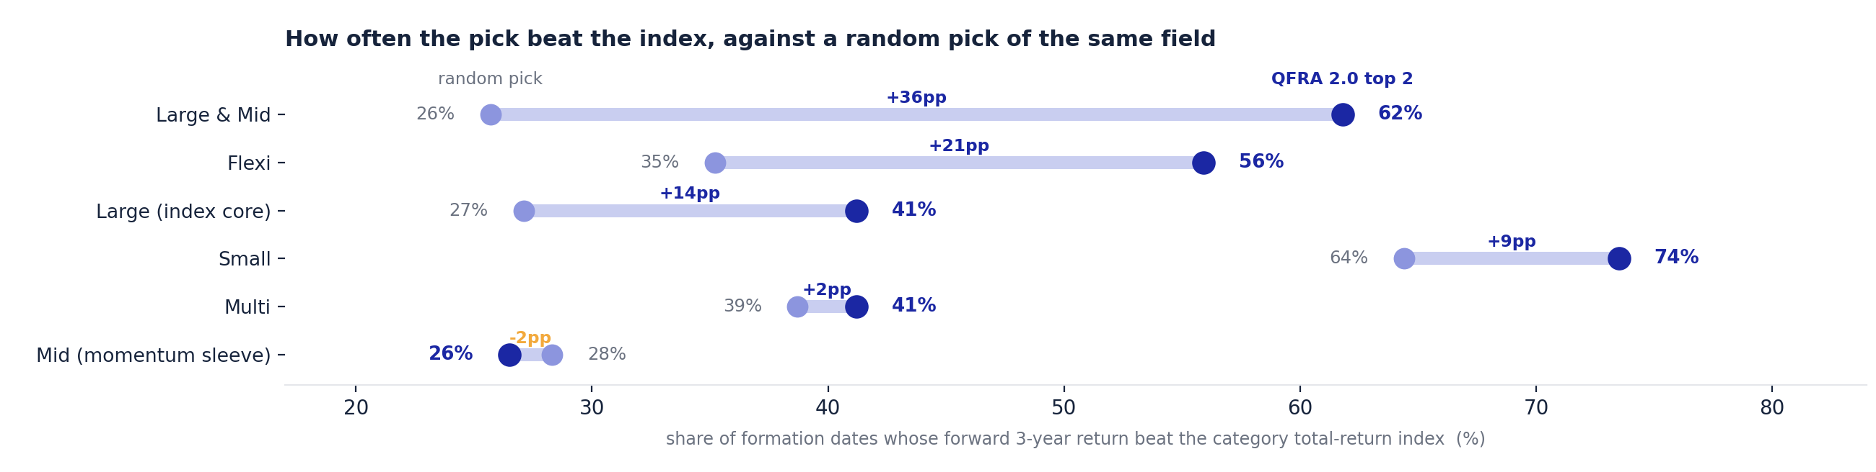
Private & Confidential
03 · THE EVIDENCE
How often the pick beat the index
The same unconstrained panel, measured as a hit rate rather than a median
WHERE A HIT RATE SAYS SOMETHING A MEDIAN DOES NOT
In Large & Mid the ranking lifts the hit rate 36 points, from 26% to 62%. In Small it lifts it 9 points, but off a 64% base: the category beat its index most of the time whoever picked. In Mid the ranking is 2 points BEHIND a random pick. And a lifted hit rate on this panel did not carry into the deployed book: Small's held book returned -1.34%/yr at three years while winning half its windows.
QFRA2_HANDOFF.md section 5, win% model versus random at 3Y, same panel as the previous page. Held-book figures: QFRA2_recommendation_performance.md. Chart: chart_qfra2_evidence.py.
QFRA 2.0 · 22

Slide 24
Private & Confidential
03 · THE EVIDENCE
Against the obvious alternative
Why not simply buy the funds with the best three-year alpha
STRATEGY
3Y MEDIAN ALPHA
3Y WIN RATE
5Y MEDIAN ALPHA
TURNOVER / YR
QFRA 2.0 final two
+0.48%
56.4%
+0.58%
3.9 deployed
Best two by 3-year alpha
+0.37%
53.4%
+0.90%
7.8
Best three by 3-year alpha
+0.31%
53.2%
+0.27%
10.8
Blind pick
-0.76%
42.8%
-0.69%
n/a
THE ANSWER, WITH ITS EXCEPTION STATED
The model wins 6 of the 8 pooled cells, and the topper still beats a blind pick, so it is a real signal rather than a straw man. Its only wins are the five-year cells, by a thin margin that reverses without factor adjustment. Small Cap is the clear exception: there the topper beats us outright.
AND ONE BELIEF THIS TEST CORRECTED
We expected the topper to churn far harder. It does not: at 7.8 changes a year it is no worse than our own unconstrained ranking at 11.1. Our low turnover comes from the churn rule, not from a steadier signal, and anyone could bolt that rule onto a topper strategy.
qfra2_pac_prep/3Y_TOPPER_BENCHMARK.md. Built on the same panel and the same pooling convention as the published model-versus-random table.
QFRA 2.0 · 23

Slide 25
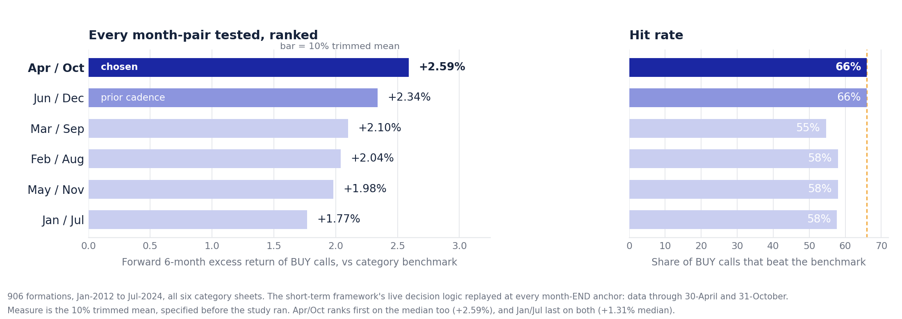
Private & Confidential
03 · THE EVIDENCE
When the model runs, and why it matters
The review anchor is worth about 8 points of hit rate, so we tested all six
APRIL AND OCTOBER, ON THE MONTH END
All six possible six-month pairs were replayed through the short-term framework's live decision logic at every month end from January 2012 to July 2024, across all six category sheets: 906 formations. April and October leads on the measure specified before the study ran, and ties with June and December on the 66% hit rate while the other four sit at 55% to 58%. Month end matters as much as the pair: a first-of-April anchor closes its window on about 31 March, so it is the March window renamed, and it scores a 53% hit rate against 66%. End-April reads prices that have digested the March-quarter and full-year results.
04_RND_LAB/STOCK_SCORECARD_750/results/anchor_pair_study/. Presented measure is the 10% trimmed mean, specified in the original brief.
QFRA 2.0 · 24

Slide 26

Private & Confidential
04
SECTION 04
The two frameworks
Why a second, shorter-horizon framework earns its place, and where each one drives the call
26-28

Slide 27
Private & Confidential
04 · TWO FRAMEWORKS
Why we run a second framework
Different horizons, one shared signal, and an honest statement of the overlap
CATEGORY
CORE
DRIVEN BY
WHY
Large Cap
Plain index
QFRA-2
Active selection is not distinguishable from a blind pick.
Large & Mid Cap
Active
QFRA-2
Best theoretical edge of any category, worst delivery gap.
Mid Cap
Factor momentum
QFRA-2
Active edge near zero and the worst realised book of the eight.
Flexi Cap
Active
Both agree
The one category where realised beat theoretical.
Multi Cap
Plain index, provisional
QFRA-2
Worst edge of the six; no evidenced factor substitute yet.
Small Cap
Index core plus a tactical satellite
Both, different jobs
The level is the market's; the short signal is ours.
STATE THE OVERLAP BEFORE ANYONE FINDS IT
The short-term framework ranks funds on their six-month total capture ratio. QFRA-2 already carries that same quantity at a weight of 0.30, plus a three-year down-capture term, so the capture family is 40% to 48% of the QFRA-2 score. When the two agree, part of that is one signal agreeing with itself. What the short-term framework clearly adds is recency and its own replayed backtest.
qfra2_pac_prep/FRAMEWORK_COMPLEMENTARITY.md; overlap verified at final_model.py:154.
QFRA 2.0 · 26

Slide 28
Private & Confidential
04 · TWO FRAMEWORKS
Small Cap, stated precisely
The claim was that we have a lot of alpha in small caps. Half of that is true, and the half that is not changes how we should run it
92%
-1.34%
+3.49%
72%
OF SMALL-CAP ALPHA A BLIND PICK ALSO GETS
DEPLOYED BOOK 3Y ALPHA IN SMALL
SHORT-TERM BUY LEG MEDIAN EXCESS
SHORT-TERM BUY LEG HIT RATE
THE LEVEL IS THE MARKET'S, NOT OURS
Small Cap has the highest absolute alpha of any category, +2.20% a year, but a blind pick captures +2.03% of it. The incremental edge is +0.17% and it did not survive into the deployed book, which returned -1.34%.
BUT THE SHORT-HORIZON SIGNAL IS REAL, AND IT IS OURS
The short-term framework's small-cap buy leg is the strongest single signal in the firm: +3.49% median forward excess at a 72% hit rate, across 906 formations. That is six-month capture persistence, not five-year stock picking.
SO RUN IT AS WHAT IT IS
An index core for the beta, plus a separately sized and separately clocked tactical satellite. What we should not do is badge that satellite as our small-cap alpha.
Random-baseline test from the model-versus-random panel; buy-leg figures from the anchor-pair study extension.
QFRA 2.0 · 27

Slide 29
Private & Confidential
04 · TWO FRAMEWORKS
Who is allowed to say sell
A defect found this review, and the rule that replaced it
THE DEFECT
QFRA 2.0 has no Sell verdict, yet our client pipeline derived one from it by treating a SENTINEL flag or a below-40 score as an exit signal. Both legs were wrong, and in one live case the rule called for selling a fund the same engine ranked second in its category with the top grade.
FRAMEWORK
ROLE NOW
Short-term (QFRA-1)
ORIGINATES the sell. It is the only framework with a sell verdict and the only one with a replayed backtest.
QFRA 2.0
VETOES only. A top-two grade blocks the sell. It can never originate one.
Disagreement
Surfaced as a contradiction for the fund manager's pack, never resolved silently to hold.
AND THE LIMIT ON THE LEG THAT NOW ORIGINATES
On the same 906 formations the buy leg is strong, at +2.59% median excess and a 66% hit rate. The sell leg is not: 49% hit, below 50% in all six anchor pairs. A sell must stand on the analyst's reason, with capture as support, not on the backtest.
Implemented at 09_PRODUCT/scripts/fund_ctx_adapter.py. Sell-leg measurement in the anchor-pair study extension.
QFRA 2.0 · 28

Slide 30

Private & Confidential
05
SECTION 05
Track record and the ask
Every review period since 2018, the limits we accept, and the decision sought
30-39

Slide 31
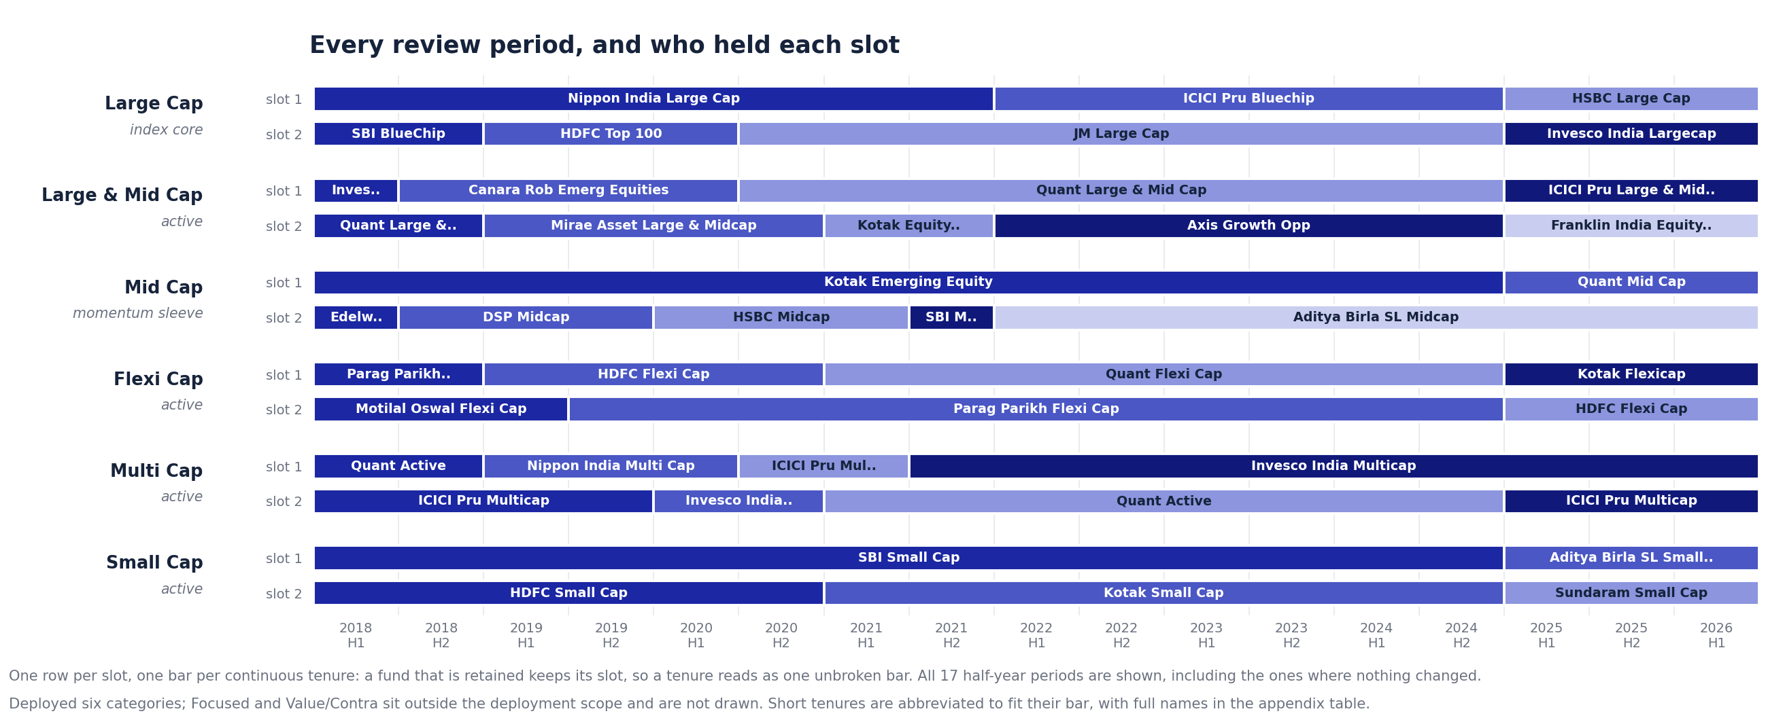
Private & Confidential
05 · TRACK RECORD
Every review period since 2018
Rebuilt this review so a retained fund keeps its slot and no period is hidden
WHAT WAS WRONG WITH THE PREVIOUS VERSION
It printed only the 43 periods in which something changed, hiding 93 of 136 rows, and it let a retained fund move between slots when the ranking reordered. JM Large Cap was held without interruption from 2020 to 2024 and appeared in both. Slot changes for retained funds are now zero, and all 17 periods are shown.
Rebuilt from QFRA2_recommendation_history.csv, which was complete all along. Script: 09_PRODUCT/scripts/qfra2_history_rebuild.py.
QFRA 2.0 · 30

Slide 32
Private & Confidential
05 · TRACK RECORD
The January-2025 book, sixteen months on
Live, not backtested, and far too short to settle anything
Realised annualised alpha of the twelve in-scope picks, Direct-plan NAVs against the category index
+0.65%/yr
+0.70%/yr
0
16 months
MEAN REALISED ALPHA
MEDIAN REALISED ALPHA
SLOT CHANGES SINCE JAN-2025
ELAPSED OF A 3-TO-5-YEAR CALL
12 picks, 6 categories in scope
the same twelve picks
both re-runs held every slot
to 2026-05-27
CATEGORY
THE TWO PICKS
CATEGORY MEAN
READ
Small Cap
+7.3% · +7.0%
+7.15%
The best pair of the twelve, both picks.
Flexi Cap
+2.4% · +1.7%
+2.05%
Consistent with its backtested edge.
Large Cap
-1.2% · +3.6%
+1.20%
Index core; the pair disagrees sharply.
Multi Cap
-6.0% · +5.2%
-0.40%
An 11-point spread inside one category.
Large & Mid Cap
-0.3% · -3.1%
-1.70%
Best backtested edge, negative live.
Mid Cap
-7.7% · -1.1%
-4.40%
The routing to momentum, vindicated early.
SIXTEEN MONTHS IS A CHECK, NOT EVIDENCE
Twelve picks over sixteen months, with a 15-point spread between the best and worst single pick, cannot confirm a three-to-five-year thesis either way.
Recomputed from QFRA2_realized.csv, rank<=2 rows, alpha_ann_pct, Jan-2025 to 2026-05-27. Slot stability from QFRA2_history_rebuilt.csv (2025-H2 and 2026-H1 both 'held' in all six). The previous pack's +0.9% is the all-eight-category mean and includes Focused, which is out of scope.
QFRA 2.0 · 31

Slide 33
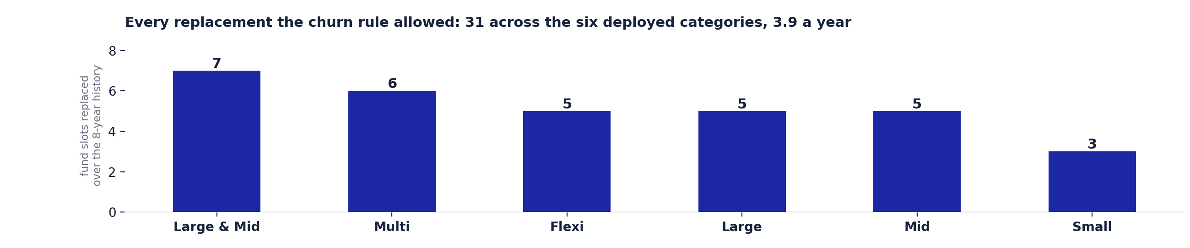
Private & Confidential
05 · TRACK RECORD
How rarely the book actually changes
Eight years of realised turnover, and what the discipline costs
WHY LOW CHURN IS A PRODUCT FEATURE AND NOT LAZINESS
Thirty-one slot changes across the six deployed categories in eight years is 3.9 a year, or an average holding near three years. That keeps gains in the long-term bracket and keeps the operational load on an advisory book small. Large & Mid changed most, at seven; Small Cap changed three times in eight years.
AND THE BILL FOR IT, STATED ONCE MORE
The same discipline absorbs most of the measured selection edge: +0.09%/yr held against +0.48% unconstrained. Low churn is being bought, not received free.
Recomputed from qfra2_pac_prep/QFRA2_history_rebuilt.csv, 17 review periods, first period excluded as the book's start; independently reproduces qfra2_charts_ceo.py's own bar data (7/6/5/5/5/3). Chart: chart_qfra2_evidence.py. The previous pack's 2.6/yr is unsupported.
QFRA 2.0 · 32

Slide 34
Private & Confidential
05 · TRACK RECORD
What we tested and did not ship
Nine rejections and one adoption, kept as a standing record
We do not ship what we cannot validate. This log is the only evidence that the rule actually binds
WHAT WAS TESTED
WHY IT IS NOT IN THE MODEL
Downside information-ratio slot
Looked good on pooled medians, then failed the paired block bootstrap. Not adopted.
Six-month tactical capture signals
Strong at six months, but high turnover and short-term-gains heavy, which a three-to-five-year mandate cannot carry. Survives only as the frozen 0.30 capture weight.
Rolling-consistency targeting
The worst of the four alternatives at three years in all eight categories.
Capture weight above 0.40
Raising the weight bought no gain that survived validation. It ships at 0.30.
Bull and bear regime timing
Mixed, unstable and era-dependent. Around 4% of dates are bear dates: too few to validate on.
A contrarian sleeve
Helped only the mean-reverting categories, so SENTINEL is switched off for Mid and Value instead of adding a sleeve.
Machine learning on the cross-section
Five to nine funds per category memorises one era. Rejected on our own evidence, well before the claim appeared on a slide.
Model retunes V1 to V5, IC-base, alpha persistence, cap split
All rejected on out-of-sample significance.
Momentum smart beta for Mid · ADOPTED
The one enhancement that cleared the same out-of-sample bar the retunes failed.
QFRA2_HANDOFF.md section 7, the integrity log. Rolling-consistency claim verified category by category against outputs/backtest/strategy_comparison.csv; the previous pack's -1.44% / 32.7% for it does not reproduce from that file and is not repeated.
QFRA 2.0 · 33

Slide 35
Private & Confidential
05 · HOW WE TEST
How we test our own engines
Five stress-tests, run this cycle on the stock-scoring engine, shown for the discipline alone
SCOPE, STATED BEFORE THE NUMBERS
Every figure on the next two pages is from the 750-stock scorecard, a different model on a different asset class, run 2026-08-04 to 2026-08-05. None of it is QFRA-2 evidence. It is shown because a committee approving one model should see how the firm tries to break its models in general.
TEST
WHAT IT CHECKS
Rolling deciles, pre- vs post-gate
Whether the balance-sheet gate, penalty and boost layer adds ranking power or costs it.
Regime and PSU split
Whether the decile edge is a bull market or a PSU rally rather than stock selection.
PEG versus plain price-to-earnings
Whether the Value pillar marks down fast growers for looking expensive on an earnings multiple alone.
Size decomposition by decile
Whether a large, mid or small-cap tilt, not the score, is driving the decile spread.
Point-in-time literal rescore
Whether a score built only from information available on the day still separates deciles.
bt_decile_rolling.py, bt_regime_psu_test.py, bt_peg_test.py, bt_size_by_decile.py, bt_decile_pit.py. Stock-score evidence, not QFRA-2.
QFRA 2.0 · 34

Slide 36
Private & Confidential
05 · HOW WE TEST
What those tests found
Two results, both from the stock score, neither one QFRA-2 evidence
THE GATE LAYER GIVES UP RANKING POWER
Across 35 rolling one-year formations on the stock score (pooled n=14,943), the composite score computed before the balance-sheet gate, penalty and boost layer separates deciles better than the deployed score computed after that layer: a top-minus-bottom spread of +9.4pp against +7.6pp, and a 94% per-formation hit rate against 86%. Windows overlap, so no t-statistic is quoted; the hit rate is the number built to survive that.
A QUARTER OF THE TOP DECILE IS GOVERNMENT-OWNED
PSU names are 8% of the bottom decile and 25% of the top one on the deployed, post-gate score. Remove them and the top-minus-bottom spread on that score falls from +7.6pp to +2.5pp: the edge does not disappear, but most of the concentration does. The PSU list used is hand-built and not exhaustive, which biases this toward understating the dependence, not overstating it.
WHAT NEITHER TEST CAN SAY
The panel behind both starts 2021-07-16; its worst 12-month forward window is about -6%. That is a flat market, not a full cycle, and the up-versus-down split is 29 formations against 7 that mostly overlap, closer to one down episode than seven. This is a stock-score limitation, and the fund-side version of it has its own page ahead.
DECILE_ROLLING_20260805/summary.json; REGIME_PSU_20260805/psu_test.csv. Stock-score evidence, not QFRA-2.
QFRA 2.0 · 35

Slide 37
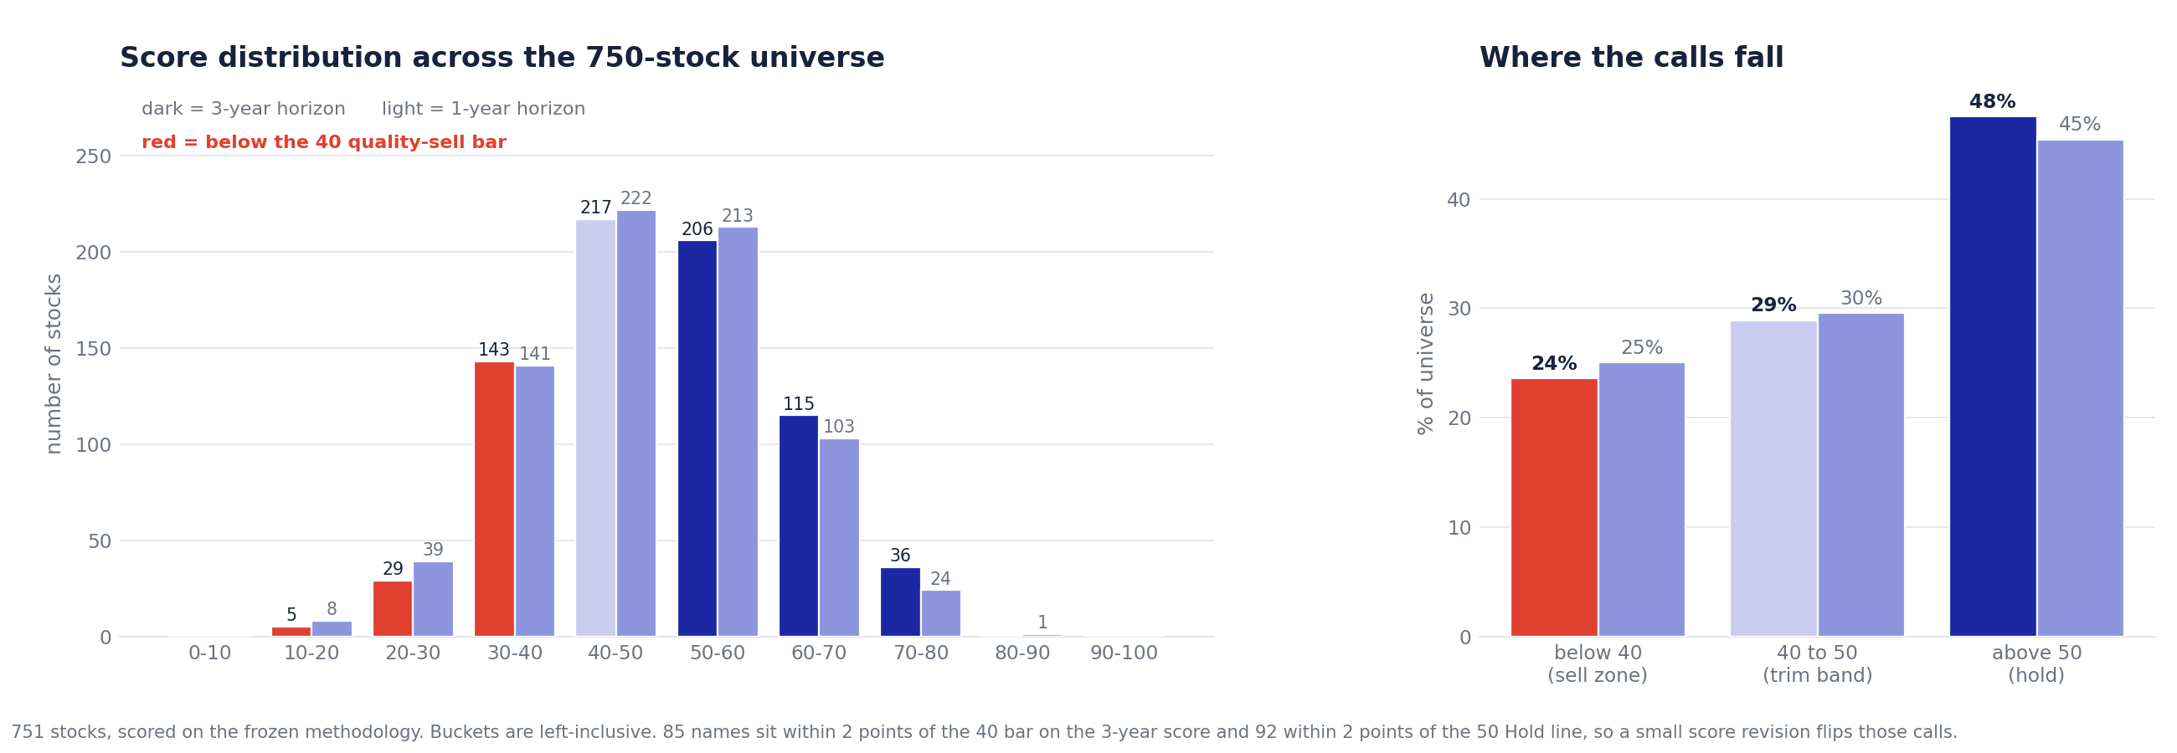
Private & Confidential
05 · HOW WE TEST
Where the calls actually sit
Stock-score evidence again, not QFRA-2: 751 names, scored 2026-08-05
56% OF THE UNIVERSE SITS IN THE TWO MIDDLE BUCKETS
751 stocks, scored on the frozen stock methodology. 217 score 40 to 50 and 206 score 50 to 60 on the 3-year horizon: 56% of the universe sits in the two buckets on either side of the Hold line. 85 names sit within 2 points of the 40 sell bar and 92 within 2 points of the 50 Hold line, close enough that a small score revision flips the call. Stock-score evidence, not QFRA-2, and the clearest single case in the firm for why a model gets tested this hard before a committee sees it.
chart_score_distribution.py output (pr_template/out/score_distribution.png), 751-row scored universe, run 2026-08-05. Stock-score evidence, not QFRA-2.
QFRA 2.0 · 36

Slide 38
Private & Confidential
05 · TRACK RECORD
The limits we accept
Stated up front, because the committee will find them anyway
The deployed edge is small
+0.09% a year at three years on the held book, against +0.48% for the unconstrained ranking. This is the honest headline.
One era of validation
Roughly 2014 to 2024, a single macro regime. The edge is regime-dependent and we cannot yet show it across a full cycle.
The universe is thin
5 to 9 eligible funds per deployed category, not the 40 to 60 previously stated. A top-five shortlist is close to the whole field in four of six categories, and the binding constraint is NAV coverage, not the gates.
Scores do not compare across categories
The score is a within-category rank. 80 out of 100 is second of five in Large and Mid; 88 is fourth of thirty-three in Focused.
The asset floor is unenforced where the feed is missing
Twelve of the forty published rows carry no asset figure, so the capacity gate cannot bite there. This includes every Focused and Value row.
The scope decision and realised alpha disagree
Focused and Value are excluded, yet they are two of only three categories whose held book was positive at three and five years. The exclusion rests on edge over a blind pick, not on realised alpha. The committee should know it is choosing between two defensible lenses.
Universe and scores verified 2026-08-04. Held-book alpha from the engine's own performance file.
QFRA 2.0 · 37

Slide 39
Private & Confidential
05 · TRACK RECORD
The test we have not pointed at QFRA-2
Built this cycle, run on the stock score. Not yet run on the fund engine itself
WHAT WE KNOW, AND WHAT WE HAVE NOT CHECKED
QFRA-2's own validation runs one era, roughly 2014 to 2024 (previous page). Separately, this cycle a bull-versus-bear regime split was built and run on the stock score: on that panel the edge shrinks but survives a flat market. That method has not been run on QFRA-2's own fund-level returns. Until it is, "one era" should be read as "untested across a downturn", not simply "a shorter sample than we would like."
WHY THIS IS NOT A SMALL GAP
QFRA-2's factor step and several of its signals, down-capture, Calmar, alpha stability, are exactly the kind of measure the stock-side quality challenge targets: that fundamentals stop discriminating in a rally. The same question applies to a fund ranked partly on down-capture and drawdown behaviour. The fix is mechanical, not conceptual: replay the eight years of category-level formations split by market regime, the design already used on the stock score.
NOT ASKED TO CLOSE TODAY
Point the regime-split method built for the stock score at QFRA-2's own category-level history. Flagged here as a gap, not answered here.
Limits from the previous page. Regime method: bt_regime_psu_test.py, REGIME_PSU_20260805/. Not yet applied to QFRA-2's own return history.
QFRA 2.0 · 38

Slide 40
Private & Confidential
05 · THE ASK
The decision sought
Approval to deploy, on the corrected numbers
6
6 months
frozen v2.0
3.9 / yr
CATEGORIES IN SCOPE
REVIEW CADENCE
NO FURTHER TUNING
EXPECTED BOOK CHANGES
APPROVE
Deployment across the six categories: Large as an index core, Large and Mid, Mid as a momentum sleeve, Flexi, Multi and Small. Governance as described: a Direct-plan and total-return basis, the SENTINEL screen, a veto-or-trim-only discretionary gate, the churn rule, and a published record of recommendations and rejected ideas.
NOTE, ON THE RECORD
This deck corrects five of the nine headline figures in the previous pack, including a machine-learning claim the engine does not support and a client-facing probability that was never computed. The model is unchanged and remains frozen; what changed is what we say about it.
TWO ITEMS WE ARE NOT ASKING TO CLOSE TODAY
Whether Focused and Value should be re-scoped, given their held books were positive while two deployed categories were not; and the small-cap follow-up. Both need work first.
Corrections logged in 07_RISK_OFFICE/ADVERSARIAL_REVIEWS.md and 03_RESEARCH_DESK/qfra2_pac_prep/NUMBER_AUDIT.md.
QFRA 2.0 · 39

Slide 41
Measure it, validate it,
screen out the losers, and say
where we cannot win.
QFRA 2.0 · Quantitative Fund Ranking Algorithm · frozen v2.0

