Slide 1

IONIC WEALTH
BY ANGEL ONE
Portfolio Review
PREPARED FOR
Anand Reddy
NDPMS (Non-Discretionary) · Profile & horizon: Not yet on file
Co-founder in your journey of wealth creation
As of 2026-07-27

Slide 2

Private & Confidential
How to read this review
Contents · vocabulary · score legend
THE SIX SECTIONS
THE WORDS WE USE
Understanding
EQUITY
SELL
TRIM
HOLD
Your mandate, policy bands and the headline plan
FUNDS
HOLD
TRIM
SWITCH
EXIT
01
Portfolio X-ray
Where the book stands today
A review of the holdings you already own; every call here applies to existing positions.
02
The Equity Book
Every direct holding, scored and read
THE IONIC SCORE, POSITIONED
03
The Fund Book
Below 40 · Sell candidate
Your funds, upside, downside, consistency
40 to 50 · watch zone; Trim only with a concentration or risk flag
04
Recommendations
50 and above · Hold
The plan, the cost, the tax and the sequence
05
Annexure
The Ionic Score flags candidates; the Portfolio Review team confirms every call.
Supporting detail, on request
THIS BUILD Annexure attached this cycle: Quality vs price · Growth projection · Spotlight holdings · Holdings detail · Sell cards · Scheme overlap · Scheme scorecards · Appendix
Portfolio Review · 02

Slide 3
Private & Confidential
00 · UNDERSTANDING
Executive summary
Where the book differs from your policy, and what we'd do
Rs 1.6 Cr
27 / 25
41%
14
7
PORTFOLIO VALUE
STOCKS / FUNDS
TOP-10 WEIGHT
EQUITY SELLS
FUND ACTIONS
Each gap below has one action, and where to read the detail.
CATEGORY
GAP VS POLICY
WHAT WE WOULD DO
SEE
Concentration
Top-2 names each >11%; our guideline caps a single name at 8%.
One exits via the sell programme; the other trims toward the cap.
01 · X-ray
Sell programme
14 direct holdings score in the Sell band (<40).
Exit all 14, sliced by liquidity.
02 · Equity
No investment policy on file
This is a first review; no written mandate (goals, timeline, risk tier) exists yet for this account.
Agree an IPS with the RM before the next review cycle.
01 · X-ray
Plan cost
Every scheme in this account is already held Direct, no Regular-plan drag to correct.
The fund actions below address structure and consistency, not cost.
03 · Funds
Fund structure
7 schemes exit for structural reasons (overlap, consolidation), not performance.
See the fund actions detail for the reasoning on each.
03 · Funds
Counts (sells, fund actions) match the scored books exactly; ‘See’ points to the section with the detail.
Portfolio Review · 03

Slide 4
Private & Confidential
00 · UNDERSTANDING
Our understanding
Mandate, construction and benchmark
OUR UNDERSTANDING
WHAT IS CORE–SATELLITE?
The Anand Reddy portfolio is managed under a NDPMS (Non-Discretionary) mandate, we advise, you authorise every trade. The stated objective is long-term capital growth with a quality bias over a horizon still to be agreed with you. The book today runs ~42% direct equity, 58% funds and 0% cash, across 27 stocks and 25 schemes.
A stable core of quality businesses does the compounding; smaller satellite positions around it aim to add return without disturbing the core. Steady at the centre, selective at the edges.
HOW WE MEASURE PROGRESS
NON-DISCRETIONARY, YOU AUTHORISE EVERY TRADE
Against our house-view mix of markets, not a single index:
Nothing in this review is executed until you authorise it. Every recommendation is Sell, Trim or Hold on a holding you already own · never a solicitation to buy.
· Foreign equity, ~15% target, under-owned
· Gold & silver, Positive, 75:25
· Low-vol / value favoured; momentum on hold
A formal named benchmark will be agreed with you.
HOW EVERY HOLDING IS SCORED
Every holding earns an Ionic Score out of 100, blending the long-term health of the business with how the market is treating it now, with built-in safety checks on debt and liquidity. The score flags; our team decides. Full method in Section 02.
The Ionic Score flags candidates; the Portfolio Review team confirms every call.
Portfolio Review · 04

Slide 5

Private & Confidential
01
SECTION 01
Portfolio X-ray
Where the book stands today
Portfolio snapshot
Allocation vs house view
Concentration risk
Sector exposure
Market-cap positioning

Slide 6
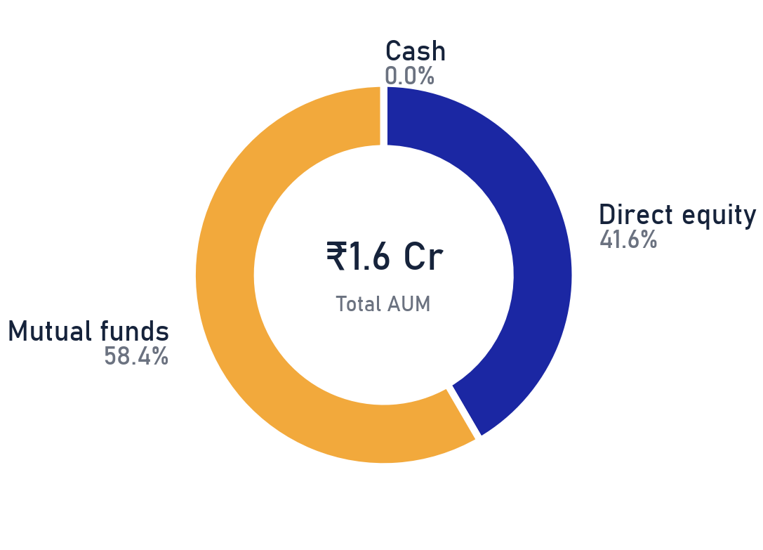
Private & Confidential
01 · PORTFOLIO X-RAY
Portfolio snapshot
Asset mix and the concentration that drives risk
₹1.61 Cr
27
25
41%
TOTAL AUM
DIRECT EQUITY NAMES
MUTUAL-FUND SCHEMES
IN THE TOP 10 HOLDINGS
THE READ
The mix itself is healthy: 42% direct equity doing the compounding, 58% in funds for breadth, 0% in cash. What deserves attention sits inside the equity sleeve: the ten largest names carry 41% of the book against an 8% single-name guideline. This review deals with that first, then the funds, then the costs.
Source: client custody statement as of 2026-07-27; Ionic Wealth Portfolio Review. Percentages of total AUM.
Portfolio Review · 06

Slide 7
Private & Confidential
01 · PORTFOLIO X-RAY
Allocation vs house view
Book positioning against house-view allocation targets
HOUSE-VIEW STANCE
ALLOCATION TARGETS
DIMENSION
OUR STANCE
No allocation targets are on file for this account yet, this is a first review with no IPS agreed. Once one is in place, the book's mix will be measured against it here.
Domestic equity
Incrementally positive
Foreign equity
~15% target, under-owned
Gold & silver
Positive, 75:25
Momentum
On hold
Low-vol / value
Favoured
WHAT IT MEANS
Allocation targets versus a house view aren't fully set for this account yet. Closing any gaps will follow once an IPS is agreed.
House-view allocation bands. Gap = current book minus house-view target, in percentage points.
Portfolio Review · 07

Slide 8
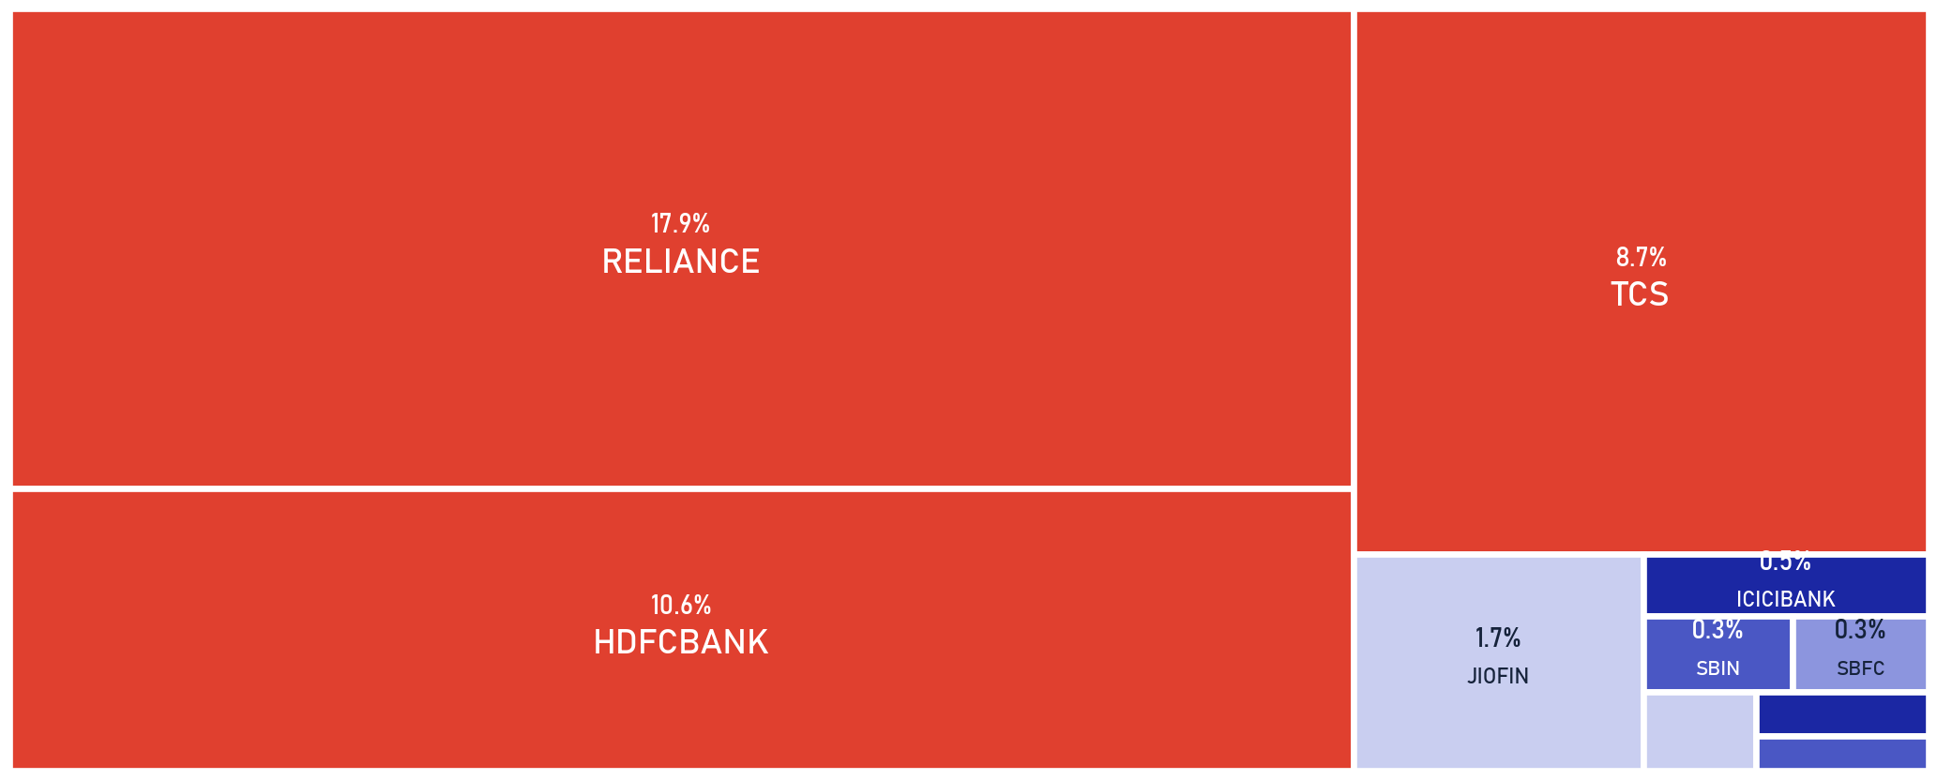
Private & Confidential
01 · PORTFOLIO X-RAY
Concentration risk
Single-name concentration against the IPS cap
SCOPE Direct equity only · as of 2026-07-27
SINGLE-NAME CAP
3 names sit above the 8% IPS single-name guideline: RELIANCE (17.9%), HDFCBANK (10.6%) and 1 more, together 37.3% of the book. RELIANCE exits via the sell programme. HDFCBANK, TCS is trimmed toward 8% into strength, sliced across days, never in one print.
28.5%
41%
8%
3
TOP 2 NAMES
TOP 10 NAMES
IPS SINGLE-NAME CAP
NAMES OVER THE CAP
Source: client holdings as of 2026-07-27. Weights as % of total AUM; Single-name guideline per house risk policy, no client-specific IPS on file yet.
Portfolio Review · 08

Slide 9
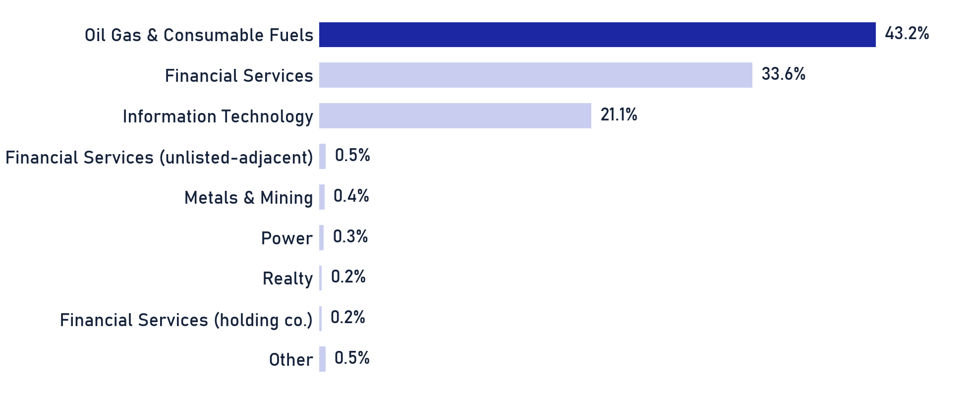
Private & Confidential
01 · PORTFOLIO X-RAY
Sector exposure
Direct-equity sector weights (sleeve basis)
SCOPE Direct equity only · as of 2026-07-27
SCOPE, MF NOT LOOKED THROUGH
This chart covers direct equity only (42% of AUM). The mutual-fund sleeve (58% of AUM) is not looked through, your true sector exposure, funds included, is higher than shown.
THE READ
Sleeve tilts to Oil Gas & Consumable Fuels (43%) and Financial Services (34%); top-3 sectors are 98% of the direct book. Sector risk compounds with the single-name concentration flagged earlier · sized together, not in isolation.
Source: client holdings as of 2026-07-27. Weights as % of the direct-equity sleeve; mutual-fund look-through not included.
Portfolio Review · 09

Slide 10
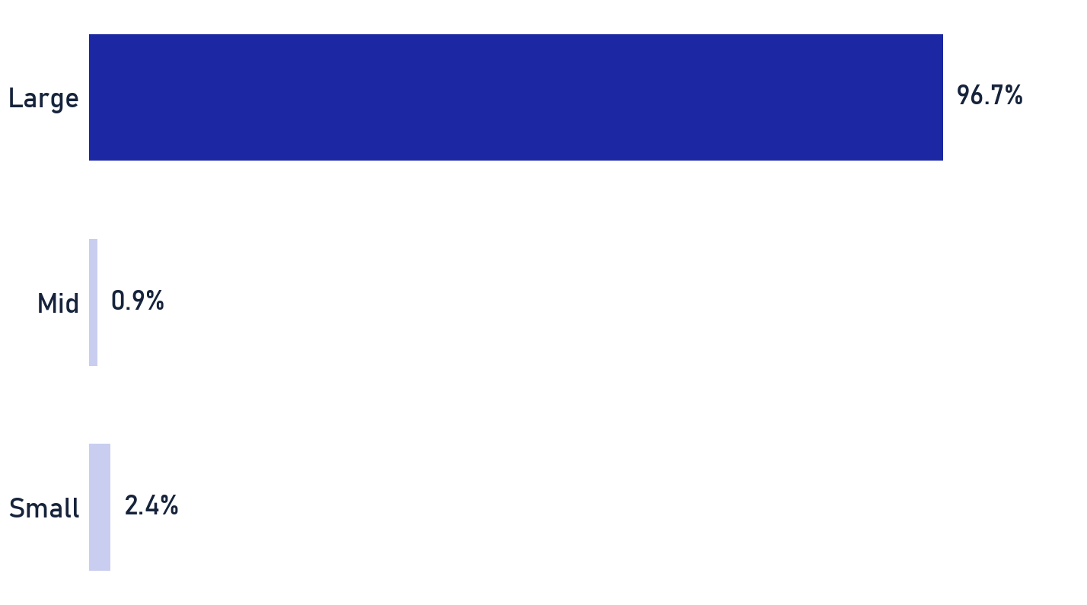
Private & Confidential
01 · PORTFOLIO X-RAY
Market-cap positioning
Direct-equity market-cap distribution vs the house view
SCOPE Direct equity only · as of 2026-07-27
SEBI MARKET-CAP CUTOFFS
SEBI / AMFI classify by full-market-cap rank: Large-cap = top 100 listed companies, Mid-cap = 101st–250th, Small-cap = 251st onward. 'Micro' is a sub-bucket we track below the small-cap line.
MID / SMALL VIEW
Mid/small-cap positioning against a target isn't set for this account yet. No allocation targets on file.
Source: client holdings as of 2026-07-27. Weights as % of the direct-equity sleeve; bands per SEBI/AMFI classification. No micro-cap exposure.
Portfolio Review · 10

Slide 11

Private & Confidential
02
SECTION 02
The Equity Book
Every direct holding, scored and read
How we score every stock
The book, scored
The book at a glance
What we would sell
What stays, and why

Slide 12
Private & Confidential
02 · EQUITY
How we score every stock
Two horizons, seven pillars, and one human call
3-YEAR VIEW
+
1-YEAR VIEW
=
IONIC SCORE
Fundamentals-led
Market-behaviour-led
One number, 0 to 100
QUALITY & GROWTH
VALUE
TREND & FLOW
What the business earns, and how fast it grows.
What you pay for those earnings.
What the price and the big investors are actually doing.
• Quality · ROE & ROCE vs peers
• Value · P/E, P/B & FCF yield vs sector
• Stage / Technical · price trend
• Growth · revenue growth, 3y & 1y
• Sector & Macro · regime fit
• Ownership Flow · FII / DII flows
• Accumulation · smart-money volume trend
SAFETY GATES A weak balance sheet or thin liquidity caps the score at 40. The debt bar is judged in context: by industry norms (utilities and lenders run levered), sovereign or group backing, and access to capital, not one fixed ratio.
THE HUMAN READ
The Ionic Score ranks and flags candidates; it is the INPUT, not the verdict. Every Sell, Trim and Hold that follows is confirmed by the Portfolio Review team, who override the number when the business case demands it · a low score on a durable franchise can still be a Hold, and vice-versa.
Below 40, either horizon
SELL
40–50, only with a concentration / risk flag
TRIM
50 and above
HOLD
Ionic scoring methodology (proprietary, held by the desk) · a 40-50 score alone is a watch signal; Trim needs a concentration or risk flag · every call reviewed by the desk.
The Ionic Score flags candidates; the Portfolio Review team confirms every call.
Portfolio Review · 12

Slide 13
Private & Confidential
02 · EQUITY
The book, scored
The largest positions, with the analyst's one-line read
SCOPE Direct equity only · as of 2026-07-27
14
13
27
SELL
HOLD
HOLDINGS
ANALYST OVERRIDE 1 name(s) score below 40 yet are held on analyst conviction, the score flags, the desk decides.
HOLDING
WT %
IONIC SCORE
CALL
ANALYST READ
Reliance Industries Ltd.
17.9
27
SELL
Bottom-quartile on quality and value versus large-cap…
HDFC Bank Ltd.
10.6
53
HOLD
Scores 53/100 on our quality/value/momentum framework , …
Tata Consultancy Services Ltd.
8.7
51
HOLD
Scores 51/100 on our quality/value/momentum framework , …
Jio Financial Services Ltd.
1.7
38
SELL
Priced at ~1.1x book for a ~14% normalised return on…
ICICI Bank Ltd.
0.5
59
HOLD
Scores 59/100 on our quality/value/momentum framework , …
State Bank of India
0.3
70
HOLD
Scores 70/100 on our quality/value/momentum framework , …
SBFC Finance Ltd.
0.3
26
SELL
Fundamentals are intact, profit up ~29% YoY, asset…
IDFC First Bank Ltd.
0.2
50
HOLD
Scores 50/100 on our quality/value/momentum framework , …
Rita Finance and Leasing Ltd.
0.2
15
SELL
A very small listed entity…
Tata Steel Ltd.
0.2
51
HOLD
, analyst override of the quant Sell.
Manappuram Finance Ltd.
0.1
45
SELL
Real tailwinds…
All 27 holdings are scored; the remaining 16 sit in the annexure. Rows link to each name's page there. Ionic Score: two-horizon composite with safety gates, reviewed by the desk.
Scores flag, people decide: each call here carries a named reviewer's sign-off.
Portfolio Review · 13

Slide 14
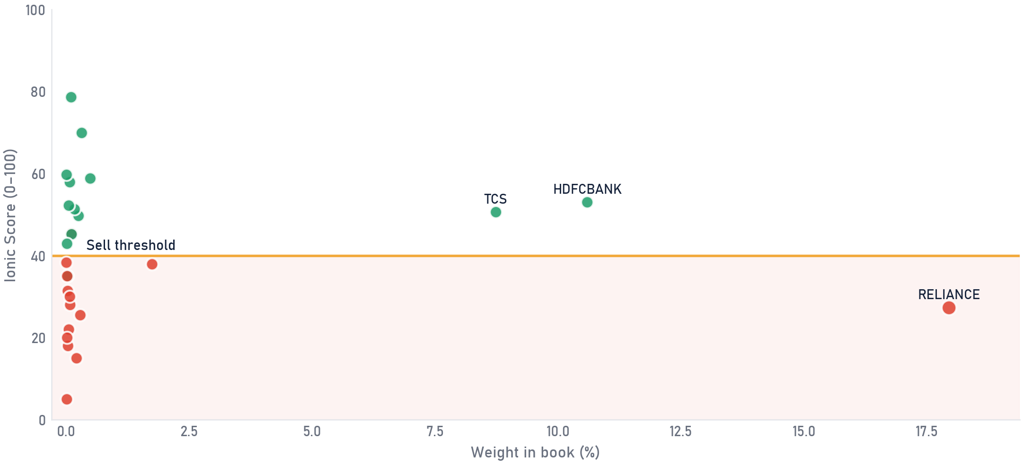
Private & Confidential
02 · EQUITY
The book at a glance
The equity book at a glance, weight against conviction
SCOPE Direct equity only · as of 2026-07-27
Each dot is a holding: how much of the book it is (across) against its Ionic Score (up). Dot size is rupee value. Anything in the shaded band scores below the Sell line; the far right, low-scoring dots are the concentration to watch.
Sell
Hold
dot size = rupee value held · gold line = Sell threshold (40) · a red dot above the line is an exceptional, documented call
Weight = share of direct-equity book · Ionic Score reflects our full review process, forward-growth adjusted.
The score is the starting point; the final word on every name belongs to the desk.
Portfolio Review · 14

Slide 15
Private & Confidential
02 · EQUITY
What we would sell
The names we would sell, and the case for each (1 of 3)
SELL ×14
SCOPE Direct equity only · as of 2026-07-27
Confirmed Sells only. Two lines carry the case; the linked page carries the full reasoning.
HOLDING
WT %
IONIC SCORE
CALL
THE CASE
DETAIL
Reliance Industries Ltd.
17.9
Bottom-quartile on quality and value versus large-cap peers; momentum has turned negative even as segment EBITDA hit a record.
27
SELL
p.42
Jio Financial Services Ltd.
1.7
Priced at ~1.1x book for a ~14% normalised return on equity the business is currently earning only 1-2% of, leaving little margin of safety.
38
SELL
p.43
SBFC Finance Ltd.
0.3
Fundamentals are intact, profit up ~29% YoY, asset quality stable, but at ~29x earnings the stock isn't cheap enough to justify holding through the recent price fall.
26
SELL
p.44
Rita Finance and Leasing Ltd.
0.2
A very small listed entity (~Rs13cr market cap on ~Rs1.3cr of sales) with the large majority of promoter holding pledged and an exchange query on unusual price movement. Exit on limit orders, not market orders.
15
SELL
p.48
Manappuram Finance Ltd.
0.1
Real tailwinds (a large institutional stake approval, easier gold-loan rules) are already more than priced in at ~29x earnings against revenue that is still falling.
45
SELL
p.45
EXCEPTIONAL
Names selling above the 40 score line are exceptional, high-conviction calls; the linked page documents each case in full.
Each row links to the name's full rationale page (score panel, the case, the bull we rejected, valuation check).
Numbers shortlist, judgment decides: every call passed a human review.
Portfolio Review · 15

Slide 16
Private & Confidential
02 · EQUITY
What we would sell
The names we would sell, and the case for each (2 of 3)
SCOPE Direct equity only · as of 2026-07-27
Confirmed Sells only. Two lines carry the case; the linked page carries the full reasoning.
HOLDING
WT %
IONIC SCORE
CALL
THE CASE
DETAIL
Lancor Holdings Ltd.
0.1
Reported profit is being carried almost entirely by a one-off litigation recovery, not the underlying business, core operating margin has collapsed and working-capital days have blown out.
28
SELL
p.49
Summit Securities Ltd.
0.1
A holding company trading at a steep discount to its investment book with no debt, but no catalyst to close that discount and no dividend history, too small a position to justify the wait.
30
SELL
p.50
Network18 Media & Investments Ltd.
0.1
Still loss-making over the last two quarters with negative return on equity; the bull case rests on an unlisted media stake with no public valuation, a story, not yet a thesis.
22
SELL
p.51
MosChip Technologies Ltd.
0.0
Trading at a rich ~129x earnings against an 11% return on equity, with promoter holding diluted through repeated share issuances and both revenue and profit declining quarter-on-quarter.
18
SELL
p.52
SJVN Ltd.
0.0
A large expansion programme (over 5,000MW under construction against ~3,100MW already live) is funded at a stretched debt-to-equity of ~2.3x, while the stock trades near 43x earnings, priced for flawless execution.
31
SELL
p.46
Each row links to the name's full rationale page (score panel, the case, the bull we rejected, valuation check).
The Ionic Score flags candidates; the Portfolio Review team confirms every call.
Portfolio Review · 16

Slide 17
Private & Confidential
02 · EQUITY
What we would sell
The names we would sell, and the case for each (3 of 3)
SCOPE Direct equity only · as of 2026-07-27
Confirmed Sells only. Two lines carry the case; the linked page carries the full reasoning.
HOLDING
WT %
IONIC SCORE
CALL
THE CASE
DETAIL
Mufin Green Finance Ltd.
0.0
A steep mismatch between price (~88x earnings) and quality (under 7% return on equity), with negative operating cash flow despite a reported accounting profit.
20
SELL
p.53
ICICI Prudential Nifty 200 Momentum 30 ETF
0.0
A liquid, well-tracked momentum ETF; momentum factors carry a regime-dependent risk our house view treats as a standing exception, so this one stays a Sell while other factor funds in this account are Held.
35
SELL
p.55
Prag Bosimi Synthetics Ltd.
0.0
Negative net worth and negative return on capital, and the company's own auditors have flagged material doubt over its ability to continue as a going concern.
5
SELL
p.54
Reliance Power Ltd.
0.0
The weakest quality score of the names reviewed, negative earnings, three years of flat revenue and a 62% price decline over the past year; balance-sheet risk flagged.
38
SELL
p.47
Each row links to the name's full rationale page (score panel, the case, the bull we rejected, valuation check).
Scores flag, people decide: each call here carries a named reviewer's sign-off.
Portfolio Review · 17

Slide 18
Private & Confidential
02 · EQUITY
What stays, and why
What stays, and why, core conviction versus watch
SCOPE Direct equity only · as of 2026-07-27
Our Holds, grouped by conviction. Each name pairs its Ionic Score with a one-line read.
CORE, high conviction
WATCH, held, monitoring
4
7
ICICI Bank Ltd. 0.49%
59
HDFC Bank Ltd. 10.59%
53
Scores 59/100 on our quality/value/momentum framework, comfortably…
Scores 53/100 on our quality/value/momentum framework, comfortably…
State Bank of India 0.32%
70
Tata Consultancy Services Ltd. 8.74%
51
Scores 70/100 on our quality/value/momentum framework, comfortably…
Scores 51/100 on our quality/value/momentum framework, comfortably…
Bank of Maharashtra 0.10%
79
IDFC First Bank Ltd. 0.25%
50
Scores 79/100 on our quality/value/momentum framework, comfortably…
Scores 50/100 on our quality/value/momentum framework, comfortably…
ITC Ltd. 0.01%
60
Tata Steel Ltd. 0.17%
51
Scores 60/100 on our quality/value/momentum framework, comfortably…
, analyst override of the quant Sell.
NTPC Ltd. 0.11%
45
, analyst override of the quant Sell.
Bharat Electronics Ltd. 0.07%
58
Scores 58/100 on our quality/value/momentum framework, comfortably…
IDBI Bank Ltd. 0.05%
52
9.9x PE prices real privatization deal uncertainty…
2 further Holds scored and read in the annexure · Conviction tier from Ionic Score × position size · reads are the analyst summary.
The score is the starting point; the final word on every name belongs to the desk.
Portfolio Review · 18

Slide 19

Private & Confidential
03
SECTION 03
The Fund Book
Upside, downside and consistency, not just returns
The fund book, scored
Equity funds vs benchmark
Hybrid funds
Fund actions

Slide 20
Private & Confidential
03 · FUNDS
The fund book, scored
A 0-100 quality score on every scheme · the score is the input, the desk sets the verdict (1 of 3)
SCOPE MF sleeve only, Direct-plan NAV, each scheme vs its own SEBI category benchmark (TRI) · as of 2026-07-27
SCHEME
CATEGORY
PLAN
WT %
FUND SCORE /100
GRADE
WATCH-OUTS
VERDICT
Mirae Asset Midcap - Direct
Mid
Dir
5.2
56
B
-
HOLD
HDFC NIFTY 50 Index
Passive
Dir
4.8
50
C
-
SELL
HDFC Hybrid Equity - Direct
Hybrid
Dir
4.0
33
D
-
WATCH
Mirae Asset ELSS Tax Saver
Elss
Dir
3.0
58
B
-
HOLD
ICICI Prudential Dividend
Dividend Yield
Dir
2.9
72
A
-
HOLD
Edelweiss Small Cap
Small
Dir
2.9
57
B
-
HOLD
Bandhan Small Cap - Direct
Small
Dir
2.7
89
A
-
HOLD
Aditya Birla Sun Life
Conservative Hybrid
Dir
2.5
61
B
-
SELL
Canara Robeco Flexi Cap
Flexi
Dir
2.4
50
C
-
HOLD
Ionic fund-quality framework · Direct-plan NAV vs each scheme's own SEBI category benchmark (TRI) · structural watch-outs flagged per scheme.
The Ionic Score flags candidates; the Portfolio Review team confirms every call.
Portfolio Review · 20

Slide 21
Private & Confidential
03 · FUNDS
The fund book, scored
A 0-100 quality score on every scheme · the score is the input, the desk sets the verdict (2 of 3)
SCOPE MF sleeve only, Direct-plan NAV, each scheme vs its own SEBI category benchmark (TRI) · as of 2026-07-27
SCHEME
CATEGORY
PLAN
WT %
FUND SCORE /100
GRADE
WATCH-OUTS
VERDICT
SBI Equity Hybrid - Direct
Hybrid
Dir
1.8
71
A
-
HOLD
HDFC Hybrid Debt - Direct
Conservative Hybrid
Dir
1.6
56
B
-
SELL
SBI Gilt - Direct Plan
Gilt
Dir
1.5
50
C
-
SELL
ICICI Prudential Equity &
Hybrid
Dir
1.4
80
A
-
HOLD
HDFC Gilt - Direct Plan
Gilt
Dir
1.3
50
C
-
SELL
ICICI Prudential Large Cap
Large
Dir
1.1
59
B
-
HOLD
UTI Flexi Cap - Direct Plan
Flexi
Dir
0.6
37
D
-
WATCH
UTI Mid Cap - Direct Plan
Mid
Dir
0.4
30
D
-
WATCH
Aditya Birla Sun Life MNC
Thematic Mnc
Dir
0.4
25
D
-
WATCH
Ionic fund-quality framework · Direct-plan NAV vs each scheme's own SEBI category benchmark (TRI) · structural watch-outs flagged per scheme.
Scores flag, people decide: each call here carries a named reviewer's sign-off.
Portfolio Review · 21

Slide 22
Private & Confidential
03 · FUNDS
The fund book, scored
A 0-100 quality score on every scheme · the score is the input, the desk sets the verdict (3 of 3)
SCOPE MF sleeve only, Direct-plan NAV, each scheme vs its own SEBI category benchmark (TRI) · as of 2026-07-27
SCHEME
CATEGORY
PLAN
WT %
FUND SCORE /100
GRADE
WATCH-OUTS
VERDICT
HDFC Floating Rate Debt
Debt Short
Dir
0.0
50
C
-
SELL
HDFC Overnight - Direct
Overnight
Dir
0.0
49
C
-
SELL
Templeton India Value
Value
Dir
4.7
68
B
-
HOLD
360 ONE Focused - Direct
Focused
Dir
4.6
68
B
-
HOLD
Parag Parikh Flexi Cap
Flexi
Dir
4.3
68
B
-
HOLD
Nippon India Multi Cap
Multi
Dir
2.8
68
B
-
HOLD
Tata Small Cap - Direct
Small
Dir
1.6
68
B
-
HOLD
The desk read: the fund score ranks the scheme; the Portfolio Review team sets the verdict. 7 of 25 schemes carry an action, mostly on cost and structure (plan, mandate rigidity, scale, consistency) rather than performance alone; 18 are Holds on merit.
Ionic fund-quality framework · Direct-plan NAV vs each scheme's own SEBI category benchmark (TRI) · structural watch-outs flagged per scheme.
The score is the starting point; the final word on every name belongs to the desk.
Portfolio Review · 22

Slide 23
Private & Confidential
03 · FUNDS
Equity funds vs benchmark
Three-year record against the index, and the desk's call
SCOPE MF sleeve · equity & index schemes · as of 2026-07-27
THE LONG-TERM TEST · 3-YEAR RECORD VS OWN CATEGORY BENCHMARK
SCHEME
3Y CAGR
VS BM
DESK CALL
NO FUNDS SCORED YET
HDFC NIFTY 50
n/a
n/a
SELL
No equity or index-style funds are scored under this category yet.
WHERE THE CALLS COME FROM
Fund calls follow our fund-quality frameworks, a long-term view and a short-horizon overlay, refreshed regularly. This review applies those calls to your holdings; it does not re-score the funds.
THE SHORT-HORIZON TEST · PARTICIPATION IN FALLS VS THE CUTOFF
NO ACTIVELY-MANAGED FUNDS TO TEST
No actively-managed equity-style funds are scored under this category yet.
3y CAGR and down-capture vs each scheme's own SEBI category benchmark (TRI), Direct-plan NAV, common 3y window · fund recommendations per the Ionic MF desk (long-term + short-term frameworks).
Portfolio Review · 23

Slide 24
Private & Confidential
03 · FUNDS
Hybrid funds · return-for-risk, drawdown, worst year
A hybrid earns its keep in the bad year, not the good one
SCOPE MF sleeve only: hybrid schemes · as of 2026-07-27
SCHEME
SORTINO
CALMAR
MAX DD (3Y)
WORST 1-YR
DOWN-CAP VS BM
FALLS VS EQUITY
VERDICT
HDFC Hybrid Equity - Direct
1.01
0.55
-12.6%
-7.8%
n/a
n/a
WATCH
SBI Equity Hybrid - Direct
1.90
1.31
-9.9%
+1.0%
n/a
n/a
HOLD
ICICI Prudential Equity &
2.14
1.33
-11.2%
+0.3%
n/a
n/a
HOLD
OUR BIAS, FUND BY FUND why each verdict stands
HDFC HYBRID EQUITY - · WATCH
ICICI PRUDENTIAL EQUITY & · HOLD
SBI EQUITY HYBRID - DIRECT · HOLD
Our bias is Watch. Worst year -7.8% at n/a% down-capture, Sortino 1.01. Behind 3.6pp/3y and 5.7pp/1y, the clearest laggard in the book.
Stays a Hold. Ahead of its own hybrid benchmark with a +0.3% worst year (Sortino 2.14), and it takes only n/a% of pure-equity falls, exactly the trade a hybrid is hired for.
Stays a Hold. Ahead of its own hybrid benchmark with a +1.0% worst year (Sortino 1.90), and it takes only n/a% of pure-equity falls, exactly the trade a hybrid is hired for.
Sortino / Calmar / max drawdown / worst 1-yr on a COMMON 3y window (funds launched at different dates are never compared on since-inception drawdowns); down-capture vs the scheme's own 65:35 hybrid benchmark (TRI); 'falls vs equity' = share of pure-equity falls taken. Direct-plan NAV.
Portfolio Review · 24

Slide 25
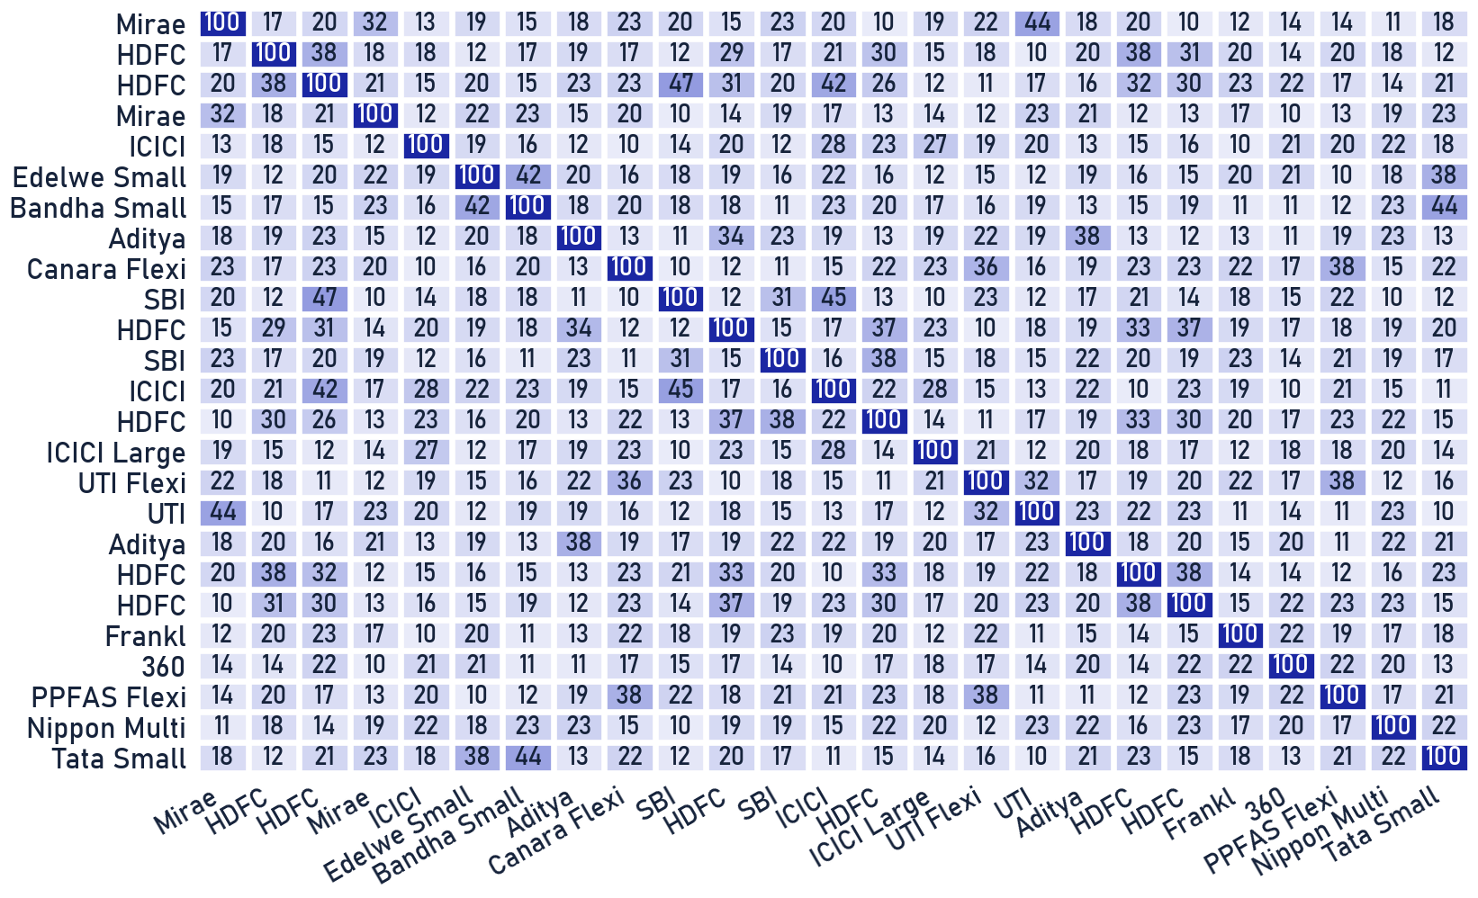
Private & Confidential
03 · THE FUND BOOK
Scheme overlap & redundancy
Where funds re-buy the same exposure
HOW TO READ IT
Each cell is the weighted common holding between two schemes: OVERLAP(A,B) = Σ min(w-A, w-B). Darker = more duplication · you pay two active fees for one underlying exposure.
ILLUSTRATIVE, NOT FINAL
These values are illustrative. The exact map needs each fund's point-in-time look-through holdings, which we build from the funds' published portfolio disclosures.
Illustrative overlap placeholder · full pairwise look-through pending the funds' published portfolio disclosures. MF sleeve only.
Portfolio Review · 25

Slide 26
Private & Confidential
03 · FUNDS
Fund actions
Every action is structural, never a performance sale
No fund here is sold on performance alone. Each action is structural: mandate, cost, scale or consistency. Where a scheme mostly re-buys index names you already hold directly, the cleaner replacement is a low-cost index sleeve (Nifty 50 / Nifty 500 class) rather than paying an active fee twice.
SELL
HDFC NIFTY 50 Index - Direct
SELL
SBI Gilt - Direct Plan
SELL
HDFC Overnight - Direct Plan
structural
structural
structural
Tracking is clean, the gap versus benchmark is essentially just the expense ratio.
Sitting exactly on the category median on performance…
Tracking the overnight category within the expected ~0.1-0.6pp drag at 0.11% TER on performance , …
SELL
Aditya Birla Sun Life Regular
SELL
HDFC Gilt - Direct Plan
structural
structural
Ahead ~2.4pp/3y, ~3.5pp/1y on performance. Sell reflects the Principal's 2026-07-29 client-specific…
A whisker above category median both windows on performance, held alongside SBI Gilt Fund, same…
SELL
HDFC Hybrid Debt - Direct Plan
SELL
HDFC Floating Rate Debt - Direct
structural
structural
Ahead ~1.75pp/3y vs its own stated benchmark on performance.
Sell reflects the Principal's 2026-07-29 client-specific instruction to exit all…
Category exemplar = the fund our quality framework ranks best in the category, used as the measuring stick, not a recommendation to buy it. Whether a replacement is named is a compliance decision.
Portfolio Review · 26

Slide 27

Private & Confidential
04
SECTION 04
What We Would Do
The calls, the cost and the tax
House-view fit
Tax impact
Your priority actions

Slide 28
Private & Confidential
04 · RECOMMENDATIONS
House-view fit
Where the plan aligns with Ionic's positioning · and where a gap stays open
Each recommendation, checked against how Ionic is currently positioned.
DIMENSION
IONIC HOUSE VIEW
WHAT THE PLAN DOES
FIT
Domestic equity
Incrementally positive
14 equity name(s) sold on quality/value grounds; no position currently sits far enough over guideline to warrant a trim.
ALIGNED
Foreign equity
~15% target, under-owned
No foreign sleeve funded yet, proceeds are held in cash pending your goals and IPS discussion.
GAP
Gold & silver
Positive, 75:25
No gold/silver sleeve funded yet, proceeds are held in cash pending your goals and IPS discussion.
GAP
Momentum
On hold
No momentum chase, every sell/hold call here is fundamentals-driven, not a price-trend call.
ALIGNED
Low-vol / value
Favoured
No redeployment sleeve funded yet, proceeds are held in cash pending your goals and IPS discussion.
GAP
READ
The plan pulls the book toward the house view where it is off. Two gaps stay open by design, foreign and gold are built in steps, not funded in a single cycle.
Ionic house view · as of 2026-07-27.
Portfolio Review · 28

Slide 29
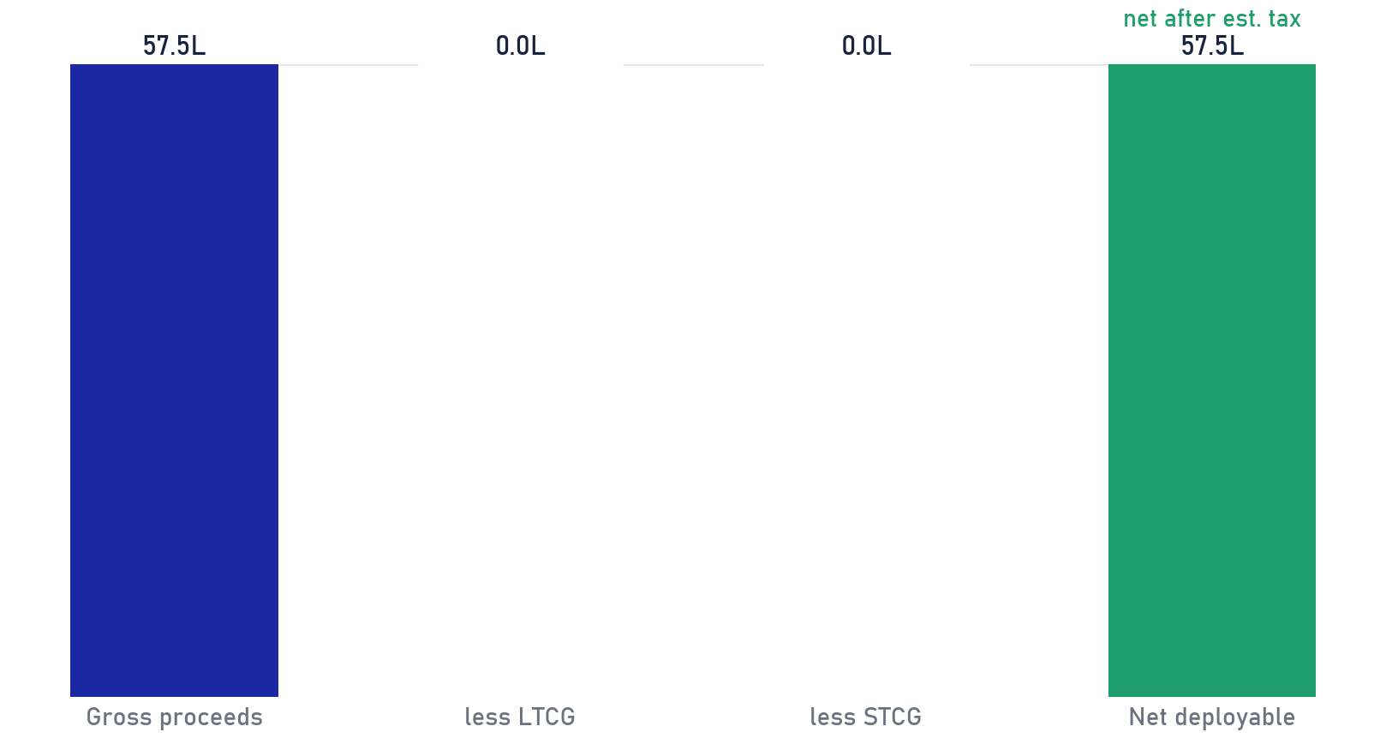
Private & Confidential
04 · RECOMMENDATIONS
Tax impact of this plan
What the recommended moves trigger · before you authorise anything
MUTUAL-FUND ACTIONS · EST. TAX CHARACTER PER MOVE
DIRECT-EQUITY SELLS & TRIMS · NET OF EST. TAX
ACTION
SCHEME
AMOUNT
TAX CHARACTER
EXIT
HDFC NIFTY 50 Index - Direct
Rs 7.8 L
LTCG (assumed)
EXIT
Aditya Birla Sun Life Regular
Rs 4.0 L
LTCG (assumed)
EXIT
HDFC Hybrid Debt - Direct Plan
Rs 2.6 L
LTCG (assumed)
EXIT
SBI Gilt - Direct Plan
Rs 2.4 L
LTCG (assumed)
EXIT
HDFC Gilt - Direct Plan
Rs 2.0 L
LTCG (assumed)
EXIT
HDFC Floating Rate Debt
Rs 0.0 L
LTCG (assumed)
EXIT
HDFC Overnight - Direct Plan
Rs 0.0 L
LTCG (assumed)
Total fund actions
Rs 18.8 L
Net after est. tax feeds the deployment plan.
DIRECT-EQUITY TAX: ESTIMATE FOR NOW
LONG-HELD UNITS: A HIGHER BAR TO SELL
The 15 sell-list shares net to a real LOSS (Rs 1.94L), equity tax is clearly Rs0. The 7 fund exits: LTCG assumed (no cost data), confirm with your adviser.
Units held >5y (>10y more so) carry gains that offset switching alpha; their bar rises to structural-only. Stocks get no such pass.
Left: mutual-fund actions. Right: direct-equity sell/trim plan. Tax characterisations are indicative and preliminary, confirm holding period, character and applicable rates with the client's tax adviser before dealing. Illustrative.
Portfolio Review · 29

Slide 30
Private & Confidential
04 · RECOMMENDATIONS
Your priority actions
What we'd do next · in order, with amounts
Rs 57.5 L
7
Rs 57.5 L
GROSS FREED
FUND ACTIONS
NET PROCEEDS
sells + trim
exit
to cash, after est. tax
1
Sell programme
Rs 33.3 L
14 names scored below the gate, staged in slices at <=10% ADV.
WAVE 1
p.15
2
Trim concentration
Rs 5.4 L
Positions above the 8% single-name guideline eased or exited, into strength.
THIS CYCLE
p.08
3
Fund actions
Rs 18.8 L
7 exits; every destination is a Direct-plan or passive vehicle.
T+2–T+3
p.26
4
Park net proceeds
Rs 57.5 L
Held in liquid / overnight funds pending your goals and IPS discussion; no redeployment is assumed or recommended here.
ON AUTHORISATION
AUTHORISATION Nothing executes until you authorise it, this is a Non-Discretionary (NDPMS) mandate.
Reviewed with client on ____________________
Net figures after estimated tax · as of 2026-07-27.
Portfolio Review · 30

Slide 31
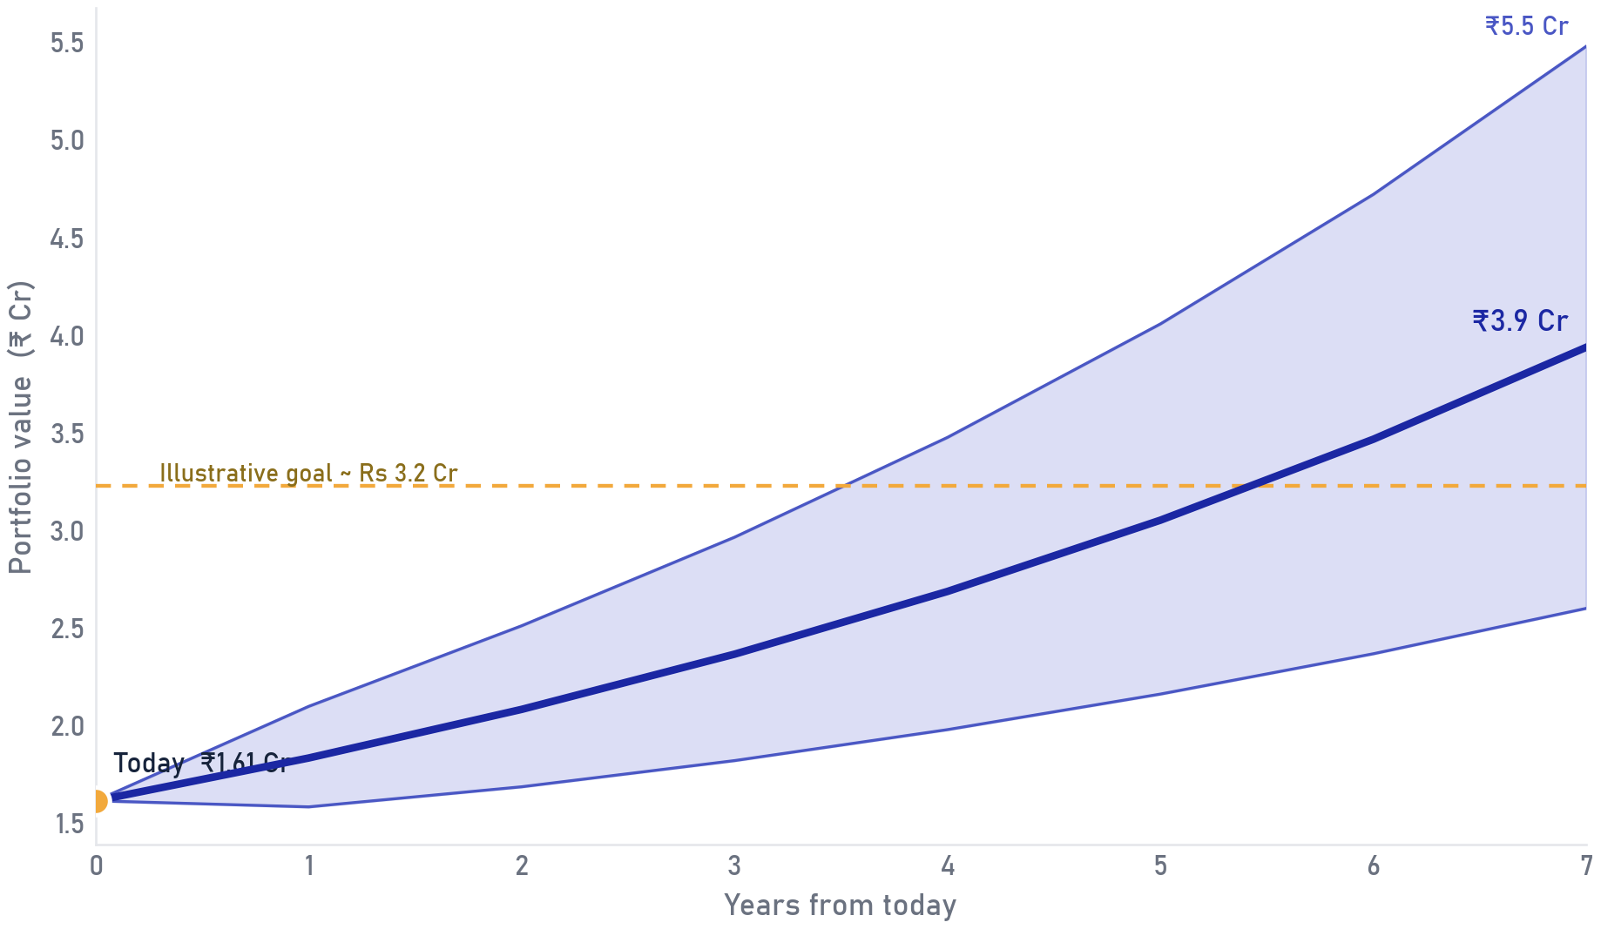
Private & Confidential
04 · RECOMMENDATIONS
Growth projection
An illustrative path for the portfolio over the horizon
ASSUMPTIONS
Median path from ₹1.61 Cr at 13.6% p.a. and 11.0% volatility over 7 years, derived from this book's own holdings-weighted growth and fund track record, not a fixed assumption. The dashed line is an illustrative wealth goal.
READ THE BAND
Read the band, not the line: the shaded area is the 10th-to-90th-percentile range. Outcomes compound path-dependently and will differ from any single number.
Illustrative projection on assumed return/volatility; not a forecast, guarantee, or indication of future returns. Actual outcomes will differ.
Portfolio Review · 31

Slide 32
Private & Confidential
04 · RECOMMENDATIONS
Data & coverage notes
What this review could not score as a normal Sell/Hold call
SCOPE These positions sit outside the normal scored tables, folding them in would distort every comparison.
LEGACY HOLDINGS, SUSPENDED OR UNDER INSOLVENCY
HOLDING
STATUS
STATEMENT VALUE
WHAT WE'D DO
Parekh Aluminex Ltd.
Liquidated (NCLT, since 2020)
Rs 36,825 (not realisable)
Write off. NSE compulsorily delisted 27-Jul-2018 after CIRP admission (20-Dec-2017); IBBI liquidation order 07-Oct-2020, still in liquidation as of Mar-2025.
Balasore Alloys Ltd.
Suspended / under insolvency
Rs 528 (not realisable)
Write off, pending RM/client communication. Trading suspended on BSE since 13-Dec-2021 (non-payment of listing fees); fresh insolvency case admitted by NCLT 12-Jun-2025.
Value Industries Ltd.
Suspended / under insolvency
Rs 760 (not realisable)
Write off, pending RM/client communication. Former Videocon Appliances entity; consolidated CIRP since Sep-2018, still unresolved as of May-2026 NCLAT order.
FUNDS BELOW OUR MINIMUM TRACK RECORD, "NO VIEW"
HOLDING
CATEGORY
WHY NO VIEW
JioBlackRock Flexi Cap Fund - Direct Plan
Flexi Cap
Brand-new fund (JioBlackRock JV), under our house minimum of 7 months' live track record before any fund gets a Sell/Hold view. No performance view given yet; re-review once it crosses 7 months live.
Suspended/insolvent status and fund launch dates verified against public listing/exchange records at the time of this review; re-confirm before any client communication that depends on them.
The Ionic Score flags candidates; the Portfolio Review team confirms every call.
Portfolio Review · 32

Slide 33
Private & Confidential
04 · RECOMMENDATIONS
Data & coverage notes
Other data-quality flags from this statement
SCOPE Flagged rather than silently resolved, each needs RM or client confirmation.
FLAG 1
MF header carries Rs 8,61,415.04, per RM, a total-of-funds figure, but it doesn't match the real fund sum (Rs 94.2L); excluded as an unexplained outlier. HDFC Overnight Fund's value is blank on the statement, shown as Sell at Rs0 pending confirmation.
FLAG 2
Per the Principal's 2026-07-29 client-specific instruction, all liquid/debt/arbitrage and debt-dominant conservative-hybrid holdings are exited to cash: SBI Gilt, HDFC Gilt, HDFC Overnight, Aditya Birla Regular Savings, HDFC Hybrid Debt, plus the pre-existing HDFC NIFTY 50 Index and HDFC Floating…
FLAG 3
Equity gain/loss uses real Invested Value from the statement, a real loss, zero tax. The 7 fund exits have no cost-basis data at all; LTCG is assumed per house convention (not computed), confirm with your tax adviser.
Confirm each item with the RM/client before it affects any execution decision.
Scores flag, people decide: each call here carries a named reviewer's sign-off.
Portfolio Review · 33

Slide 34

Private & Confidential
05
SECTION 05
Annexure
Detail and frameworks, on request
Before and after
Holding spotlights
All holdings, scored
Sell rationale cards

Slide 35
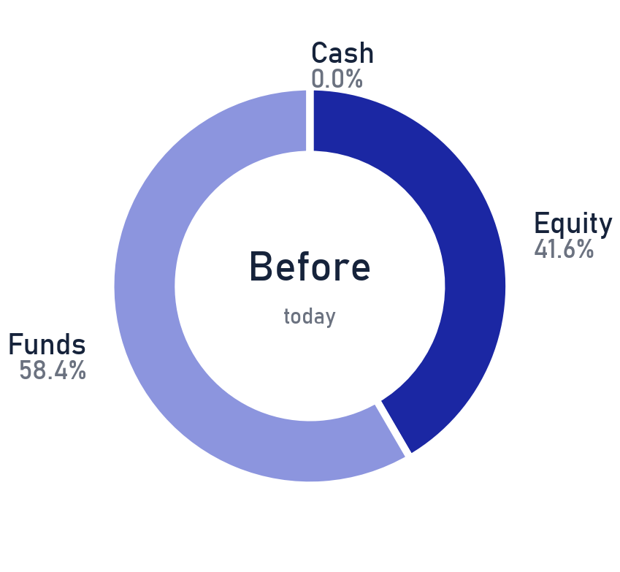
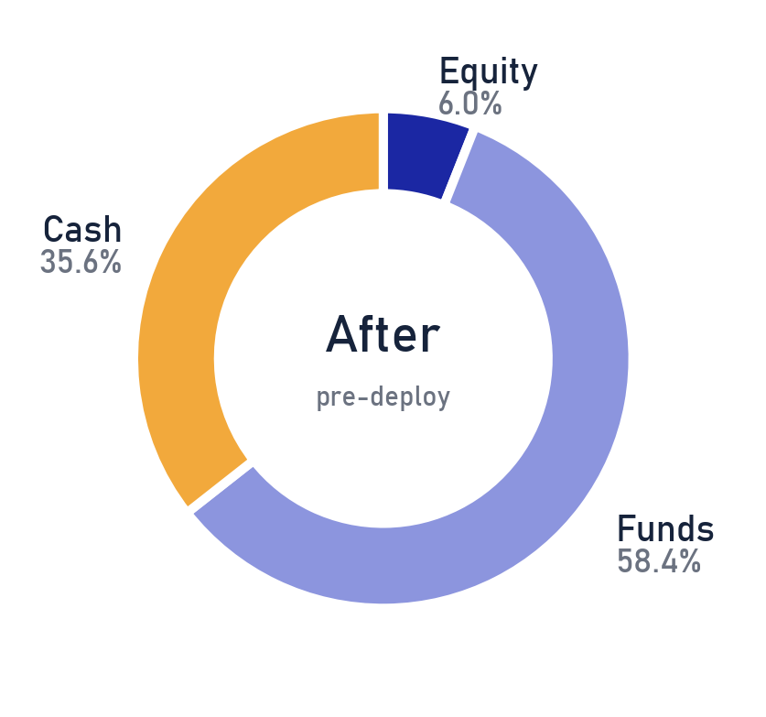
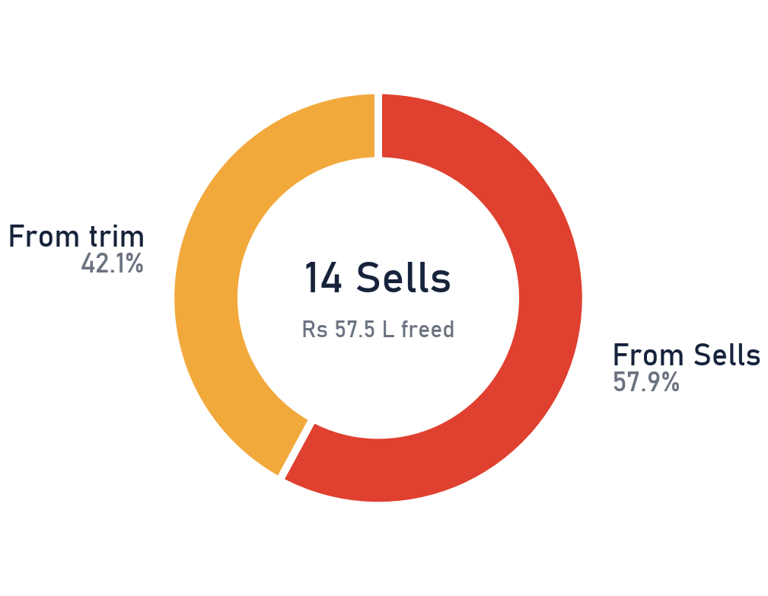
Private & Confidential
05 · ANNEXURE
Before and after
What the book looks like once the sells and trims settle · cash freed, not redeployed
ASSET MIX, TODAY
AFTER SELLS (PRE-DEPLOY)
PROCEEDS to CASH
FREED CASH
Rs 57.5 L is freed to cash after execution and stays in cash until deployment is agreed separately, never auto-invested; the staging framework sits on the previous page.
Fund switches are like-for-like within the fund sleeve, so the mix above moves only with equity sells and the trim. Direct-equity only for the sell/trim step; as of 2026-07-27.
Portfolio Review · 35

Slide 36
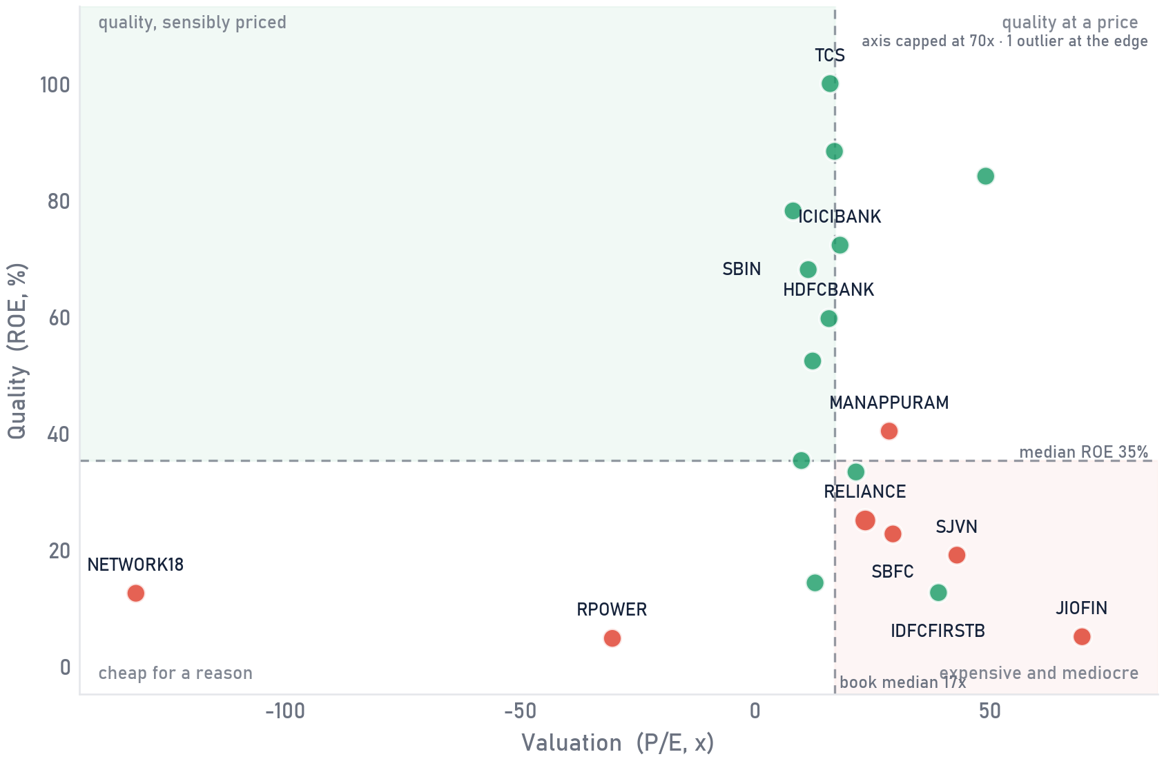
Private & Confidential
05 · ANNEXURE
Quality vs price
Every holding on quality against valuation
SCOPE Direct equity only · as of 2026-07-27
HOW TO READ IT
Right = pricier (higher P/E). Up = higher quality (higher ROE). Bubble size = position size in the book. The sweet spot is top-left · quality you are not overpaying for.
THE CALL
Hold
Sell
19 of 27 holdings shown (names with a reported P/E and ROE). Bubble colour = current call; the largest positions and every Sell are named; dashed lines = book medians.
Portfolio Review · 36

Slide 37
Private & Confidential
05 · ANNEXURE
Spotlight
Reliance Industries Ltd. · Oil Gas & Consumable Fuels · 17.9% of the book
IONIC SCORE
OUR READ
27
Bottom-quartile on quality and value versus large-cap peers; momentum has turned negative even as segment EBITDA hit a record.
27
3Y 27 · 1Y 32
SELL
Large-cap · Exit
THE CALL, SELL
Exit, the forward risk/reward no longer justifies the position. Driver: Quality below peers.
BACK TO THE BOOK · p.13
Ionic Score is a quantitative input; the Portfolio Review team confirms every call. Point-in-time as of 2026-07-21.
Scores flag, people decide: each call here carries a named reviewer's sign-off.
Portfolio Review · 37

Slide 38
Private & Confidential
05 · ANNEXURE
Spotlight
HDFC Bank Ltd. · Financial Services · 10.6% of the book
IONIC SCORE
OUR READ
53
Scores 53/100 on our quality/value/momentum framework, comfortably within our Hold range; no changes recommended this review.
53
3Y 53 · 1Y 50
HOLD
Large-cap · Watch
THE CALL, HOLD
Keep the position (Watch conviction).
BACK TO THE BOOK · p.13
Ionic Score is a quantitative input; the Portfolio Review team confirms every call. Point-in-time as of 2026-07-21.
The score is the starting point; the final word on every name belongs to the desk.
Portfolio Review · 38

Slide 39
Private & Confidential
05 · ANNEXURE
Spotlight
Tata Consultancy Services Ltd. · Information Technology · 8.7% of the book
IONIC SCORE
OUR READ
51
Scores 51/100 on our quality/value/momentum framework, comfortably within our Hold range; no changes recommended this review.
51
3Y 51 · 1Y 49
HOLD
Large-cap · Watch
THE CALL, HOLD
Keep the position (Watch conviction).
BACK TO THE BOOK · p.13
Ionic Score is a quantitative input; the Portfolio Review team confirms every call. Point-in-time as of 2026-07-21.
Numbers shortlist, judgment decides: every call passed a human review.
Portfolio Review · 39

Slide 40
Private & Confidential
05 · ANNEXURE
All holdings, scored
The whole book, scored (page 1 of 2)
SCOPE Direct equity only · as of 2026-07-27
HOLDING
SECTOR
WT %
IONIC
3Y
1Y
CALL
RELIANCE
Oil & Gas
17.95
27
27
32
SELL
HDFCBANK
Financials
10.59
53
53
50
HOLD
TCS
IT
8.74
51
51
49
HOLD
JIOFIN
Financials
1.75
38
38
38
SELL
ICICIBANK
Financials
0.49
59
59
54
HOLD
SBIN
Financials
0.32
70
70
50
HOLD
SBFC
Financials
0.29
26
26
41
SELL
IDFCFIRSTB
Financials
0.25
50
50
48
HOLD
RITAFIN
Financial Services
0.21
15
15
15
SELL
TATASTEEL
Metals & Mining
0.17
51
51
32
HOLD
MANAPPURAM
Financials
0.11
45
45
39
SELL
NTPC
Power
0.11
45
45
33
HOLD
MAHABANK
Financials
0.10
79
79
63
HOLD
LANCORHOL
Realty
0.08
28
28
28
SELL
SUMMITSEC
Financial Services
0.07
30
30
30
SELL
BEL
Industrials
0.07
58
58
47
HOLD
IDBI
Financials
0.05
52
52
47
HOLD
NETWORK18
Media
0.05
22
22
22
SELL
The Ionic Score flags candidates; the Portfolio Review team confirms every call.
Portfolio Review · 40

Slide 41
Private & Confidential
05 · ANNEXURE
All holdings, scored
The whole book, scored (page 2 of 2)
SCOPE Direct equity only · as of 2026-07-27
HOLDING
SECTOR
WT %
IONIC
3Y
1Y
CALL
MOSCHIP
IT
0.04
18
18
18
SELL
MOVALUE
Passive/Factor ETF
0.04
35
35
35
HOLD
SJVN
Power
0.03
31
31
29
SELL
MUFIN
Financials
0.02
20
20
20
SELL
MOM30IETF
Passive/Factor ETF
0.02
35
35
35
SELL
UCOBANK
Financials
0.02
43
43
44
HOLD
PRAGBOSIMI
Textiles/Chemicals
0.01
5
5
5
SELL
ITC
FMCG
0.01
60
60
45
HOLD
RPOWER
Power
0.00
38
38
31
SELL
Scores flag, people decide: each call here carries a named reviewer's sign-off.
Portfolio Review · 41

Slide 42
Private & Confidential
05 · ANNEXURE
Sell rationale
Reliance Industries Ltd. · Quality below peers
IONIC SCORE
27
27
3Y 27 · 1Y 32 · 17.95% of book
SELL
WHY IT'S ON THE SELL LIST
THE BULL WE REJECTED
Bottom-quartile on quality and value versus large-cap peers; momentum has turned negative even as segment EBITDA hit a record.
On file with the analyst desk.
REVERSE-DCF: MARGIN OF SAFETY
WHAT WOULD CHANGE OUR MIND
On file with the analyst desk.
A durable step-up in ROE / margins back to peer level, sustained over several quarters.
BACK TO THE SELL LIST · p.15
Analyst-confirmed Sell. Point-in-time as of 2026-07-21.
The score is the starting point; the final word on every name belongs to the desk.
Portfolio Review · 42

Slide 43
Private & Confidential
05 · ANNEXURE
Sell rationale
Jio Financial Services Ltd. · Rich valuation, thin margin of safety
IONIC SCORE
38
38
3Y 38 · 1Y 38 · 1.75% of book
SELL
WHY IT'S ON THE SELL LIST
THE BULL WE REJECTED
Priced at ~1.1x book for a ~14% normalised return on equity the business is currently earning only 1-2% of, leaving little margin of safety.
On file with the analyst desk.
REVERSE-DCF: MARGIN OF SAFETY
WHAT WOULD CHANGE OUR MIND
On file with the analyst desk.
A valuation reset (through time or price) that restores a real margin of safety at our reverse-DCF hurdle.
BACK TO THE SELL LIST · p.15
Analyst-confirmed Sell. Point-in-time as of 2026-07-21.
Numbers shortlist, judgment decides: every call passed a human review.
Portfolio Review · 43

Slide 44
Private & Confidential
05 · ANNEXURE
Sell rationale
SBFC Finance Ltd. · Rich valuation, thin margin of safety
IONIC SCORE
26
26
3Y 26 · 1Y 41 · 0.29% of book
SELL
WHY IT'S ON THE SELL LIST
THE BULL WE REJECTED
Fundamentals are intact, profit up ~29% YoY, asset quality stable, but at ~29x earnings the stock isn't cheap enough to justify holding through the recent price fall.
On file with the analyst desk.
REVERSE-DCF: MARGIN OF SAFETY
WHAT WOULD CHANGE OUR MIND
On file with the analyst desk.
A valuation reset (through time or price) that restores a real margin of safety at our reverse-DCF hurdle.
BACK TO THE SELL LIST · p.15
Analyst-confirmed Sell. Point-in-time as of 2026-07-26.
The Ionic Score flags candidates; the Portfolio Review team confirms every call.
Portfolio Review · 44

Slide 45
Private & Confidential
05 · ANNEXURE
Sell rationale
Manappuram Finance Ltd. · Rich valuation, thin margin of safety
IONIC SCORE
45
45
3Y 45 · 1Y 39 · 0.11% of book
SELL
WHY IT'S ON THE SELL LIST
THE BULL WE REJECTED
Real tailwinds (a large institutional stake approval, easier gold-loan rules) are already more than priced in at ~29x earnings against revenue that is still falling.
On file with the analyst desk.
REVERSE-DCF: MARGIN OF SAFETY
WHAT WOULD CHANGE OUR MIND
On file with the analyst desk.
A valuation reset (through time or price) that restores a real margin of safety at our reverse-DCF hurdle.
BACK TO THE SELL LIST · p.15
Analyst-confirmed Sell. Point-in-time as of 2026-07-26.
Scores flag, people decide: each call here carries a named reviewer's sign-off.
Portfolio Review · 45

Slide 46
Private & Confidential
05 · ANNEXURE
Sell rationale
SJVN Ltd. · Balance-sheet strain
IONIC SCORE
31
31
3Y 31 · 1Y 29 · 0.03% of book
SELL
WHY IT'S ON THE SELL LIST
THE BULL WE REJECTED
A large expansion programme (over 5,000MW under construction against ~3,100MW already live) is funded at a stretched debt-to-equity of ~2.3x, while the stock trades near 43x earnings, priced for flawless execution.
On file with the analyst desk.
REVERSE-DCF: MARGIN OF SAFETY
WHAT WOULD CHANGE OUR MIND
On file with the analyst desk.
Genuine deleveraging · interest cover back above our comfort level and net-debt/EBITDA normalising toward peers.
BACK TO THE SELL LIST · p.15
Analyst-confirmed Sell. Point-in-time as of 2026-07-26.
The score is the starting point; the final word on every name belongs to the desk.
Portfolio Review · 46

Slide 47
Private & Confidential
05 · ANNEXURE
Sell rationale
Reliance Power Ltd. · Weaker forward risk-reward
IONIC SCORE
38
38
3Y 38 · 1Y 31 · 0.00% of book
SELL
WHY IT'S ON THE SELL LIST
THE BULL WE REJECTED
The weakest quality score of the names reviewed, negative earnings, three years of flat revenue and a 62% price decline over the past year; balance-sheet risk flagged.
On file with the analyst desk.
REVERSE-DCF: MARGIN OF SAFETY
WHAT WOULD CHANGE OUR MIND
On file with the analyst desk.
A better forward risk/reward · a cheaper entry or a clear fundamental inflection.
BACK TO THE SELL LIST · p.15
Analyst-confirmed Sell. Point-in-time as of 2026-07-26.
Numbers shortlist, judgment decides: every call passed a human review.
Portfolio Review · 47

Slide 48
Private & Confidential
05 · ANNEXURE
Sell rationale
Rita Finance and Leasing Ltd. · Governance concern
IONIC SCORE
15
15
3Y 15 · 1Y 15 · 0.21% of book
SELL
WHY IT'S ON THE SELL LIST
THE BULL WE REJECTED
A very small listed entity (~Rs13cr market cap on ~Rs1.3cr of sales) with the large majority of promoter holding pledged and an exchange query on unusual price movement. Exit on limit orders, not market orders.
On file with the analyst desk.
REVERSE-DCF: MARGIN OF SAFETY
WHAT WOULD CHANGE OUR MIND
On file with the analyst desk.
A clean forensic re-audit · related-party / pledge / governance concerns resolved and two consecutive clean reporting cycles.
BACK TO THE SELL LIST · p.15
Analyst-confirmed Sell. Point-in-time as of 2026-07-27.
The Ionic Score flags candidates; the Portfolio Review team confirms every call.
Portfolio Review · 48

Slide 49
Private & Confidential
05 · ANNEXURE
Sell rationale
Lancor Holdings Ltd. · Weaker forward risk-reward
IONIC SCORE
28
28
3Y 28 · 1Y 28 · 0.08% of book
SELL
WHY IT'S ON THE SELL LIST
THE BULL WE REJECTED
Reported profit is being carried almost entirely by a one-off litigation recovery, not the underlying business, core operating margin has collapsed and working-capital days have blown out.
On file with the analyst desk.
REVERSE-DCF: MARGIN OF SAFETY
WHAT WOULD CHANGE OUR MIND
On file with the analyst desk.
A better forward risk/reward · a cheaper entry or a clear fundamental inflection.
BACK TO THE SELL LIST · p.15
Analyst-confirmed Sell. Point-in-time as of 2026-07-27.
Scores flag, people decide: each call here carries a named reviewer's sign-off.
Portfolio Review · 49

Slide 50
Private & Confidential
05 · ANNEXURE
Sell rationale
Summit Securities Ltd. · Weaker forward risk-reward
IONIC SCORE
30
30
3Y 30 · 1Y 30 · 0.07% of book
SELL
WHY IT'S ON THE SELL LIST
THE BULL WE REJECTED
A holding company trading at a steep discount to its investment book with no debt, but no catalyst to close that discount and no dividend history, too small a position to justify the wait.
On file with the analyst desk.
REVERSE-DCF: MARGIN OF SAFETY
WHAT WOULD CHANGE OUR MIND
On file with the analyst desk.
A better forward risk/reward · a cheaper entry or a clear fundamental inflection.
BACK TO THE SELL LIST · p.15
Analyst-confirmed Sell. Point-in-time as of 2026-07-27.
The score is the starting point; the final word on every name belongs to the desk.
Portfolio Review · 50

Slide 51
Private & Confidential
05 · ANNEXURE
Sell rationale
Network18 Media & Investments Ltd. · Weaker forward risk-reward
IONIC SCORE
22
22
3Y 22 · 1Y 22 · 0.05% of book
SELL
WHY IT'S ON THE SELL LIST
THE BULL WE REJECTED
Still loss-making over the last two quarters with negative return on equity; the bull case rests on an unlisted media stake with no public valuation, a story, not yet a thesis.
On file with the analyst desk.
REVERSE-DCF: MARGIN OF SAFETY
WHAT WOULD CHANGE OUR MIND
On file with the analyst desk.
A better forward risk/reward · a cheaper entry or a clear fundamental inflection.
BACK TO THE SELL LIST · p.15
Analyst-confirmed Sell. Point-in-time as of 2026-07-27.
Numbers shortlist, judgment decides: every call passed a human review.
Portfolio Review · 51

Slide 52
Private & Confidential
05 · ANNEXURE
Sell rationale
MosChip Technologies Ltd. · Weaker forward risk-reward
IONIC SCORE
18
18
3Y 18 · 1Y 18 · 0.04% of book
SELL
WHY IT'S ON THE SELL LIST
THE BULL WE REJECTED
Trading at a rich ~129x earnings against an 11% return on equity, with promoter holding diluted through repeated share issuances and both revenue and profit declining quarter-on-quarter.
On file with the analyst desk.
REVERSE-DCF: MARGIN OF SAFETY
WHAT WOULD CHANGE OUR MIND
On file with the analyst desk.
A better forward risk/reward · a cheaper entry or a clear fundamental inflection.
BACK TO THE SELL LIST · p.15
Analyst-confirmed Sell. Point-in-time as of 2026-07-27.
The Ionic Score flags candidates; the Portfolio Review team confirms every call.
Portfolio Review · 52

Slide 53
Private & Confidential
05 · ANNEXURE
Sell rationale
Mufin Green Finance Ltd. · Weaker forward risk-reward
IONIC SCORE
20
20
3Y 20 · 1Y 20 · 0.02% of book
SELL
WHY IT'S ON THE SELL LIST
THE BULL WE REJECTED
A steep mismatch between price (~88x earnings) and quality (under 7% return on equity), with negative operating cash flow despite a reported accounting profit.
On file with the analyst desk.
REVERSE-DCF: MARGIN OF SAFETY
WHAT WOULD CHANGE OUR MIND
On file with the analyst desk.
A better forward risk/reward · a cheaper entry or a clear fundamental inflection.
BACK TO THE SELL LIST · p.15
Analyst-confirmed Sell. Point-in-time as of 2026-07-27.
Scores flag, people decide: each call here carries a named reviewer's sign-off.
Portfolio Review · 53

Slide 54
Private & Confidential
05 · ANNEXURE
Sell rationale
Prag Bosimi Synthetics Ltd. · Weaker forward risk-reward
IONIC SCORE
5
5
3Y 5 · 1Y 5 · 0.01% of book
SELL
WHY IT'S ON THE SELL LIST
THE BULL WE REJECTED
Negative net worth and negative return on capital, and the company's own auditors have flagged material doubt over its ability to continue as a going concern.
On file with the analyst desk.
REVERSE-DCF: MARGIN OF SAFETY
WHAT WOULD CHANGE OUR MIND
On file with the analyst desk.
A better forward risk/reward · a cheaper entry or a clear fundamental inflection.
BACK TO THE SELL LIST · p.15
Analyst-confirmed Sell. Point-in-time as of 2026-07-27.
The score is the starting point; the final word on every name belongs to the desk.
Portfolio Review · 54

Slide 55
Private & Confidential
05 · ANNEXURE
Sell rationale
ICICI Prudential Nifty 200 Momentum 30 ETF · Weaker forward risk-reward
IONIC SCORE
35
35
3Y 35 · 1Y 35 · 0.02% of book
SELL
WHY IT'S ON THE SELL LIST
THE BULL WE REJECTED
A liquid, well-tracked momentum ETF; momentum factors carry a regime-dependent risk our house view treats as a standing exception, so this one stays a Sell while other factor funds in this account are Held.
On file with the analyst desk.
REVERSE-DCF: MARGIN OF SAFETY
WHAT WOULD CHANGE OUR MIND
On file with the analyst desk.
A better forward risk/reward · a cheaper entry or a clear fundamental inflection.
BACK TO THE SELL LIST · p.15
Analyst-confirmed Sell. Point-in-time as of 2026-07-27.
Numbers shortlist, judgment decides: every call passed a human review.
Portfolio Review · 55

Slide 56
Private & Confidential
05 · ANNEXURE
Scheme scorecard
HDFC Hybrid Equity Fund - Direct Plan
WATCH
33
D
n/a
n/a
n/a
-3.6%
FUND SCORE / 100
GRADE
UP-CAPTURE
DOWN-CAPTURE
3Y HIT-RATE
NET ALPHA P.A.
r² n/a · Info ratio n/a · Max DD (3y) -12.6% · Worst 1-yr -7.8% · Sortino 1.01 · Calmar 0.55 · TER 0.55%
Measured against NIFTY 50 Hybrid Composite Debt 65:35 · all risk stats on the common 3-year window
WHY WE ACT
OUR READ
Behind 3.6pp/3y and 5.7pp/1y, the clearest laggard in the book.
Our read is Watch. Net alpha -3.6% p.a., down-capture n/a%, worst year -7.8%. Max drawdown on record: -12.6%.
Direct-plan NAV vs the scheme's own SEBI category benchmark (TRI), point-in-time · risk stats on the common 3y window · Ionic fund-quality framework.
Portfolio Review · 56

Slide 57
Private & Confidential
05 · ANNEXURE
Scheme scorecard
Aditya Birla Sun Life Regular Savings Fund - Direct Plan
SELL
61
B
n/a
n/a
n/a
+2.4%
FUND SCORE / 100
GRADE
UP-CAPTURE
DOWN-CAPTURE
3Y HIT-RATE
NET ALPHA P.A.
r² n/a · Info ratio n/a · Max DD (3y) -3.0% · Worst 1-yr 4.1% · Sortino 4.17 · Calmar 3.05 · TER 0.55%
Measured against NIFTY 50 Hybrid Composite Debt 15:85 · all risk stats on the common 3-year window
WHY WE ACT
OUR READ
Ahead ~2.4pp/3y, ~3.5pp/1y on performance. Sell reflects the Principal's 2026-07-29 client-specific instruction to exit all liquid/debt/arbitrage and debt-dominant conservative-hybrid holdings to cash, not a quality concern with the scheme.
Our read is Sell. Net alpha +2.4% p.a., down-capture n/a%, worst year +4.1%. Max drawdown on record: -3.0%.
Direct-plan NAV vs the scheme's own SEBI category benchmark (TRI), point-in-time · risk stats on the common 3y window · Ionic fund-quality framework.
Portfolio Review · 57

Slide 58
Private & Confidential
05 · ANNEXURE
Scheme scorecard
HDFC Hybrid Debt Fund - Direct Plan
SELL
56
B
n/a
n/a
n/a
+1.7%
FUND SCORE / 100
GRADE
UP-CAPTURE
DOWN-CAPTURE
3Y HIT-RATE
NET ALPHA P.A.
r² n/a · Info ratio n/a · Max DD (3y) -3.6% · Worst 1-yr -0.2% · Sortino 3.19 · Calmar 2.24 · TER 0.55%
Measured against NIFTY 50 Hybrid Composite Debt 15:85 · all risk stats on the common 3-year window
WHY WE ACT
OUR READ
Ahead ~1.75pp/3y vs its own stated benchmark on performance. Sell reflects the Principal's 2026-07-29 client-specific instruction to exit all liquid/debt/arbitrage and debt-dominant conservative-hybrid holdings to cash, not a quality concern with the scheme.
Our read is Sell. Net alpha +1.7% p.a., down-capture n/a%, worst year -0.2%. Max drawdown on record: -3.6%.
Direct-plan NAV vs the scheme's own SEBI category benchmark (TRI), point-in-time · risk stats on the common 3y window · Ionic fund-quality framework.
Portfolio Review · 58

Slide 59
Private & Confidential
05 · ANNEXURE
Scheme scorecard
SBI Gilt Fund - Direct Plan
SELL
50
C
n/a
n/a
n/a
+0.0%
FUND SCORE / 100
GRADE
UP-CAPTURE
DOWN-CAPTURE
3Y HIT-RATE
NET ALPHA P.A.
r² n/a · Info ratio n/a · Max DD (3y) -3.2% · Worst 1-yr 0.0% · Sortino 4.04 · Calmar 2.14 · TER 0.55%
Measured against Gilt category median · all risk stats on the common 3-year window
WHY WE ACT
OUR READ
Sitting exactly on the category median on performance (CRISIL Dynamic Gilt index return unpublished; category median of 22 direct-growth gilt schemes substituted, disclosed). Sell reflects the Principal's 2026-07-29 client-specific instruction to exit all liquid/debt/arbitrage holdings to cash, not a quality concern with the scheme.
Our read is Sell. Net alpha +0.0% p.a., down-capture n/a%, worst year +0.0%. Max drawdown on record: -3.2%.
Direct-plan NAV vs the scheme's own SEBI category benchmark (TRI), point-in-time · risk stats on the common 3y window · Ionic fund-quality framework.
Portfolio Review · 59

Slide 60
Private & Confidential
05 · ANNEXURE
Scheme scorecard
HDFC Gilt Fund - Direct Plan
SELL
50
C
n/a
n/a
n/a
+0.1%
FUND SCORE / 100
GRADE
UP-CAPTURE
DOWN-CAPTURE
3Y HIT-RATE
NET ALPHA P.A.
r² n/a · Info ratio n/a · Max DD (3y) -3.0% · Worst 1-yr -0.8% · Sortino 4.00 · Calmar 2.32 · TER 0.55%
Measured against Gilt category median · all risk stats on the common 3-year window
WHY WE ACT
OUR READ
A whisker above category median both windows on performance, held alongside SBI Gilt Fund, same category, same single risk factor (sovereign duration). Sell reflects the Principal's 2026-07-29 client-specific instruction to exit all liquid/debt/arbitrage holdings to cash, not a quality concern with either scheme.
Our read is Sell. Net alpha +0.1% p.a., down-capture n/a%, worst year -0.8%. Max drawdown on record: -3.0%.
Direct-plan NAV vs the scheme's own SEBI category benchmark (TRI), point-in-time · risk stats on the common 3y window · Ionic fund-quality framework.
Portfolio Review · 60

Slide 61
Private & Confidential
05 · ANNEXURE
Scheme scorecard
UTI Flexi Cap Fund - Direct Plan
WATCH
37
D
n/a
n/a
n/a
-3.3%
FUND SCORE / 100
GRADE
UP-CAPTURE
DOWN-CAPTURE
3Y HIT-RATE
NET ALPHA P.A.
r² n/a · Info ratio n/a · Max DD (3y) -20.1% · Worst 1-yr -10.2% · Sortino 1.03 · Calmar 0.46 · TER 0.55%
Measured against NIFTY 500 TRI · all risk stats on the common 3-year window
WHY WE ACT
OUR READ
Behind ~3.3pp/3y and ~3.1pp/1y; lags the flexi-cap category average (16.0%/3y) harder than it lags the index.
Our read is Watch. Net alpha -3.3% p.a., down-capture n/a%, worst year -10.2%. Max drawdown on record: -20.1%.
Direct-plan NAV vs the scheme's own SEBI category benchmark (TRI), point-in-time · risk stats on the common 3y window · Ionic fund-quality framework.
Portfolio Review · 61

Slide 62
Private & Confidential
05 · ANNEXURE
Scheme scorecard
UTI Mid Cap Fund - Direct Plan
WATCH
30
D
n/a
n/a
n/a
-5.3%
FUND SCORE / 100
GRADE
UP-CAPTURE
DOWN-CAPTURE
3Y HIT-RATE
NET ALPHA P.A.
r² n/a · Info ratio n/a · Max DD (3y) -22.7% · Worst 1-yr -8.5% · Sortino 1.22 · Calmar 0.60 · TER 0.55%
Measured against NIFTY Midcap 150 TRI · all risk stats on the common 3-year window
WHY WE ACT
OUR READ
Behind ~5.3pp/3y and ~3.7pp/1y; ranked 34th in category on 3y, the widest sustained gap in the equity sleeve.
Our read is Watch. Net alpha -5.3% p.a., down-capture n/a%, worst year -8.5%. Max drawdown on record: -22.7%.
Direct-plan NAV vs the scheme's own SEBI category benchmark (TRI), point-in-time · risk stats on the common 3y window · Ionic fund-quality framework.
Portfolio Review · 62

Slide 63
Private & Confidential
05 · ANNEXURE
Scheme scorecard
Aditya Birla Sun Life MNC Fund - Direct Plan
WATCH
25
D
n/a
n/a
n/a
-6.0%
FUND SCORE / 100
GRADE
UP-CAPTURE
DOWN-CAPTURE
3Y HIT-RATE
NET ALPHA P.A.
r² n/a · Info ratio n/a · Max DD (3y) -22.2% · Worst 1-yr -8.1% · Sortino 0.99 · Calmar 0.41 · TER 0.55%
Measured against Nifty MNC TRI · all risk stats on the common 3-year window
WHY WE ACT
OUR READ
Behind its own theme index by ~6pp on both windows, the shortfall is stock selection inside the theme, not the theme itself.
Our read is Watch. Net alpha -6.0% p.a., down-capture n/a%, worst year -8.1%. Max drawdown on record: -22.2%.
Direct-plan NAV vs the scheme's own SEBI category benchmark (TRI), point-in-time · risk stats on the common 3y window · Ionic fund-quality framework.
Portfolio Review · 63

Slide 64
Private & Confidential
05 · ANNEXURE
Scheme scorecard
HDFC Floating Rate Debt Fund - Direct Plan
SELL
50
C
n/a
n/a
n/a
n/a
FUND SCORE / 100
GRADE
UP-CAPTURE
DOWN-CAPTURE
3Y HIT-RATE
NET ALPHA P.A.
TER 0.55%
Measured against CRISIL Liquid Fund Index · full risk-stat battery not yet available for this scheme
WHY WE ACT
OUR READ
Sell reflects the Principal's 2026-07-29 client-specific instruction to exit all liquid/debt/arbitrage holdings to cash; not a concern with the scheme's mandate or management.
Our read is Sell, on portfolio construction rather than a performance call. Sell reflects the Principal's 2026-07-29 client-specific instruction to exit all liquid/debt/arbitrage holdings to cash; not a concern with the scheme's mandate or management.
Direct-plan NAV vs the scheme's own SEBI category benchmark (TRI), point-in-time · risk stats on the common 3y window · Ionic fund-quality framework.
Portfolio Review · 64

Slide 65
Private & Confidential
05 · ANNEXURE
Scheme scorecard
HDFC Overnight Fund - Direct Plan
SELL
49
C
n/a
n/a
n/a
-0.2%
FUND SCORE / 100
GRADE
UP-CAPTURE
DOWN-CAPTURE
3Y HIT-RATE
NET ALPHA P.A.
r² n/a · Info ratio n/a · Max DD (3y) 0.0% · Worst 1-yr 5.2% · Sortino n/a · Calmar n/a · TER 0.55%
Measured against Overnight category avg. · all risk stats on the common 3-year window
WHY WE ACT
OUR READ
Tracking the overnight category within the expected ~0.1-0.6pp drag at 0.11% TER on performance, cash parking was doing its job. Sell reflects the Principal's 2026-07-29 client-specific instruction to exit all liquid/debt/arbitrage holdings to cash, not a performance concern. NOTE: the value of this holding is MISSING from the client's statement, see DATA_GAPS.
Our read is Sell. Net alpha -0.2% p.a., down-capture n/a%, worst year +5.2%. Max drawdown on record: -0.0%.
Direct-plan NAV vs the scheme's own SEBI category benchmark (TRI), point-in-time · risk stats on the common 3y window · Ionic fund-quality framework.
Portfolio Review · 65

Slide 66
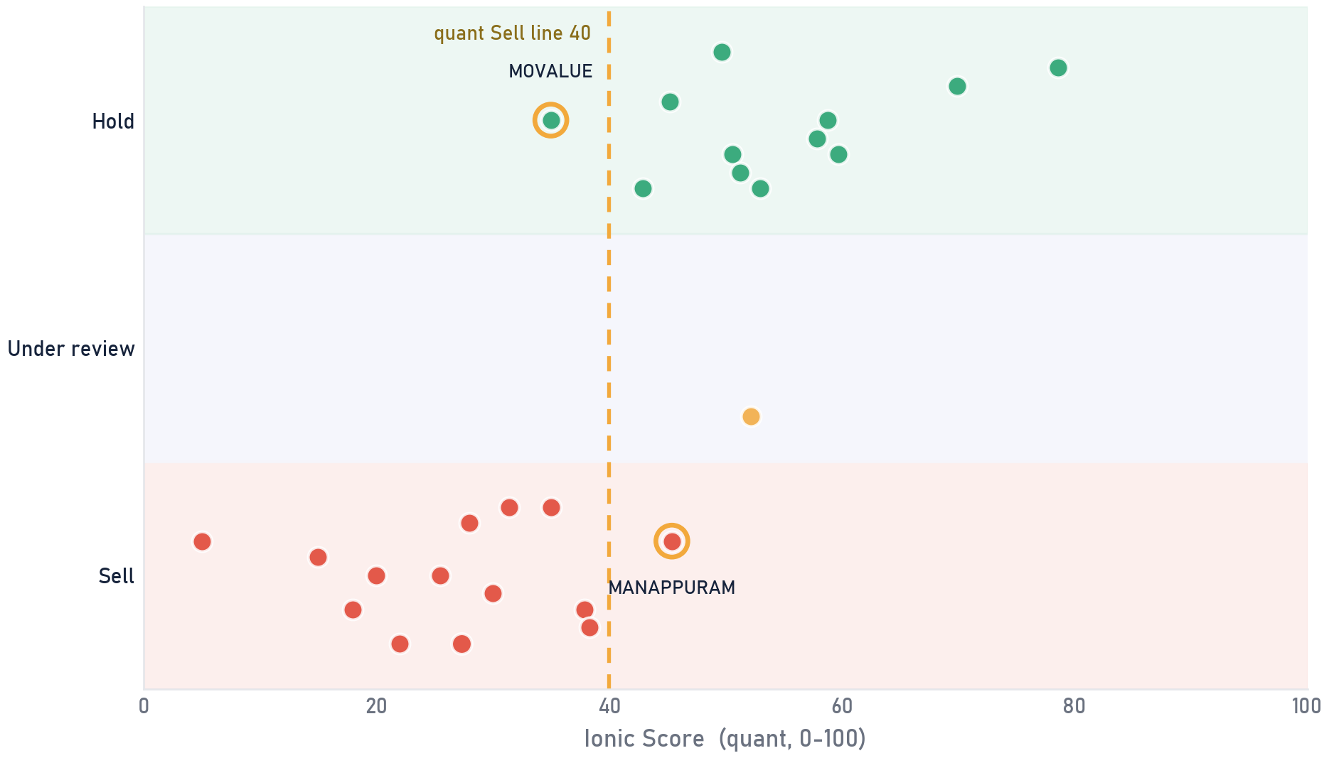
Private & Confidential
05 · ANNEXURE
Score vs final call
Where the human moved the machine
SCOPE All 27 direct equity holdings · quant score vs final analyst call · as of 2026-07-27
WHERE ANALYSTS OVERRULED THE MODEL
STOCK
SCORE
CALL
QUANT SAID
MOVALUE
35
HOLD
Sell zone
MANAPPURAM
45
SELL
Pass
2 CALLS MOVED, EACH DOCUMENTED
The quant score is a screen; a verdict needs a person. On 1 names the analyst holds a low scorer for reasons the model cannot see; on 1 the call is Sell despite a passing score. Every override carries a written rationale, on the record.
Bubble = position value · gold ring = the analyst moved away from the quant read
Ionic quant score (0-100, PIT 2026-07-21) vs final Portfolio Review call per holding; escalated Holds shown as Under review; overrides ringed in gold.
The score is the starting point; the final word on every name belongs to the desk.
Portfolio Review · 66

Slide 67
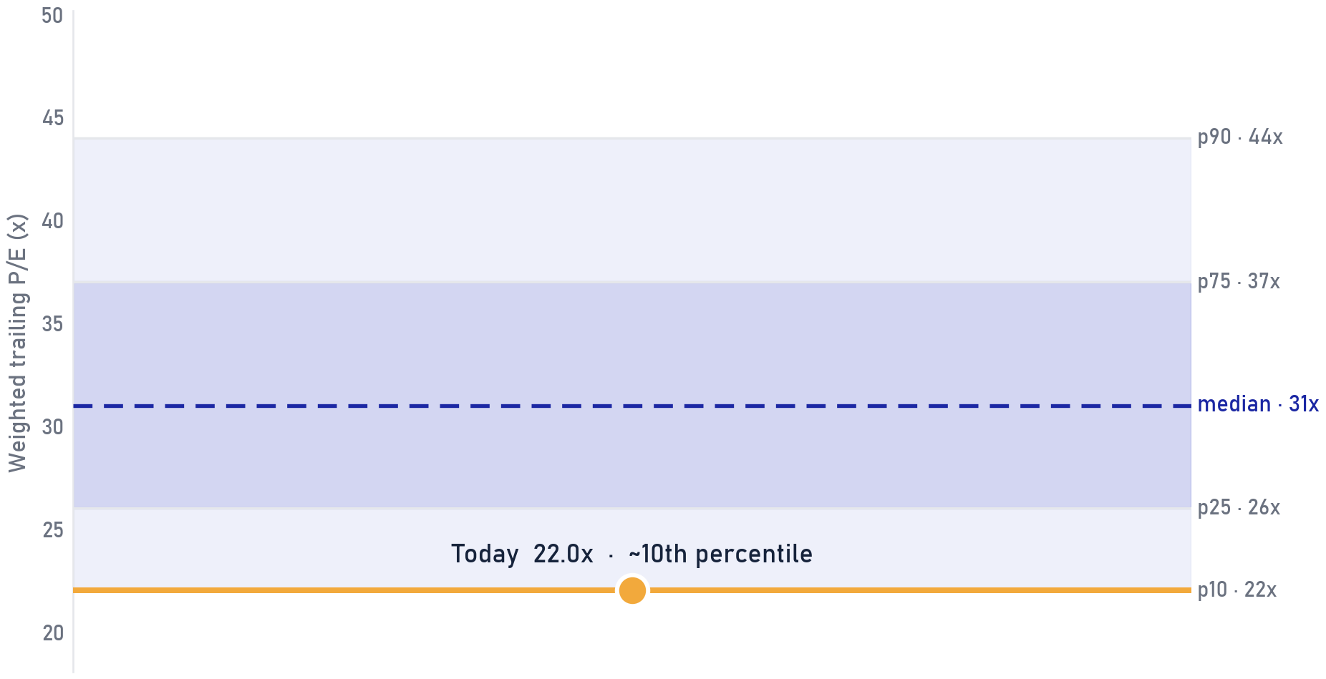
Private & Confidential
05 · ANNEXURE
Valuation check
The book's P/E against its own 10-year range
SCOPE Direct equity book · weighted trailing P/E on 41% of book weight (usable multiples below 150x) · band [ILLUSTRATIVE]
WHAT THIS SAYS
The weighted trailing P/E of the direct book is 22.0x, around the 10th percentile of the illustrative 10-year band for this sector blend. The starting multiple is the one return driver already known today, and it sits high.
WHAT IT DOES NOT SAY
A high percentile is not a timing signal: expensive books can stay expensive for years. What it does change is the margin of safety, so the bar for adding rises, the case for trimming the weakest scores strengthens, and staged deployment of new money matters more.
Weighted trailing P/E over the 41% of book weight with usable multiples (extremes above 150x excluded); 10-year percentile band is synthetic [ILLUSTRATIVE] pending index-blend history.
Portfolio Review · 67

Slide 68
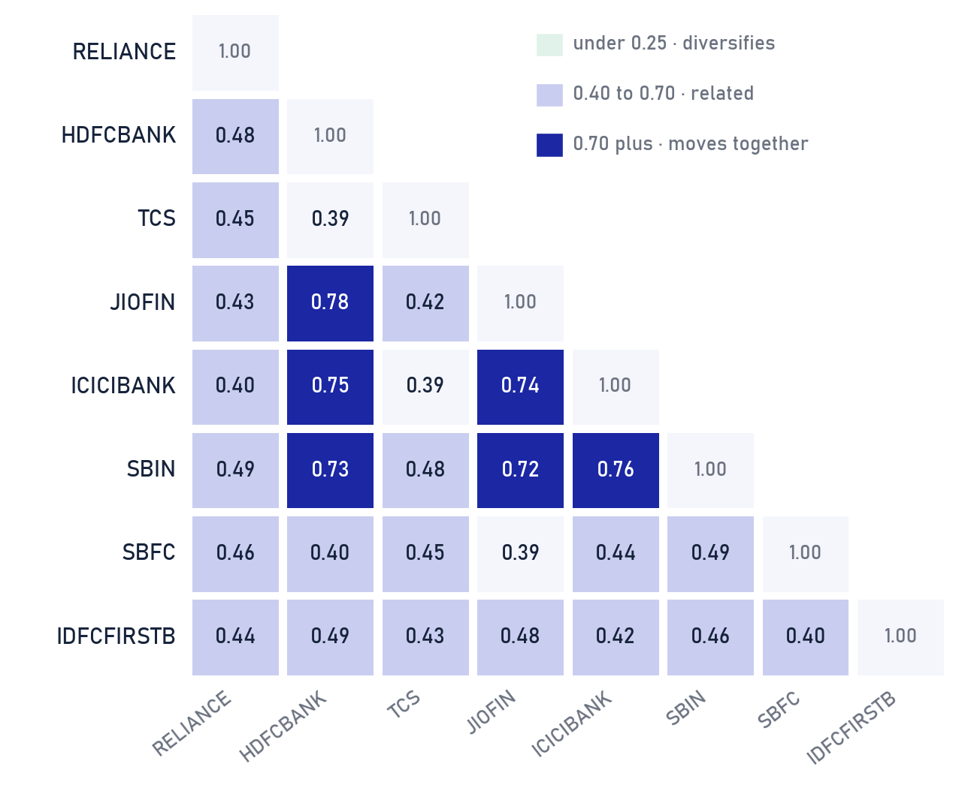
Private & Confidential
05 · ANNEXURE
What the top eight actually share
Pairwise correlation of the largest direct-equity holdings
SCOPE [ILLUSTRATIVE] Top-8 direct-equity holdings by weight · synthetic pairwise correlations · as of 2026-07-27
DIVERSIFICATION ACTUALLY HELD
The 4 financial names move as a block: JIOFIN and HDFCBANK top the grid at 0.78. ICICIBANK against TCS is the most independent pair at 0.39. Average pairwise correlation is 0.51, so these eight tickers diversify like a smaller handful.
WHEN TO USE THIS VIEW
Bring this page out when the number of holdings is offered as diversification. Portfolio risk is set by how much the names respond to the same forces (rates, credit, the consumer); a ninth name from the same cluster adds little.
Synthetic correlation estimates for illustration, patterned on typical 3-year weekly-return relationships; not measured from market data. [ILLUSTRATIVE]
Portfolio Review · 68

Slide 69
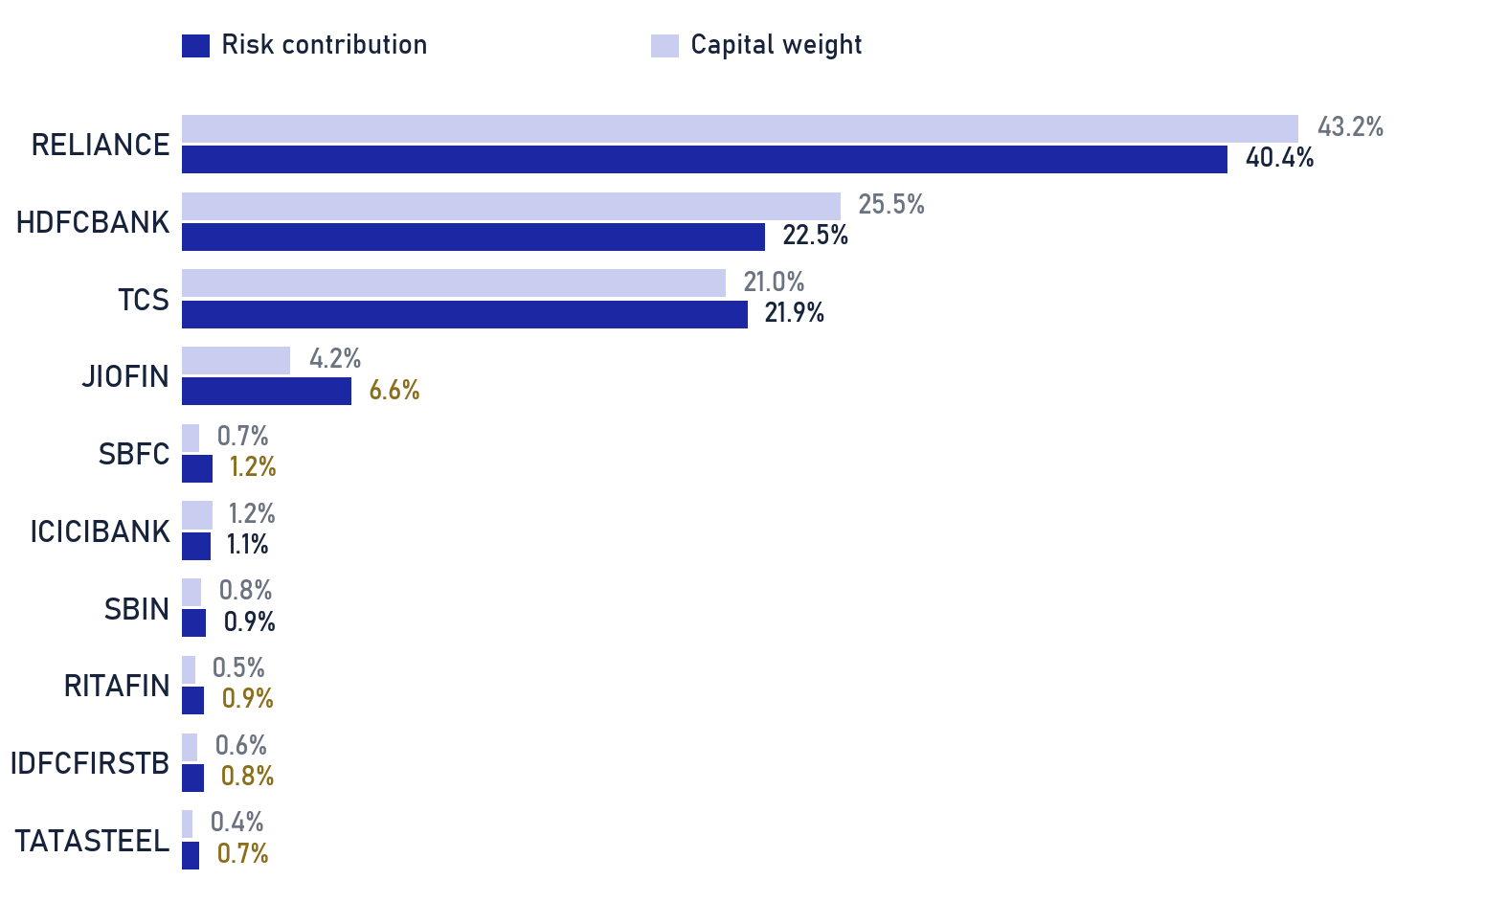
Private & Confidential
05 · ANNEXURE
Capital weight is not risk weight
Estimated risk contribution vs capital weight · top 10 names
SCOPE [ILLUSTRATIVE] Direct-equity book · as of 2026-07-27
CAPITAL WEIGHT IS NOT RISK WEIGHT
The ten largest risk contributors hold 98% of equity capital but an estimated 97% of its risk. RELIANCE leads both lists on sheer size, while higher-volatility names such as JIOFIN and SBFC carry clearly more risk than their capital weight (gold figures).
WHEN TO USE THIS VIEW
Use this page when a trim looks too small to matter in rupee terms. Risk is weight times volatility: a one-point trim of a high-volatility name removes more portfolio risk than the same point off a steady large cap, and the trim list is sequenced accordingly.
Risk contribution estimated as capital weight times an assumed per-name volatility proxy (synthetic), normalised to 100%; a full covariance treatment would shift details, the ordering is the point. [ILLUSTRATIVE]
Portfolio Review · 69

Slide 70
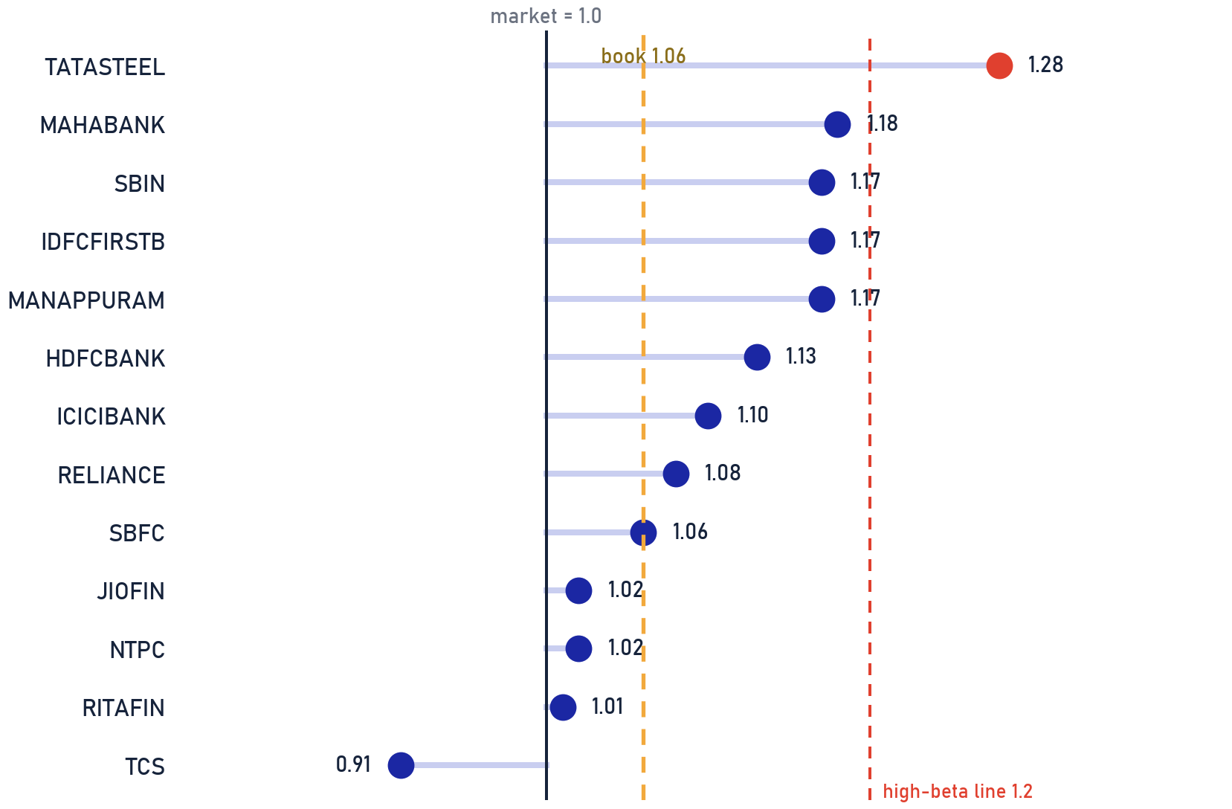
Private & Confidential
05 · ANNEXURE
Volatility ladder
Which holdings amplify the market, and by how much
SCOPE Direct equity book · sector-keyed betas [ILLUSTRATIVE] pending regression on price history · as of 2026-07-27
THE HIGH-BETA TAIL · 0.2% OF BOOK
HIGH-BETA NAME
BETA
WEIGHT
CALL
TATASTEEL
1.28
0.2%
HOLD
HOW TO READ THE LADDER
Book-weighted beta is 1.06, close to the market. The tail above 1.2 (0.2% of the book) is where a drawdown bites hardest: these names fall further than the index and recover on their own cycle. Position sizes there should earn their volatility.
Betas are sector-keyed illustrative estimates with a fixed per-name offset [ILLUSTRATIVE], not regression output; ladder shows the largest positions plus every flagged name.
Portfolio Review · 70

Slide 71
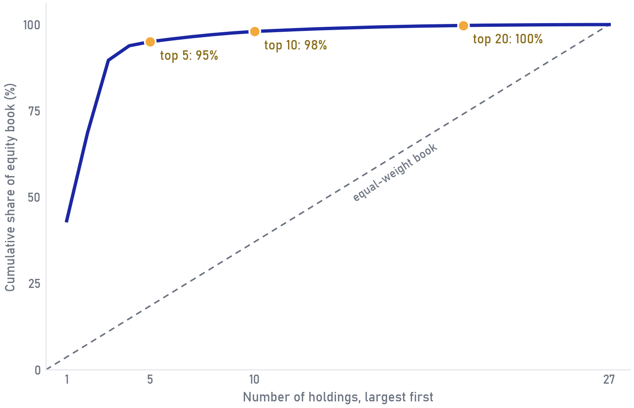
Private & Confidential
05 · ANNEXURE
How top-heavy is the equity book
Cumulative weight curve vs an equal-weight reference line
SCOPE Direct-equity sleeve only · 27 holdings · weights as share of the equity book · as of 2026-07-27
BASKET
THIS BOOK
EQUAL WEIGHT
Top 5
95%
19%
Top 10
98%
37%
Top 20
100%
74%
HOW TO READ THE CURVE
The faster the curve climbs, the more the book depends on its first few names. The dashed diagonal is a book of equal slices; the space between the two lines is the concentration, made visible.
WHEN TO USE THIS VIEW
Use this page alongside the 8% single-name cap in the IPS: 3 name(s) sit above the cap today, and the planned trims pull the front of this curve down toward the diagonal.
Cumulative weights of the 27 direct-equity holdings, largest first, as a share of the equity book; equal-weight line = 100/27 per name.
Portfolio Review · 71

Slide 72
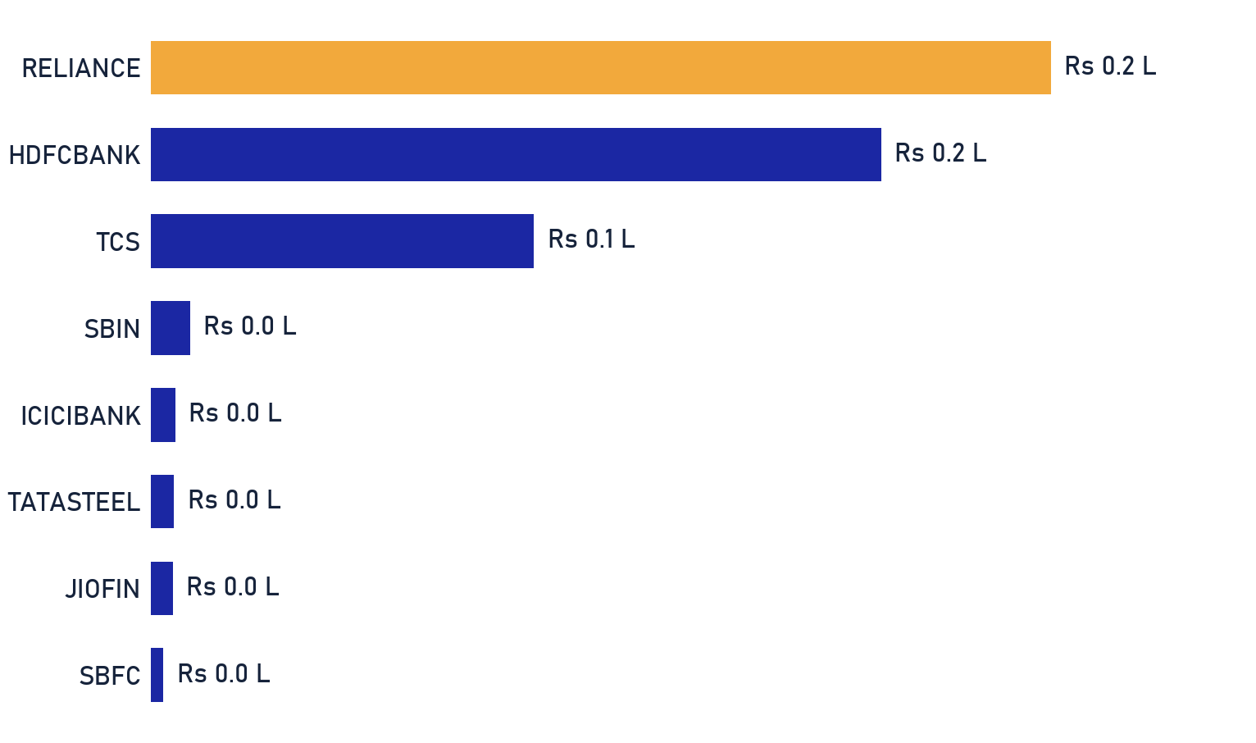
Private & Confidential
05 · ANNEXURE
What the book pays while it compounds
Estimated annual dividend income by holding · Rs lakhs
SCOPE [ILLUSTRATIVE] Direct-equity sleeve · position value x assumed dividend yield per name · as of 2026-07-27
₹0.6 L
0.8%
EST. ANNUAL DIVIDENDS
BLENDED EQUITY YIELD
WHERE THE INCOME SITS
RELIANCE and HDFCBANK pay about 74% of the book's cash income; the growth names pay almost nothing by design. At 0.8% on the equity sleeve, dividends here are a byproduct of stock selection, never its purpose.
WHEN TO USE THIS VIEW
When regular cash flow becomes a goal, this is the base it starts from. If income becomes a goal, it is funded through planned withdrawals or a dedicated income sleeve agreed in the IPS, rather than by tilting this growth book toward high-dividend names.
Estimated dividends: position value times an assumed per-name dividend yield (synthetic, patterned on typical payout levels); no forecast of actual distributions. [ILLUSTRATIVE]
Portfolio Review · 72

Slide 73
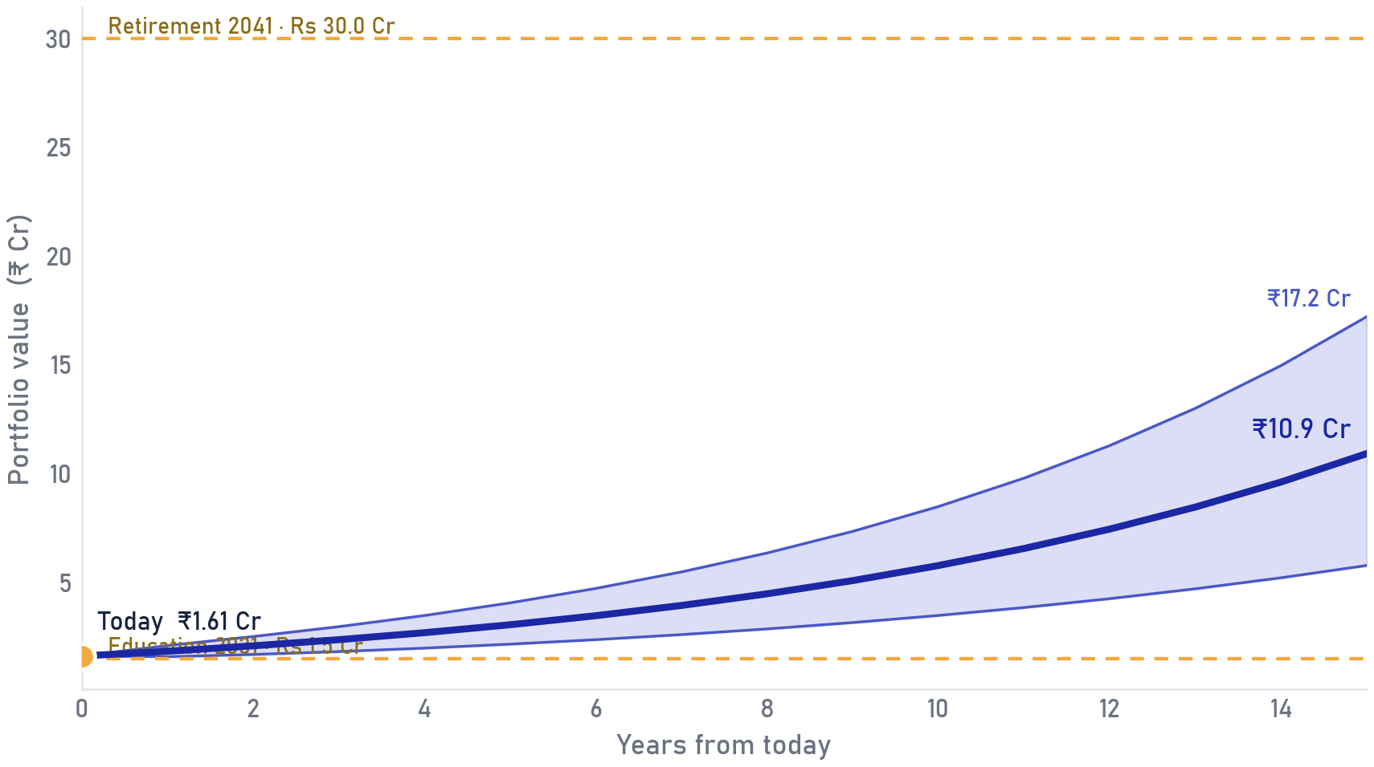
Private & Confidential
05 · ANNEXURE
Goal mapping
What the corpus already covers, goal by goal
SCOPE Whole portfolio (Rs 1.6 Cr) vs illustrative goals [ILLUSTRATIVE, to be replaced by the family's confirmed goals] · as…
GOAL
NEEDED THEN
NEEDED TODAY AT 14%
FUNDED TODAY
Education (2031)
Rs 1.5 Cr
Rs 0.79 Cr
100%
Second home (2034)
Rs 3.0 Cr
Rs 1.08 Cr
76%
Retirement (2041)
Rs 30.0 Cr
Rs 4.43 Cr
0%
All goals together
Rs 34.5 Cr
Rs 6.30 Cr
26%
HOW TO READ FUNDED-TODAY
Funded-today discounts each goal at the holdings-derived 14% return and fills goals nearest-first. The nearer goals are 100%, 76% funded respectively, today's corpus; retirement is ~0% funded, a gap that ongoing savings and the 15-year horizon can close. A goal short of 100% calls for contributions or time, never for stretching the risk profile.
Illustrative projection at 14% p.a. return, 11% volatility; goal amounts and dates are placeholders [ILLUSTRATIVE], not advice or a forecast; outcomes will differ.
Portfolio Review · 73

Slide 74
Private & Confidential
05 · APPENDIX
Methodology & data sources
How the numbers on these pages are built
SCORING EQUITIES
EVALUATING FUNDS
Each stock earns a 0-100 Ionic Score from two horizons, a 3-year, fundamentals-tilted view and a 1-year, trend-tilted view, combined across pillars (Quality & Growth, Value, Trend & Flow). Forensic / balance-sheet gates cap the score at 40. Below 40 on either horizon = Sell; 40-50 is a watch zone (Trim only with a concentration or risk flag); 50+ = Hold.
Funds are scored 0-100 by the firm's fund-quality framework on Direct-plan NAV against total-return benchmarks, point-in-time. It rewards net-of-fee alpha, rolling-window consistency and downside cushioning, and penalises structural watch-outs. Verdicts: Hold / Trim / Switch / Exit.
DATA SOURCES
Scored universe: the firm's stock-scoring engine + per-stock analyst files (point-in-time). · Fund NAVs: Direct-plan, total-return-benchmark relative. · SEBI market-cap cut-offs and category rules. · House-view sector / allocation bands. · Official statutory tax rates, updated each Budget. · Client IPS and holdings as supplied by the advisory desk.
Data sources for this review.
Portfolio Review · 74

Slide 75
Disclaimer & basis of preparation
This document is a review of existing holdings prepared for the named client under a Non-Discretionary Portfolio Management mandate. Recommendations are Sell / Trim / Hold on current positions only and are not a solicitation or an offer to buy any security. Nothing is executed until the client authorises it. The Ionic Score is a quantitative input reviewed by the Portfolio Review team; it is not a guarantee of future performance. Tax characterisations are indicative · confirm with the client's tax adviser before dealing. Mutual-fund evaluation uses Direct-plan NAV against total-return benchmarks, point-in-time. Past performance is not indicative of future results. This review is prepared for the named client's actual holdings as supplied to the firm; where source data was incomplete or unverifiable, that is disclosed explicitly in the review rather than assumed.
IONIC WEALTH
Private & Confidential · Prepared exclusively for the named client
Ionic Wealth by Angel One · Portfolio Review · Private & Confidential

