Slide 1

IONIC WEALTH
BY ANGEL ONE
Portfolio Review
PREPARED FOR
ABXY Family
NDPMS (Non-Discretionary) · Aggressive · Long term (7yr+)
Co-founder in your journey of wealth creation
As of 2026-07-25 · [ILLUSTRATIVE, synthetic demo client; not a real portfolio]

Slide 2

Private & Confidential
00 · UNDERSTANDING
Investment Policy Statement
Your plan, in one page
[ILLUSTRATIVE, demo IPS]
RISK TIER
OBJECTIVE
AGGRESSIVE
Long-term capital growth with a quality bias; tolerates interim drawdowns for higher compounding.
TARGETS & LIMITS
STRATEGIC ALLOCATION BANDS
min, target, max
Time horizon
7 yr+
0
50
100
Equity
65–85% tgt 78
Single-name cap
max 8% of the book
Hybrid/Debt
5–25% tgt 12
Foreign / global equity
15% target of equity
Alternatives/Gold
0–10% tgt 5
Gold & silver sleeve
5% target
Cash
0–15% tgt 5
CONSTRAINTS
No single stock above 8% of the book
Min 15% of equity in foreign/global by target
No unrated / F&O / leveraged positions
ESG: no tobacco primary-producer adds
Portfolio Review · 02

Slide 3
Private & Confidential
00 · UNDERSTANDING
Executive summary
The five things that need attention
Rs 6.8 Cr
47 / 9
40%
10
4
PORTFOLIO VALUE
STOCKS / FUNDS
TOP-10 WEIGHT
EQUITY SELLS
FUND ACTIONS
Below are the five things to fix. Each has one clear next step.
CATEGORY
GAP VS POLICY
WHAT WE WOULD DO
SEE
Too concentrated
Your 2 biggest shares are over 11%; the plan caps any one at 8%.
One exits via the sell list; the other is reduced slowly.
01 · X-ray
Weak holdings
10 shares score in the Sell zone.
Sell all of them, in a planned order.
02 · Equity
Too little abroad
About 12 points below the 15% overseas target.
Plan an overseas step for when we reinvest.
04 · Plan
Paying extra fees
About Rs 32k/yr of avoidable Regular-plan cost.
Every fund change we suggest lands in a cheaper Direct plan.
04 · Plan
Fund line-up
2 funds trail the index or are built too rigidly.
Switch to an index/factor fund and a Flexi-Cap.
03 · Funds
Counts (sells, fund actions) match the scored books exactly; ‘See’ points to the section with the detail.
Portfolio Review · 03

Slide 4

Private & Confidential
01
SECTION 01
Portfolio X-ray
Where the book stands today
Portfolio snapshot
Concentration risk

Slide 5
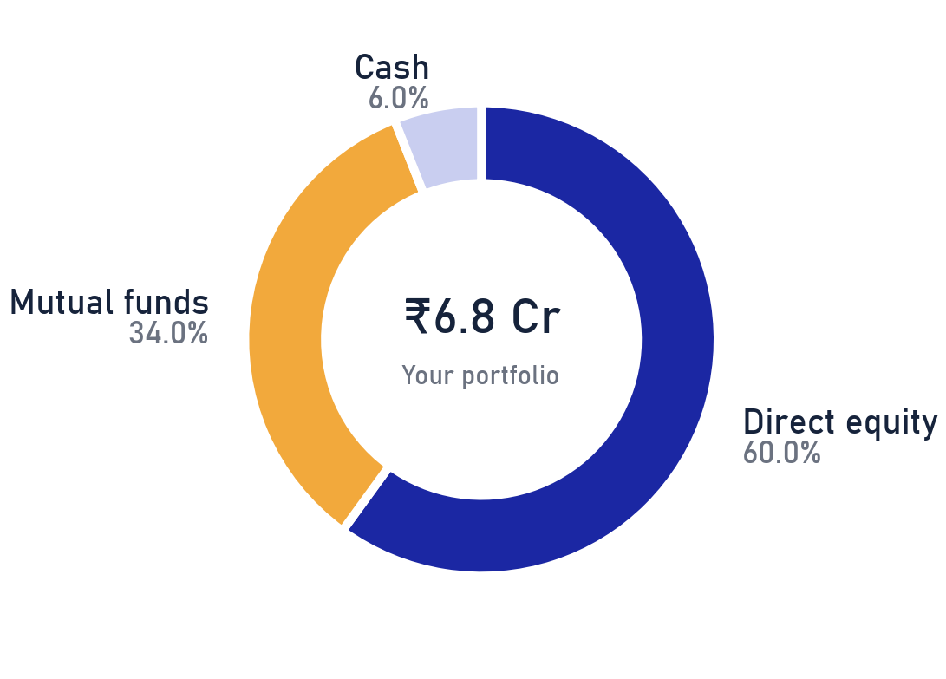
Private & Confidential
01 · PORTFOLIO X-RAY
Your portfolio at a glance
What you own today
₹6.80 Cr
47
9
40%
TOTAL PORTFOLIO VALUE
DIRECT EQUITY NAMES
MUTUAL-FUND SCHEMES
IN THE TOP 10 HOLDINGS
IN SHORT
Most of your money, about 60%, is invested directly in shares. About 34% is in mutual funds and 6% is kept as cash. A lot sits in just a few shares. We look at that next.
Source: client custody statement as of 2026-07-25; Ionic Wealth Portfolio Review. Percentages of total AUM.
Portfolio Review · 05

Slide 6
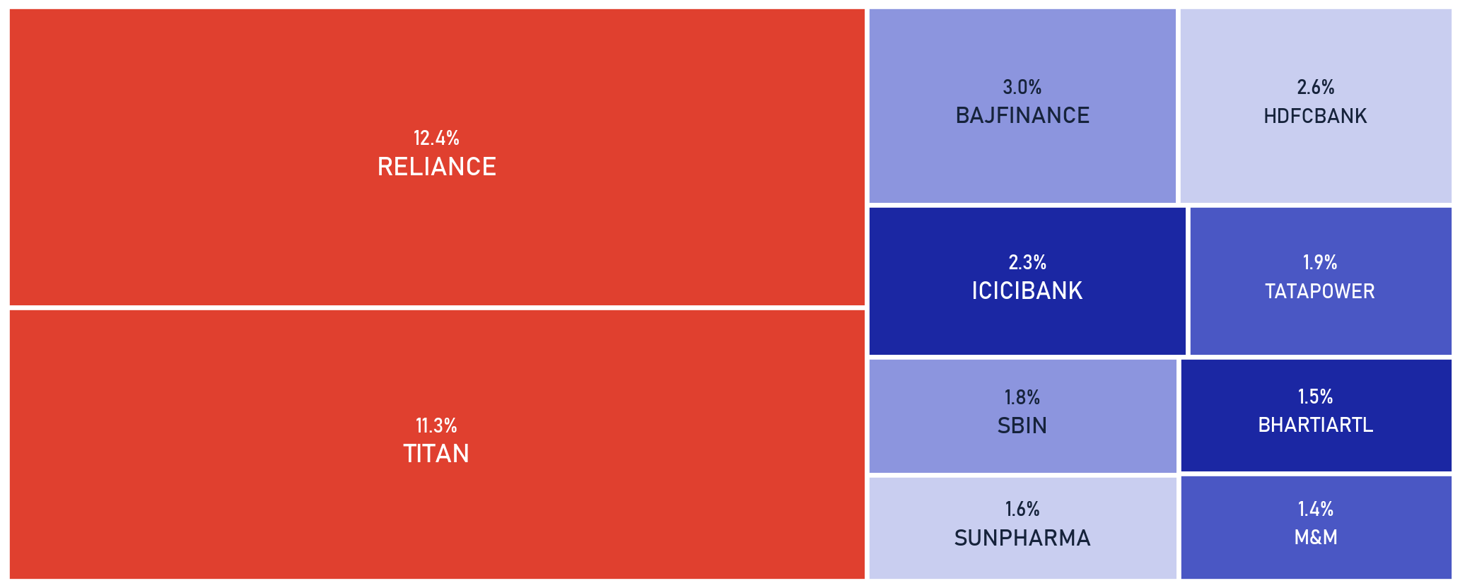
Private & Confidential
01 · PORTFOLIO X-RAY
Too much in too few names
Your ten biggest holdings
SCOPE Direct equity only · as of 2026-07-25
SINGLE-NAME CAP
2 shares are bigger than our 8% single-name limit: RELIANCE (12.4%), TITAN (11.3%). RELIANCE is on the sell list anyway. TITAN we reduce slowly toward 8%.
23.7%
40%
8%
2
TOP 2 NAMES
TOP 10 NAMES
OUR SINGLE-STOCK LIMIT
NAMES OVER THE CAP
Source: client holdings as of 2026-07-25. Weights as % of total AUM; IPS single-name guideline per the Investment Policy Statement.
Portfolio Review · 06

Slide 7

Private & Confidential
02
SECTION 02
The Equity Book
Every direct holding, scored and read
The book at a glance
What we would sell

Slide 8
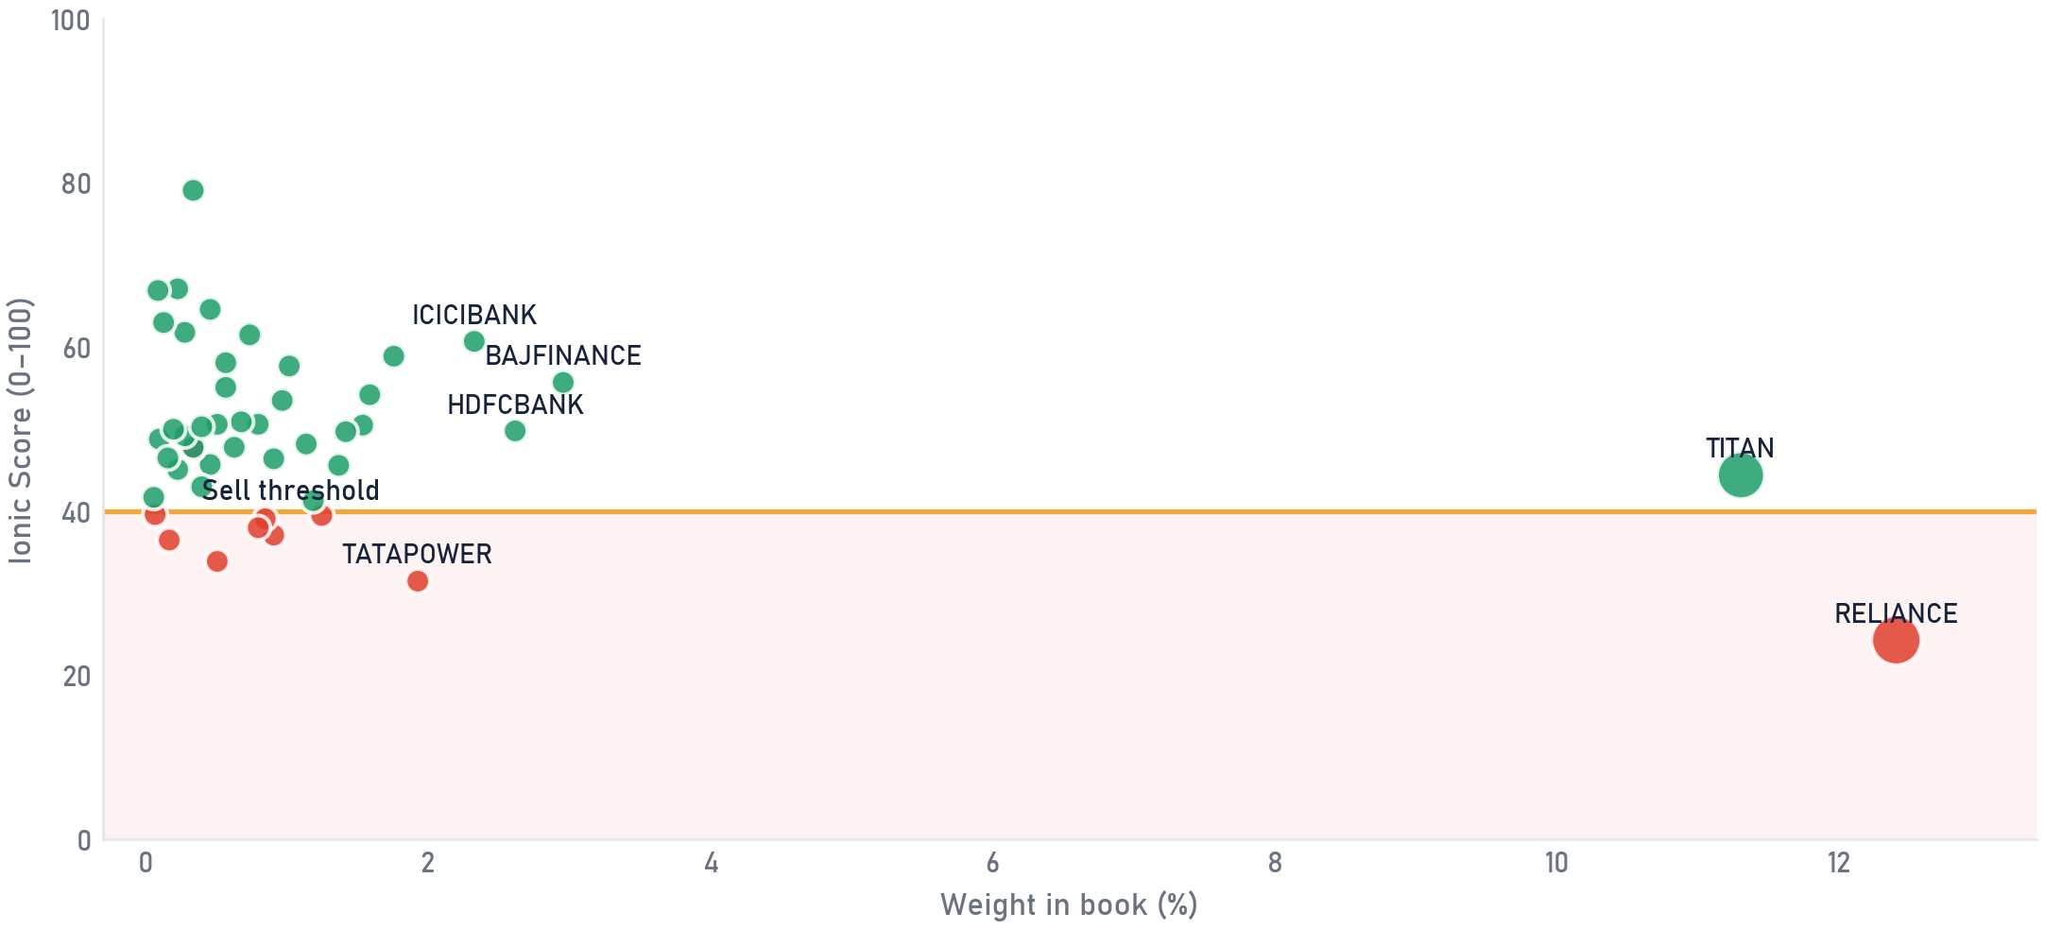
Private & Confidential
02 · EQUITY
The book at a glance
Your shares, all on one picture
SCOPE Direct equity only · as of 2026-07-25
Every dot is one holding. Further right = a bigger part of your money. Higher up = a stronger score. Anything in the red band scores low.
Sell
Hold
dot size = rupee value held · gold line = Sell threshold (40) · a red dot above the line is an exceptional, documented call
Weight = share of direct-equity book · Ionic Score reflects our full review process, forward-growth adjusted · illustrative synthetic book.
The Ionic Score flags candidates; the Portfolio Review team confirms every call.
Portfolio Review · 08

Slide 9
Private & Confidential
02 · EQUITY
What we would sell
The shares we would sell, and why (1 of 2)
SELL ×10
SCOPE Direct equity only · as of 2026-07-25
Each name shows the reason in two lines; the page link has the full story.
HOLDING
SHARE %
IONIC SCORE
CALL
THE CASE
DETAIL
Reliance Industries Ltd.
12.4
Bottom-quartile on quality and value with negative momentum; our own sum-of-the-parts sits at today's price, no bargain.
24
SELL
Tata Power Co. Ltd.
1.9
Borrowings rose Rs 17,500 cr in FY26 to fund a capex plan that has already slipped; leverage is rising while returns stay thin.
32
SELL
Larsen & Toubro Ltd.
1.2
FY27 guidance has been cut and H1 execution guided soft; at ~32x trailing earnings there is little cushion, so we sell into strength.
40
SELL
Jio Financial Services Ltd.
0.9
A Rs 1.4-lakh-crore valuation still resting mostly on treasury income; the operating businesses are too young to carry the price.
37
SELL
Deepak Nitrite Ltd.
0.8
A commodity downcycle name: FY22's peak margins have halved and the price still assumes the cycle returns quickly.
39
SELL
Each row links to the name's full rationale page (score panel, the case, the bull we rejected, valuation check). Illustrative synthetic book.
Scores flag, people decide: each call here carries a named reviewer's sign-off.
Portfolio Review · 09

Slide 10
Private & Confidential
02 · EQUITY
What we would sell
The shares we would sell, and why (2 of 2)
SCOPE Direct equity only · as of 2026-07-25
Each name shows the reason in two lines; the page link has the full story.
HOLDING
SHARE %
IONIC SCORE
CALL
THE CASE
DETAIL
Hindustan Unilever Ltd.
0.8
Headline profit is demerger-inflated (organic growth ~4%); three-year revenue growth of 2% does not support the price.
38
SELL
GAIL (India) Ltd.
0.5
Marketing margins are in a structural reset: five straight quarters of profit decline, and the dividend now exceeds free cash flow.
34
SELL
Hindustan Copper Ltd.
0.3
FY26's profit boom is copper price, not mining volume; the capacity ramp is delayed and a PSU stake-sale overhang sits at a peak multiple.
48
SELL
EXCEPTIONAL
UltraTech Cement Ltd.
0.2
Priced at 42-46x earnings for a 10.7% ROE while cement pricing stays soft; no dated catalyst offsets it.
36
SELL
ITC Hotels Ltd.
0.1
44-46x trailing earnings on a 7% ROE with a promoter-stake overhang; one strong quarter does not yet earn the multiple.
40
SELL
Names selling above the 40 score line are exceptional, high-conviction calls; the linked page documents each case in full.
Each row links to the name's full rationale page (score panel, the case, the bull we rejected, valuation check). Illustrative synthetic book.
The score is the starting point; the final word on every name belongs to the desk.
Portfolio Review · 10

Slide 11

Private & Confidential
03
SECTION 03
The Fund Book
Upside, downside and consistency, not just returns
The fund book, scored
Fund actions

Slide 12
Private & Confidential
03 · FUNDS
Your funds, graded
A simple quality grade for each fund, and what we suggest
SCOPE MF sleeve only, Direct-plan NAV, each scheme vs its own SEBI category benchmark (TRI) · as of 2026-07-25
SCHEME
CATEGORY
SHARE %
QUALITY /100
SUGGESTED
LIC MF Large Cap
Equity
5.6
30
SWITCH
HDFC Flexi Cap (Dir)
Equity
4.2
68
HOLD
LIC MF Multi Cap
Equity
3.3
59
SWITCH
ICICI Pru Multi-Asset (Dir)
Hybrid
3.7
65
HOLD
PGIM India Small Cap
Equity
0.4
17
EXIT
LIC MF Balanced Advantage
Hybrid
2.8
57
TRIM
Parag Parikh Flexi Cap (Dir)
Equity
7.0
69
HOLD
Nippon India Nifty 50 Index
Passive
3.7
56
HOLD
HDFC Balanced Advantage (Dir)
Hybrid
3.3
65
HOLD
What this means: 4 of 9 funds could be improved, usually because of high fees or the wrong structure, not just weak returns. 5 are worth keeping.
Ionic fund-quality framework · Direct-plan NAV vs each scheme's own SEBI category benchmark (TRI) · structural watch-outs flagged per scheme. Illustrative synthetic funds.
The Ionic Score flags candidates; the Portfolio Review team confirms every call.
Portfolio Review · 12

Slide 13
Private & Confidential
03 · FUNDS
Changes to your funds
A few structural fixes, none is about last year's return
No fund here is sold on performance alone. Each action is structural: mandate, cost, scale or consistency. Where a scheme mostly re-buys index names you already hold directly, the cleaner replacement is a low-cost index sleeve (Nifty 50 / Nifty 500 class) rather than paying an active fee twice.
SWITCH
LIC MF Large Cap
EXIT
PGIM India Small Cap
NEG_ALPHA · DOWN_CAP_HI · HELD ~9Y, COSTLIER TO SWITCH
DEEP_DD · NEG_ALPHA · OVER_ALLOC
Trails the large-cap index by 4-5pp a year over 3 and 5 years; active fees for below-index outcomes.
Sub-scale ~3L beside a larger small-cap fund; persistent underperformance and duplication, structural exit.
Measured against a low-cost Large-Cap Index / Factor fund
Measured against the primary small-cap sleeve already held
SWITCH
LIC MF Multi Cap
TRIM
LIC MF Balanced Advantage
MANDATE_RIGIDITY
SUB_SCALE · SHORT_RECORD · REG_PLAN_DRAG
Multi-cap's SEBI 25/25/25 floor forces small/mid we prefer to size ourselves, structural, not performance.
Under four years of record, sub-scale, Regular plan; we fold the sleeve into the proven hybrid held.
Measured against a Flexi-Cap (manager-flexible cap mix)
Measured against the hybrid core already held (HDFC BAF, Direct)
Category exemplar = the fund our quality framework ranks best in the category, used as the measuring stick, not a recommendation to buy it. Whether a replacement is named is a compliance decision. Synthetic demo funds.
Portfolio Review · 13

Slide 14

Private & Confidential
04
SECTION 04
What We Would Do
The calls, the cost and the tax
What you're paying today
Tax impact
Your priority actions

Slide 15
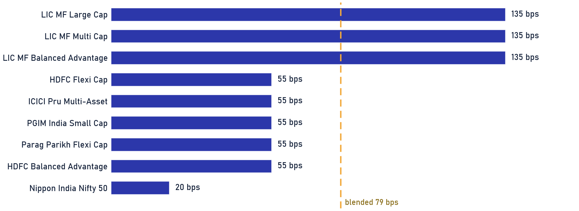
Private & Confidential
04 · RECOMMENDATIONS
What your funds cost
What each fund charges you, every year
Rs 1.8 L
79 bps
20–135 bps
FUND FEES A YEAR
AVERAGE CHARGE
LOWEST AND HIGHEST
79 bps blended
across all your funds
your cheapest and priciest fund
NEXT STEP Ask your relationship manager to run the numbers across cheaper options.
Basis: scheme Total Expense Ratio (current plan) from scheme documents, weighted by holding value. Illustrative for the ABXY demo.
Portfolio Review · 15

Slide 16
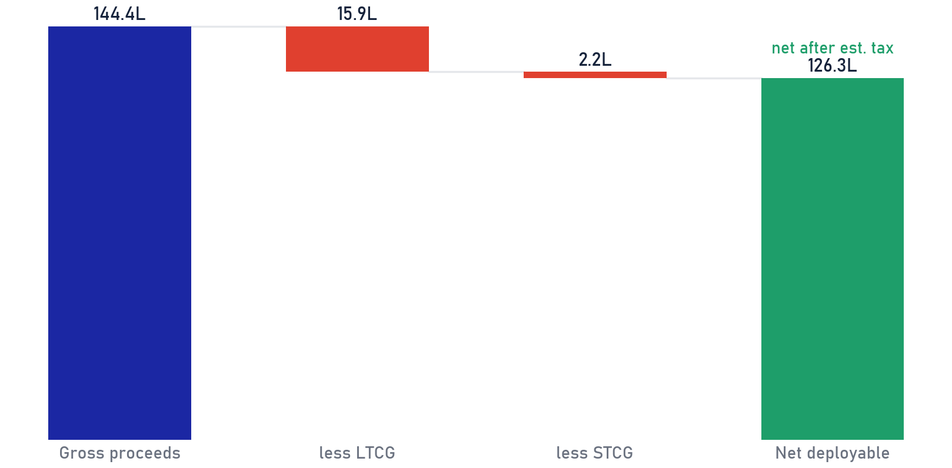
Private & Confidential
04 · RECOMMENDATIONS
What tax this plan may cost
The tax on these moves · an estimate to confirm with your adviser
YOUR FUND CHANGES · THE TAX TYPE EACH MAY TRIGGER
SELLING THE WEAK SHARES · WHAT'S LEFT AFTER EST. TAX
ACTION
SCHEME
AMOUNT
TAX CHARACTER
SWITCH
LIC MF Large Cap
Rs 38.1 L
LTCG
SWITCH
LIC MF Multi Cap
Rs 22.2 L
LTCG
EXIT
PGIM India Small Cap
Rs 2.9 L
LTCG
TRIM
LIC MF Balanced Advantage
Rs 19.0 L
LTCG
Total fund actions
Rs 82.2 L
Net after est. tax feeds the deployment plan.
THE SHARE-SALE TAX IS AN ESTIMATE FOR NOW
LONG-HELD UNITS: A HIGHER BAR TO SELL
The equity tax opposite is an estimate; the exact bill needs the demat trade file (buy dates + cost per lot), not in the statement provided.
For funds held over 5 years the tax bill can eat the gain from switching, so we switch those only for structural reasons.
The table covers your fund changes; the chart covers the share sales. These tax numbers are estimates only. Please confirm the exact tax with your tax adviser before we act. Illustrative.
Portfolio Review · 16

Slide 17
Private & Confidential
04 · RECOMMENDATIONS
What happens next
Your action plan, step by step
Rs 1.44 Cr
4
Rs 1.26 Cr
CASH FREED
FUND CHANGES
CASH IN HAND
from sells + trim
switch / drop / trim
after estimated tax
1
Sell the weak names
Rs 1.31 Cr
Sell the 10 weakest-scoring stocks, a little at a time.
FIRST
2
Right-size the biggest names
Rs 13.6 L
Gently reduce any single stock that is too large a share of your money.
SOON
3
Fix the funds
Rs 82.2 L
Tidy the fund list, replace 3 weak funds with stronger, cheaper ones, drop the tiny one.
A FEW DAYS
4
Keep the cash ready
Rs 1.26 Cr
The freed money sits safely in a liquid fund; where it goes next is decided with you, separately.
TOGETHER
AUTHORISATION Nothing happens without your approval; every step is yours to confirm.
Reviewed with client on ____________________
Amounts illustrative for the ABXY demo · net figures after estimated tax · as of 2026-07-25.
Portfolio Review · 17

Slide 18
Disclaimer & basis of preparation
This document is a review of existing holdings prepared for the named client under a Non-Discretionary Portfolio Management mandate. Recommendations are Sell / Trim / Hold on current positions only and are not a solicitation or an offer to buy any security. Nothing is executed until the client authorises it. The Ionic Score is a quantitative input reviewed by the Portfolio Review team; it is not a guarantee of future performance. Tax characterisations are indicative · confirm with the client's tax adviser before dealing. Mutual-fund evaluation uses Direct-plan NAV against total-return benchmarks, point-in-time. Past performance is not indicative of future results. This is a synthetic demonstration document; the ABXY Family is fictional and no content constitutes advice on a real portfolio.
IONIC WEALTH
Private & Confidential · Prepared exclusively for the named client
Ionic Wealth by Angel One · Portfolio Review · Private & Confidential

