Slide 1

IONIC WEALTH
BY ANGEL ONE
Portfolio Review
PREPARED FOR
ABXY Family
NDPMS (Non-Discretionary) · Aggressive · Long term (7yr+)
Co-founder in your journey of wealth creation
As of 2026-07-25 · [ILLUSTRATIVE, synthetic demo client; not a real portfolio]

Slide 2

Private & Confidential
How to read this review
Contents · vocabulary · score legend
THE SIX SECTIONS
THE WORDS WE USE
Understanding
EQUITY
SELL
TRIM
HOLD
Your mandate, policy bands and the headline plan
FUNDS
HOLD
TRIM
SWITCH
REDEEM-TO-DIRECT
EXIT
01
Portfolio X-ray
Where the book stands today
A review of the holdings you already own; every call here applies to existing positions.
02
The Equity Book
Every direct holding, scored and read
THE IONIC SCORE, POSITIONED
03
The Fund Book
Below 40 · Sell candidate
Your funds, upside, downside, consistency
40 to 50 · watch zone; Trim only with a concentration or risk flag
04
Recommendations
50 and above · Hold
The plan, the cost, the tax and the sequence
05
Annexure
The Ionic Score flags candidates; the Portfolio Review team confirms every call.
Supporting detail, on request
THIS BUILD Annexure attached this cycle: Opportunity set · Quality vs price · Factor profile · Growth projection · Spotlight holdings · Holdings detail · Sell cards · Scheme overlap · Scheme scorecards · Appendix
Portfolio Review · 02

Slide 3
Private & Confidential
00 · UNDERSTANDING
Investment Policy Statement
The mandate we manage to
[ILLUSTRATIVE, demo IPS]
RISK TIER
OBJECTIVE
AGGRESSIVE
Long-term capital growth with a quality bias; tolerates interim drawdowns for higher compounding.
TARGETS & LIMITS
STRATEGIC ALLOCATION BANDS
min, target, max
Time horizon
7 yr+
0
50
100
Equity
65–85% tgt 78
Single-name cap
max 8% of the book
Hybrid/Debt
5–25% tgt 12
Foreign / global equity
15% target of equity
Alternatives/Gold
0–10% tgt 5
Gold & silver sleeve
5% target
Cash
0–15% tgt 5
CONSTRAINTS
No single stock above 8% of the book
Min 15% of equity in foreign/global by target
No unrated / F&O / leveraged positions
ESG: no tobacco primary-producer adds
Portfolio Review · 03

Slide 4
Private & Confidential
00 · UNDERSTANDING
Executive summary
Where the book differs from your policy, and what we'd do
Rs 6.8 Cr
47 / 9
40%
10
6
PORTFOLIO VALUE
STOCKS / FUNDS
TOP-10 WEIGHT
EQUITY SELLS
FUND ACTIONS
Each gap below has one action, and where to read the detail.
CATEGORY
GAP VS POLICY
WHAT WE WOULD DO
SEE
Concentration
Top-2 names each >11%; policy caps a single name at 8%.
One exits via the sell programme; the other trims toward the cap.
01 · X-ray
Sell programme
10 direct holdings score in the Sell band (<40).
Exit all 10, sliced by liquidity.
02 · Equity
Foreign under-allocation
~12 pts below the 15% foreign-equity target.
Plan a foreign sleeve at deployment (annexure framework).
04 · Plan
Regular-plan cost
~Rs 53k/yr avoidable trail on Regular-plan funds.
Redeem-to-Direct where the same scheme exists Direct.
04 · Plan
Fund structure
3 schemes: index-trailing / weak consistency / rigid mandate.
Switch to passive-LC / factor + a Flexi-Cap.
03 · Funds
Counts (sells, fund actions) match the scored books exactly; ‘See’ points to the section with the detail.
Portfolio Review · 04

Slide 5
Private & Confidential
00 · UNDERSTANDING
Our understanding
Mandate, construction and benchmark
OUR UNDERSTANDING
WHAT IS CORE–SATELLITE?
The ABXY Family portfolio is managed under a NDPMS (Non-Discretionary) mandate, we advise, you authorise every trade. The stated objective is long-term capital growth with a quality bias over a 7-year-plus horizon, built core–satellite. The book today runs ~60% direct equity, 34% funds and 6% cash, across 47 stocks and 9 schemes.
A stable core of quality businesses does the compounding; smaller satellite positions around it aim to add return without disturbing the core. Steady at the centre, selective at the edges.
HOW WE MEASURE PROGRESS
NON-DISCRETIONARY, YOU AUTHORISE EVERY TRADE
Against our house-view mix of markets, not a single index:
Nothing in this review is executed until you authorise it. Every recommendation is Sell, Trim or Hold on a holding you already own · never a solicitation to buy.
· Foreign equity, ~15% target, under-owned
· Gold & silver, Positive, 75:25
· Low-vol / value favoured; momentum on hold
A formal named benchmark will be agreed with you.
HOW EVERY HOLDING IS SCORED
Every holding earns an Ionic Score out of 100, blending the long-term health of the business with how the market is treating it now, with built-in safety checks on debt and liquidity. The score flags; our team decides. Full method in Section 02.
Scores flag, people decide: each call here carries a named reviewer's sign-off.
Portfolio Review · 05

Slide 6

Private & Confidential
01
SECTION 01
Portfolio X-ray
Where the book stands today
Portfolio snapshot
Allocation vs house view
Concentration risk
Sector exposure
Market-cap positioning

Slide 7
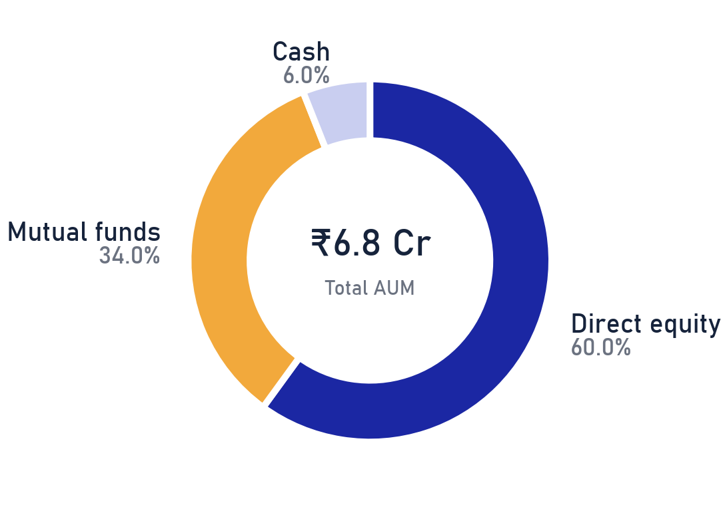
Private & Confidential
01 · PORTFOLIO X-RAY
Portfolio snapshot
Asset mix and the concentration that drives risk
₹6.80 Cr
47
9
40%
TOTAL AUM
DIRECT EQUITY NAMES
MUTUAL-FUND SCHEMES
IN THE TOP 10 HOLDINGS
THE READ
The mix itself is healthy: 60% direct equity doing the compounding, 34% in funds for breadth, 6% in cash. What deserves attention sits inside the equity sleeve: the ten largest names carry 40% of the book against an 8% single-name guideline. This review deals with that first, then the funds, then the costs.
Source: client custody statement as of 2026-07-25; Ionic Wealth Portfolio Review. Percentages of total AUM.
Portfolio Review · 07

Slide 8
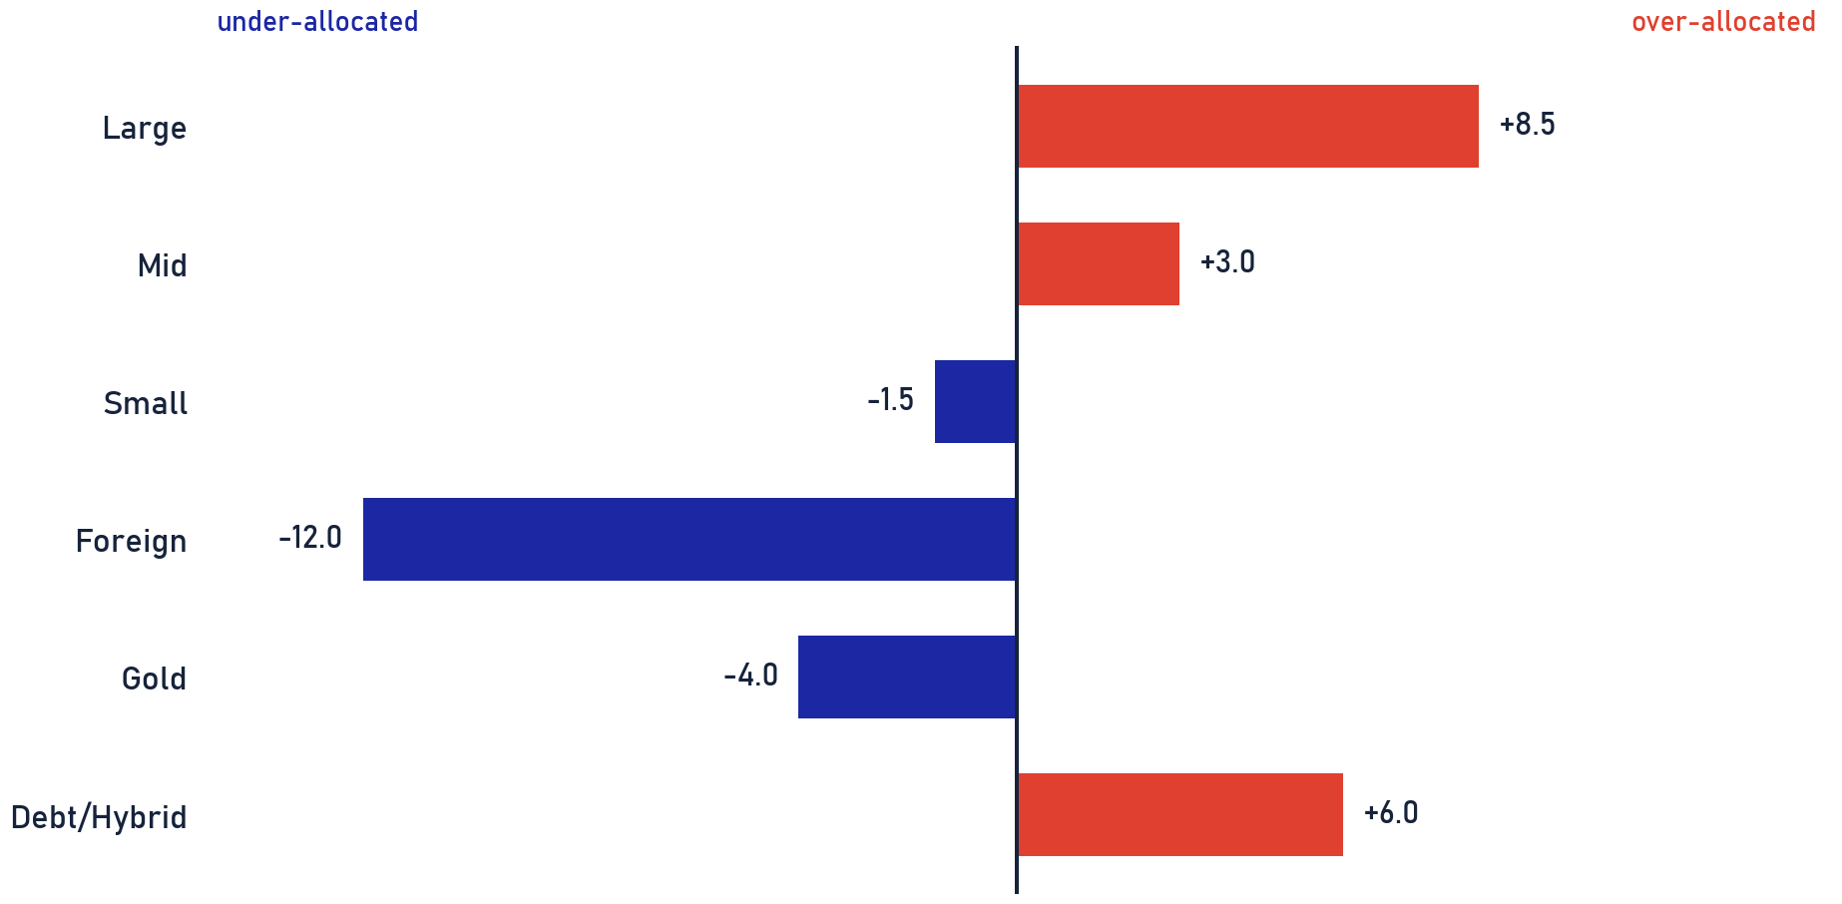
Private & Confidential
01 · PORTFOLIO X-RAY
Allocation vs house view
Book positioning against house-view allocation targets
HOUSE-VIEW STANCE
DIMENSION
OUR STANCE
Domestic equity
Incrementally positive
Foreign equity
~15% target, under-owned
Gold & silver
Positive, 75:25
Momentum
On hold
Low-vol / value
Favoured
WHAT IT MEANS
Pronounced large-cap domestic tilt (+8.5 vs target); foreign ~12pts and gold ~4pts light. Closing these gaps is planned at deployment (transition framework, annexure), on your authorisation.
House-view allocation bands are illustrative for this demo. Gap = current book minus house-view target, in percentage points.
Portfolio Review · 08

Slide 9
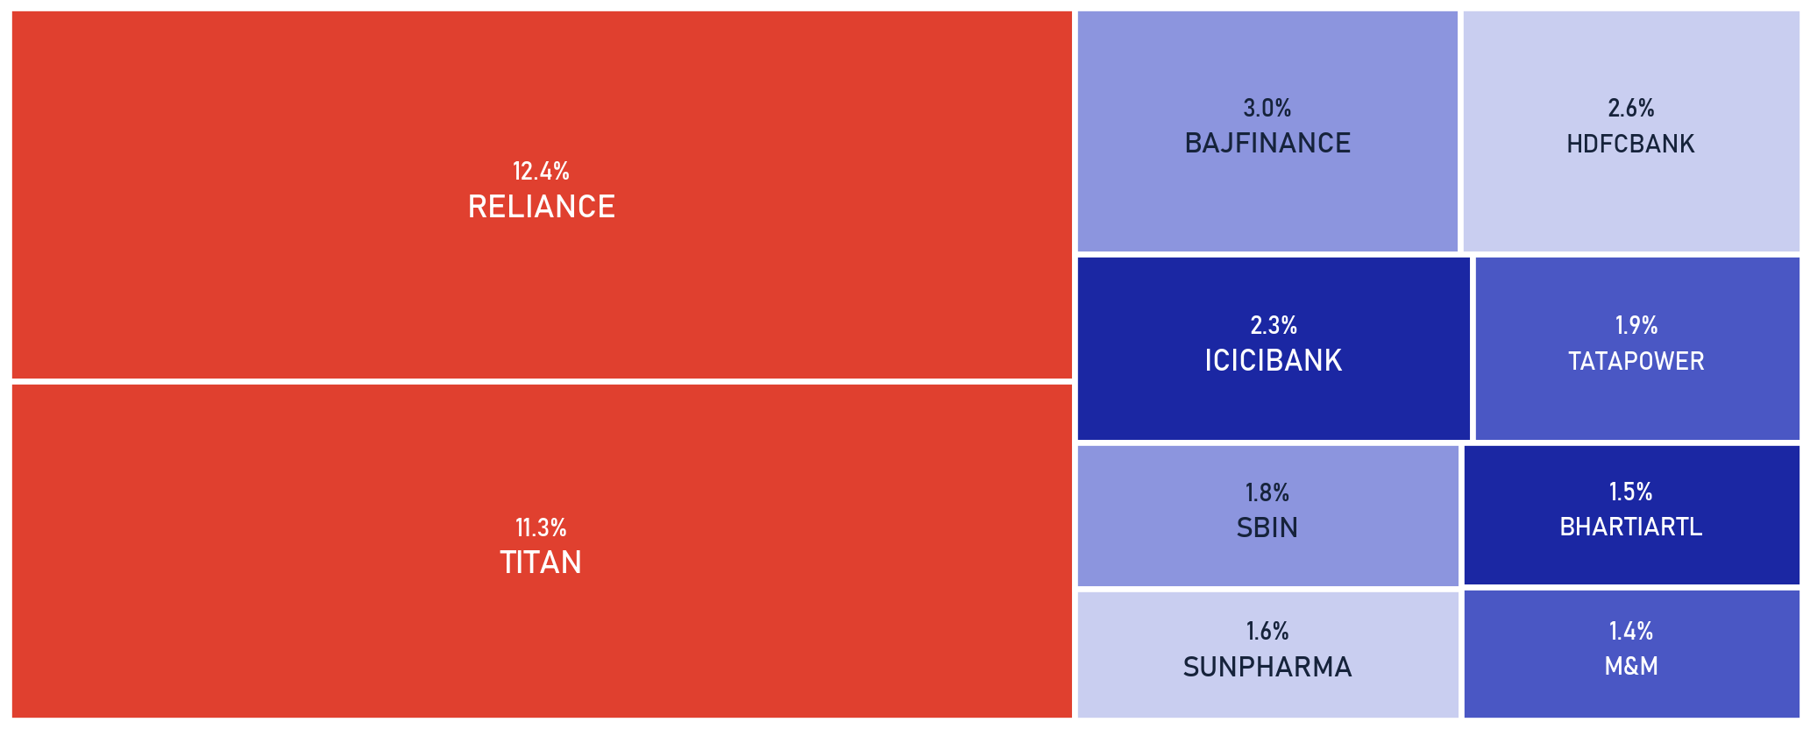
Private & Confidential
01 · PORTFOLIO X-RAY
Concentration risk
Single-name concentration against the IPS cap
SCOPE Direct equity only · as of 2026-07-25
SINGLE-NAME CAP
2 names sit above the 8% IPS single-name guideline: RELIANCE (12.4%), TITAN (11.3%), together 23.7% of the book. RELIANCE exits via the sell programme. TITAN is trimmed toward 8% into strength, sliced across days, never in one print.
23.7%
40%
8%
2
TOP 2 NAMES
TOP 10 NAMES
IPS SINGLE-NAME CAP
NAMES OVER THE CAP
Source: client holdings as of 2026-07-25. Weights as % of total AUM; IPS single-name guideline per the Investment Policy Statement.
Portfolio Review · 09

Slide 10
Private & Confidential
01 · PORTFOLIO X-RAY
Group concentration
One promoter group is more than a fifth of the equity book
SCOPE Direct equity sleeve · promoter-group mapping · threshold 20% of the sleeve · as of 2026-07-25
26.5%
22.2%
TATA GROUP
RELIANCE GROUP
5 holdings
2 holdings
HOLDING
WT % OF EQUITY SLEEVE
IONIC SCORE
CALL
HOW WE TREAT THE TATA GROUP
Titan Company Ltd.
18.8
44
HOLD
A promoter group is one balance sheet, one management culture and one event risk. The sell calls already on the table take Tata from 26.5% to ~23% of the sleeve; we would cap any single group near 20% and not add Tata-group names until it is back inside the line.
Tata Power Co. Ltd.
3.2
32
SELL
Tata Consultancy Services Ltd.
2.0
41
HOLD
Tata Steel Ltd.
1.9
48
HOLD
Tata Technologies Ltd.
0.6
48
HOLD
Group mapping = promoter affiliation of listed holdings; share measured on the direct-equity sleeve. This page appears only when a group crosses the threshold.
The score is the starting point; the final word on every name belongs to the desk.
Portfolio Review · 10

Slide 11
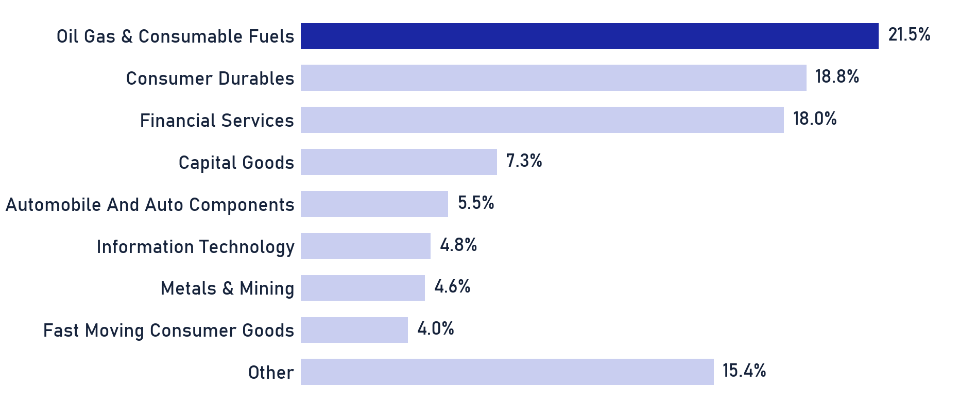
Private & Confidential
01 · PORTFOLIO X-RAY
Sector exposure
Direct-equity sector weights (sleeve basis)
SCOPE Direct equity only · as of 2026-07-25
SCOPE, MF NOT LOOKED THROUGH
This chart covers direct equity only (60% of AUM). The mutual-fund sleeve (34% of AUM) is not looked through, your true sector exposure, funds included, is higher than shown.
THE READ
Sleeve tilts to Oil Gas & Consumable Fuels (22%) and Consumer Durables (19%); top-3 sectors are 58% of the direct book. Sector risk compounds with the single-name concentration flagged earlier · sized together, not in isolation.
Source: client holdings as of 2026-07-25. Weights as % of the direct-equity sleeve; mutual-fund look-through not included.
Portfolio Review · 11

Slide 12
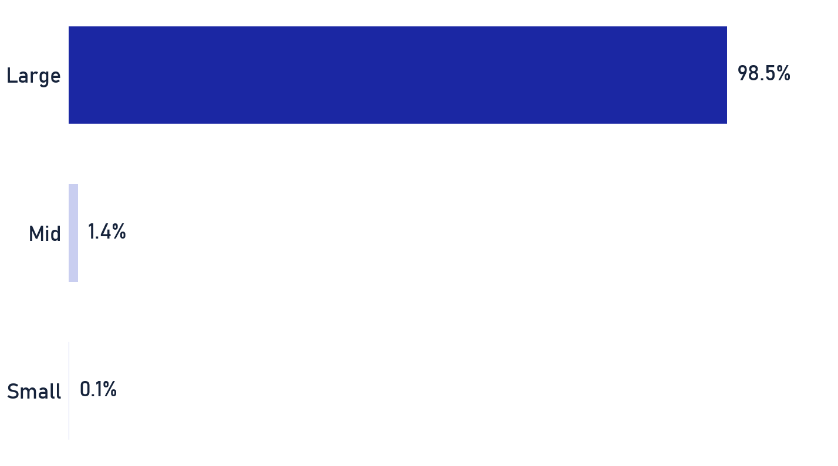
Private & Confidential
01 · PORTFOLIO X-RAY
Market-cap positioning
Direct-equity market-cap distribution vs the house view
SCOPE Direct equity only · as of 2026-07-25
SEBI MARKET-CAP CUTOFFS
SEBI / AMFI classify by full-market-cap rank: Large-cap = top 100 listed companies, Mid-cap = 101st–250th, Small-cap = 251st onward. 'Micro' is a sub-bucket we track below the small-cap line.
MID / SMALL VIEW
House view: mid-caps modestly over-owned (+3.0 vs target), small-caps a touch light (-1.5). With momentum on hold we favour low-vol / value over adding small-cap beta into stretched valuations.
Source: client holdings as of 2026-07-25. Weights as % of the direct-equity sleeve; bands per SEBI/AMFI classification. No micro-cap exposure.
Portfolio Review · 12

Slide 13

Private & Confidential
02
SECTION 02
The Equity Book
Every direct holding, scored and read
How we score every stock
The book, scored
The book at a glance
What we would sell
What stays, and why

Slide 14
Private & Confidential
02 · EQUITY
How we score every stock
Two horizons, seven pillars, and one human call
3-YEAR VIEW
+
1-YEAR VIEW
=
IONIC SCORE
Fundamentals-led
Market-behaviour-led
One number, 0 to 100
QUALITY & GROWTH
VALUE
TREND & FLOW
What the business earns, and how fast it grows.
What you pay for those earnings.
What the price and the big investors are actually doing.
• Quality · ROE & ROCE vs peers
• Value · P/E, P/B & FCF yield vs sector
• Stage / Technical · price trend
• Growth · revenue growth, 3y & 1y
• Sector & Macro · regime fit
• Ownership Flow · FII / DII flows
• Accumulation · smart-money volume trend
SAFETY GATES A weak balance sheet or thin liquidity caps the score at 40. The debt bar is judged in context: by industry norms (utilities and lenders run levered), sovereign or group backing, and access to capital, not one fixed ratio.
THE HUMAN READ
The Ionic Score ranks and flags candidates; it is the INPUT, not the verdict. Every Sell, Trim and Hold that follows is confirmed by the Portfolio Review team, who override the number when the business case demands it · a low score on a durable franchise can still be a Hold, and vice-versa.
Below 40, either horizon
SELL
40–50, only with a concentration / risk flag
TRIM
50 and above
HOLD
Ionic scoring methodology (proprietary, held by the desk) · a 40-50 score alone is a watch signal; Trim needs a concentration or risk flag · every call reviewed by the desk.
The score is the starting point; the final word on every name belongs to the desk.
Portfolio Review · 14

Slide 15
Private & Confidential
02 · EQUITY
The book, scored
The largest positions, with the analyst's one-line read
SCOPE Direct equity only · as of 2026-07-25
10
37
47
SELL
HOLD
HOLDINGS
HOLDING
WT %
IONIC SCORE
CALL
ANALYST READ
Reliance Industries Ltd.
12.4
24
SELL
At 21.7x trailing earnings for bottom-quartile quality…
Titan Company Ltd.
11.3
44
HOLD
Titan's FY26 headline growth…
Bajaj Finance Ltd.
3.0
56
HOLD
Bajaj Finance remains India's best-capitalised…
HDFC Bank Ltd.
2.6
50
HOLD
HDFC Bank's post-merger repair is real but slower than…
ICICI Bank Ltd.
2.3
61
HOLD
ICICI Bank's asset quality keeps setting new lows…
Tata Power Co. Ltd.
1.9
32
SELL
Tata Power's -4.7% FY26 revenue decline is confirmed in…
State Bank of India
1.8
59
HOLD
SBI's FY26 numbers show a bank in clearly strong health…
Sun Pharmaceutical Industries Ltd.
1.6
54
HOLD
Sun Pharma's FY26 print masks a decelerating Q4…
Bharti Airtel Ltd.
1.5
50
HOLD
Bharti Airtel's FY26 results show real structural…
Mahindra & Mahindra Ltd.
1.4
50
HOLD
M&M is compounding volumes and share on both engines of…
ITC Ltd.
1.4
46
HOLD
ITC's -30.1% ret_12m is real, not a demerger artifact…
All 47 holdings are scored; the remaining 36 sit in the annexure. Rows link to each name's page there. Ionic Score: two-horizon composite with safety gates, reviewed by the desk · illustrative synthetic book.
Numbers shortlist, judgment decides: every call passed a human review.
Portfolio Review · 15

Slide 16
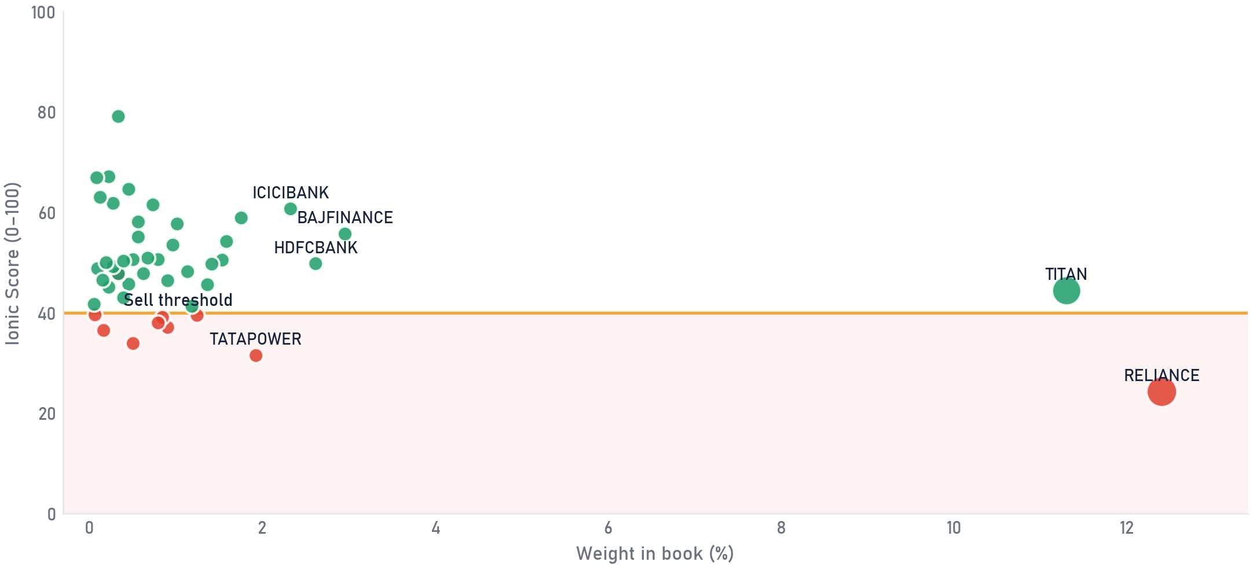
Private & Confidential
02 · EQUITY
The book at a glance
The equity book at a glance, weight against conviction
SCOPE Direct equity only · as of 2026-07-25
Each dot is a holding: how much of the book it is (across) against its Ionic Score (up). Dot size is rupee value. Anything in the shaded band scores below the Sell line; the far right, low-scoring dots are the concentration to watch.
Sell
Hold
dot size = rupee value held · gold line = Sell threshold (40) · a red dot above the line is an exceptional, documented call
Weight = share of direct-equity book · Ionic Score reflects our full review process, forward-growth adjusted · illustrative synthetic book.
The Ionic Score flags candidates; the Portfolio Review team confirms every call.
Portfolio Review · 16

Slide 17
Private & Confidential
02 · EQUITY
What we would sell
The names we would sell, and the case for each (1 of 2)
SELL ×10
SCOPE Direct equity only · as of 2026-07-25
Confirmed Sells only. Two lines carry the case; the linked page carries the full reasoning.
HOLDING
WT %
IONIC SCORE
CALL
THE CASE
DETAIL
Reliance Industries Ltd.
12.4
Bottom-quartile on quality and value with negative momentum; our own sum-of-the-parts sits at today's price, no bargain.
24
SELL
p.44
Tata Power Co. Ltd.
1.9
Borrowings rose Rs 17,500 cr in FY26 to fund a capex plan that has already slipped; leverage is rising while returns stay thin.
32
SELL
p.45
Larsen & Toubro Ltd.
1.2
FY27 guidance has been cut and H1 execution guided soft; at ~32x trailing earnings there is little cushion, so we sell into strength.
40
SELL
p.46
Jio Financial Services Ltd.
0.9
A Rs 1.4-lakh-crore valuation still resting mostly on treasury income; the operating businesses are too young to carry the price.
37
SELL
p.47
Deepak Nitrite Ltd.
0.8
A commodity downcycle name: FY22's peak margins have halved and the price still assumes the cycle returns quickly.
39
SELL
p.48
Each row links to the name's full rationale page (score panel, the case, the bull we rejected, valuation check). Illustrative synthetic book.
Scores flag, people decide: each call here carries a named reviewer's sign-off.
Portfolio Review · 17

Slide 18
Private & Confidential
02 · EQUITY
What we would sell
The names we would sell, and the case for each (2 of 2)
SCOPE Direct equity only · as of 2026-07-25
Confirmed Sells only. Two lines carry the case; the linked page carries the full reasoning.
HOLDING
WT %
IONIC SCORE
CALL
THE CASE
DETAIL
Hindustan Unilever Ltd.
0.8
Headline profit is demerger-inflated (organic growth ~4%); three-year revenue growth of 2% does not support the price.
38
SELL
p.53
GAIL (India) Ltd.
0.5
Marketing margins are in a structural reset: five straight quarters of profit decline, and the dividend now exceeds free cash flow.
34
SELL
p.49
Hindustan Copper Ltd.
0.3
FY26's profit boom is copper price, not mining volume; the capacity ramp is delayed and a PSU stake-sale overhang sits at a peak multiple.
48
SELL
p.50
EXCEPTIONAL
UltraTech Cement Ltd.
0.2
Priced at 42-46x earnings for a 10.7% ROE while cement pricing stays soft; no dated catalyst offsets it.
36
SELL
p.51
ITC Hotels Ltd.
0.1
44-46x trailing earnings on a 7% ROE with a promoter-stake overhang; one strong quarter does not yet earn the multiple.
40
SELL
p.52
Names selling above the 40 score line are exceptional, high-conviction calls; the linked page documents each case in full.
Each row links to the name's full rationale page (score panel, the case, the bull we rejected, valuation check). Illustrative synthetic book.
The score is the starting point; the final word on every name belongs to the desk.
Portfolio Review · 18

Slide 19
Private & Confidential
02 · EQUITY
What stays, and why
What stays, and why, core conviction versus watch
SCOPE Direct equity only · as of 2026-07-25
Our Holds, grouped by conviction. Each name pairs its Ionic Score with a one-line read.
CORE, high conviction
WATCH, held, monitoring
2
7
ICICI Bank Ltd. 2.33%
61
Titan Company Ltd. 11.30%
44
ICICI Bank's asset quality keeps setting new lows…
Titan's FY26 headline growth (33% full-year revenue, 46-50% in Q4)…
State Bank of India 1.76%
59
Bajaj Finance Ltd. 2.96%
56
SBI's FY26 numbers show a bank in clearly strong health wearing a…
Bajaj Finance remains India's best-capitalised, best-asset-quality…
HDFC Bank Ltd. 2.62%
50
HDFC Bank's post-merger repair is real but slower than originally…
Sun Pharmaceutical Industries Ltd. 1.59%
54
Sun Pharma's FY26 print masks a decelerating Q4…
Bharti Airtel Ltd. 1.54%
50
Bharti Airtel's FY26 results show real structural improvement…
Mahindra & Mahindra Ltd. 1.42%
50
M&M is compounding volumes and share on both engines of its…
ITC Ltd. 1.37%
46
ITC's -30.1% ret_12m is real, not a demerger artifact - the ITC…
28 further Holds scored and read in the annexure · Conviction tier from Ionic Score × position size · reads are the analyst summary · illustrative synthetic book.
Numbers shortlist, judgment decides: every call passed a human review.
Portfolio Review · 19

Slide 20

Private & Confidential
03
SECTION 03
The Fund Book
Upside, downside and consistency, not just returns
The fund book, scored
Equity funds vs benchmark
Hybrid funds
Category & structure rules
Fund actions

Slide 21
Private & Confidential
03 · FUNDS
The fund book, scored
A 0-100 quality score on every scheme · the score is the input, the desk sets the verdict
SCOPE MF sleeve only, Direct-plan NAV vs total-return benchmark · as of 2026-07-25
SCHEME
CATEGORY
PLAN
WT %
FUND SCORE /100
GRADE
WATCH-OUTS
VERDICT
LIC MF Large Cap
Equity
Reg
5.6
28
D
TRAILS
DOWNSIDE
SWITCH
LIC MF Flexi Cap
Equity
Reg
4.2
32
D
TRAILS
WEAK 3-YR
SWITCH
LIC MF Multi Cap
Equity
Reg
3.3
59
B
RIGID
SWITCH
ICICI Pru Multi-Asset (Reg)
Hybrid
Reg
3.7
73
A
COST DRAG
TO-DIRECT
PGIM India Small Cap
Equity
Dir
0.4
8
D
DEEP FALL
TRAILS
OVERSIZED
EXIT
LIC MF Balanced Advantage
Hybrid
Reg
2.8
55
B
TINY FUND
NEW FUND
COST DRAG
TRIM
Parag Parikh Flexi Cap
Equity
Dir
7.0
72
A
-
HOLD
Nippon India Nifty 50 Index
Passive
Dir
3.7
56
B
-
HOLD
HDFC Balanced Advantage
Hybrid
Dir
3.3
80
A
-
HOLD
The desk read: the fund score ranks the scheme; the Portfolio Review team sets the verdict. 6 of 9 schemes carry an action, mostly on cost and structure (plan, mandate rigidity, scale, consistency) rather than performance alone; 3 are Holds on merit.
Ionic fund-quality framework · Direct-plan NAV vs total-return benchmark · structural watch-outs flagged per scheme. Illustrative synthetic funds.
Scores flag, people decide: each call here carries a named reviewer's sign-off.
Portfolio Review · 21

Slide 22
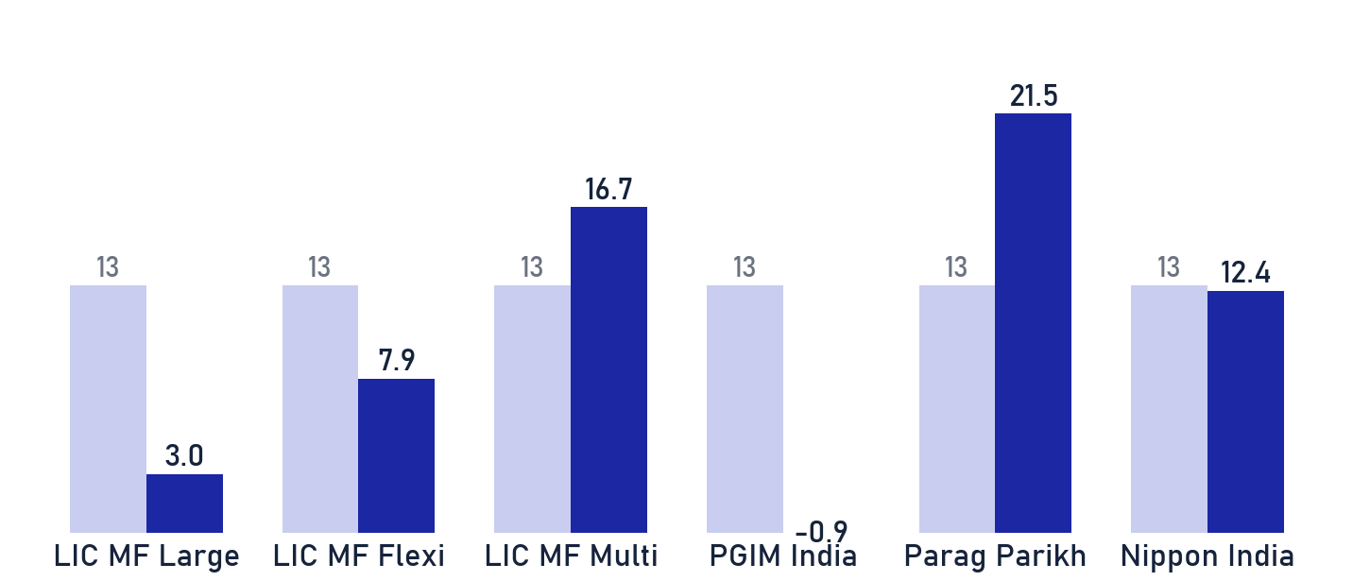
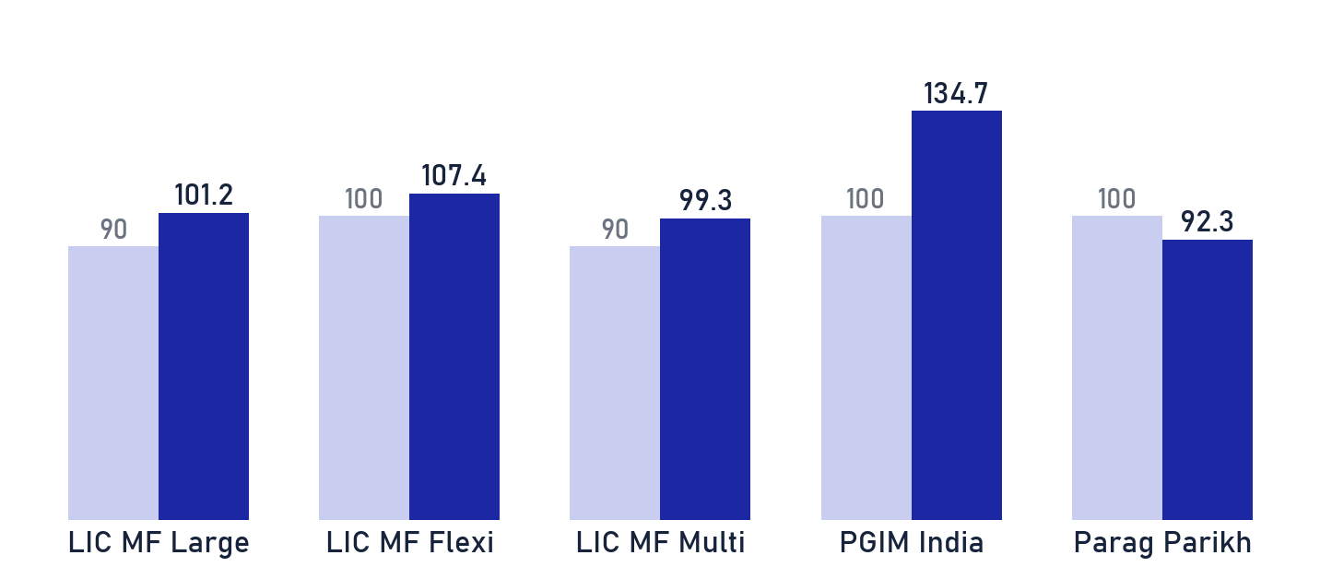
Private & Confidential
03 · FUNDS
Equity funds vs benchmark
Three-year record against the index, and the desk's call
SCOPE MF sleeve · equity & index schemes · Direct-plan NAV vs total-return benchmark · as of 2026-07-25
THE LONG-TERM TEST · 3-YEAR RECORD VS INDEX
SCHEME
3Y CAGR
VS BM
DESK CALL
LIC MF Large Cap
3.0%
-9.7
SWITCH
LIC MF Flexi Cap
7.9%
-4.8
SWITCH
LIC MF Multi Cap
16.7%
+4.0
SWITCH
PGIM India Small
-0.9%
-13.6
EXIT
Parag Parikh Flexi
21.5%
+8.8
HOLD
THE SHORT-HORIZON TEST · PARTICIPATION IN FALLS VS THE CUTOFF
Nippon India Nifty
12.4%
-0.3
HOLD
WHERE THE CALLS COME FROM
Fund calls follow our fund-quality frameworks, a long-term view and a short-horizon overlay, refreshed regularly. This review applies those calls to your holdings; it does not re-score the funds.
Navy = fund, light = the framework's line · below the line passes
3y CAGR vs total-return benchmark, Direct-plan NAV · fund recommendations per the Ionic MF desk (long-term + short-term frameworks) · illustrative synthetic funds.
Portfolio Review · 22

Slide 23
Private & Confidential
03 · FUNDS
Hybrid funds · return-for-risk, drawdown, worst year
A hybrid earns its keep in the bad year, not the good one
SCOPE MF sleeve only: hybrid schemes · Direct-plan NAV vs TR benchmark · as of 2026-07-25
SCHEME
SORTINO
CALMAR
MAX DD
WORST 1-YR
DOWN-CAP
VERDICT
ICICI Pru Multi-Asset (Reg)
3.75
2.59
-11.0%
+8.2%
71%
TO-DIRECT
LIC MF Balanced Advantage
1.93
0.89
-15.7%
-3.3%
79%
TRIM
HDFC Balanced Advantage
5.57
4.18
-8.4%
+15.8%
57%
HOLD
OUR BIAS, FUND BY FUND why each verdict stands
LIC MF BALANCED ADVANTAGE · TRIM
ICICI PRU MULTI-ASSET · TO-DIRECT
HDFC BALANCED ADVANTAGE · HOLD
Our bias is Trim, on scale and record, not results. Under four years old, sub-scale, 79% down-capture so far is fine; it cannot yet carry a full allocation next to the proven core.
To-Direct, not a quality call. The fund passes the bad-year test: +8.2% worst year, 71% down-capture, Sortino 3.75. The identical fund is available Direct; the Regular-plan trail is pure avoidable cost. We keep the exposure and change the plan.
Stays a Hold. A +15.8% worst year at 57% down-capture (Sortino 5.57) means it gives up some upside and buys back the bad year, which is exactly the trade a hybrid is hired for. The book's benchmark for the category.
Sortino / Calmar, max drawdown, worst 1-yr rolling return & down-capture vs total-return benchmark; Direct-plan NAV. Illustrative synthetic funds.
Portfolio Review · 23

Slide 24
Private & Confidential
03 · FUNDS
Category & structure · preference rules
Two rules that decide the vehicle, before performance
RULE 1
RULE 2
Flexi-Cap > Multi-Cap
Factor / Passive > Active Large-Cap
WHY
WHY
Multi-Cap carries a SEBI 25/25/25 floor, a hard minimum in large, mid and small caps, so it can't shift with the cycle. A Flexi-Cap runs the same brief with full cap freedom at a similar fee. We'd rather size mid/small ourselves than pay for a locked mandate.
Net-of-fee alpha in active Large-Cap is thin and inconsistent, and the held scheme has trailed its index over both 3 and 5 years. A low-cost passive or factor Large-Cap secures the same beta and frees the fee budget for categories where active management can pay.
IN THIS BOOK
IN THIS BOOK
LIC MF Multi Cap
LIC MF Large Cap
SWITCH TO FLEXI
SWITCH TO PASSIVE/FACTOR
AMC CONCENTRATION
4 of your 9 schemes (~15.9% of the book) sit with a single AMC, LIC MF. That concentrates house-style and single-manager risk; diversifying the switch targets across fund houses is part of the fix.
SEBI category framework (25/25/25 multi-cap floor) · net-of-fee alpha and r² measured vs total-return benchmark. Rules applied to the held schemes. Illustrative synthetic funds.
Portfolio Review · 24

Slide 25
Private & Confidential
03 · FUNDS
Fund actions
Every action is structural, never a performance sale
No fund here is sold on performance alone. Each action is structural: mandate, cost, scale or consistency. Where a scheme mostly re-buys index names you already hold directly, the cleaner replacement is a low-cost index sleeve (Nifty 50 / Nifty 500 class) rather than paying an active fee twice.
SWITCH
LIC MF Large Cap
REDEEM TO DIRECT
ICICI Pru Multi-Asset (Reg)
NEG_ALPHA · DOWN_CAP_HI · HELD ~9Y, COSTLIER TO SWITCH
REG_PLAN_DRAG · HELD ~6Y, COSTLIER TO SWITCH
Trails the large-cap index by 4-5pp a year over 3 and 5 years; active fees for below-index outcomes.
The identical fund is available Direct; the Regular-plan trail is pure avoidable cost.
Measured against a low-cost Large-Cap Index / Factor fund
Measured against the same fund's Direct plan
SWITCH
LIC MF Flexi Cap
EXIT
PGIM India Small Cap
NEG_ALPHA · WEAK_CONSIST
DEEP_DD · NEG_ALPHA · OVER_ALLOC
Trails the broad market by ~4pp a year over five years; the record misses our consistency bar.
Sub-scale ~3L beside a larger small-cap fund; persistent underperformance and duplication, structural exit.
Measured against a top-quartile Flexi-Cap from the approved list
Measured against the primary small-cap sleeve already held
SWITCH
LIC MF Multi Cap
TRIM
LIC MF Balanced Advantage
MANDATE_RIGIDITY
SUB_SCALE · SHORT_RECORD · REG_PLAN_DRAG
Multi-cap's SEBI 25/25/25 floor forces small/mid we prefer to size ourselves, structural, not performance.
Under four years of record, sub-scale, Regular plan; we fold the sleeve into the proven hybrid held.
Measured against a Flexi-Cap (manager-flexible cap mix)
Measured against the hybrid core already held (HDFC BAF, Direct)
Category exemplar = the fund our quality framework ranks best in the category, used as the measuring stick, not a recommendation to buy it. Whether a replacement is named is a compliance decision. Synthetic demo funds.
Portfolio Review · 25

Slide 26

Private & Confidential
04
SECTION 04
What We Would Do
The calls, the cost and the tax
House-view fit
What you're paying today
Tax impact
Your priority actions

Slide 27
Private & Confidential
04 · RECOMMENDATIONS
House-view fit
Where the plan aligns with Ionic's positioning · and where a gap stays open
Each recommendation, checked against how Ionic is currently positioned.
DIMENSION
IONIC HOUSE VIEW
WHAT THE PLAN DOES
FIT
Domestic equity
Incrementally positive
Core book kept; only sub-gate names sold and the two >11% positions trimmed toward guideline.
ALIGNED
Foreign equity
~15% target, under-owned
~28% of net proceeds seeds a global sleeve, a first step; the full ~15% target is phased over cycles.
GAP
Gold & silver
Positive, 75:25
New gold–silver sleeve (75:25) added from proceeds; still building toward the ~5% target.
GAP
Momentum
On hold
No momentum chase, every sell is fundamentals-driven, not a price-trend call.
ALIGNED
Low-vol / value
Favoured
Largest redeployment sleeve is a low-vol / value core, the closest-substitute risk profile.
ALIGNED
READ
The plan pulls the book toward the house view where it is off. Two gaps stay open by design, foreign and gold are built in steps, not funded in a single cycle.
Ionic house view · illustrative for this demo · as of 2026-07-25.
Portfolio Review · 27

Slide 28
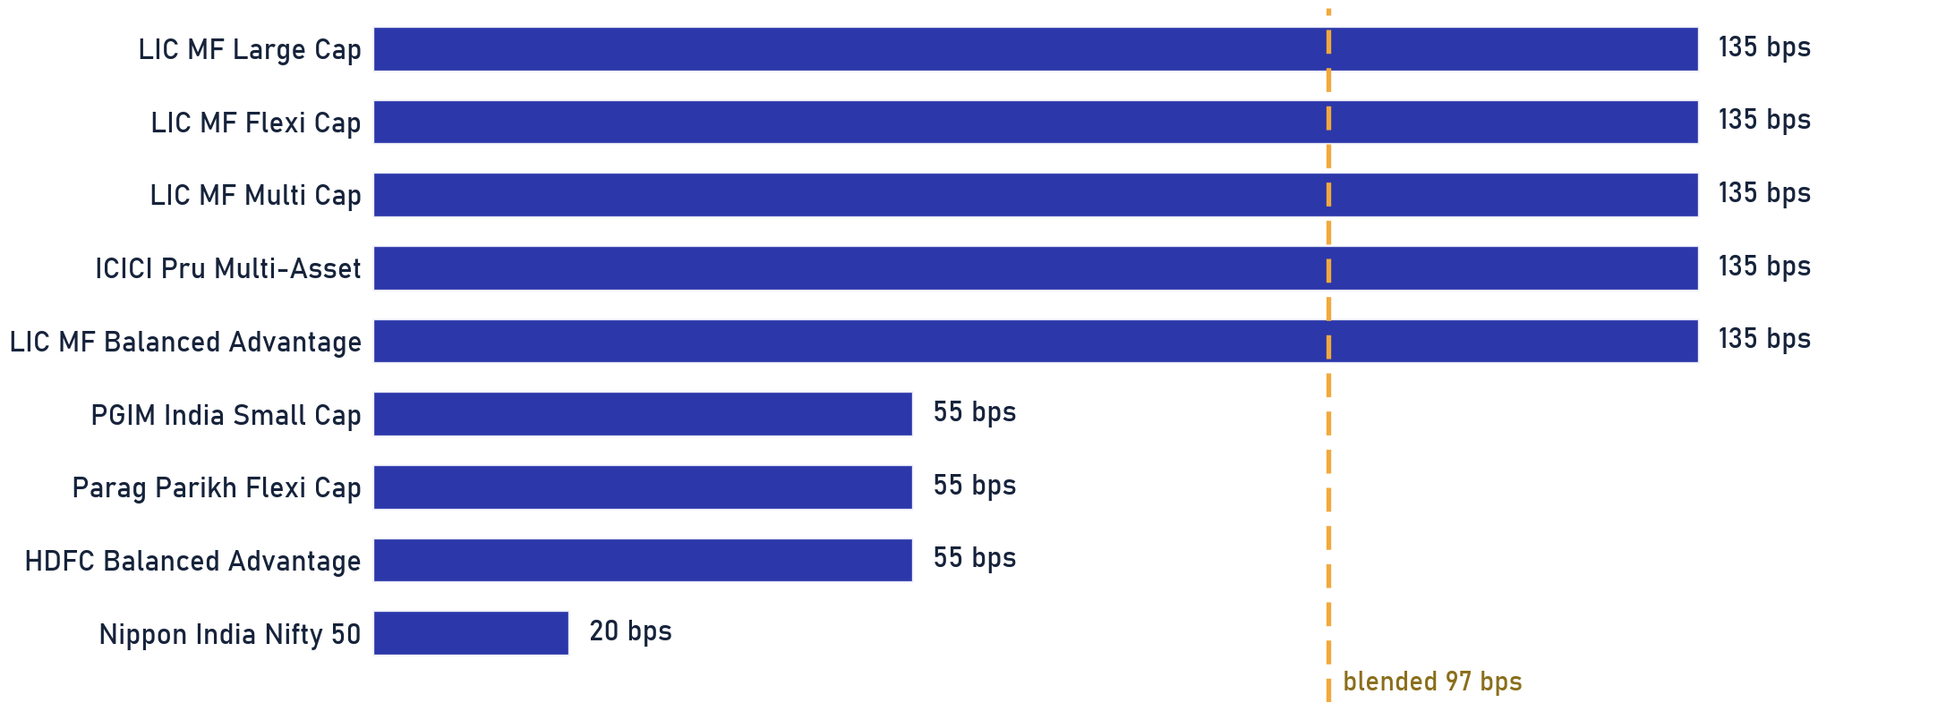
Private & Confidential
04 · RECOMMENDATIONS
What you're paying today
Fund-level cost of ownership · what each scheme charges
Rs 2.2 L
97 bps
20–135 bps
FUND FEES, A YEAR
BLENDED FUND TER
COST SPREAD
97 bps blended
value-weighted, current plan
cheapest to priciest holding
NEXT STEP A full fee-optimisation run across alternatives is available on request.
Basis: scheme Total Expense Ratio (current plan) from scheme documents, weighted by holding value. Illustrative for the ABXY demo.
Portfolio Review · 28

Slide 29
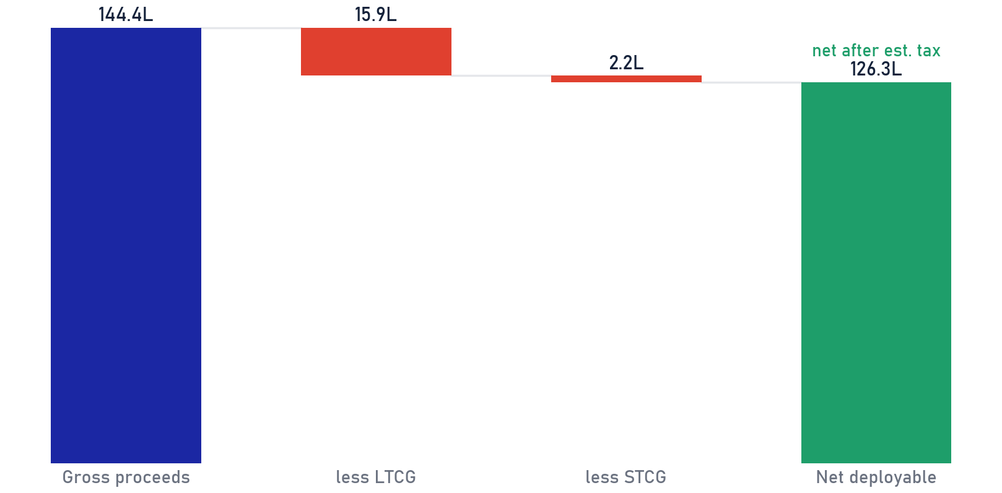
Private & Confidential
04 · RECOMMENDATIONS
Tax impact of this plan
What the recommended moves trigger · before you authorise anything
MUTUAL-FUND ACTIONS · EST. TAX CHARACTER PER MOVE
DIRECT-EQUITY SELLS & TRIMS · NET OF EST. TAX
ACTION
SCHEME
AMOUNT
TAX CHARACTER
SWITCH
LIC MF Large Cap
Rs 38.1 L
LTCG
SWITCH
LIC MF Flexi Cap
Rs 28.6 L
LTCG
SWITCH
LIC MF Multi Cap
Rs 22.2 L
LTCG
REDEEM
ICICI Pru Multi-Asset (Reg)
Rs 25.4 L
Mixed, lot-by-lot
EXIT
PGIM India Small Cap
Rs 2.9 L
LTCG
TRIM
LIC MF Balanced Advantage
Rs 19.0 L
LTCG
Total fund actions
Rs 1.36 Cr
Net after est. tax feeds the deployment plan.
DIRECT-EQUITY TAX: ESTIMATE FOR NOW
LONG-HELD UNITS: A HIGHER BAR TO SELL
The equity tax opposite is an estimate; the exact bill needs the demat trade file (buy dates + cost per lot), not in the statement provided.
Units held >5y (>10y more so) carry gains that offset switching alpha; their bar rises to structural-only. Stocks get no such pass.
Left: mutual-fund actions. Right: direct-equity sell/trim plan. Tax characterisations are indicative and preliminary, confirm holding period, character and applicable rates with the client's tax adviser before dealing. Illustrative.
Portfolio Review · 29

Slide 30
Private & Confidential
04 · RECOMMENDATIONS
Your priority actions
What we'd do next · in order, with amounts
Rs 1.44 Cr
6
Rs 1.26 Cr
GROSS FREED
FUND ACTIONS
NET PROCEEDS
sells + trim
switch / redeem / exit
to cash, after est. tax
1
Sell programme
Rs 1.31 Cr
10 names scored below the gate, staged in slices at <=10% ADV.
WAVE 1
p.17
2
Trim concentration
Rs 13.6 L
Positions above the 8% single-name guideline eased or exited, into strength.
THIS CYCLE
p.09
3
Fund actions
Rs 1.36 Cr
6 switches / redeem-to-Direct / exit, Regular to Direct or passive; exit the sub-scale sleeve.
T+2–T+3
p.25
4
Park net proceeds
Rs 1.26 Cr
Held in liquid / overnight funds; deployment is agreed separately (transition framework in the annexure).
ON AUTHORISATION
p.32
AUTHORISATION Nothing executes until you authorise it, this is a Non-Discretionary (NDPMS) mandate.
Reviewed with client on ____________________
Amounts illustrative for the ABXY demo · net figures after estimated tax · as of 2026-07-25.
Portfolio Review · 30

Slide 31

Private & Confidential
05
SECTION 05
Annexure
Detail and frameworks, on request
Transition framework
Before and after
Holding spotlights
All holdings, scored
Sell rationale cards

Slide 32
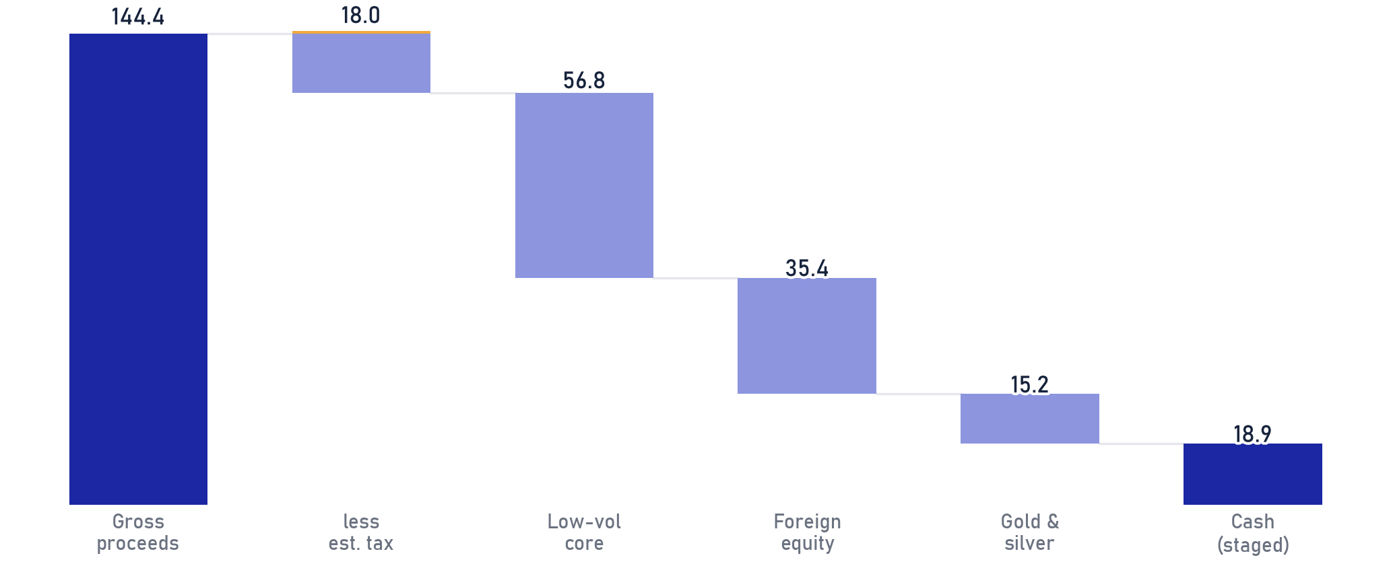
Private & Confidential
05 · ANNEXURE
Transition framework · on request
How net proceeds could be staged, sequenced by liquidity
SEQUENCING
1
Execute clear-Sell names first, conviction-driven, not market-timing.
2
Stage by liquidity: largest / least-liquid names sliced across days at <=10% ADV.
3
Fund switches settle T+2/T+3; redeploy only settled cash.
Low-vol / value core add Rs 56.8 L Closest-substitute risk profile to what's being sold.
4
Trim the two >11% positions toward the 8% single-name guideline last, into strength.
Foreign / global equity Rs 35.4 L Closes the ~12pt gap to the 15% foreign target, a real…
Gold & silver sleeve Rs 15.2 L Adds the missing 4pt vs the 5% target.
PERSONALISED TO THIS MANDATE
Education 2031 · foreign sleeve doubles as the USD hedge
Cash (staged) Rs 18.9 L Held as cash until settlement; deployed on liquidity, never…
Liquidity · Rs 25L 12-month call met by staged cash
Tax posture · 5y+ fund units: structural switches only
Annexure framework, not a recommendation: no scheme or security is being recommended here. Sequencing reflects liquidity and settlement logic, not a market-timing call; sleeves are illustrative and nothing executes without your authorisation. Amounts are net of estimated tax.
Portfolio Review · 32

Slide 33
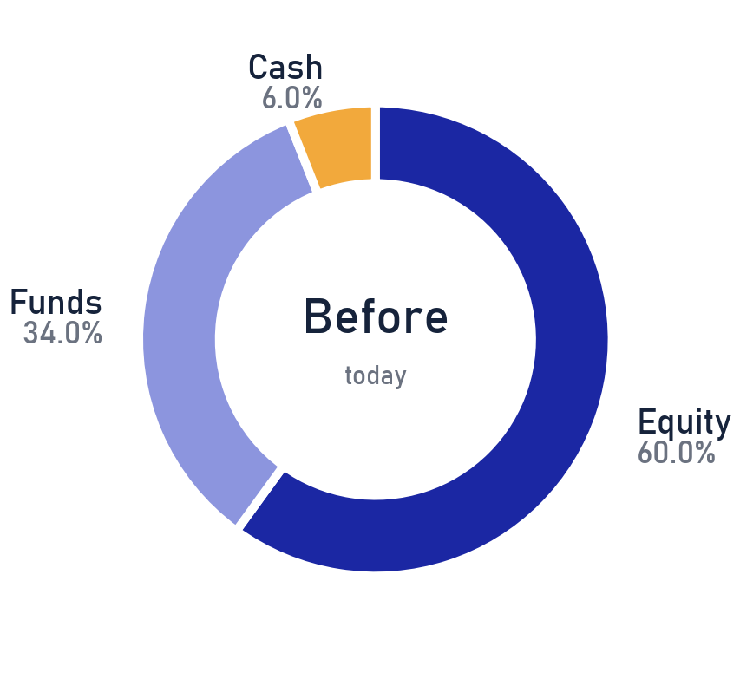
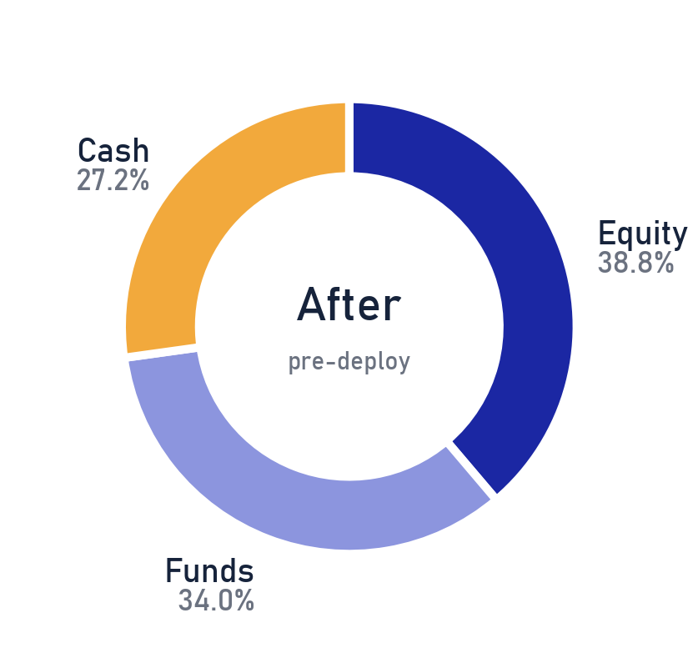
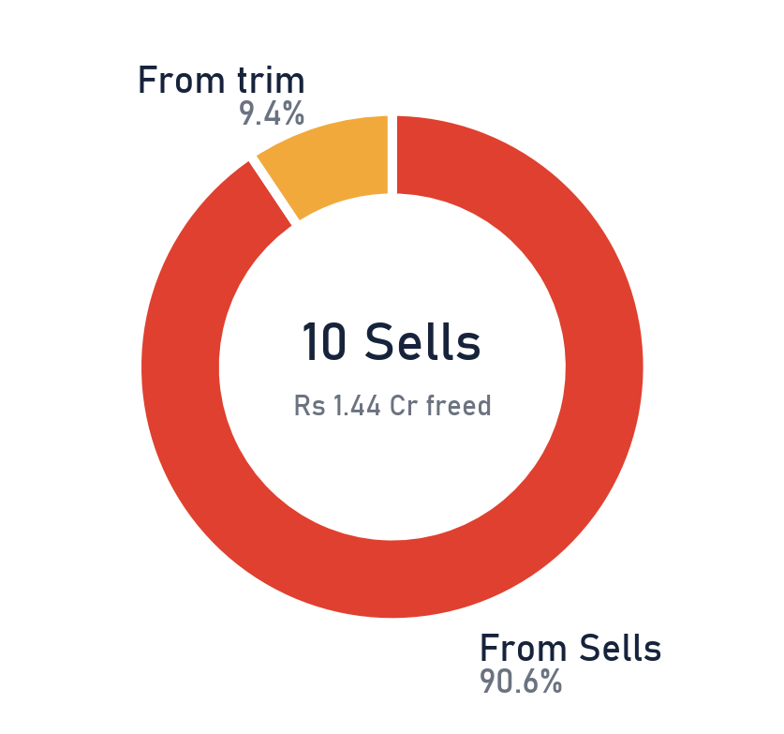
Private & Confidential
05 · ANNEXURE
Before and after
What the book looks like once the sells and trims settle · cash freed, not redeployed
ASSET MIX, TODAY
AFTER SELLS (PRE-DEPLOY)
PROCEEDS to CASH
FREED CASH
Rs 1.44 Cr is freed to cash after execution and stays in cash until deployment is agreed separately, never auto-invested; the staging framework sits on the previous page.
Fund switches are like-for-like within the fund sleeve, so the mix above moves only with equity sells and the trim. Direct-equity only for the sell/trim step; as of 2026-07-25.
Portfolio Review · 33

Slide 34
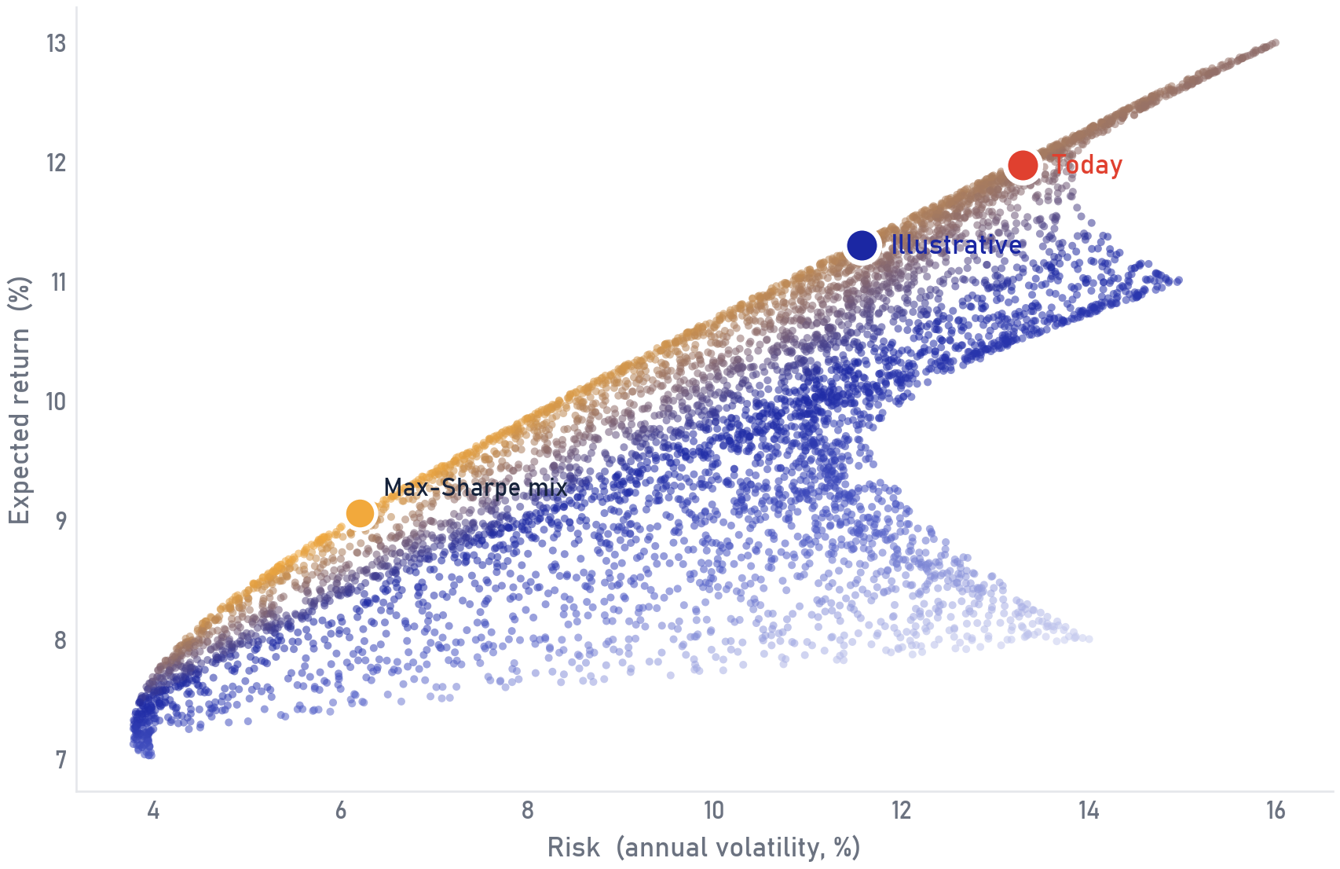
Private & Confidential
05 · ANNEXURE
Opportunity set
Long-run risk and return, and where the book can move
WHAT THIS SHOWS
Each dot is a feasible mix of the four assets; up is more expected return, right is more risk. The gold dot is the best risk-adjusted (max-Sharpe) mix on these assumptions.
TODAY VS AN ILLUSTRATIVE MIX
The book today (rust) is concentrated in Indian equity with little foreign or gold. The navy marker is an illustrative diversified mix for discussion · it shows the direction the frontier points, it is not a recommendation.
Illustrative long-run capital-market assumptions (expected return / risk, % p.a.): Indian eq 13/16 · Foreign eq 11/15 · Debt 7/4 · Gold 8/14. Not a forecast, not a recommendation.
Portfolio Review · 34

Slide 35
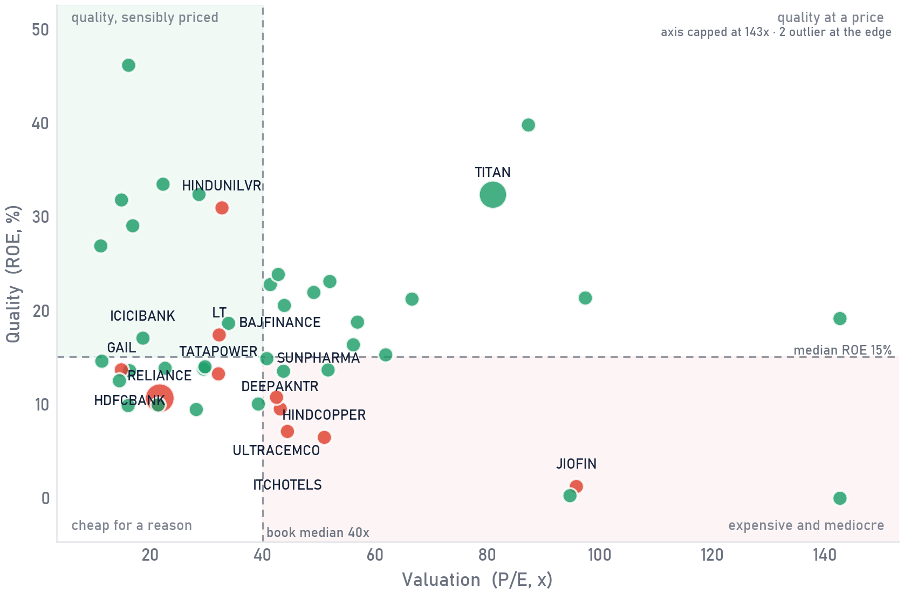
Private & Confidential
05 · ANNEXURE
Quality vs price
Every holding on quality against valuation
SCOPE Direct equity only · as of 2026-07-25
HOW TO READ IT
Right = pricier (higher P/E). Up = higher quality (higher ROE). Bubble size = position size in the book. The sweet spot is top-left · quality you are not overpaying for.
THE CALL
Hold
Sell
46 of 47 holdings shown (names with a reported P/E and ROE). Bubble colour = current call; the largest positions and every Sell are named; dashed lines = book medians.
Portfolio Review · 35

Slide 36
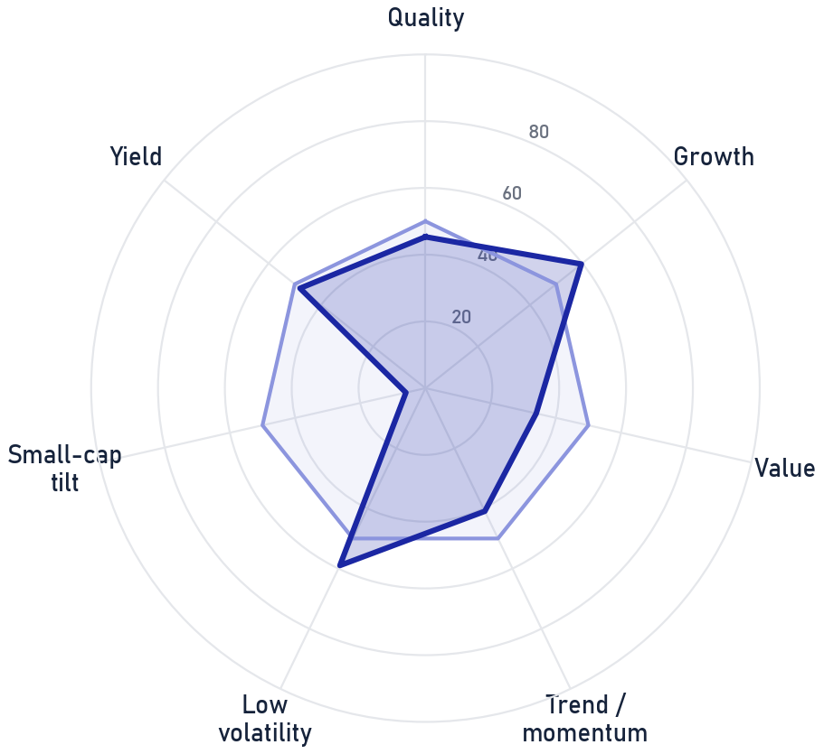
Private & Confidential
05 · ANNEXURE
Factor profile
What the book is tilted toward, versus a neutral benchmark
SCOPE Direct equity only · as of 2026-07-25
WHAT THE BOOK LEANS INTO
Growth (60); Low volatility (59). A quality-and-trend tilt, as you'd expect from a large-cap core.
WHERE IT IS LIGHT
Small-cap tilt (6); Value (34); Trend / momentum (41). These are the diversifiers the proposed changes lean toward.
This book
Neutral (50)
Illustrative factor tilts approximated from the book's weighted 3Y/1Y scores, growth, valuation and market-cap mix; 50 = neutral benchmark.
Portfolio Review · 36

Slide 37
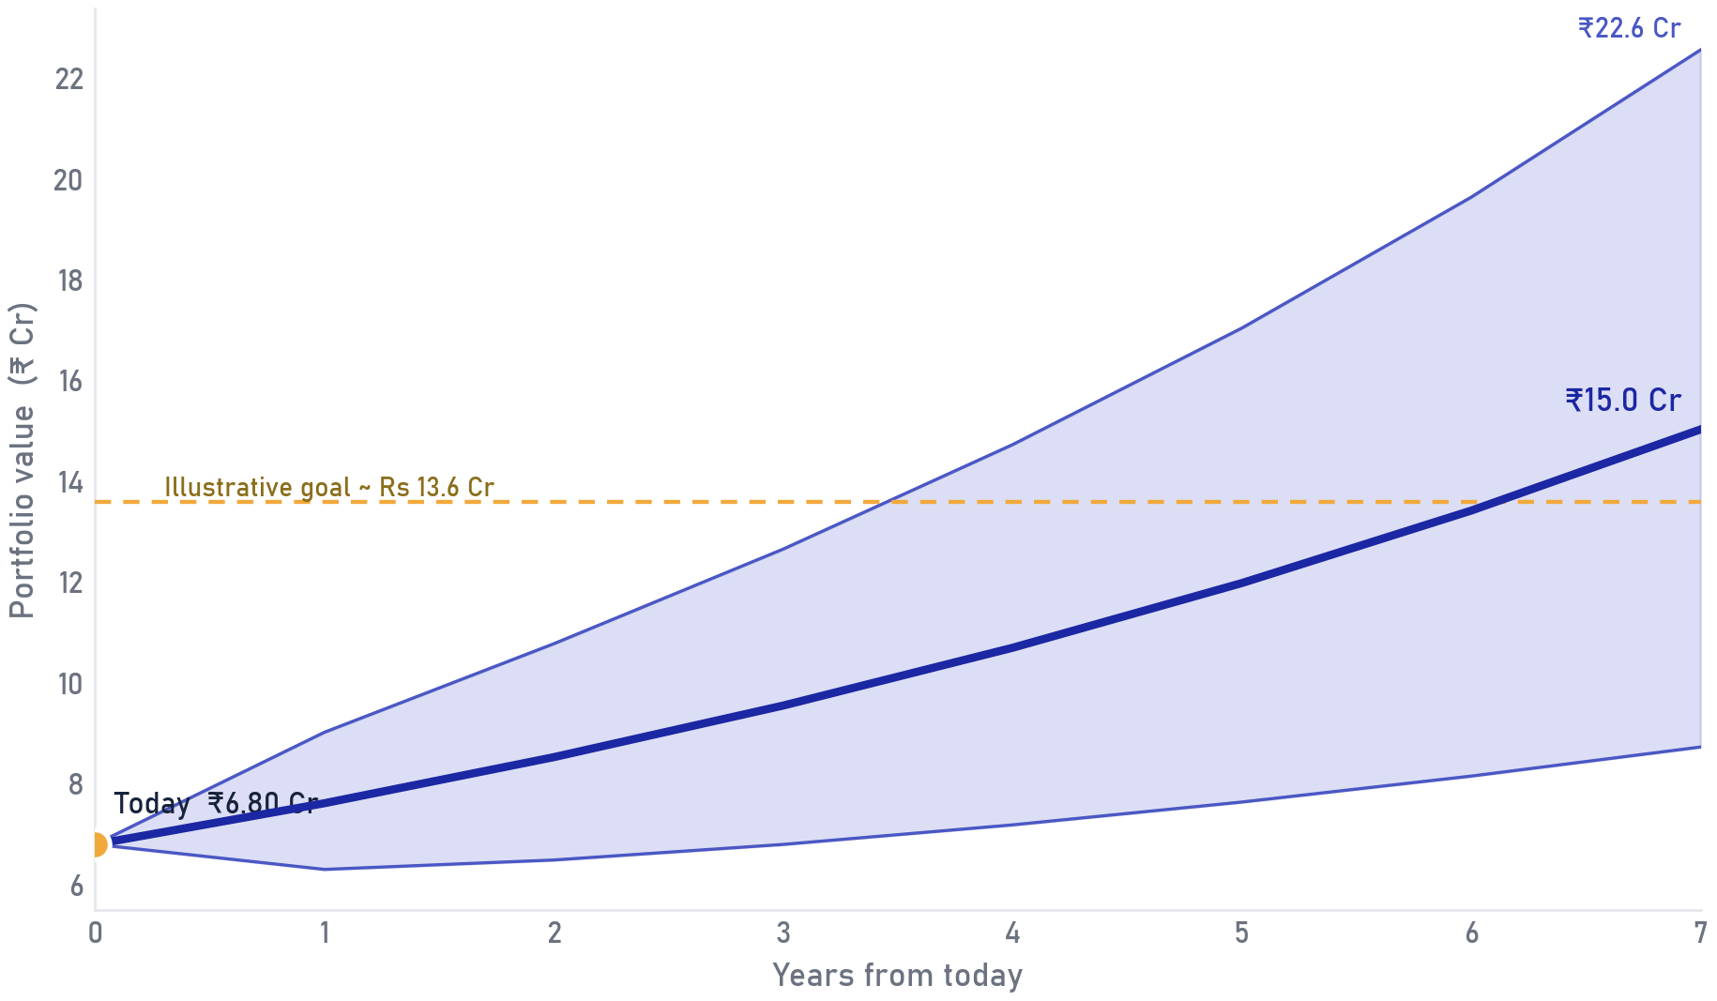
Private & Confidential
05 · ANNEXURE
Growth projection
An illustrative path for the portfolio over the horizon
ASSUMPTIONS
Median path from ₹6.80 Cr at an assumed 12% p.a. return and 14% volatility over 7 years. The dashed line is an illustrative wealth goal.
READ THE BAND
Read the band, not the line: the shaded area is the 10th-to-90th-percentile range. Outcomes compound path-dependently and will differ from any single number.
Illustrative projection on assumed return/volatility; not a forecast, guarantee, or indication of future returns. Actual outcomes will differ.
Portfolio Review · 37

Slide 38
Private & Confidential
05 · ANNEXURE
Spotlight
Reliance Industries Ltd. · Oil Gas & Consumable Fuels · 12.4% of the book
IONIC SCORE
OUR READ
24
At 21.7x trailing earnings for bottom-quartile quality and value scores, with free cash flow still slightly negative as a second capex supercycle begins and six- and twelve-month momentum both negative, the price leaves no margin of safety, we call Sell.
24
3Y 26 · 1Y 22
SELL
Large-cap · Exit
THE CALL, SELL
Exit, the forward risk/reward no longer justifies the position. Driver: Quality below peers.
BACK TO THE BOOK · p.15
Ionic Score is a quantitative input; the Portfolio Review team confirms every call. Point-in-time as of 2026-07-21.
The score is the starting point; the final word on every name belongs to the desk.
Portfolio Review · 38

Slide 39
Private & Confidential
05 · ANNEXURE
Spotlight
Titan Company Ltd. · Consumer Durables · 11.3% of the book
IONIC SCORE
OUR READ
44
Titan's FY26 headline growth (33% full-year revenue, 46-50% in Q4) is real but importantly gold-price and gold-coin-mix inflated - true buyer/volume growth only recovered to high-single-digits in Q4FY26 after three near-flat quarters, and company-blended operating margin compressed from 11% to 7% quarter-on-quarter as low-margin coin/investment-gold volume nearly tripled.
44
3Y 46 · 1Y 43
HOLD
Large-cap · Watch
THE CALL, HOLD
Keep the position (Watch conviction).
BACK TO THE BOOK · p.15
Ionic Score is a quantitative input; the Portfolio Review team confirms every call. Point-in-time as of 2026-07-21.
Numbers shortlist, judgment decides: every call passed a human review.
Portfolio Review · 39

Slide 40
Private & Confidential
05 · ANNEXURE
Spotlight
Bajaj Finance Ltd. · Financial Services · 3.0% of the book
IONIC SCORE
OUR READ
56
Bajaj Finance remains India's best-capitalised, best-asset-quality large NBFC, CRAR 21.6% against a 15% floor, gearing a conservative ~3.8x, GNPA/NNPA even at its FY25 stress peak (~1.24%/0.60%) still better than most peers' clean-cycle numbers, clean promoter governance with no pledge history, and a 124-million-customer distribution franchise reaccelerating AUM growth to +24% YoY in Q1 FY27.
56
3Y 53 · 1Y 60
HOLD
Large-cap · Watch
THE CALL, HOLD
Keep the position (Watch conviction).
BACK TO THE BOOK · p.15
Ionic Score is a quantitative input; the Portfolio Review team confirms every call. Point-in-time as of 2026-07-21.
The Ionic Score flags candidates; the Portfolio Review team confirms every call.
Portfolio Review · 40

Slide 41
Private & Confidential
05 · ANNEXURE
All holdings, scored
The whole book, scored (page 1 of 3)
SCOPE Direct equity only · as of 2026-07-25
HOLDING
SECTOR
WT %
IONIC
3Y
1Y
CALL
RELIANCE
Oil & Gas
12.40
24
26
22
SELL
TITAN
Cons. Durables
11.30
44
46
43
HOLD
BAJFINANCE
Financials
2.96
56
53
60
HOLD
HDFCBANK
Financials
2.62
50
54
44
HOLD
ICICIBANK
Financials
2.33
61
59
63
HOLD
TATAPOWER
Power
1.93
32
34
28
SELL
SBIN
Financials
1.76
59
68
46
HOLD
SUNPHARMA
Healthcare
1.59
54
54
54
HOLD
BHARTIARTL
Telecom
1.54
50
47
56
HOLD
M&M
Auto & Comp.
1.42
50
51
47
HOLD
ITC
FMCG
1.37
46
52
36
HOLD
LT
Construction
1.25
40
46
30
SELL
TATASTEEL
Metals & Mining
1.14
48
56
37
HOLD
HINDALCO
Metals & Mining
1.02
58
68
43
HOLD
MARUTI
Auto & Comp.
0.97
54
55
51
HOLD
JIOFIN
Financials
0.91
37
36
38
SELL
DEEPAKNTR
Chemicals
0.85
39
33
48
SELL
PIDILITIND
Chemicals
0.80
51
46
58
HOLD
Scores flag, people decide: each call here carries a named reviewer's sign-off.
Portfolio Review · 41

Slide 42
Private & Confidential
05 · ANNEXURE
All holdings, scored
The whole book, scored (page 2 of 3)
SCOPE Direct equity only · as of 2026-07-25
HOLDING
SECTOR
WT %
IONIC
3Y
1Y
CALL
ABB
Capital Goods
0.74
62
67
54
HOLD
SIEMENS
Capital Goods
0.68
51
50
52
HOLD
BHEL
Capital Goods
0.63
48
47
49
HOLD
POWERINDIA
Capital Goods
0.57
58
64
50
HOLD
GAIL
Oil & Gas
0.51
34
30
39
SELL
CIPLA
Healthcare
0.51
51
48
54
HOLD
APLAPOLLO
Capital Goods
0.46
65
70
57
HOLD
PERSISTENT
IT
0.46
46
46
44
HOLD
COCHINSHIP
Capital Goods
0.40
43
51
31
HOLD
HINDCOPPER
Metals & Mining
0.34
48
60
29
SELL
TATATECH
IT
0.34
48
45
52
HOLD
BOSCHLTD
Auto & Comp.
0.28
49
50
48
HOLD
NATIONALUM
Metals & Mining
0.28
62
77
39
HOLD
MOTHERSON
Auto & Comp.
0.23
67
70
62
HOLD
VBL
FMCG
0.23
45
51
37
HOLD
ULTRACEMCO
Cement
0.17
36
35
39
SELL
BANDHANBNK
Financials
0.13
63
60
67
HOLD
IRCTC
Cons. Services
0.10
49
51
45
HOLD
The score is the starting point; the final word on every name belongs to the desk.
Portfolio Review · 42

Slide 43
Private & Confidential
05 · ANNEXURE
All holdings, scored
The whole book, scored (page 3 of 3)
SCOPE Direct equity only · as of 2026-07-25
HOLDING
SECTOR
WT %
IONIC
3Y
1Y
CALL
ITCHOTELS
Cons. Services
0.07
40
34
48
SELL
CMSINFO
Services
0.06
42
45
36
HOLD
TCS
IT
1.19
41
43
38
HOLD
INFY
IT
0.91
46
51
40
HOLD
HINDUNILVR
FMCG
0.80
38
42
32
SELL
BEL
Capital Goods
0.57
55
59
49
HOLD
SCHAEFFLER
Auto & Comp.
0.40
50
50
50
HOLD
SUZLON
Capital Goods
0.34
79
82
74
HOLD
DIXON
Diversified
0.20
50
50
50
HOLD
ETERNAL
Cons. Services
0.16
46
43
52
HOLD
ANANDRATHI
Financials
0.09
67
68
65
HOLD
Numbers shortlist, judgment decides: every call passed a human review.
Portfolio Review · 43

Slide 44
Private & Confidential
05 · ANNEXURE
Sell rationale
Reliance Industries Ltd. · Quality below peers
IONIC SCORE
24
24
3Y 26 · 1Y 22 · 12.40% of book
SELL
WHY IT'S ON THE SELL LIST
THE BULL WE REJECTED
Return quality is mediocre for the multiple the market pays across RIL's segments individually: ROE of 10.6% and ROCE of 13.7% are unremarkable for a conglomerate carrying this valuation, and free cash flow remains slightly negative (an FCF yield of about -0.2%) as a second major capex cycle (New Energy, Rs 75,000 crore Phase 1) begins layering…
Both of RIL's two largest, best-understood segments hit record quarterly EBITDA in Q1 FY27: O2C at Rs 17,010 crore (+17.2% YoY, a 4-year high, on a GRM recovery to an estimated $23/bbl from ~$12/bbl a year ago) and Jio Platforms at Rs 20,865 crore (+15.1% YoY), with ARPU up to Rs 215.6 and 8.9 million net subscriber additions taking the base to…
REVERSE-DCF: MARGIN OF SAFETY
WHAT WOULD CHANGE OUR MIND
Building a conservative, judgment-based sum-of-the-parts rather than a formula-driven DCF: (1) O2C, using FY26 full-year segment EBITDA of roughly Rs 60,500 crore (a fairer base than annualizing this quarter's cyclically strong GRM print) and a 7-9x EV/EBITDA multiple appropriate for a mature, cyclical, globally oversupplied…
A durable step-up in ROE / margins back to peer level, sustained over several quarters.
BACK TO THE SELL LIST · p.17
Analyst-confirmed Sell. Point-in-time as of 2026-07-21.
The Ionic Score flags candidates; the Portfolio Review team confirms every call.
Portfolio Review · 44

Slide 45
Private & Confidential
05 · ANNEXURE
Sell rationale
Tata Power Co. Ltd. · Balance-sheet strain
IONIC SCORE
32
32
3Y 34 · 1Y 28 · 1.93% of book
SELL
WHY IT'S ON THE SELL LIST
THE BULL WE REJECTED
Leverage is elevated and moving in the wrong direction: non-current borrowings jumped to Rs 61,609 cr in FY26 from Rs 44,130 cr, funding a capex plan (FY27 guided ~Rs 25,000 cr) that has already slipped once (FY26 actual capex of Rs 13,000 cr missed the original Rs 20,000-22,000 cr guide on right-of-way/evacuation delays), reported D/E…
The FY26 revenue decline is largely optics/one-off rather than a demand problem: the Mundra UMPP's Q4FY26 shutdown (Gujarat PPA expiry) is already resolved via a new supplemental PPA effective April 1, 2026, and part of the thermal-segment revenue fall simply reflects lower Indonesian coal costs passing through tariff formulas.
REVERSE-DCF: MARGIN OF SAFETY
WHAT WOULD CHANGE OUR MIND
At ~Rs 378 (17-Jul-2026, market cap ~Rs 120,500 cr), Tata Power trades at ~32x trailing earnings (on attributable PAT of ~Rs 3,747 cr across ~319 cr shares). For an 11.5%-ROCE, 13.2%-ROE capital-intensive conglomerate, that multiple is rich against pure regulated-utility comparables…
Genuine deleveraging · interest cover back above our comfort level and net-debt/EBITDA normalising toward peers.
BACK TO THE SELL LIST · p.17
Analyst-confirmed Sell. Point-in-time as of 2026-07-21.
Scores flag, people decide: each call here carries a named reviewer's sign-off.
Portfolio Review · 45

Slide 46
Private & Confidential
05 · ANNEXURE
Sell rationale
Larsen & Toubro Ltd. · Rich valuation, thin margin of safety
IONIC SCORE
40
40
3Y 46 · 1Y 30 · 1.25% of book
SELL
WHY IT'S ON THE SELL LIST
THE BULL WE REJECTED
FY26 revenue growth of 12% fell short of the company's own 15% guidance, and FY27 guidance was cut to a more modest 10-12% order-inflow/revenue growth with explicitly flattish margins, management itself is signaling deceleration.
Order book at an all-time high of ~Rs 7.40 lakh crore (+28% YoY) against FY26 revenue of Rs 2.86 lakh crore, roughly 2.6x book-to-bill, gives several years of visible revenue, on the back of the best order-inflow year (+22% YoY) in the company's history.
REVERSE-DCF: MARGIN OF SAFETY
WHAT WOULD CHANGE OUR MIND
At a current price of roughly Rs 3,850 (~32x trailing consolidated EPS, ~5.6x book, against a ~17% ROE), the market is pricing sustained mid-to-high-teens earnings compounding for several years, well above what management's own FY27 guidance (10-12% revenue growth, flattish margins) supports over the next one to two years.
A valuation reset (through time or price) that restores a real margin of safety at our reverse-DCF hurdle.
BACK TO THE SELL LIST · p.17
Analyst-confirmed Sell. Point-in-time as of 2026-07-21.
The score is the starting point; the final word on every name belongs to the desk.
Portfolio Review · 46

Slide 47
Private & Confidential
05 · ANNEXURE
Sell rationale
Jio Financial Services Ltd. · Rich valuation, thin margin of safety
IONIC SCORE
37
37
3Y 36 · 1Y 38 · 0.91% of book
SELL
WHY IT'S ON THE SELL LIST
THE BULL WE REJECTED
The bear case is that today's profitability doesn't support even the current, already-de-rated multiple. Consolidated ROE is roughly 1.1-1.2% on an ex-treasury-income basis and has not moved despite 150%+ NBFC book growth, this quarter's headline 156% PAT growth was more than half driven by a lumpy Rs 509 crore dividend/investment-income line…
The bull case is real, not promotional: Jio Credit's AUM has grown 2.6x YoY to Rs 30,667 crore with quarterly disbursements up 2.7x YoY to Rs 11,252 crore, funded by continued promoter capital infusions (Rs 9,890 crore cumulative) rather than balance-sheet stress, D/E is just 0.16, so there is no solvency risk while the ramp plays out.
REVERSE-DCF: MARGIN OF SAFETY
WHAT WOULD CHANGE OUR MIND
Using a simple justified-P/B framework, P/B = (ROE - g) / (COE - g), a multiple of ~1.1x against a plausible ~13% cost of equity for an Indian financial and a ~5% terminal growth assumption backs out an implied normalized ROE of roughly 13.5-14%, i.e., the market is pricing in JIOFIN eventually earning a return modestly ABOVE its…
A valuation reset (through time or price) that restores a real margin of safety at our reverse-DCF hurdle.
BACK TO THE SELL LIST · p.17
Analyst-confirmed Sell. Point-in-time as of 2026-07-21.
Numbers shortlist, judgment decides: every call passed a human review.
Portfolio Review · 47

Slide 48
Private & Confidential
05 · ANNEXURE
Sell rationale
Deepak Nitrite Ltd. · Rich valuation, thin margin of safety
IONIC SCORE
39
39
3Y 33 · 1Y 48 · 0.85% of book
SELL
WHY IT'S ON THE SELL LIST
THE BULL WE REJECTED
Valuation is rich on any reasonable basis: trailing P/E of about 42x at the Rs 1,708 close (EV/EBITDA near 23x) against earnings still well below the company's own historical run-rate, and an independent rating desk (MarketsMojo) downgraded the stock from Hold to Sell on July 2, 2026 explicitly citing stretched valuation.
Q4 FY26 delivered a real, board-reported margin inflection, OPM of 17.7-18%, up ~703bps QoQ and ~319bps YoY and the best in seven quarters, with net profit up 8.6% YoY to Rs 220 crore, and management guided further sequential improvement into Q1 FY27 on secured feedstock and cost optimization.
REVERSE-DCF: MARGIN OF SAFETY
WHAT WOULD CHANGE OUR MIND
At a trailing P/E of ~38-43x (Rs ~1,640-1,710 recent range, FY26 EPS ~Rs 40.4 on Rs 551 crore PAT), the market is pricing meaningful multi-year margin normalization on top of the current trough, plus real option value for the polycarbonate/downstream capex bridge.
A valuation reset (through time or price) that restores a real margin of safety at our reverse-DCF hurdle.
BACK TO THE SELL LIST · p.17
Analyst-confirmed Sell. Point-in-time as of 2026-07-21.
The Ionic Score flags candidates; the Portfolio Review team confirms every call.
Portfolio Review · 48

Slide 49
Private & Confidential
05 · ANNEXURE
Sell rationale
GAIL (India) Ltd. · Quality below peers
IONIC SCORE
34
34
3Y 30 · 1Y 39 · 0.51% of book
SELL
WHY IT'S ON THE SELL LIST
THE BULL WE REJECTED
The profit decline is not a single bad quarter, our data shows five consecutive quarters of falling consolidated net profit, from ~Rs 4,084 crore (quarter ended Dec-2024) to ~Rs 1,481 crore (quarter ended Mar-2026), a ~64% peak-to-trough erosion over 15 months, while quarterly sales stayed roughly flat (Rs 32,756-36,835 crore), confirming this…
The regulated transmission business, GAIL's core annuity, is growing, not stagnant: segment EBIT rose 13.5% YoY to ~Rs 6,229 crore in FY26, and City Gas Distribution grew revenue 22.3% YoY, the fastest segment in the portfolio, tied to India's structural CNG/PNG penetration push.
REVERSE-DCF: MARGIN OF SAFETY
WHAT WOULD CHANGE OUR MIND
At ~Rs 170, GAIL trades at ~15x trailing consolidated EPS and ~1.3x book against a 13.6% ROE, but the key judgment is that this 15x is being paid on an EPS base already depressed by the FY26 marketing-spread collapse and petrochem loss, not on a mid-cycle or peak number.
A durable step-up in ROE / margins back to peer level, sustained over several quarters.
BACK TO THE SELL LIST · p.17
Analyst-confirmed Sell. Point-in-time as of 2026-07-21.
Scores flag, people decide: each call here carries a named reviewer's sign-off.
Portfolio Review · 49

Slide 50
Private & Confidential
05 · ANNEXURE
Sell rationale
Hindustan Copper Ltd. · Rich valuation, thin margin of safety
IONIC SCORE
48
48
3Y 60 · 1Y 29 · 0.34% of book
SELL
WHY IT'S ON THE SELL LIST
THE BULL WE REJECTED
The FY26 profit surge is low-quality growth in the sense that matters for a re-rating case: ore production was up only 6% YoY (3.67 MT) and MIC sales up 12% YoY (27,369 tonnes), against 48.6% revenue growth and a near-doubling of profit, meaning copper-price pass-through, not incremental mining volume or operational execution, drove the…
HCL is a clearly scarce strategic asset: India's only vertically integrated copper miner-to-metal producer, a designated player in the 2025 National Critical Mineral Mission, a KABIL member (with NALCO/MECL) for overseas critical-mineral acquisition, and a June-2026 MoA with Engineers India Ltd covering copper, critical minerals and rare earths…
REVERSE-DCF: MARGIN OF SAFETY
WHAT WOULD CHANGE OUR MIND
At ~51x trailing EPS (Rs 9.52) and ~14x book, working backwards from the current ROE of ~32-33%, the market needs HCL to sustain something close to its just-completed price-and-volume growth spurt for several more years to justify today's price on a normalized basis, effectively treating FY26's profit-doubling quarter-by-quarter cadence as the…
A valuation reset (through time or price) that restores a real margin of safety at our reverse-DCF hurdle. For a commodity name, additionally: a confirmed upcycle, structural demand (electrification / AI build-out) showing up in realised earnings and supply deficits, not just in the metal price.
BACK TO THE SELL LIST · p.17
Analyst-confirmed Sell. Point-in-time as of 2026-07-21.
The score is the starting point; the final word on every name belongs to the desk.
Portfolio Review · 50

Slide 51
Private & Confidential
05 · ANNEXURE
Sell rationale
UltraTech Cement Ltd. · Rich valuation, thin margin of safety
IONIC SCORE
36
36
3Y 35 · 1Y 39 · 0.17% of book
SELL
WHY IT'S ON THE SELL LIST
THE BULL WE REJECTED
The valuation is clearly rich relative to current return ratios: ~42-46x trailing consolidated earnings (a ~20-25% premium to the cement sector's mid-30s average) against ROE of only 10.7% and ROCE of 16.9%, an independent bear source (Marketsmojo) reaches an explicit SELL on near-identical logic, arguing the multiple already prices in…
Capacity crossed 200 MTPA in April 2026, a year ahead of the company's own target, with a further roadmap to 212.7 MTPA (FY27) and 242.5 MTPA (FY28) plus a fresh 22.8 mtpa brownfield/greenfield tranche, funded entirely from internal accruals (FY26 capex Rs 9,680 crore against FY26 operating cash flow of Rs 15,320 crore, net debt/EBITDA ~0.94x).
REVERSE-DCF: MARGIN OF SAFETY
WHAT WOULD CHANGE OUR MIND
At a current price of roughly Rs 11,739 (market cap ~Rs 3.39 lakh crore) against FY26 consolidated PAT of Rs 8,305 crore (pre-exceptional), the stock trades at ~42-46x trailing earnings, the market is pricing several more years of double-digit EPS compounding plus meaningful margin expansion, not merely the ~8-10% organic volume growth…
A valuation reset (through time or price) that restores a real margin of safety at our reverse-DCF hurdle.
BACK TO THE SELL LIST · p.17
Analyst-confirmed Sell. Point-in-time as of 2026-07-21.
Numbers shortlist, judgment decides: every call passed a human review.
Portfolio Review · 51

Slide 52
Private & Confidential
05 · ANNEXURE
Sell rationale
ITC Hotels Ltd. · Quality below peers
IONIC SCORE
40
40
3Y 34 · 1Y 48 · 0.07% of book
SELL
WHY IT'S ON THE SELL LIST
THE BULL WE REJECTED
At ~44-46x trailing earnings for a company generating just a 7.0% ROE (12.6% ROCE), ITC Hotels is not cheap in absolute terms, and it sits mid-to-upper in its peer set (IHCL 54-67x, EIH ~27-33x, Chalet ~27-30x) despite EIH and Chalet plausibly running comparable or better returns on capital - some of the premium is a bet on mix-shift…
Q1 FY27 (reported 16 July 2026, after our scoring window closed) shows the business accelerating: consolidated revenue +14.8% YoY to Rs 936cr, PAT +36% YoY to Rs 182cr, EBITDA margin +112bps to 31.6%, RevPAR +8% YoY (ADR +4%, occupancy +290bps to 76% in owned/leased properties) while holding a 33% RevPAR premium over the industry, and management…
REVERSE-DCF: MARGIN OF SAFETY
WHAT WOULD CHANGE OUR MIND
At Rs 174.7 (16 July 2026) and ~44-46x trailing consolidated PAT (~Rs 821cr FY26 reported / a slightly higher TTM figure post-Q1FY27), for a company with just 7.0% ROE, the multiple is clearly NOT pricing today's return on capital - it is pricing a multi-year mix-shift story: rising asset-light management-fee income…
A durable step-up in ROE / margins back to peer level, sustained over several quarters.
BACK TO THE SELL LIST · p.17
Analyst-confirmed Sell. Point-in-time as of 2026-07-21.
The Ionic Score flags candidates; the Portfolio Review team confirms every call.
Portfolio Review · 52

Slide 53
Private & Confidential
05 · ANNEXURE
Sell rationale
Hindustan Unilever Ltd. · Quality below peers
IONIC SCORE
38
38
3Y 42 · 1Y 32 · 0.80% of book
SELL
WHY IT'S ON THE SELL LIST
THE BULL WE REJECTED
The headline profit numbers this year are not what they look like: the ice-cream demerger booked one-time gains of roughly Rs 4,611 crore (Q2FY26) and Rs 4,516 crore (Q3FY26), and Q4's reported 20% PAT growth similarly leans on a smaller divestment gain rather than operations - PAT before exceptional items grew just 4% in Q4, and Screener's own…
The Q4FY26 print is the strongest evidence in three years that HUL's demand engine is clearly turning: 6% underlying volume growth (best in 12 quarters) alongside 7% underlying sales growth means this is volume-led, not a price/mix illusion, and it shows up broadly - Home Care's best quarter in 11 quarters (fabric wash double-digit), Beauty &…
REVERSE-DCF: MARGIN OF SAFETY
WHAT WOULD CHANGE OUR MIND
At ~Rs 2,144 and ~33x trailing consolidated earnings (Screener, 17 July 2026), HUL trades at roughly half its own 2018-2020 premium (55-65x), so a lot of the growth de-rating is already in the price.
A durable step-up in ROE / margins back to peer level, sustained over several quarters.
BACK TO THE SELL LIST · p.17
Analyst-confirmed Sell. Point-in-time as of 2026-07-21.
Scores flag, people decide: each call here carries a named reviewer's sign-off.
Portfolio Review · 53

Slide 54
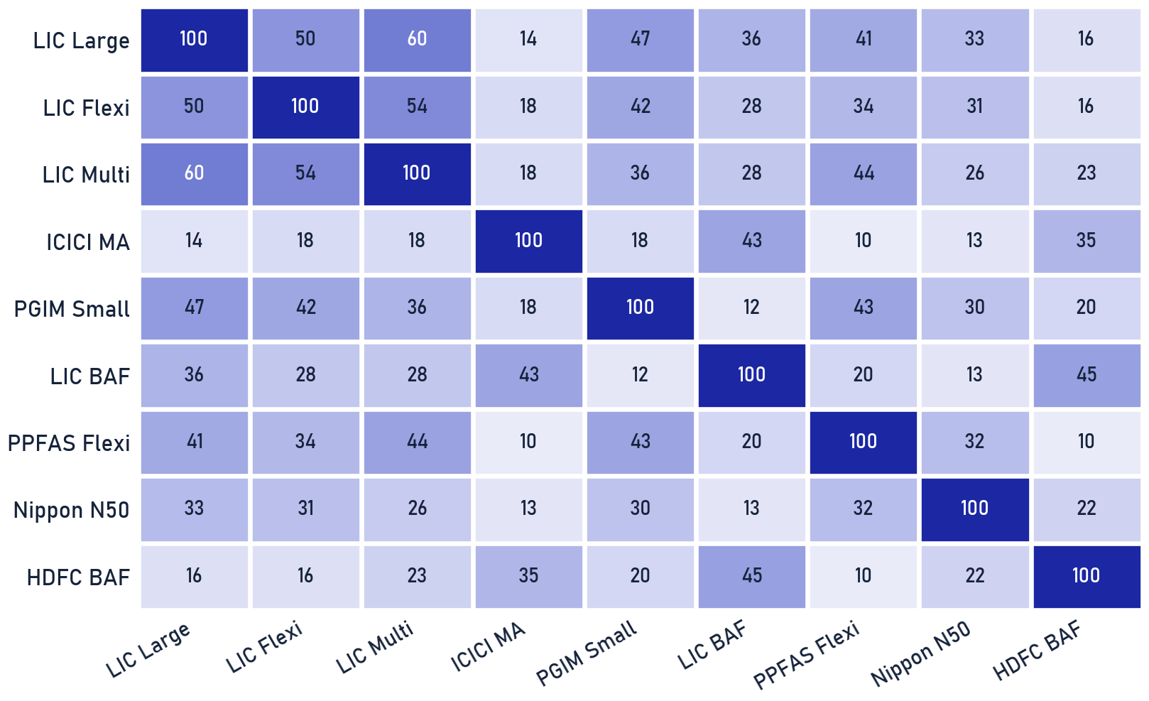
Private & Confidential
05 · ANNEXURE
Scheme overlap & redundancy
Where funds re-buy the same exposure
HOW TO READ IT
Each cell is the weighted common holding between two schemes: OVERLAP(A,B) = Σ min(w-A, w-B). Darker = more duplication · you pay two active fees for one underlying exposure.
ILLUSTRATIVE, NOT FINAL
These values are illustrative. The exact map needs each fund's point-in-time look-through holdings, which we build from the funds' published portfolio disclosures.
Illustrative overlap placeholder · full pairwise look-through pending the funds' published portfolio disclosures. MF sleeve only.
Portfolio Review · 54

Slide 55
Private & Confidential
05 · ANNEXURE
Scheme scorecard
LIC MF Large Cap Fund
SWITCH
28
D
93%
101%
34%
-8.6%
FUND SCORE / 100
GRADE
UP-CAPTURE
DOWN-CAPTURE
3Y HIT-RATE
NET ALPHA P.A.
r² 0.68 · Info ratio -0.86 · Max DD -19.1% · Worst 1-yr -13.5% · Sortino 0.42 · Calmar 0.16 · TER 0.95%
TRAILS
DOWNSIDE
WHY WE ACT
OUR READ
Trails the large-cap index by 4-5pp a year over 3 and 5 years; active fees for below-index outcomes. Measured against exemplar: a low-cost Large-Cap Index / Factor fund.
Our read is Switch. A fund score of 28/100 (grade D) sits below the category exemplar: 93% up-capture does not pay for 101% down-capture, and net alpha runs -8.6% p.a. Watch-outs: negative net alpha, high down-capture. Max drawdown on record: -19.1%.
Direct-plan NAV vs total-return benchmark, point-in-time · Ionic fund-quality framework.
Portfolio Review · 55

Slide 56
Private & Confidential
05 · ANNEXURE
Scheme scorecard
LIC MF Flexi Cap Fund
SWITCH
32
D
102%
107%
38%
-4.0%
FUND SCORE / 100
GRADE
UP-CAPTURE
DOWN-CAPTURE
3Y HIT-RATE
NET ALPHA P.A.
r² 0.88 · Info ratio -0.67 · Max DD -18.8% · Worst 1-yr -10.2% · Sortino 0.86 · Calmar 0.42 · TER 0.95%
TRAILS
WEAK 3-YR
WHY WE ACT
OUR READ
Trails the broad market by ~4pp a year over five years; the record misses our consistency bar. Measured against exemplar: a top-quartile Flexi-Cap from the approved list.
Our read is Switch. A fund score of 32/100 (grade D) sits below the category exemplar: 102% up-capture does not pay for 107% down-capture, and net alpha runs -4.0% p.a. Watch-outs: negative net alpha, weak 3-yr consistency. Max drawdown on record: -18.8%.
Direct-plan NAV vs total-return benchmark, point-in-time · Ionic fund-quality framework.
Portfolio Review · 56

Slide 57
Private & Confidential
05 · ANNEXURE
Scheme scorecard
LIC MF Multi Cap Fund
SWITCH
59
B
103%
99%
52%
+3.7%
FUND SCORE / 100
GRADE
UP-CAPTURE
DOWN-CAPTURE
3Y HIT-RATE
NET ALPHA P.A.
r² 0.88 · Info ratio 0.67 · Max DD -16.7% · Worst 1-yr -5.5% · Sortino 1.75 · Calmar 1.00 · TER 0.95%
RIGID
WHY WE ACT
OUR READ
Multi-cap's SEBI 25/25/25 floor forces small/mid we prefer to size ourselves, structural, not performance. Measured against exemplar: a Flexi-Cap (manager-flexible cap mix).
Our read is Switch. A fund score of 59/100 (grade B) sits below the category exemplar: 103% up-capture does not pay for 99% down-capture, and net alpha runs +3.7% p.a. Watch-outs: mandate rigidity. Max drawdown on record: -16.7%.
Direct-plan NAV vs total-return benchmark, point-in-time · Ionic fund-quality framework.
Portfolio Review · 57

Slide 58
Private & Confidential
05 · ANNEXURE
Scheme scorecard
ICICI Pru Multi-Asset (Regular)
REDEEM-TO-DIRECT
73
A
88%
71%
61%
+12.8%
FUND SCORE / 100
GRADE
UP-CAPTURE
DOWN-CAPTURE
3Y HIT-RATE
NET ALPHA P.A.
r² 0.88 · Info ratio 2.35 · Max DD -11.0% · Worst 1-yr 8.2% · Sortino 3.75 · Calmar 2.59 · TER 0.95%
COST DRAG
WHY WE ACT
OUR READ
The identical fund is available Direct; the Regular-plan trail is pure avoidable cost. Measured against exemplar: the same fund's Direct plan.
Our read is Redeem-to-Direct. The scheme itself passes (+12.8% net alpha p.a., 71% down-capture); the Regular plan is the defect, so we move the same exposure to Direct rather than exit. Watch-outs: Regular-plan cost drag. Max drawdown on record: -11.0%.
Direct-plan NAV vs total-return benchmark, point-in-time · Ionic fund-quality framework.
Portfolio Review · 58

Slide 59
Private & Confidential
05 · ANNEXURE
Scheme scorecard
PGIM India Small Cap Fund
EXIT
8
D
119%
135%
44%
-11.5%
FUND SCORE / 100
GRADE
UP-CAPTURE
DOWN-CAPTURE
3Y HIT-RATE
NET ALPHA P.A.
r² 0.73 · Info ratio -0.95 · Max DD -31.4% · Worst 1-yr -23.3% · Sortino 0.11 · Calmar -0.03 · TER 0.55%
DEEP FALL
TRAILS
OVERSIZED
WHY WE ACT
OUR READ
Sub-scale ~3L beside a larger small-cap fund; persistent underperformance and duplication, structural exit. Measured against exemplar: the primary small-cap sleeve already held.
Our read is Exit. The case for staying is gone: net alpha runs -11.5% p.a., down-capture is 135% against 119% up-capture, and the worst year printed -23.3%. Watch-outs: deep drawdown, negative net alpha, over-allocation. Max drawdown on record: -31.4%.
Direct-plan NAV vs total-return benchmark, point-in-time · Ionic fund-quality framework.
Portfolio Review · 59

Slide 60
Private & Confidential
05 · ANNEXURE
Scheme scorecard
LIC MF Balanced Advantage
TRIM
55
B
82%
79%
48%
+0.8%
FUND SCORE / 100
GRADE
UP-CAPTURE
DOWN-CAPTURE
3Y HIT-RATE
NET ALPHA P.A.
r² 0.90 · Info ratio 0.16 · Max DD -15.7% · Worst 1-yr -3.3% · Sortino 1.93 · Calmar 0.89 · TER 0.95%
TINY FUND
NEW FUND
COST DRAG
WHY WE ACT
OUR READ
Under four years of record, sub-scale, Regular plan; we fold the sleeve into the proven hybrid held. Measured against exemplar: the hybrid core already held (HDFC BAF, Direct).
Our read is Trim, on scale and record, not results. The scheme is young (under four years) on a sub-scale asset base, so it cannot yet carry a full allocation; the position stays, smaller, while the record matures. Watch-outs: sub-scale AUM, record under 4 years, Regular-plan cost drag. Max drawdown on record: -15.7%.
Direct-plan NAV vs total-return benchmark, point-in-time · Ionic fund-quality framework.
Portfolio Review · 60

Slide 61
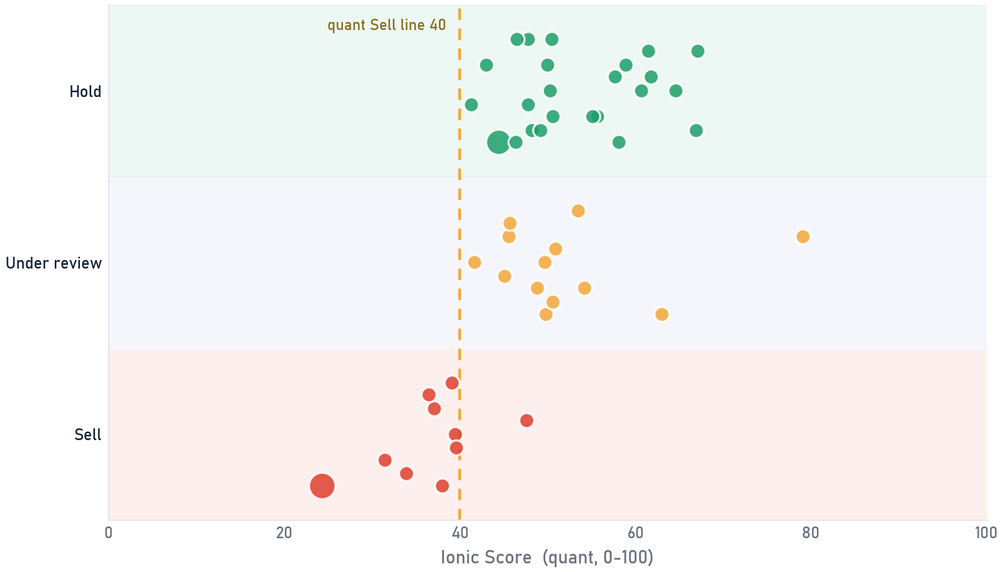
Private & Confidential
05 · ANNEXURE
Score vs final call
Where the human moved the machine
SCOPE All 47 direct equity holdings · quant score vs final analyst call · as of 2026-07-25
WHERE ANALYSTS OVERRULED THE MODEL
STOCK
SCORE
CALL
QUANT SAID
0 CALLS MOVED, EACH DOCUMENTED
The quant score is a screen; a verdict needs a person. On 0 names the analyst holds a low scorer for reasons the model cannot see; on 0 the call is Sell despite a passing score. Every override carries a written rationale, on the record.
Bubble = position value · gold ring = the analyst moved away from the quant read
Ionic quant score (0-100, PIT 2026-07-21) vs final Portfolio Review call per holding; escalated Holds shown as Under review; overrides ringed in gold.
Scores flag, people decide: each call here carries a named reviewer's sign-off.
Portfolio Review · 61

Slide 62
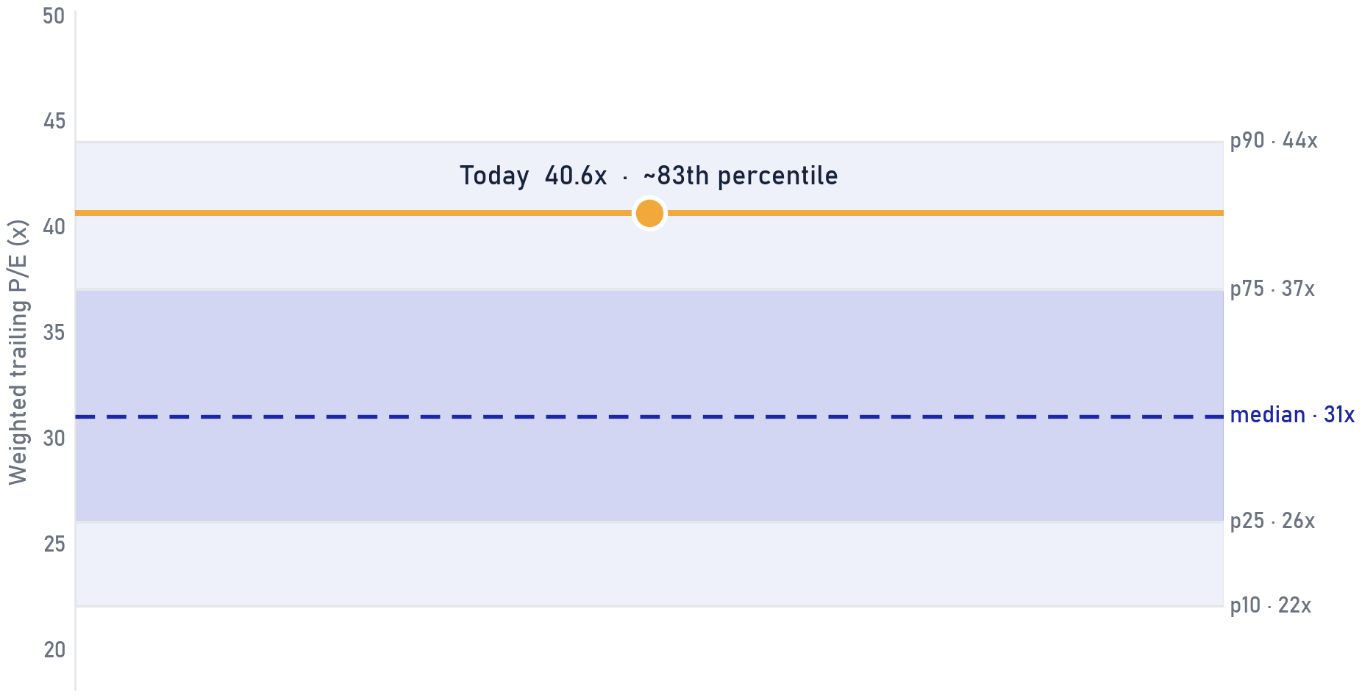
Private & Confidential
05 · ANNEXURE
Valuation check
The book's P/E against its own 10-year range
SCOPE Direct equity book · weighted trailing P/E on 59% of book weight (usable multiples below 150x) · band [ILLUSTRATIVE]
WHAT THIS SAYS
The weighted trailing P/E of the direct book is 40.6x, around the 83th percentile of the illustrative 10-year band for this sector blend. The starting multiple is the one return driver already known today, and it sits high.
WHAT IT DOES NOT SAY
A high percentile is not a timing signal: expensive books can stay expensive for years. What it does change is the margin of safety, so the bar for adding rises, the case for trimming the weakest scores strengthens, and staged deployment of new money matters more.
Weighted trailing P/E over the 59% of book weight with usable multiples (extremes above 150x excluded); 10-year percentile band is synthetic [ILLUSTRATIVE] pending index-blend history.
Portfolio Review · 62

Slide 63
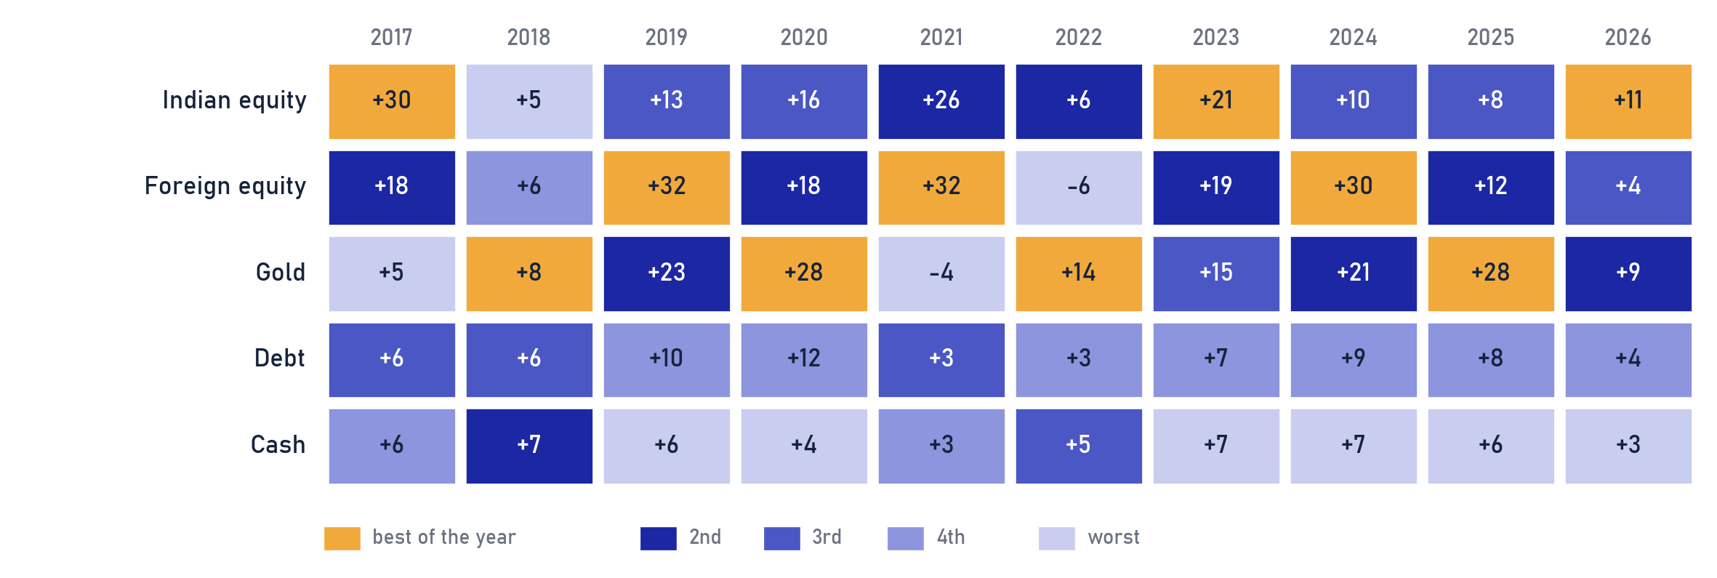
Private & Confidential
05 · ANNEXURE
Ten years, five assets · the winner rotates
Annual returns ranked within each year, 2017 to 2026
SCOPE [ILLUSTRATIVE] Asset-class annual returns in INR, 2017-2026 YTD · not a performance record
THE HUMILITY CHART
Gold led four of these ten years, foreign equity three, Indian equity three; in 2018 even cash beat Indian equity. Use this page when one asset has just had a hot run: the leader rotates, so the plan is the rebalanced allocation across all five, never last year's winner.
Illustrative synthetic annual returns in INR; asset proxies: Nifty 50 TRI, S&P 500 in INR, domestic gold price, short-duration debt, liquid funds. Directionally representative, not a performance record. [ILLUSTRATIVE]
Portfolio Review · 63

Slide 64
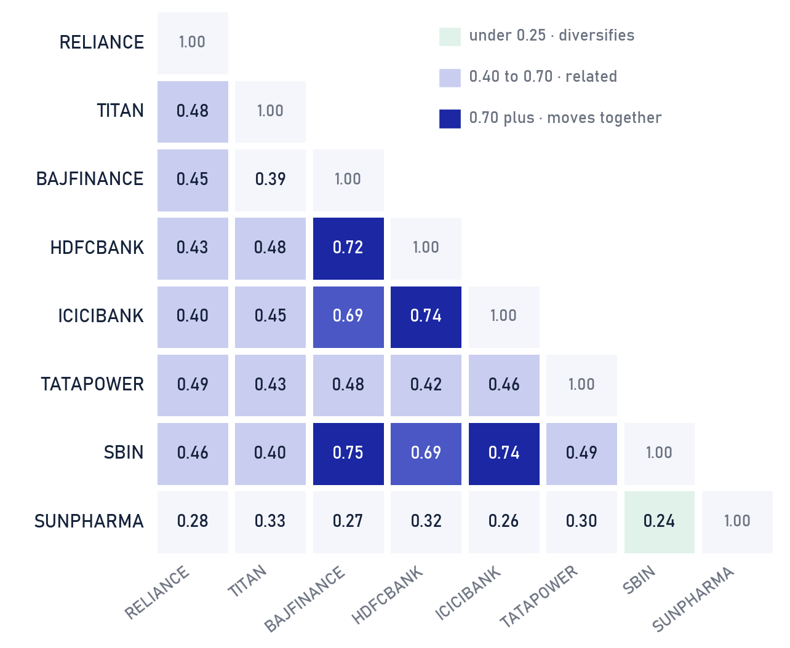
Private & Confidential
05 · ANNEXURE
What the top eight actually share
Pairwise correlation of the largest direct-equity holdings
SCOPE [ILLUSTRATIVE] Top-8 direct-equity holdings by weight · synthetic pairwise correlations · as of 2026-07-25
DIVERSIFICATION ACTUALLY HELD
The 4 financial names move as a block: SBIN and BAJFINANCE top the grid at 0.75. SUNPHARMA against SBIN is the most independent pair at 0.24. Average pairwise correlation is 0.47, so these eight tickers diversify like a smaller handful.
WHEN TO USE THIS VIEW
Bring this page out when the number of holdings is offered as diversification. Portfolio risk is set by how much the names respond to the same forces (rates, credit, the consumer); a ninth name from the same cluster adds little.
Synthetic correlation estimates for illustration, patterned on typical 3-year weekly-return relationships; not measured from market data. [ILLUSTRATIVE]
Portfolio Review · 64

Slide 65
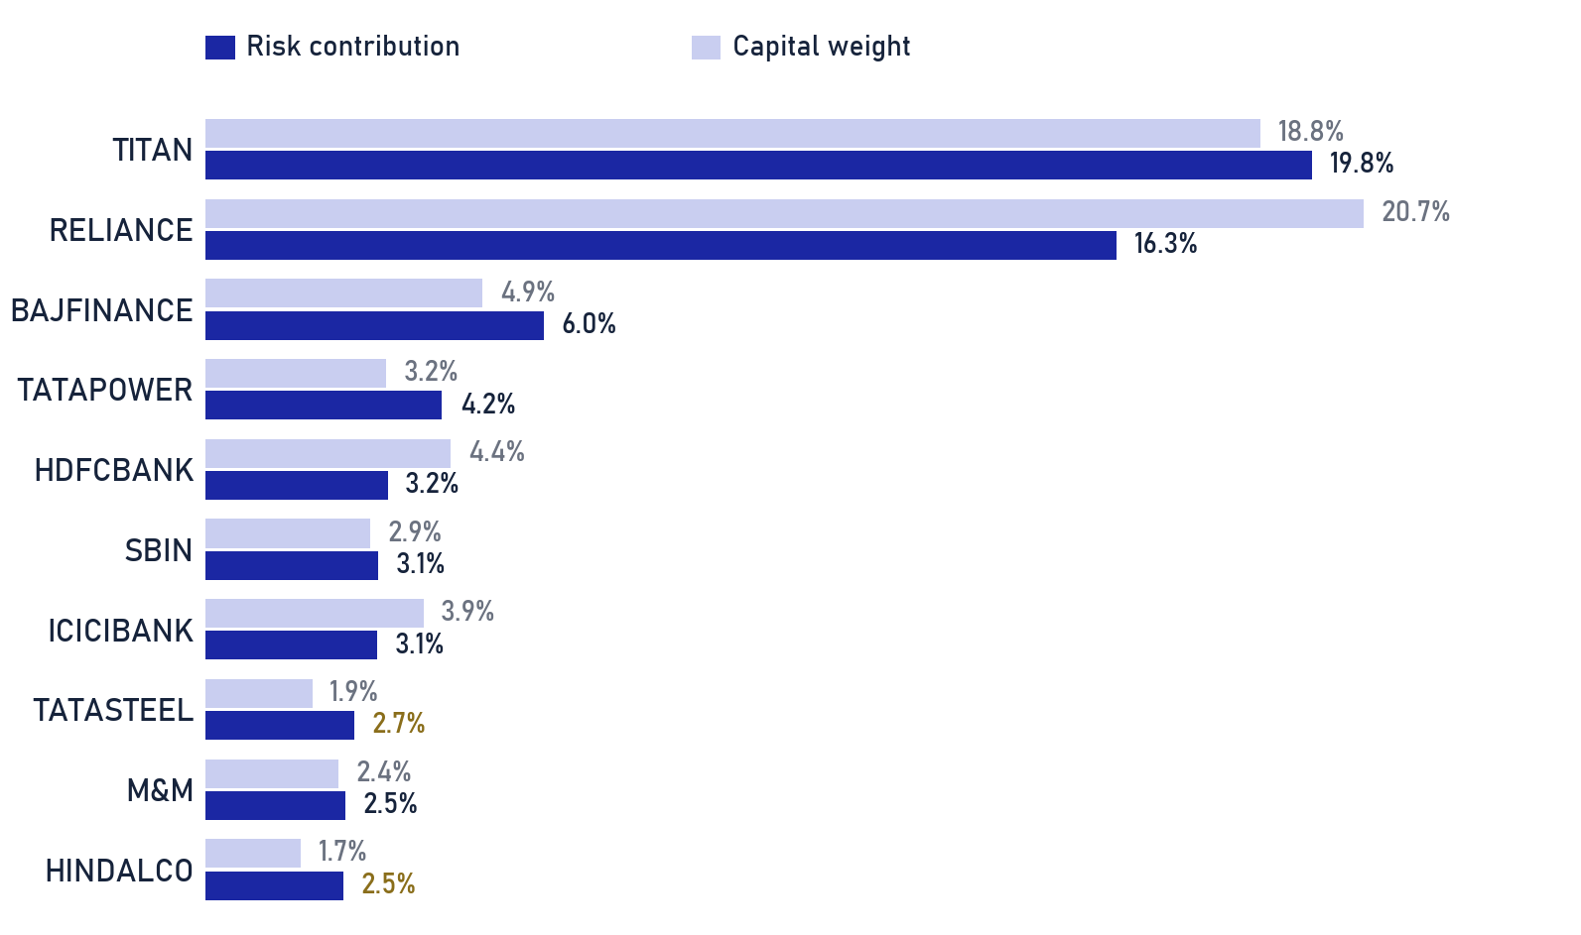
Private & Confidential
05 · ANNEXURE
Capital weight is not risk weight
Estimated risk contribution vs capital weight · top 10 names
SCOPE [ILLUSTRATIVE] Direct-equity book · as of 2026-07-25
CAPITAL WEIGHT IS NOT RISK WEIGHT
The ten largest risk contributors hold 65% of equity capital but an estimated 63% of its risk. RELIANCE is the biggest rupee position, yet TITAN tops the risk list, while higher-volatility names such as TATASTEEL and HINDALCO carry clearly more risk than their capital weight (gold figures).
WHEN TO USE THIS VIEW
Use this page when a trim looks too small to matter in rupee terms. Risk is weight times volatility: a one-point trim of a high-volatility name removes more portfolio risk than the same point off a steady large cap, and the trim list is sequenced accordingly.
Risk contribution estimated as capital weight times an assumed per-name volatility proxy (synthetic), normalised to 100%; a full covariance treatment would shift details, the ordering is the point. [ILLUSTRATIVE]
Portfolio Review · 65

Slide 66
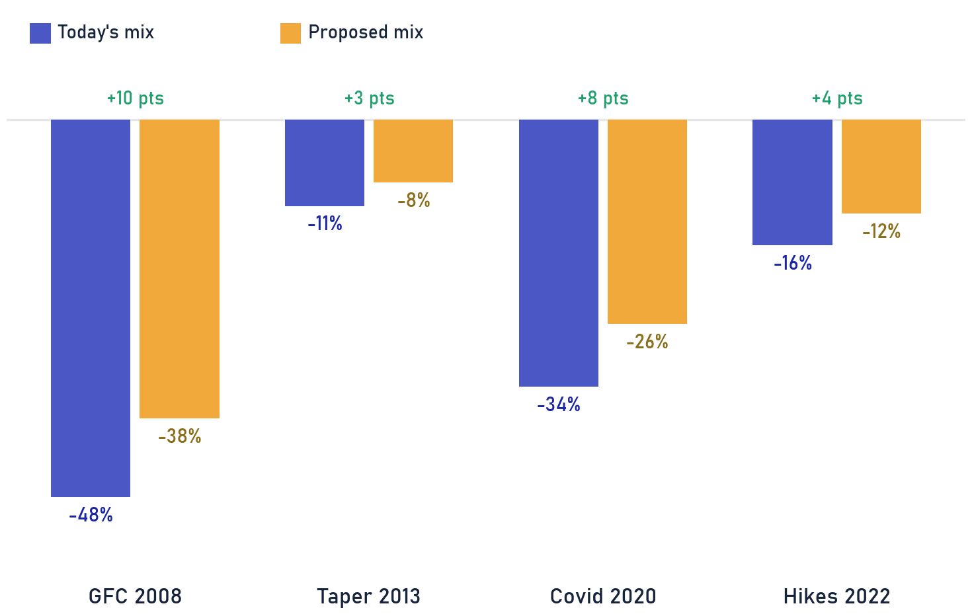
Private & Confidential
05 · ANNEXURE
Four crises, replayed on this book
Estimated drawdown: today's mix vs the proposed mix
SCOPE [ILLUSTRATIVE] Scenario replay on synthetic weights · today's mix vs proposed post-deployment mix · as of 2026-07-25
HOW THESE ARE ESTIMATED
Each pair replays that window's asset-class moves through today's mix and through the proposed mix (more foreign equity, gold and staged cash). These are estimates on synthetic weights; wide error bars apply.
THE DEPLOYMENT PLAN, IN RISK TERMS
The proposed mix would have cut the worst window (GFC 2008) by about +10 points and the others by 3 to 8 points, while giving up little in calm markets. Use this page when the deployment plan needs a reason beyond return: it is bought protection, funded by the Sell list.
Scenario drawdowns are illustrative estimates: historical asset-class peak-to-trough moves applied to synthetic current and proposed allocations; no forecast implied. [ILLUSTRATIVE]
Portfolio Review · 66

Slide 67
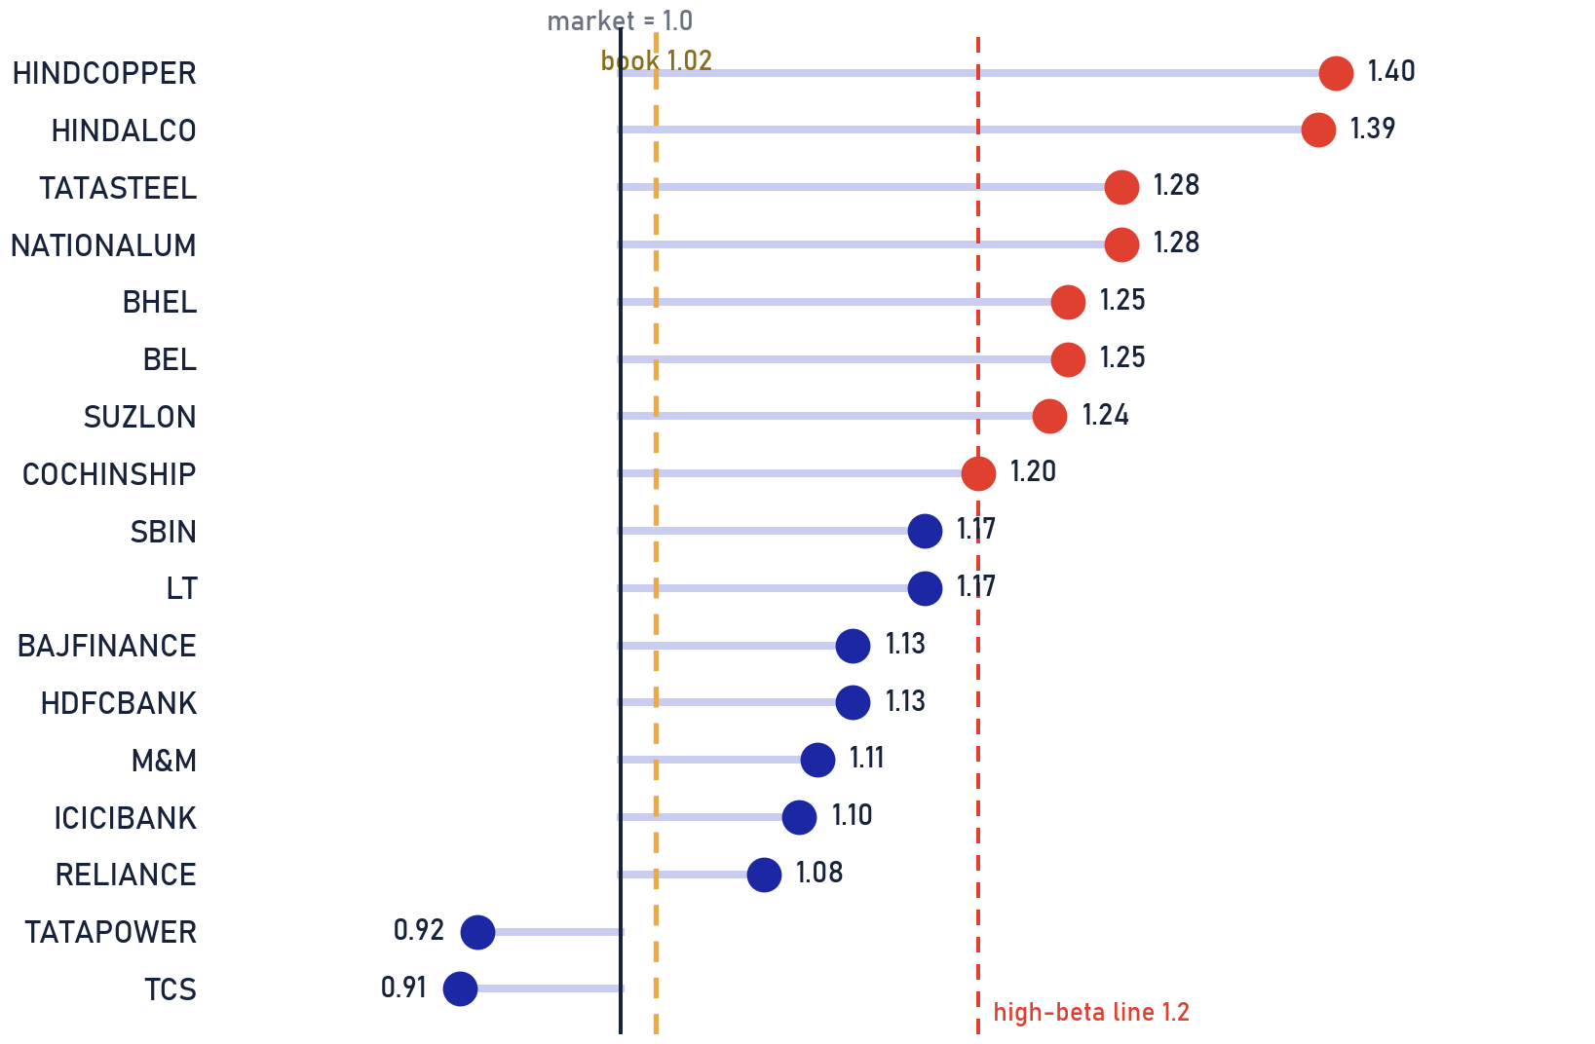
Private & Confidential
05 · ANNEXURE
Volatility ladder
Which holdings amplify the market, and by how much
SCOPE Direct equity book · sector-keyed betas [ILLUSTRATIVE] pending regression on price history · as of 2026-07-25
THE HIGH-BETA TAIL · 4.7% OF BOOK
HIGH-BETA NAME
BETA
WEIGHT
CALL
HINDCOPPER
1.40
0.3%
SELL
HINDALCO
1.39
1.0%
HOLD
TATASTEEL
1.28
1.1%
HOLD
NATIONALUM
1.28
0.3%
HOLD
BHEL
1.25
0.6%
HOLD
BEL
1.25
0.6%
HOLD
SUZLON
1.24
0.3%
HOLD
COCHINSHIP
1.20
0.4%
HOLD
HOW TO READ THE LADDER
Book-weighted beta is 1.02, close to the market. The tail above 1.2 (4.7% of the book) is where a drawdown bites hardest: these names fall further than the index and recover on their own cycle. Position sizes there should earn their volatility.
Betas are sector-keyed illustrative estimates with a fixed per-name offset [ILLUSTRATIVE], not regression output; ladder shows the largest positions plus every flagged name.
Portfolio Review · 67

Slide 68
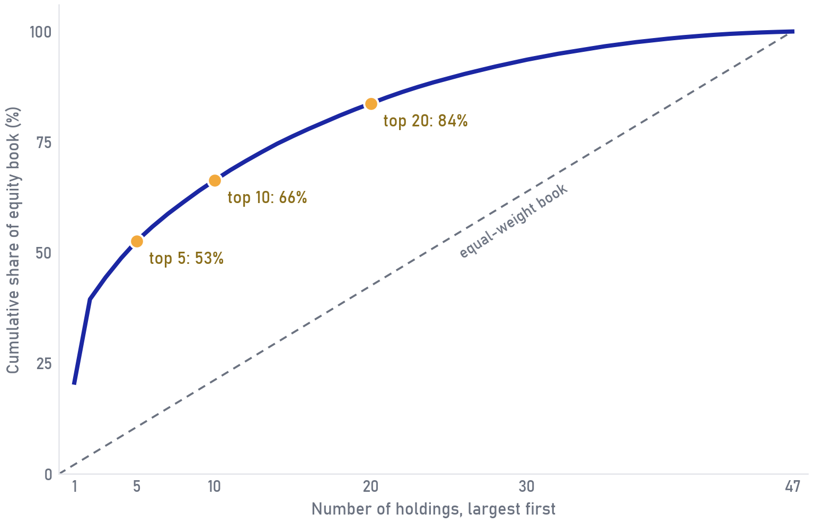
Private & Confidential
05 · ANNEXURE
How top-heavy is the equity book
Cumulative weight curve vs an equal-weight reference line
SCOPE [ILLUSTRATIVE] Direct-equity sleeve only · 47 holdings · weights as share of the equity book · as of 2026-07-25
BASKET
THIS BOOK
EQUAL WEIGHT
Top 5
53%
11%
Top 10
66%
21%
Top 20
84%
43%
HOW TO READ THE CURVE
The faster the curve climbs, the more the book depends on its first few names. The dashed diagonal is a book of equal slices; the space between the two lines is the concentration, made visible.
WHEN TO USE THIS VIEW
Use this page alongside the 8% single-name cap in the IPS: 2 name(s) sit above the cap today, and the planned trims pull the front of this curve down toward the diagonal.
Cumulative weights of the 47 direct-equity holdings, largest first, as a share of the equity book; equal-weight line = 100/47 per name. Synthetic demo book. [ILLUSTRATIVE]
Portfolio Review · 68

Slide 69

Private & Confidential
05 · ANNEXURE
How fast this book turns into cash
Share of the book exitable per days-to-exit bucket, at 20% of daily volume
SCOPE [ILLUSTRATIVE] Whole book (equity + funds + cash) · as of 2026-07-25
61%
98%
0.4%
EXITABLE IN 1 DAY
EXITABLE WITHIN A WEEK
NEEDS OVER 10 DAYS
THE TWO BIG POSITIONS
WHY 20% OF DAILY VOLUME
The two largest positions, RELIANCE (12.4%) and TITAN (11.3%), sit in the 1-day bucket: their traded volumes are deep enough that size alone does not slow the exit. The slow tail is the clutter of small positions in thinner names, where the Sell list already concentrates.
Exit math assumes taking at most a fifth of a day's traded volume, slow enough not to move the price against the book. Use this page before any large redemption plan: it sets a timetable the market can actually fill.
Days-to-exit at 20% of assumed average daily volume per name; synthetic liquidity tiers assessed at pooled-mandate size, not this account alone; mutual funds mapped to T+2/T+3 redemption settlement. [ILLUSTRATIVE]
Portfolio Review · 69

Slide 70
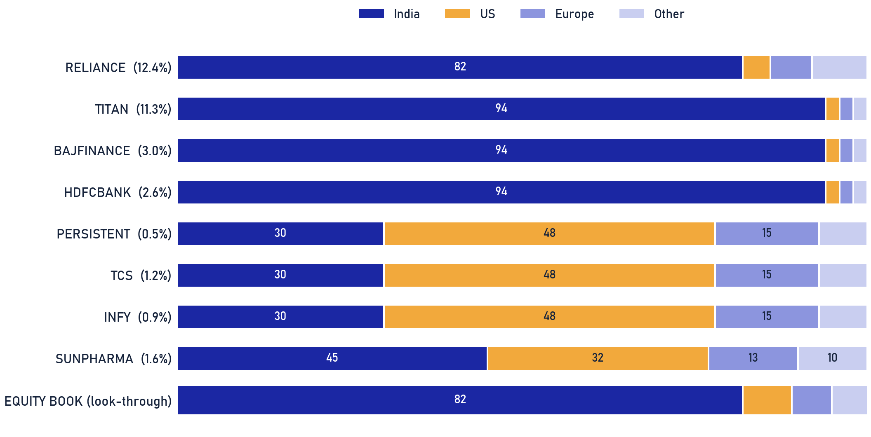
Private & Confidential
05 · ANNEXURE
Revenue geography
Where the book actually earns its money
SCOPE Direct equity book · look-through revenue by geography, sector-keyed splits [ILLUSTRATIVE] · as of 2026-07-25
THE NATURAL FX HEDGE
Roughly 18% of the book's underlying revenue is earned outside India, led by IT, healthcare and auto-component exporters. That is a real, if partial, currency hedge: a weaker rupee lifts those earnings without any action from us.
WHY THE FOREIGN TARGET STILL STANDS
Export revenue does not close the foreign-equity gap (-12 pts vs the 15% IPS target). These shares still trade at India-market multiples and fall with the India market; owning foreign assets diversifies the market itself, which revenue geography cannot. The deployment plan funds the first foreign sleeve.
Revenue splits are sector-keyed illustrative estimates [ILLUSTRATIVE], pending company segment disclosures; book row is the weight-averaged look-through.
Portfolio Review · 70

Slide 71
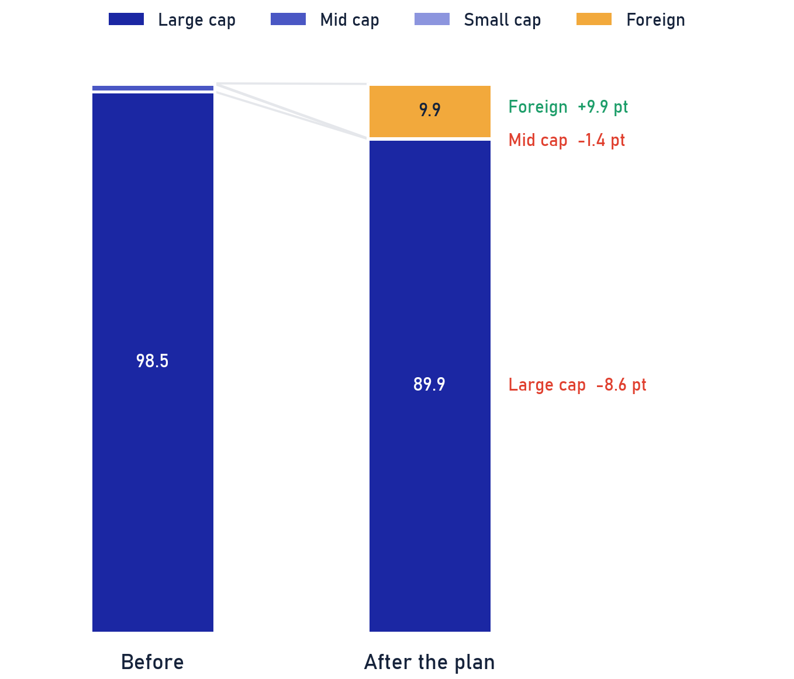
Private & Confidential
05 · ANNEXURE
Market-cap migration
What the deployment plan does to the cap mix
SCOPE Equity sleeve only (gold and staged cash excluded) · as of 2026-07-25
SEGMENT
BEFORE
AFTER
CHANGE
Large cap
98.5%
89.9%
-8.6 pt
Mid cap
1.4%
0.0%
-1.4 pt
Small cap
0.1%
0.1%
+0.0 pt
Foreign
0.0%
9.9%
+9.9 pt
TIED TO THE DEPLOYMENT PLAN
The plan is a quality rotation, and the cap mix shows it: proceeds from the 10 Sells and the two concentration trims (~18.6% of the book, net of estimated tax) go back into a low-vol large-cap core and open the first foreign sleeve. Large-cap character is preserved; what changes is single-name risk and the zero foreign weight.
Cap mix as % of the equity sleeve, before vs after the recommended actions; redeployment split per the deployment-plan sleeves; net of estimated tax leak.
Portfolio Review · 71

Slide 72
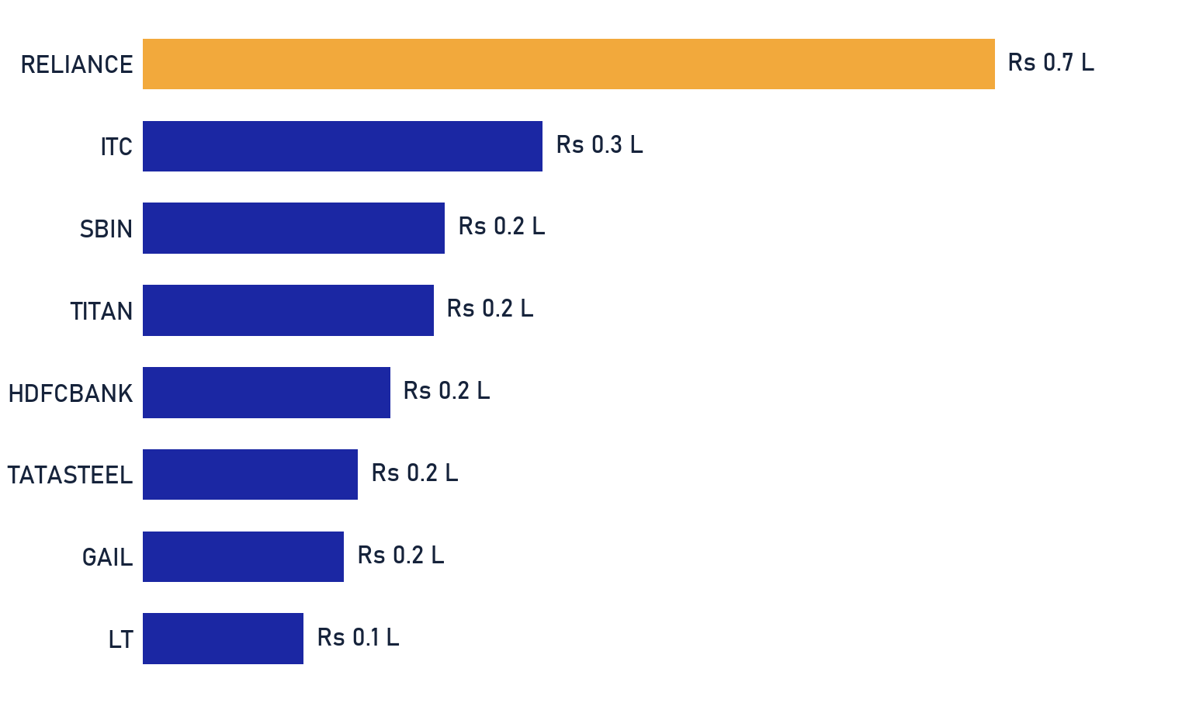
Private & Confidential
05 · ANNEXURE
What the book pays while it compounds
Estimated annual dividend income by holding · Rs lakhs
SCOPE [ILLUSTRATIVE] Direct-equity sleeve · position value x assumed dividend yield per name · as of 2026-07-25
₹3.5 L
0.9%
EST. ANNUAL DIVIDENDS
BLENDED EQUITY YIELD
WHERE THE INCOME SITS
RELIANCE and ITC pay about 28% of the book's cash income; the growth names pay almost nothing by design. At 0.9% on the equity sleeve, dividends here are a byproduct of stock selection, never its purpose.
WHEN TO USE THIS VIEW
When regular cash flow becomes a goal, this is the base it starts from. If income becomes a goal, it is funded through planned withdrawals or a dedicated income sleeve agreed in the IPS, rather than by tilting this growth book toward high-dividend names.
Estimated dividends: position value times an assumed per-name dividend yield (synthetic, patterned on typical payout levels); no forecast of actual distributions. [ILLUSTRATIVE]
Portfolio Review · 72

Slide 73
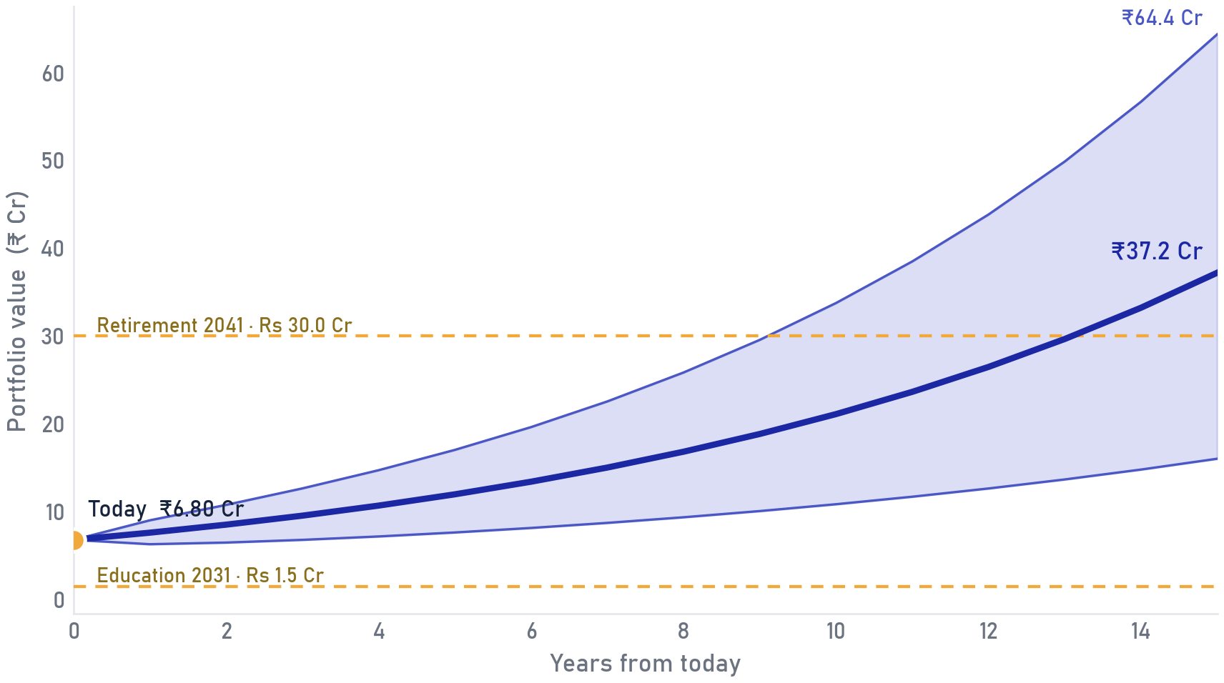
Private & Confidential
05 · ANNEXURE
Goal mapping
What the corpus already covers, goal by goal
SCOPE Whole portfolio (Rs 6.8 Cr) vs illustrative goals [ILLUSTRATIVE, to be replaced by the family's confirmed goals] · as…
GOAL
NEEDED THEN
NEEDED TODAY AT 12%
FUNDED TODAY
Education (2031)
Rs 1.5 Cr
Rs 0.85 Cr
100%
Second home (2034)
Rs 3.0 Cr
Rs 1.21 Cr
100%
Retirement (2041)
Rs 30.0 Cr
Rs 5.48 Cr
86%
All goals together
Rs 34.5 Cr
Rs 7.54 Cr
90%
HOW TO READ FUNDED-TODAY
Funded-today discounts each goal at the assumed 12% return and fills goals nearest-first. Education and the home are fully covered by today's corpus; retirement is ~86% funded, a gap that ongoing savings and the 15-year horizon can close. A goal short of 100% calls for contributions or time, never for stretching the risk profile.
Illustrative projection at 12% p.a. return, 14% volatility; goal amounts and dates are placeholders [ILLUSTRATIVE], not advice or a forecast; outcomes will differ.
Portfolio Review · 73

Slide 74
Private & Confidential
05 · APPENDIX
Methodology & data sources
How the numbers on these pages are built
SCORING EQUITIES
EVALUATING FUNDS
Each stock earns a 0-100 Ionic Score from two horizons, a 3-year, fundamentals-tilted view and a 1-year, trend-tilted view, combined across pillars (Quality & Growth, Value, Trend & Flow). Forensic / balance-sheet gates cap the score at 40. Below 40 on either horizon = Sell; 40-50 is a watch zone (Trim only with a concentration or risk flag); 50+ = Hold.
Funds are scored 0-100 by the firm's fund-quality framework on Direct-plan NAV against total-return benchmarks, point-in-time. It rewards net-of-fee alpha, rolling-window consistency and downside cushioning, and penalises structural watch-outs. Verdicts: Hold / Trim / Switch / Redeem-to-Direct / Exit.
DATA SOURCES
Scored universe: the firm's stock-scoring engine + per-stock analyst files (point-in-time). · Fund NAVs: Direct-plan, total-return-benchmark relative. · SEBI market-cap cut-offs and category rules. · House-view sector / allocation bands. · Official statutory tax rates, updated each Budget. · Client IPS and holdings as supplied by the advisory desk.
Illustrative synthetic demo (ABXY Family); equity scores real, holdings & funds synthetic.
Portfolio Review · 74

Slide 75
Disclaimer & basis of preparation
This document is a review of existing holdings prepared for the named client under a Non-Discretionary Portfolio Management mandate. Recommendations are Sell / Trim / Hold on current positions only and are not a solicitation or an offer to buy any security. Nothing is executed until the client authorises it. The Ionic Score is a quantitative input reviewed by the Portfolio Review team; it is not a guarantee of future performance. Tax characterisations are indicative · confirm with the client's tax adviser before dealing. Mutual-fund evaluation uses Direct-plan NAV against total-return benchmarks, point-in-time. Past performance is not indicative of future results. This is a synthetic demonstration document; the ABXY Family is fictional and no content constitutes advice on a real portfolio.
IONIC WEALTH
Private & Confidential · Prepared exclusively for the named client
Ionic Wealth by Angel One · Portfolio Review · Private & Confidential

