Slide 1
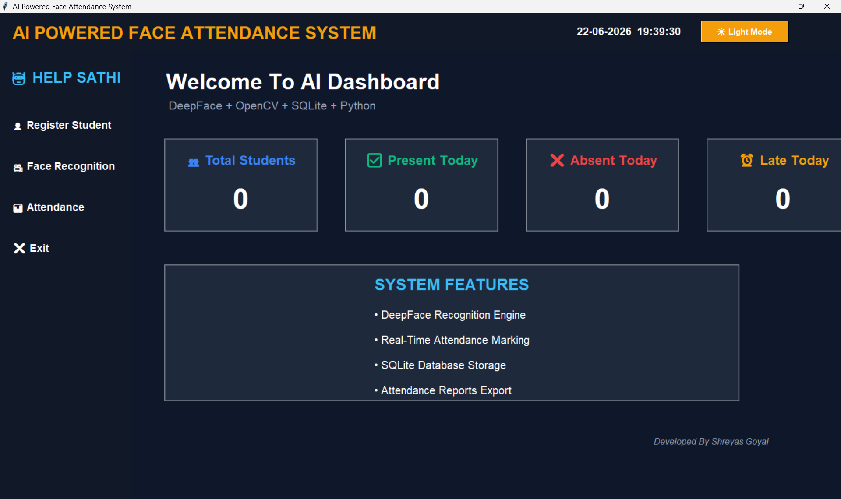
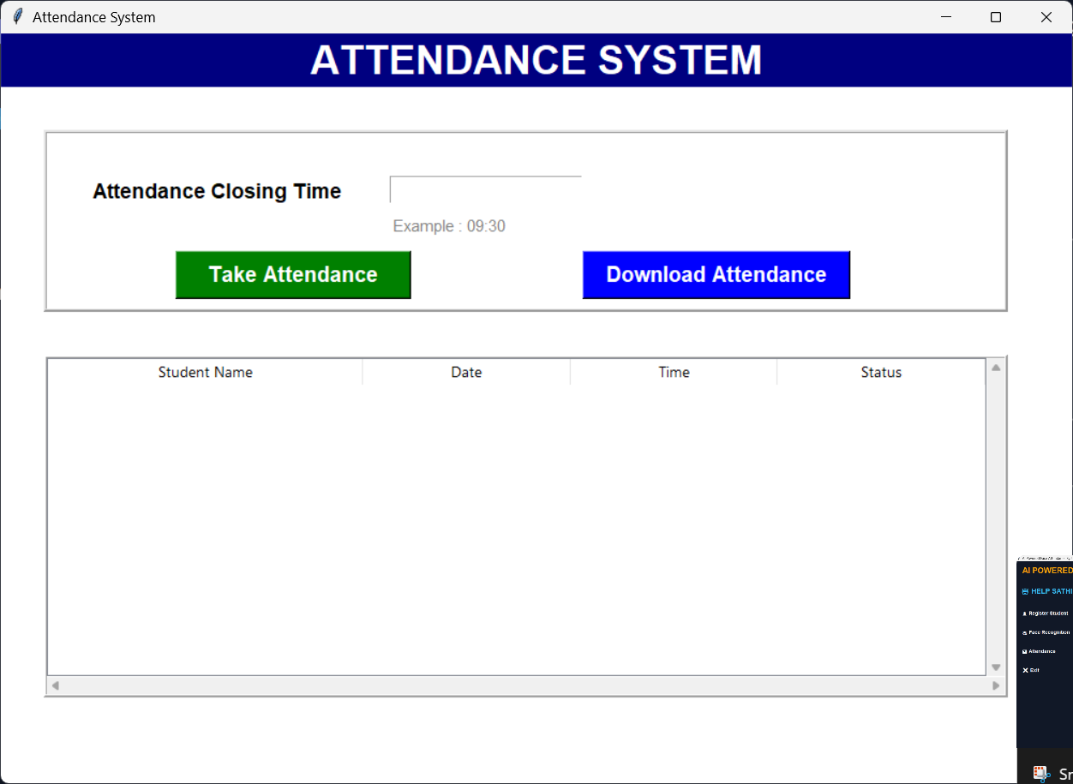
AI & ML PROJECT
Main Dashboard
AI-Powered
Face Attendance
System
Attendance Module
Automating Attendance Using Artificial Intelligence & Computer Vision
Shreyas Goyal
B.Tech CSE (AI & ML – IBM)
Amrapali University, Haldwani

Slide 2
02 INTRODUCTION
What is it?
Why Automate?
The AI-Powered Face Attendance System is a Python-based application that uses DeepFace (Facenet512 model) and OpenCV to automatically identify students from a live webcam feed and mark their attendance — eliminating manual roll calls entirely.
Built with a modern Tkinter dashboard (dark/light mode), it stores all records in SQLite and exports attendance as CSV.
⏱
Saves 5–10 min per class session
🎯
Eliminates proxy & human errors
📱
Real-time dashboard analytics
💾
Digital SQLite + CSV records
🤝
100% contactless and hygienic

Slide 3
03 PROBLEM STATEMENT
Traditional attendance methods fail modern academic institutions:
⏱
Time Consuming
✗
Human Errors
Manual roll calls waste 5–10 minutes per session, reducing effective teaching time across hundreds of classes annually.
Faculty may mark wrong entries, skip names, or misrecord dates — creating inaccurate academic records.
⚠
Proxy Attendance
📋
Difficult to Scale
Students can mark attendance for absent classmates — directly undermining academic integrity and reporting accuracy.
Managing large batches, multiple sections, and bulk data becomes unmanageable without an automated digital solution.

Slide 4
04 PROJECT OBJECTIVES
01
Automate Attendance
95%
Replace manual roll calls with real-time DeepFace AI recognition.
02
Improve Accuracy
92%
Facenet512 model delivers high-accuracy 128D face embedding matching.
03
Reduce Manual Effort
100%
Eliminate paperwork — faculty focus on teaching, not admin tasks.
04
Prevent Proxy Attendance
100%
Physical presence verified by live face — no impersonation possible.
05
Digital Record Keeping
90%
All data stored in SQLite DB and exportable as CSV anytime.

Slide 5
05 TECHNOLOGY STACK
🐍
Python 3
👁
OpenCV
🧠
DeepFace
Core programming language — handles all system logic, GUI, and integrations.
Computer Vision library for webcam access, face detection, frame processing.
Facenet512 model for 128D face embedding extraction and cosine similarity matching.
🖥
Tkinter
💾
SQLite
📊
Pandas / NumPy
Python GUI toolkit used to build the modern dark/light mode dashboard.
Lightweight embedded database storing student registration and attendance records.
Data manipulation, numerical operations, and CSV export of attendance records.

Slide 6
06 SYSTEM ARCHITECTURE
1
2
3
4
5
📷
🔍
🧠
✅
💾
Camera Input
Face Detection
Feature Extraction
Verification
DB Update
Webcam captures
live video stream
OpenCV Haar Cascade
detects face region
DeepFace extracts
128D face encoding
Cosine distance vs
registered encodings
Attendance saved
to SQLite + CSV

Slide 7
07 WORKING METHODOLOGY
📸
Capture Face
🔲
Detect Face
Webcam opens via OpenCV VideoCapture(0) and reads frames in real time.
Haar Cascade Classifier draws bounding box around detected face region.
STEP 1
STEP 2
⚙
Extract Features
🔗
Compare Dataset
DeepFace generates a 128-dimensional numerical face embedding vector.
Cosine distance compared against all stored embeddings in the dataset.
STEP 3
STEP 4
🎯
Identify Person
✅
Mark Attendance
Best match below distance threshold → student identity confirmed.
Name, date, time & status written to SQLite DB — no duplicates today.
STEP 5
STEP 6

Slide 8
08 KEY FEATURES
⚡
Real-Time Recognition
🤖
Auto Attendance
🎯
High Accuracy
Processes live webcam frames instantly with DeepFace Facenet512 model.
System marks attendance automatically — zero manual intervention required.
128D embeddings with cosine similarity ensure precise identity matching.
🌓
Dark / Light Dashboard
📂
Digital Records
🛡
Anti-Proxy Protection
Toggle between dark and light mode on the modern Tkinter AI dashboard.
All data persisted in SQLite and exportable to CSV with one click.
Live face verification prevents any form of proxy or fake attendance.

Slide 9
09 APP SCREENSHOTS
Real screenshots from the working application
Main Dashboard (Dark Mode)
Live clock & theme toggle
Stats cards: Total / Present / Absent / Late
"HELP SATHI" sidebar navigation
System features overview panel
"Developed By Shreyas Goyal" credit
DeepFace + OpenCV + SQLite stack

Slide 10
10 ATTENDANCE MODULE
Live screenshot of the Attendance System module in action
Attendance System Module
⏰
Closing Time Input
Faculty sets the cutoff time. Late arrivals auto-tagged as "Late" status.
📷
Take Attendance Btn
Opens OpenCV webcam — DeepFace scans and marks attendance in real time.
📥
Download Attendance
Exports full attendance log to CSV file with Name, Date, Time, Status.
📋
Live Attendance Table
Scrollable table shows all records ordered by latest entry first.

Slide 11
11 CODE HIGHLIGHTS
DeepFace Recognition (attendance.py)
Mark Attendance (database.py)
Face Capture (add_face.py)
result = DeepFace.find(
def mark_attendance(self, name, status):
while img_id < 50:
img_path="temp.jpg",
today = datetime.now()
ret, frame = cap.read()
db_path="dataset",
.strftime("%d-%m-%Y")
faces = detector.detectMultiScale(
model_name="Facenet512",
# Prevent duplicate entries
gray, 1.3, minNeighbors=5)
detector_backend="opencv",
if not already_marked(name, today):
face = cv2.resize(face,(224,224))
enforce_detection=False
INSERT INTO attendance ...
cv2.imwrite(img_path, face)
)

Slide 12
12 ADVANTAGES
⏱
Saves Time
90%
Attendance completed in seconds — not minutes per class session.
📈
Improves Efficiency
88%
Faculty concentrate on teaching rather than admin tasks.
📄
Zero Paperwork
100%
Fully digital system — no physical attendance sheets needed.
🤲
Contactless & Hygienic
100%
No physical contact — important for health-conscious campuses.
🗂
Better Record Management
95%
SQLite storage with CSV export makes reports instantly accessible.

Slide 13
13 FUTURE SCOPE
☁
Cloud Database
📱
Mobile Application
📊
AI Analytics Dashboard
Migrate SQLite to Firebase or AWS RDS for multi-device real-time sync.
Android/iOS app for faculty attendance monitoring from anywhere.
ML-powered insights: absenteeism trends, alerts, and predictive analytics.
🎥
Multi-Camera Support
🔐
Admin Authentication
🏫
Institution-Wide Deploy
Scale to multiple simultaneous feeds for large lecture halls and auditoriums.
Secure admin login system protecting registration and attendance management.
Integration with university ERP systems for automated campus-wide attendance.

Slide 14
14 CONCLUSION
The AI-Powered Face Attendance System successfully demonstrates how modern Artificial Intelligence and Computer Vision can eliminate traditional attendance challenges. By combining DeepFace's Facenet512 model with OpenCV, Python, and SQLite, the system delivers fast, accurate, and contactless attendance marking — significantly reducing manual effort, preventing proxy attendance, and providing digital record management for academic institutions.
🤖
DeepFace AI automates what took 10+ minutes manually
🎯
128D Facenet512 embeddings ensure high-accuracy recognition
📈
Scalable SQLite architecture ready for real-world deployment
🔮
Strong foundation for future cloud + mobile AI campus solutions

Slide 15
AI-POWERED FACE ATTENDANCE SYSTEM
THANK
YOU!
Questions & Answers
Shreyas Goyal
B.Tech CSE (AI & ML – IBM)
Amrapali University, Haldwani
IBM AI & ML Essentials Graduate
github.com/shreyas2007-goyal/Face-Attendance-System

