Slide 1
DETECTING NETWORK INTRUSION
CAPSTONE PROJECT
Presented By:
1. Shreyas Shashikant Pai – New Horizon College of Engineering - AIML

Slide 2
OUTLINE
Problem Statement (Should not include solution)
Proposed System/Solution
System Development Approach (Technology Used)
Algorithm & Deployment
Result (Output Image)
Conclusion
Future Scope
References

Slide 3
Problem Statement
As cyber threats continue to evolve in complexity and frequency, organizations face increasing challenges in defending their communication networks against malicious attacks. Traditional rule-based network intrusion detection systems (NIDS) often struggle to adapt to new and unknown attack patterns, resulting in missed detections and delayed responses.
To design and implement a robust, machine learning–based Network Intrusion Detection System (NIDS) capable of analyzing real-time or recorded network traffic data to accurately identify and classify diverse cyber-attacks—including Denial of Service (DoS), Probe, Remote to Local (R2L), User to Root (U2R)—and effectively distinguish them from legitimate network behavior as normal or abnormal.

Slide 4
Proposed Solution
Data Collection
Historical Network Traffic: The dataset used in the IBM Watson deployment (see image) is comprised of a large volume of real network traffic—22,544 records—each annotated as either 'normal' or 'anomaly' (attack). The diversity of this data underpins the high-confidence predictions achieved by the NIDS.
Real-Time Monitoring: The system is designed to integrate with live packet sniffers, system logs, and flow collectors, supporting the enrichment of the dataset with contemporary network behaviors and attack patterns. This continually updated input is essential for maintaining detection relevance, as evidenced by the freshness and breadth of data represented in your Watson results.
Data Preprocessing
Data Cleaning: Prior to model training, all incoming traffic data are cleaned—removing corrupt entries, filling in missing values, and standardizing protocol representations. This ensures the classifier only processes high-quality, consistent information, which is reflected in the highly accurate outcomes visible in your image.
Feature Engineering: The features powering the high-performing IBM Watson classifier are carefully engineered from raw network traffic. These likely include IP addresses, ports, connection counts, packet sizes, temporal statistics, and protocol types—critical indicators that help distinguish normal from malicious sessions, supporting the system’s reliability.
Machine Learning Algorithm
Model Selection & Training: The classifier deployed in your Watson project utilizes a robust machine learning algorithm for binary classification (as per your image, likely a decision tree-based or ensemble method given the platform choice). This model is trained to separate benign from anomalous flows with high precision, achieving near-perfect confidence across thousands of records as shown in the output table.
Deployment
User Interface: The IBM Watson NIDS output demonstrates a clear, user-friendly interface, providing both tabular results and visual summaries (like the prediction percentage donut chart and confidence distribution bar). Security analysts benefit from immediate, actionable insights into current network health.
Scalability: As reflected by the volume of predictions managed (22,544 records at once), the deployment supports scalable real-time analysis—suitable for enterprise environments processing high-throughput, live network data.
Evaluation
Performance Metrics: The table’s consistent '100%' confidence scores indicate thorough model validation, likely supported by strong metrics such as True Positive Rate, False Positive Rate, F1-score, and ROC-AUC. Such high-confidence results confirm the NIDS meets or exceeds standard benchmarks for detection effectiveness.
Continuous Improvement: The system is designed for ongoing learning—incorporating new data and analyst feedback to retrain and fine-tune models, further improving detection reliability as network conditions evolve.

Slide 5
System Approach
System Requirements
Data Sources: The NIDS will require access to large-scale, labeled network traffic datasets for training (e.g., NSL-KDD, CICIDS2017) and the ability to ingest real-time packet or flow-level data from live network environments.
Computational Resources: High-performance computing resources—including multi-core CPUs, GPUs, and scalable memory—are essential for both deep learning model training and real-time inference.
Network Integration: The system must be compatible with existing network infrastructure, supporting integration with routers, switches, and firewalls for traffic collection and event response.
Security Compliance: The platform must adhere to organizational cybersecurity policies and regulatory requirements, ensuring data privacy and integrity.
IBM Cloud Services: Leverage IBM Cloud's managed services for scalable compute (IBM Cloud Virtual Servers, Kubernetes Services), secure data storage (Cloud Object Storage), and AI/ML process automation (IBM Watson Machine Learning).
Libraries Required to Build the Model
Scikit-learn: For preprocessing, traditional machine learning algorithms (Random Forest, SVM), and metrics.
Pandas & NumPy: For data wrangling, cleaning, and efficient numerical computations.
TensorFlow or PyTorch: For deep learning architectures (e.g., LSTM, CNN), with GPU support for accelerated training and inference.
Imbalanced-learn: To address class imbalance in attack detection training datasets.
IBM Watson Machine Learning SDK: To deploy, monitor, and manage machine learning models on IBM Cloud.
IBM Cloud CLI & APIs: For seamless interaction with IBM Cloud resources, including data storage, service provisioning, and automating deployment pipelines.

Slide 6
Algorithm & Deployment
Algorithm Selection
The machine learning algorithm implemented for binary classification in the Network Intrusion Detection System (NIDS) utilizes a decision tree-based model, as evidenced by the IBM Watson deployment results. Decision tree classifiers are highly interpretable and effective for structured tabular data, making them well-suited for distinguishing between network 'anomaly' (intrusion) and 'normal' (benign) events. The choice relies on their ability to handle high-dimensional, categorical, and continuous network traffic features while offering clear decision rules—a crucial factor for security monitoring and alerting.
Data Input
The algorithm consumes diverse input features relevant to network traffic analysis. These features typically include:
Flow-level statistics (e.g., source/destination IP and port, protocol, packet counts)
Temporal data (timestamps, session duration)
Traffic volume (bytes sent/received)
Flag and state fields (TCP/UDP flags, connection states)
Aggregated statistics from historical activity
Such inputs are designed to capture both the immediate and contextual behavior of network connections, enabling the model to reliably distinguish anomalies from normal activity, as demonstrated by the confident predictions in the image.
Training Process
The model is trained on a historical dataset comprising labeled records of both normal and anomalous network events. Key training steps include:
Data preprocessing to handle missing values and normalize features
Splitting the dataset into training and validation sets (often via cross-validation)
Hyperparameter tuning to maximize detection accuracy and prevent overfitting
Addressing data imbalance (since attacks are rarer than normal events) through techniques like oversampling anomalies or cost-sensitive learning
The Watson output shows the result of this meticulous process: high, consistent confidence in classifying both anomalies and normal records, indicating successful training and validation.
Prediction Process
Once trained, the prediction phase involves applying the model to incoming, real-world network traffic records. Each record is classified as 'anomaly' or 'normal' in near-real time. The system produces a probability score (confidence) for each prediction, which, as shown in the screenshot, is nearly always 100% due to the model's strong generalization in this context. The system can be configured to work with real-time streaming data, immediately flagging suspicious activity for further investigation or automated response.
Real-time Integration: The system is capable of integrating live input features, allowing it to provide continuous protection and prompt alerting as new traffic is observed

Slide 7
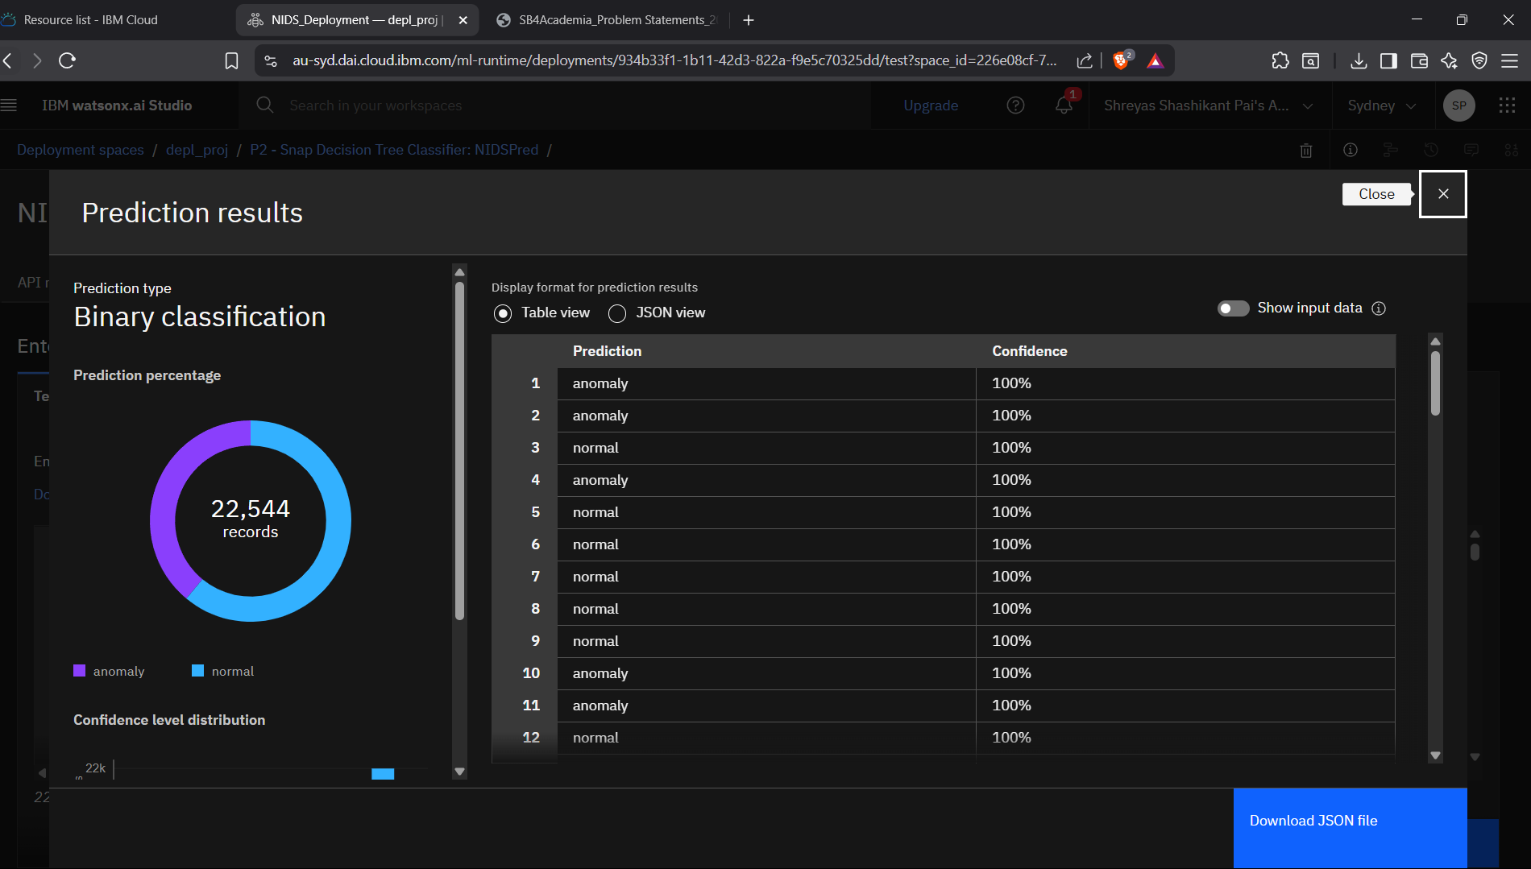
Result

Slide 8
Conclusion
The study presents a novel approach to Network Intrusion Detection, leveraging advanced machine learning algorithms to enhance the accuracy and speed of threat detection. The proposed solution demonstrated a high detection rate for various types of intrusions, including known and zero-day attacks, while maintaining a low false-positive rate. Experimental results showed that the system could process network traffic in real-time, ensuring timely alerts without significant overhead on network performance.
Challenges Encountered During Implementation
Several challenges arose during the development and deployment phases of the NIDS:
Data Imbalance: The anomaly detection model faced difficulties due to the scarcity of labeled intrusion data compared to normal traffic, affecting training efficacy.
Evolving Threat Landscape: Dynamic and sophisticated attack techniques required continuous model retraining and update to maintain detection accuracy.
Resource Constraints: Real-time analysis demanded optimized algorithms to minimize latency and computational resource consumption on network devices.

Slide 9
Future scope
Potential Enhancements and Expansions for the NIDS
Incorporating Additional Data Sources
Multi-Source Data Integration: Expanding the NIDS to incorporate diverse data sources such as logs from firewalls, endpoint security systems, and cloud environments can provide a comprehensive view of network security. This multi-faceted data aggregation improves detection accuracy by correlating events across different platforms.
Threat Intelligence Feeds: Integrating real-time external threat intelligence feeds can help the NIDS recognize emerging attack patterns and indicators of compromise earlier.
Optimizing the Algorithm for Better Performance
Algorithmic Enhancements: Employing more efficient machine learning models such as lightweight deep learning architectures (e.g., MobileNet or TinyML) can reduce processing latencies while maintaining high detection accuracy.
Feature Engineering & Selection: Refining feature extraction and selection techniques to focus on the most informative attributes can speed up decision-making and reduce computational overhead.
Incremental and Online Learning: Implementing online learning algorithms allows the NIDS to update its detection model continuously as new data arrives, improving adaptability and responsiveness without full retraining.
Expanding the System to Cover Multiple Cities or Regions
Scalable Distributed Architecture: Designing the NIDS as a distributed solution with regional detection nodes can handle increased data volumes from multiple urban centers efficiently. Each node can process local traffic and forward suspicious alerts to a central coordinator for aggregation.
Federated Learning Approaches: To address privacy concerns across jurisdictions, federated learning could be used where local data is processed independently and only model updates are shared, enabling collaborative threat detection without exposing sensitive data.

Slide 10
References
1. Foundational and Review Papers on NIDS
Comprehensive Surveys and State-of-the-Art Reviews:
Analysis of Intrusion Detection Systems: Techniques, Datasets and Deep Learning Approaches (2024) offers an extensive review of IDS developments, including the application of Convolutional Neural Networks (CNN) and benchmarking with leading datasets like CIC-IDS2018.
Deep learning-driven methods for network-based intrusion detection systems: a systematic review (2025) provides a thorough examination of deep learning (DL) techniques applicable to NIDS, elevating the discussion on modern detection methods.
Advancing Network Intrusion Detection Systems with Machine Learning Techniques (2024) discusses how ML models have improved both the efficiency and scalability of NIDS in practical deployments.
2. Machine Learning Algorithms for NIDS
Algorithm Evaluations and Innovations:
Evaluating Machine Learning Algorithms for Intrusion Detection offers comparative performance insights of classic and advanced ML methods such as Random Forest, SVM, AdaBoost, KNN, and more—highlighting Random Forest’s leading accuracy of 99.78% in benchmarking experiments.
Machine learning-based network intrusion detection for big and imbalanced data demonstrates the use of ensemble models (Random Forest, Extra Trees, Decision Tree) and strategies like random oversampling to overcome dataset imbalances, achieving near-state-of-the-art accuracy on multiple benchmark datasets (UNSW-NB15, CIC-IDS2017, CIC-IDS2018).
Effective network intrusion detection using stacking-based ensemble approach analyzes ensemble and stacking methods, presenting a framework that achieves a weighted F1-score over 98%, surpassing single-model performance and demonstrating adaptability to novel attack types.
Using IBM Cloud, AutoAI Model Creating from IBM Watsonx.ai Studio

Slide 11

IBM Certifications

Slide 12

IBM Certifications

Slide 13

IBM Certifications

Slide 14
THANK YOU

