Slide 1
Visual Question Answering
Ritwik Harit, 2021557
Vasan Vohra, 2021572
Shreyas Kabra, 2021563

Slide 2
Problem Statement
Our study evaluates the BLIP model’s performance in Visual Question Answering (VQA) across three datasets. Using WUPS Score, BERT Score, VQA Score, etc, we assess its ability to generalise and predict answers accurately. We provide insights into metric selection, rationale, and advantages/disadvantages. This analysis informs on the BLIP model’s capabilities in VQA, guiding future research.

Slide 3
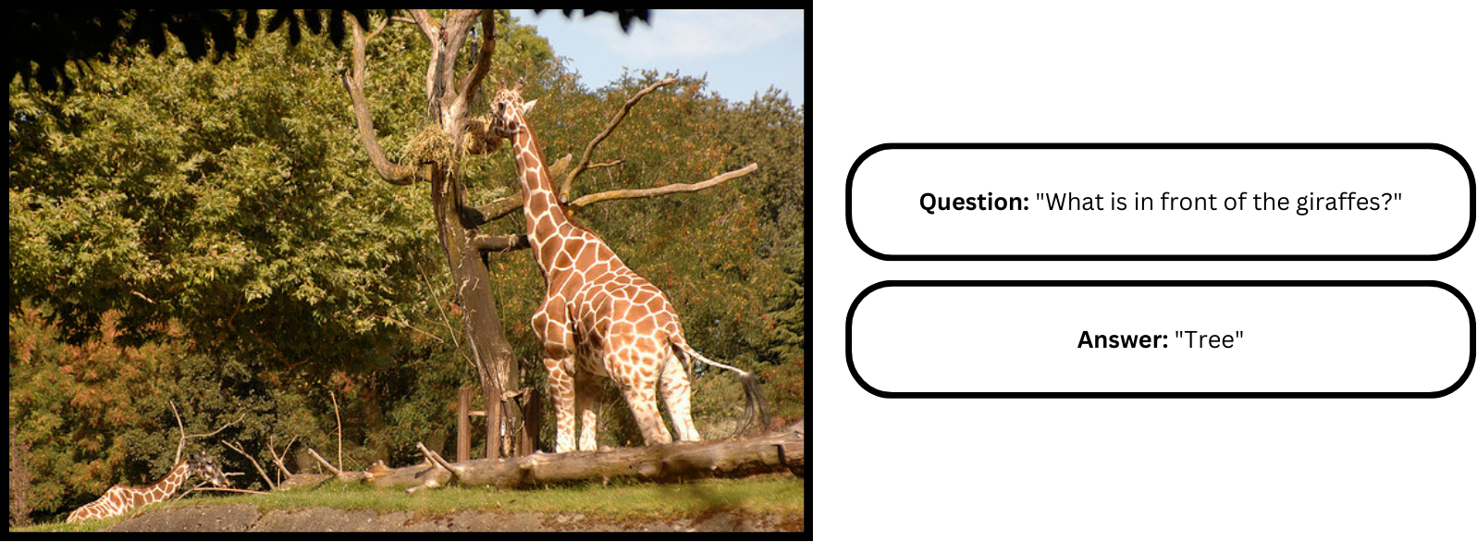
Introduction
In the realm of Computer Vision and Natural Language Processing, Visual Question Answering (VQA) presents a formidable challenge, demanding a deep comprehension of both linguistic nuances and visual semantics. This task involves an AI system analysing an image alongside a corresponding natural language query and then generating a coherent textual response. Our project endeavours to assess the efficacy of the BLIP model across three distinct datasets (VQA v2.0 dataset (training), VQA v2.0 dataset (validation) and DAQUAR - DAtaset for QUestion Answering on Real-world images), aiming to ascertain its ability to generalise and accurately predict answers. To comprehensively evaluate the model’s performance, we adopt a diverse set of evaluation metrics, including WUPS Score, BERT Score,
and VQA Score, etc. Each metric offers unique insights into the model’s capabilities, and we delve into the rationale behind their selection, along with their respective advantages and disadvantages, to provide a comprehensive evaluation framework.

Slide 4
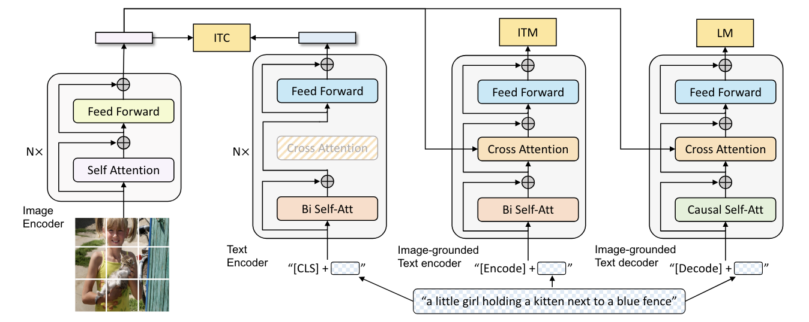
Literature Review
Bootstrapping Language-Image Pre-training
The BLIP model architecture proposed by Li et. al [2], is a new Vision-Language Pre Training framework that achieves state-of-the-art performance on various vision-language tasks by addressing the limitations of existing methods. BLIP utilises a new dataset bootstrapping technique called CapFilt, which generates synthetic captions and filters out noisy captions to improve the quality of the dataset. The proposed framework introduces a multimodal mixture of encoder-decoder (MED) model architecture and leverages pre-training objectives such as image-text contrastive learning, image-text matching, and image-conditioned language modelling to achieve flexible transfer learning and effective multi-task pre-training.

Slide 5
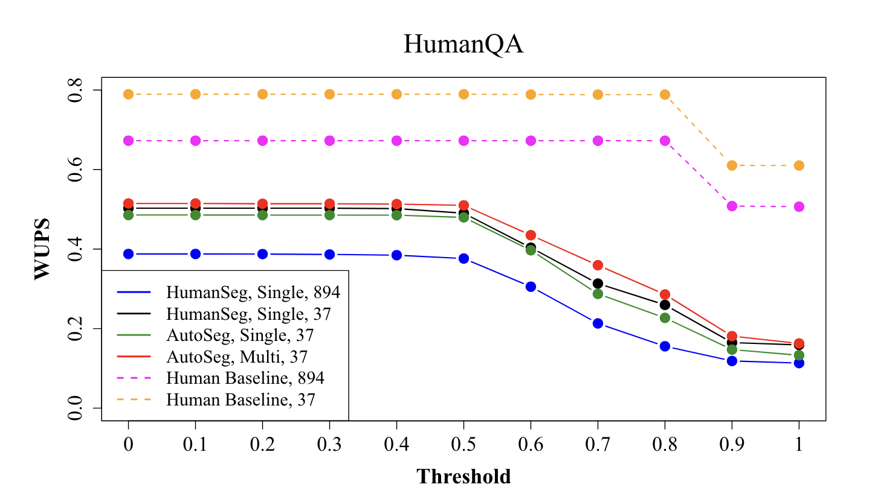
Literature Review
Wu-Palmer Similarity Score In paper by Malinowsk et. al introduces a performance measure called the WUPS score for evaluating the quality of system-generated answers. It draws inspiration from Fuzzy Sets theory and utilises the Wu-Palmer Similarity (WUPS) score to account for semantic fuzziness between classes. WUPS score penalises both underestimation and overestimation of answers. The formula considers the intersection of system and ground-truth answers, employing a soft membership measure. Empirical findings suggest a WUP score of approximately 0.9 for precise answers, prompting down-weighting for scores below a threshold. A curve over thresholds illustrates the trade-off between precision and forgiveness, with WUPS at 0 being the most lenient measure and WUPS at 1.0 equating to standard accuracy. Further details about the evaluation metric will be discussed in the subsequent sections.

Slide 6
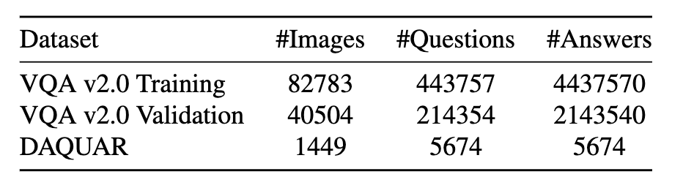
Dataset Description
Dataset Description
We have utilized three distinct datasets to evaluate the performance of the BLIP model: VQA v2.0 Training, VQA v2.0 Validation, and the DAQUAR Dataset.
For the VQA v2.0 Training and Validation datasets, we were provided with 10 answers for each question. The majority is considered as the final ground truth answer.

Slide 7
Experimental Setup
Since the VQA v2 dataset was very large (approximately 82,000 in the training dataset), we divided it into 10 parts and split these parts among the 3 members to achieve parallelisation. We used the BLIP model for each part and then combined the outputs for all the parts to evaluate the results.
For the validation set of VQA v2 we divided it into 2 parts combined the outputs for both parts to evaluate the results.
DAQUAR dataset was not large (approximately 1500 images), so we did not divide it into parts.
Used GPU T4x2 available on Kaggle.

Slide 8
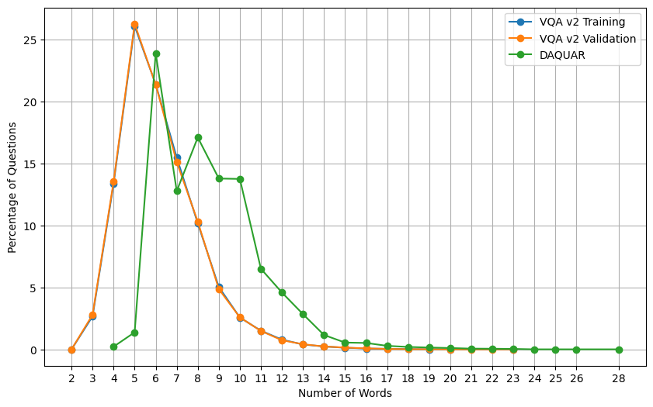
Exploratory Data Analysis
Question Length Distribution Across Datasets
The graph indicates that the majority of questions in both the training and validation sets of the VQA v2 dataset consist of 4 to 7 words, with the distributions almost overlapping, implying the validation set’s representativeness of the training set. Conversely, questions in the DAQUAR dataset tend to be longer, primarily falling within the range of 6 to 11 words.

Slide 9
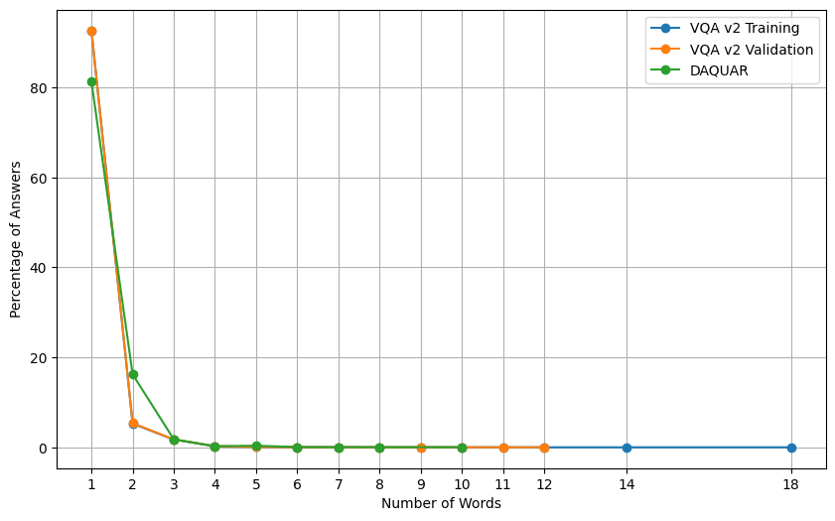
Exploratory Data Analysis
Answer Length Distribution Across Datasets
The graph reveals that the majority of answers in both the VQA v2 datasets (training and validation sets) and the DAQUAR dataset consist of 1 or 2 words. This could suggest that the questions are designed to elicit simple or direct information from the images, rather than requiring complex or elaborate explanations.

Slide 10
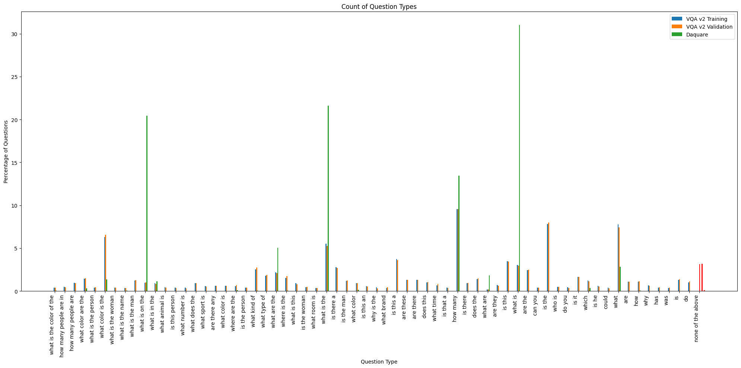
Exploratory Data Analysis
Question Type Distribution Across Datasets
The graph provides insights into the design of questions within the datasets. In the VQA v2 datasets (both training and validation sets), questions starting with “how many,” “is the,” and “what” are predominant. Conversely, in the DAQUAR dataset, questions frequently begin with “what is on the,” “what is the,” and “what is.” This suggests a focus on different types of queries in each dataset, with VQA v2 emphasising queries about quantity, state, and general attributes, while DAQUAR leans towards inquiries about object identification and description.

Slide 11
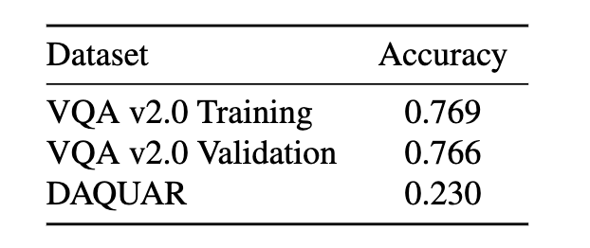
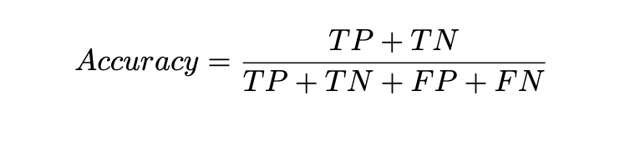
Results
Accuracy
Accuracy is the proportion of correctly predicted instances (True Positive and True Negative) out of all instances. In this an answer is correctly predicted only if it is exactly same as the ground truth answer i.e. strict matching.

Slide 12
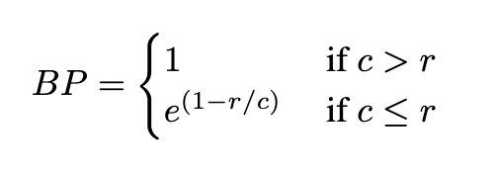
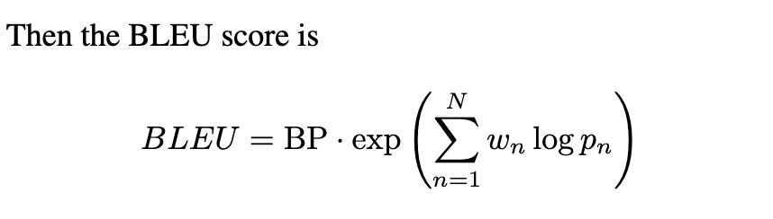
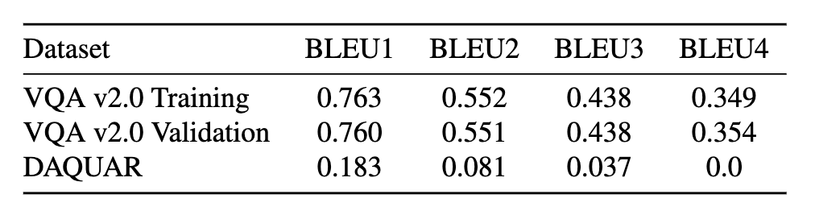
Results
BLEU Score
It is the geometric average of the modified n-gram precisions, pn, using n-grams up to length N and positive weights wn summing to one. Let c be the length of the predicted sentence and r be the ground truth sentence length. The brevity penalty BP is calculated as
We utilize BLEU-1, BLEU-2, BLEU-3, and BLEU-4 by respectively adjusting N and applying uniform weights wn = 1/N.

Slide 13
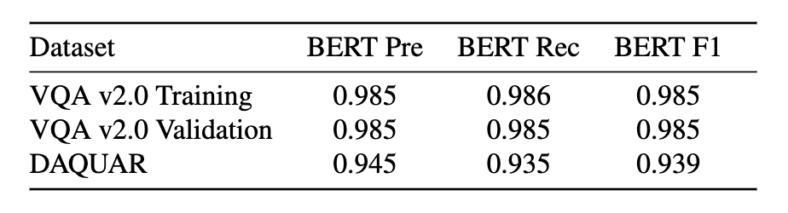
Results
BERT Scores
BERT Score leverages the pre-trained contextual embeddings from BERT and matches words in candidate and reference sentences by cosine similarity. It has been shown to correlate with human judgment on sentence-level and system-level evaluation. Moreover, BERT Score computes precision, recall, and F1 measure, which can be useful for evaluating different language generation tasks.

Slide 14
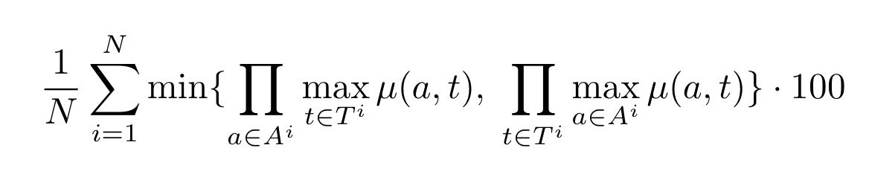
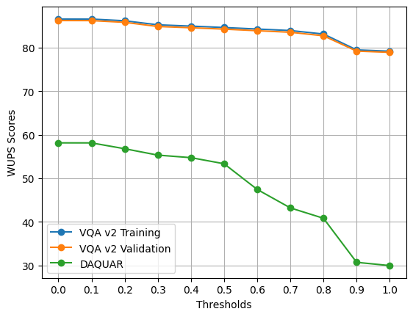
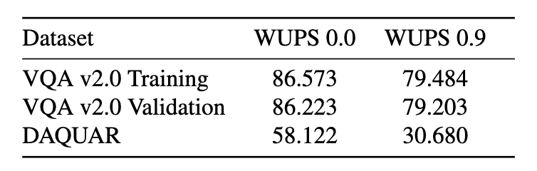
Results
WUPS Score
The WUPS calculates the similarity between two words based on their longest common subsequence in the taxonomy tree. If the similarity between two words is less than a threshold then a score of zero will be given to the candidate answer. We have used the Wordnet database to measure the similarity between the words. The WUPS Score is calculated using the below formula

Slide 15
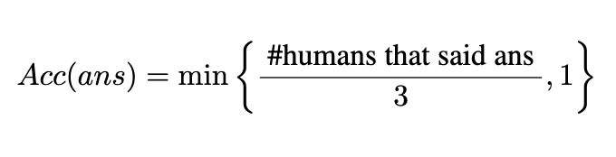
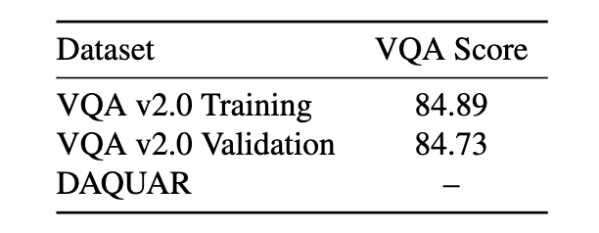
Results
VQA Score
The VQA accuracy metric assesses the correspondence between the model’s response and all potential answers provided for a given question. If the model’s response matches exactly with a minimum of three among the available answers, the VQA accuracy is rated as 1; otherwise, it falls below 1. To evaluate using this metric, multiple answers to a question are required. However, since we don’t have that in the DAQUAR dataset, we haven’t calculated it for this.

Slide 16
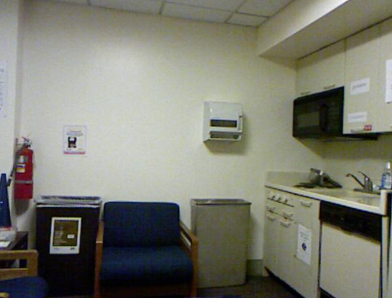
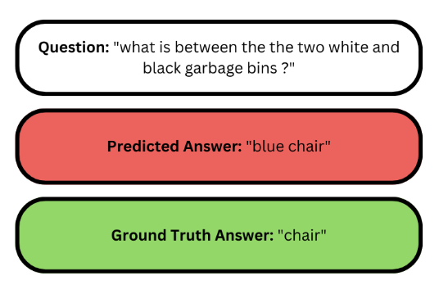
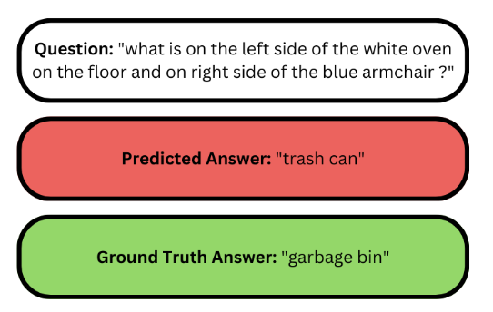
Analysis
In this section we will go through the drawbacks and advantages of the evaluation metric with the help of two question-answer pairs projected on the same image. Figure 1 shows an image instance from DAQUAR dataset to which the BLIP question-answer model is applied. Figure 2 presents two cases which includes the question asked, the prediction we get and the ground truth on the image.
Case 1
Case 2
Figure 2
Figure 1

Slide 17
Analysis
Accuracy
As evident from the results, the BLIP model exhibits relatively low accuracy. However, relying solely on accuracy metrics may not comprehensively assess the model’s performance. As shown in the example below, strict matching between predicted and best ground truth results may overlook semantically similar answers.
• Case 1: The model predicted ”trash can” while the ground truth was ”garbage bin”, resulting in a 0 accuracy score despite the similarity in meaning.
• Case 2: The model predicted ”blue chair” while the ground truth was ”chair”, resulting in a 0 accuracy score despite the more detailed answer.
Hence, accuracy alone may not adequately reflect the model’s effectiveness in capturing nuanced semantic relationships.
Case 1
Case 2

Slide 18
Analysis
BLEU Score
The BLIP model’s subpar accuracy underscores the importance of adopting nuanced evaluation metrics such as the BLEU score. Unlike traditional accuracy, BLEU considers n-gram overlaps, providing a more comprehensive understanding of the model’s performance across diverse datasets.
• Case 1: The model predicted ”trash can” while the ground truth was ”garbage bin”, resulting in a 0 BLUE score despite the similarity in meaning because it checks for the n-gram overlaps.
• Case 2: The model predicted ”blue chair” while the ground truth was ”chair”, resulting in a 0.5 BLUE score due to a small degree of overlap in the answer.
Thus, the BLUE score is better than the standard accuracy but is still insufficient because it does not take the semantic similarity into account.
Case 1
Case 2

Slide 19
Analysis
BERT Score
• Case 1: The model achieved a BERT Precision score of 0.90, indicating high semantic similarity between the model’s output (“trash can”) and the ground truth value (“garbage bin”).
• Case 2: The model predicted ”blue chair” while the ground truth was ”chair”, resulting in a BERT Precision score of 0.83 due to high similarity.
Thus, as shown by the results, the BERT score is a highly valuable metric for assessing the performance of the model.
Case 1
Case 2

Slide 20
Analysis
WUPS Score
• Case 1: The WUPS score is good in case 1. The score is 0.76 at 0 threshold and 0.0076 at 0.9 threshold.
• Case 2: The WUPS does not provide a good score in case 2. The score is 0.11 at 0 threshold and is 0.0011 at 0.9 threshold.
WUPS score provides us insight into the semantic similarity between our model’s output and the ground truth values in some cases, however, it is unable to capture the semantic similarity of the words in all the cases.
Case 1
Case 2

Slide 21
Analysis
VQA Accuracy
• Case 1: VQA accuracy is 0.67 because the model’s output matched 2 answers out of the 10 available answers.
• Case 2: VQA accuracy is 0.33 because the model’s output matched exactly 1 answer of the 10 available answers.
VQA score provides a more accurate depiction of the model’s performance as compared to simple accuracy by comparing the predictions with all the available answers. However, it still does not take the semantic similarity into account, which is not ideal.
Case 1
Case 2

Slide 22
Hypothesis
After analyzing the outcomes derived from implementing the BLIP model across three distinct datasets, we postulate that its efficacy is notably pronounced when the dataset distribution aligns closely with that of the VQA v2 dataset. Nonetheless, our findings suggest a potential decline in model performance when confronted with datasets exhibiting differing distributions, as evidenced by the DAQUAR dataset. This raises pertinent concerns regarding the model's generalizability across diverse datasets.

Slide 23
Individual Contribution
Dataset Analysis: Vasan, Ritwik
Model Inference: Shreyas, Ritwik, Vasan
Evaluation: Ritwik, Shreyas
Analysis of the results: Vasan, Shreyas and Ritwik
ALL MEMBERS CONTRIBUTED EQUALLY IN THE PROJECT

Slide 24
References
[1] Jacob Devlin, Ming-Wei Chang, Kenton Lee, and Kristina Toutanova. Bert: Pre-training of deep bidirectional
transformers for language understanding. arXiv preprint arXiv:1810.04805, 2018.
[2] Junnan Li, Dongxu Li, Caiming Xiong, and Steven Hoi. Blip: Bootstrapping language-image pre-training for unified vision-language understanding and generation. In International conference on machine learning, pages 12888–12900. PMLR,2022.
[3] Mateusz Malinowski and Mario Fritz. A multi-world approach to question answering about real-world scenes based on uncertain input. Advances in neural information processing systems, 27, 2014.
[4] George A Miller. Wordnet: a lexical database for english. Communications of the ACM, 38(11):39–41, 1995.

